Slide 1
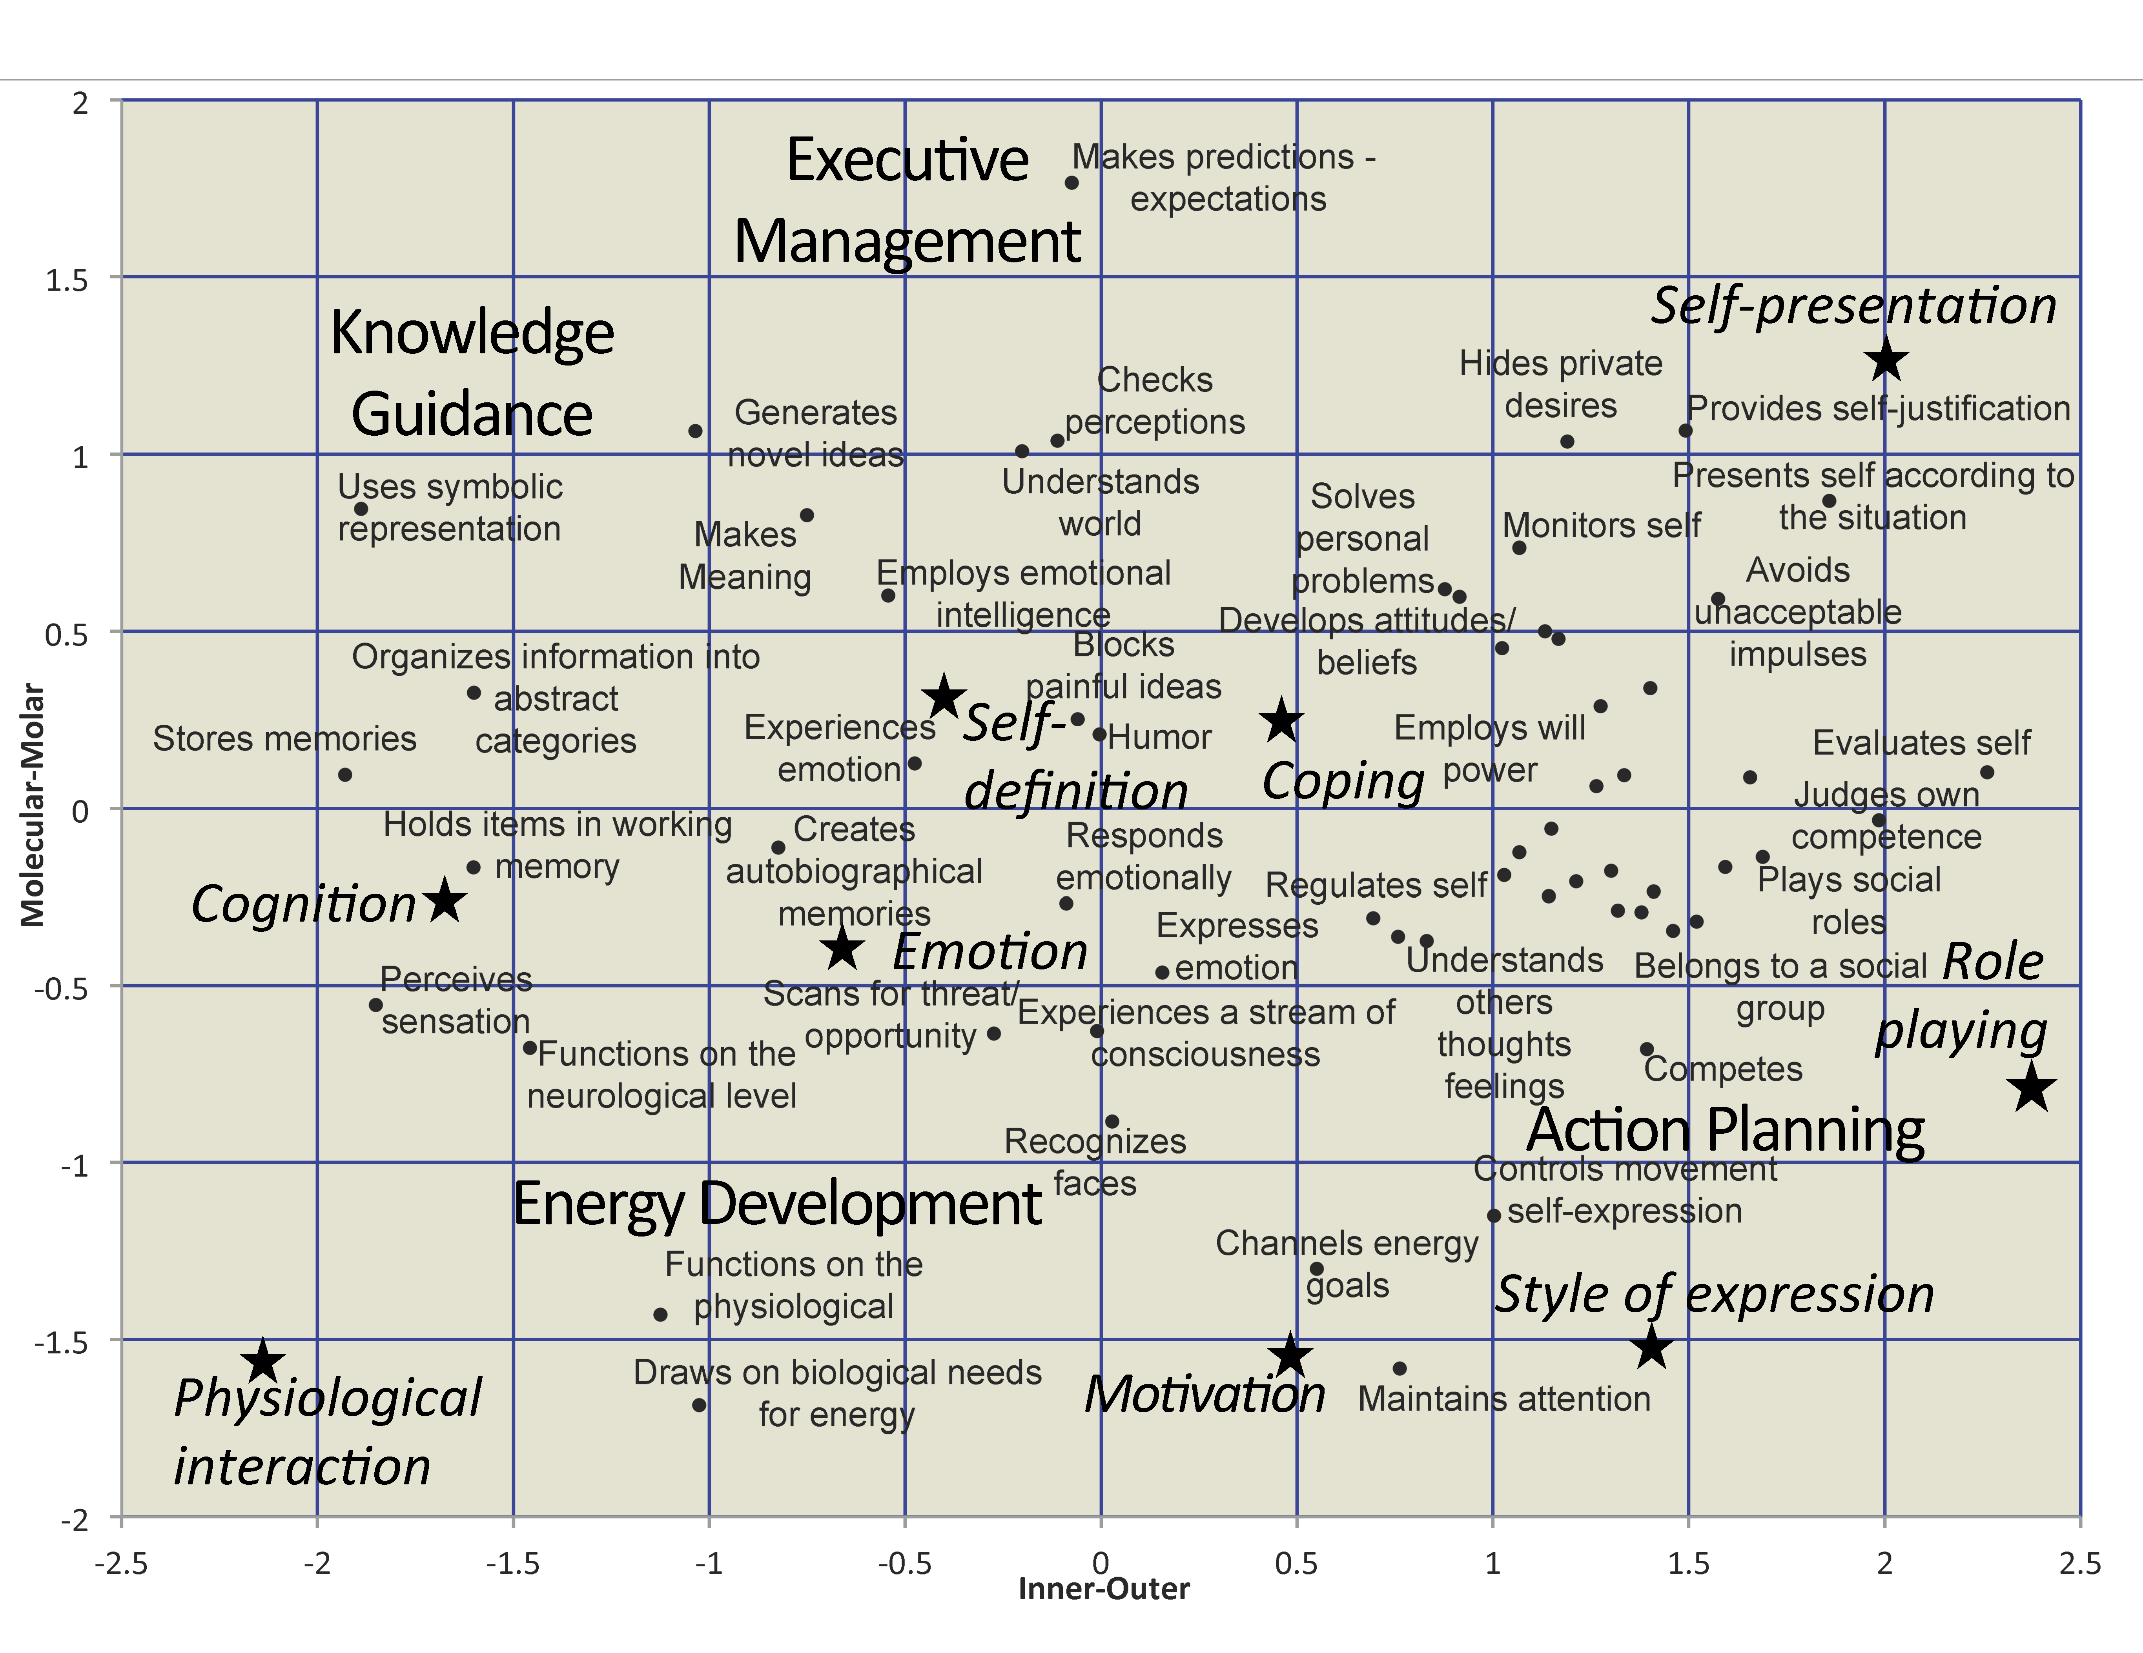
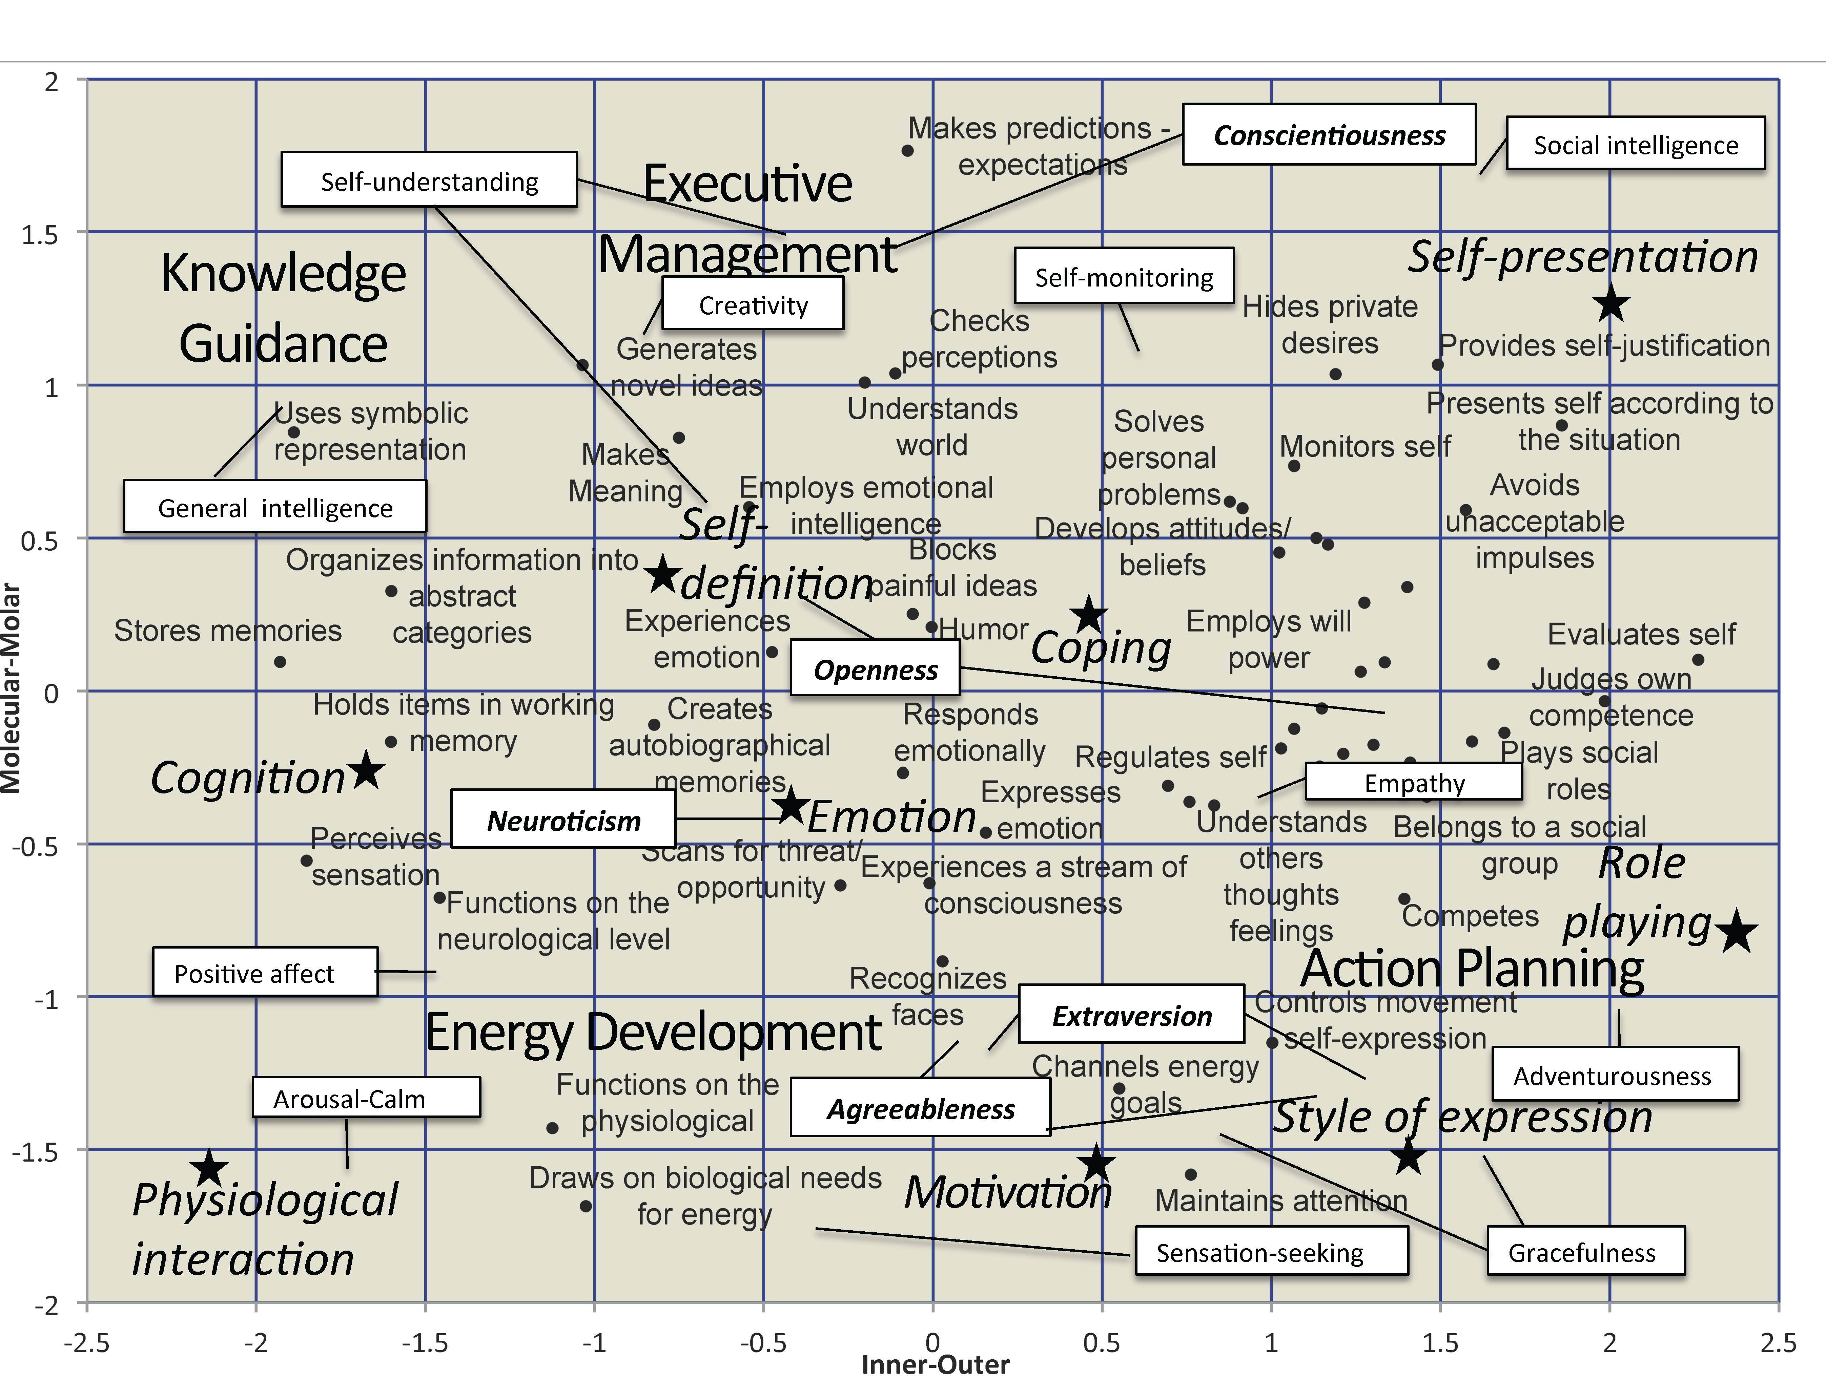
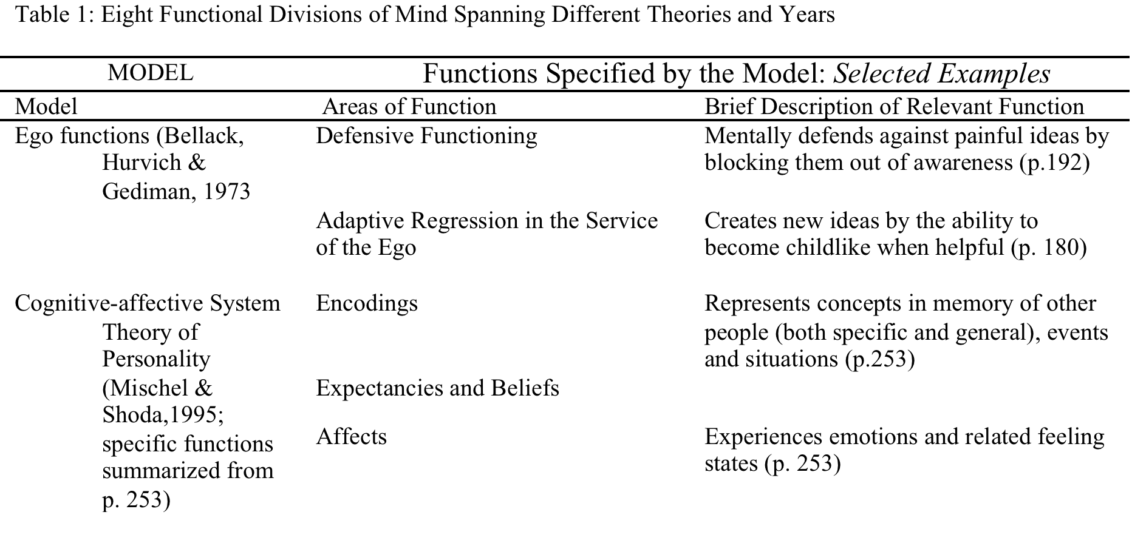
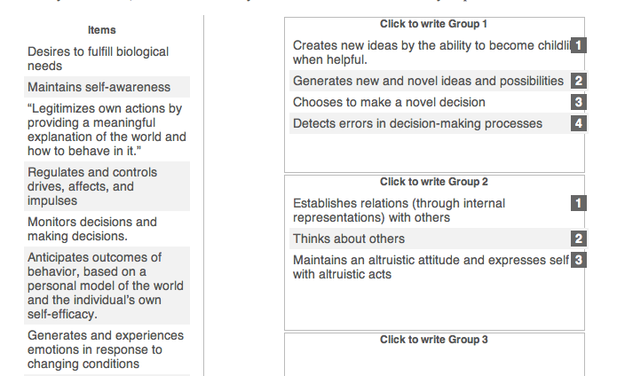
Mapping the Mind and its Traits
Bonnie A. Barlow and John D. Mayer
University of New Hampshire
Abstract
Psychologists have long sought a means to organize personality functions. Different theorists have proposed models of mental functions that employ different dimensions. For example, Freud’s topological model had an unconscious—conscious dimension. Perhaps the most commonly-mentioned dimension, however, is the molecular—molar dimension (smaller versus larger systems). The study reported here is the third in a series exploring how people actually employ dimensions in thinking about the mind; this new study uses 60 personality functions and then arranges traits among them. Undergraduate participants (N=362) sorted 60 personality functions into groups according to their conceptual similarity. We used multidimensional scaling to identify the dimensions participants used to organize personality functions. The study replicated the “Molecular versus Molar” and “Inner versus Outer” dimensions of the previous two studies. The map based on these dimensions rests on a more solid empirical foundation than earlier depictions of personality, and may help researchers organize traits.
Figure 2 Study 3 map of Inner Outer and Molecular-Molar dimensions with labeled centers
Results (Continued)
Based on both mathematical criterion and interpretability we decided to retain three of five dimensions; in MDS sometimes only some dimensions of the optimal solution are interpretable (Davidson, 1983). The stress statistic for this five dimensional solution was .09 and the RSQ was .93. The three dimensions (Molecular-Molar Inner-Outer and Conflicted-Coordinated) that were represented in the previous two studies were strongly present in this map (only two are shown here). The Molecular–Molar dimension was represented on the molecular end by “functions on the physiological level,” and on the molar end by “judges competence in dealing with the world.” The Inner–Outer dimension was represented by “experiences a stream of consciousness,” and the outer end by “belongs to a social group.” Finally, the conflicted end of the “Conflicted–Coordinated” dimension was represented by “defends self against attack from others” with “makes meaning” at the coordinated end. The remaining two dimensions were uninterpretable. We created a map of the Molecular–Molar and Inner–Outer dimensions of this solution in Figure 2.
Introduction
People use organizational tools to make sense of large amounts of data. A map is one such tool. In geography, a map can organize cities in a way that shows spatial relationships between geographical features such as rivers, mountains and cities. Psychologists too have long sought a way to organize personality functions. Gordon Allport (1937) sought a map to organize personality functions because it was difficult to understand the relationships among the long lists of functions without some organizing scheme. In two previous studies, we replicated two dimensions – Inner-Outer, and Molecular-Molar – which people use to organize personality. We found these dimensions by asking people to organize functions found in personality literature (See Table 1). The purpose of the third study is to combine and refine the list of functions found in the first two studies in order to form a final map of personality functions, which can organize traits.
Methods
We developed a final master list of 60 personality functions based on cluster analysis of 150 functions that were sorted by participants in two previous studies. The original 150 functions came from from eight sources from various perspectives (e.g. Mischel & Shoda, 1995; Mayer, 2001; 2003: Henriques, 2011; Magnavita, 2005; Lluis-Font, 2006; Sheldon et al., 2011). In an online survey, we asked 487 participants from a public New England university’s undergraduate psychology participant pool to sort the list of functions based on conceptual similarity into as many boxes as they liked (up to 25). For example, the function “Creates autobiographical memories” seems closer to the function “Experiences emotions and feelings” than to “Controls physical movement for self-expression.” After completing the consent form and answering demographic questions, participants encountered the sorting survey. To the left of the screen was the list of 60 functions and to the right of the screen was a set of boxes. Participants grouped traits by first selecting a function and then placing conceptually similar functions together in a box. Participants determined how many boxes were needed to sort all of the functions. Participants continued sorting functions until all the functions had been placed into a group (please refer to Figure 1).
Results
After the data was downloaded from the online survey, we used multidimensional scaling (MDS) to extract dimensions. MDS forms dimensional maps of the items by assigning coordinates for each item (function) sorted for each dimension extracted. Ideally, a map would have between 2-3 dimensions because people think of maps in terms of two to three dimensions (East-West, North-South, Altitude). Two fit statistics are used to choose the best solution: stress and correlation squared (RSQ). RSQ indicates the proportion of variance accounted for by a particular dimensional solution. An RSQ greater than .60 indicates good fit. Kruskal and Wish proposed that a stress statistic below .10 is a good criterion for fit (1978, p. 54). The number of objects scaled may affect the fit statistics (Kruskal & Wish, 1978, p. 58) and 60 functions is on the larger side for scaled objects.
Figure 2. Major areas of personality functions arranged by inner–outer and molecular–molar dimensions. The four areas are Energy Development, which includes motives and emotions; Knowledge Guidance, which involves mental representations and reasoning; Action planning, which includes procedural knowledge about acting in the social world, and Executive Management, which involves awareness and self-control. Regional areas marked with capitol stars including self-definition (upper left), self-presentation (upper right) and Expression style (lower right) are also added. The functions are positioned as in the results from Study 3.
.
Figure 3 Study 3 map of Inner Outer and Molecular Molar dimensions with traits
Main Points
People organize personality functions using three dimensions: Inner-Outer, Molecular-Molar, Conflicted-Coordinated.
Not all models of personality employ these dimensions to organize personality functions. Those that do use these dimensions will be more understandable to lay people because they are more intuitive.
These maps can organize areas of personality functions (Figure 2) and organize traits (Figure 3).
Table 1 Eight Functional Divisions of Mind Spanning Different Theories and Years
Figure 1. Sorting the Functions
Items from the left are moved to the boxes on the right.
References
Allport, G.W., (1937). Personality A Psychological Interpretation. London: Constable & Company.
Bellak, L, Hurvich, M. & Gediman, H. (1973). Ego functions in schizophrenics, neurotics and normals. NY: John Wiley and Sons.
Cacioppo, J. T., Amaral, D. G., Blanchard, J. J., Cameron, J. L., Carter, C. S.& Crews, D., et al. (2007). Social neuroscience: Progress and implications for mental health. Perspectives on Psychological Science, 2(2), 99-123. doi:10.1111/j.1745-6916.2007.00032.x
Davidson, M.L. (1983). Multidimensional Scaling. NY: John Wiley and Sons.
Freud, S. (1960). The Ego and the Id. (J.Riviere, Trans,. and J. Strachy, Ed.). New York: Basic Books. (Original work published 1923.)
Henriques, G (2011). A New Unified Theory of Psychology. NY: Springer
Hilgard, E.R.,(1980) The trilogy of the mind: Cognition, affection, and conation. Journal of the History of the Behavioral Sciences. 16, 107-117.
Kruskal, J.B. and Wish, M. (1978). Multidimensional Scaling. London: Sage.
Lluis-Font, (2006) Personality systems net theory. Individual Differences Research, 3, 213-238. [Also employed web site w www.thepersonalitysystem.org
Magnavita, J., (2005). Personality-guided relational psychotherapy: A unified approach. Washington, DC: American Psychological Association.
Mayer, J. D. (2001). Primary divisions of personality, Journal for the Theory of Social Behavior, 31, 449-474.
Mayer, J. D. (2003). Structural divisions of personality and the classification of traits. Review of General Psychology, 7, 381-401. Mayer, J. D. (2005). A tale of two visions. American Psychologist. 4, 294-307.
Mischel, W. & Shoda, Y. (1995) A Cognitive-Affective Systems Theory of Personality.Reconceptualizing Situations, Dispositions, Dynamics and Invariance in Personality Structure. Psychological Review, 102, 246-268.
Sheldon.K, Cheng, C. & Hilpert, J.(2011) Understanding Well-Being and Optimal Functioning: Applying the Multilevel Personality in Context (MPIC) Model. Psychological Inquiry, 22, 1-16.
Sheldon, K. M., Cheng, C., Hilpert, J., (2011). Consilience within the biopsychosocial system. Psychological Inquiry, 22(1).
Figure 3. Major areas of personality functioning and the traits that describe them as organized by inner–outer and molecular–molar dimensions. The four areas are Energy Development, Knowledge Guidance, Action Planning and Executive Management. Traits that describe major areas of functioning are now added including the Big Five and other traits, which indicate more specific areas of functioning. For example, the trait conscientiousness is in the self-presentation area because the trait conscientiousness describes a way of presenting the self. Conversely, the trait openness is connected to the areas of Cognition and Role playing because the trait openness describes both intellect and activities.
Notes:
This one! ARP 2015

