Slide 1
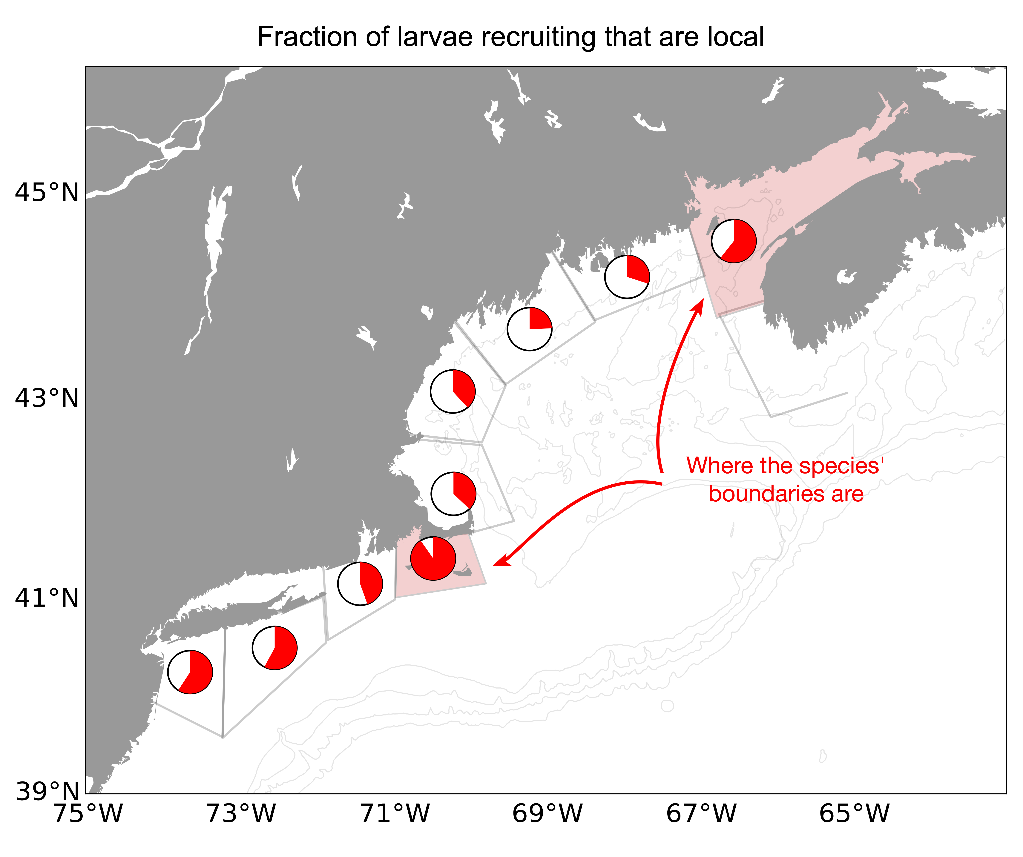


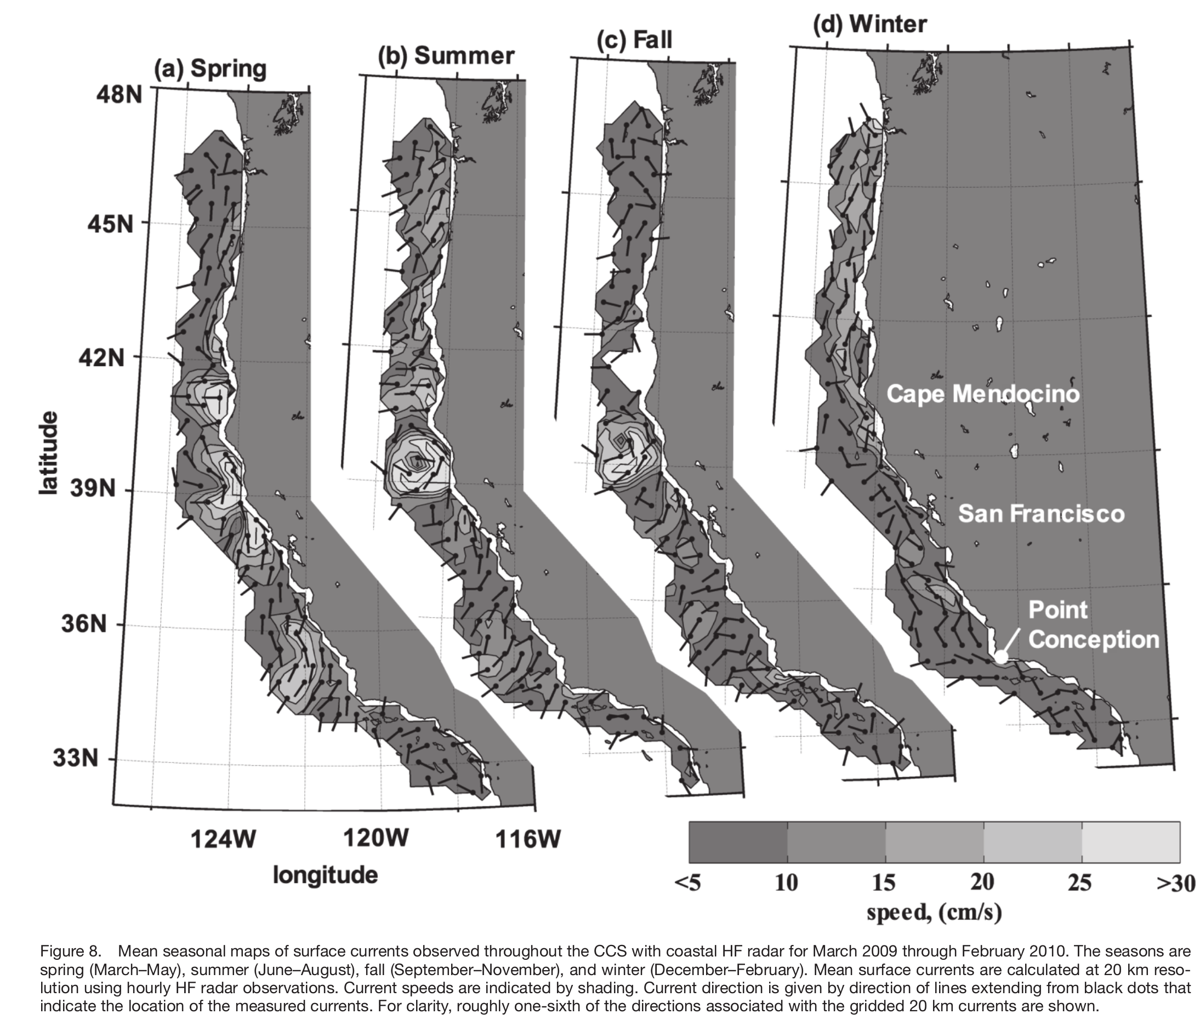
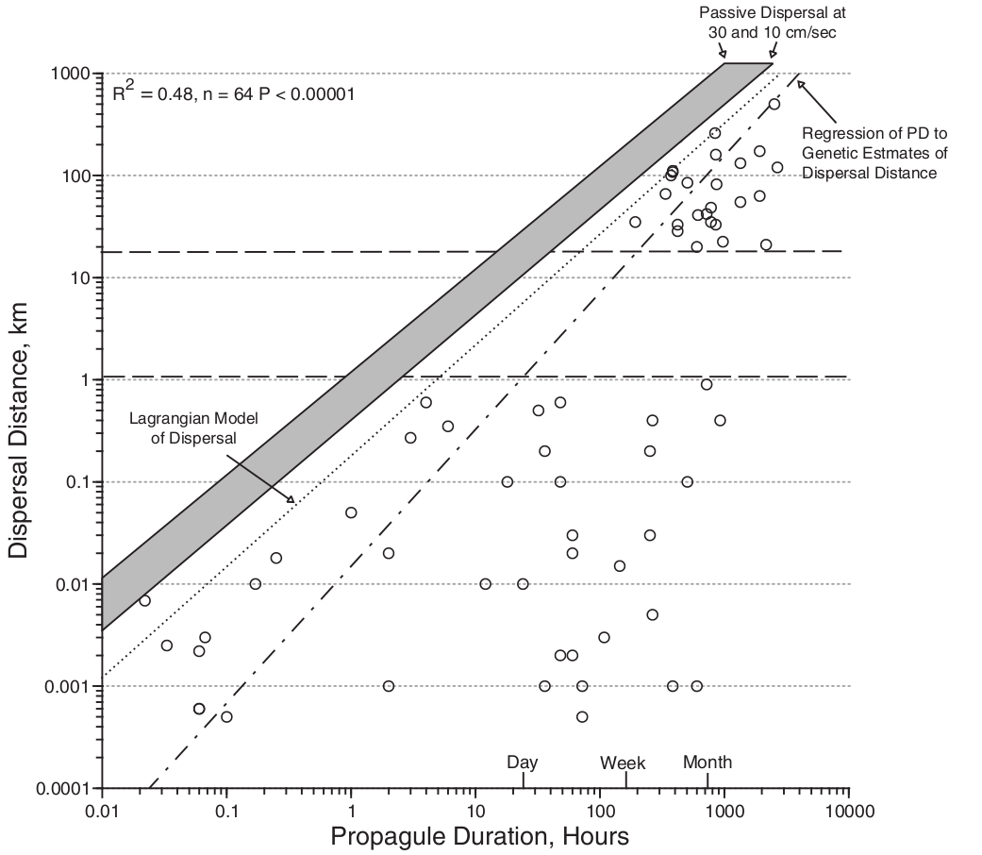
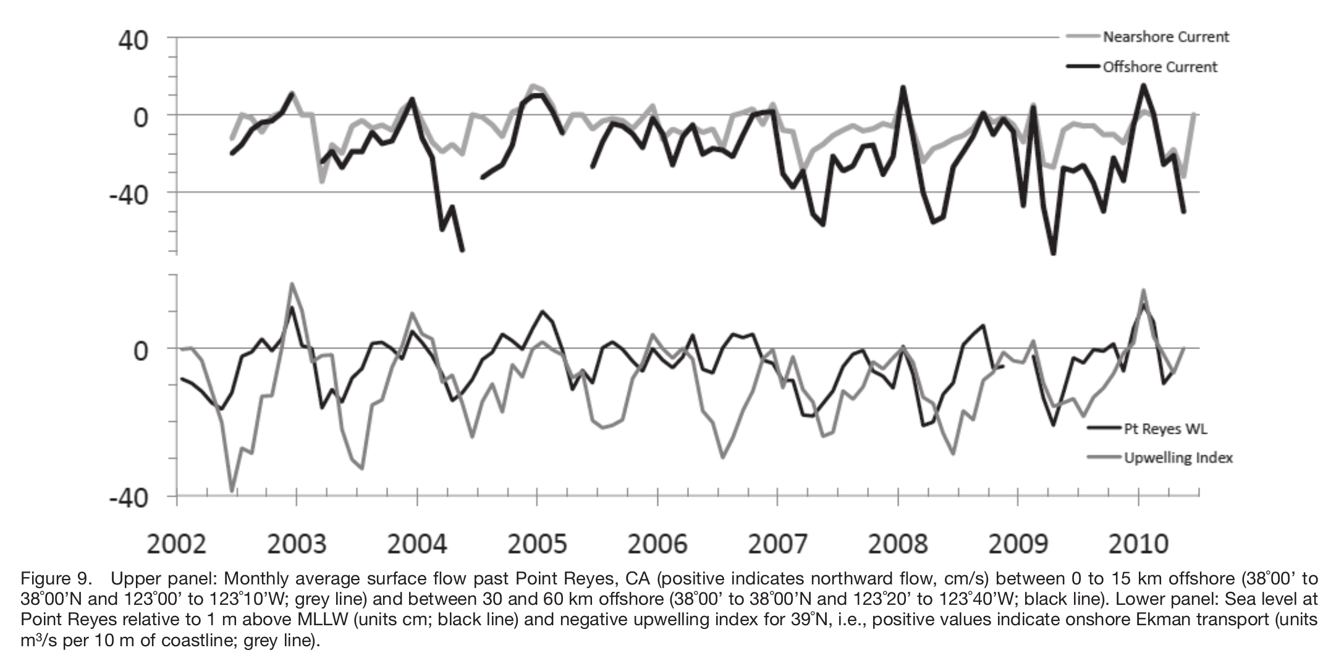
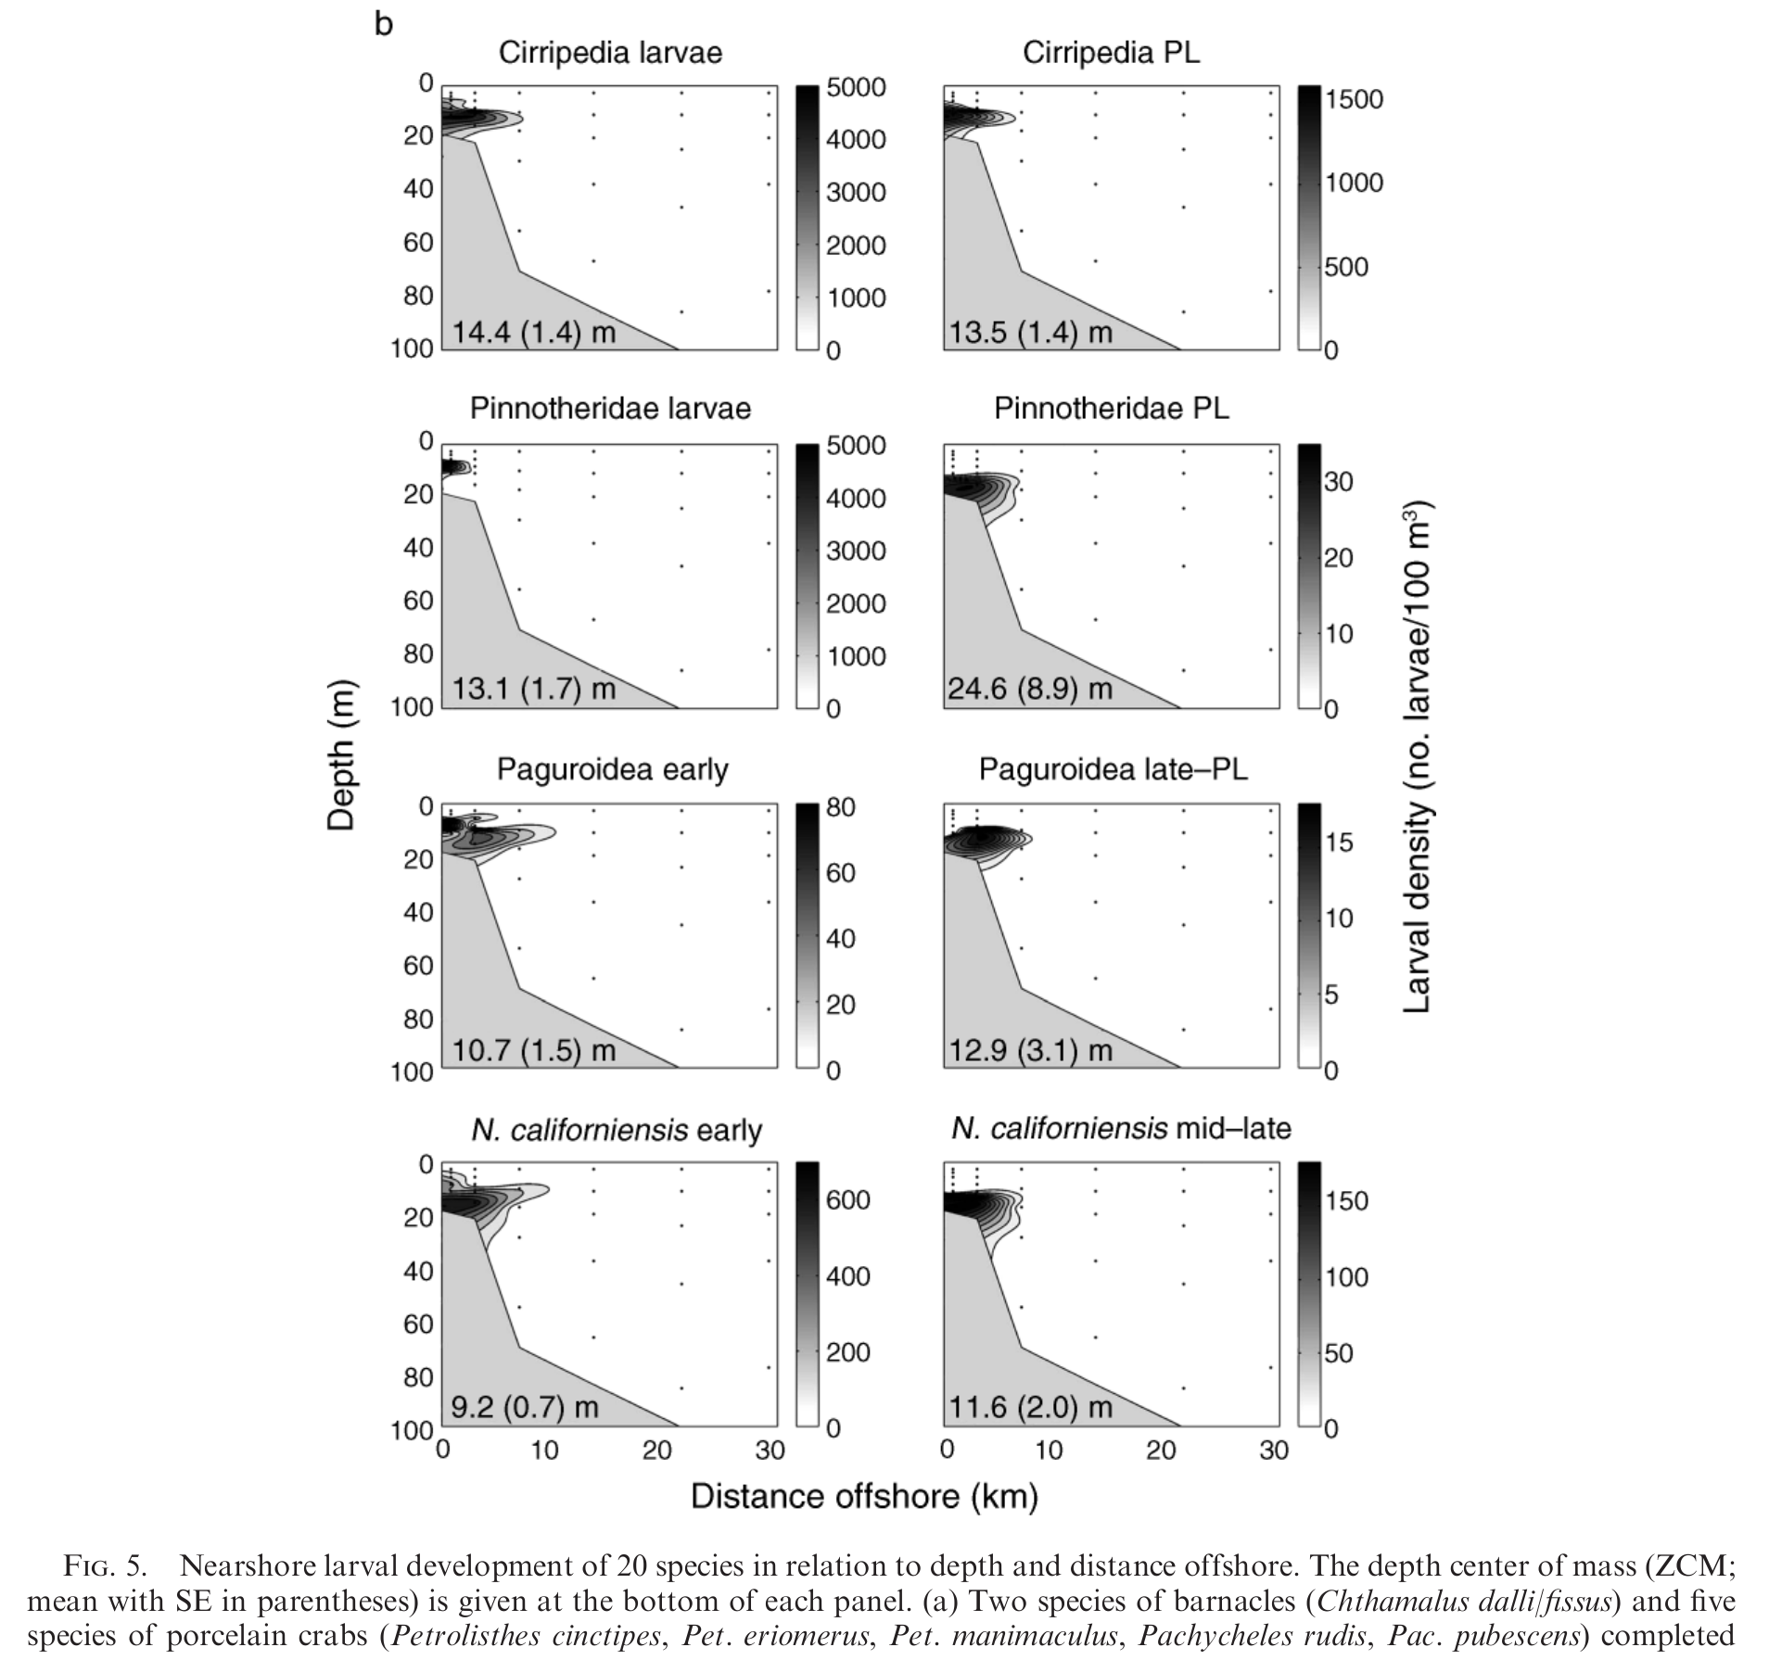
Lessons learned: What to get right when applying circulation models to connectivity, biogeograph and phylogeography
James M. Pringle, in collaboration with Jeb Byers, John Wares, Paula Pappalardo and others
Funded by NSF awards OCE 0961344 and OCE 1029602
Contact: jpringle@unh.edu
Persistence governed by ratio of mean to stochastic larval transport distance
In an advective environment, enough offspring must return to the location of their parents to replace the parents’ mortality, if the species is to persist. All the rest of this is commentary on this fact.
Range boundaries governed by alongshore variability and fitness gradients
Range boundaries can persist where the fitness/competitive advantage of a species over its competitors exceeds the ratio of locally retained larvae to migrants from upstream. Thus:
Alongshore variability in alongshore transport is O(1) important
Note well: any numerical artifacts that trap Lagrangian particles in topographic irregularities and grid-scale embayments can badly distort results. Also, boundary conditions matter! Must accurately represent larval inflow from upstream.
Must capture dispersal variability over reproductive lifetime of species
Important to capture variability in larval pathways BOTH while larvae are in plankton AND between different larval releases by same parent.
Seasonal variability
Interannual variability (for long lived species)
Both figures from Bjorkstedt et al. 2010
Several papers, many truths learned
Papers:
Altman S, Robinson JD, Pringle JM, Byers JE, Wares JP (2013) Edges and Overlaps in Northwest Atlantic Phylogeography. Diversity 5:263–275
Blakeslee AMH, McKenzie CH, Darling JA, Byers JE, Pringle JM, Roman J (2010) A hitchhiker’s guide to the Maritimes: anthropogenic transport facilitates long-distance dispersal of an invasive marine crab to Newfoundland. Divers Distrib 16:879–891
Byers JE, Pringle JM (2006) Going against the flow: retention, range limits and invasions in advective environments. Mar Ecol Prog Ser 313:27–41
Byers JE, Pringle JM (2008) Going against the flow: how marine invasions spread and persist in the face of advection. ICES J Mar Sci 65:723
Byers, J.E., R. Smith, M. Bishop, J.M. Pringle, E. Johnson, G. Ruiz, G. Inglis, C. Hewitt. Not done invading--environmental and temporal controls on the geographic extent of non-native marine species. In Review, Scientific Reports, 2015.
Ewers-Saucedo C, Pringle JM, Sepulveda HH, Byers JE, Navarrete SA, Wares JP (2015) Relative fitness shifts in an oceanographic “seascape” generate stable genomic cline in the widely-dispersing intertidal barnacle Notochthamalus scabrosus. Evolution: In review for far too long…
Huret M, Runge JA, Chen C, Cowles G, Xu Q, Pringle JM (2007) Dispersal modeling of fish early life stages: sensitivity with application to Atlantic cod in the western Gulf of Maine. Mar Ecol Prog Ser 347:261–274
Pappalardo P, Pringle J, Byers J, Wares J (2014) The location, strength and mechanisms behind marine biogeographic boundaries of the east coast of North America. Ecography 38:001-010.
Pringle JM, Blakeslee AMH, Byers JE, Roman J (2011) Asymmetric dispersal allows an upstream region to control population structure throughout a species’ range. Proc Natl Acad Sci 108(37):15288–15293
Pringle JM, Byers JE, He R, Pappalardo P, Wares JP (In Review) Ocean currents cluster coastal marine range boundaries: implications for coexistence, climate induced range shifts and the relative competitiveness of benthic marine organisms. Ecol Lett
Pringle JM, Byers JE, Pappalardo P, Wares JP, Marshall DJ (2014) Circulation constrains the evolution of larval development modes and life histories in the coastal ocean. Ecology
Pringle JM, Lutscher F, Glick E (2009) Going against the flow: effects of non-Gaussian dispersal kernels and reproduction over multiple generations. Mar Ecol Prog Ser 377:13–1
Pringle JM, Wares JP (2007) Going against the flow: maintenance of alongshore variation in allele frequency in a coastal ocean. Mar Ecol-Prog Ser 335:69–84
Storch, L.M, J.M. Pringle (In Prep) From chaos to periodicity: Revisiting the logistic map with an ecologically realistic spatial structure and dispersal mechanism. In prep, looking for a good home.
Wares JP, Pringle JM (2008) Drift by drift: Effective population size is limited by advection. BMC Evol Biol 8:235
Larvae are not Lagrangian!
Theoretical work indicates that any behavior that reduces mean larval transport will be selected for. Observations consistently support this. Shanks 2009:
Morgan et al 2009:
Seasonal/Interannual variability often leads to non-Gaussian Kernels; this tends to aid species persistence in longer lived species.
Different mean currents in different years, or in different seasons, will lead to a total dispersal kernel that is non-Gaussian, even if the kernel for each larval release is Gaussian. The same is true for year to year or season to season changes in the current variability in the time the larvae are in the water. As discussed in Pringle et al. (2009), these effects will often make it easier for a species to persist.

