Slide 1


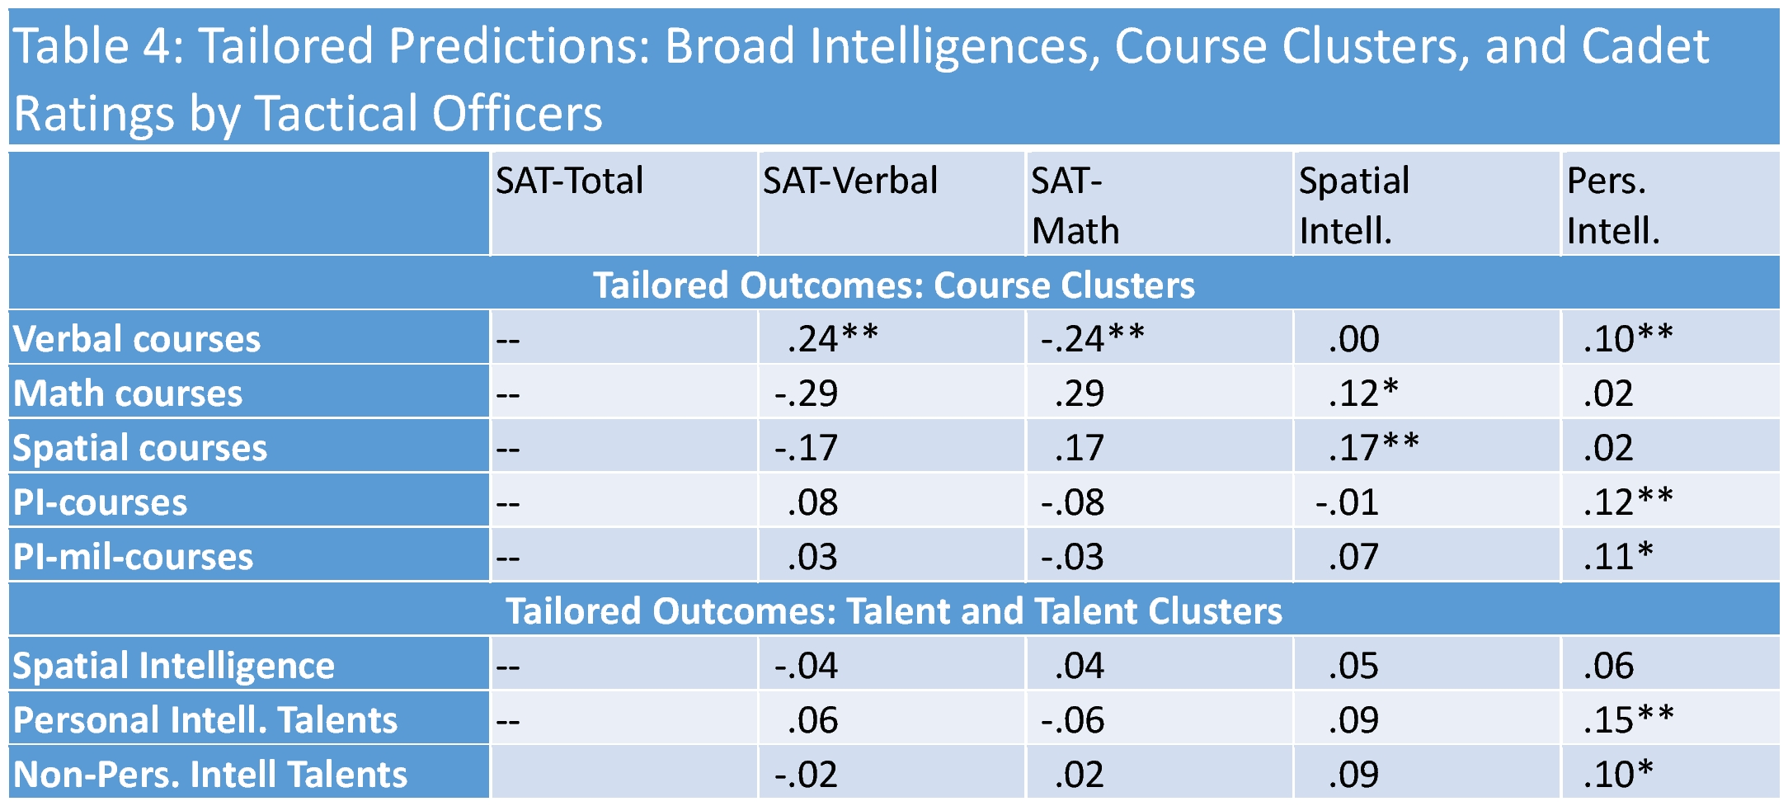
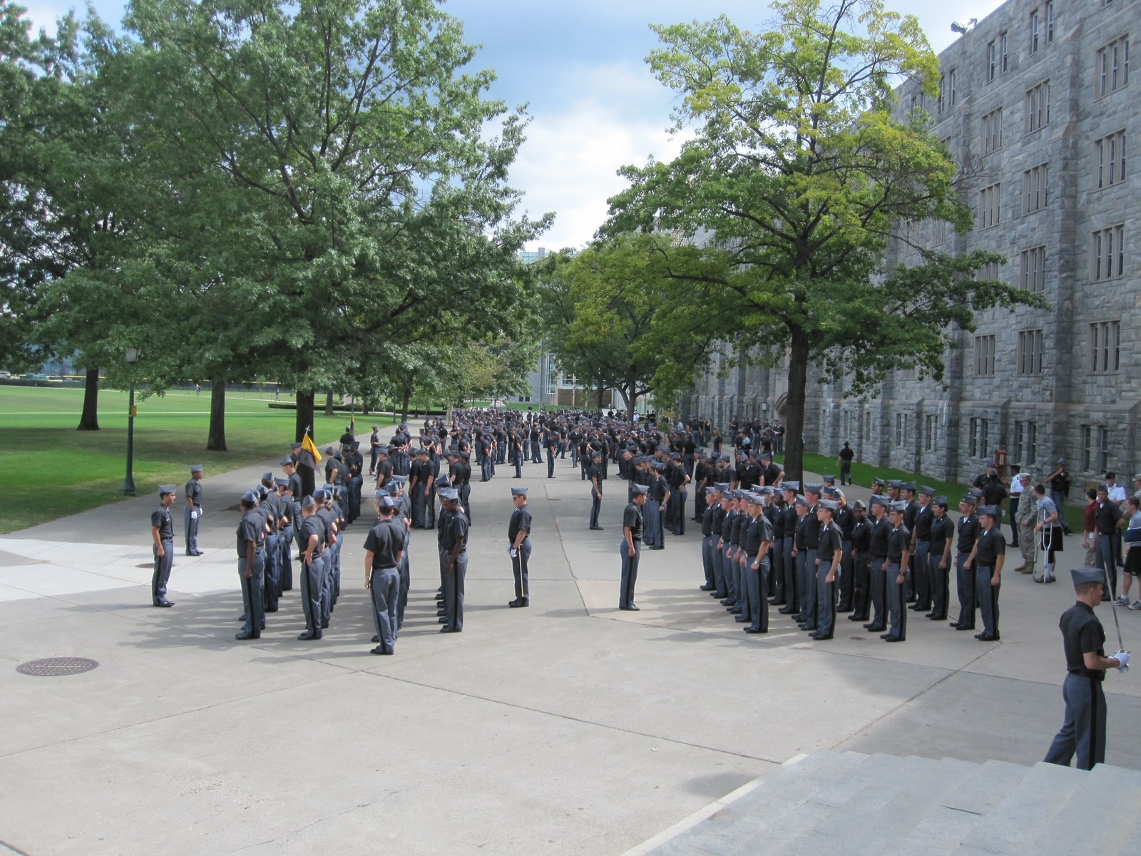
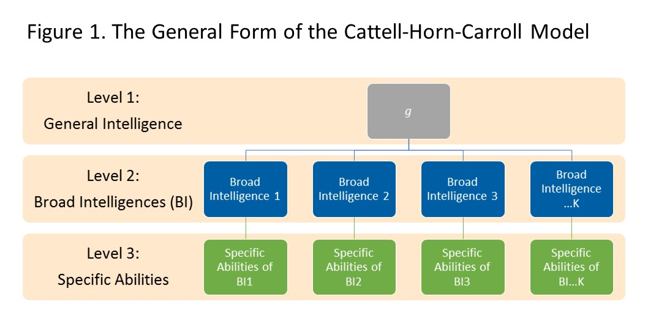
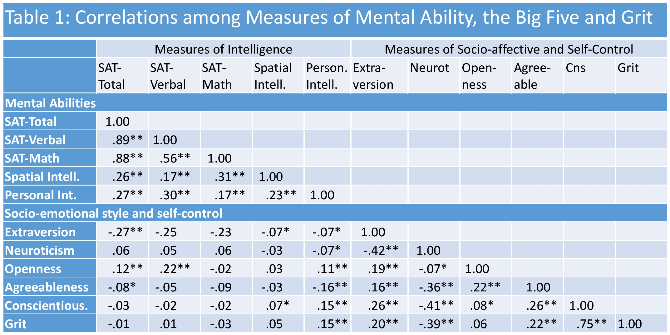
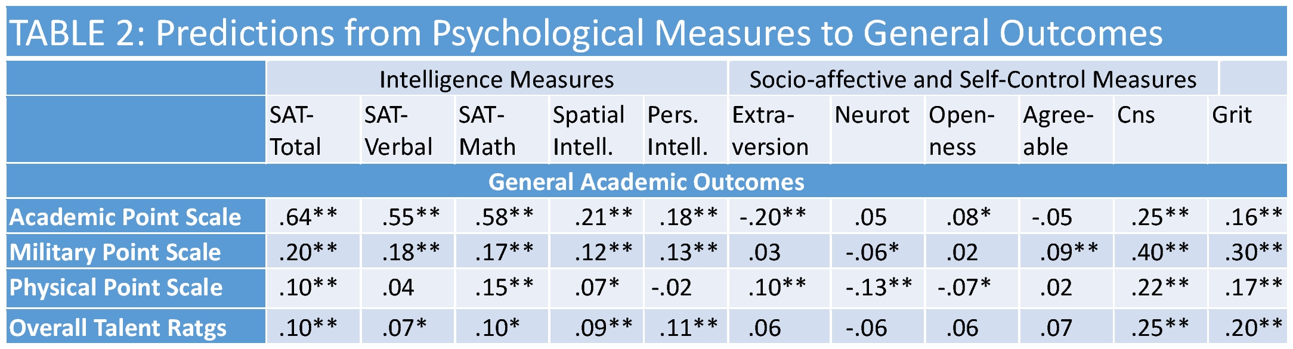
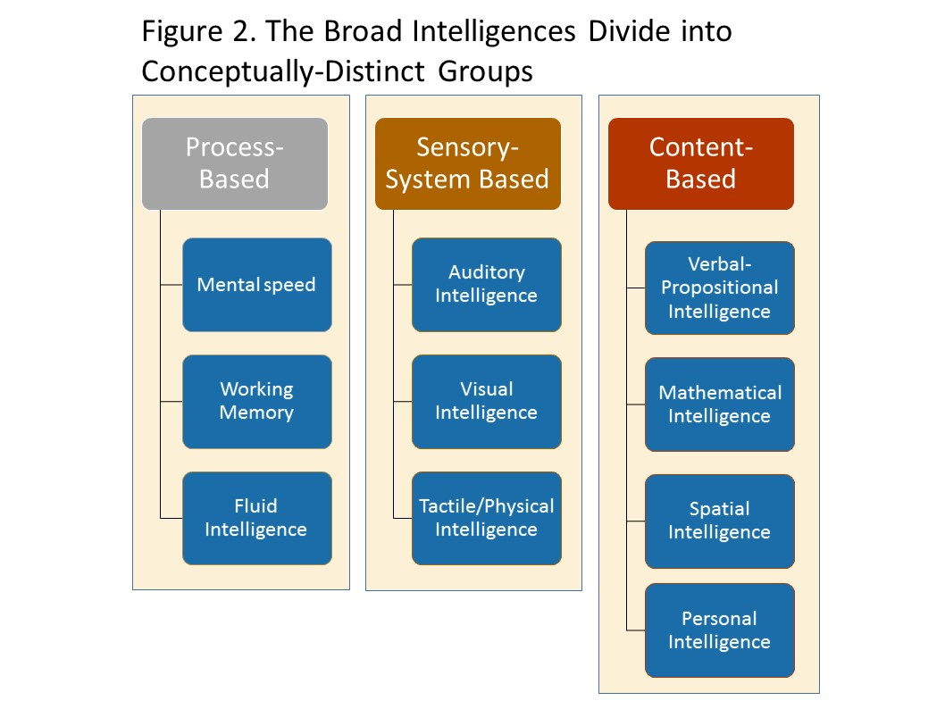
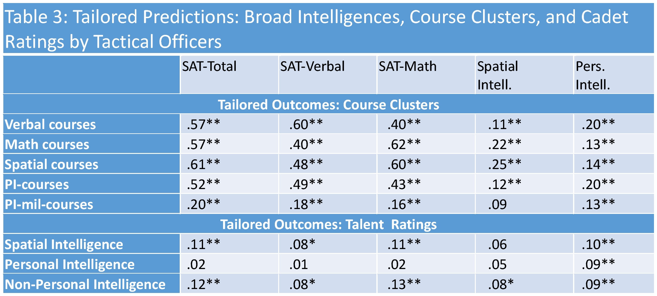
Psychological Predictors of Cadet Performance at West Point
John D. Mayer William Skimmyhorn
University of New Hampshire United States Military Academy, West Point
Abstract
Using data from the United States Military Academy at West Point collected in 2013 (N = 1012), we examined the correlations between measures of broad intelligences, socio-emotional style, and self control, on the one hand, and their predictions to consequential outcomes such as cadet performance at the Academy, leadership potential, and other qualities. Measures of mental ability included broad abilities in the areas of verbal, mathematical, spatial, and personal intelligences. SAT-verbal, SAT-math, spatial and personal intelligences were individually predictive of key outcomes as was the big-five trait of conscientiousness. In addition, individual broad intelligences exhibited modest incremental predictions above the more general measures of mental ability.
Four Reasons to Study Broad Intelligences
Models of human abilities that represent both broad intelligences and g fit patterns of mental abilities better than models that include g alone. In one representative study, the comparative fit index (CFI) rose from .90 to .96.
Existing assessments require few modifications to include measures of broad intelligences
Defining broad intelligences clearly leads to distinct tests that include relevant questions and exclude content-irrelevant test questions.
Including differentiated intelligences allows for meaningful improvements in predictions of key outcomes such as grades and work performance over g alone, at levels of about 2-6% variance—partial correlations controlling for g between r = .14 and .24 (Schneider & Newman, 2015).
Measures (cont.)
Mental ability measures.
The ONET measure of Spatial Ability from the U.S. Department of Labor Employment (National Center for O*NET Development, 2015).
The TOPI 1.4. The Test of Personal Intelligence is an ability-based measure of reasoning about personality—inner experiences, traits, goals, and other qualities (Mayer, Panter, & Caruso, 2014).
4. Incremental Predictions—Preliminary Estimates
The broad intelligences continue to exhibit significant relations with criteria: for instance, personal intelligence continues to predict related courses and talent ratings at significant levels, even after controlling for SAT scores. This is a very strict test, because some SAT-verbal “critical reading” test items include content that overlaps with personal intelligence.
Measures of Socio-Emotional Styles and of Self-Control.
The Five Factor Test. The 100 item version of the five factor inventory yields scores on Extraversion, Neuroticism, Openness, Agreeableness and Conscientiousness drawn from the International Personality Item Pool (Goldberg et al., 2006).
Grit. The 12-item Grit scale measures perseverance and goal-commitment under pressure (Duckworth, Peterson, Matthews, & Kelly, 2007).
Introduction
Study Overview
General Outcome Criteria
GPAs. Overall Academic Scale (college GPA), Military Point Scale (performance of military tasks), Physical Point Scale (physical fitness and performance),
Talent Rating. The cadets’ tactical officers rated them on a group of 20 talents; this is the average rating.
Tailored Outcome Criteria
Grade point averages for clusters of 3-5 required courses in the areas of Verbal, Math, Spatial and Personal Intelligence.
Specific Talent Ratings
Ratings for personal intelligence and spatial talents.
Discussion and Conclusions
General and Broad Intelligences
In the Cattell-Horn-Carroll model of intelligences, g or general intelligence is at the top of a three-tiered hierarchy, with broad intelligences in the middle level and specific skills at the bottom. Figure 1 depicts a schematic illustration.
We conducted our research at the United States Military Academy at West Point. There, the Talent-Based Matching Program assesses cadets so as to assist them to choose the branch of the army they would
Each of the hypotheses we tested yielded some interesting information about the broad intelligences we examined.
We had predicted, first, that broad intelligences would correlate at low levels with the Big Five. Both verbal and personal intelligences correlated with Openness—a commonly-found correlation between intelligence and the Big Five. Personal intelligence correlated with conscientiousness as well—it is the only broad intelligence to date that shows this pattern consistently. Other correlations, for example, between verbal intelligence and extraversion, are probably spurious, as the correlation over samples is typically closer to r = 0.
We also predicted that psychological variables would predict consequential outcomes. Conscientiousness and the SAT (total score) were highly predictive of outcomes in particular. Both spatial and personal intelligences also exhibited significant powers of predictions for many of the outcomes.
Our third hypothesis was that broad intelligences would predict outcomes relevant to their problem-solving areas: that verbal intelligence would predict grades in literature classes, for example, and that spatial intelligence would predict courses requiring spatialization such as calculus and geography. There was partial support for this idea. Verbal SAT predicted verbal courses best of all, personal intelligence predicted courses related to reasoning about personality (literature, psychology, leadership) best of all. That said, SATs out-performed the other intelligences in predicting course performance. Tactical officers at West Point rated their students on various talents, and the students’ broad intelligences all predicted their overall talent ratings about equivalently; that is, personal intelligence, and SAT-math and –verbal all predicted a general sense of the cadet’s talents.
Evidence for incremental validity was also present. For example, personal intelligence predicted the personal intelligence course cluster and tactical officers’ ratings of personal intelligence even after controlling for total SAT scores.
Results
do best in after graduation (e.g., Infantry, Corps of Engineers) in part to promote the retention of high quality officers over time.
Data were drawn from cadets’ files, and a mass testing also was conducted during which additional psychological measures including of intelligence and the Big Five were collected.
Broad Intelligences and the Big Five
Key Hypotheses
Through the late 20th century, research on the contribution of intelligence to academic and occupational success focused on general mental ability (at the top)—a powerful predictor of many outcomes (Deary, 2012). Recently, however, many researchers have shifted their attention to broad intelligences (Schneider & Newman, 2015).
Broad intelligences will correlate in the r = 0.0 to .25 range with socio-emotional variables and self-control
Both intelligences and the socio-emotional/self-control variables will predict consequential outcomes at West Point
Broad intelligences will predict selected tailored outcomes
Broad intelligences will predict outcomes incrementally above general intelligence
2. Predictions to General Criteria
The Cattell-Horn-Carroll model depicts a variety of such broad intelligences (see Fig. 2). Our focus here is on intelligences defined by content areas of knowledge such as the verbal and spatial (McGrew, 2009; Ackerman, 2014).
Key Sources
Methods
Ackerman, P. L. (2014). Adolescent and adult intellectual development. Current Directions in Psychological Science, 23(4), 246-251.
Deary, I. J. (2012). Intelligence. Annual Review of Psychology, 63, 453-482. doi:10.1146/annurev-psych-120710-100353
Duckworth, A. L., Peterson, C., Matthews, M. D., & Kelly, D. R. (2007). Grit: Perseverance and passion for long-term goals. Journal of Personality and Social Psychology, 92(6), 1087- 1101.
Goldberg, L. R., Johnson, J. A., Eber, H. W., Hogan, R., Ashton, M. C., Cloninger, C. R., &
Gough, H. G. (2006). The international personality item pool and the future of public-domain personality measures. Journal of Research in Personality, 40(1), 84-96.
Mayer, J. D., Panter, A. T., & Caruso, D. R. (2012). Does personal intelligence exist? evidence from a new ability-based measure. Journal of Personality Assessment, 94, 124-140. doi:10.1080/00223891.2011.646108
McGrew, K. S. (2009). CHC theory and the human cognitive abilities project: Standing on the shoulders of the giants of psychometric intelligence research. Intelligence, 37(1), 1-10. doi:10.1016/j.intell.2008.08.004
National Center for O*NET Development. (2015). Ability profiler (AP). O*NET resource center. Retrieved from http://www.onetcenter.org/AP.html
Schneider, W. J., & Newman, D. A. (2015). Intelligence is multidimensional: Theoretical review and implications of specific cognitive abilities. Human Resource Management Review, 25(1), 12-27.
Participants
Participants were 1114 cadets in the class of 2014 at the United States Military Academy (USMA) at West Point. Data were drawn from their files and from testing performed by the as part of the Talent Based Branching (TBB) program.
3. Predictions to Specific Criteria
Other Predictors
We also examined the power of other predictors including the Big Five and Grit—although our focus was mostly on the broad intelligences.
Measures
Mental ability measures.
The SAT. Most cadets (N = 932) had SAT scores in their files, with subscores for verbal, mathematical and writing abilities.
Reference: Mayer, J. D. & Skimmyhorn, W. (2015, June). Psychological predictors of cadet performance at West Point. Poster session presented at the Biennial Meeting of the Association for Research in Personality, St Louis, MO

