Slide 1



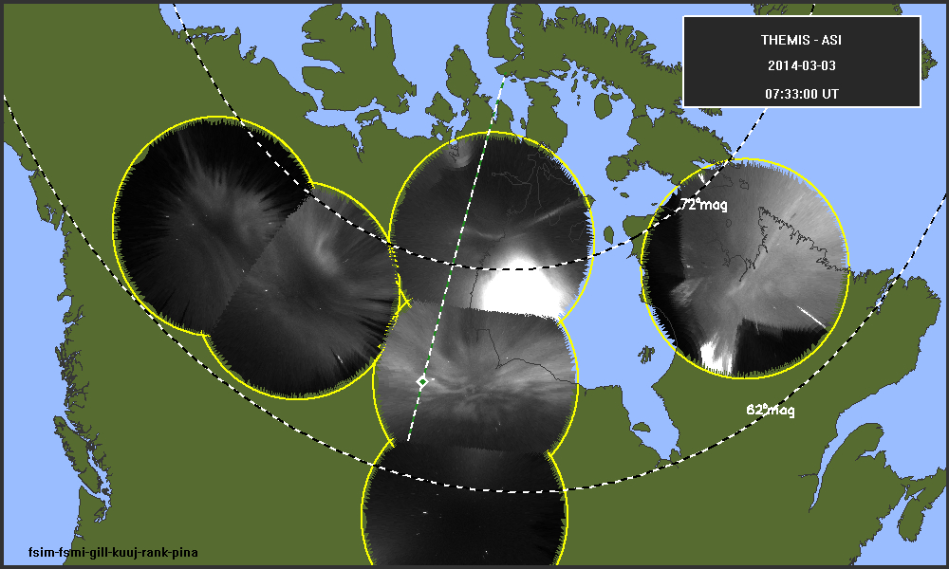
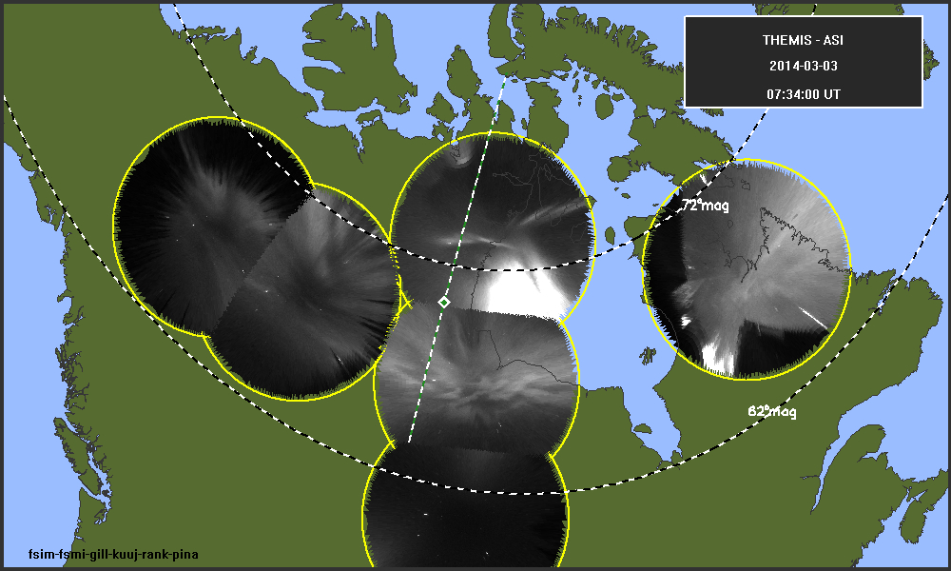
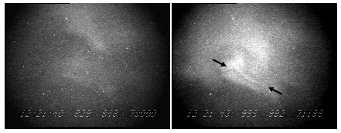
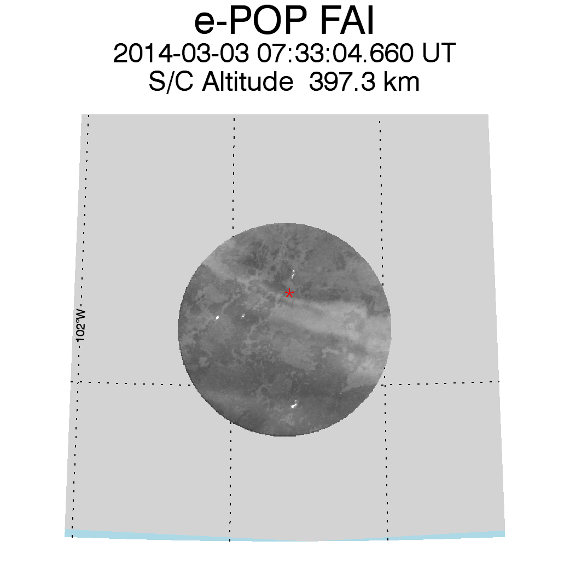
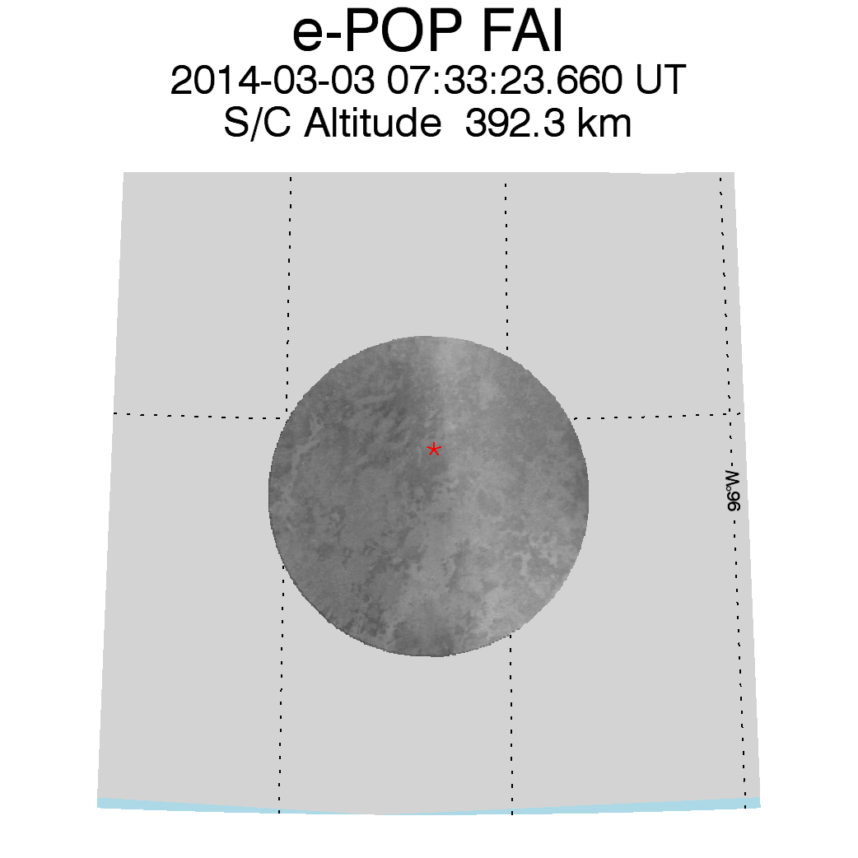
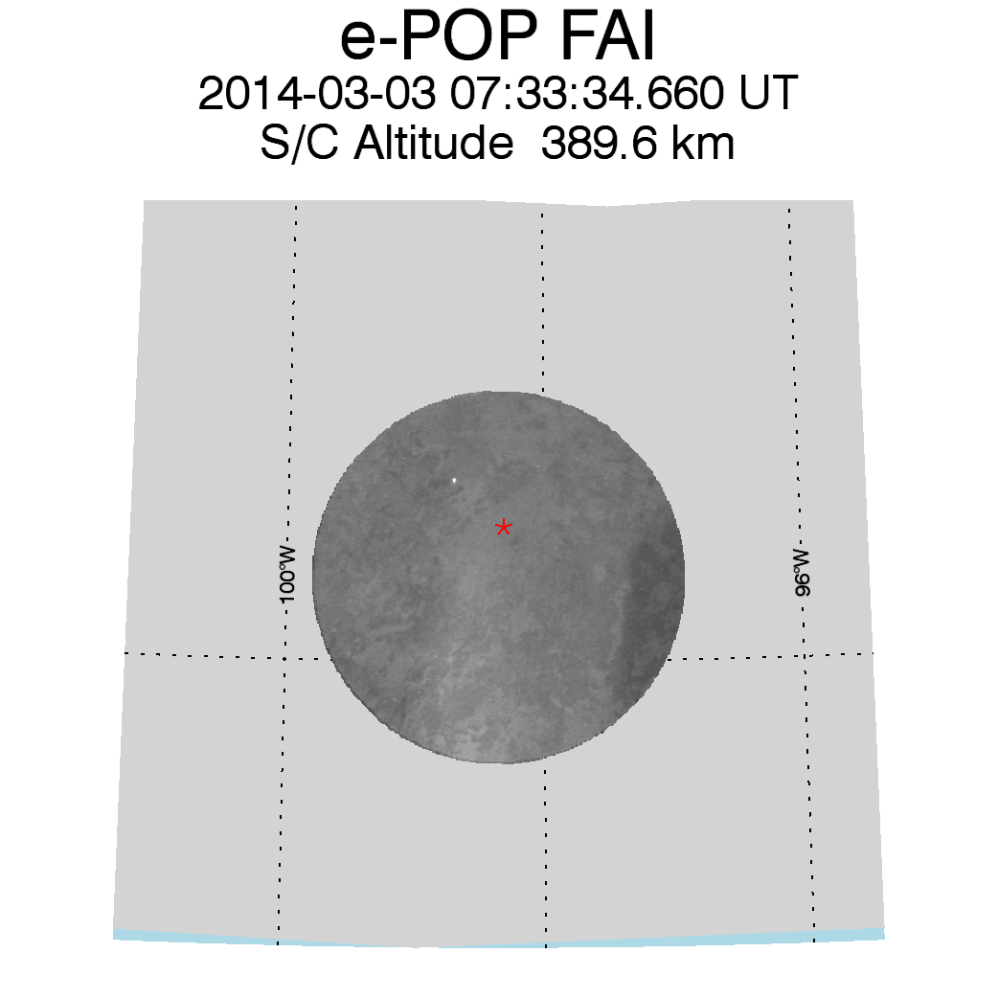
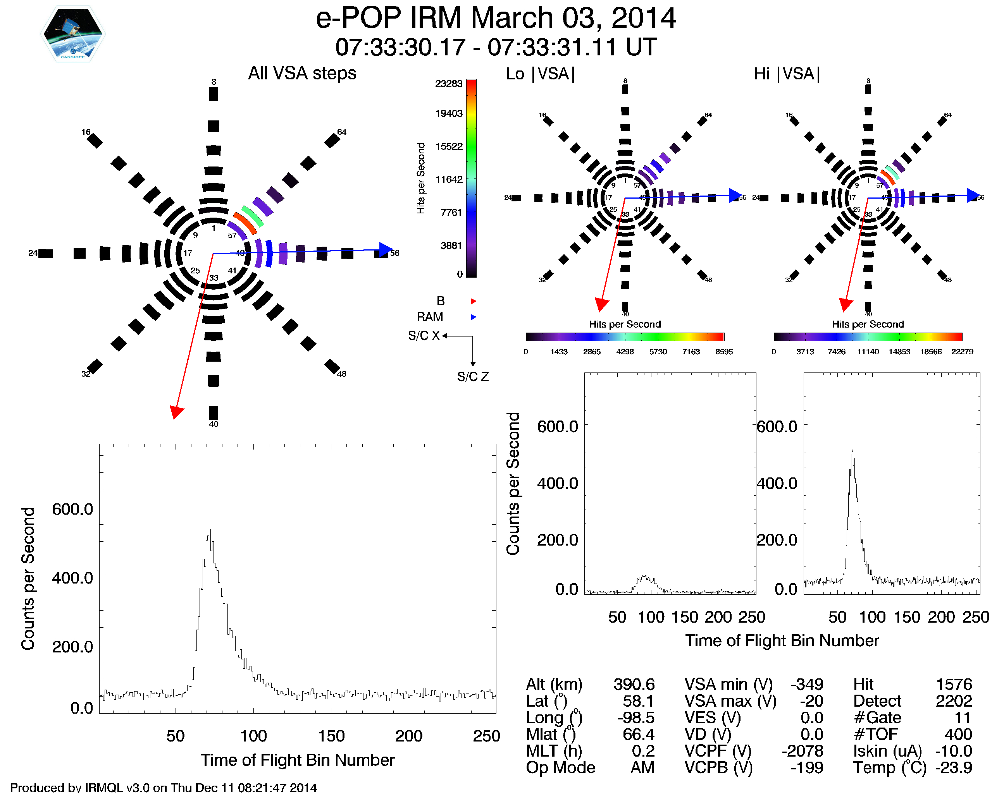
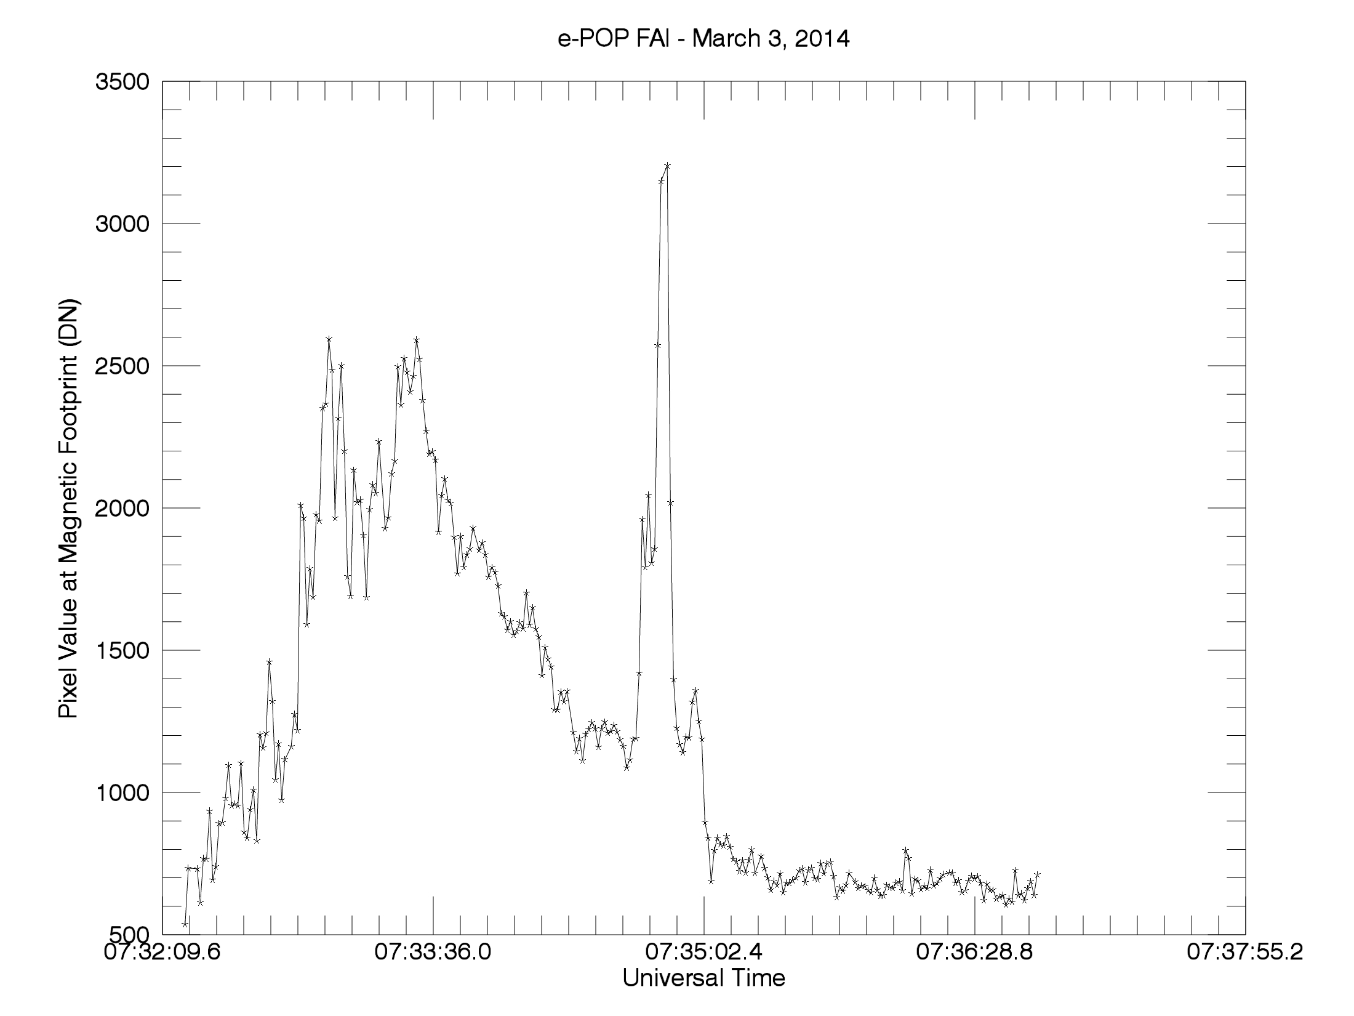
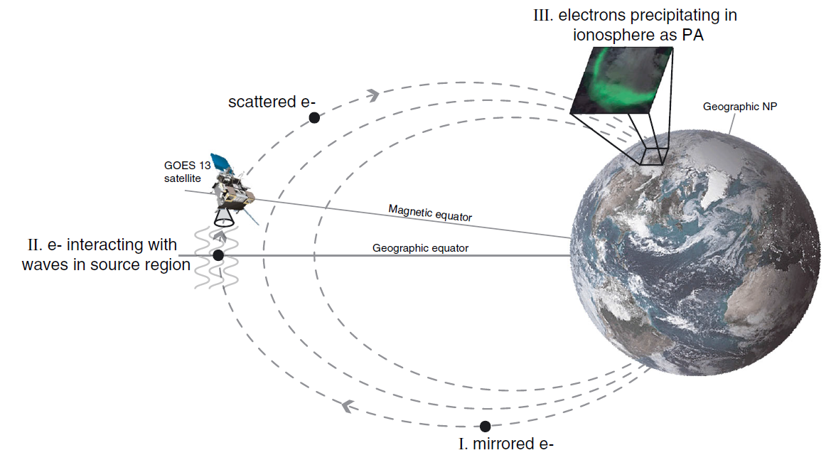
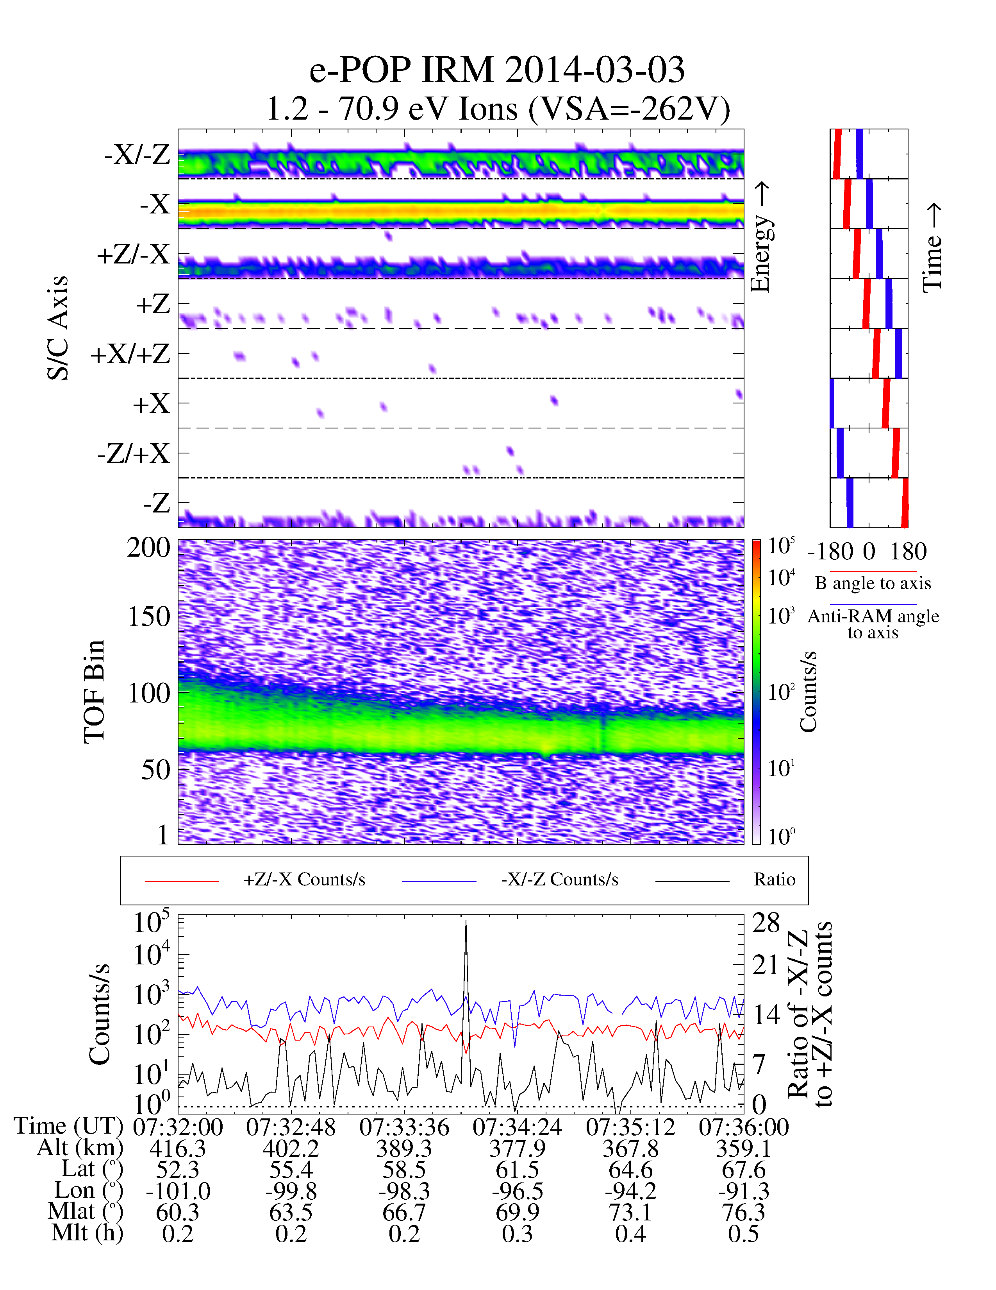
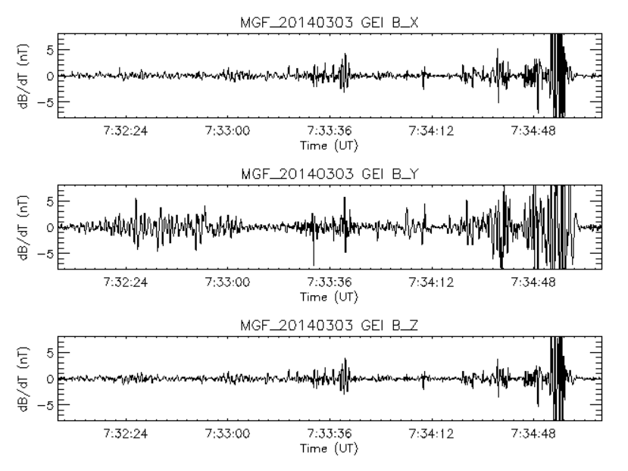
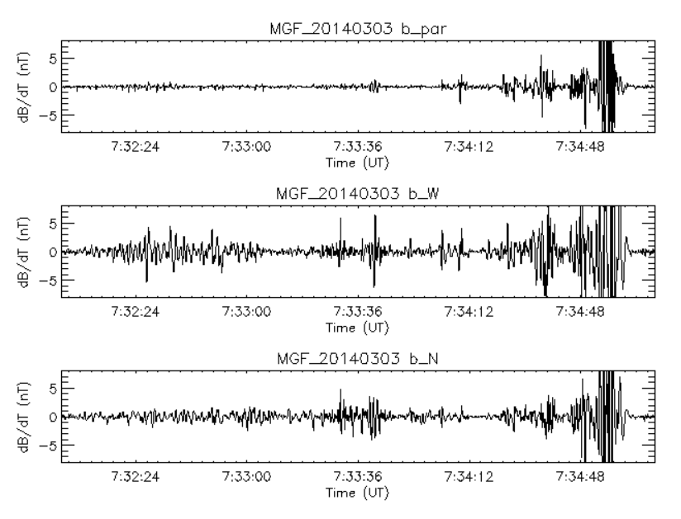
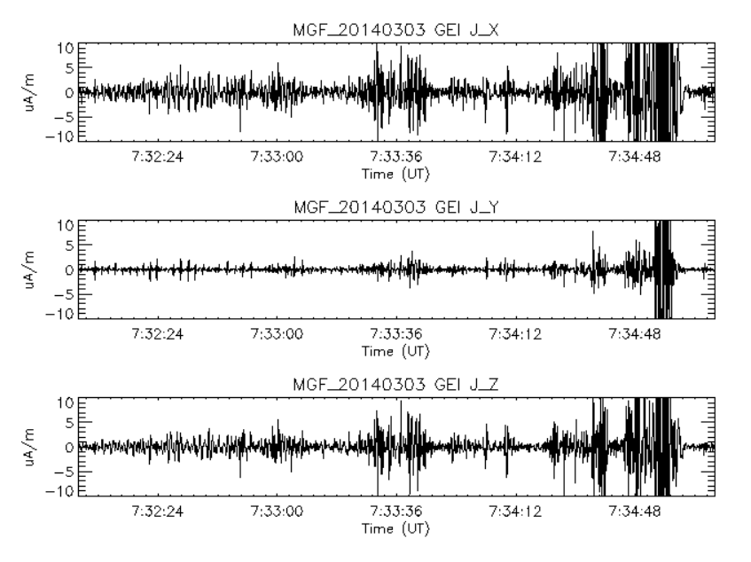
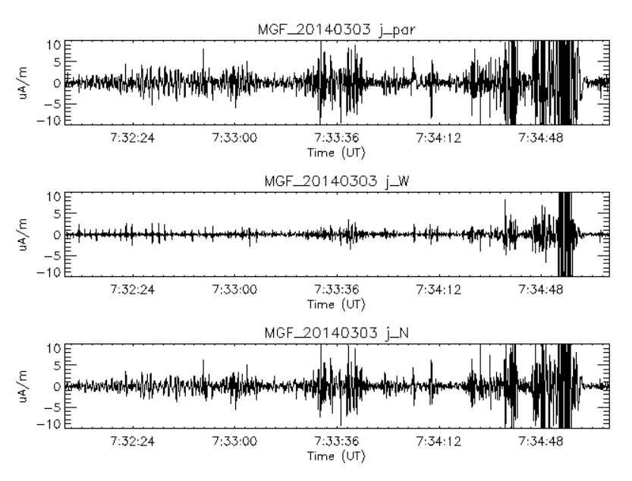
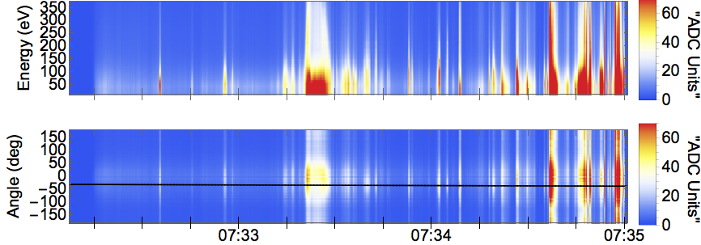
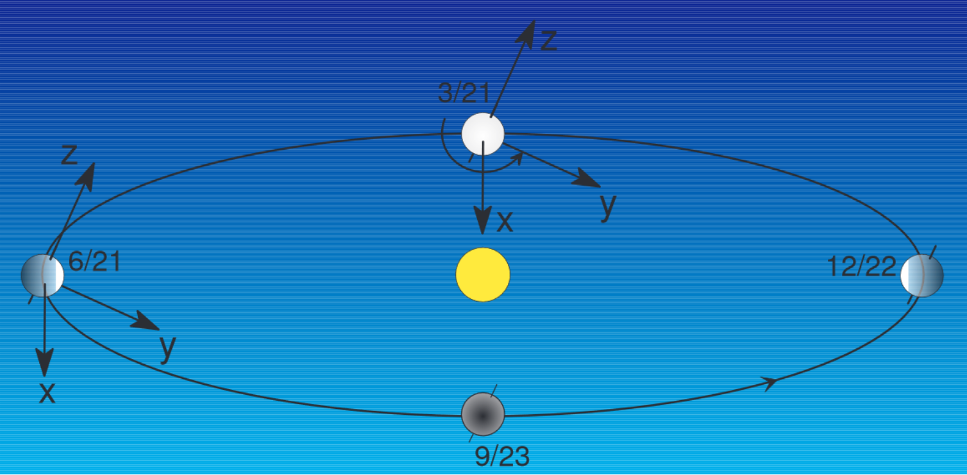
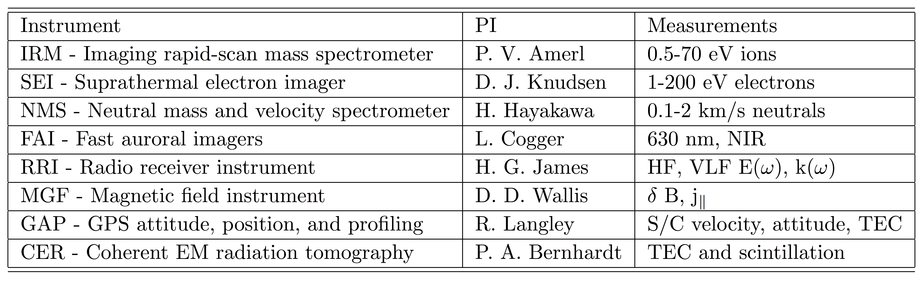
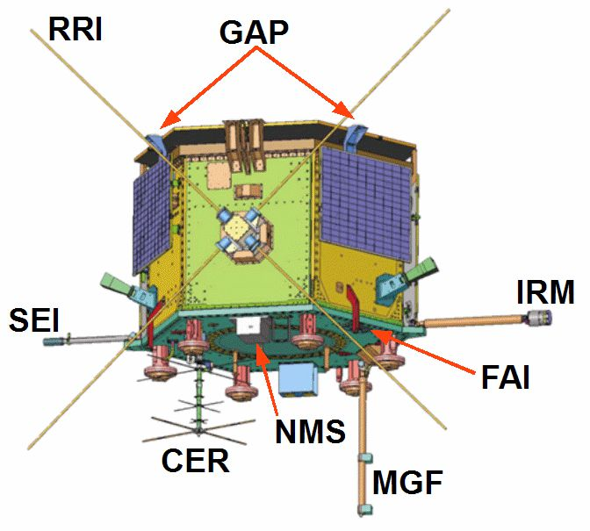
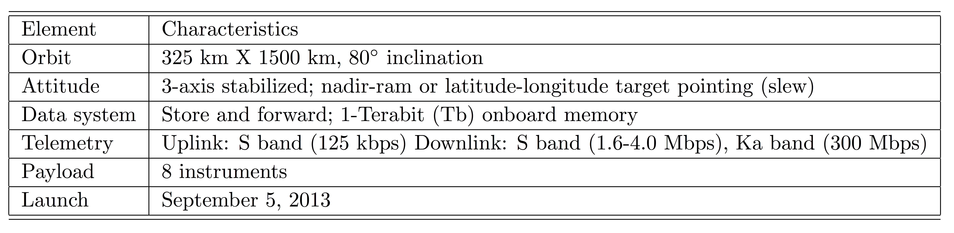
E-POP Observations of Pulsating Aurora
Bruce Fritz, Marc Lessard¹, Leroy Cogger², Andrew Yau², David Knudsen², Emma Spanswick^{2,} Eric Donovan² and Andrew Howarth²
1. University of New Hampshire, Space Science Center, Durham, NH, USA; 2. University of Calgary, Department of Physics, Calgary, AB, Canada
Sponsored by NSF
Introduction
Pulsating aurora, March 3, 2014
Pulsating Aurora are patches often observed along the equatorward side of the auroral oval after substorm break up within a widespread region of diffuse aurora, which over time begin to pulsate. Pulsating aurora is characterized by quasi-periodic brightness modulations with periods ranging from 2 to 20 seconds (or 8 seconds on average) [Royrvik and Davis]. Individual patches pulse out of phase with each other and may have slightly different periods. The patches, which can span 10s to 100s of kilometers, vary greatly in shape and size, with the shape changing on a timescale of minutes [Johnstone, 1978]. Streaming is often seen in the patches with brightening in one area that expands outward during the pulsation. Pulsating aurora is generally quite dim compared to discrete auroras, with a typical brightness in the range of 100s Rayleighs - a few kiloRayleighs in the 427.8 nm emission. Reviews of pulsating aurora are provided by Johnstone (1978), Davidson (1990) and Lessard (2012).
(1)
(2)
THEMIS ground-based allsky camera observations
Image from 07:33:00 UT: e-POP IGRF footpoint projected to 100 km altitude using AACGM. e-POP passes over a region of pulsating aurora.
Image from 07:34:00 UT: e-POP leaves the region of interest
In between, near 07:33:21, e-POP passed over a small region of diffuse (perhaps pulsating) aurora.
e-POP FAI observations are of 650-1100 nm wavelength emissions.
Details of the pulsating auroral region can be seen
e-POP is just entering the region of interest
e-POP is exiting the region.
The auroral form may or may not have been pulsating but it clearly was not a discrete arc.
We assume that the electrons were scattered plasma sheet electrons (2-3 keV, typical of diffuse aurora) or pulsating auroral electrons, with energies a few tens of keV (e-POP is not instrumented to make this measurement).
83 km
Black aurora
Ø 175 km
IGRF footpoint
January 18, 2007
60 km
(1)
(2)
(3)
Example of a black auroral form (black arrows) embedded within a pulsating patch. Brightness and contrast have been modified.
The image above of pulsating auroral patches were taken with a white light intensified camera. Although the patches are fairly uniform in luminosity, evidence of structure is clear, begging the questions of what controls the structure and how such a process might form the basis for an ionospheric feedback mechanism.
Other recent results have shown electron and ion signatures at geosynchronous orbit along the field line above pulsating aurora, as well as small scale field-aligned currents in the ionosphere directly above pulsating aurora. Figure from Jaynes et al [2013].
Recent results have shown that pulsating patches typically maintain well-defined shapes for many pulsating periods, even throughout intervals where the pulsation activity appears to have ceased and then re-appears. That is, the basic shape of the patches is well-defined and persistent. As these features, in principle, map to the equatorial region we are led to the following questions:
What process(es) determines the size and shape of pulsating auroral patches?
  In principle, ionospheric feedback should play some role, though details are not clear.
How can it be that the shape of the patches is maintained even after it seems to have ceased pulsating but then returns?
Do black regions represent return currents?
The figure above shows luminosity along the e-POP footpoint (at 100 km projections).
Brightness is shown in DN, which are approximately the same as Rayleighs
The red line marks 7:33:20, which is when the electrons are detected (see below)
Note: Earth’s albedo likely contributed substantially to the brightness
The star-shaped diagram represents the anodes on the IRM (ion) instrument
The blue arrow represents ions entering from the RAM direction
The red arrow shows the local B field
The highlighted area shows ions that have been accelerated upwards (upflowing ions)
  We estimate that the upward velocity is the order of 1 km/s, higher than radar observations but still below escape velocity.
What is the role of the ionosphere in pulsating aurora?
The role of the ionosphere
The figure to the left shows ion observations. The bottom panel shows a ratio of the detector channels in the yellow box in the figure above
The plot below shows electron measurements of the event, beginning at 07:33:20 and lasting roughly 10 seconds (in the yellow box). The energy of these electrons is 50 eV or less and the distribution is isotropic. These are thought to be backscattered from the incident population [Evans, 1987].
GEI Coordinates
B_par
De-trended magnetic field data and the correlated current density as e-POP passes over the auroral zone. The strongest FAC near the end coincide with bright arcs. In the region of diffuse/pulsating aurora we see weak, small-scale (~1 km) FAC. Requirements for current closure suggest a complex pattern of conductivity and electric field within the patch.
V
B_N
Rotated coordinate system used above
B
B_W
Instrumentation
Conclusion
e-POP observations of diffuse/pulsating aurora lead to the following conclusion:
We observe a backscatterred/secondary population of suprathermal electrons having an isotropic distribution function. At the same time, we observe ions that have been accelerated upwards, quite similar to ion conics that have been observed in the cusp region and in active arcs on the nightside. In this case, however, the assumed more energetic primary population suggests that the ambipolar (vertical) electric field must be established by these backscattered electrons, as opposed to heated electron populations, as observed in the cusp.
We observe weak small-scale field-aligned currents above this aurora. Since these currents must close in the patch itself. The implication is that significant structure exists in the patch, in spite of its uniform appearance.
The e-POP mission focuses on quantitative in-situ measurements of small-scale plasma structures, waves, and fields, at the highest possible spatial-temporal resolution, and imaging and tomographic measurements of the meso- and large-scale auroral morphology and ionospheric topology.
The e-POP orbit is designed to initially cover the pre-midnight/pre-noon regions, but will precess so that e-POP observes all local times during its nominal lifetime. The satellite was launched in September, 2013 by SpaceX.
Acknowledgement: Research at the University of New Hampshire was supported by NSF grants.

