Slide 1


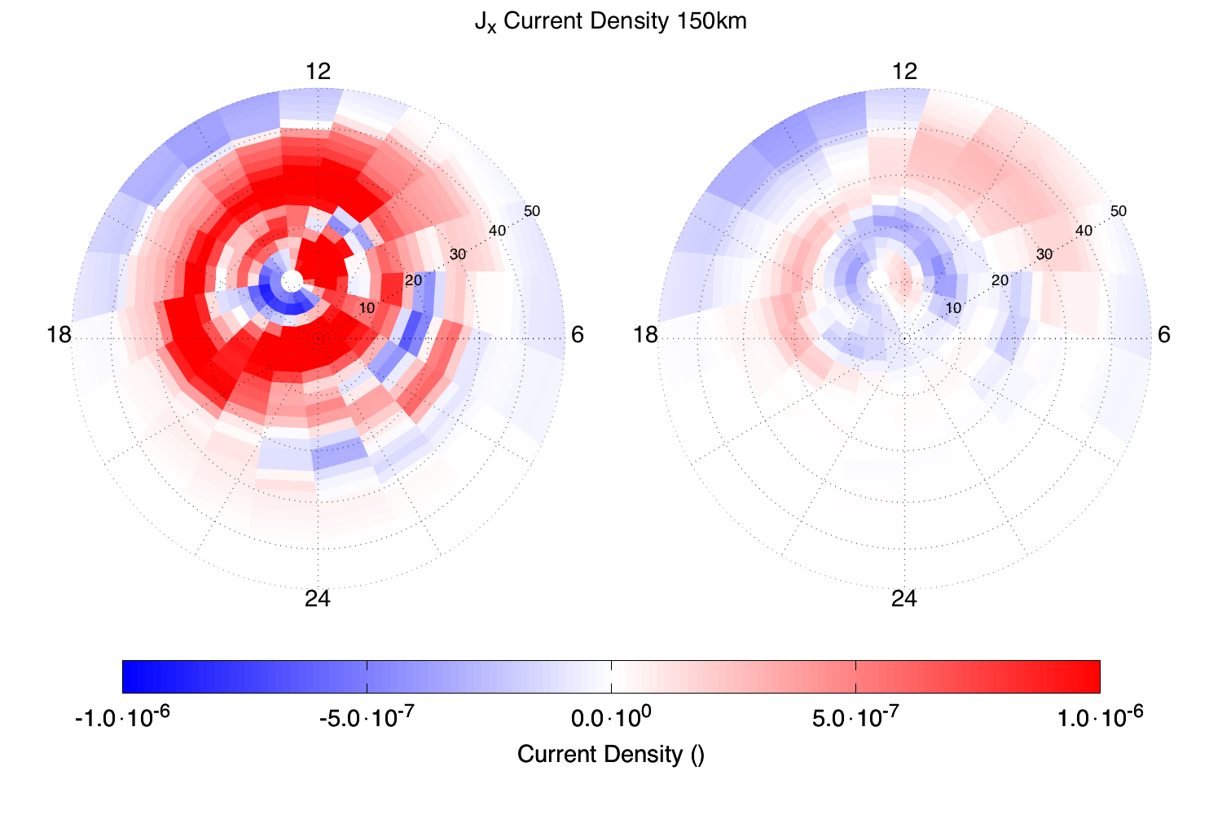
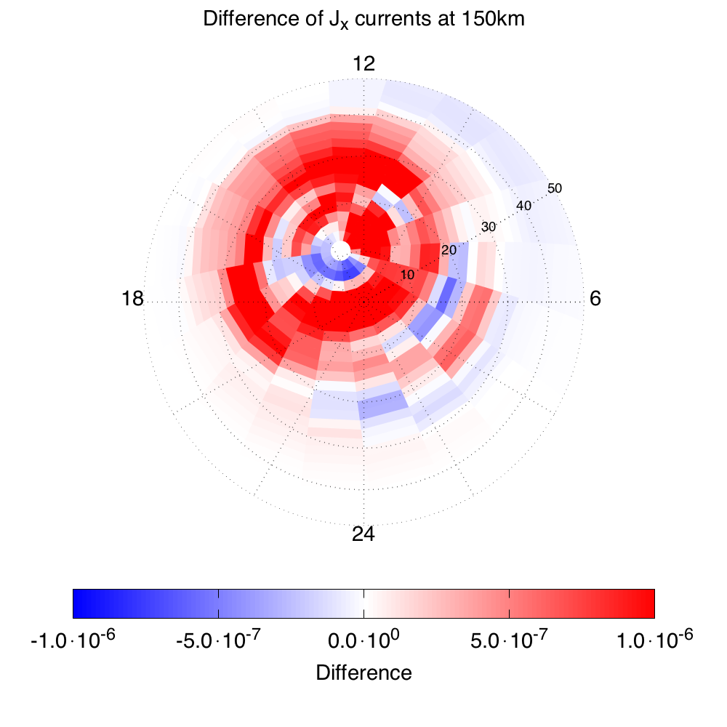
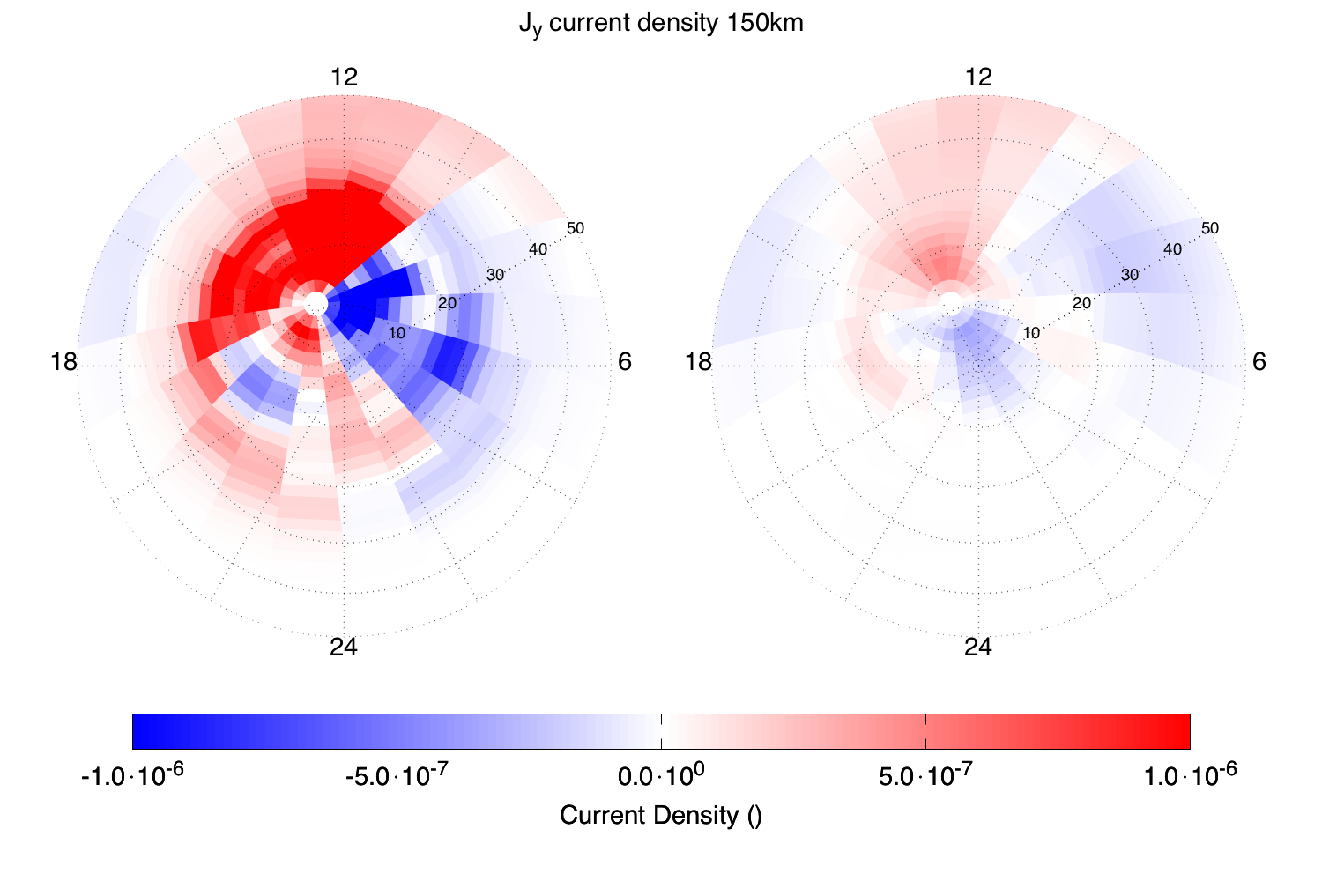
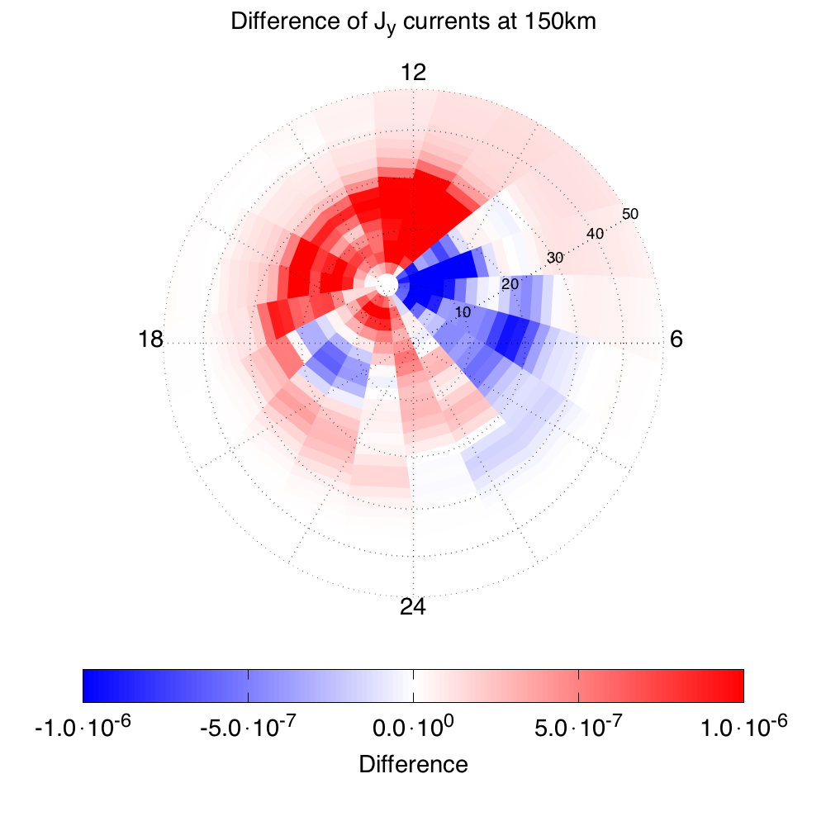
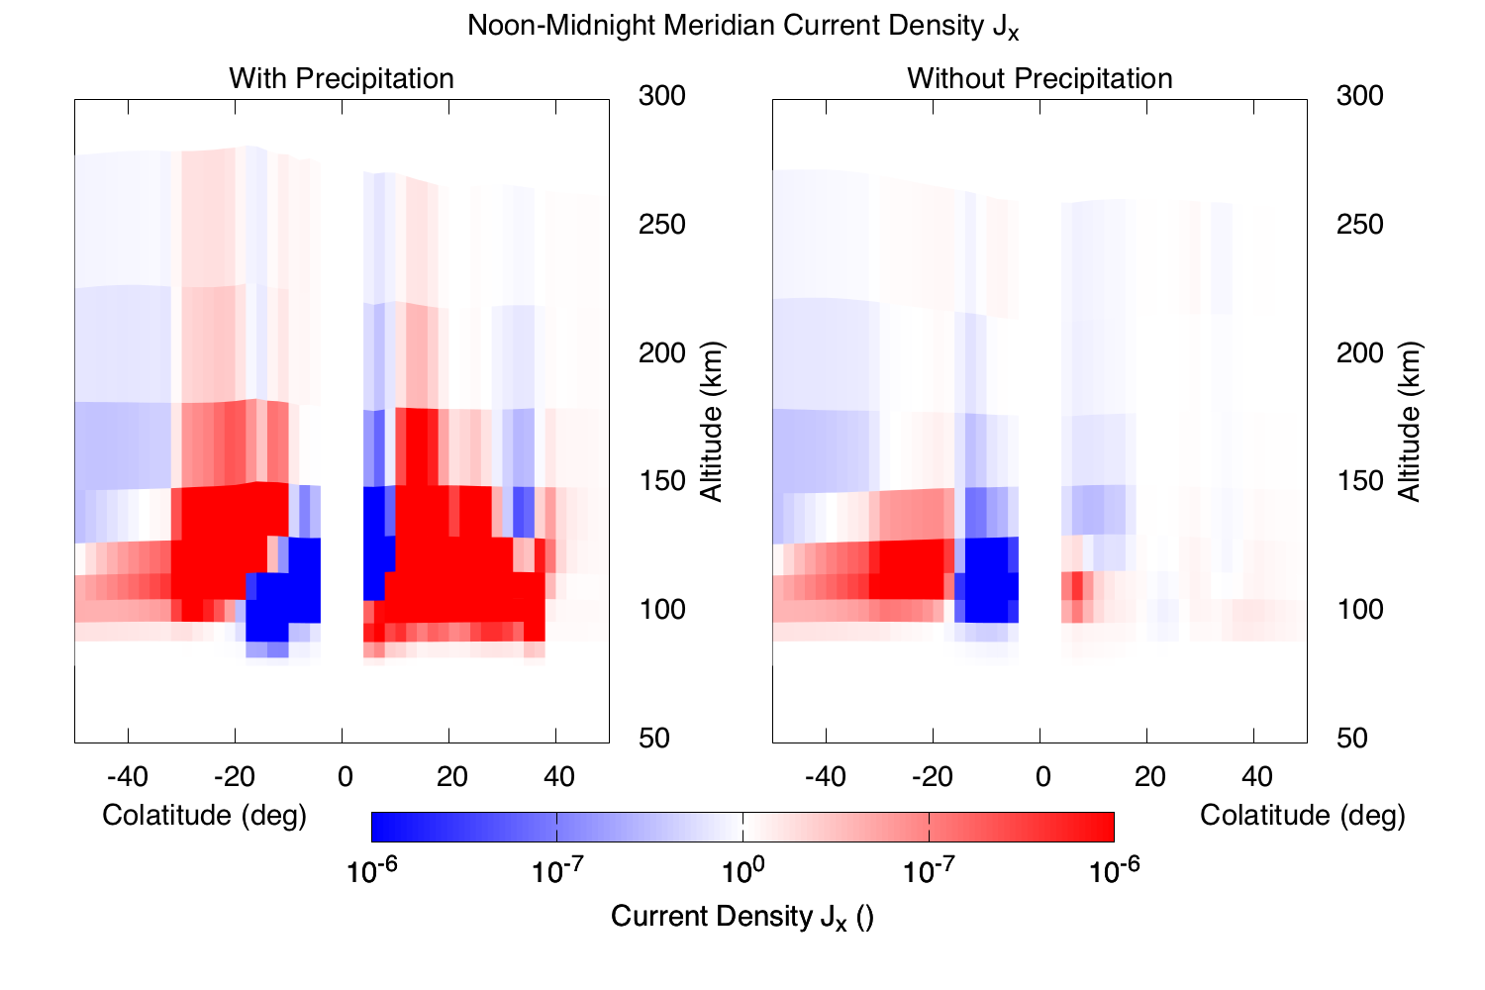
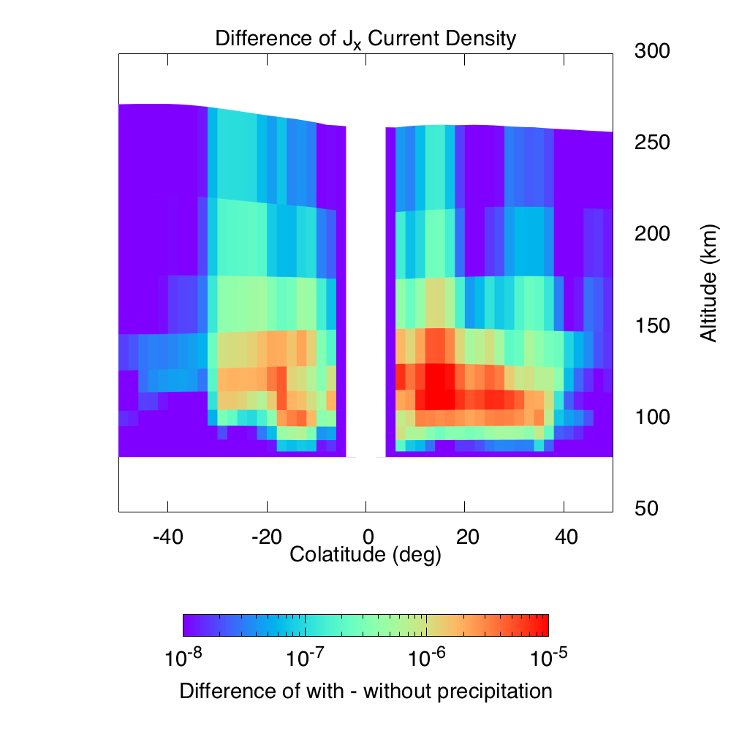
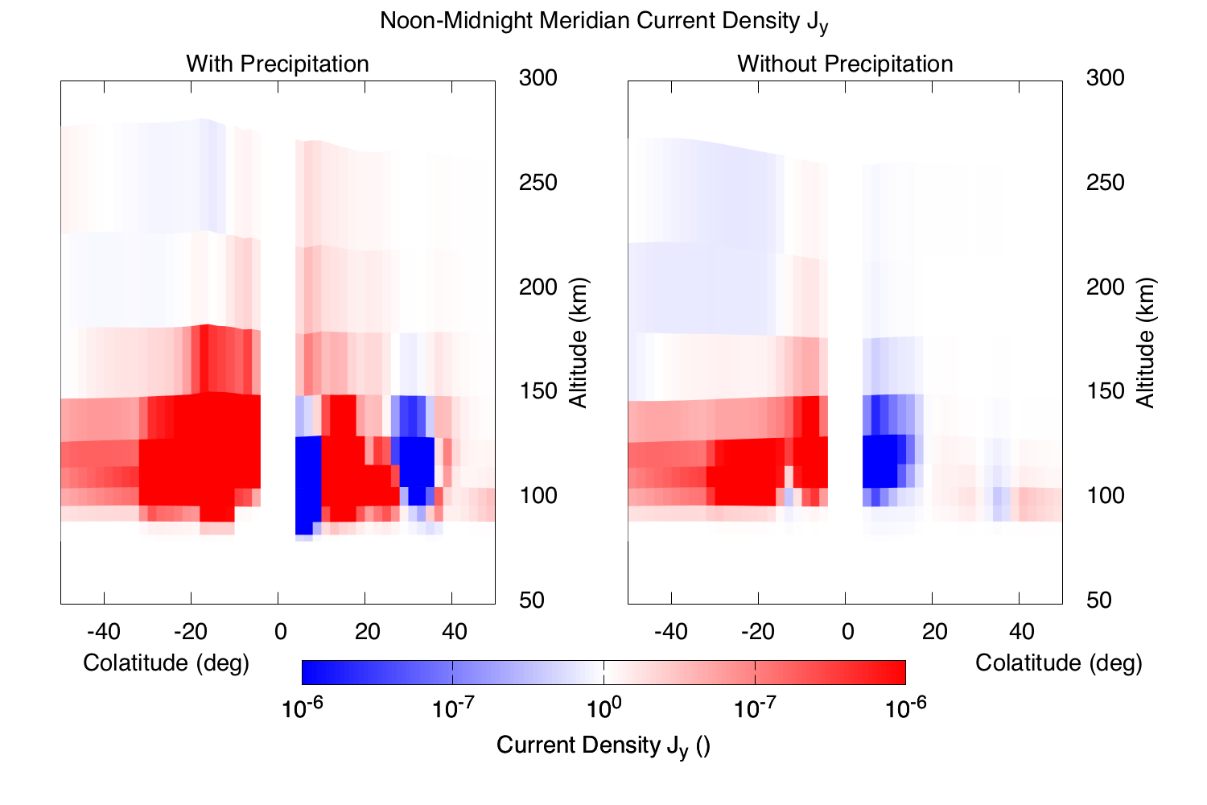
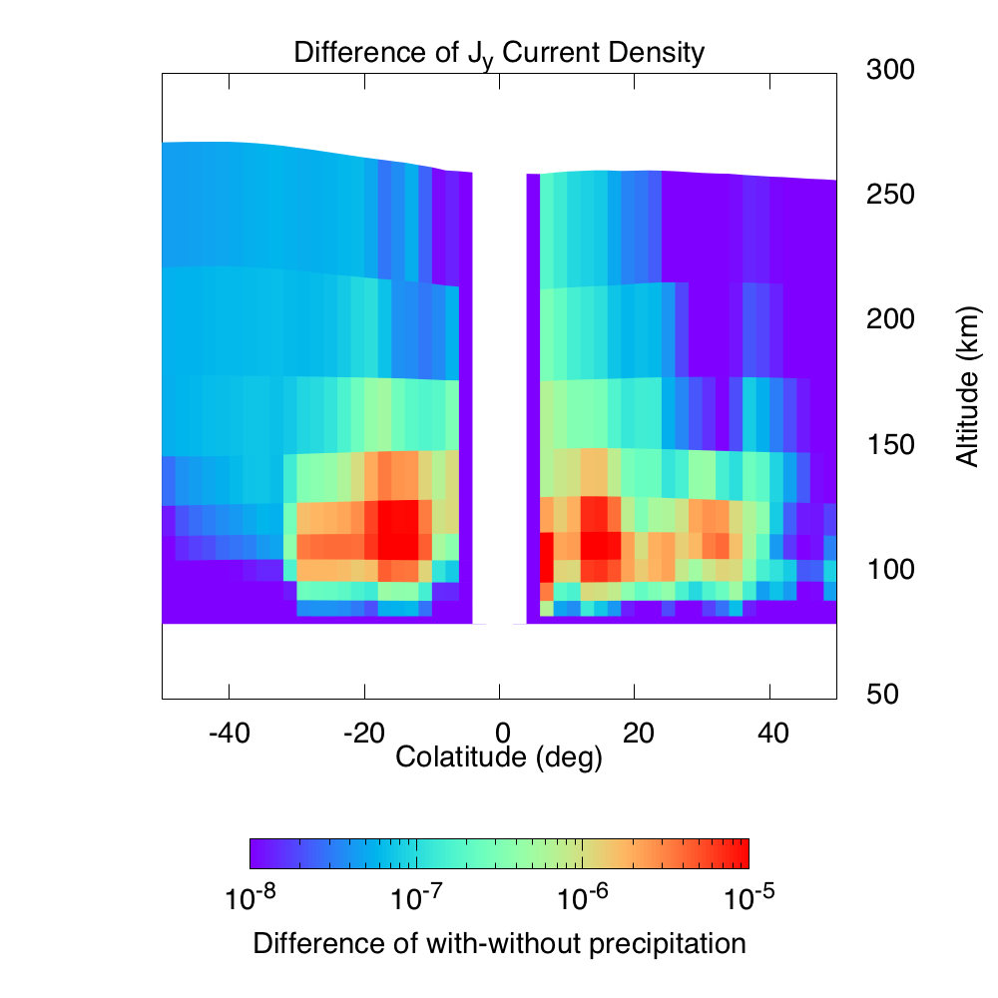
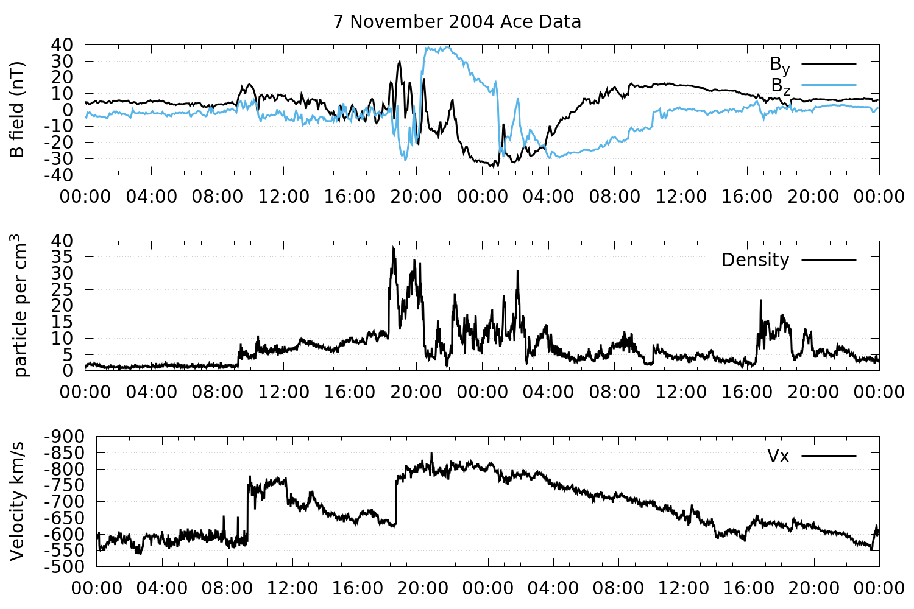
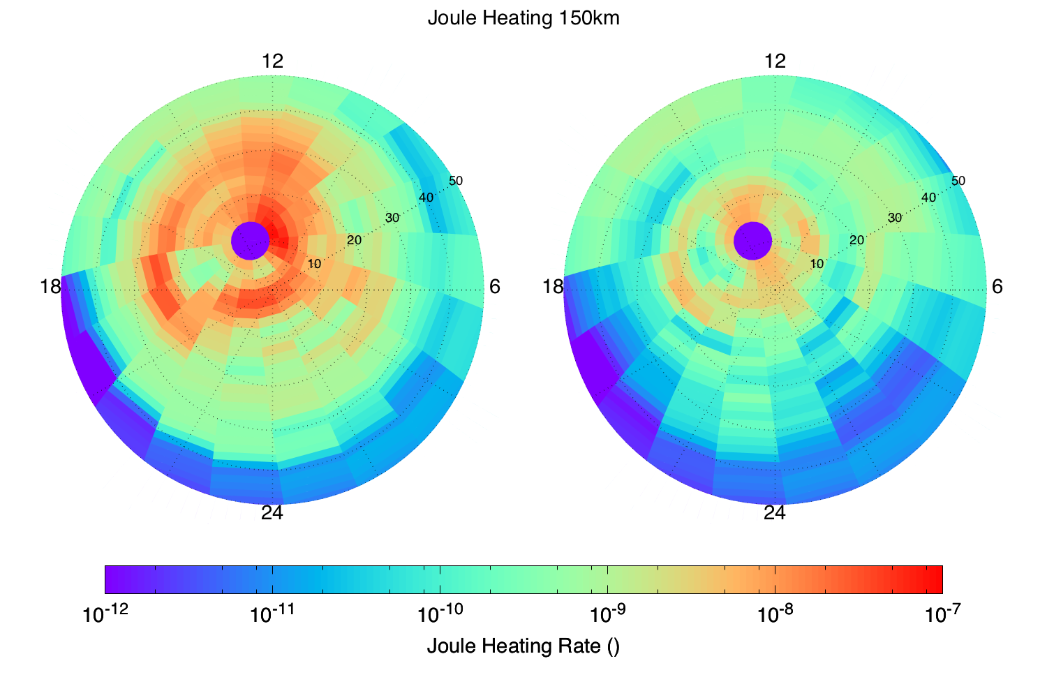
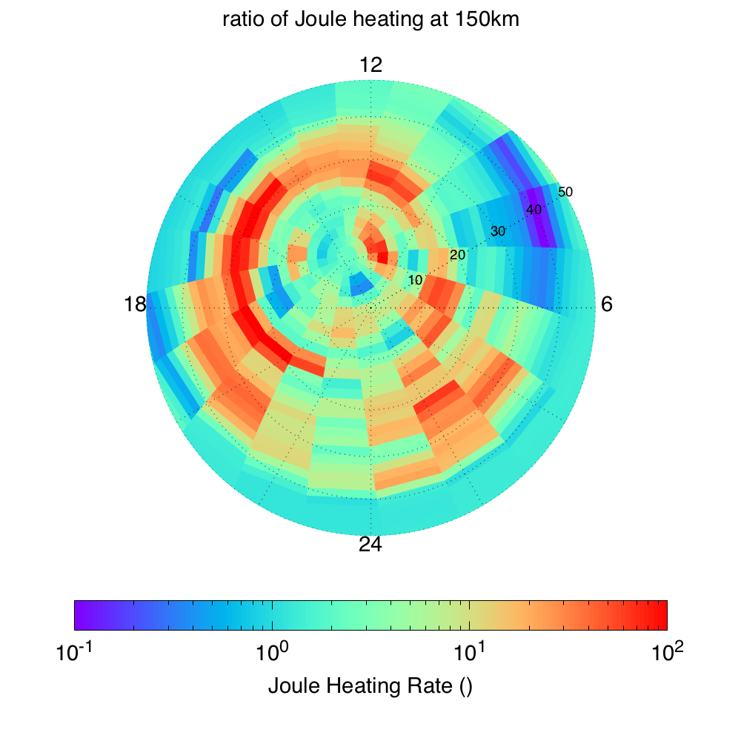
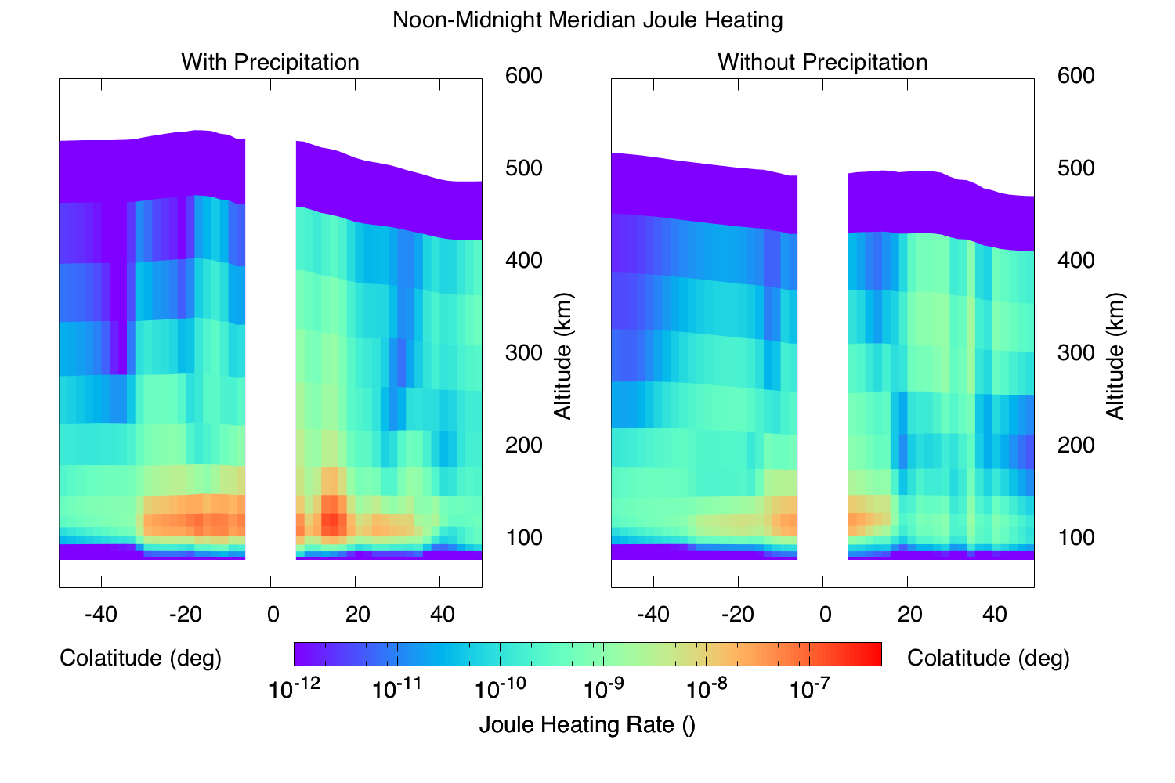
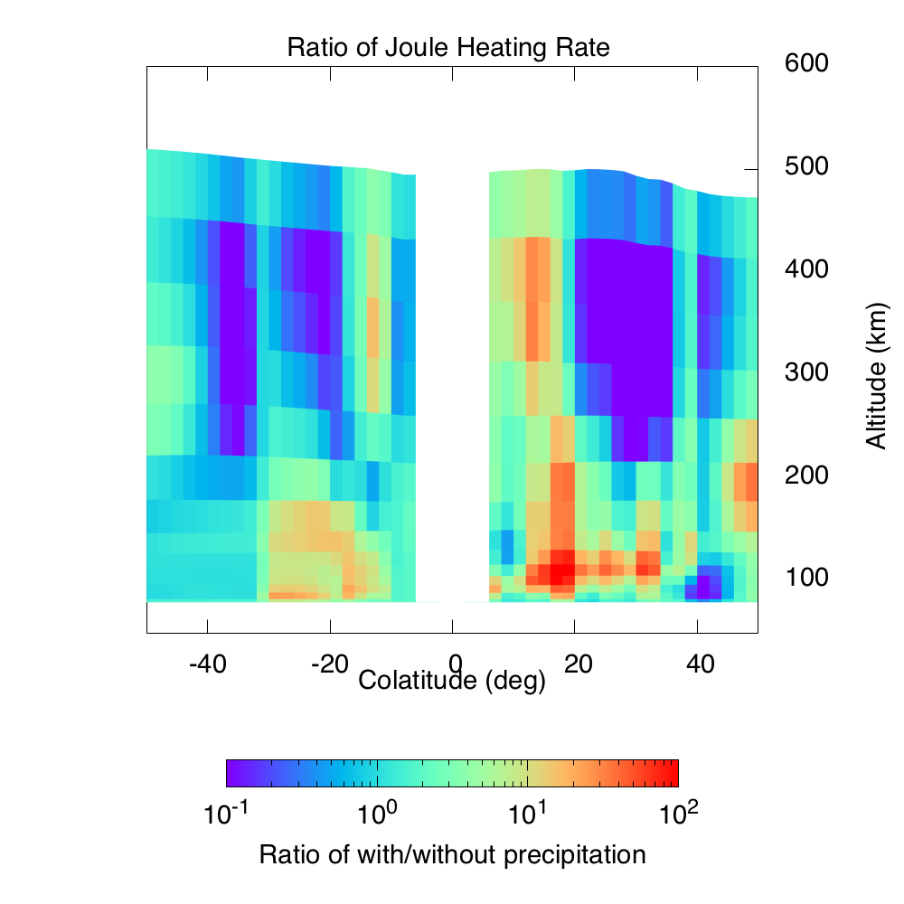
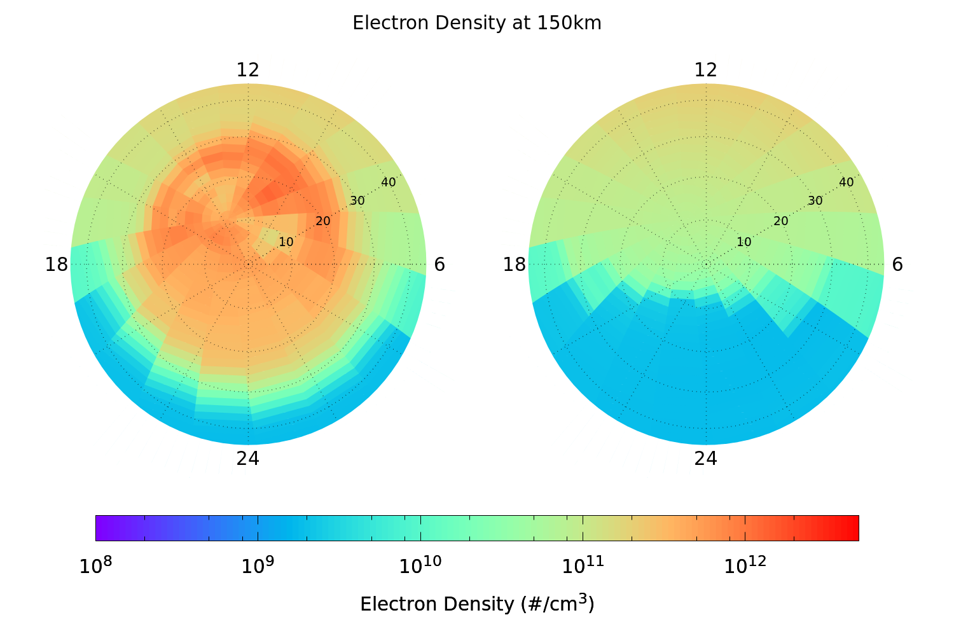
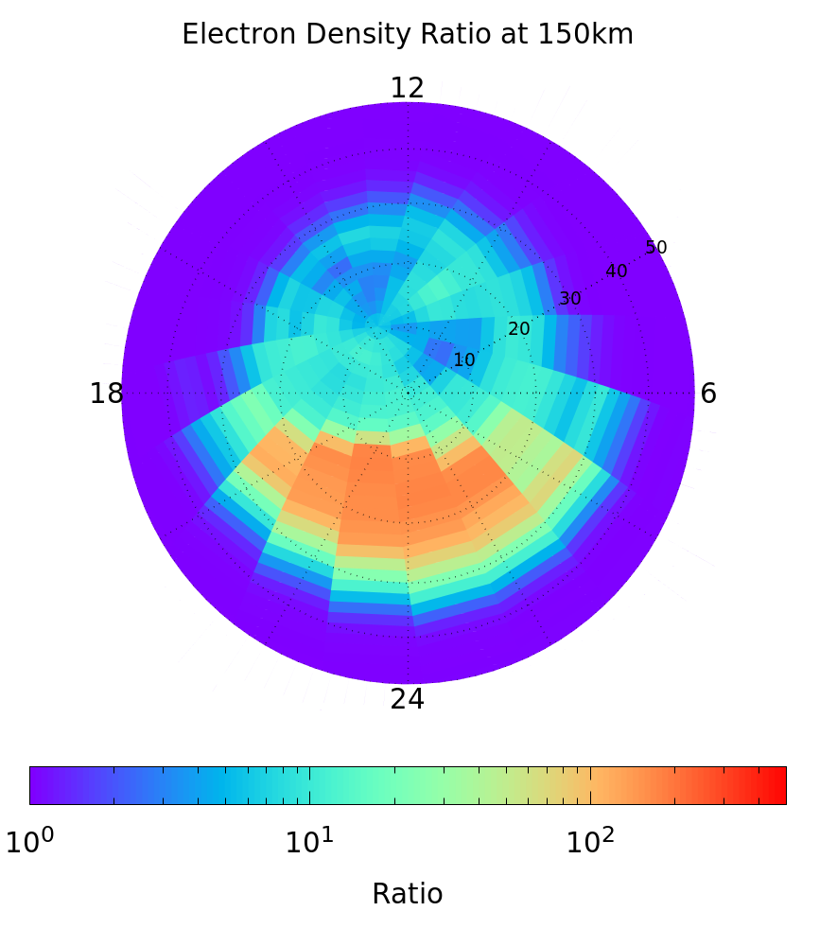
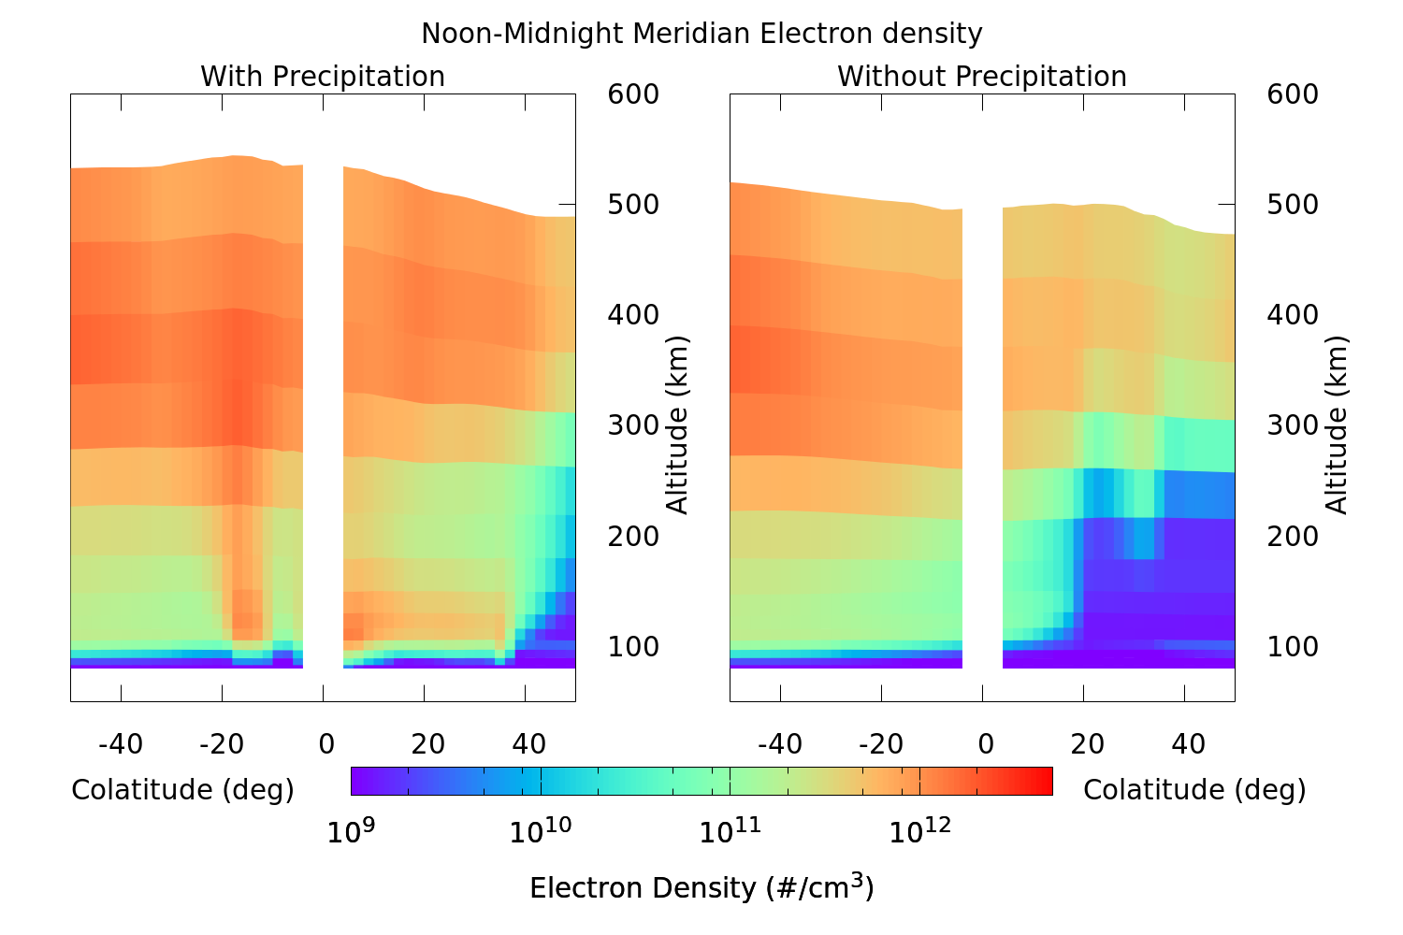
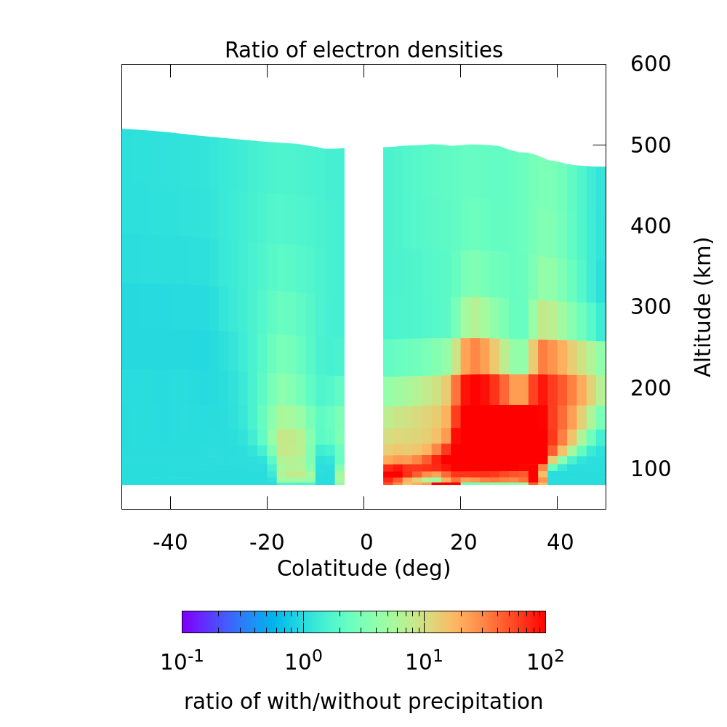
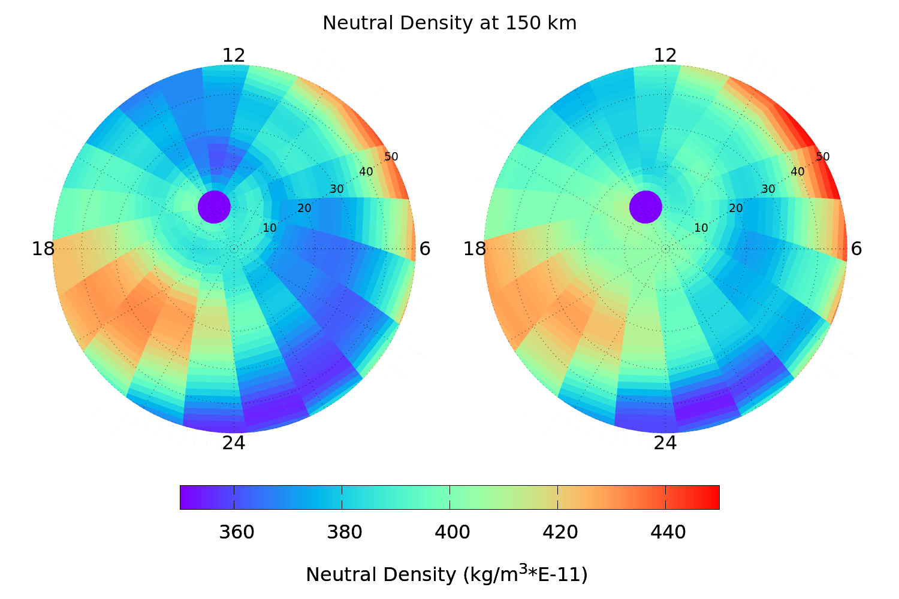
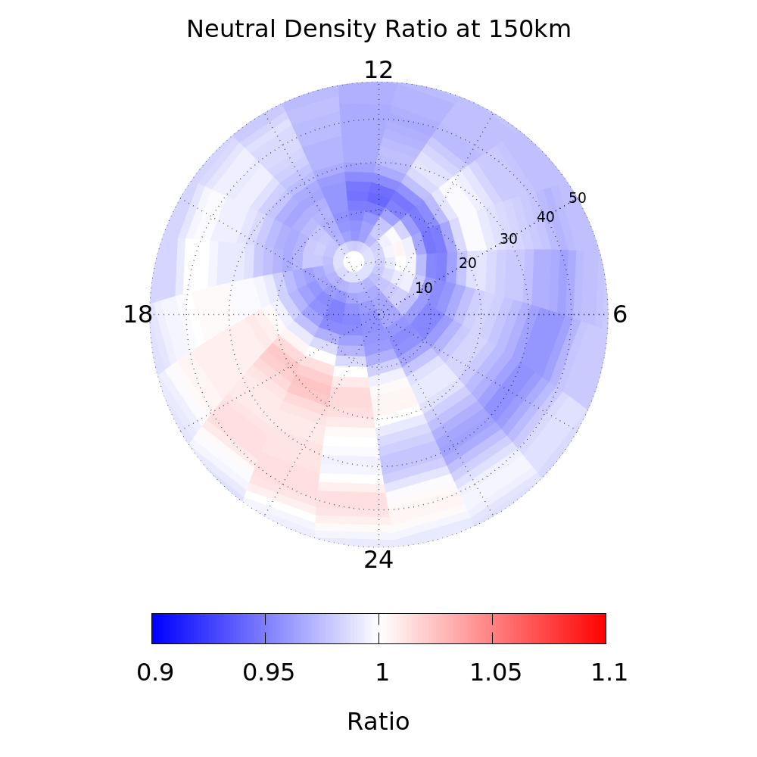
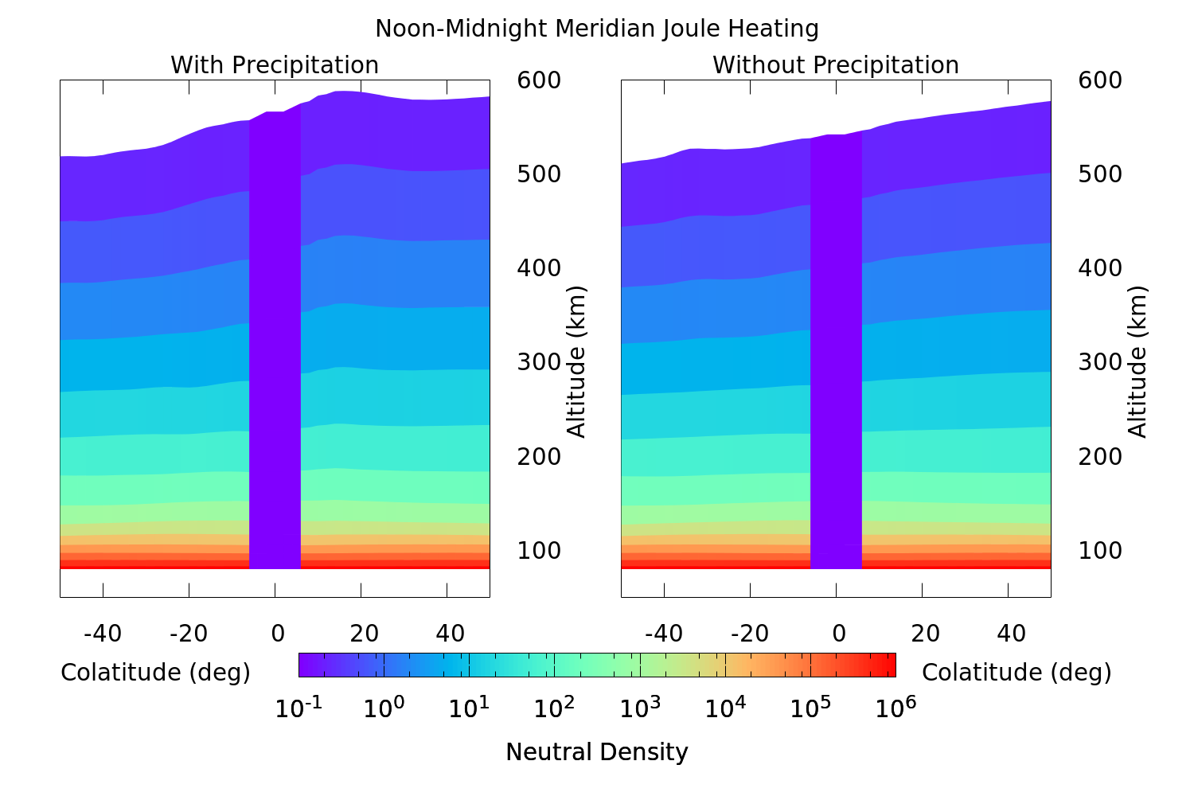
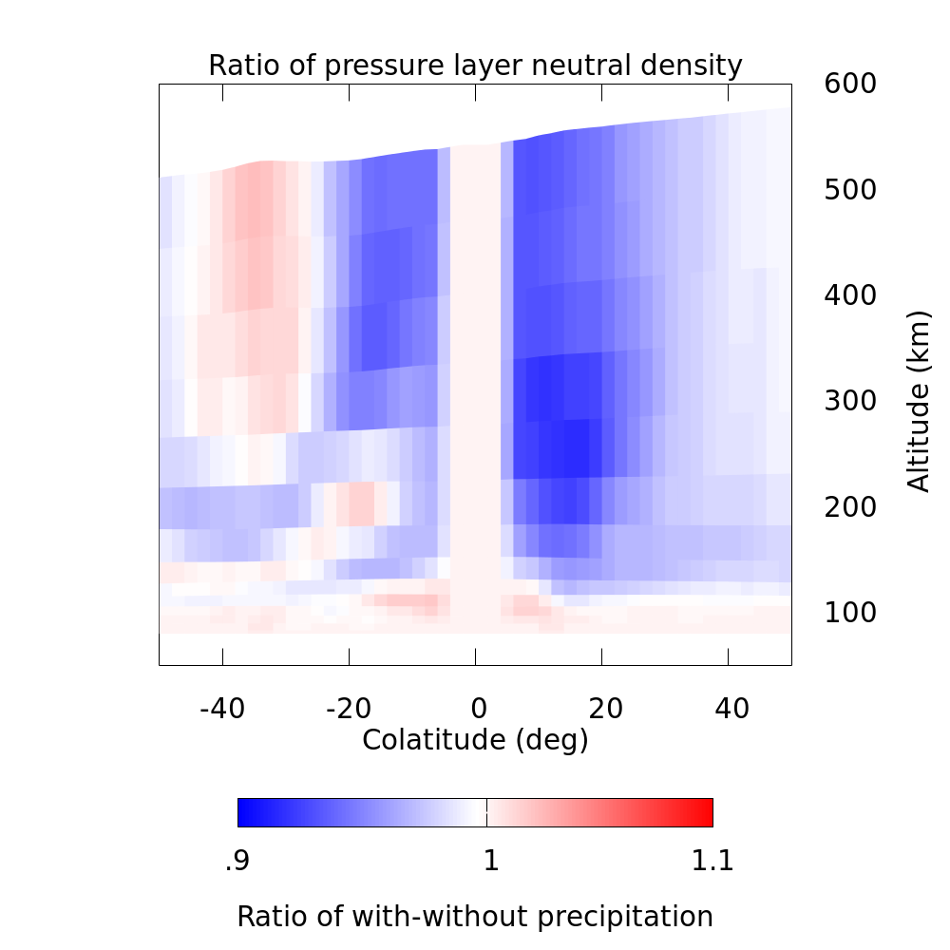
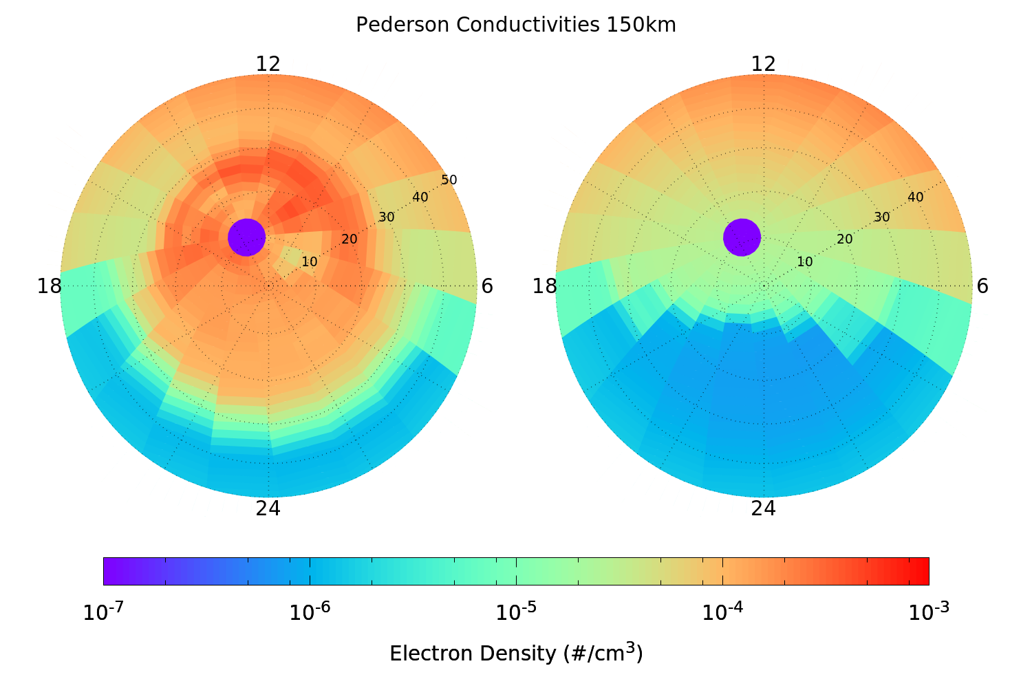
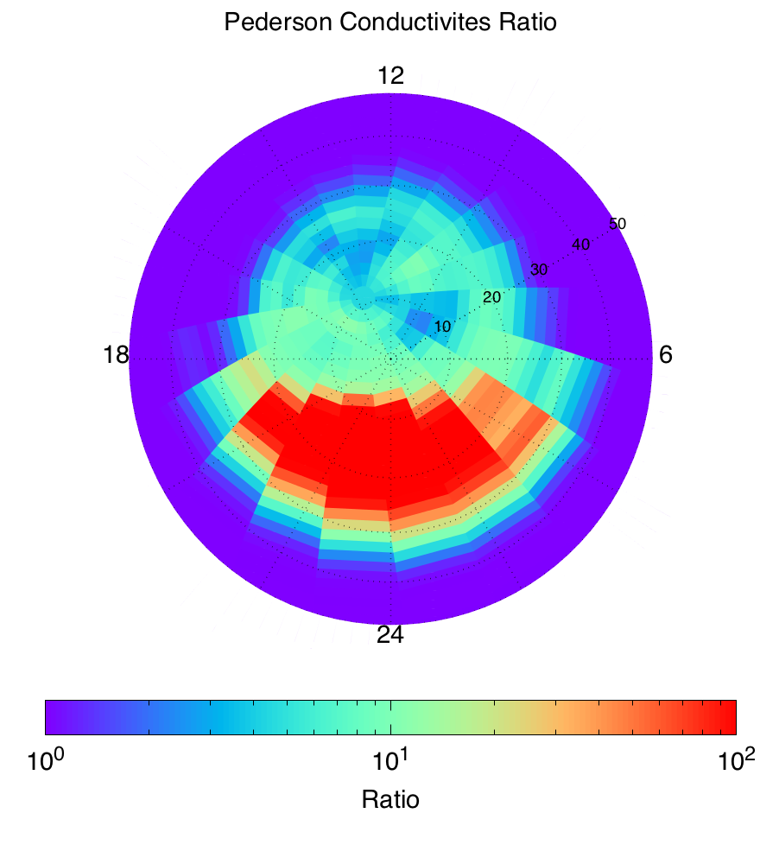
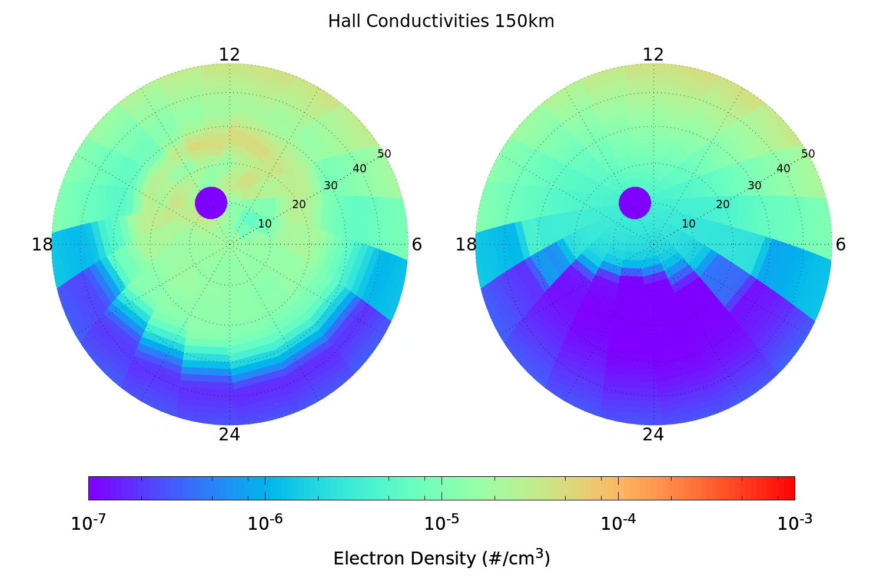
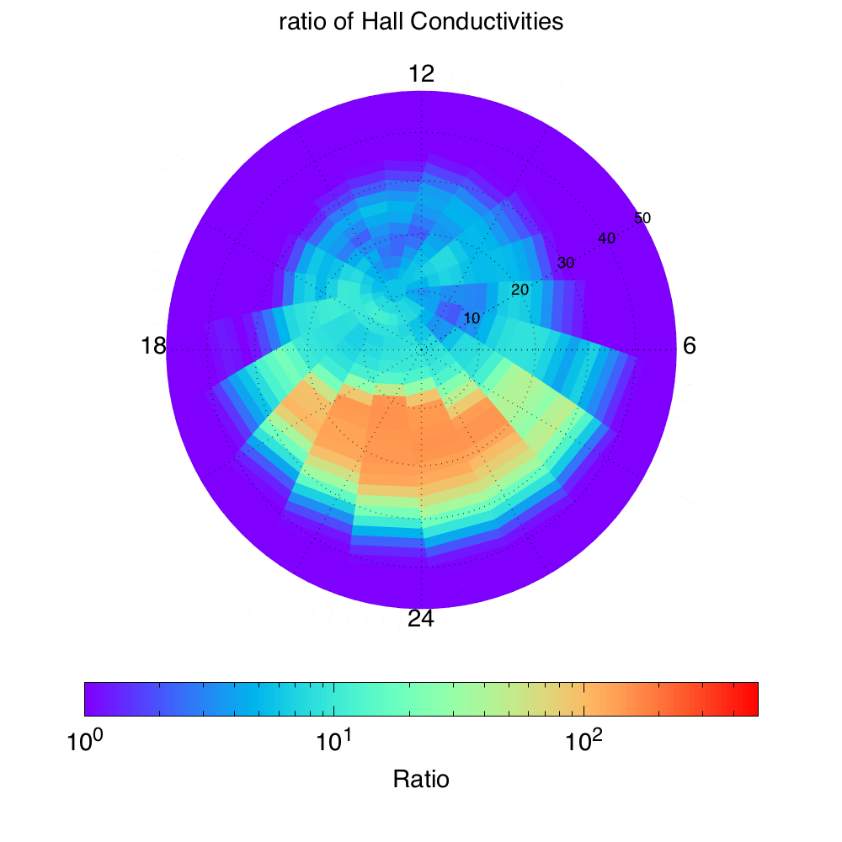
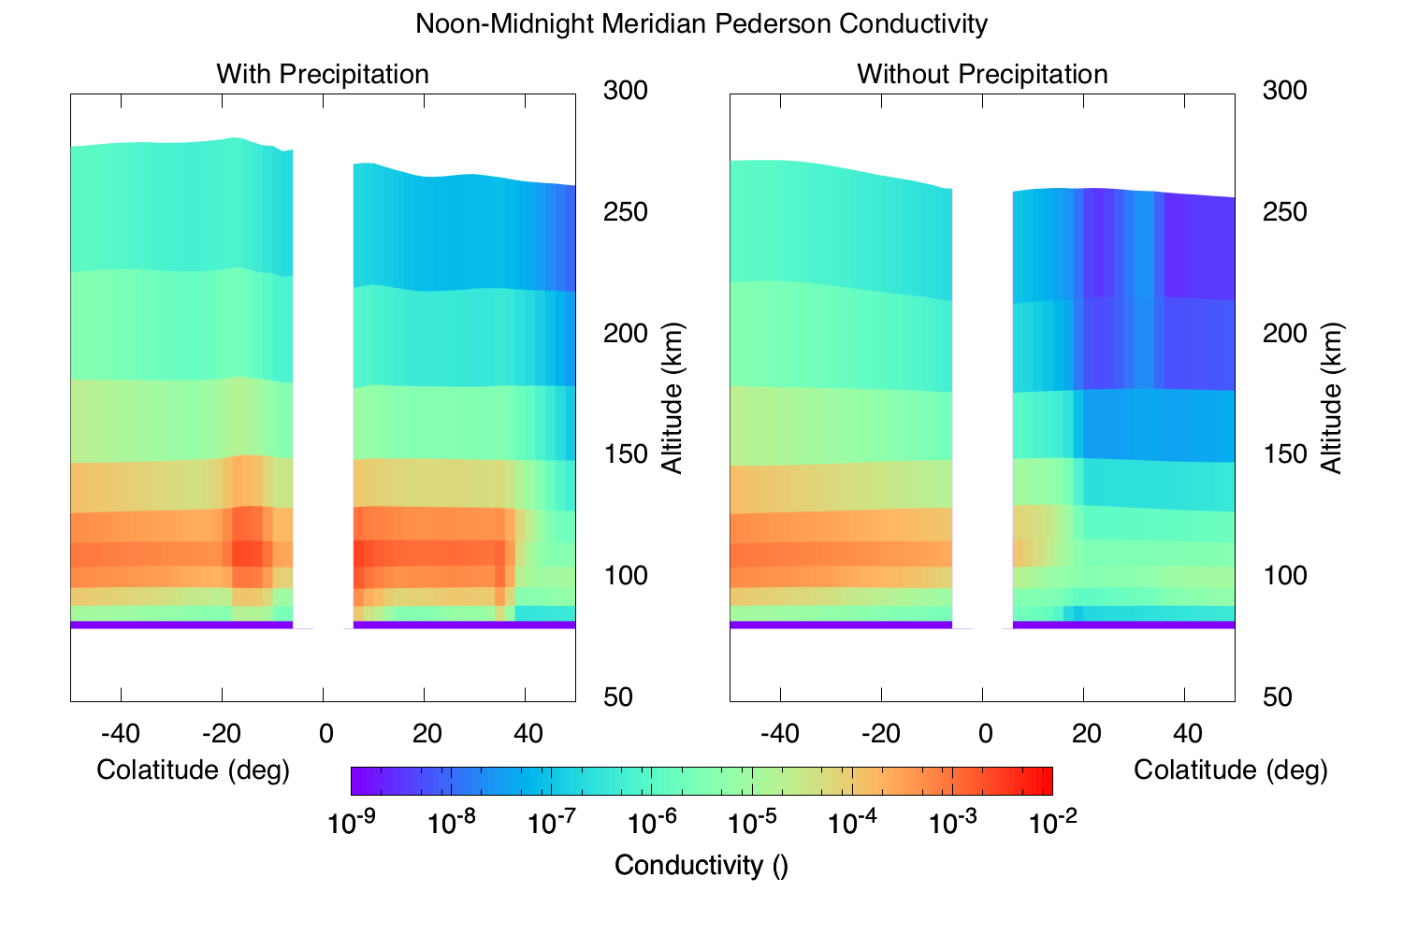
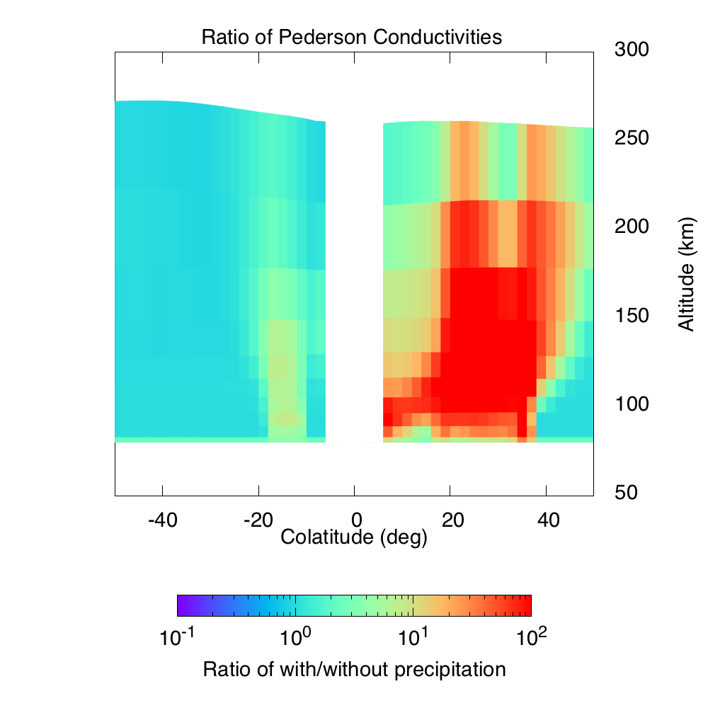
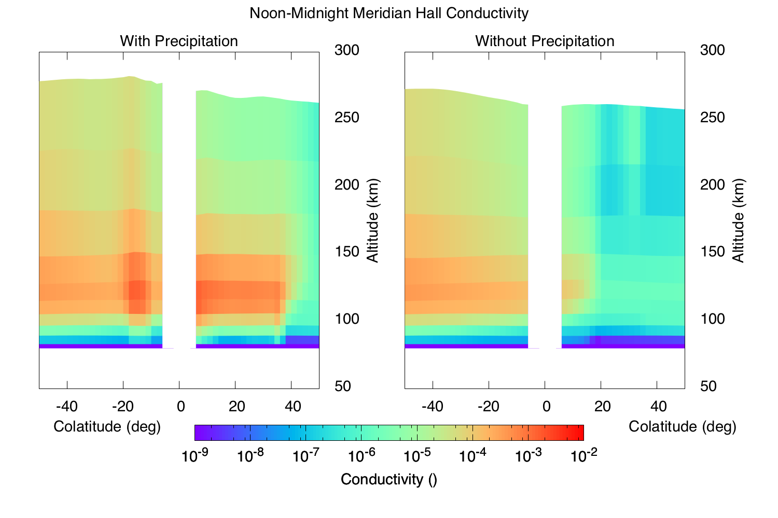
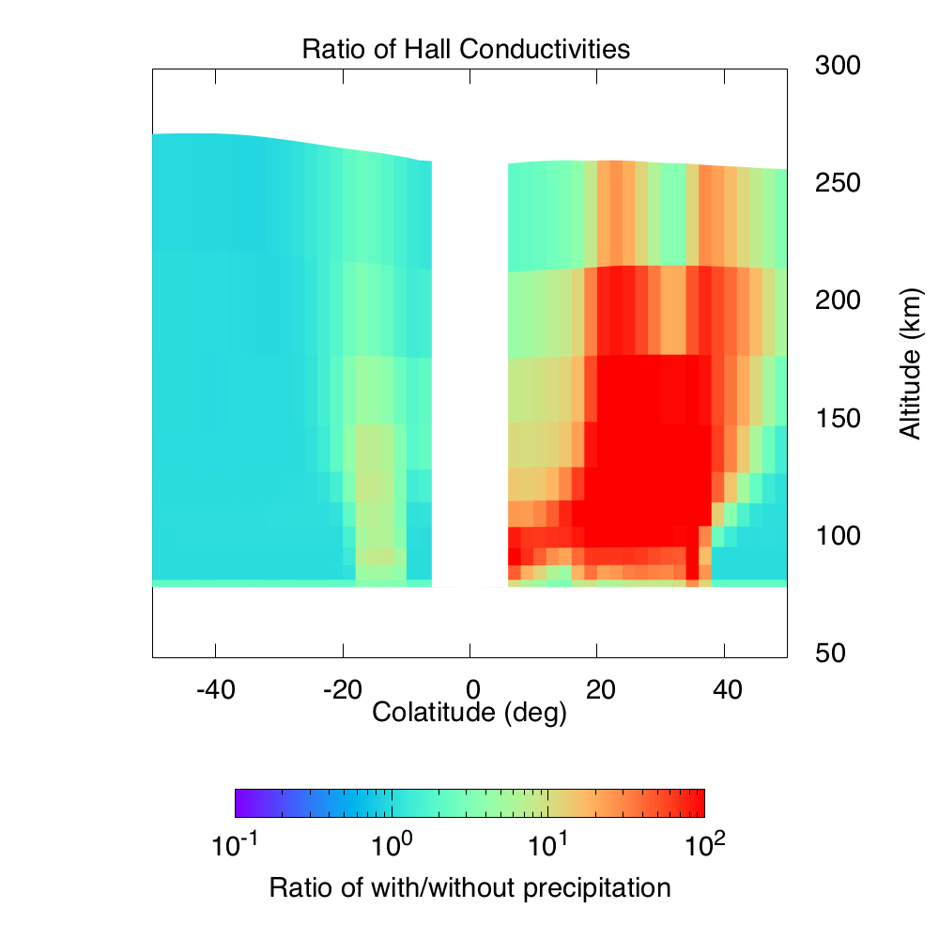
Precipitation Effects on Joule Heating and Neutral Densities of the Polar Ionosphere
Authors: Joseph B. Jensen¹, Jimmy Raeder¹
1.University of New Hampshire, Space Science Center, Durham NH, USA
Introduction
Current Density
Using the coupled OpenGGCM-CTIM model we study the effect of particle precipitation on the joule heating of the earth’s ionosphere-thermosphere system. We have run two simulations with all parameter identical with one difference between the two; we have set the incoming particle precipitation from the magnetosphere to zero. Granted this is a unphysical view, as it can usually be assumed that the loss cone is filled and that precipitation occurs all the time with a fair amount of variability, but it rarely if ever ceases completely.
The intent for these simulations is to compare the difference for electron density, conductance
Current Densities
Figure 5 shows a plot of the current densities for north-south, and east-west components. In the precipitating case the magnitudes of current density are greater by an order of magnitude than that of the non-precipitating case. Also the current density is much more enhanced in the night side as anticipated. The currents rearrange in the polar cap region but they do not necessarily close where the increased conductivity is. Altitude dependent plots are shown, for both north-south east-west plots and the differences can be seen clearly. The current system on the night side permit more current to close.
Precipitation
Increased ionization
Conductivity increased
Modified currents
Joule heating
current densities, and Joule heating. This causal chain is shown in figure 1. As we compare the precipitating and non-precipitating case we can gain insights into how Joule
heating is effected, as well as many other physical processes that could be compared (such as ionospheric convection or tail reconnection for example) that are beyond the scope of this poster.
Figure 1: show a causal chain for how Joule heating occurs in the earth’s ionosphere
Case Study 7 Nov 2004
Case Study 7 Nov 2004
We take as a case study the storm event on the 7th of November 2004. Figure 2 shows the solar wind parameters. There are 2 large shocks that occur at 9:20 UT and 18:20 UT (at ACE) previous to the time we have chosen to output our figures at 18:50 UT after the 2nd shock has hits the magnetosphere. This series of shocks led to a major storm that reached a minimum Dst of -374.
Figure 5: Is of the same format as figure four but the left panels show the North-South current densities and the right panels show the East-West current densities.
Joule Heating
J
The CTIM model calculates Joule heating from the current densities and the electric fields. The Joule heating is the process whereby electrical energy is converted to mechanical energy. Figure 6 shows the Joule heating as calculated by CTIM, again we have an order of magnitude increase in frictional heating that extends over a greater area of the polar cap.
Figure 2: shows the solar wind parameters for the 7 November storm taken from ACE data
Electron Density
Electron densities
As particles cascade into the ionosphere most of their energy is transmitted to neutral particles in the form of collisions, these result in more ions and electrons. Figure 3 shows an example of the precipitation event on 7 November 2015. Particle precipitation around the auroral oval (10-20 degrees colatitude from magnetic poles) has increased dramatically. The greatest increase can be seen on the night side as the photoionization process has stopped and the ratio of the two simulations has the greatest change on the night side.
Figure 3 also has an altitude profile of the electron densities. This is taken from
Including Precipitation
Precipitation Removed
Electron Density Ratio at 150 km
the noon midnight meridian. The precipitation effects can be seen in the plots and effects regions down well into the E-region. Again the greatest change is in the nightside ionosphere.
Figure 3: Shows a plot of the northern hemisphere the top three panels are in Solar Magnetosphere coordinates. These plots show an altitude slice at 150 km in the ionosphere. The bottom panels show the noon midnight meridian and plot the altitudinal variation from 100-500 km. The left panels show the simulation where particle precipitation is calculated normally. The center panels show the simulation where precipitation is turned off. The right most panels show a ratio of the two fields. The gap in the center corresponds to the geographic north pole.
Figure 6: Is of the same format as figure 3 but shows the Joule heating rate at 150km. The expansion of the Joule heating over the whole auroral oval especially on the night side.
Neutral Densities
Current Densities
The neutral densities have a typical change pattern. As energy is converted from electromagnetic to mechanical the ionosphere is heated up causing the neutral particles to expand. This can most easily be seen in the altitudinal plots in the bottom left, the topmost pressure layer of the atmosphere rose more than 40 km. The differences in the pressure layer themselves are shown on the top plots an there is some 10% variation within the layer themselves. Mostly a decrease in the density in the precipitation case. This is probably due to the rising pressure layer has less particles than the cold dense lower pressure layer. The actual density at any given altitude is going to increase.
Conductivity
Conductivities
The conductivity in the earth's ionosphere is changed with the increase in electron densities. This creates a more conducting ionosphere that will in turn change how currents flow in the ionosphere. The conductivities have a linear relationship with electron densities and as such in the models they follow closely the increase in densities as shown in figure 4. The altitude dependence is also shown and again the night side has the greatest difference as precipitation is the main ionizing influence.
Figure 7: Graphs of the Neutral density of the same format as figure 3. Note that this is a graph of the pressure levels in the ionosphere, not the absolute altitude.
Summary
Summary
Electron precipitation has a large impact on the earth's ionosphere resulting in increases in electron densities, conductivities, current densities, Joule heating and neutral densities. With these modeling tools we plan to investigate in the future some of the basic physics on how precipitation affects ionospheric convection patterns, how precipitation affects magnetotail dynamics, and magnetospheric convection.
Figure 4: Shows the conductivities in the ionosphere. The top left 3 panels show the pederson conductivities at 150 km with precipitation, without precipitation, and the ratio. The bottom three left panels show the Pederson conductivities height profile along the noon midnight meridian, again with, without and a ratio. The right panels have the same format but are of the Hall conductivities.
References
-Li, W., D. Knipp, J. Lei, and J. Raeder (2011), The relation between dayside local Poynting flux enhancement and cusp reconnection, J. Geophys. Res., 116, A08301, doi:10.1029/2011JA016566.
-Raeder, J. (2003), Global magnetohydrodynamics—A tutorial, in Space Plasma Simulation, Lecture Notes in Physics, vol. 615, edited by J. Büchner, C. T. Dum, and M. Scholer, pp. 212–246, Springer, Berlin, doi:10.1007/3-540-36530-3_11.sdf

