Slide 1

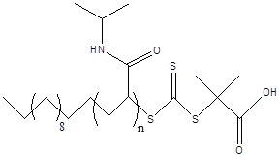




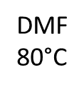
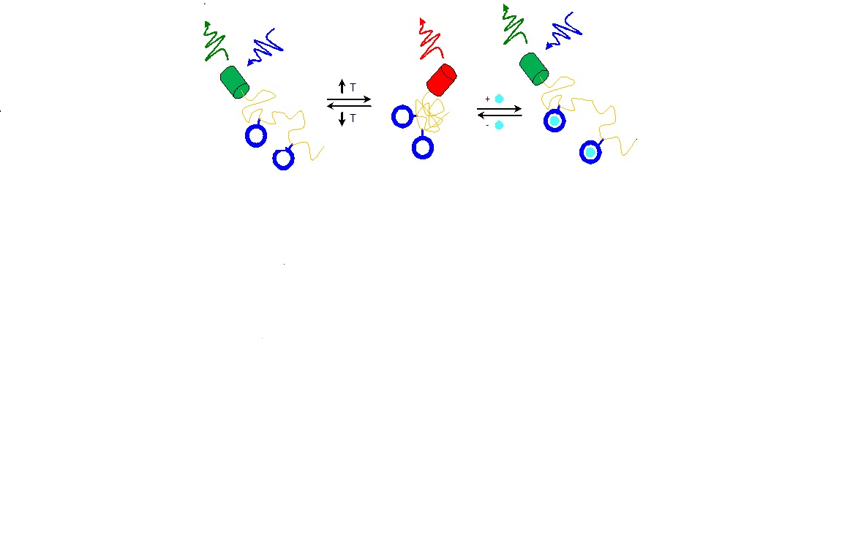
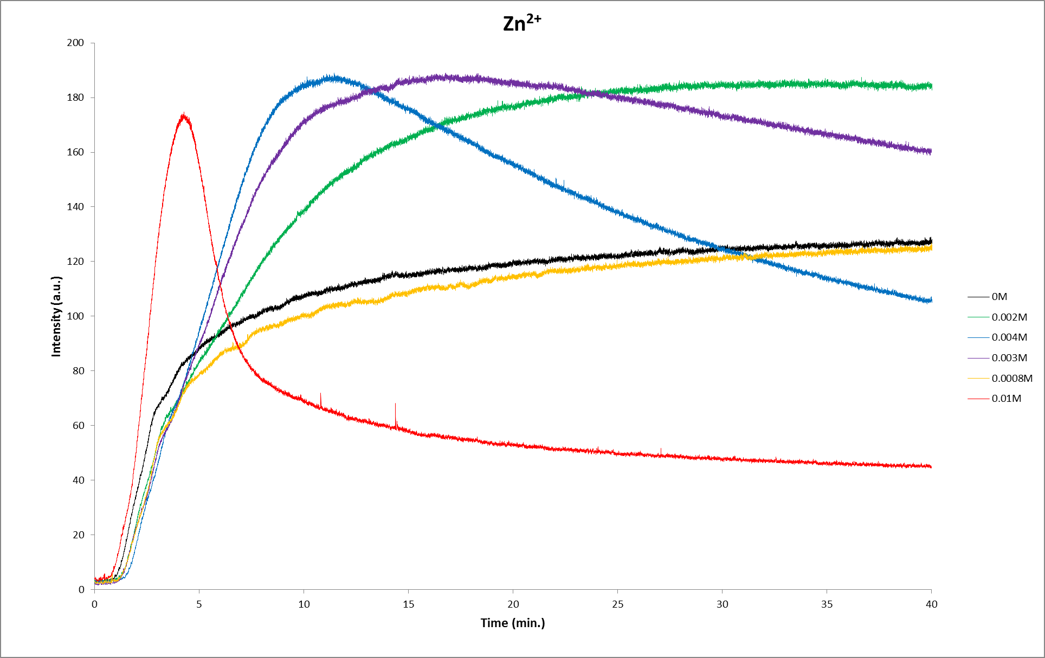
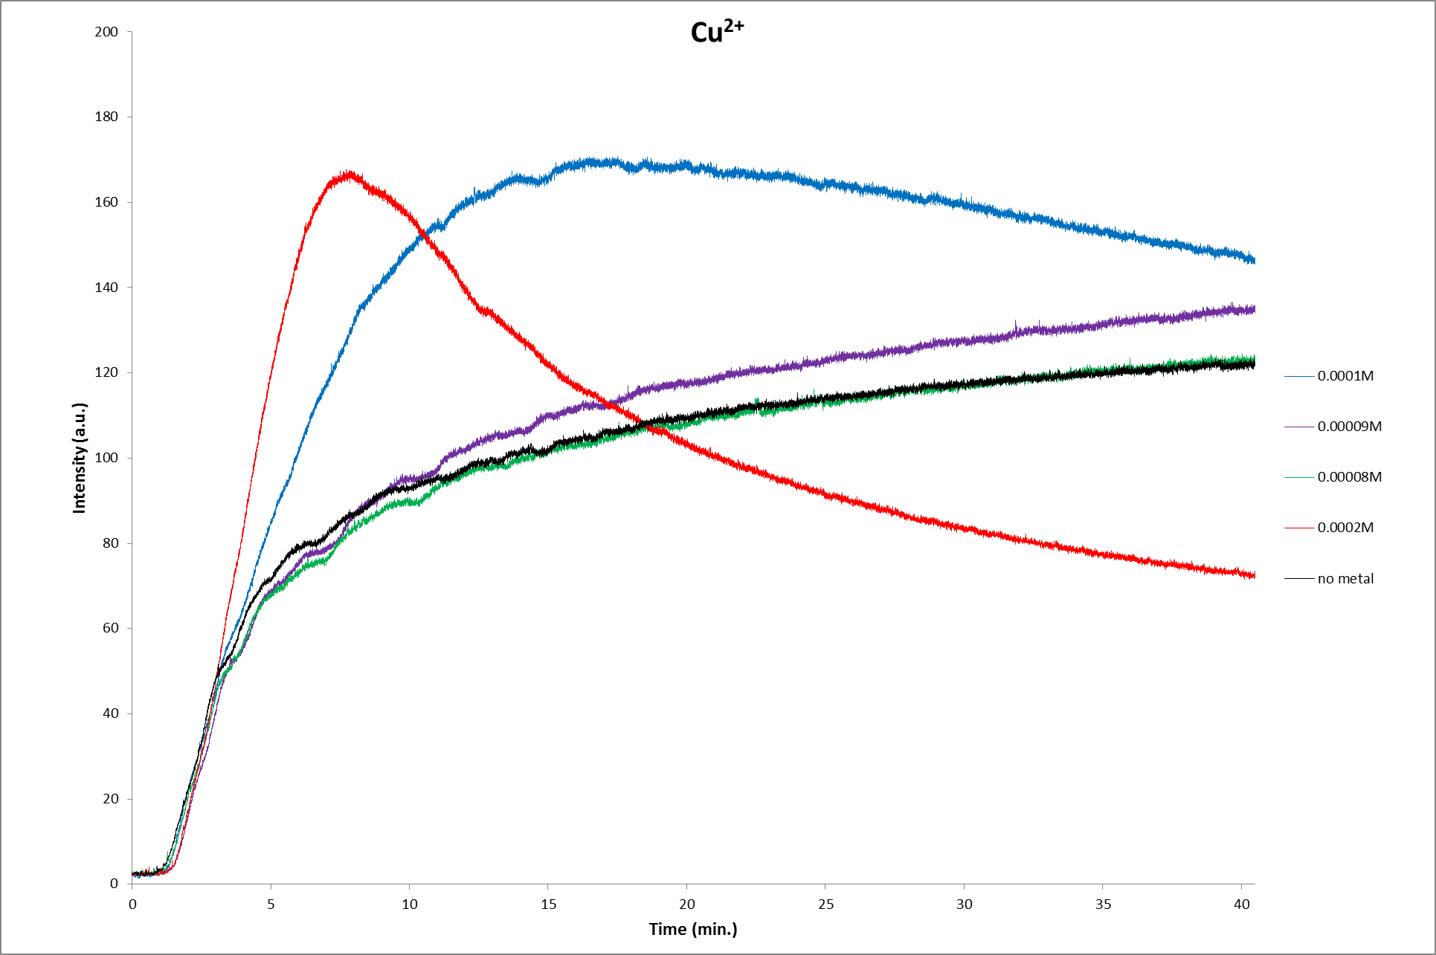
A ratiometric fluorescent metal ion indicator based on dansyl labeled PNIPAM
Lea Nyiranshuti, Luke Fulton, W. Rudolf Seitz, Roy P. Planalp
University of New Hampshire, Durham, NH
Abstract
Unfunctionalized PNIPAM
Functionalized PNIPAM
Titration with Zn(II) at 25ºC
Metals are necessary for life, however excess metal ions can lead to deleterious effect on aquatic organisms and human health. For example, Cu(II) can be toxic to living organisms in low concentration. This toxicity of metal ions depends on the concentration of free ion rather than total metal concentration.¹ In our group, we are developing a novel fluorescent ratiometric sensor to measure the bioavailable copper(II) in the environment, especially in water supplies. This indicator consists of Poly(N-isopropyl acrylamide) (“PNIPAM”), a high affinity ligand (N-2-pyridinylethyl)-(N-2-pyridylmethyl)-3-aminopropyl-acrylamide (“PEPMA-C3-AM”), and 5-(dimethylamino)naphthalene-1-sulfonyl (dansyl) fluorophore. Due to the change in the polymer environment dansyl shifts in maximum emission, which allows us to calculate an intensity ratio. By separating complexation and fluorescence events, we are able to design a ratiometric indicator for a metal despite its usual fluorescence quenching.
Response with Cu(II) by using 2,2’ bipyridine as a competing ligand
Metal Sensitive 2nd Order Scattering
0.05 g/L PNIPAM, 0.3M MOPS pH 6.3, 35 °C
Temperature studies
Introduction
Results & Discussion
It is a challenge to design sensors for Cu(II) mainly due to its ability to quench fluorescence. However, when using a polymer system that has PNIPAM backbone, high affinity ligand and environmental fluorophores can help to design a ratiometric sensor for Cu(II).
In this research, we are able to take advantage of PNIPAM, a polymer responsive to temperature and charge. Below the lower critical solution temperature (LCST), PNIPAM is soluble in water and above LCST, polyNIPAM precipitates from solution². Polymerizing selected bifunctional ligands into the polymer system allows us to tune the target metal and concentration range for this indicator.
In this study we report changes in dansyl’s intensity ratio upon complexation with Cu²⁺ and Zn²⁺. Dansyl’s fluorescence maximum shifts to longer wavelengths in more hydrophilic environments. By binding charged metal ions to the polymer we aim to better solvate the polymer above the LCST. This will open the polymers collapsed state and encourage more aqueous character in the fluorophore’s surroundings. Measuring the ratio between dansyl’s hydrophobic and hydrophilic intensities will provide a metal dependent response that accounts for quenching effects.
Future Work
Grow Cu-Pepma model ligand crystals
Optimizing polymer system and get A/D ratio change at 25ºC &45ºC
Since Cu(II) is very toxic in low concentration, our overall goal is to design a system that can be used to measure free copper (II) concentration in rivers and wastewater.
Acknowlegments
This work wouldn’t be possible without support from Dr. Roy Planalp, Dr. W.R. Seitz, UNH chemistry department and NSF grant CHE-1012897(W.R.Seitz & R.P. Planalp).
1. Allen, H.E.; Hall, R.H.; Brisbin, T.D. Environ. Sc. Technol. 1980, 14, 441-443
2. Osambo, J.; Seitz, W.R.;Kennedy, P, D.; Planalp, P. R.; Jones, A.M.; Jackson, R.K.; Burdette, S.; Sensors 13(2013) 1341-1352
References

