Slide 1

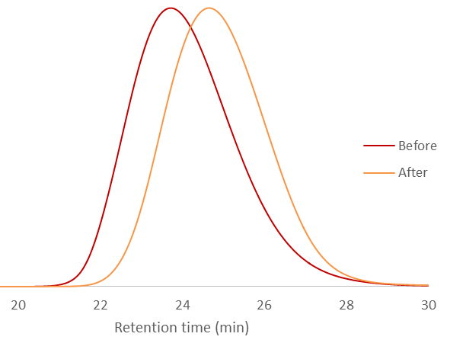
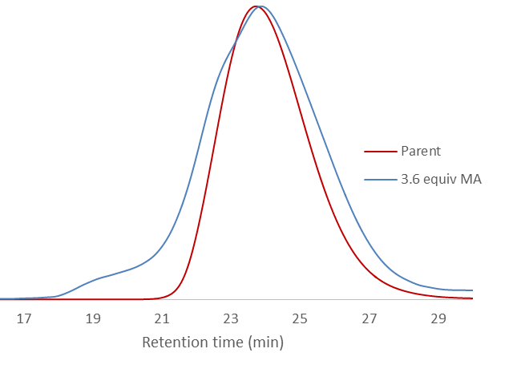
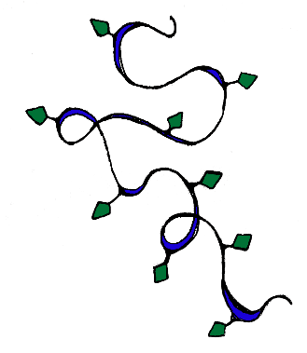
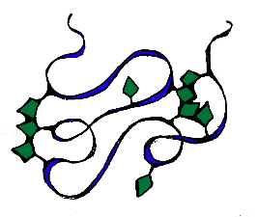
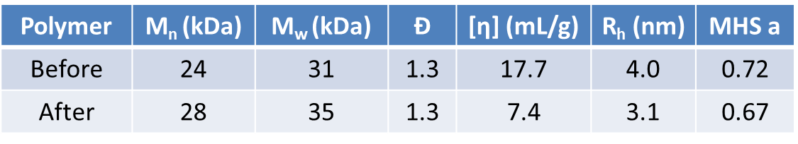
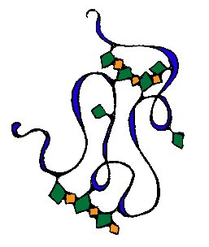


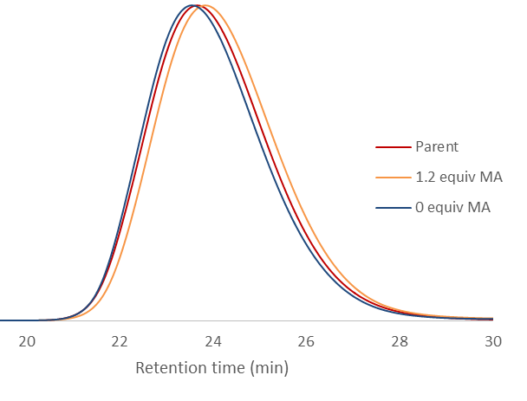
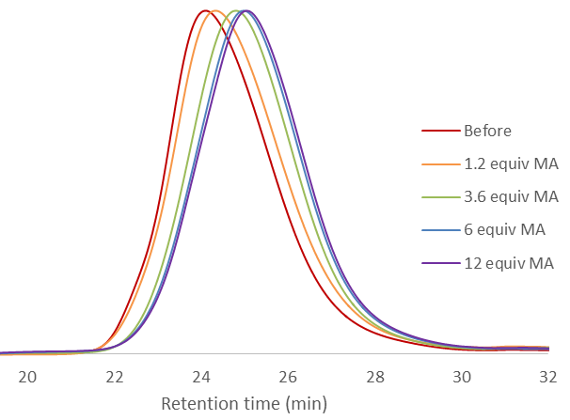
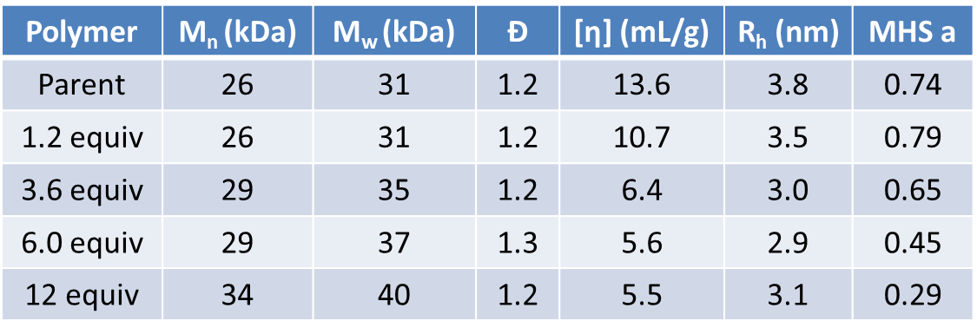

Exploring the modularity of single-chain nanoparticle synthesis
via alternating copolymerization of pendant stilbene units
Christopher K. Lyon, Erik. B. Berda
University of New Hampshire, Chemistry Department
Abstract
Materials & Methods
Results
Conclusions
The synthesis of single-chain polymer nanoparticles (SCNP) via the intra-chain copolymerization of pendant stilbene units with electron deficient monomers is described herein. A linear polymer containing cationic benzyltriphenylphosphine units was synthesized. This polymer was furnished with olefin units via a Wittig reaction with benzaldehyde or formaldehyde, followed by the radical intra-chain copolymerization with N-ethyl maleimide or maleic anhydride. In this study, we show the modularity of this approach by incorporating functional stilbene or styrene units and using N-functionalized maleimides in the SCNP formation step.
A phosphonium salt-functionalized styrene (4VBTPP) derivative was synthesized from 4-vinylbenzyl chloride by S_{N}2 reaction with triphenylphosphine, followed by anion metathesis with sodium tetrafluoroborate to improve the monomer’s solubility in polar organic solvents.[4]
4VBTPP was copolymerized with styrene via RAFT polymerization. Subsequent Wittig reaction with formaldehyde or benzaldehyde produced styrene or stilbene functionalized polymers 1 or 2, respectively.
Dilute solutions of polymers 1 and 2 were heated with AIBN as a radical initiator, in the presence and absence of maleic anhydride. Stilbene-containing polymer 2 was also heated in the presence of N-ethyl maleimide.
When exposed to a radical source in dilute solution, the styrene-functionalized polymer decreased in size and increased in molecular weight (figure 2a). When maleic anhydride was introduced as an electron deficient comonomer, however, the distribution broadens and appears multimodal, with a shoulder at shorter retention time suggesting the presence of multi-chain aggregates.
Single-chain nanoparticles were synthesized by the radical homopolymerization of pendant styrene units in linear poly(styrene-co-divinylbenzene). However, the addition of maleic anhydride to this process resulted in a loss of control and the formation of multi-chain aggregates. When the styryl groups are replaced with stilbene units, the copolymerization with maleic anhydride or N-ethyl maleimide proceeds smoothly to form SCNP. When MA or NEM were not present, the stilbene-functionalized polymer did not show signs of SCNP formation. The successful incorporation of reactive anhydride units and modular maleimide units are promising for future work involving this system.
(a)
(b)
Introduction
References
Lyon, C. K.; Prasher, A.; Hanlon, A. M.; Tuten, B. T.; Tooley, C. A.; Frank, P. G.; Berda, E. B. Polymer Chemistry 2015, 6 (2), 181-197.
Cole, J. P.; Lessard, J. J.; Lyon, C. K.; Tuten, B. T.; Berda, E. B. Polymer Chemistry 2015.
Mecerreyes, D.; Lee, V.; Hawker, C. J.; Hedrick, J. L.; Wursch, A.; Volksen, W.; Magbitang, T.; Huang, E.; Miller, R. D. Advanced Materials 2001, 13 (3), 204-208.
Borguet, Y. P.; Tsarevsky, N. V. Polymer Chemistry 2012, 3 (9), 2487-2494.
Figure 2. SEC traces for polymer 1 before and after exposure to radical initiator in (a) absence and (b) presence of maleic anhydride. Tabulated SEC data are for traces in (a).
Figure 1. SCNP formation via radical polymerization (top route) and alternating radical polymerization (bottom route)
In the case of stilbene-bearing polymer 2, the exclusion of maleic anhydride from the cross-linking process results in a negligible change in peak shape and retention time by SEC. Cross-linking occurs in the presence of various concentrations of maleic anhydride, with larger concentrations resulting in longer retention times, smaller radii and larger molecular weight, consistent with SCNP formation.
A recently popular technique in fabricating polymer nanostructures is the collapse of single polymer chains in dilute solution. The formation of these single-chain nanoparticles (SCNP) is particularly useful for the synthesis of structures on the order of 5 – 20 nm. Many types of covalent and non-covalent chemistries have been used to this end.[1]
Crosslinking techniques involving radical chemistry have been used to synthesize SCNP. In our laboratory, a radical process involving a poly(norbornene imide) based polymer was studied.[2] There are also instances in which crosslinks are formed via the radical polymerization of pendant olefin units.[3,4]
We sought to take advantage of alternating radical copolymerization as a means to form well-defined crosslinks in SCNP. The alternating nature of the polymerization introduces a simple level of structural control while simultaneously incorporating functionality; i.e. from the anhydride group of maleic anhydride, or a functionalized maleimide derivative.
Polymer 1
Polymer 2
Acknowledgments
University of New Hampshire Chemistry Department
New Hampshire Space Grant Consortium
Army Research Office
(c)
(d)
Figure 3. SEC traces for polymer 2 before and after exposure to radical initiator in (c) absence and (d) presence of maleic anhydride. Tabulated SEC data are for traces in (d).

