Slide 1

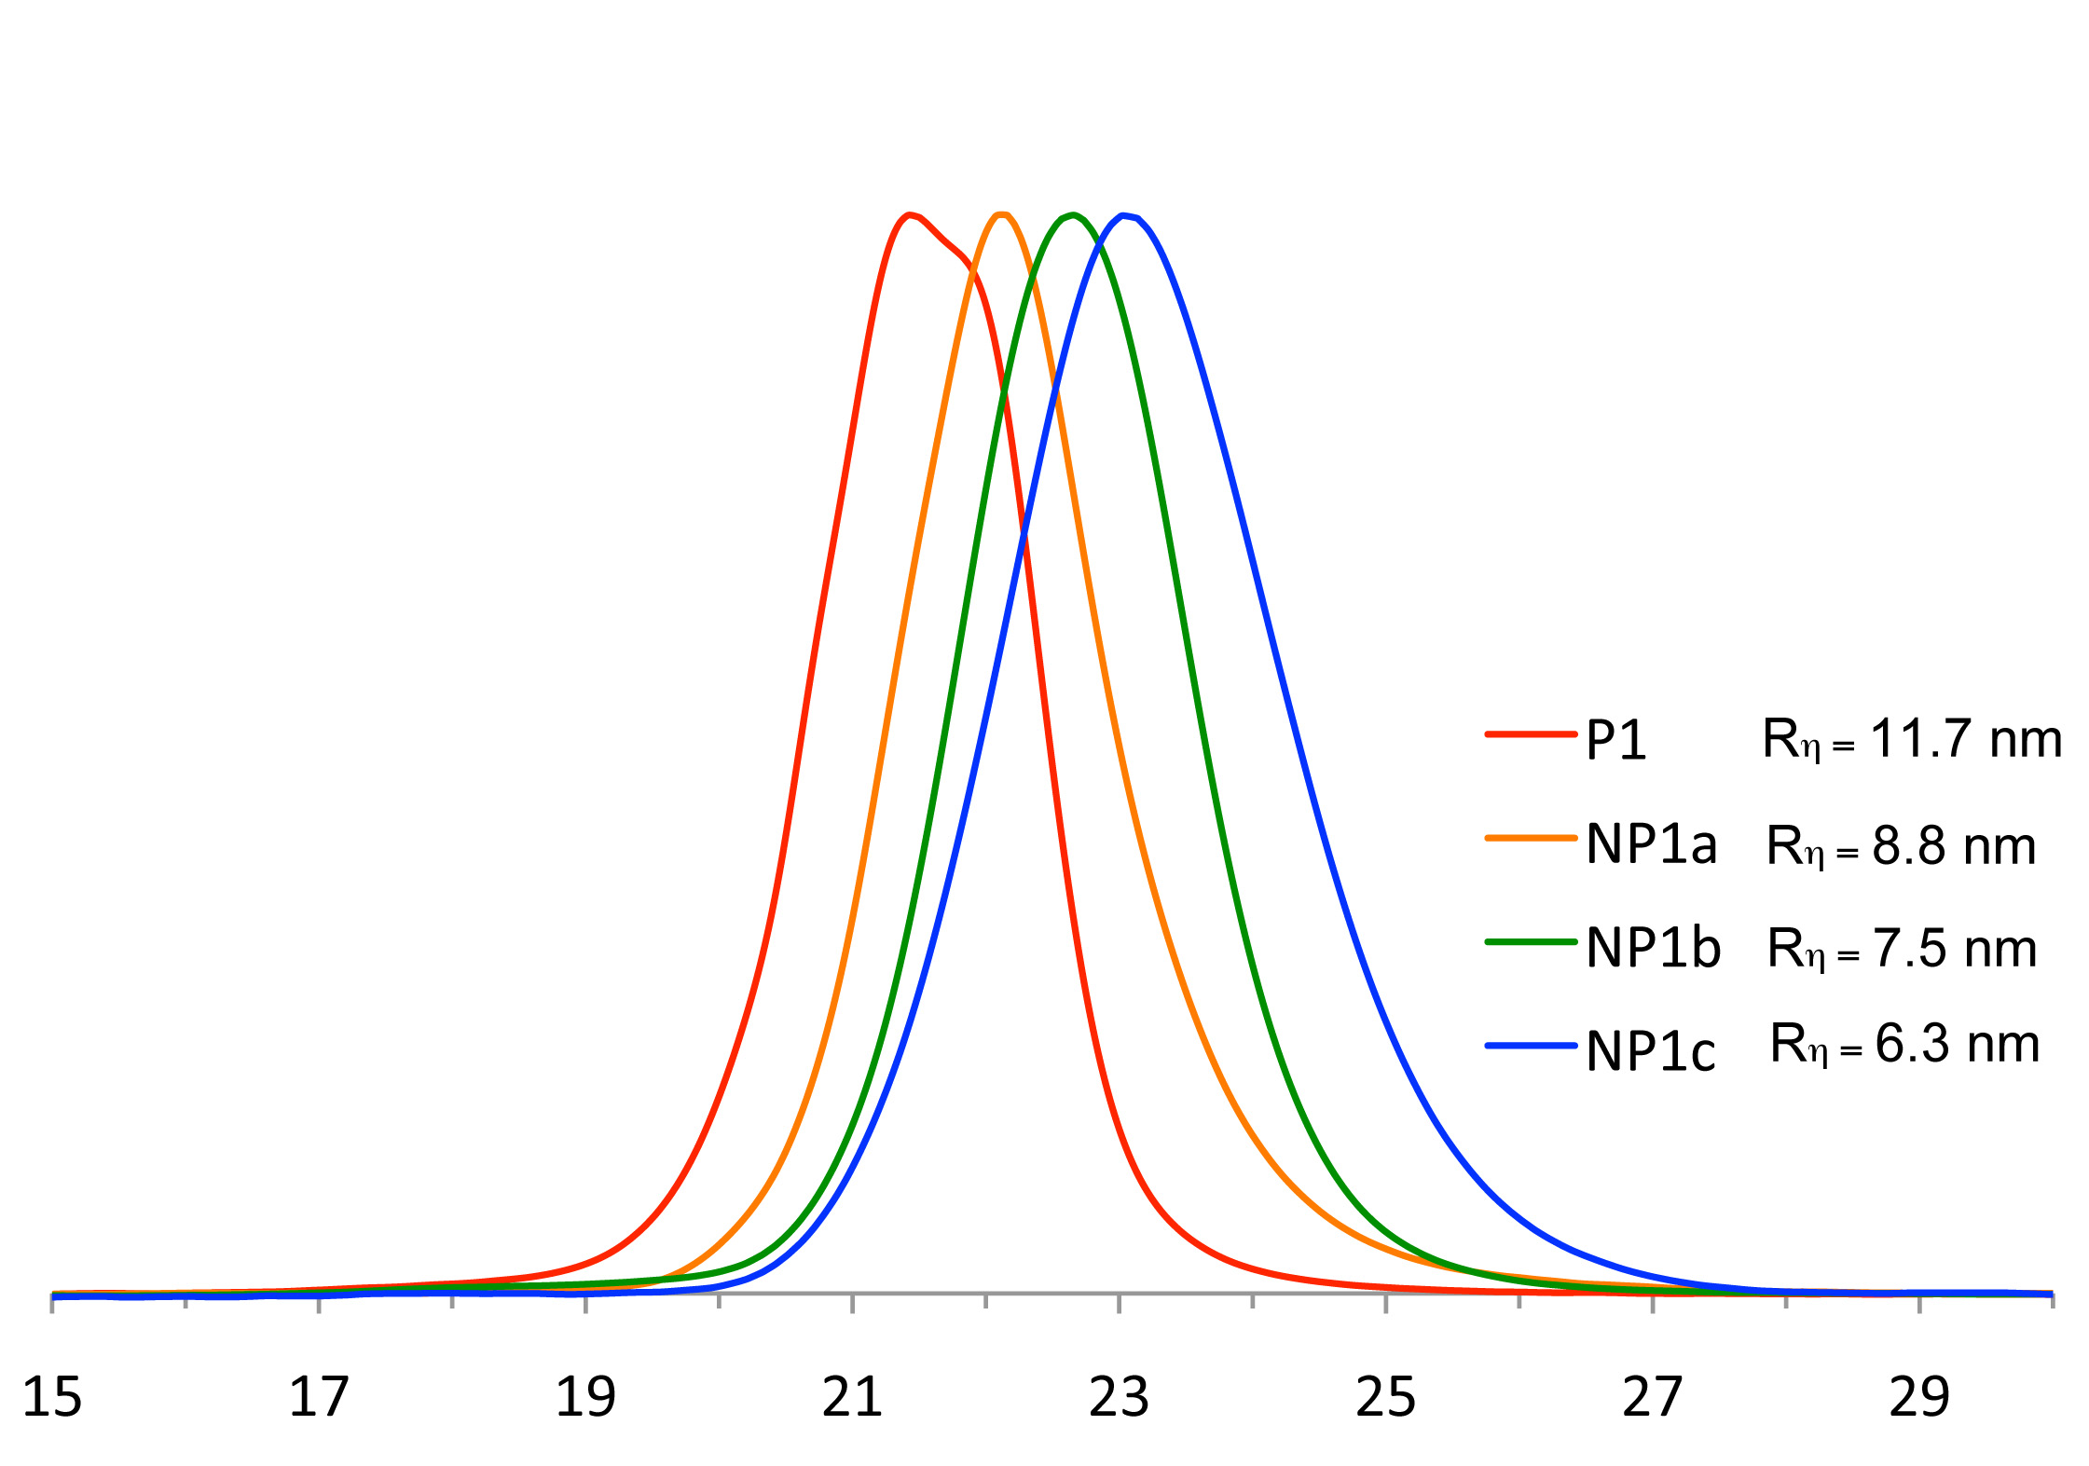
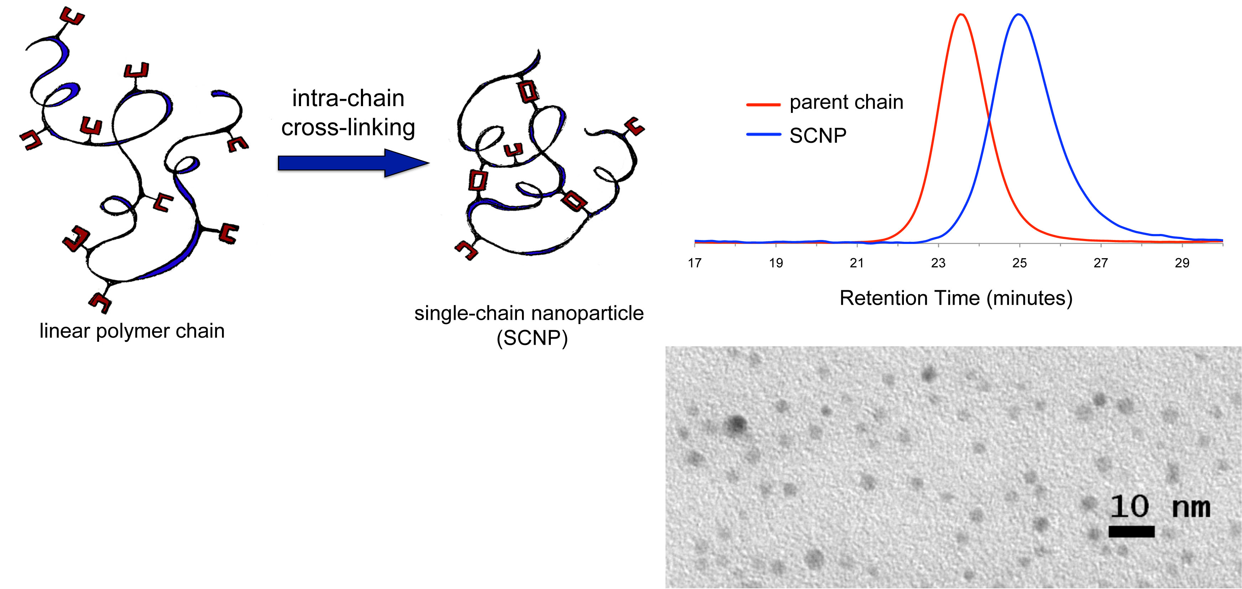

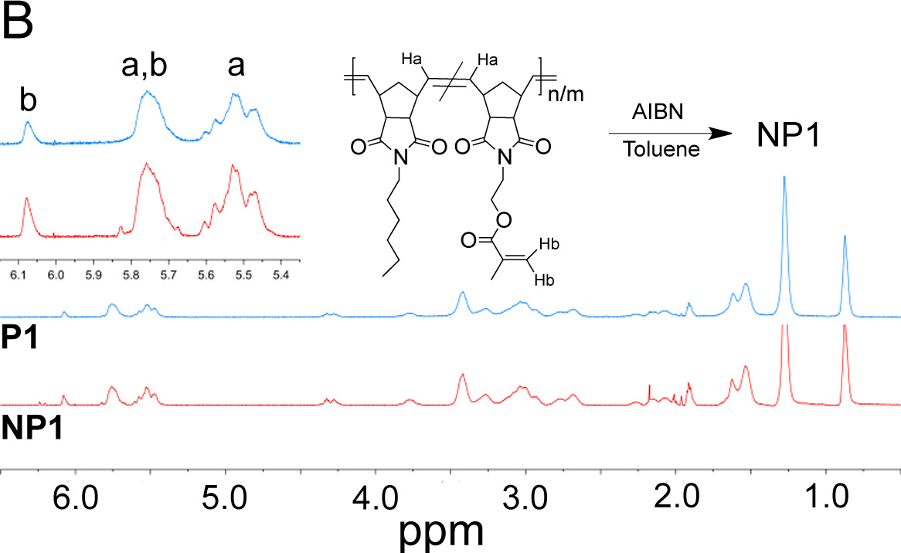
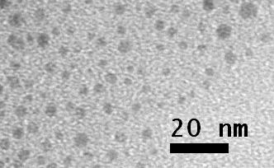
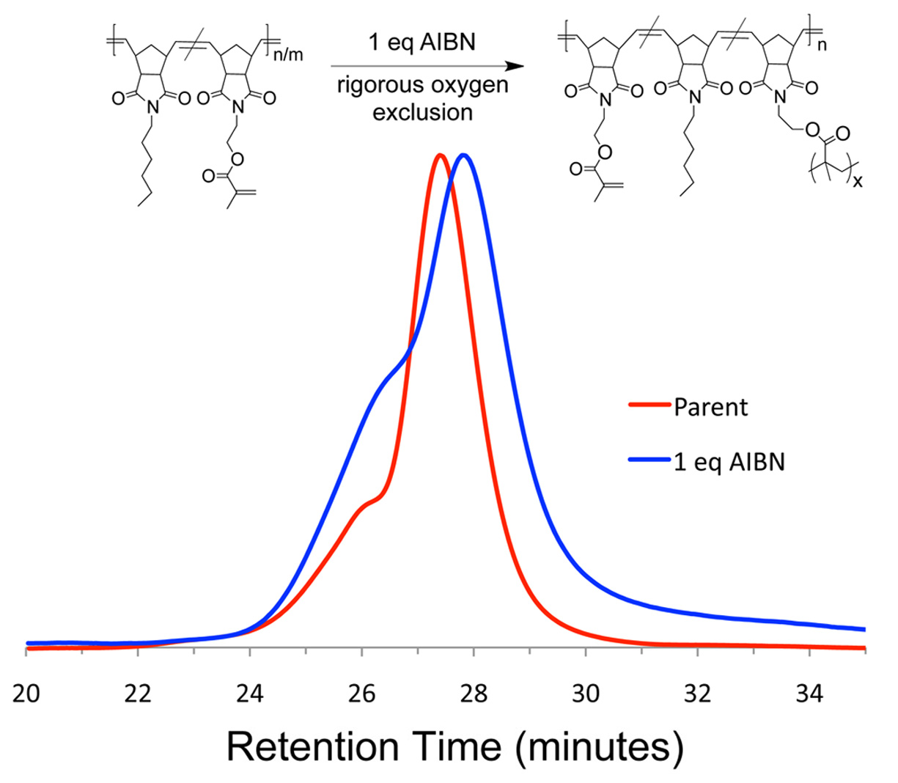
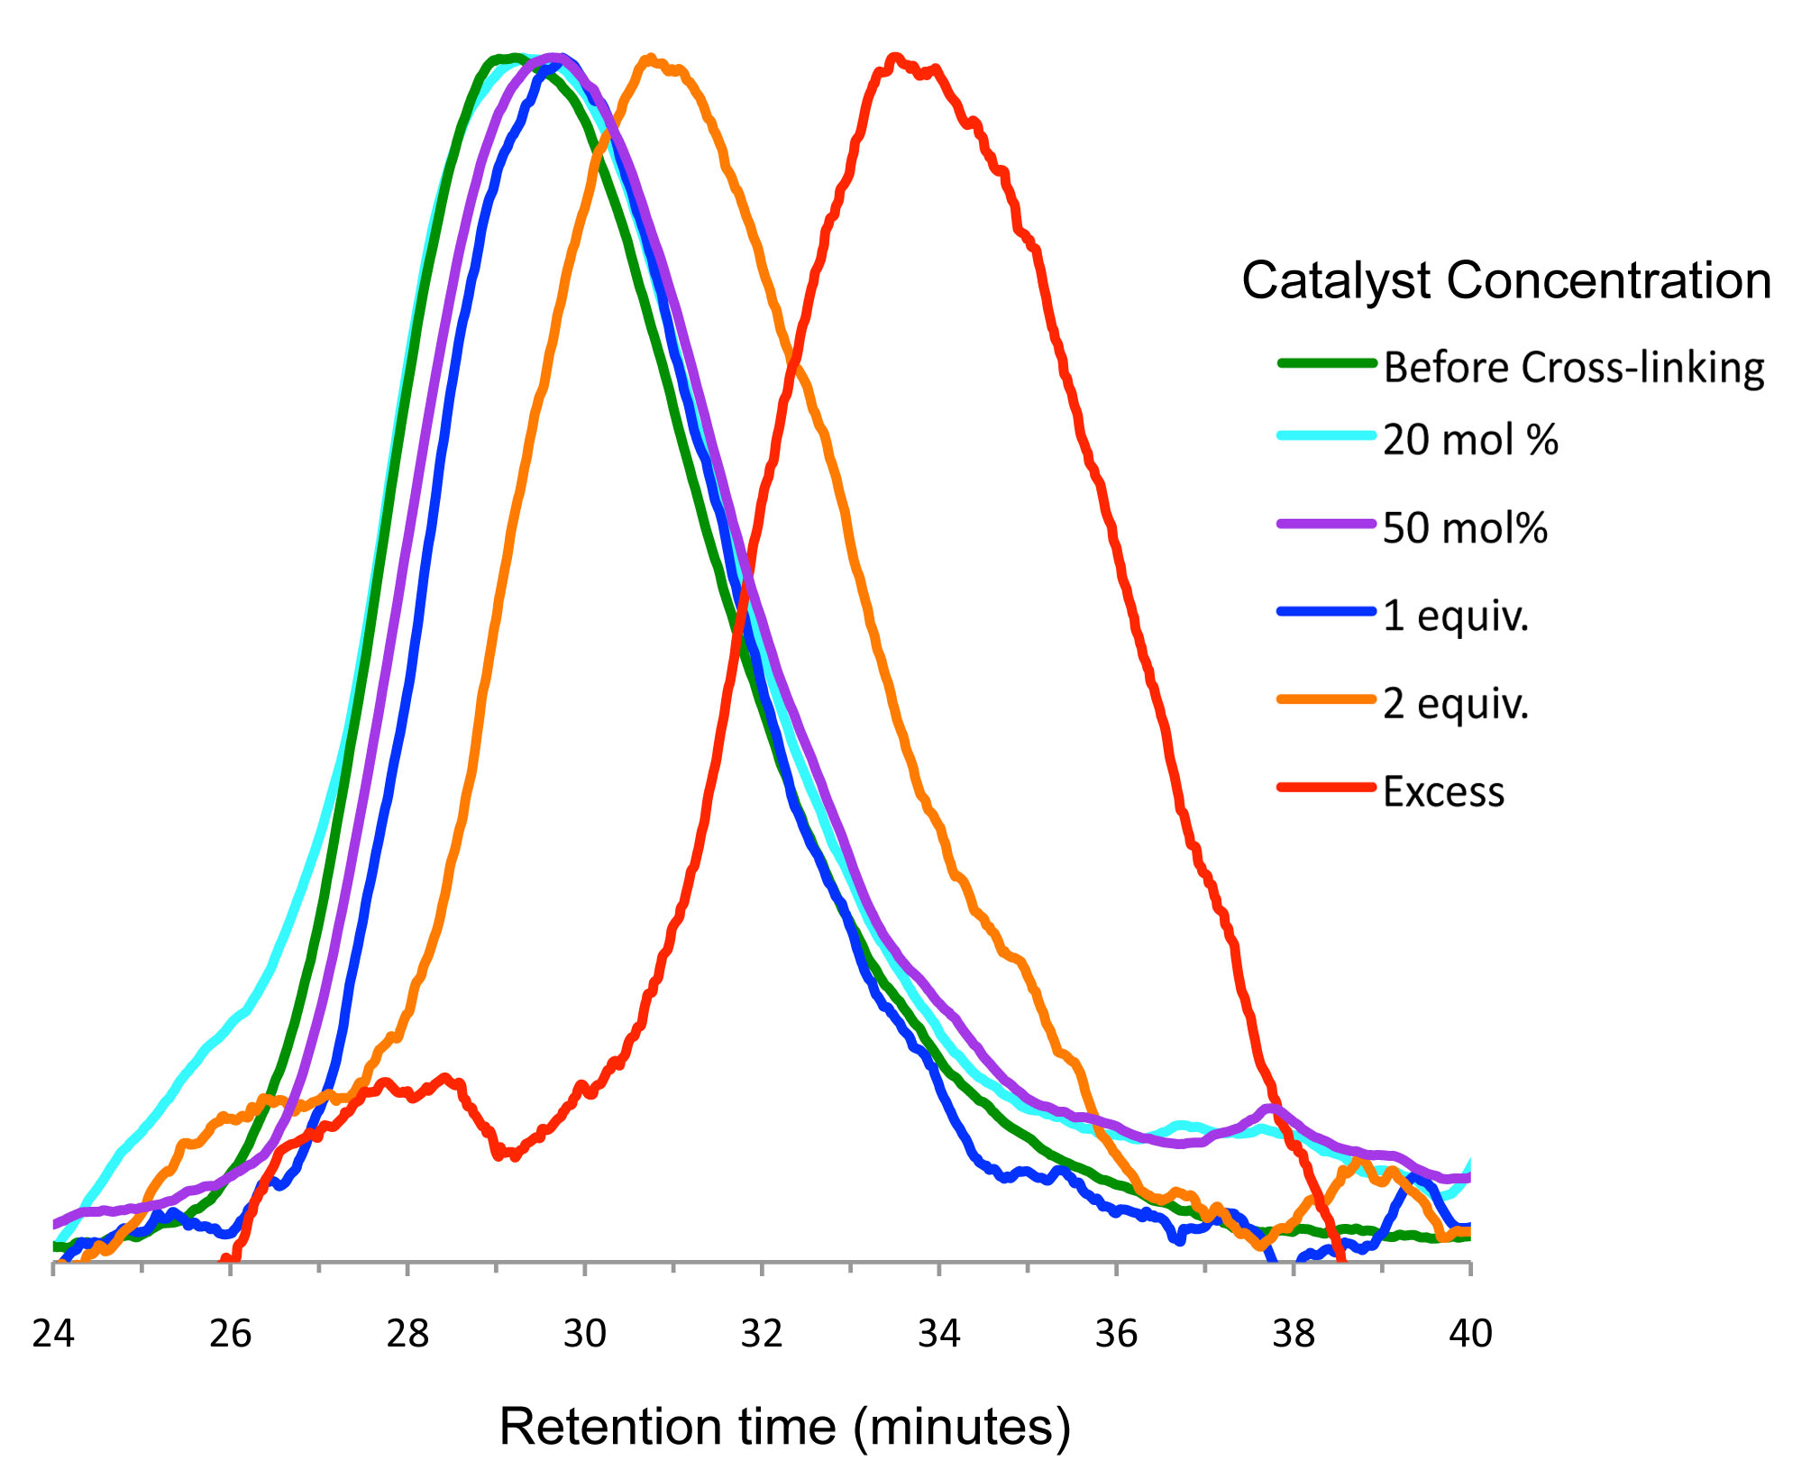
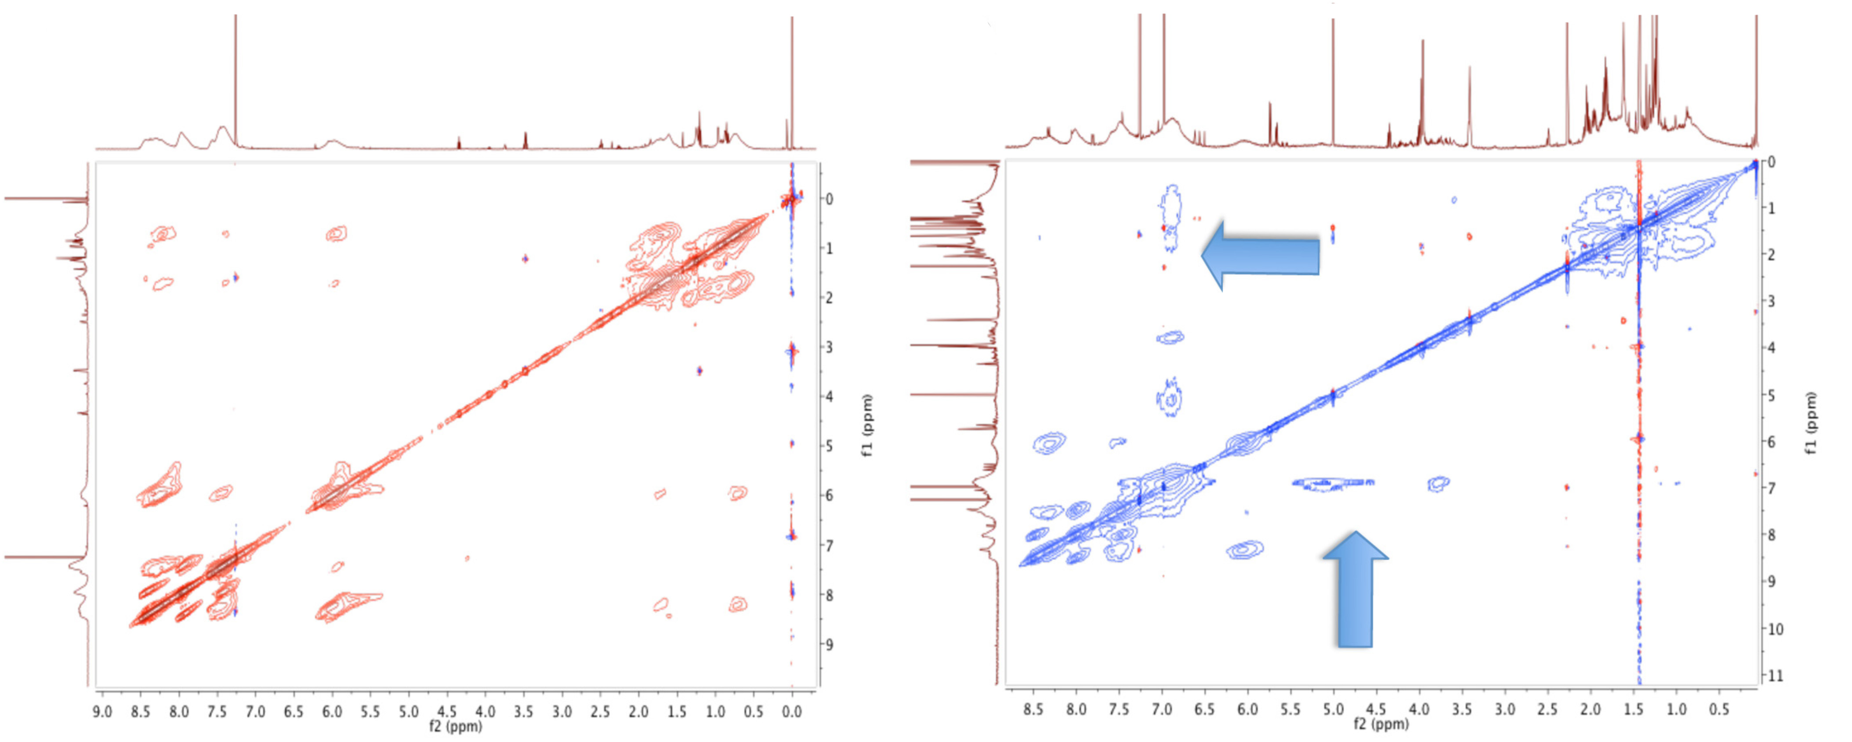






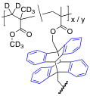
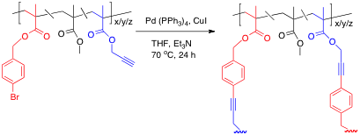

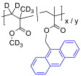
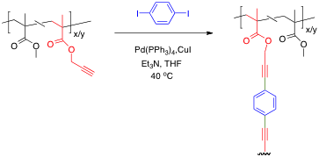
What we’re learning about single-chain nanoparticles
Alka Prasher, Bryan Tuten, Peter Frank, Chris Lyon, Ashley Hanlon, Christian Tooley, Justin Cole, and Erik Berda*
Department of Chemistry and Materials Science Program, University of New Hampshire
23 Academic Way, Durham, NH 03824
\
\
Introduction and background.
The devil is in the details.
Don’t believe everything the GPC tells you.
Single-chain nanoparticles (SCNP) are quite simple in principle: a linear polymer chain is decorated with reactive functional groups such that triggering these units in dilute solution induces intramolecular cross-linking. The process results in the compaction of the chain into a nano-sized gel with dimensions usually in the sub 20-nm size regime. The characteristics of the particles (e.g. size, shape, chemical character, functionality, etc.) are readily tunable via synthetic manipulations during the synthesis of the parent polymer and requisite monomers.
In the most basic system there are a few key variables to take into consideration: the identity of the reactive functional group, the extent to which it is incorporated into the polymer, the molecular weight of the parent polymer, and concentration at which SCNP formation is executed. The data in this section show how widely minor alterations in any of these parameters can alter the final outcome, even when keeping the cross-linking chemistry constant across a range of samples.
Recently we’ve been (re)examining SCNP synthesis via intra-chain polymerization through a vinyl side chain. Some open questions remain in this area regarding how effective different monomer units might be, what synthetic route to the parent polymer is most effective, and is there potential for improved structural control or scale up?
In our first design, we thought we could take advantage of a fast ROMP of methacrylate decorated norbornene monomers and expose the resulting polymer to radical chemistry to subsequently induce SCNP formation. Based on the GPC results, it appeared our design was working beautifully. The ¹H NMR disagreed though…
Figure 3: Sonogashira Coupling as an intra-chain cross-linking reaction. Changing solution concentration can determine whether single-chain or multi-chain particles are formed
a: 1.0 eq AIBN
b: 5.0 eq AIBN
c:10.0 eq AIBN
Before cross-linking
After cross-linking
Figure 1: Schematic representation of SCNP synthesis (above), typical GPC result showing change in solution volume (top left) and TEM image of SCNP (bottom left)
Retention time (minutes)
Figure 6 (above): GPC data for our SCNP made by intra-chain radical chemistry.
Figure 7 (left): ¹H NMR overlay showing the plan didn’t actually work as well as we thought
Figure 8 (below): Oxygen exclusion is crucial when the internal olefins are present in the poly(norbornene) backbone
5 mg/mL
2 mg/mL
1 mg/mL
The overarching goal with this research line is to control the three dimensional placement of repeating unit chemistry in a specified nanometer-sized unit volume. Rudimentary control of “tertiary structure” in this fashion is a yet unmet research challenge requiring a multifaceted approach by experts in several areas of our discipline. Our group examines a variety of small molecule and polymer synthesis and characterization techniques to attack this problem via simple synthetic model systems. We’re learning that while this process is simple in principle, in practice it is quite a bit more complex and not without surprises.
The GPC-MALS data above demonstrates the profound effect the concentration of the cross-linking solution can have on the resulting particles. At 5 mg/mL, entirely intermolecular coupling is observed. At 2 mg/mL we see a mix of intermolecular and intramolecular coupling. Only when the concentration is decreased to 1 mg/mL or lower does this particular system reliably undergo primarily intra-chain cross-linking.
By carefully controlling several structural and procedural parameters we discovered that molecular oxygen, present in tiny amounts, was contributing to both chain scission and cross-linking through oxygen bridges. When rigorously degassed the original design does work, but clearly needs some optimizing.
Figure 4: Nanoparticles synthesized using Sonogashira chemistry at a polymer concentration of 5 mg/mL.
Structural characterization is not trivial.
It is easy enough to demonstrate the appearance or disappearance of a characteristic spectral signature of the functional group being manipulated during a SCNP synthesis. This provides little, if any information about the overall structure of the nanoparticle. How can we overcome this? The data below show some initial investigations using multidimensional NMR on deuterium labeled polymers. Eventually we hope to tease out structural information by this technique using more exotic polymer architectures.
Switching the way we execute this reaction also changes the resulting particle formation. Rather than use an external cross-linker as shown above, in the data to the right we built both reactive partners into the same chain. The results suggest that while primarily single-chain chemistry is occurring here, huge amounts of catalyst are required. We attribute the difference to the local environment in which the reaction takes place and the availability of reactive partners to be efficiently activated and find one another.
\
References
C. K. Lyon, A. Prasher, A. M. Hanlon, B. T. Tuten, C. A. Tooley, P. G. Frank and E. B. Berda, Polymer Chemistry, 2015, 6, 181-197.
J. P. Cole, J. J. Lessard, C. K. Lyon, B. T. Tuten and E. B. Berda, Polymer Chemistry, 2015. ASAP
Figure 2: NOESY ¹H NMR spectra show increased through-space correlation after SCNP formation
\
Acknowledgements
70NANB15H060
Figure 5: Effect of catalyst concentration on the performance of intra-chain Sonogashira Coupling reactions. At normal catalyst loadings very little collapse is observed.
W911NF-14-1-0177

