Slide 1
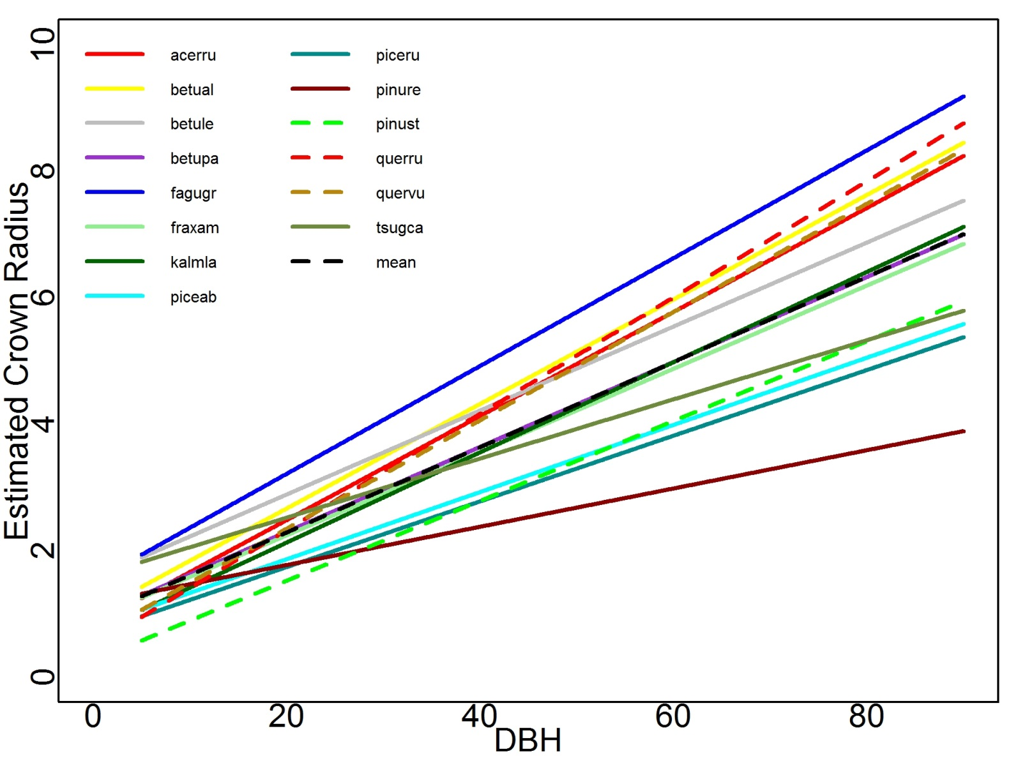
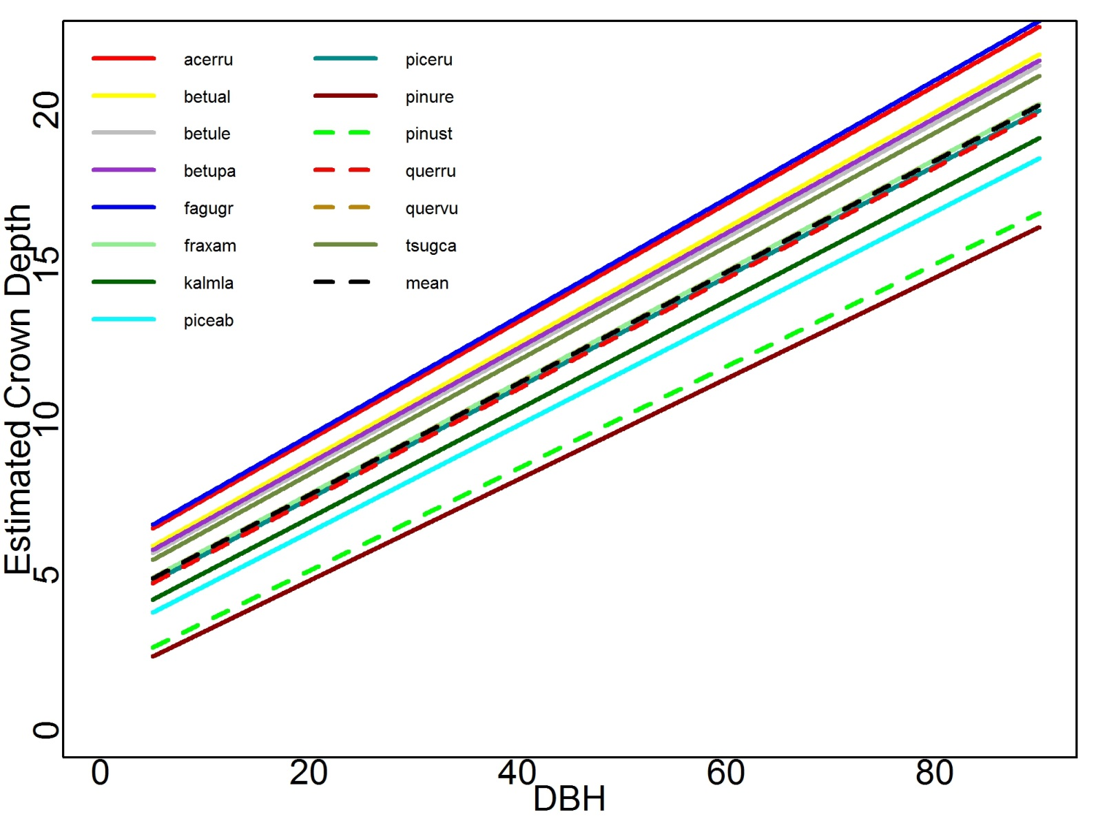
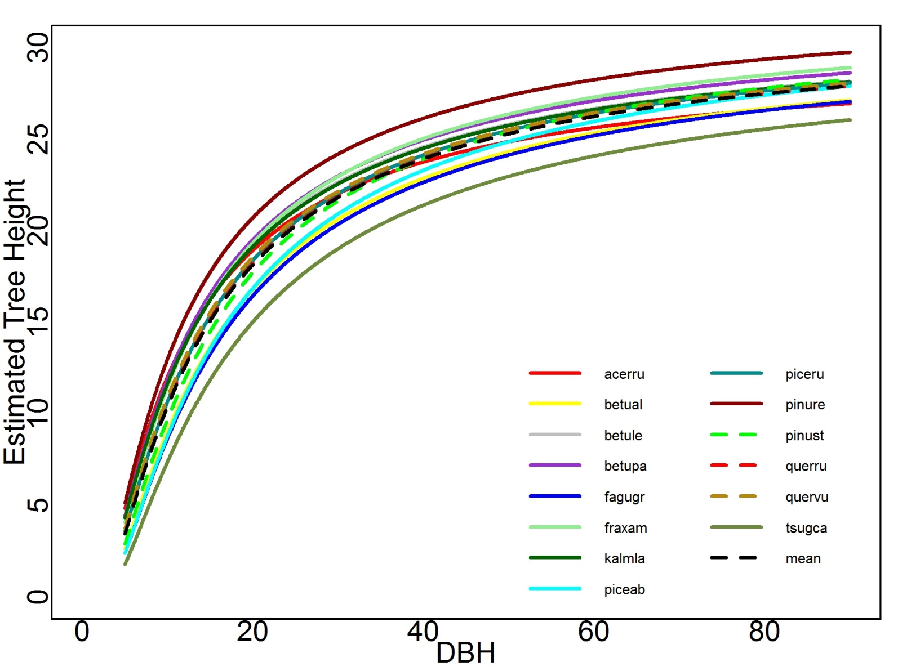
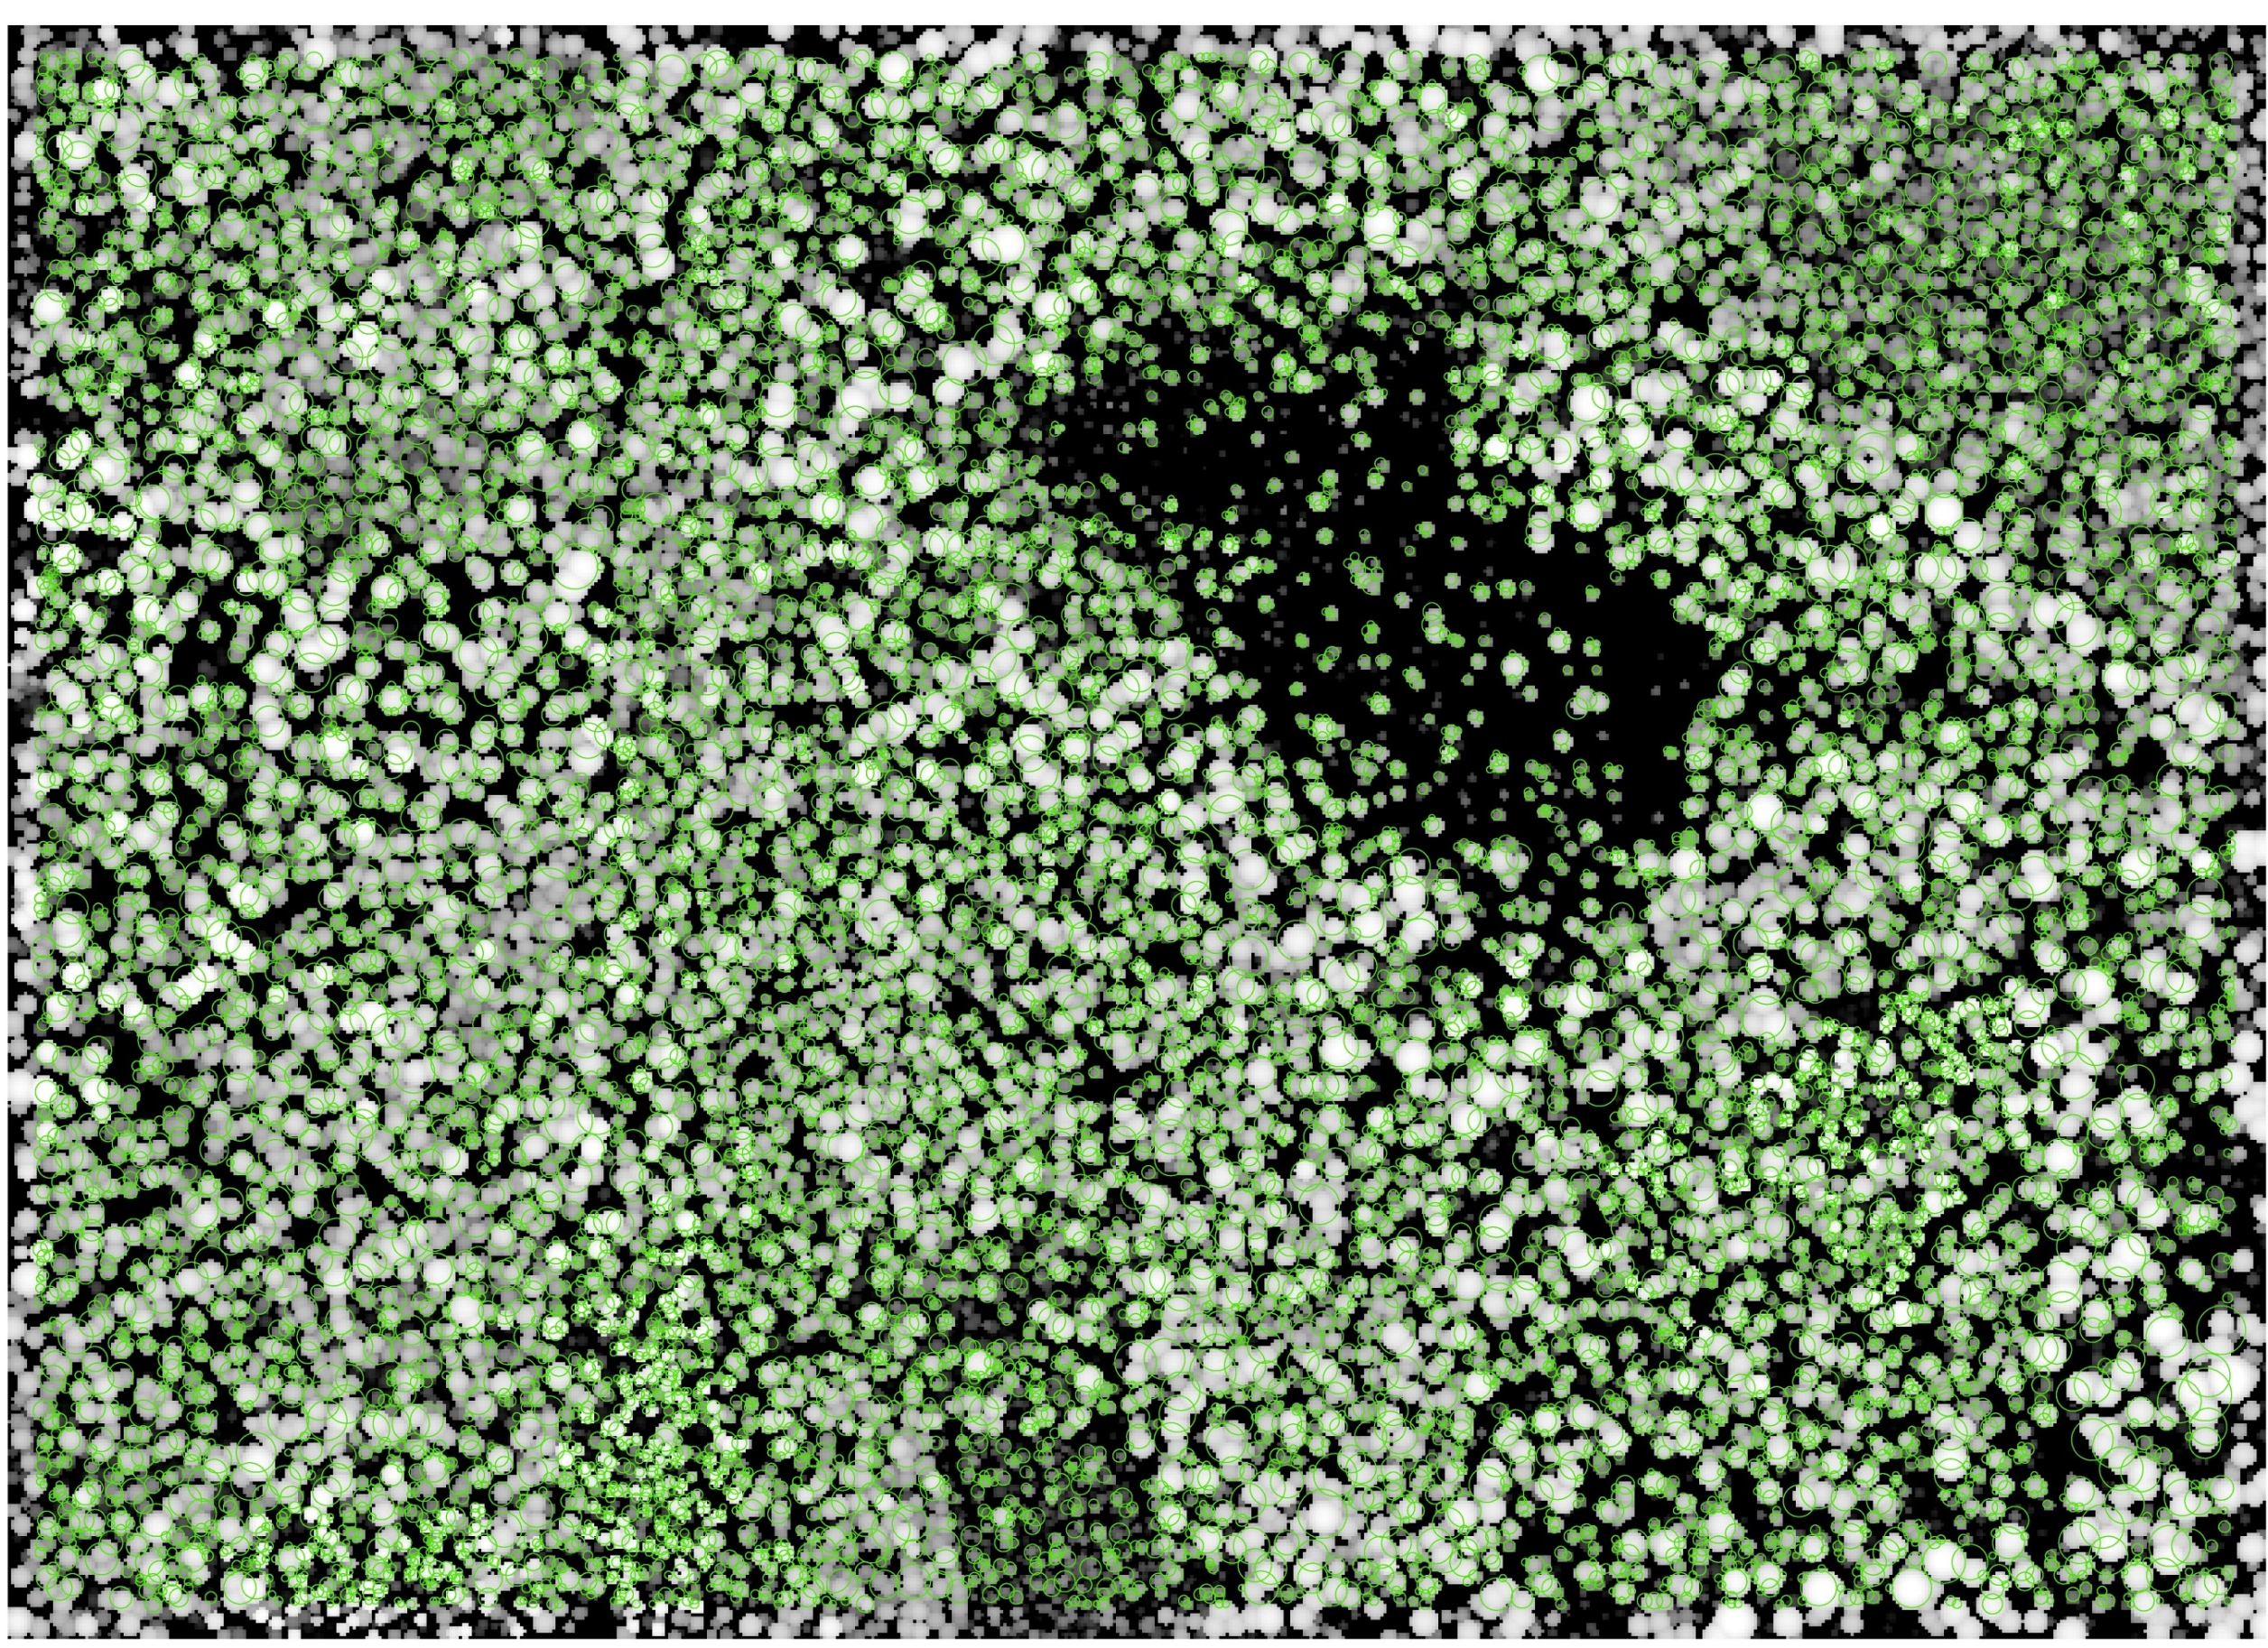
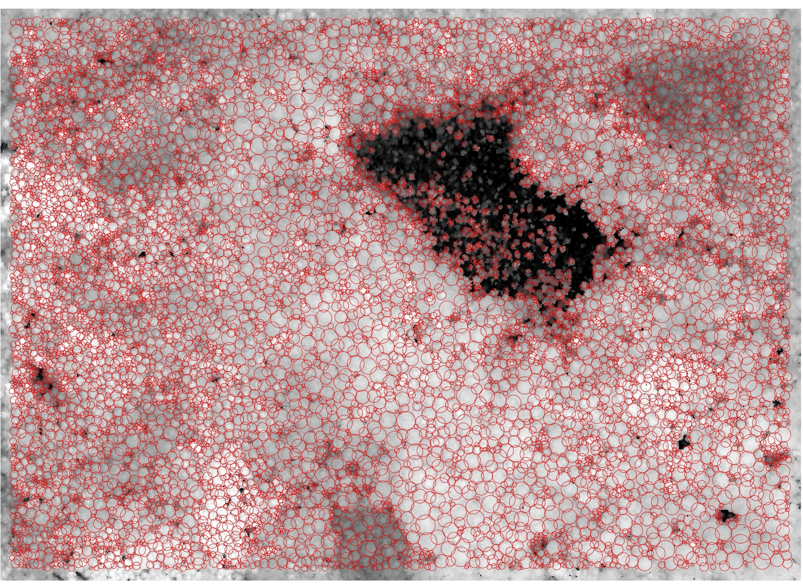
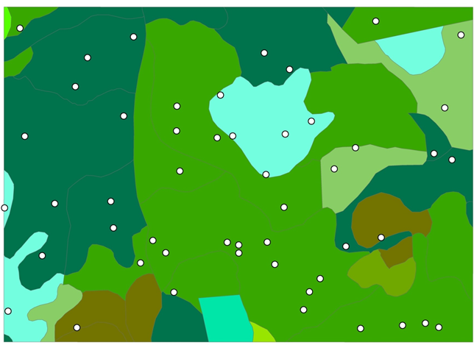
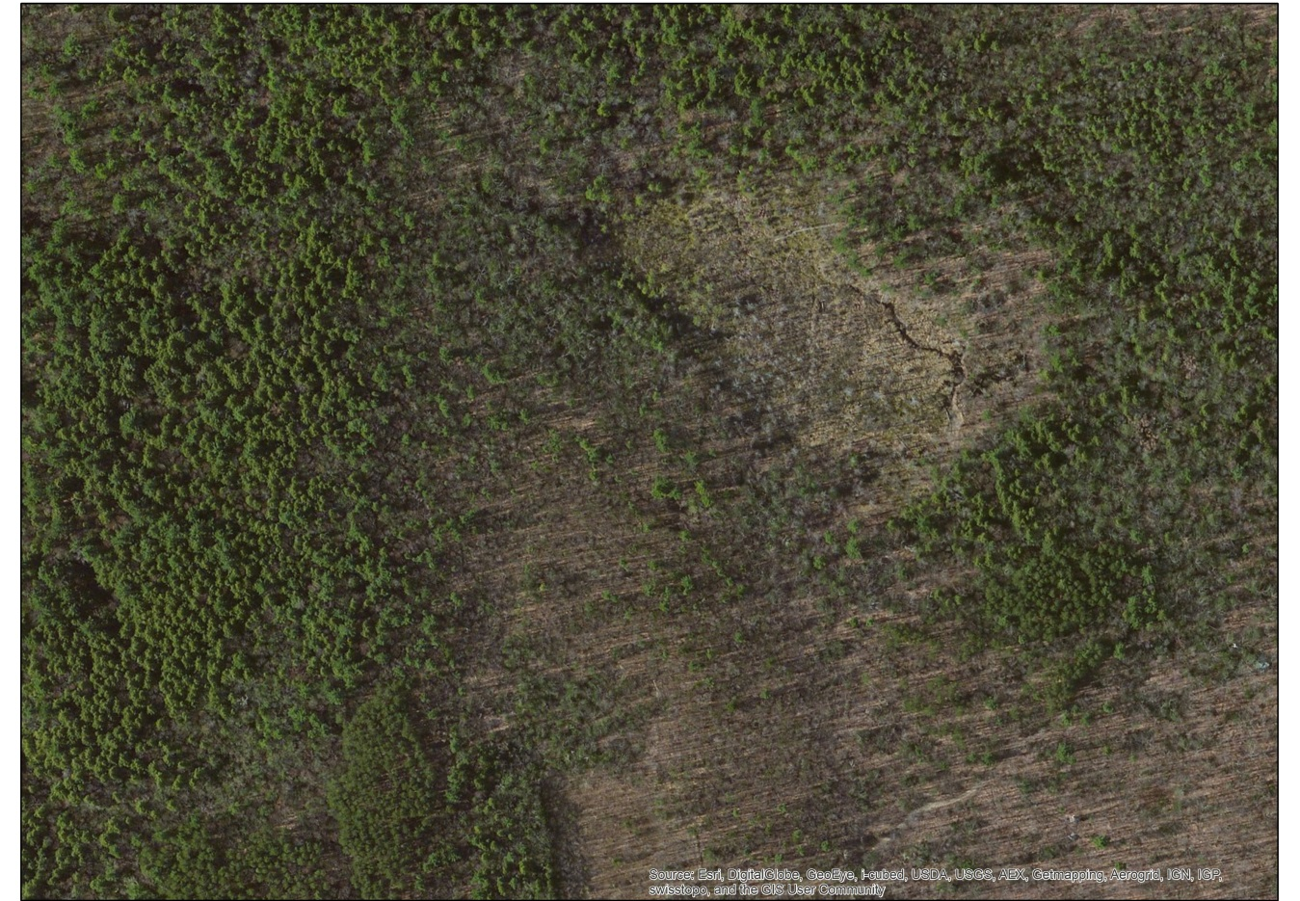
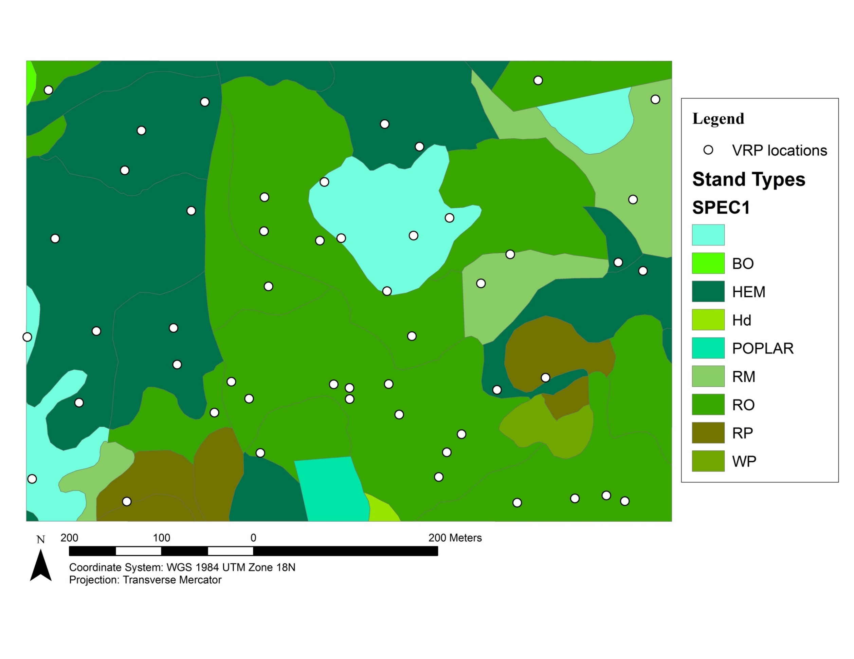
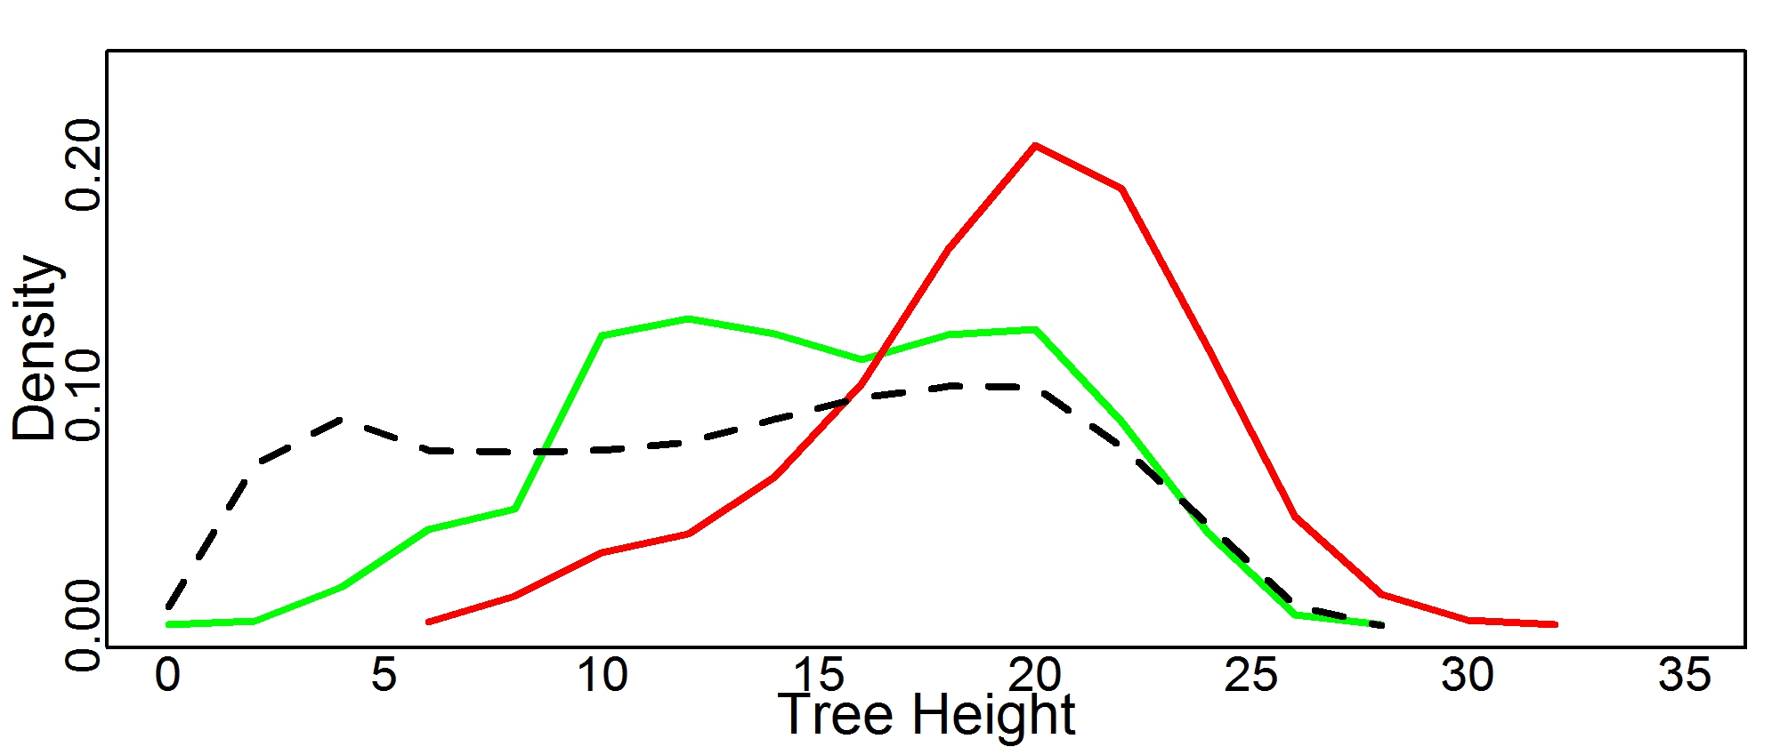
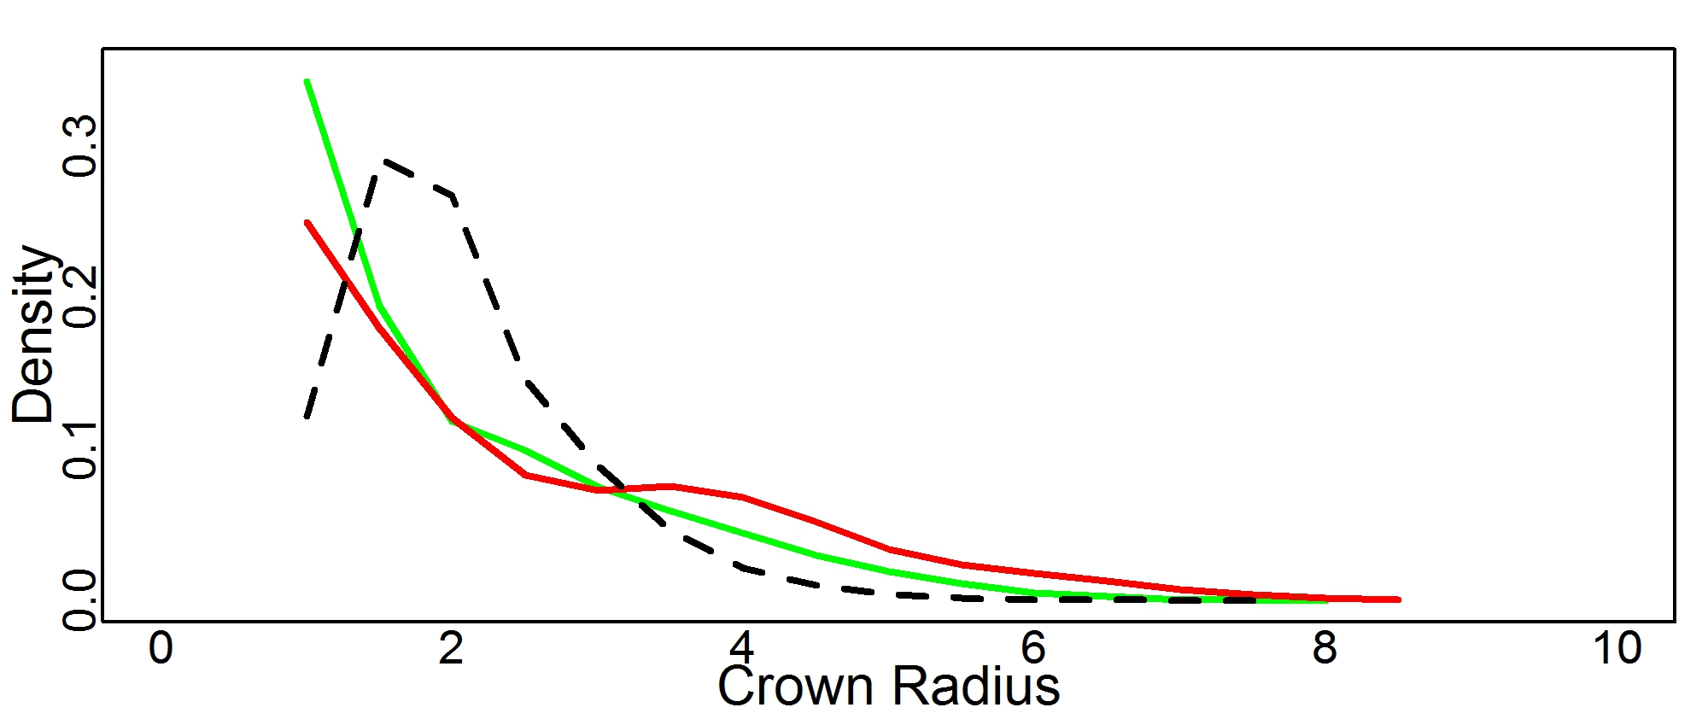
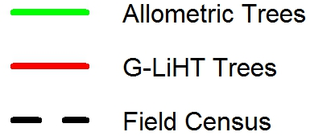
Comparison of stem map developed from crown geometry allometry linked census data to airborne and terrestrial lidar at Harvard Forest, MA
Franklin Sullivan^{1ϕ}, Michael Palace¹, Mark Ducey², David Orwig³, Bruce Cook⁴, Lucie Lepine¹
1. Institute for the Study of Earth, Oceans and Space (EOS), University of New Hampshire (UNH), Durham, NH; ^{ϕ}contact information: fsulliva@gmail.com
2. Department of Natural Resources & Environment, UNH, Durham, NH 3. Harvard Forest, Harvard University, Petersham, MA 4. NASA Goddard Space Flight Center, Greenbelt, MD
Abstract
Forest structure is intricately linked to ecosystem process and forest structure. Lidar remote sensing has proven valuable to quantifying forest structure. Using discrete return lidar and data from field campaigns, we examined forest structure at Harvard Forest. Harvard Forest in Petersham, MA, USA is the location of one of the first temperate forest plots established by the Center for Tropical Forest Science (CTFS) as a joint effort with Harvard Forest and the Smithsonian Institute’s Forest Global Earth Observatory (ForestGEO) to characterize ecosystem processes and forest dynamics.
35 ha census of Prospect Hill completed during winter of 2014 by Harvard Forest researchers
39 variable radius plots (VRPs) were randomly sampled for tree biometric properties within and throughout the Prospect Hill CTFS/ForestGEO plot during September and October 2013
Stem map developed using the Harvard Forest ForestGEO Prospect Hill census by applying allometric equations of crown depth, radius and tree height
Tree height and crown radius distributions from crown delineation (Palace et al. 2008) of both images were compared
In future work, high quality field-based stem maps with species and crown geometry information will allow for better interpretation of individual tree spectra extracted from the G-LiHT (Cook et al. 2013) hyperspectral data using our automated crown delineation of the G-LiHT lidar canopy height model.
Results & Discussion
Crown Geometry Allometric Equations from VRPs – Mixed Effects Modeling
Crown Radius±
Pseudo R²: 0.434
RMSE: 1.22
CV(RMSE): 38.8%
Crown Depth±
Pseudo R²: 0.35
RMSE: 3.24
CV(RMSE): 32.8%
Tree Height*
Pseudo R²: 0.701
RMSE: 2.96
CV(RMSE): 13.8%
*plot effect insignificant
±plot effect significant, removed
Methods
Prospect Hill Tract Census
Between June 2010 and March 2014, >116,000 individual stems >1 cm diameter-at-breast-height (DBH, 1.3 m) were tagged and measured according to CTFS protocol for an initial census. In total, 60 unique species ranging in DBH from 1.0 cm to 93.5 cm were logged. Of these, there were 38,272 live stems with 44 unique species of >5 cm DBH.
Tree Biometrics and Crown Geometry
During Fall 2013, variable radius plot sampling was conducted at 39 randomly selected coordinate sets distributed throughout the Prospect Hill census plot for trees approx. >5 cm. Total height, crown base height, and crown radius toward and away from plot center were measured for sampled trees. Plots were distributed throughout the census area to account for all stand types (on right) and variations in stand conditions. In total, 374 trees were sampled with 14 unique species ranging in diameter from 4.5 cm to 71.1 cm and ranging in total height from 1.3 m to 35.5 m.
Lidar Acquisition
Airborne lidar
Airborne lidar were acquired using the G-LiHT sensor package during the growing season of 2012. The lidar sensor used is the VQ-480 (Riegl USA, Orlando, FL, USA; Cook et al. 2013). At an altitude of 335 m, the sensor has a beam width of 10 cm and approximately 8 returns per pulse. Using terrain removed elevations, a CHM was developed.
Terrestrial lidar
Terrestrial lidar were acquired during September 2013 prior to leaf-off. At each variable radius plot center, one ground-based lidar scan was collected using a FARO Focus 3D, which has a beam width of <5 mm at 50 m and approximately 40 million returns per scan.
Statistical Analyses
Allometric equations for crown geometry were developed using mixed effects modeling in R (version 3.0.1) with DBH as the fixed effect and sample plot and species as random effects. Final models were determined by ANOVA and Akaike Information Criterion to compare model strength. Although the random effect of plot would not be directly applied in the extrapolation, by including it in this analysis it ensures that our models were more efficiently fit. Allometric equations were applied to the census data set to develop a canopy height model and stem map.
Above: Coefficients for the random effect, species (represented by different colored lines in the above figures), were allowed to vary using mixed effects modelling in R. Significant positive relationships resulted from allometric modelling of crown geometry. Allometric models were developed using mixed effects modelling, using DBH as the fixed effect and species and sample plot as random effects. Significant relationships remain when the mean plot effect was applied. The plot effect was not significant for tree height, and could not be accounted for in the census data stem map.
Allometric Canopy Height Model
G-LiHT Canopy Height Model
Study Site – Prospect Hill Tract, Harvard Forest, MA
Allometry: Canopy height model generated from allometric equations applied to census, assuming ellipsoidal crown shape, with crown delineation results displayed. Max height 28.02 m.
Lidar: Canopy height model from G-LiHT collected in June 2012 with crown delineation results displayed. Brighter colors indicated higher elevation. Scales differ (max height 33.06 m).
Crown Delineation Comparison
References
Cook BD, Corp LW, Nelson RF, Middleton EM, Morton DC, McCorkel JT, Masek JG, Ranson KJ, Ly V, and Montesano PM. 2013. NASA Goddard's Lidar, Hyperspectral and Thermal (G-LiHT) airborne imager. Remote Sens 5: 4045-4066, doi:10.3390/rs5084045.
Palace M, Keller M, Asner GP, Hagen S, Braswell B. 2008. Amazon forest structure from IKONOS satellite data and the automated characterization of forest canopy properties. Biotropica 40(20): 141-150.
Acknowledgements Airborne lidar were collected by NASA’s G-LiHT airborne imager (http://gliht.gsfc.nasa.gov/). Census data were collected by David Orwig and numerous field assistants, with financial assistance provided by the Smithsonian Institute (http://www.forestgeo.si.edu/), NSF LTER program (DEB 06-20443 and DEB 12-37491) and Harvard University.
Primary Species
Red Maple
Wetland
Red Oak
Black Oak
Hemlock
Red Pine
Hardwood
White Pine
Poplar
Stand map as of 1993 within the extent of the Prospect Hill census plot showing the primary species within each stand except for within wetland areas. The most sampled species in the VRP campaign were hemlock, red oak, red maple, and white pine, which were also four of the most prevalent in the census data.
Height: Distribution of individual tree heights from crown delineation results of allometry (green, n=10882 trees) and G-LiHT (red, n=10240) images displayed against estimated tree height from census data (n=38272). The disparity in number of trees is likely due to understory trees not visible in CHMs.
Crown Radius: Distribution of individual crown radii from crown delineation results of allometry (green) and G-LiHT (red) displayed against estimated crown radius from census data. Minimum tree crown radius cutoff of 1.0 m was applied for crown delineation and estimated crown sizes <1.0 m were excluded from census.

