Slide 1


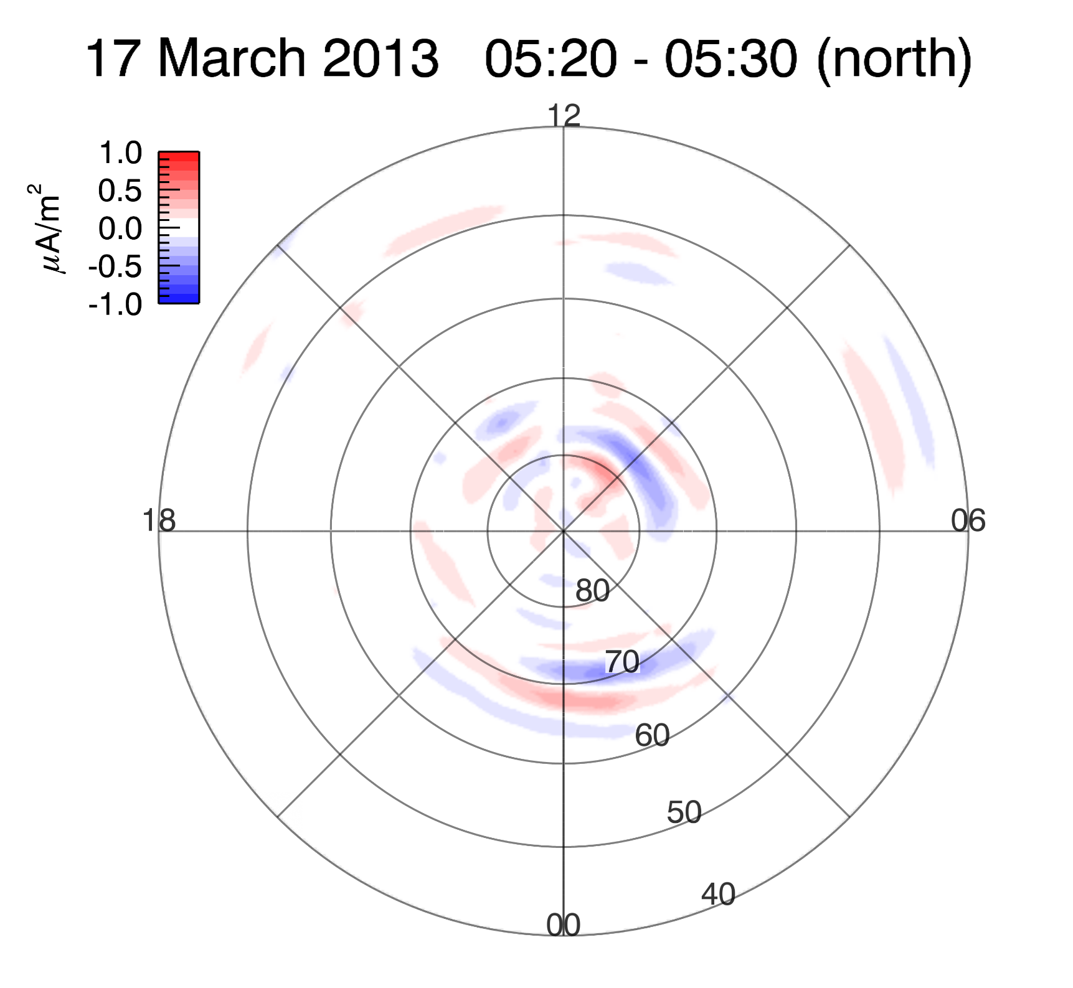
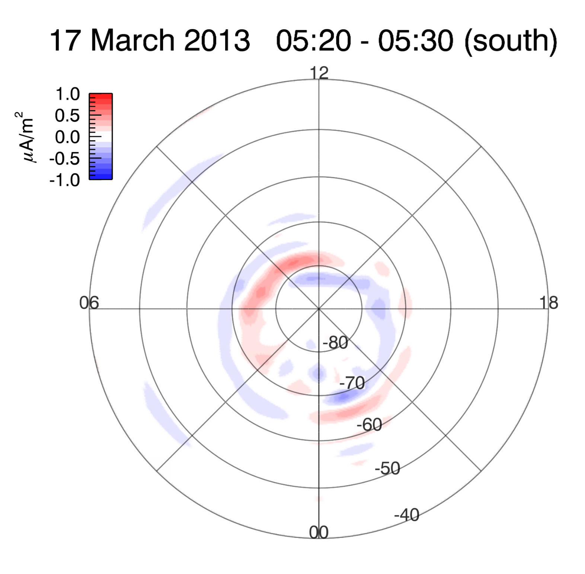
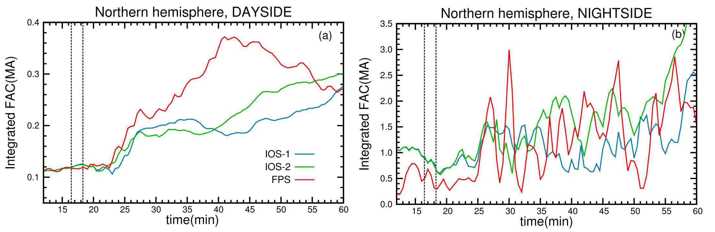
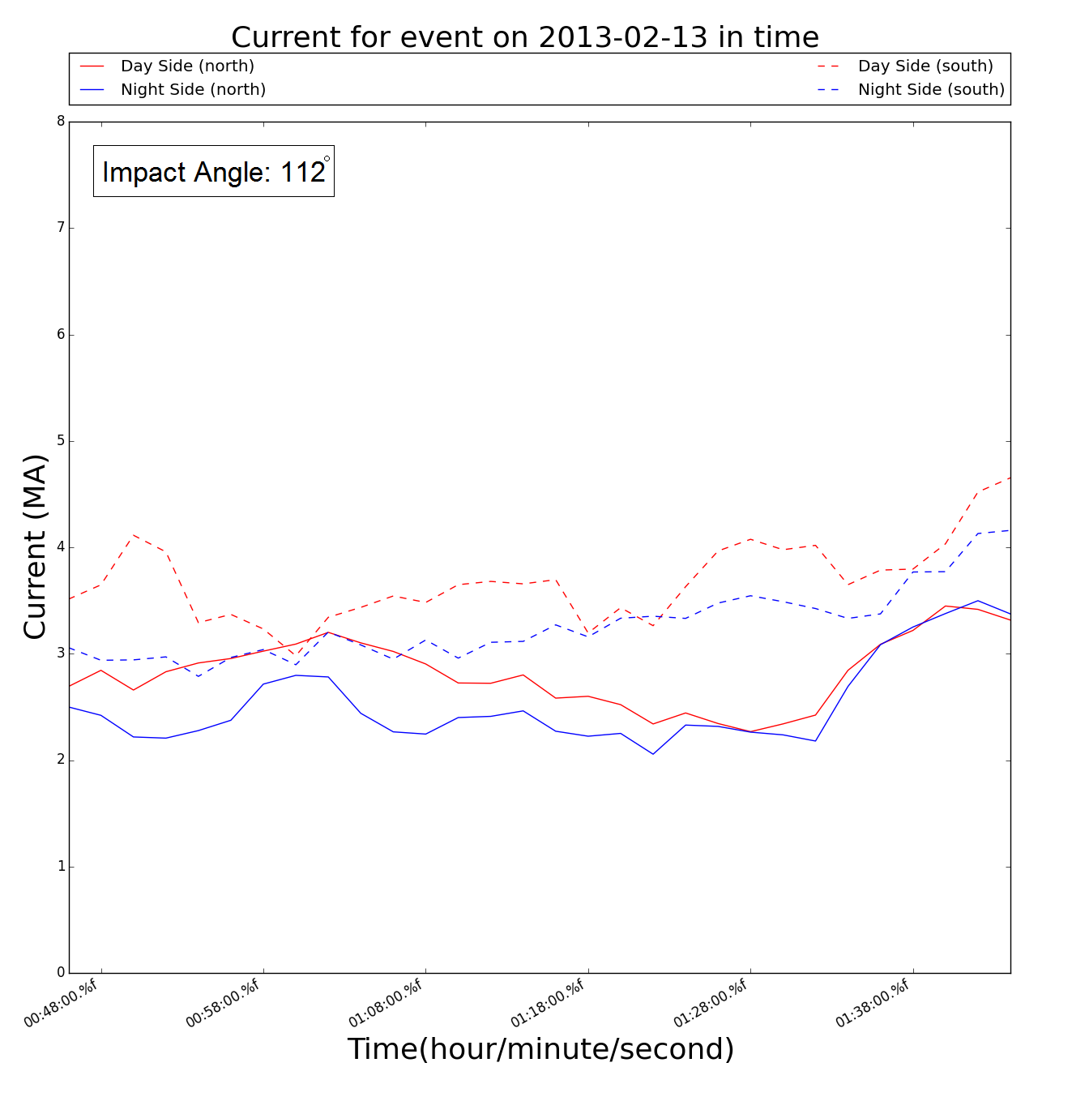
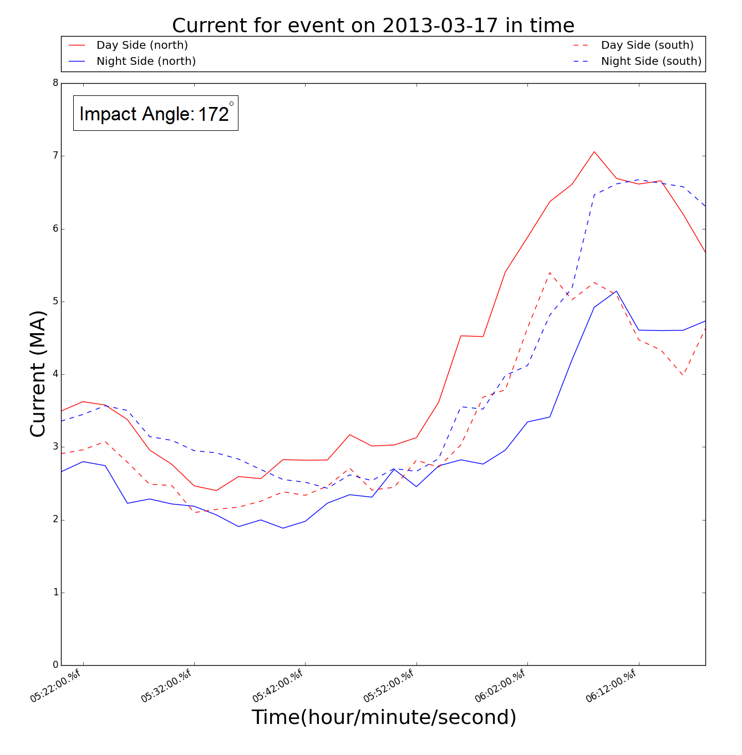
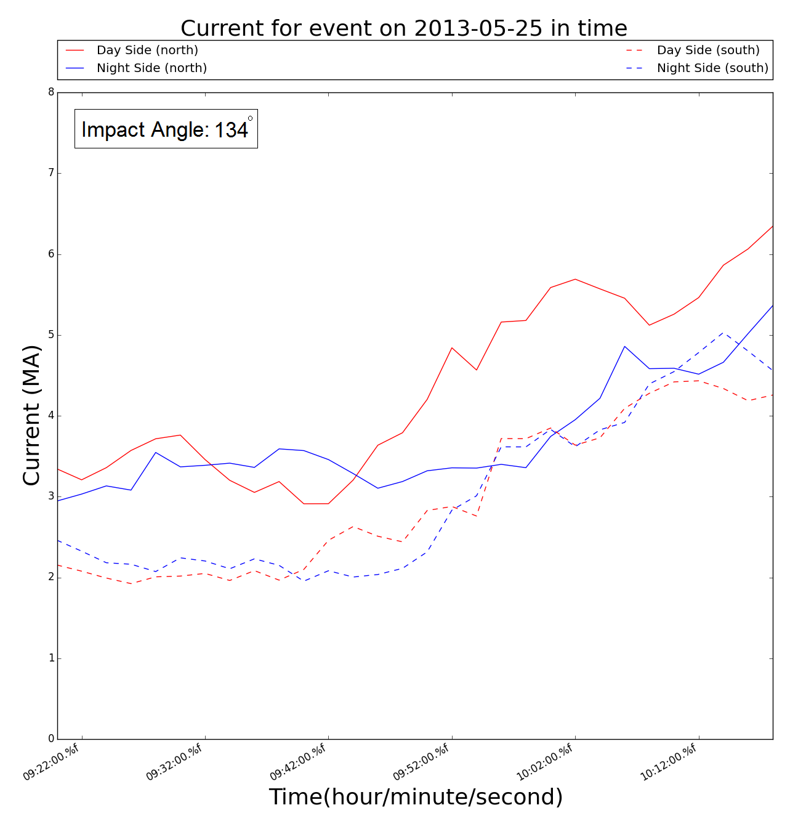
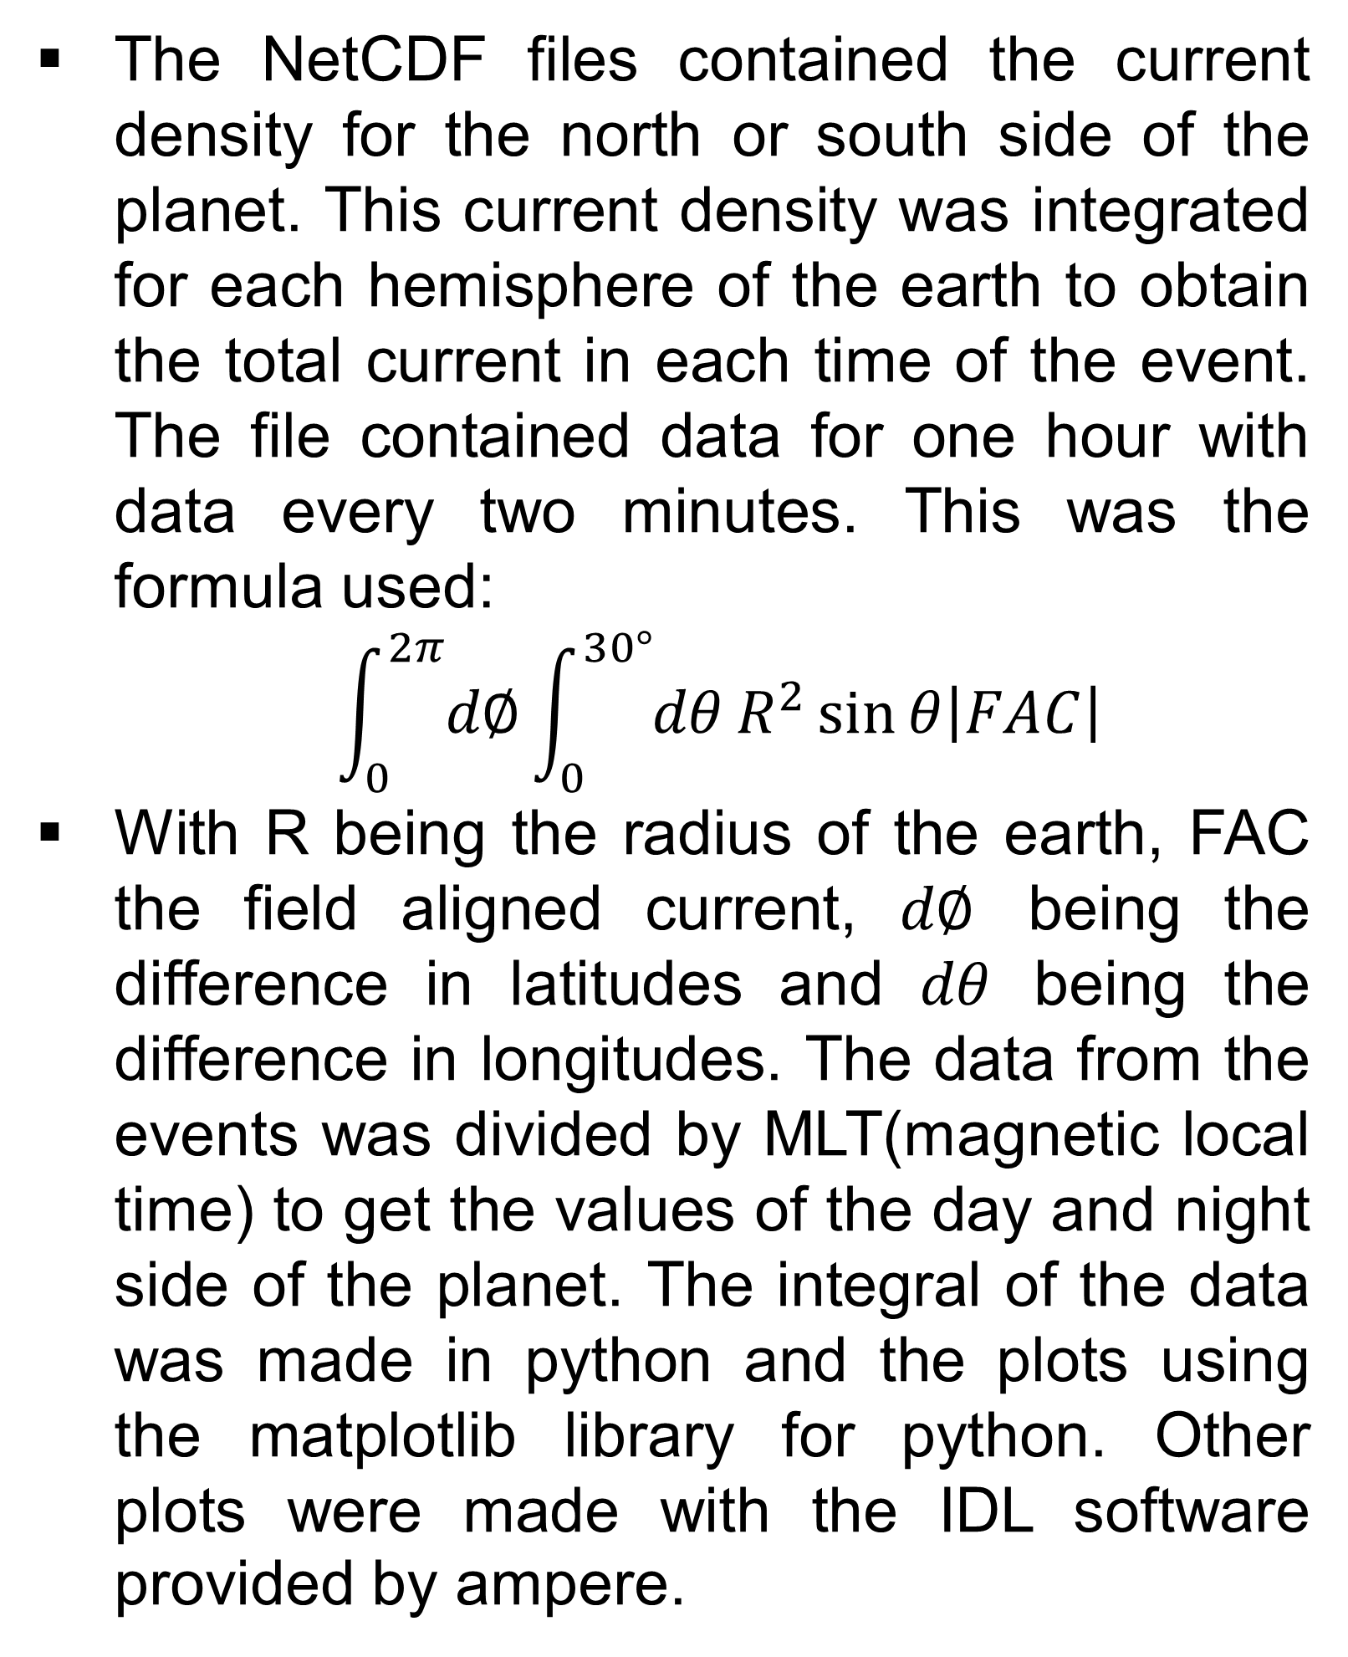
Current in geomagnetic storms
By: J. Martínez ¹
Faculty Advisors: J. Raeder², H. Vo¹, D. Cramer²
University of New Hampshire², Department of Physics & Space Science | Universidad Del Turabo, PR¹
Introduction
Results
Summary
Frequently the earth experiences Geomagnetic storms, events that cause a temporary disturbance on the earths magnetosphere. This is because the earth is hit by a solar wind shock wave or cloud of magnetic field. This creates a variation of currents in the magnetosphere of the earth.
If not for the protection of the magnetosphere would damage satellites orbiting the earth. These shocks cause electrical currents into and out of the Hemispheres.
Introduction
The events were chosen on different shock angles. In the plots on Figure 1 and 2 different points of the Hemispheres of the planet are shown as the shock hits, the red represents currents going out and the blue represents currents going in.
As the shock in Figures 1 and 2 show, the current density is higher on the day side at the beginning of the event. After the shock passes to the night side a higher impact on the magnetosphere is seen, which causes greater current difference.
Plotting the change in total current in time it is shown how the difference in current rises. As it is shown in Figures 3, 4 and 5 the current initially is higher on the day side and then the current rises in the night side. In figure 4 it is shown how the night side current rises on the south side it’s much greater than the day side current in the south.
On the simulated data, the angles are:
  IOS-1=150
  IOS-2=135
  FPS=180
Your text would go here.
Your text would go here.
It can be seen how the shocks have a profound impact on the magnetosphere. From these results it is shown the way the shock affects the earth.
It is shown in the plots that even though the shock hits first on the day side it is clear that a greater current difference in the night side. For most events after some time because of the shock.
The current changes depending on the angle of the shock. When angles are lower than 180 it is seen that the current rises faster on the night side after the initial shock on the day side.
Data source
Figure 1: Current density 2013-03-17, north
The log of electrical currents are available online in the AMPERE website (http://ampere.jhuapl.edu) which is obtained from the IRIDIUM satellites). This data was downloaded in the Net CDF format. On the ampere website there is also a IDL software provided for plotting the net CDF data.
References
Oliveira, D. M., and J. Raeder (2014), Impact angle control of interplanetary shock geoeffectiveness, J. Geophys. Res. Space Physics, 119,8188–8201, doi:10.1002/2014JA020275.
Data Processing
The NetCDF files contained the current density for the north or south side of the planet. This current density was integrated for each hemisphere of the earth to obtain the total current in each time of the event. The file contained data for one hour with data every two minutes. This was the formula used:
  $$\int_{0}^{2π}{d∅}\int_{0}^{30°}{dθ}R^{2}\sin{θ\left|FAC\right|}$$
With R being the radius of the earth, FAC the field aligned current, $d∅$ being the difference in latitudes and $dθ$ being the difference in longitudes. The data from the events was divided by MLT(magnetic local time) to get the values of the day and night side of the planet. The integral of the data was made in python and the plots using the matplotlib library for python. Other plots were made with the IDL software provided by ampere.
References
Figure 3: Simulated FAC
Figure 2: Current density 2013-03-17, south
In Figure 3 it is shown that the simulated data although similar to the data from AMPERE The pattern stays very similar but magnitudes for day and night vary.
Acknowledgements
We thank the AMPERE team and the AMPERE Science Center for providing the Iridium-derived data products.
This Research was sponsored by The National Science Foundation under the grant AGS-1303579
Figure 4: current 2013-02-13
Figure 5: current 2013-03-17
Figure 6: current 2013-05-25

