Slide 1


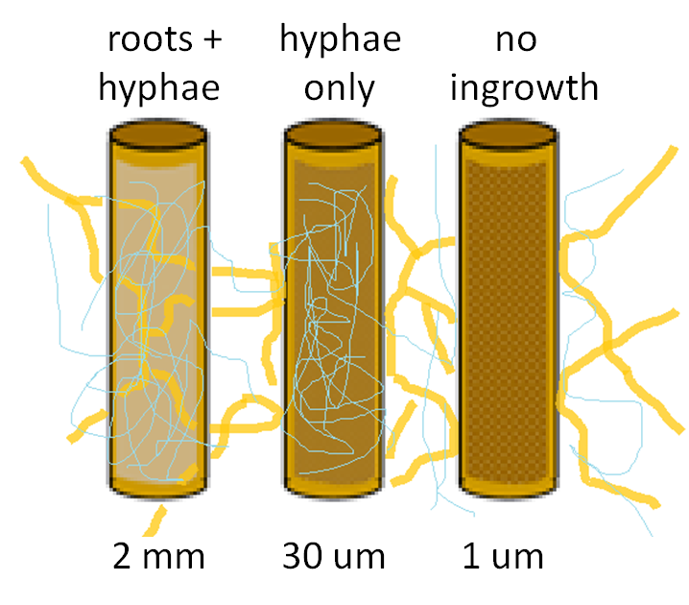
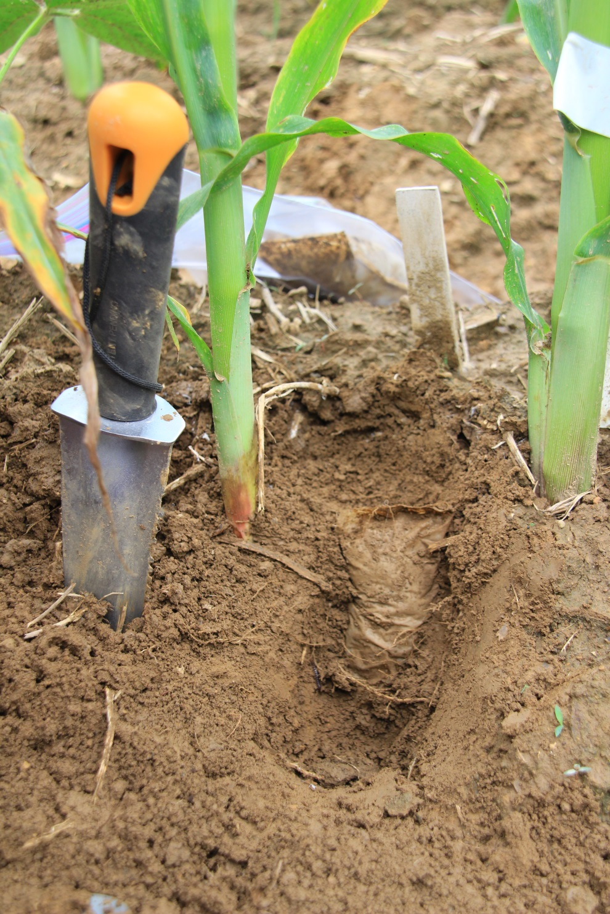
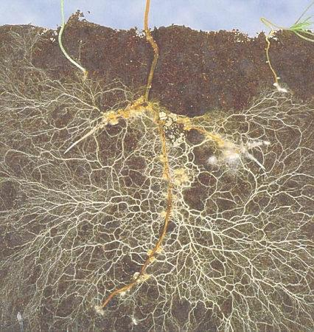
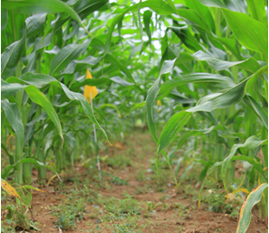
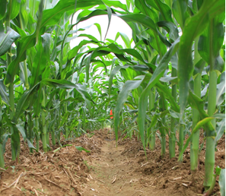
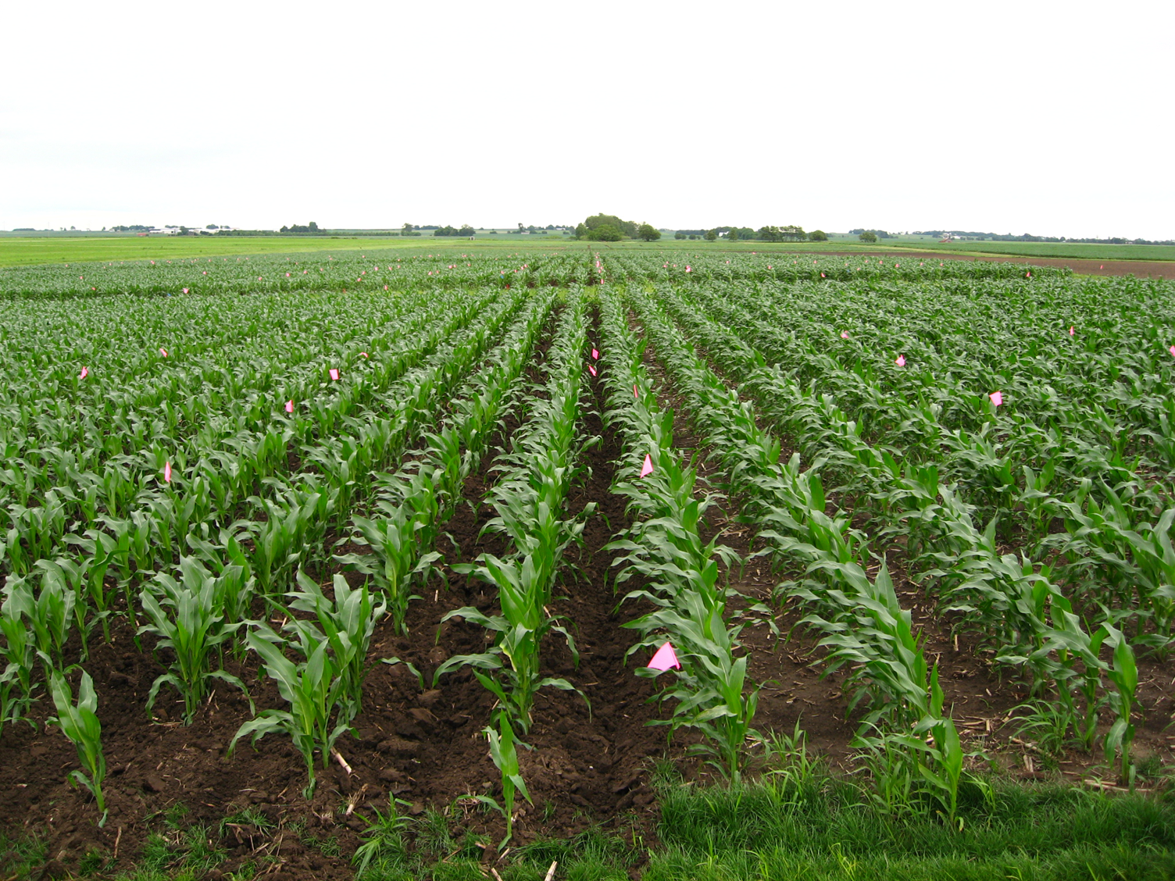
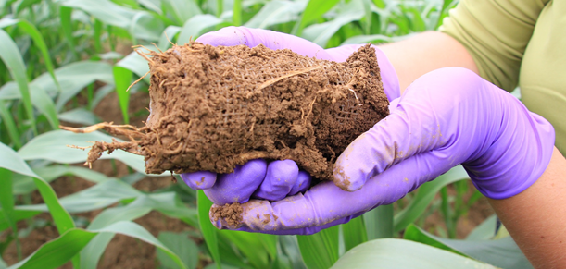
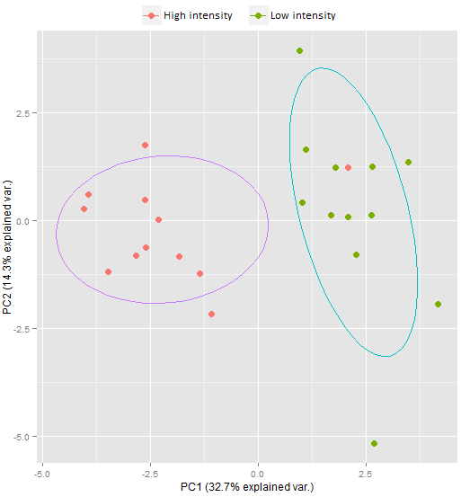
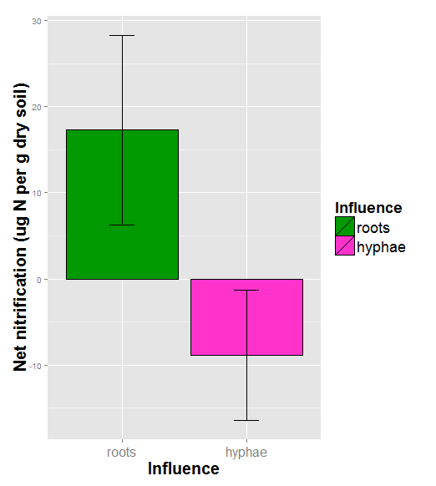
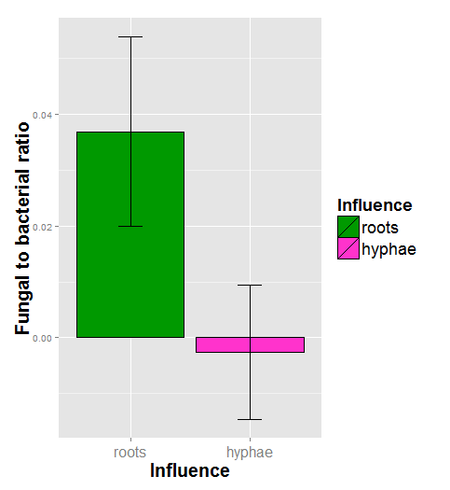
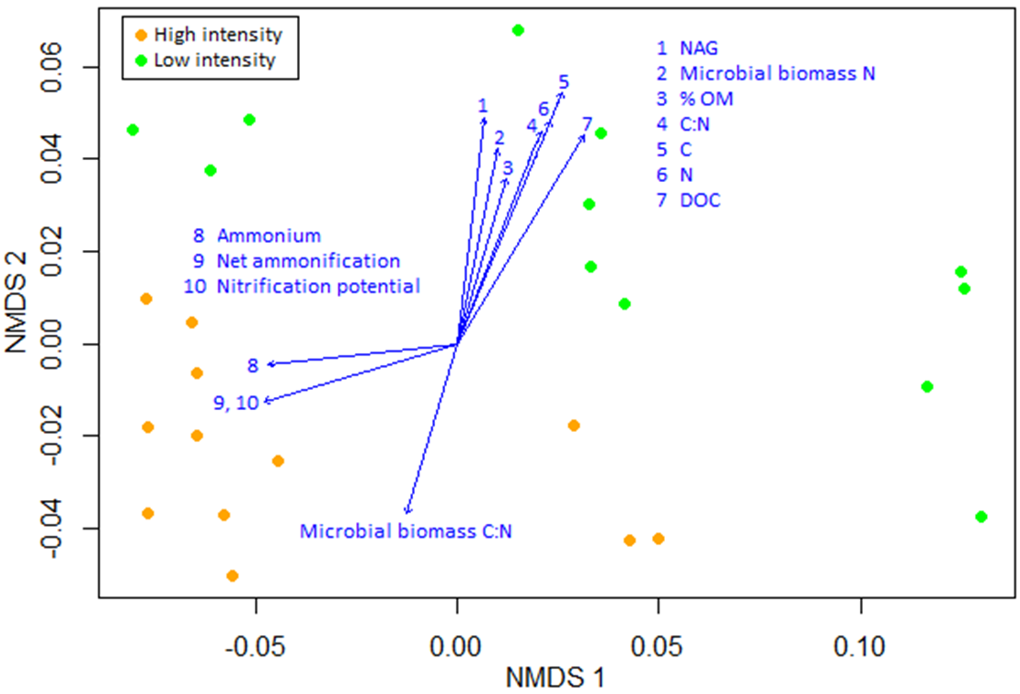
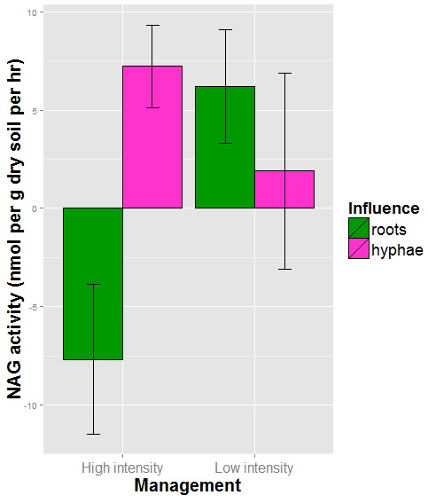
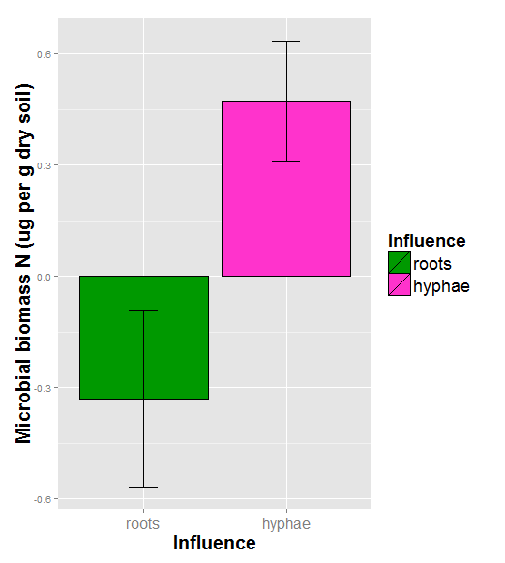

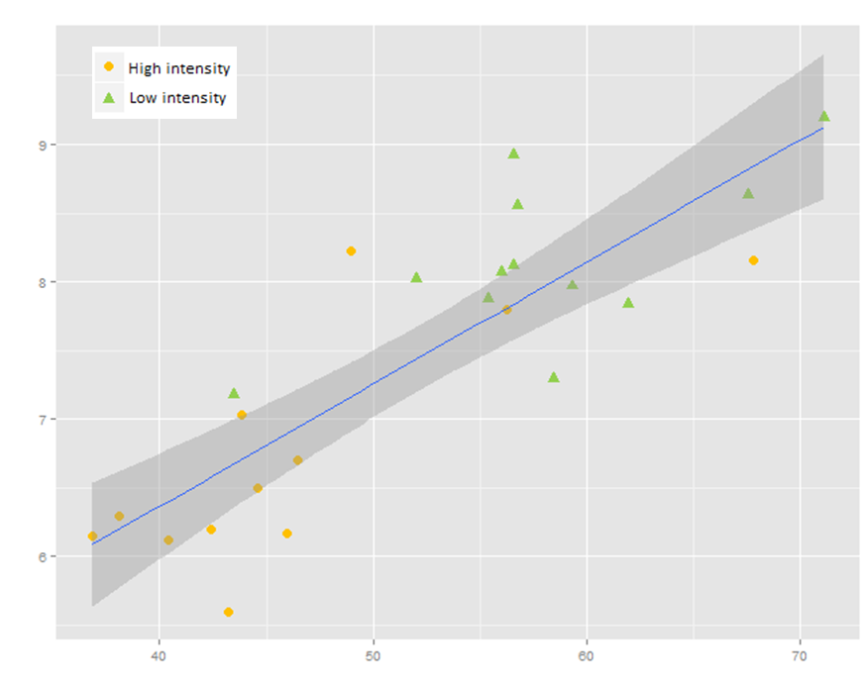
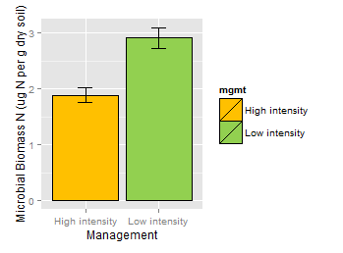
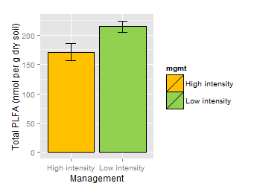
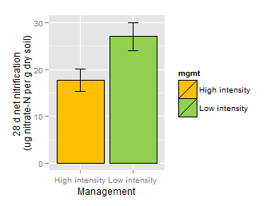
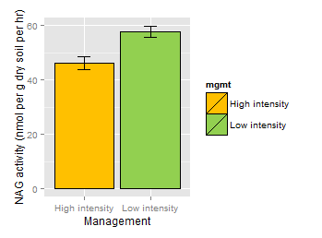
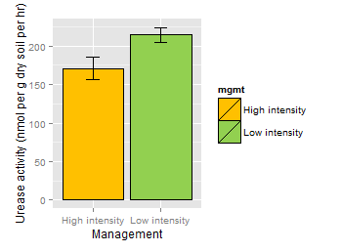
Roots and arbuscular mycorrhizal fungi influence nitrogen cycling in agricultural soils under contrasting management
Amanda B. Daly, A. Stuart Grandy
Department of Natural Resources and the Environment, University of New Hampshire, Durham NH USA
Motivating Questions
Field Experiment: We deployed in-growth cores of three different mesh treatments at Penn State University’s Russell Larson Agricultural Research Center in Rock Springs, PA, in plots with contrasting agricultural management treatments that are expected to differ in microbial community structure and function:
In-growth core treatments
Core deployment: Different cores were filled with soil from each plot, then buried between adjacent maize plants in the top 10 cm of their respective plots
Overview
Labile C inputs, such as
those from plant roots or
arbuscular mycorrhizal fungi
(AMF), may stimulate microbes
to increase mineralization of
soil organic nitrogen (N)
Can roots and hyphae maximize
N turnover to minimize
agricultural N losses?
Chisel-plowed
+ inorganic N
no cover crop
= “High intensity”
“Low intensity” =
Ridge-tilled
no added N
rye cover crop
Soil disturbance
Organic inputs
Soil biological activity
Microbial diversity
Organic N mineralization?
Rhizosphere
Hyphosphere
To what extent do roots and AMF stimulate microbes to mineralize N?
Timing: Cores installed 28 May 2013 and destructively harvested after 42 d and 84 d
Replication: 2 managements x 4 plots x 3 mesh sizes x 2 harvests = 48 samples
Processing: Soils sieved to 4 mm and snap-frozen in liquid nitrogen, transported on dry ice, and maintained at -80°C until RNA extraction
Functional assays: Gross and net N mineralization, activity of soil proteases and N-acquiring enzymes, nitrification potential, size of N pools (total, inorganic, organic, and microbial); “priming” calculated as difference in N cycling function between cores
Is root and AMF stimulation of N mineralization enhanced under low-intensity management?
Root in-growth in 2 mm core
View of buried 30 um core
Management intensity strongly influences
microbial community & nitrogen cycling
Roots favor fungi & nitrification;
Hyphae: microbial N & NAG activity
Insights
Figure 4. Differences in soil variables between cores.
hyphae only
– no ingrowth
= “hyphal influence”
roots + hyphae
– hyphae only
= “root influence”
Root influence increases net nitrification and fungal dominance.
Hyphal influence increases microbial N content, and under high-intensity management increases NAG activity.
All differences significant (p < 0.05) unless otherwise indicated.
Low-intensity management shifts microbial community structure and function, and seems to improve organic N mineralization
*
NS
Roots appear to stimulate N mineralization, perhaps by increasing the relative proportion of saprotrophic fungi in rhizosphere soil
Figure 1. Soils under low-intensity management contain distinct extracellular enzyme profiles from soils under high-intensity management (PCA ordination, groups different by MRPP at p < 0.05)
Figure 2. Microbial communities are distinct under low-intensity management by NMDS ordination, and associated with soil variables related to organic N (including N-acetylglucosaminidase activity, microbial N content), while microbial communities under high-intensity management are associated with inorganic N (stress = 0.07458, groups different by MRPP at p < 0.05)
Hyphae boost microbial N content, and may improve N cycling under high-intensity management by selecting for NAG-producing microbes in the hyphosphere
16:1ω5 PLFA as % of total PLFA
Management
Acknowledgements: Research support was provided by the US Department of Agriculture National Institute of Food and Agriculture (USDA NIFA) under Grant No. 2014-67019-21716, “Nitrogen synchrony at the crop-soil interface: optimizing root-microbe interactions to minimize environmental nitrogen losses,” as well as the National Science Foundation Graduate Research Fellowship Program under Grant No. 0913620. Any opinions, findings, and conclusions or recommendations expressed in this material are those of the authors and do not necessarily reflect the views of the National Science Foundation. We thank Natasha K. Lessard, Elisabetta Tomé and Adam Knedeisen for field assistance, and Mel Knorr for technical support.
Figure 3. Low intensity management increases microbial biomass and N content, net nitrification, and the activity of N-acetylglucosaminidase and urease N-acquiring enzymes in soil. All differences significant (p < 0.05)
NAG activity (umol g⁻¹ dry soil hr⁻¹)
Figure 5. N-acetylglucosaminidase enzyme activity is positively associated with AMF biomass, as measured by 16:1ω5 phosopholipid fatty acid relative abundance. R² = 0.6976, p < 0.0001

