Slide 1
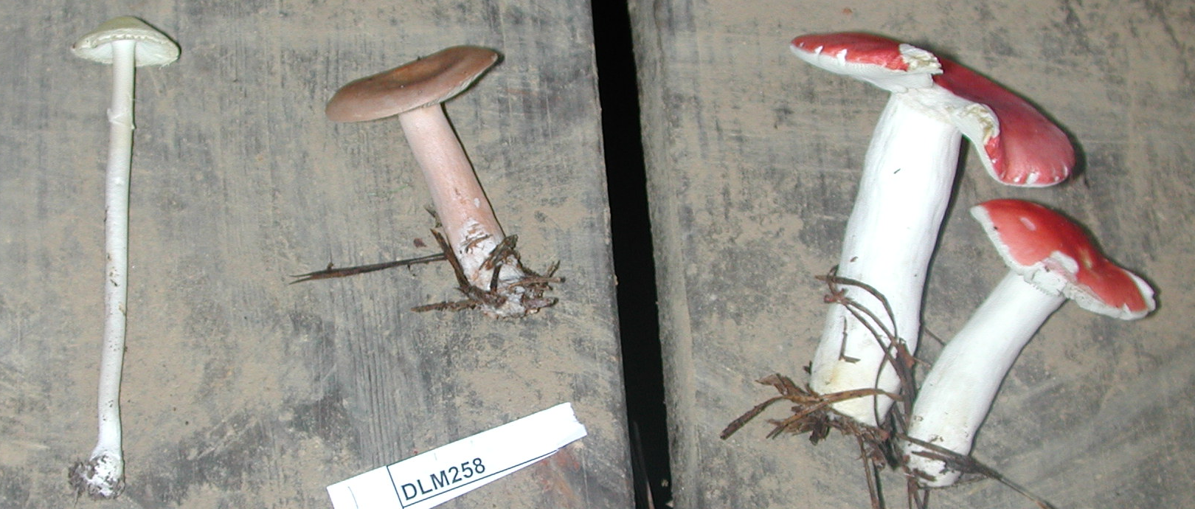
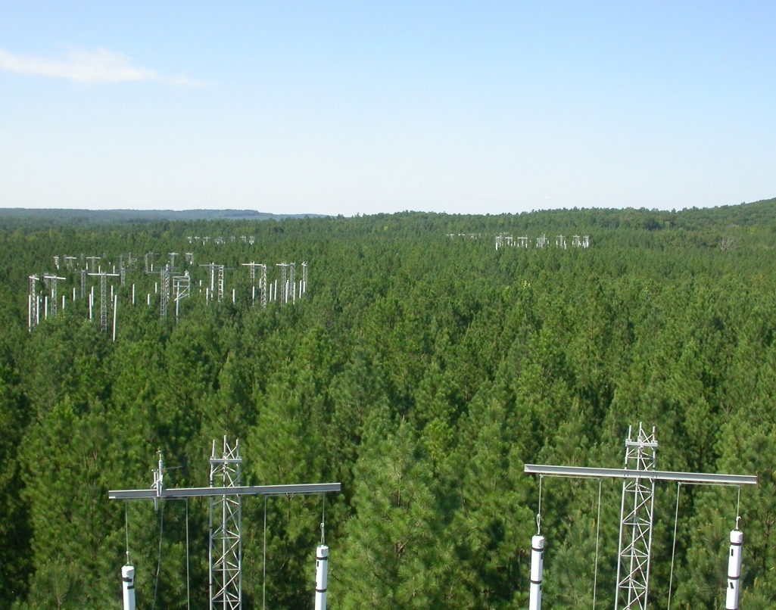
Isotopic analysis of protein and structural material of sporocarps reveals fungal C and N sources
Janet Chen¹, Linda T.A. van Diepen¹, Kirsten S. Hofmockel ² & Erik A. Hobbie¹
PS 14: Biogeochemistry: C & N cycling in response to global change #54881
¹University of New Hampshire, Durham, NH, USA. ²Iowa State University, Ames, IA, USA.
Contact information: janet.chen@unh.edu
Introduction
Results
Determining fungal sources of C and N is important for understanding the role of fungi in C and N cycling, but it is often difficult to study under field conditions. ¹³C and ¹⁵N labels introduced in the Duke Free Air CO2 enrichment (FACE) experiment provided a unique opportunity to study the sources of C and N for ectomycorrhizal and saprotrophic fungi in a loblolly pine plantation. Analysis of ¹³C and ¹⁵N labels in structural and protein sporocarp material were used to determine whether fungi were receiving C from recent plant photosynthate, plant litter or old organic nitrogen and whether fungi were receiving N from surficial or deep soil pools.
¹³C analysis of protein and structural material after fumigation shutoff: δ¹³C of protein from sporocarps indicates C use of organic matter previously synthesized during CO2 fumigation by ectomycorrhizal fungi and saprotrophic fungi. δ¹³C of structural material indicates C use of organic matter by
saprotrophic fungi and hydrophilic ectomycorrhizal fungi and recent photosynthate by hydrophobic ectomycorrhizal fungi.
Fig 3a
Fig 3b
Hydrophilic
Hydrophobic
Saprotrophic
Hydrophilic
Hydrophobic
Saprotrophic
Study Site
Studies were conducted at the Duke FACE experiment.
Loblolly pine plantation in North Carolina, USA.
Pinus taeda and understory Liquidambar styraciflua, Acer rubrum, Cercis canadensis and Cornus florida are dominant vegetation.
Three control and three elevated CO2 plots (30 m diameter) 200 ppm above ambient levels.
CO2 fumigation (δ¹³C of -43.0 ± 0.6‰) initiated in 1996, lowered δ¹³C of rings by 12‰ to -20‰.
Fumigation shutoff on November 1, 2010.
98 atom% ¹⁵N tracer (75% NH4Cl and 25% KNO3 at 15 mg ¹⁵N m⁻² in 0.25 L H2O) was applied in May 2003.
Hydrophilic (short- and medium-distance smooth exploration types) and hydrophobic (medium-distance fringe and long-distance exploration types) ectomycorrhizal and saprotrophic sporocarps were collected during fumigation and 2 years after shutoff.
Figure 3. ¹³C of protein
and structural material.
δ¹³C of protein (3a) and structural
(3b) material of hydrophilic and
hydrophobic ectomycorrhizal sporocarps and saprotrophic sporocarps collected in ambient and elevated CO2 plots at the Duke Forest FACE site two years after CO2 fumigation shutoff.
¹⁵N and ¹³C in protein and structural material after CO2 fumigation shutoff : Distinct ¹⁵N and ¹³C values indicates hydrophobic ectomycorrhizal use of old organic matter and recent photosynthate and use of young organic matter by saprotrophic fungi. Hydrophilic ectomycorrhizal fungi use young organic matter and recent photosynthate. N content and δ¹⁵N composition are the greatest controls on ¹³C enrichment between protein and structural material.
Results
Fig 4a
Fig 4b
Characterization of ¹³C and ¹⁵N in soil profiles: ¹³C is depleted in elevated CO2 treated soils, even after fumigation shutoff. ¹³C is enriched in mineral soils and¹⁵N is enriched in organic horizons.
Fig 1a
Fig 1b
Oi
Oh
15 cm
30 cm
Regression model | δ¹³C_{pro-struc} coefficient
Adj r² =0.429 | ± SE | % variance | p
Hydrophobicity (sap-Ho) | 14.72 ± 4.32 | 3.8% | 0.335
Bulk δ¹⁵N | -0.12 ± 0.05 | 24.2% | 0.024
Bulk δ¹³C | 0.17 ± 0.13 | 6.5% | 0.213
%C_{pro-struc} | 0.05 ± 0.04 | 4.4% | 0.304
%N_{pro-struc} | -0.44 ± 0.18 | 23.0% | 0.027
δ¹⁵N_{pro-struc} | 0.60 ± 0.19 | 38.0% | 0.007
Figure 4. Protein and structural material
δ¹³C and δ¹⁵N.
δ¹³C and δ¹⁵N (4a) and δ¹³Cpro-struc and δ¹⁵Npro-struc (4b) values
of hydrophobic (Ho) and hydrophilic (Hi) ectomycorrhizal and
saprotrophic (Sap) sporocarps collected in ambient and
elevated CO2 plots at the Duke FACE site two years after CO2
fumigation shutoff.
Oi
Oh
15 cm
30 cm
Figure 1. δ¹³C and δ¹⁵N of FACE soils.
Soil cores were collected from FACE experimental plots in 2010 during CO2 fumigation and in 2013
three years after fumigation shutoff. Soils were separated at the Oi and Oh horizons and to 15 cm and
30 cm depths in mineral soil and analyzed for bulk δ¹³C (1a) and δ¹⁵N (1b).
Table 1. Stepwise multiple regression analysis of δ¹³Cpro-struc.
Bulk ¹³C analysis: Only saprotrophic sporocarps retained the ¹³C signature two years after shutoff, indicating use of litter and wood C for saprotrophic fungi and recent photosynthate for ectomycorrhizal fungi.
Conclusions
¹³C and ¹⁵N analysis of protein and structural sporocarp material provides information on fungal C and N sources that are not detectable using bulk tissue analysis.
C in protein and structural material of sporocarps is derived from different pools.
Hydrophobic ectomycorrhizal fungi mine old organic material for protein C and N material and use recent photosynthate for structural C material.
Hydrophilic ectomycorrhizal fungi use recent photosynthate and young organic matter for structural and protein C and N material.
Saprotrophic fungi uses young organic matter for protein and structural C and N material.
Fig 2a
Fig 2b
Figure 2. ¹³C of bulk sporocarps.
δ¹³C for bulk hydrophilic and
hydrophobic ectomycorrhizal
sporocarps and saprotrophic
sporocarps collected in ambient
and elevated CO2 plots at the
Duke Forest FACE site during CO2
fumigation (2a) and two years after
CO2 fumigation shutoff (2b).
Hydrophilic
Hydrophobic
Saprotrophic
Hydrophilic
Hydrophobic
Saprotrophic
Acknowledgements
This work was supported by grants from NSF DEB and DOE.
Special thanks to Dr. Erik Lilleskov for sharing sporocarp collections.

