Slide 1


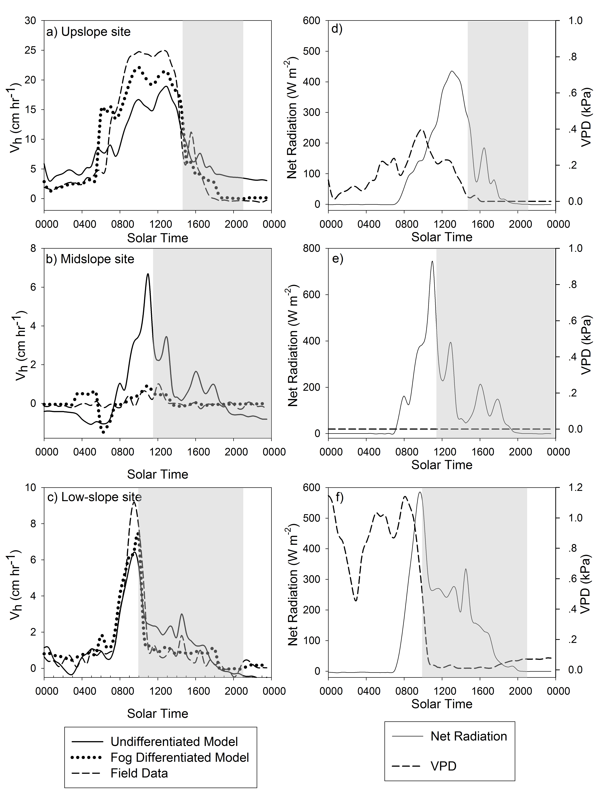
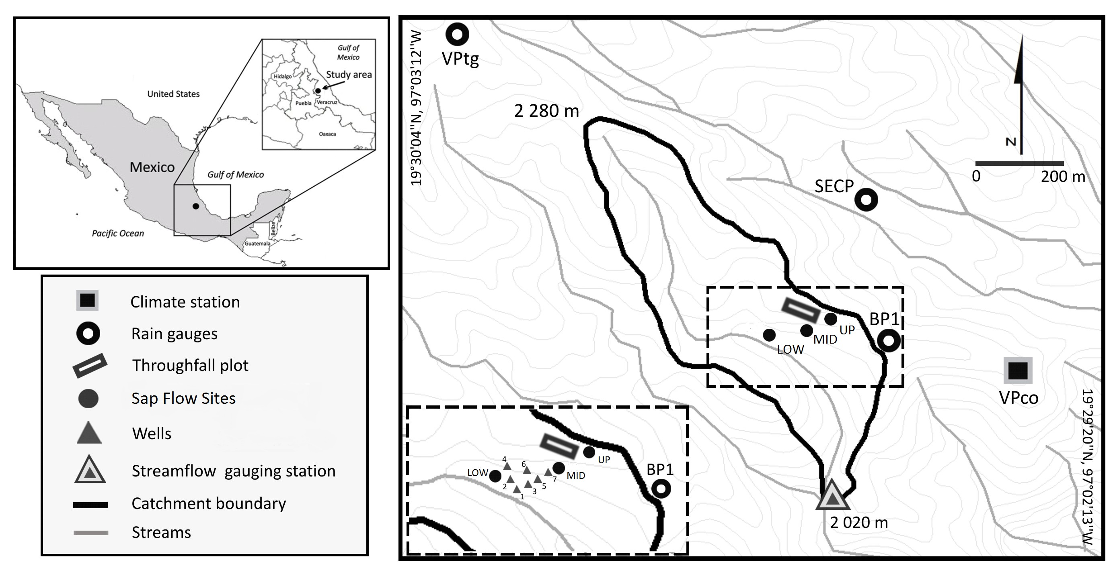
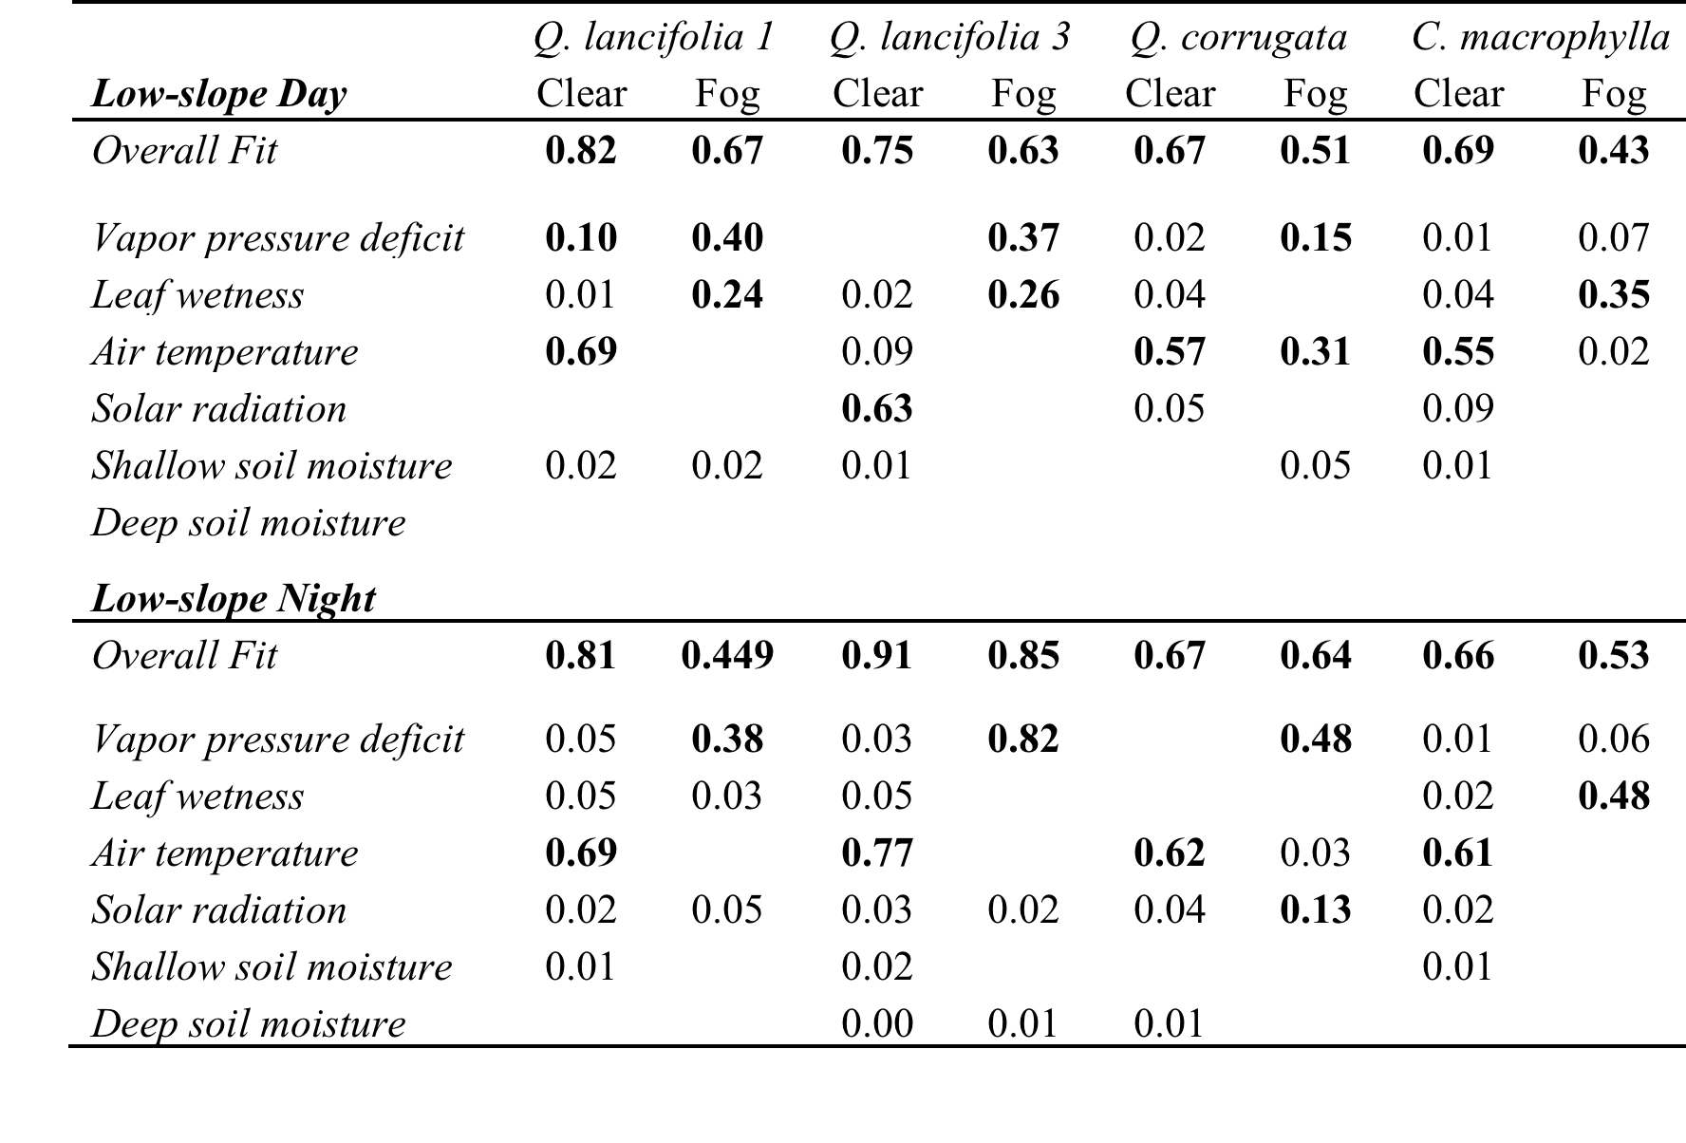
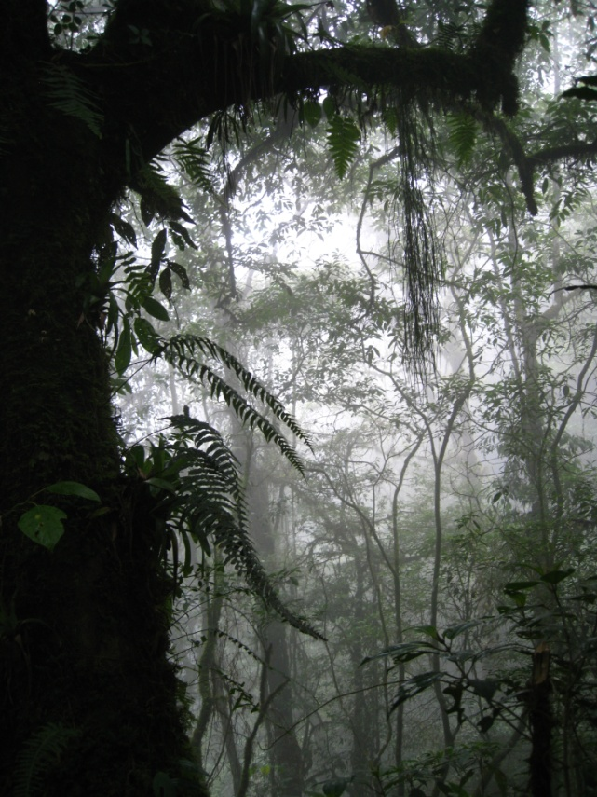
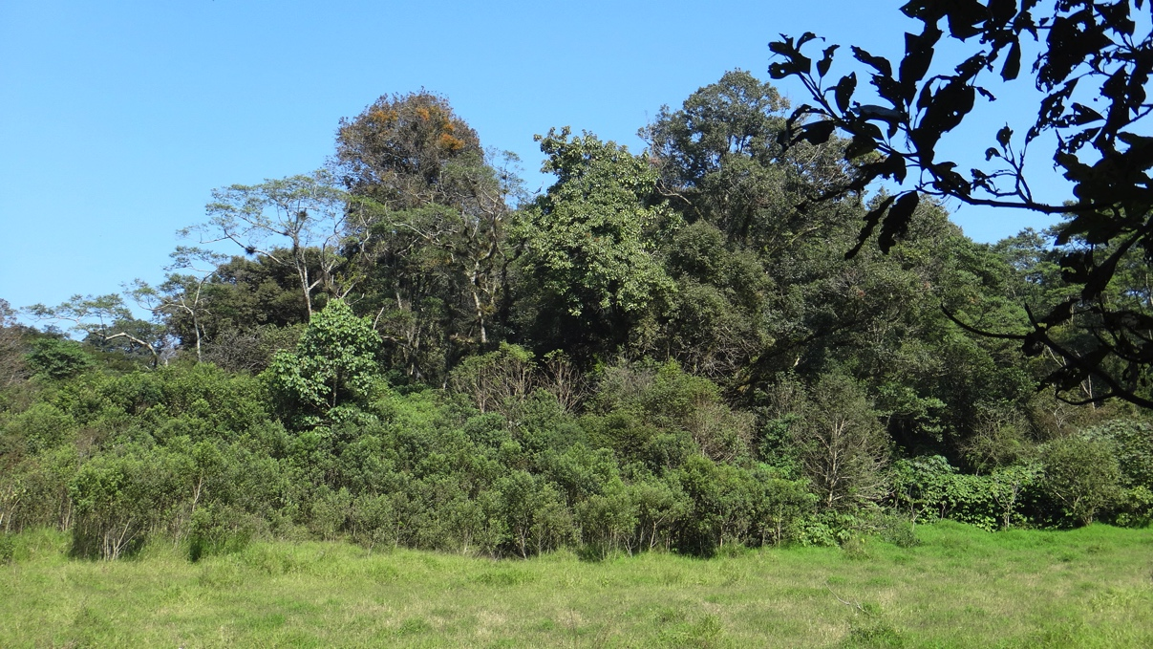
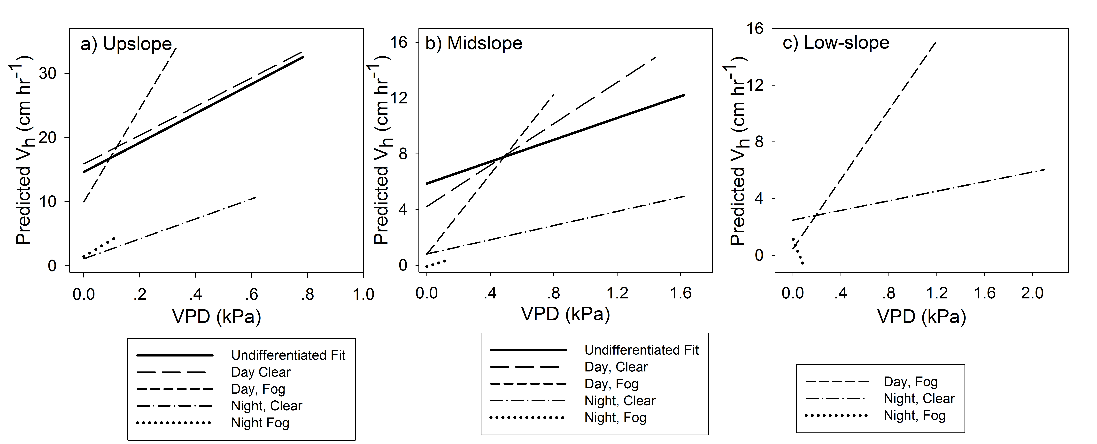
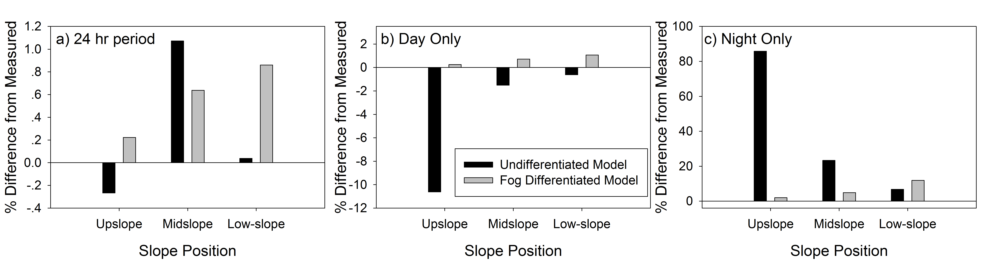
Examining the influence of environmental parameters on sap flow across slope positions in a tropical montane cloud forest
Z. Carter Berry¹, Sybil G. Gotsch², Friso Holwerda³, Lyssette E. Muñoz-Villers³, Heidi Asbjornsen¹
¹University of New Hampshire, Durham, USA , ²Franklin and Marshall College, Lancaster, USA , ³Universidad Nacional Autónoma de México, México D.F., Mexico
Introduction
Results
Conclusions
Tropical montane cloud forests (TMCF) are unique ecosystems characterized by a highly variable weather conditions including strong swings in solar radiation, temperature, and evaporative demand. This occurs during transitions from clear to fog periods and seasonality in rainfall and fog exposure.
Because TMCF typically occurs in steep mountain regions, there is also strong variation in microclimate and tree water use over very short distances, such as across hillslopes. Studies that scale tree water use to the stand or ecosystem level typically use values derived at one site which are then applied across stands or catchments.
In this study, we examined the environmental parameters that influenced tree sap flow velocities across three slope positions in a TMCF. We expected solar radiation and VPD to be more important during clear, daytime periods while VPD and leaf wetness would explain patterns during fog and nighttime periods. Across slope positions, we expected soil moisture and air temperature to drive sap velocities at slope positions with higher temperatures and lower soil moistures.
Model Fits
Model Assessment
In a TMCF ecosystem the influence of VPD, solar radiation, air temperature, leaf wetness, and soil moisture on V_{h} varied across three slope positions. Upslope and midslope sites had water use patterns more coupled with environmental variables and were predominantly driven by VPD, solar radiation, and air temperature. Coupling at the low-slope site appeared weaker, in that VPD explained less of the variation in V_{h} with a greater influence of leaf wetness.
VPD explained large proportions of the variation at two sites, particularly during fog periods and nighttime periods. This combined with the greater influence of leaf wetness at the low-slope sites suggests a shift in tree water management during fog and nighttime periods. Fog periods of low and negative sap flow have been shown to be important for annual tree water balance.
Soil moisture rarely explained a large proportion of the variation which could be due to relatively wet soils during the study period, rooting depth of the species studied, or the scale of measurement (short) in this study.
Models that separated fog and nighttime periods improved predictions of periods of low sap flow, such as during fog or night. This was particularly true at the upslope and midslope sites more coupled to the environment.
Outputs from this study could be particularly useful for studies trying to model nighttime transpiration rates or periods of foliar uptake. Both patterns have been shown to be significant contributors to plant water balance patterns in TMCFs.
Table 1. Model fits (r²) values from stepwise multiple linear regression models at upslope, midslope, and low-slope sites. Linear models were developed for each tree and separated into clear and fog periods during both the day and night to assess how model fits from each variable changes in response to fog. If an r²value is included, it was a significant predictor variable in the model. If no value is included then that variable was not a significant predictor in that model. R-squared values greater than 0.10 are bolded.
Methods
Figure 3. Comparison of model outputs for one day that includes a fog period in the afternoon. Panels a-c represent the prediction of the undifferentiated model (solid line), the fog differentiated model (dotted line), and the actual measured field data (dashed line) for the three slope positions. Panels d-f show net radiation (solid line) and VPD (dashed line) during the same period. Grey boxes represent fog periods.
.
Temperature and solar radiation explained most of the variation during clear periods while VPD was a dominant factor during fog and night periods.
Leaf wetness explained more variation in heat pulse velocities at the low- and midslope sites while VPD was an important factor at the up and midslope sites.
While soil moisture was common in many of the models, it rarely explained a large portion of the variation.
Figure 1. Map showing the location of the three sap flow sites at different hillslope positions along with other measurements taken during the study. Figure adapted from Muñoz-Villers & McDonnell (2012).
The fog differentiated model resulted in improved predictions of heat pulse velocities during low flow periods (fog and night).
The fog differentiated model improved predictions of daily V_{h} at the upslope and midslope site.
The fog differentiated model improved predictions during day and night periods and reduced the variability of values across all three sites.
We examined the influence of microclimate (solar radiation, VPD, temperature, leaf wetness, shallow soil moisture, deep soil moisture) on tree water use across three slope positions in a TMCF of Veracruz, Mexico (Figure 1).
Heat ratio method (HRM) sap flow methodology was used to monitor fluxes in Quercus lancifolia, Quercus corrugata, and Clethra macrophylla.
Micrometeorology was monitored within the canopy at each site and at a meteorology tower in a nearby open grassland.
All data was divided into clear/fog and day/night periods and multiple regression models were developed for each tree at each slope position. Best models were chosen using Akaike Information Criterion (AIC).
Figure 5. Microclimate varies in TMCF across locations and include periods of high fog (left) to periods of high sunlight and evaporative demand (right).
Acknowledgements
Figure 2. Predicted effects of variation in vapor pressure deficit (VPD) on heat pulse velocities for one Quercus lancifolia at each of the three slope positions. The response of predicted V_{h} to VPD is shown for the undifferentiated model (solid line) and each fog differentiated model (dotted lines). Temperature was held constant at 18°C, leaf wetness at 5%, soil volumetric water content at 50%, and solar radiation at either 500 W m⁻² (day) or 50 W m⁻² (night).
Support was provided through a grant from the National Science Foundation (NSF/DEB0746179). Adan Hernandez, Sergio Cruz Martinez and Lexi Weintraub all aided in the installation and maintenance of the sap flow stations.
Figure 4. The average percent difference in daily V_{h} between the two model outputs and measured V_{h} at three slope positions. Panel (a) represents a total 24-hour period while (b) and (c) divide the same comparisons into daytime and night time periods. Black bars represent the undifferentiated model and grey bars represent the fog differentiated model.
Contact: Z. Carter Berry zcberry@gmail.com

