Slide 1

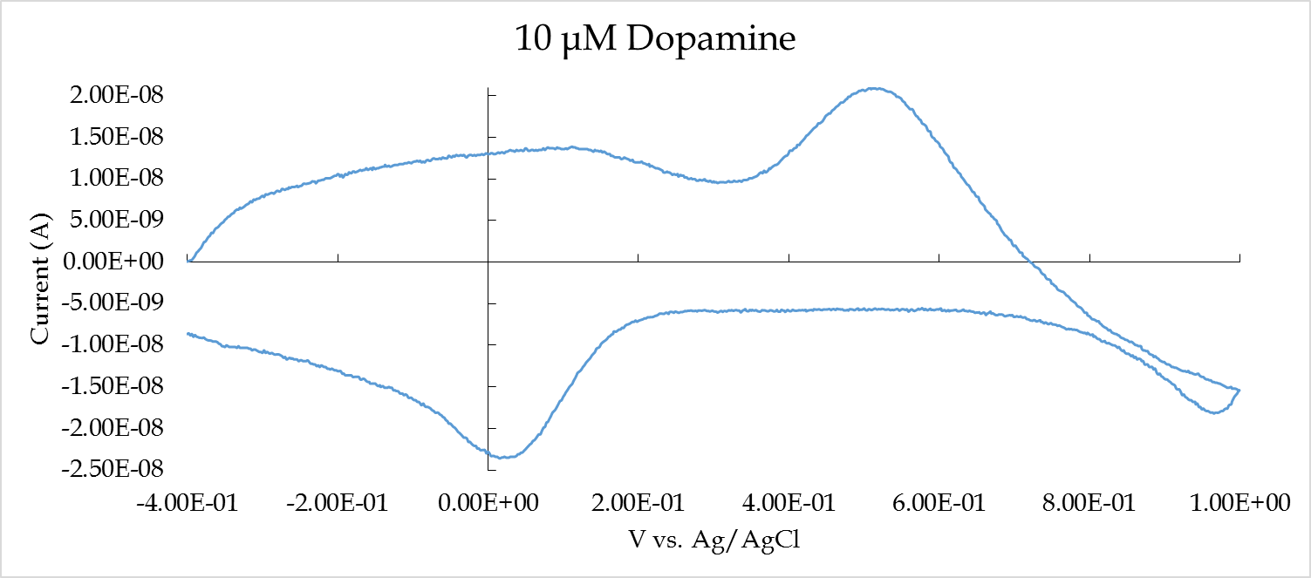
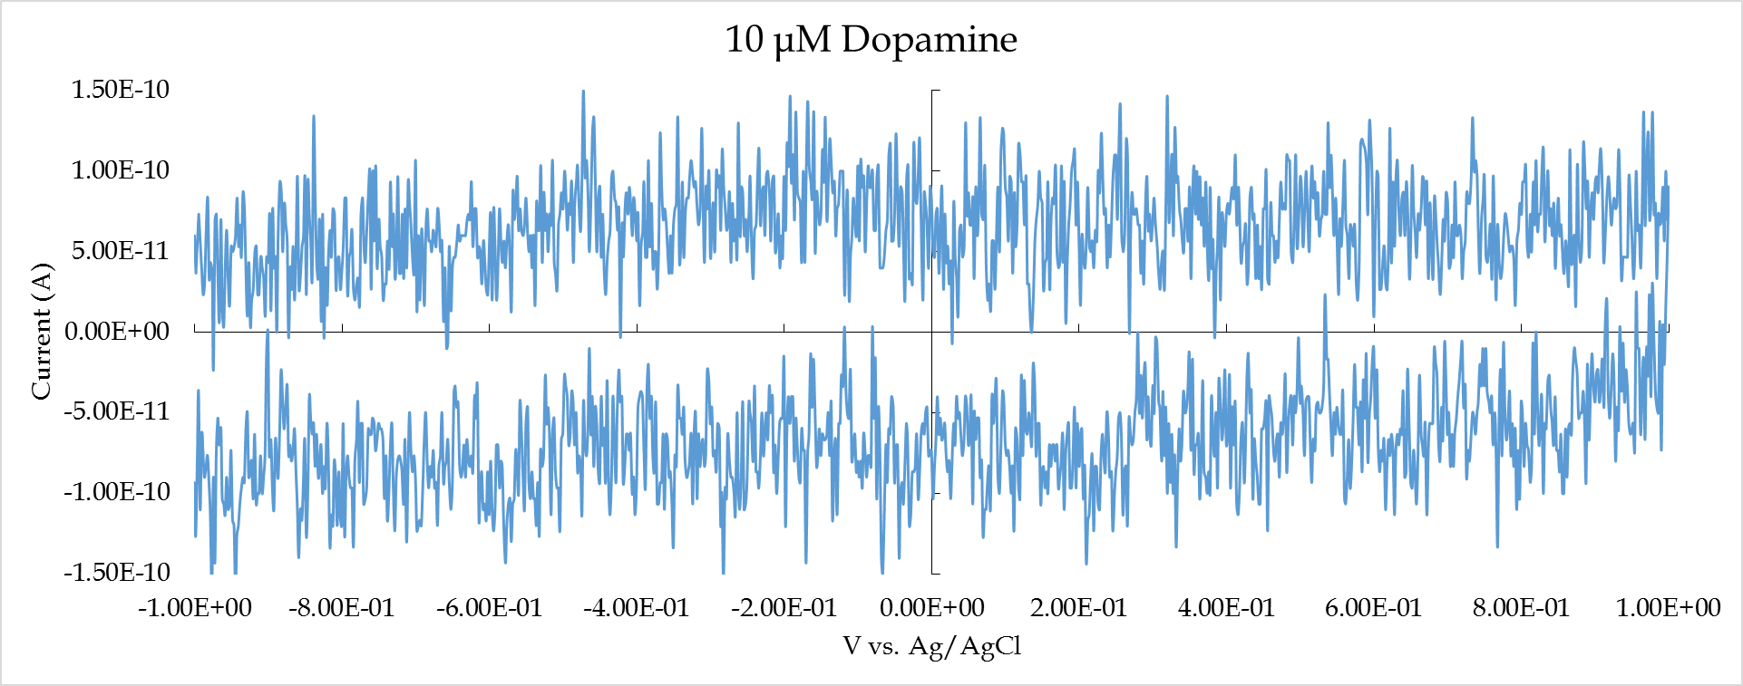
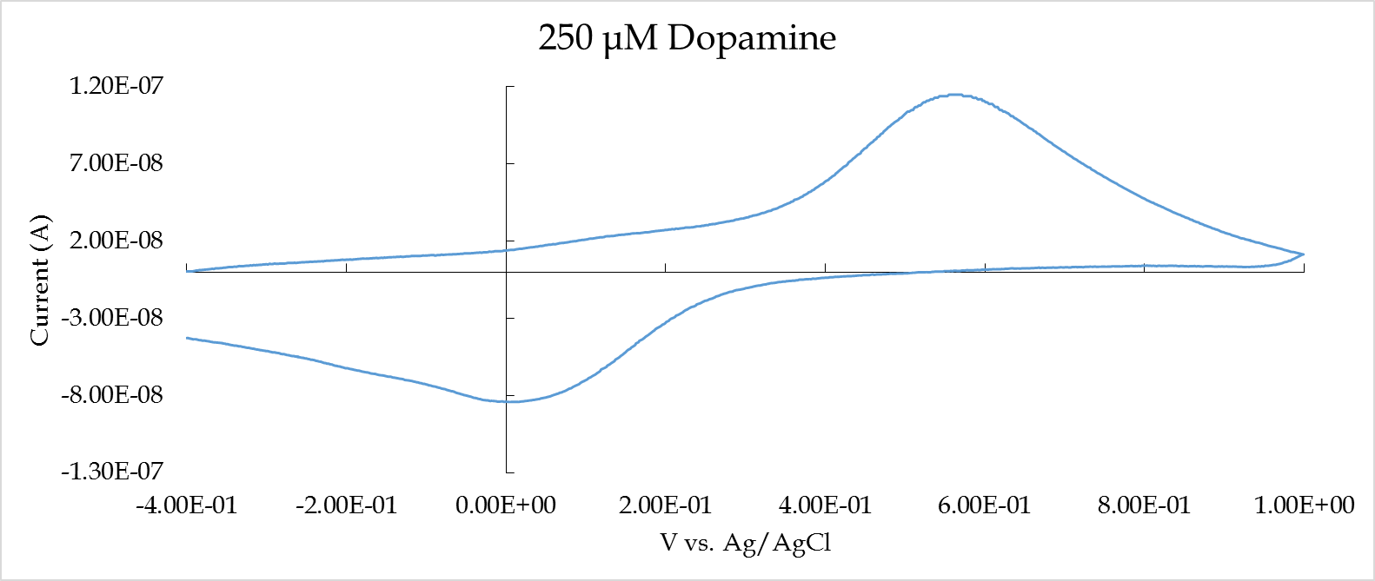
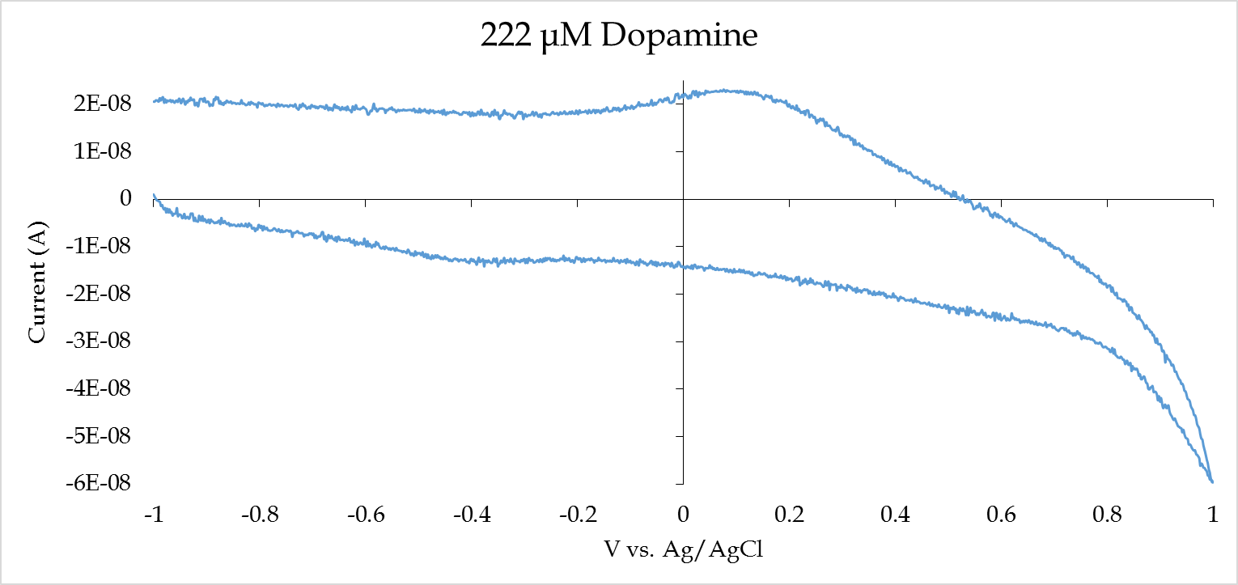
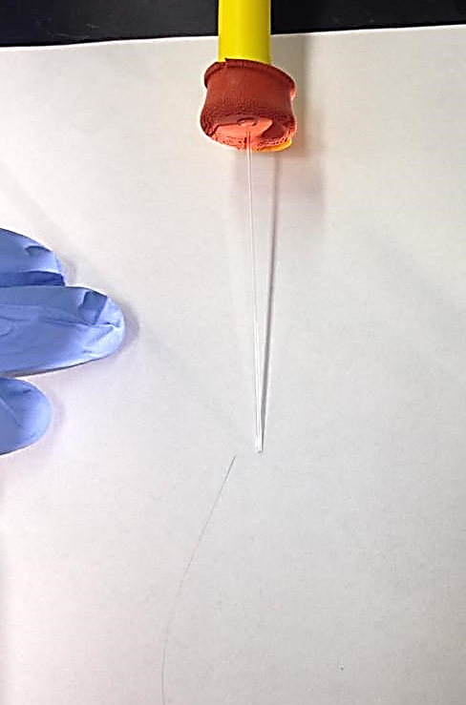
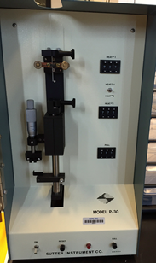
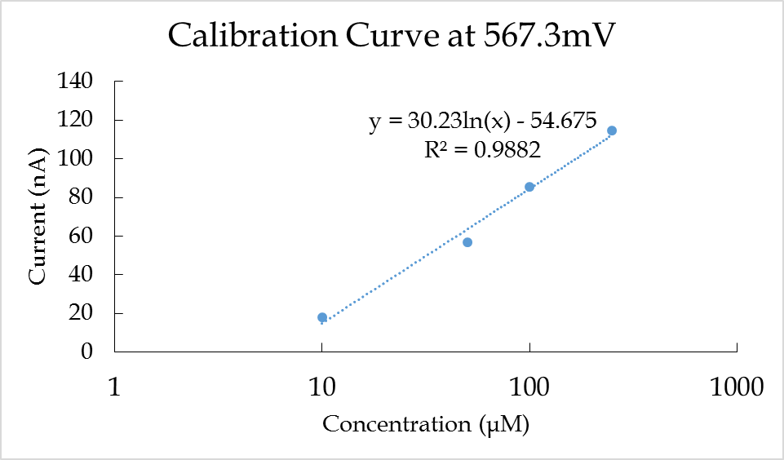
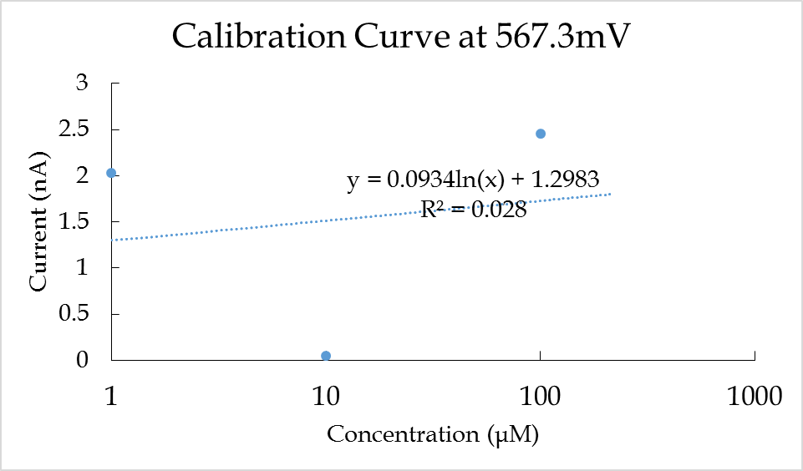
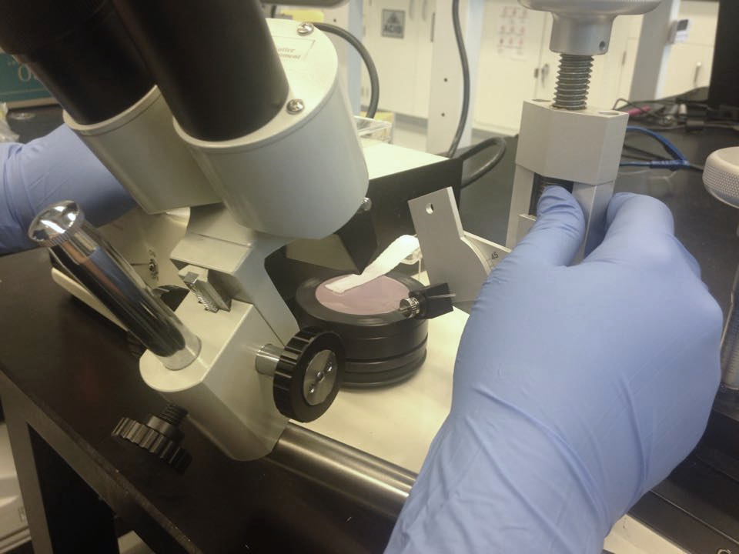
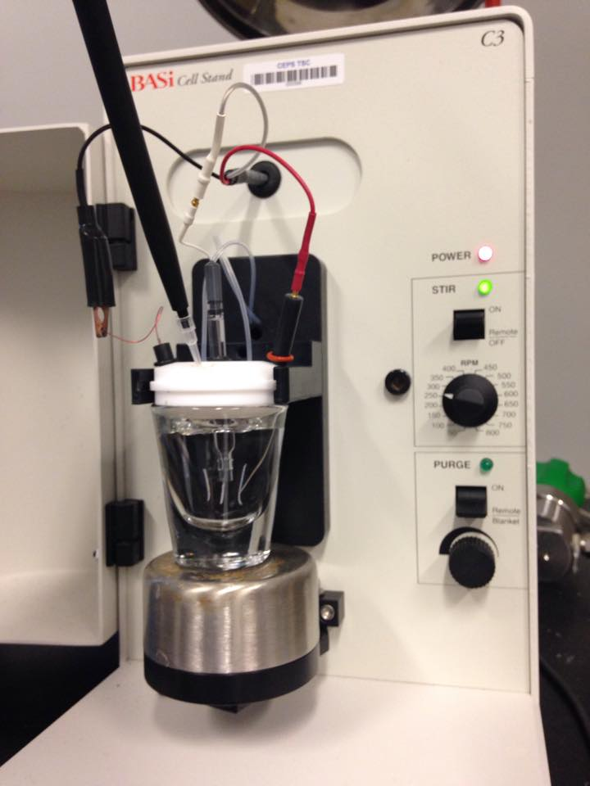
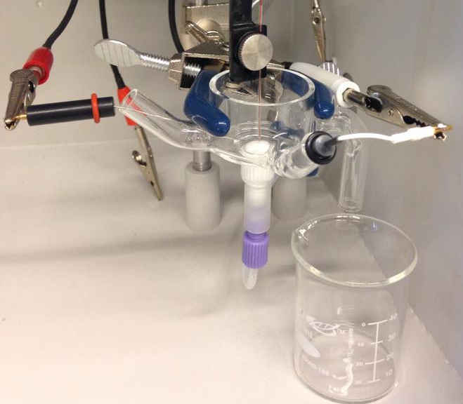
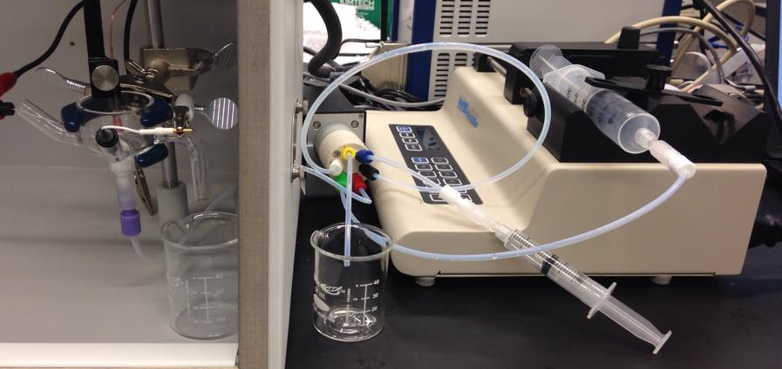

Comparison of Flow Cell vs. Static Cell
Kathryn Rose Verfaillie
Advisor: Dr. Jeffrey Halpern
Flow Cell
Individual samples are made for each concentration
  Scans from low to high concentration in sample loop
Scans PBS, sample, PBS
(ENG) 1132648
Overview of Project
What Was Done
Built a flow cell to be tested with dopamine
Tested dopamine in the flow cell and the C3 static cell
Will the curves from the two cells look the same or different?
Determined advantages and disadvantages of each cell
Benefits of Flow Cell:
Able to go backwards and forwards in the serial dilution
Able to do buffer between each serial dilution
Always refreshing the sample over the electrode
Uses smaller volumes than a static cell (5 mL vs 40 mL)
Static Cell
Dopamine is added to the cell
  Increasing concentration from low to high with micro pipette
Uses stir bar to mix added samples
Voltammetric Analysis Tools
FSCV stands for Fast Scan Cyclic Volatammetry.
  Gamry Potentiostat
  Scan rate of 300 V/s
  Each electrochemically active species creates a signal
Background Subtraction
  Removes noise and PBS to get the pure dopamine curve
How to Make Electrodes
Separate a singular 7 μm diameter carbon fiber
Use suction to draw the fiber into a capillary
Use the puller to make two pointed electrodes
Cut the electrode under the microscope to make a flush tip
Mix Epon Resin 828 and m-phenylenediamine to make epoxy to seal the electrodes
Bevel the electrode to create a flush disc electrode
Flow Cell vs. Static Cell
Pros – flow cell uses smaller volumes
With 4 mL of sample -
  Can run two serial dilutions in less time
  Produces a great amount of data
  Less waste
Cons – first run on the flow cell, still needs to be perfected
Lots more noise in the scan and an odd shape
  Possibly due to moving fluid
The pros of the flow cell over time out weight the cons
Still more work to be done on the cell and its program
2.
3.
6.
Counter
Working
Sample
Counter
Making Electrodes - Photos by Mohamadi, Thompson,
Working
Acknowledgements
This research was supported with funding from the National Science Foundation’s grant to NH EPSCoR (ENG-1101245).
The RETE Program, Steve Hale
UNH, Alexis Mack, Mariah Arral, Garrett Thompson, Elnaz Mohamadi
PSU, Dr Susan Swope, Dr Jeremiah Duncan
Solution
Reference
Buffer
Solution
Sample Loop
Sample
Static Cell Experimental Set Up - Photo by Elnaz Mohamadi
Reference
Flow Cell Experimental Set Up

