Slide 1
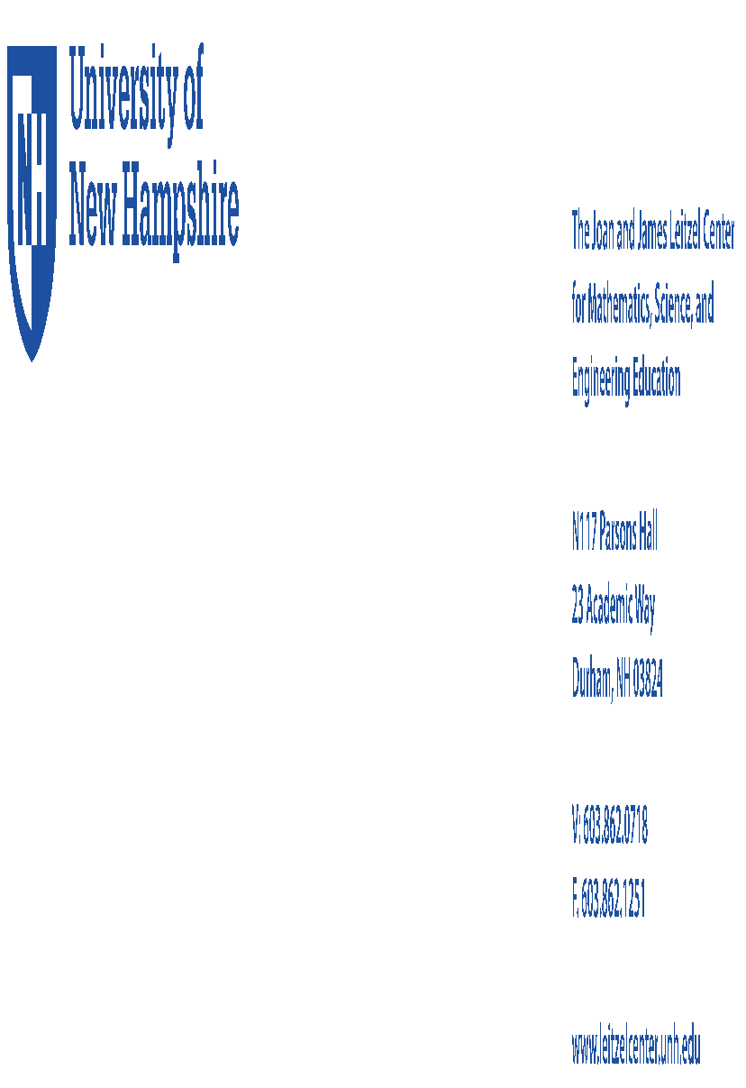

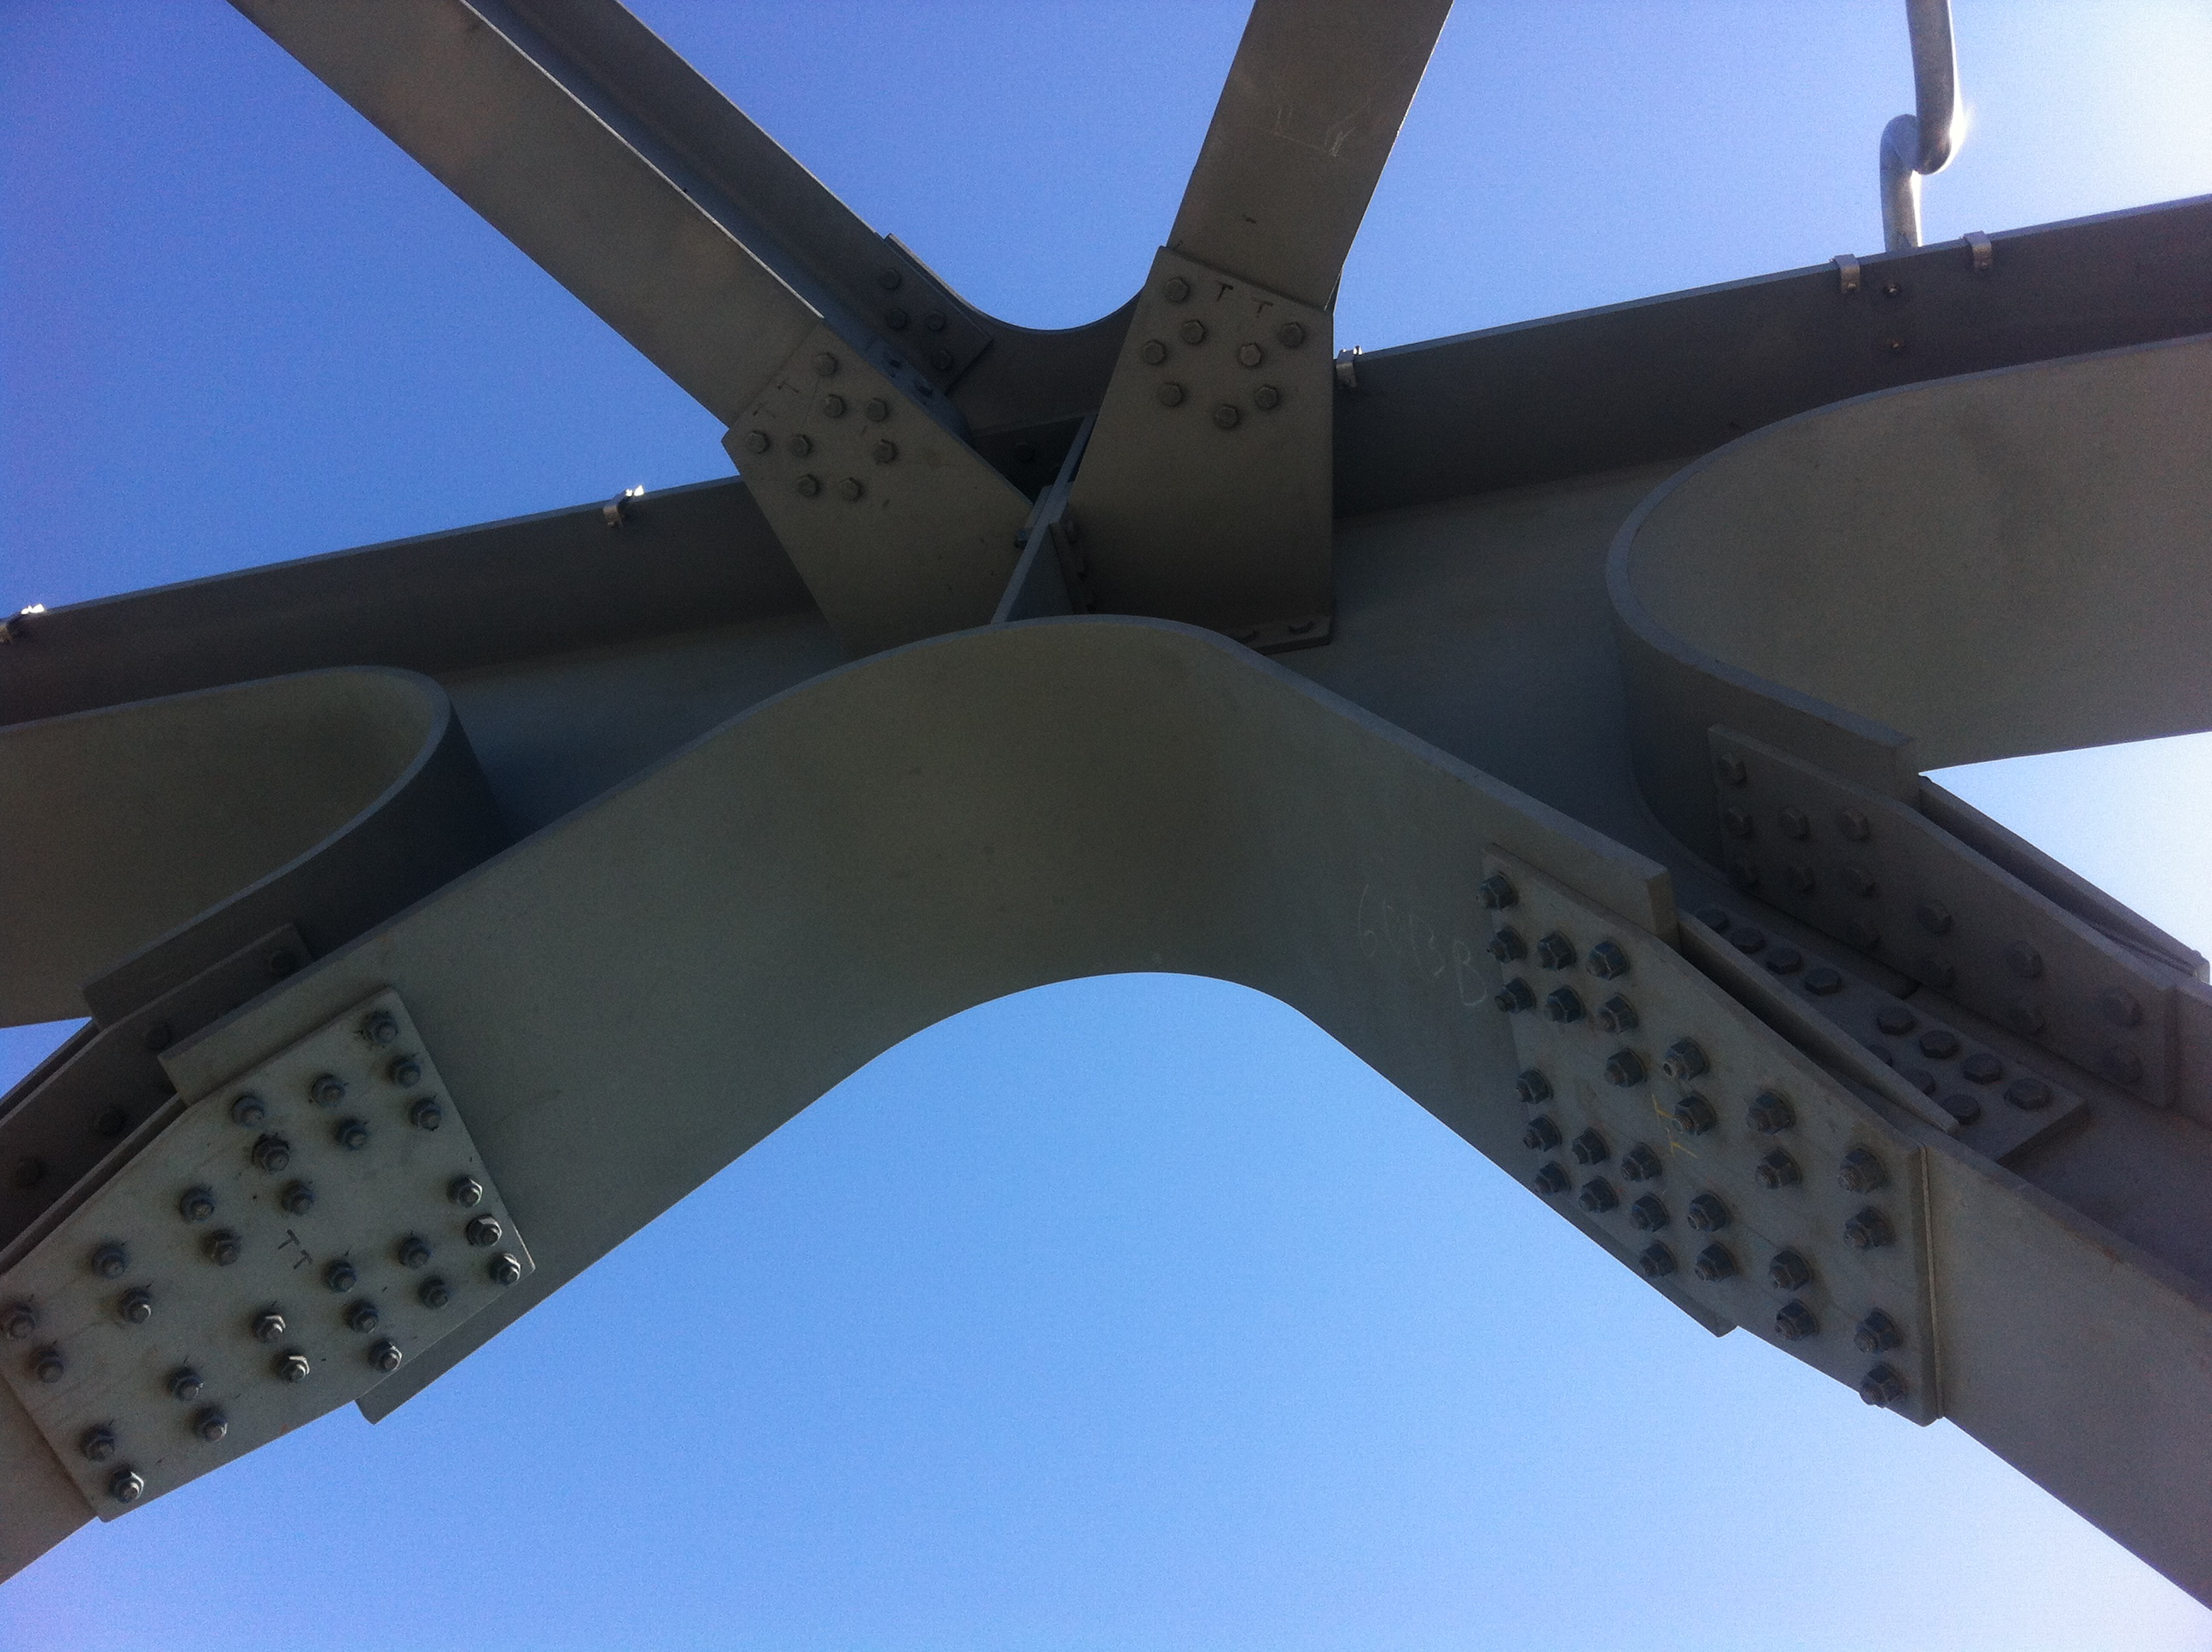
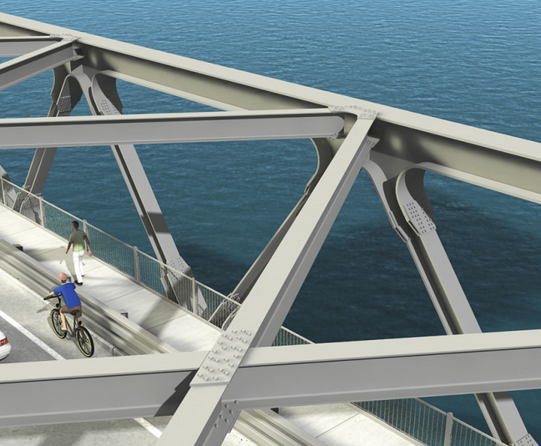
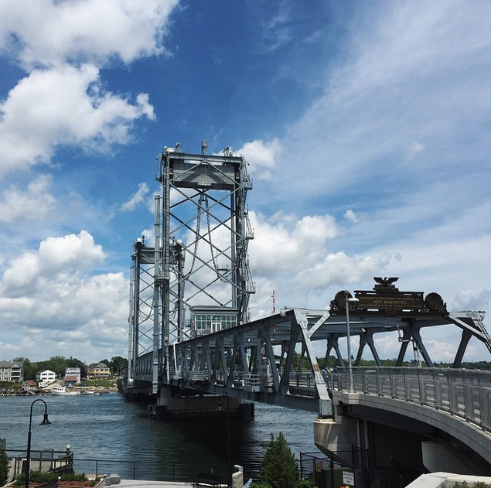
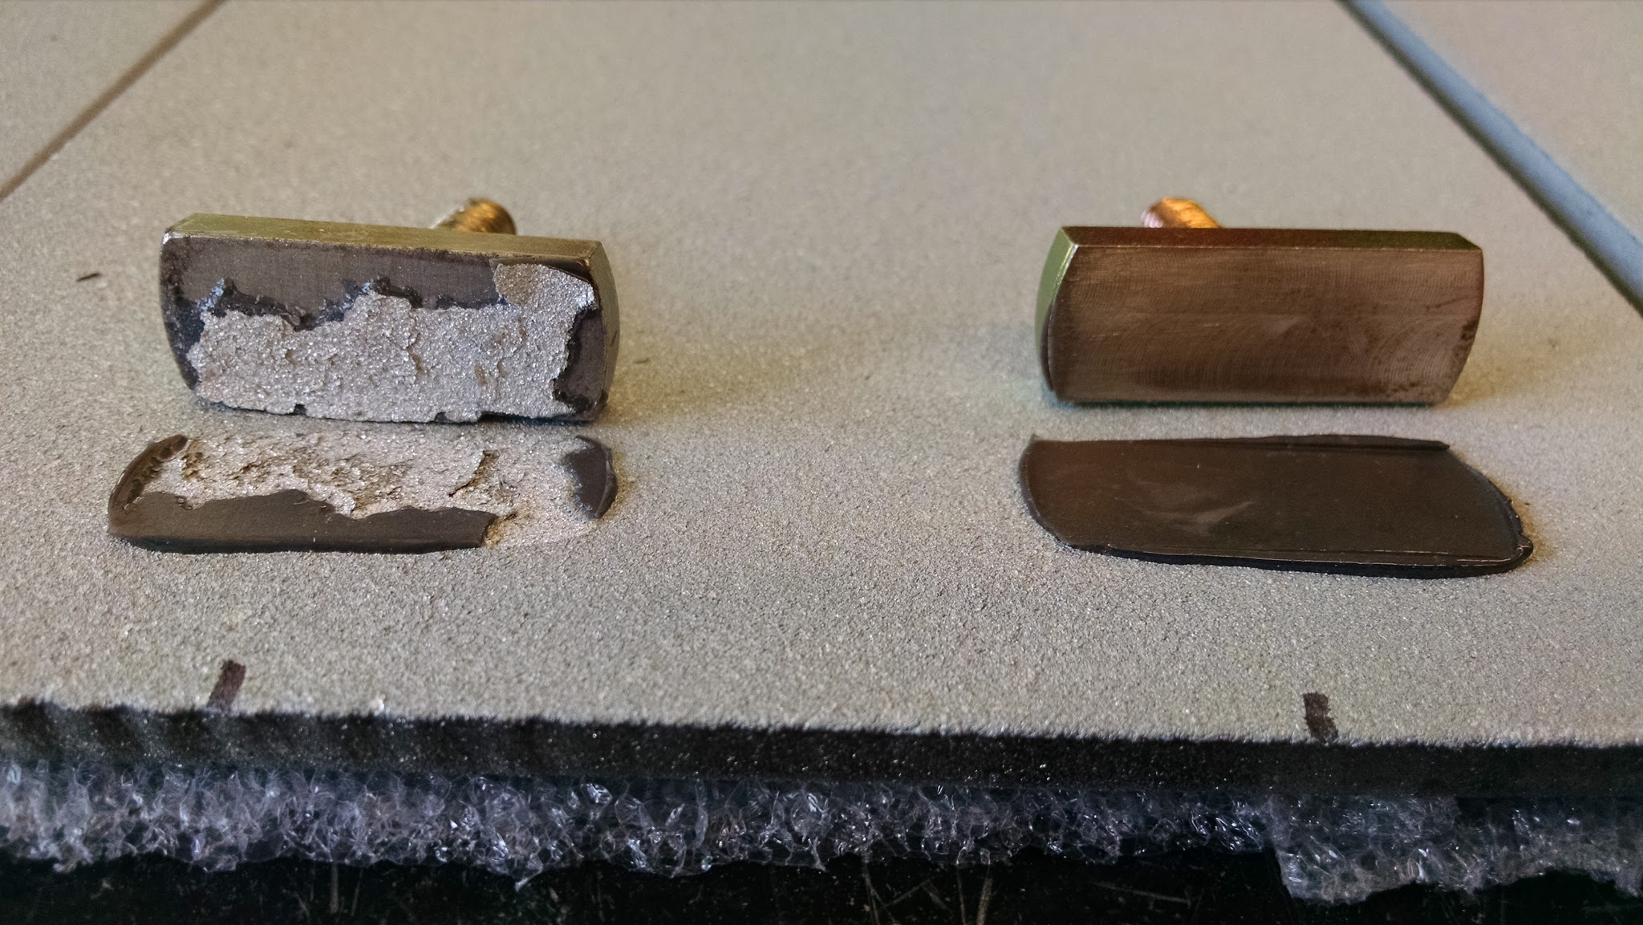
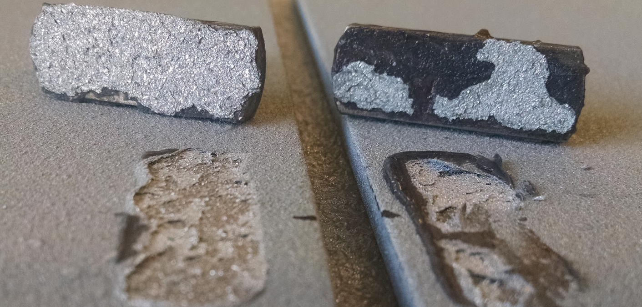
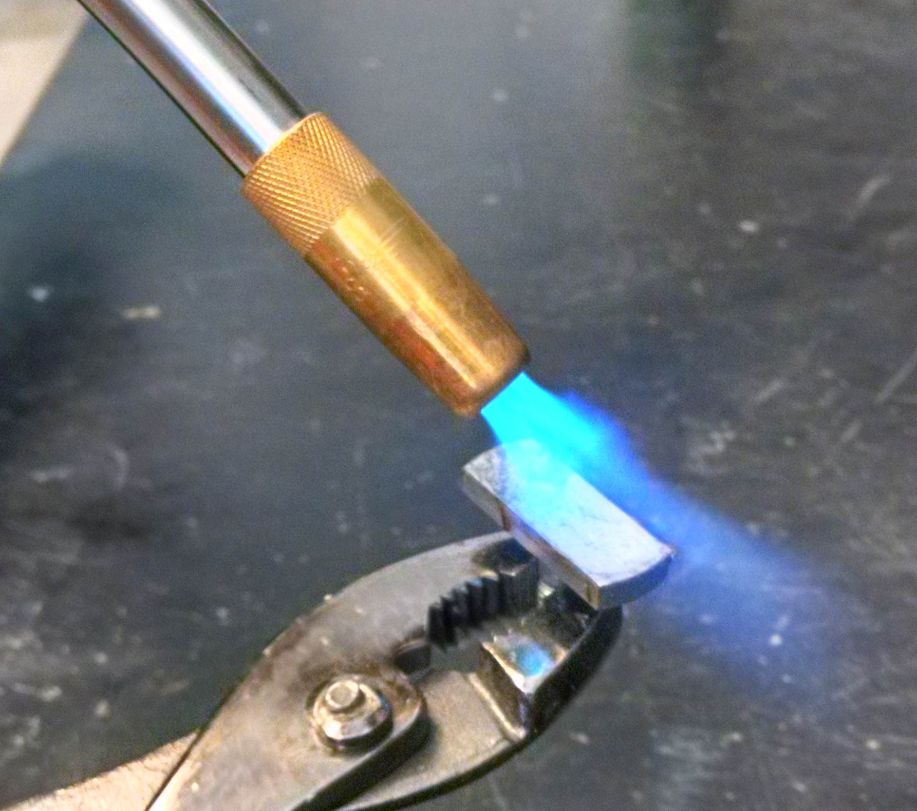
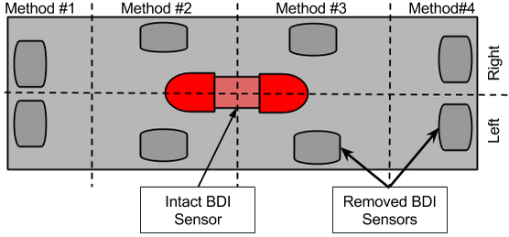
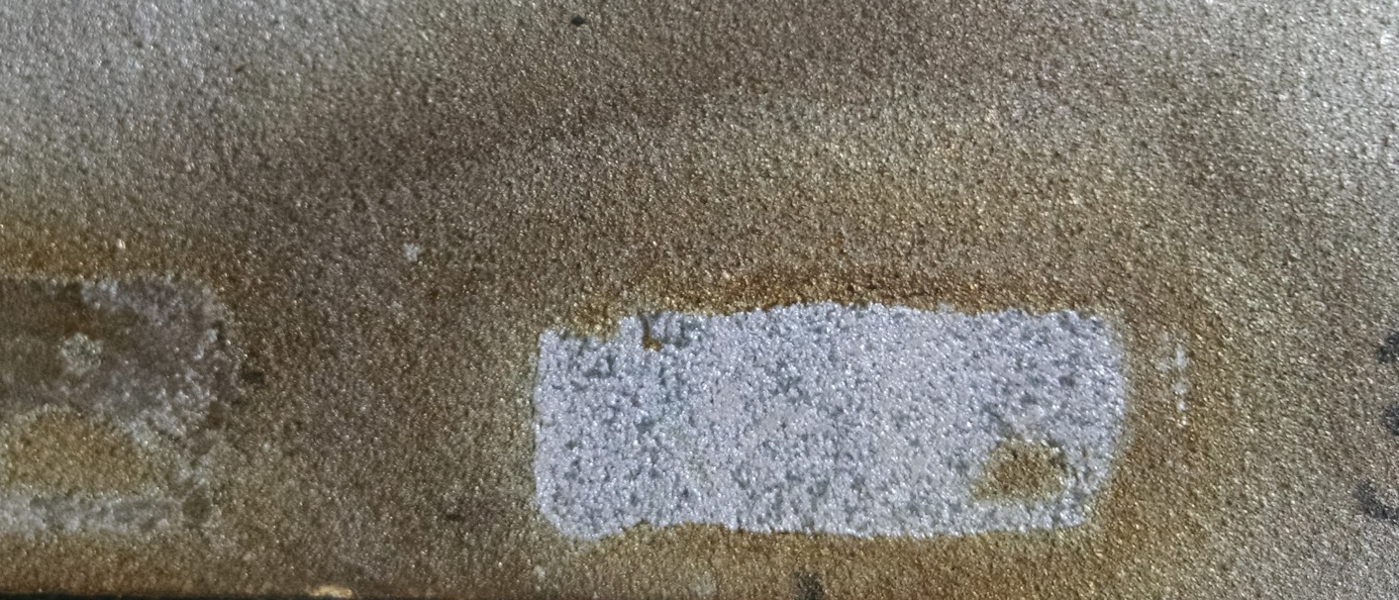
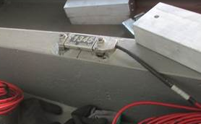
Determining Methods of Removal for Bridge Monitoring Sensors on Portsmouth’s Memorial Bridge
Adrien P. Deshaies, Kimberly R. Forance, Dr. Erin Bell
RETE Participant, Belmont High School, Civil Engineering Department, University of New Hampshire
Introduction
The new Memorial Bridge design utilizes innovative plate girder truss connections to replace gusset plates (Fig 1, Fig 2). This was intended to minimize maintenance needs and extended the service life of the bridge through more efficient stress distribution through the truss joint. Structural health monitoring collects data related to continuous stress/activity for bridge behavior. This information allows designers and managers to if the bridge is functioning as designed. To better understand how the bridge responds to daily activity a series of Bridge Diagnostics Inc. (BDI) Sensors will be installed on the Memorial Bridge as part of the NSF-funded Living Bridge Project.
The Memorial bridge was treated with a corrosion resistant zinc coating in a process known as metalizing to extend the life of the bridge. This coating must remain intact and undamaged to protect the steel beneath. As a result, the BDI Sensors cannot be welded directly to the steel and must be mounted using an epoxy.
Preliminary studies show that removal of the BDI Sensors and epoxy still damages the Metalized Zinc Coating. The goal of this research is to find a removal method that does not damage the protective coating on the bridge.
Table 1: Statistical impact of removal methods on plate thickness (n=24)
Removal Method |  | Thickness Before (Inches) | Thickness After (Inches) | P Value | Max Thickness Difference (Inches) | % of Feet Causing Damaged
1 | Snap Off | 0.2778 | 0.2733 | <0.0001 | 0.015 | 54
2 | Electric Heat Gun | 0.2769 | 0.2750 | <0.001 | 0.006 | 4
3 | Refrigerant Spray | 0.2768 | 0.2711 | <0.0001 | 0.013 | 67
4 | Blow Torch | 0.2774 | 0.2767 | 0.25 | 0.003 | 0*
*Best results were produced when holding the flame horizontally to the surface, heating on the bolt on the BDI Feet. If the flame was held too close to the surface the zinc coating became discolored.
Figure 1: Innovative plate girder truss connections consist of specialized curved welds to eliminate gussets
Figure 2: The plate girder truss connections are used exclusively on all three bridge spans
Results
Discussion
Removal methods #1 and #3 had the greatest impact on the corrosive resistant coating during the removal process. In many instances, removing the BDI feet through these processes also resulted in a removal of the majority of the underlying zinc coating, as observed in figures 3 & 4. This caused a significant decrease in overall plate thickness (P<0.0001) with over 50% of the feet causing visible damage in both types of removals.
Removal methods that involved applications of heat to the BDI feet and Epoxy were not only most effective in removing them from the coated samples, but also caused significantly less damage to the metalized coating itself (Table 1). These methods were most effective when the BDI feet were heated to approximately 150ºC. At this temperature the J-B Weld begins to weaken allowing the BDI feet to be removed from the Epoxy with very little effort, similar to what was observed in Figure 3 to the right.
        Only
Methods:
To assess the impact each removal method had on the corrosive resistant coating, each of the twelve plates were broken down into four zones, one for each removal method. In each zone, the thickness of the plate was measured in two areas. The BDI feet (see Figure 1) were then mounted in the identified areas using J-B Weld epoxy and allowed to cure for eighteen hours. Once cured, the BDI feet were removed by the outlined removal process for that zone. Excess epoxy was removed using a heat and putty knife to allow for the thickness of each area to be measured using a micrometer after the plates had cooled back down to room temperature.
Figure 3: Image highlighting the visual differences between removals of the BDI feet that caused excessive damage to the protective zinc coating (left) and removals that had minimal impact, leaving the zinc coating intact (right).
        Only removal method #4, which utilized a blow torch, caused no significant change in plate thickness (P=0.25). While this method did cause some changes in coloring around the removal location, this was easily preventable by focusing the flame only on the BDI feet while avoiding contact with the plate itself. Removal speed was also much greater in comparison to using the electric heat gun. In general the BDI feet could be removed easily within 10-20 seconds, leaving the epoxy behind.
Conclusion/Summary
In this study, the blow torch used in Method #4 proved to be the most effective tool for removing both the BDI Feet and J-B Weld Epoxy from the coated plates. By causing no significant reduction in plate thickness, the corrosive resistant coating remained intact. It is also likely that the removal of the warm, deformable Epoxy from the plate during this process would cause more damage than leaving the epoxy attached. This method is also the most promising method for application in the field. The equipment needed are easily accessible, access to electricity is not required, and it only requires a single person to be both effective and efficient.
To better understand the long term impacts of these removal processes, the plates are being subjected to further study. Each of the twelve plates are rotating between harsh environments to mimic freeze thaw cycles as well as a corrosion promoting salt environment. The needs of all stakeholders will be met as long as the removal sites on the plates remain corrosion free and the BDI Feet intact allowing for accurate strain and accelerations to be measured over time.
Method #1: Snap Off
BDI feet were snapped off using pliers at room temperature (21ºC).
Method #2: Electric Heat Gun
BDI feet were heated using a heat gun
The feet were then snapped off using pliers
Method #3: Refrigerant Spray
CRC Freeze Spray was used to rapidly cool the mounted BDI feet
The BDI feet were then snapped off using pliers.
Method#4: Blow Torch
BDI feet were heated for 10-20 seconds up to approximately 150ºC.
The feet here then snapped off, leaving behind the epoxy.
The epoxy was then further heated using the blowtorch and removed with a putty knife.
Figure 4: Image depicting damage that resulted from removal Method #3 which utilized a refrigerant spray to rapidly cool the feet, where significant amounts of the zinc coating were also removed.
Literature Cited
ASTM Int'l. (2008). Standard Test Method for Evaluation of Painted or Coated Specimens Subjected to Corrosive Environments. ASTM Int'l.
Lévesque, & Ampleman. (2015, April 16). Metallizing: A Choice Solution for Corrosion Protection of Steel. Retrieved from Canam Bridges: http://blog.canambridges.com/metallizing-a-choice-solution-for-corrosion-protection-of-steel/
Structural Monitoring & Load Testing Systems. (2015). Retrieved from Bridge Diagnostics Inc.: http://bridgetest.com/
Figure 5: Area on a plate resulting from removal Method #4 using a blow torch. This method visually appeared to leave the zinc coating intact; however, if used too aggressively it discolored the plates.
Acknowledgements – This research was supported with funding from the National Science Foundation’s grant ENG-1132648
Notes:
1

