Slide 1

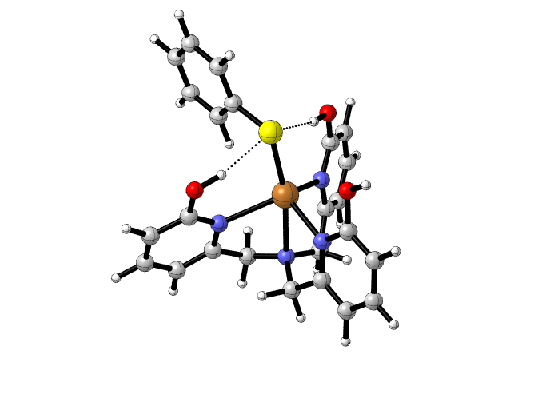
Stabilizing Transition-Metal-Alkylthiolate Bonds via Secondary Sphere Hydrogen Bonding
Ryan L. Hall and Samuel Pazicni. Department of Chemistry, University of New Hampshire.
Introduction
Arylthiolate Binding
Future Work
Via a three-step synthesis, the ligand H₃thpa can be obtained (Fig. 2, 3, 4). H₃thpa, when bound to a metal, adopts a structure that provides a framework for intramolecular hydrogen bonding. This hydrogen bonding capability has been shown to regulate the bond strength between a bound copper and a halide¹. There are numerous known metalloproteins that contain a metal-sulfur bond ^{2,3}. This research aims to evaluate the hydrogen bonding impact on metal-sulfur bonds to gain a fundamental understanding of the regulatory function of hydrogen bonding in metal-sulfur containing metalloproteins.
During complexation with a metal, H₃thpa undergoes tautomerization to give a structure with three hydrogen bonding donors situated above an open coordination site. Attempted alkylthiolate complexation in this cavity resulted in the previously reported copper fluoride complex (Fig. 5). Fluoride abstraction from BF₄⁻ has been shown to occur in protic solvents⁴. Aprotic solvents are therefore being employed to circumvent this issue. Figure 6 shows a possible synthetic route to CuSPh(H₃thpa)BF₄.
Binding alkylthiols to copper, nickel, and iron H₃thpa complexes.
Investigating possible fluoride abstraction from BF₄⁻ in aprotic solvents arising from hydroxyl pendants on H₃thpa.
Synthesis of tpa complexes (e.g. 8) to study the impact of hydrogen bonding on the metal-sulfur bond with specific regard to bond length and redox potential.
5
Figure 5: Reaction of H₃thpa with copper (II) and NaSPh in NaBF₄ to give CuF(H₃thpa)BF₄ 6 instead of the desired CuSPh(H₃thpa)BF₄ 5
vs
4
5
8
Figure 1: H₃thpa in its 2-hydroxypyridine tautomer.
Figure 7: CuSPh(tpa)⁺ as a model complex for assessing the impact of hydrogen bonding on stabilizing a thiolate donor.
Ligand Synthesis
6
Summary and Conclusions
Figure 6: Proposed reaction of H₃thpa with copper (II) and NaSPh with NaBF₄ to give CuSPh(H₃thpa)BF₄ 5
The previously reported CuF(H₃thpa)BF₄ complex was synthesized and verified via single crystal X-ray diffraction. Fluoride was abstracted from the counter ion BF₄⁻ . This differs from the reported synthesis where CsF is used as the fluoride source¹.
DFT Calculations predict elongated bonds in the proposed CuSPh(H₃thpa)⁺ structure in comparison to CuCl(H₃thpa)⁺ (Table 1). One hydroxyl arm has its proton oriented away from the bound sulfur, meaning sulfur is stabilized by two hydrogen bond donors vs. the expected three.
4
5
1
2
DFT Calculations of CuSPh(H₃thpa)
Figure 2: Wohl-Ziegler bromination of 1 to afford 2-bromomethyl-6-methoxypyridine 2.
400 MHz ¹H NMR (CDCl₃): 7.54 (1H, dd, Ar-H), 6.98 (1H, d, Ar-H), 6.65 (1H, d, Ar-H), 4.45 (2H, s, CH₂), 3.94 (3H, s, OCH₃). Percent Yield: 65%
The CuSPh(H₃thpa)⁺ structure was modeled using B3LYP/TZVP basis set. The resulting structure and relevant bond lengths are shown in Figure 7 and Table 1. The experimental bond lengths of the Cu–Cl complex are shorter than what is calculated using B3LYP/TZVP. Similar results are expected for the experimental bond lengths of the CuSPh(H₃thpa)⁺ complex.
Acknowledgements
2
3
S
Kyle Rodriguez
Christian Tooley
SURF USA Grant: UNH Hamel
Center
University Instrumentation
Center of UNH
Norris-Richards Undergraduate
Research Scholarship: ‘’’’’Northeast Section ACS
Travel & Presentation Grant: UNH Hamel Center
Jon Briggs
Figure 3: Condensation of three units of 2 to afford tpa^{OMe} 3
400 MHz ¹H NMR (CDCl₃): 7.53 (3H, t, Ar-H), 7.23 (3H, d, Ar-H), 6.59 (3H, d, Ar-H), 3.92 (9H, s, OCH₃), 3.83 (6H, s, CH₂). Percent Yield: 47%
Cu
N3
Figure 7: DFT structure of CuSPh(H₃thpa)⁺ 5 and sketch of previously reported CuCl(H₃thpa)⁺ 7
N2
N1
N4
5
7
Bond | Calculated Bond Lengths of 5 (Å) | Calculated Bond Lengths of 7 (Å) ¹ | Actual Bond Lengths of 7 (Å) ¹
N1 (ax) - Cu | 2.51 | 2.038 | 1.990
N2 (eq) - Cu | 2.38 | 2.178 (avg.) | 2.103 (avg.)
N3 (eq) - Cu | 2.30 | 2.178 (avg.) | 2.103 (avg.)
N4 (eq) - Cu | 2.19 | 2.178 (avg.) | 2.103 (avg.)
S – Cu (5) Cl – Cu (7) | 2.36 | 2.338 | 2.263
References
3
Moore, C.; Szymczak, N. Chem. Commun., 2015, 51, 5490- 5492.
Beinert, H. J. Biol. Inorg. Chem., 2005, 5 (1), 2-15.
3. Holm, R.; Kennepohl, P.; Solomon, E. Chem. Rev. 1996, 96, 2239-2314.
4. Kannan, S..; Moody, M.; Barnes, C.; Duval, P. Inorg. Chem., 2006, 45 (23), 9206-9212.
4
Figure 4: Demethylation in triplicate of 3 to afford pyridone tautomer of H₃thpa 4
400 MHz ¹H NMR (DMSO-d₆): 11.85 (3H, s, NH), 7.35 (3H, dd, Ar-H), 6.22 (3H, d, Ar-H), 6.13 (3H, d, Ar-H), 3.40 (6H, s, CH₂). Percent Yield: 28%
Table 1: bond lengths for the corresponding structures 5 and 7.

