Slide 1

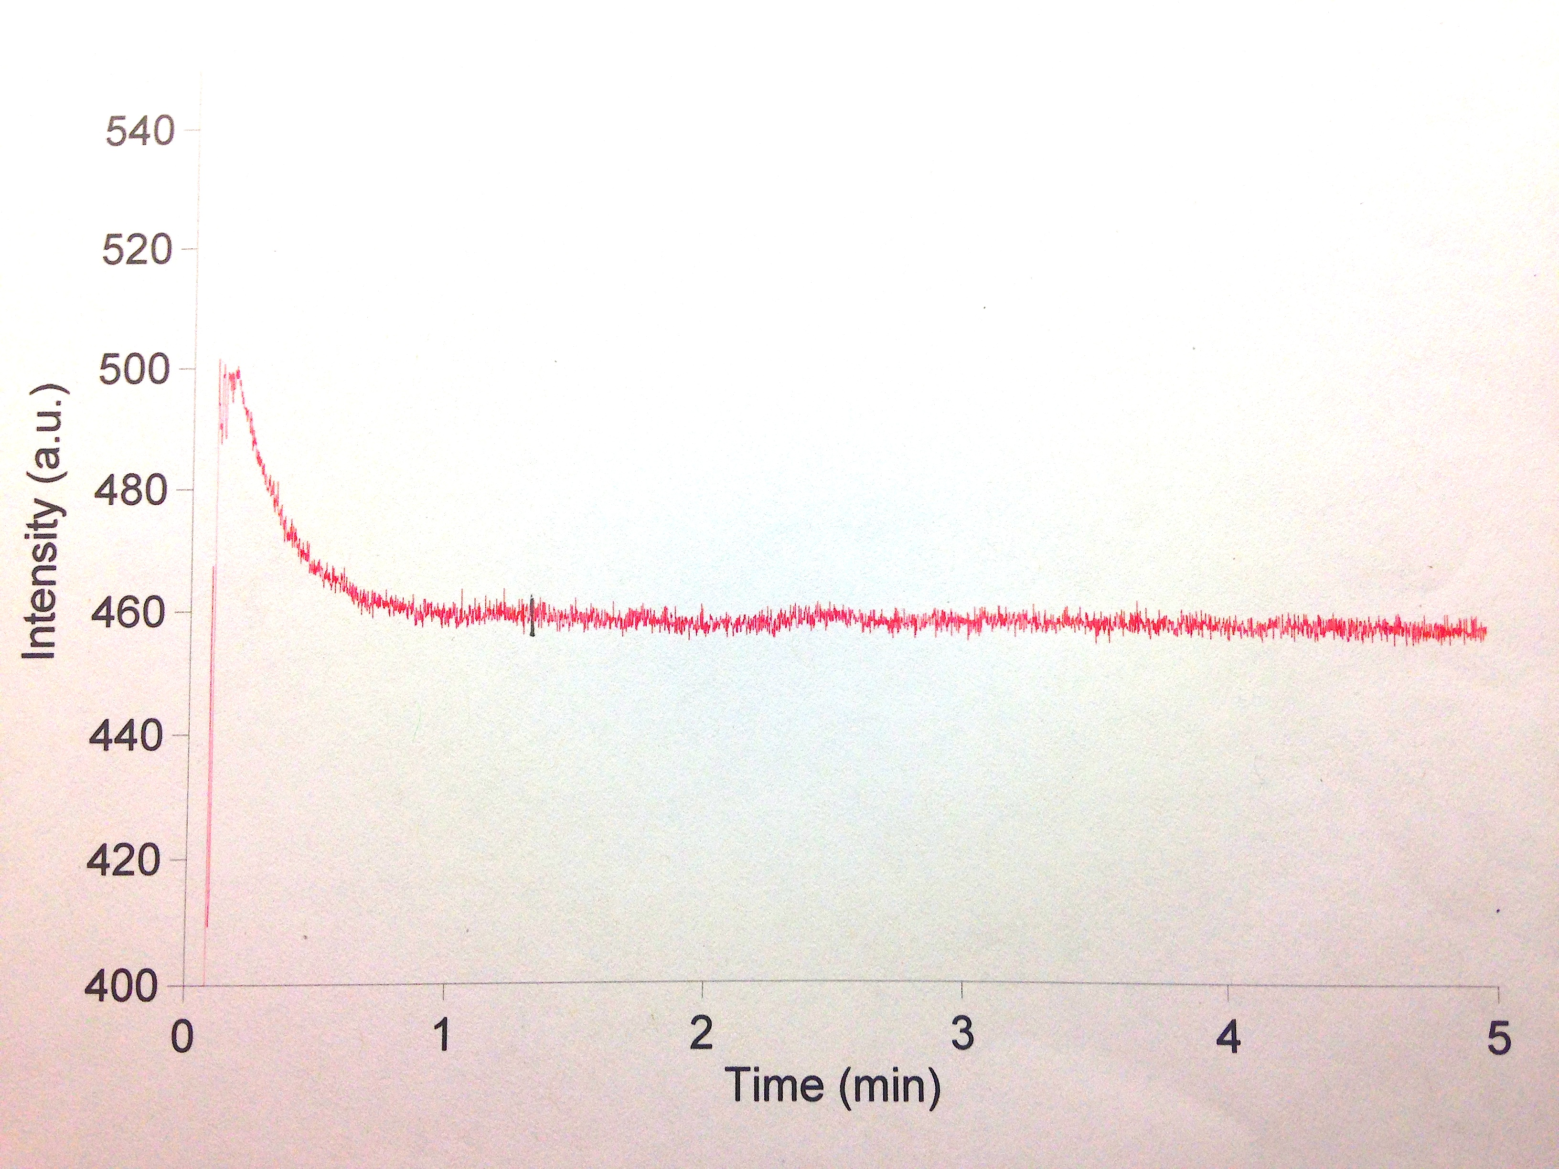
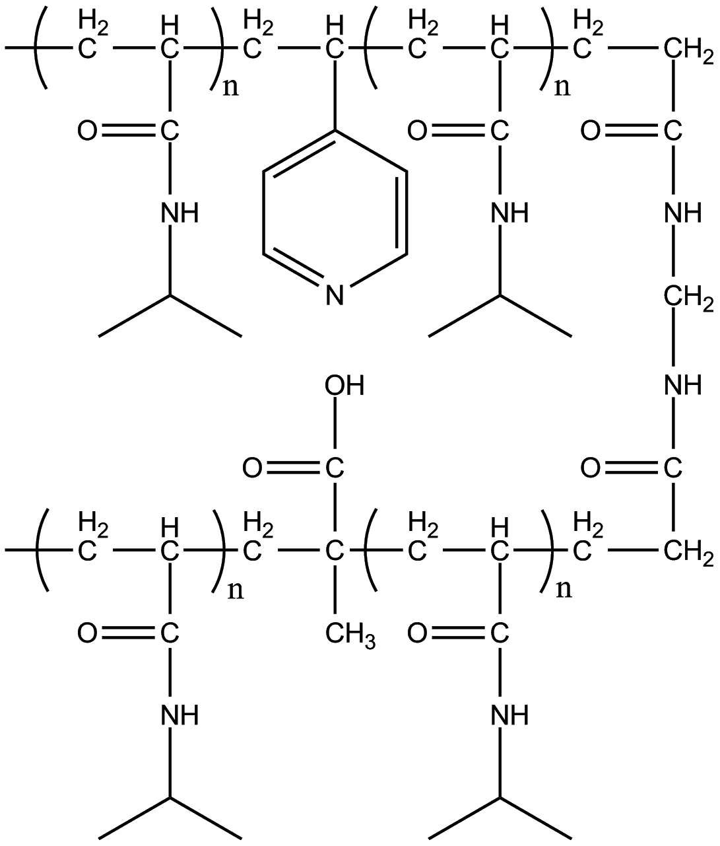
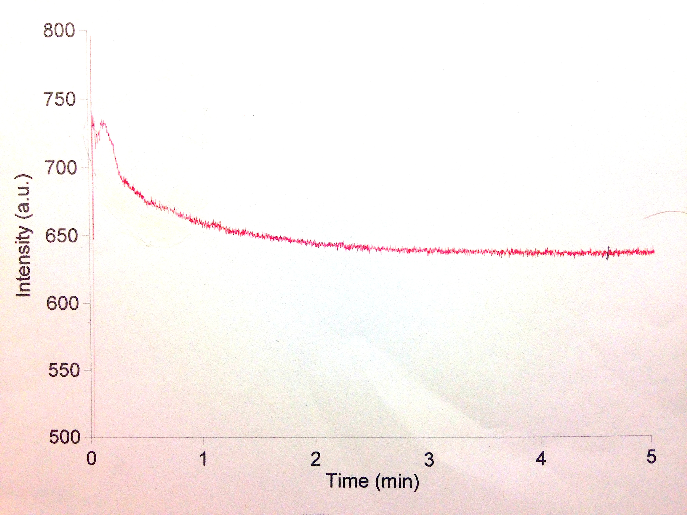
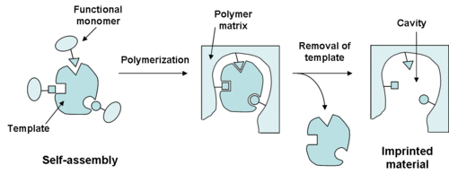
Templated Non-Covalently Crosslinked N-Isopropylacrylamide Copolymers for Ink Jet Printing
Anthony Timberman, Casey Grenier, Rongfang Yang, Leila F. Deravi, and W. Rudolf Seitz
University of New Hampshire, Chemistry Department, Durham, NH 03824
Introduction
Methods
Summary
Non-covalently cross-linked molecularly imprinted copolymers were prepared to recognize aqueous fluorescein.
Prepared using free radical polymerization in 1,4-dioxane with poly(NIPAm) as backbone.
4-vinylpyridine used as recognition monomer
Methylene-bisacrylamide used as covalent cross-link
Methacrylic acid used to create non-covalent crosslinks with excess 4-vinylpyridine.
Equilibrium Dialysis used to show high binding affinity for aqueous fluorescein.
Non-Templated versions of same polymer showed less affinity.
Polymer Composition
• N-isopropylacrylamide – Co-monomer (backbone)
• 4-Vinylpryidine – Functional Monomer (9 mole %) and Base Monomer
• Methacrylic Acid - Acid Monomer (5 mole %)
• Fluorescein – Template Molecule (1 to 4 with Functional Monomer %)
• Methylene-bisacrylamide – Covalent Crosslinker (2 mole %)
• Azobisisobutyronitrile (AIBN) – Initiator 2% (w/w)
• 1,4-Dioxane - Polymerization Solvent
• Solutions polymerized thermally as a free radical polymerization at 70°C for at least 16 hours after Freeze-Pump-Thawing three times.
Kinetics Studies
Molecularly imprinted copolymer solutions show strong affinity for binding aqueous fluorescein.
Distribution coefficients much higher for templated solutions, showing binding tied to molecular imprinting of template.
Higher binding affinity above LCST of copolymer backbone.
Molecule binds quickly (<2 min) at room temperature and above LCST (<5 min).
Strong affinity for template coupled with quick binding times make this formulation and ideal candidate for inkjet printing to make small sensors.
While stirring, a solution of copolymer was added to a template solution.
This tests how quickly the copolymer binds the template.
Blanks of water added to template were also run to show that the drop in relative intensity was due to binding of the template molecule.
Template Molecule Removal
Template removal through dialysis.
1st Solution: 75% Methanol and 25% Water to remove unreacted monomer.
2nd Solution: 75% acidified Water and 25% Methanol to remove template.
Future Work
Investigate selectivity of current formulation with a comparison copolymer templated with a similar molecule.
Begin to inkjet print the polymer onto paper and glass to utilize as an in field testing method.
Equilibrium Dialysis
Polymer and template molecule are dissolved in water.
Placed in separate sides of equilibrium dialysis block.
Separated by a 3,500 MWCO dialysis sheet.
Allowed to equilibrate for 12 to 24 hours.
Experiment performed at both room temperature and 50°C (Above LCST).
References
Fig. 1. General structure of our molecularly imprinted polymer.
Hien Nguyen, T.; Ansell, R. J., N-isopropylacrylamide as a functional monomer for noncovalent molecular imprinting. Journal of Molecular Recognition 2012, 25 (1), 1-10
Bajpai, A. K.; Bajpai, J.; Saini, R.; Gupta, R., Responsive Polymers in Biology and Technology. Polymer Reviews 2011, 51 (1), 53-97.
Ahmed, Z.; Gooding, E. A.; Pimenov, K. V.; Wang, L.; Asher, S. A., UV Resonance Raman Determination of Molecular Mechanism of Poly(N-Isopropylacrylamide) Volume Phase Transition. The Journal of Physical Chemistry. B 2009, 113 (13), 4248-4256.
Masqué, N.; Marcé, R. M.; Borrull, F.; Cormack, P. A. G.; Sherrington, D. C., Synthesis and Evaluation of a Molecularly Imprinted Polymer for Selective On-Line Solid-Phase Extraction of 4-Nitrophenol from Environmental Water. Analytical Chemistry 2000, 72 (17), 4122-4126.
Vandevelde, F.; Leichle, T.; Ayela, C.; Bergaud, C.; Nicu, L.; Haupt, K., Direct Patterning of Molecularly Imprinted Microdot Arrays for Sensors and Biochips. Langmuir 2007, 23, 6490-6493
Goal
Fig. 3. Templated formula at RT (Top Trace) and templated formula at 50°C (Bottom Trace).
To synthesize a flexible molecularly imprinted polymer with non-covalent and acid-base crosslinks that is capable of rapid detection of templated polar organic compounds that is also amenable to inkjet printing.
Results
Polymer | In the Presence of | Molarity | Concentration After Equilibrium Dialysis (nM) | Concentration in Polymer Solution (nM) | Distribution Coefficient
Templated Formula at RT (w/ 2 mole % 2-AMIPA and 3-MAPTA added) | Aqueous Fluorescein | 1000 nM | 189.6 | 619.2 | 3.27
Non-Templated Formula at RT (w/ 2 mole % 2-AMIPA and 3-MAPTA added) | Aqueous Fluorescein | 1000 nM | 450.2 | 99.0 | 0.22
Templated Formula at 50°C (w/ 2 mole % 2-AMIPA and 3-MAPTA added) | Aqueous Fluorescein | 1000 nM | 115.9 | 768.4 | 6.63
Non-Templated Formula at 50°C (w/ 2 mole % 2-AMIPA and 3-MAPTA added) | Aqueous Fluorescein | 1000 nM | 446.7 | 107.2 | 0.24
Templated Formula at RT | Aqueous Fluorescein | 1000 nM | 223.0 | 553.0 | 2.48
Non-Templated Formula at RT | Aqueous Fluorescein | 1000 nM | 405.3 | 190.5 | 0.47
Templated Formula at 50°C | Aqueous Fluorescein | 1000 nM | 75.2 | 849.8 | 11.30
Non-Templated Formula at 50°C | Aqueous Fluorescein | 1000 nM | 335.6 | 328.9 | 0.98
Approach
Use Poly-(N-isopropylacrylamide, poly(NIPAm) as polymer backbone.
Poly(NIPAm) soluble in water at temperatures <32°C and undergoes phase change at temperatures >32°C
Phase transition due to amide bonds in NIPAm favoring hydrogen bonding at lower temperatures.
Can use phase transition to our benefit to encourage tighter binding of templated molecules.
Polymerize in presence of template molecule to create molecule specific binding site.
Remove template via dialysis.
Allow template molecule to re-bind with site thus sensing its presence
Test binding using equilibrium dialysis and fluorescence emission.
Acknowledgements and Contact Information
Partial support for this research was provided by NSF grant 1012897 and the UNH Chemistry Department.
Anthony David Timberman
Analytical Chemistry Ph.D Student
University of New Hampshire
Email: adt2002@wildcats.unh.edu
Phone: (302) 632-9875
Concentrations determined by analyzing the template side of the dialysis block using fluorescence emission. Excitation was at 480 nm and a scan was done from 490 to 600 nm. Peak fluorescence was seen at 514 nm.
Distribution coefficients were calculated by dividing molarity of bound fluorescein by the molarity of free fluorescein.
Emission of a blank at RT and 50° (water on one side, aqueous fluorescein on the other) was used to convert relative intensities to a nM value (Assumed that each side of block had 500 nM fluorescein after equilibrium)
Fig. 2. Generalized molecular imprinting process as seen as a “lock and key” type mechanism.
Notes:
An additional 5 mole % of 4-vinylpryidine should be added to ensure there is no competing between template and acid monomer, this the percentage used as the functional monomer.
Removing the template molecule is done through dialysis. Dialysis solutions: 75% methanol and 25% water to remove unreacted monomers and small chain polymers and 75% acidified water (1ml of glacial acetic acid to 500ml water) and 25% methanol to remove template molecule.

