Slide 1

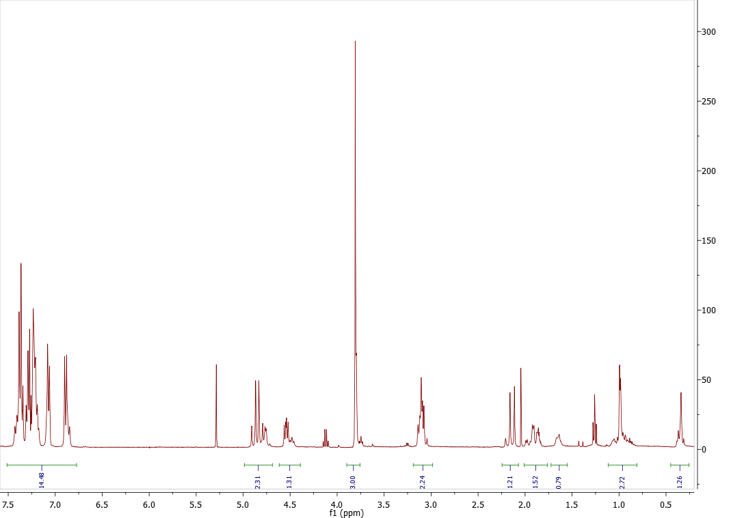
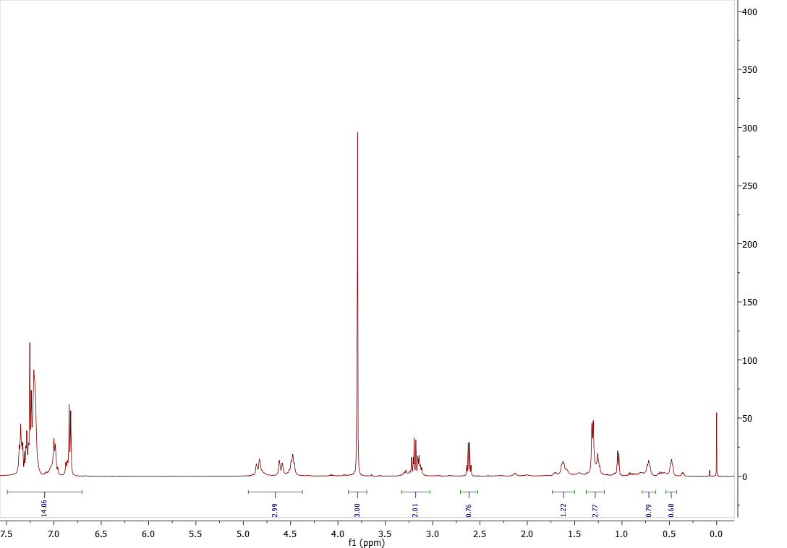
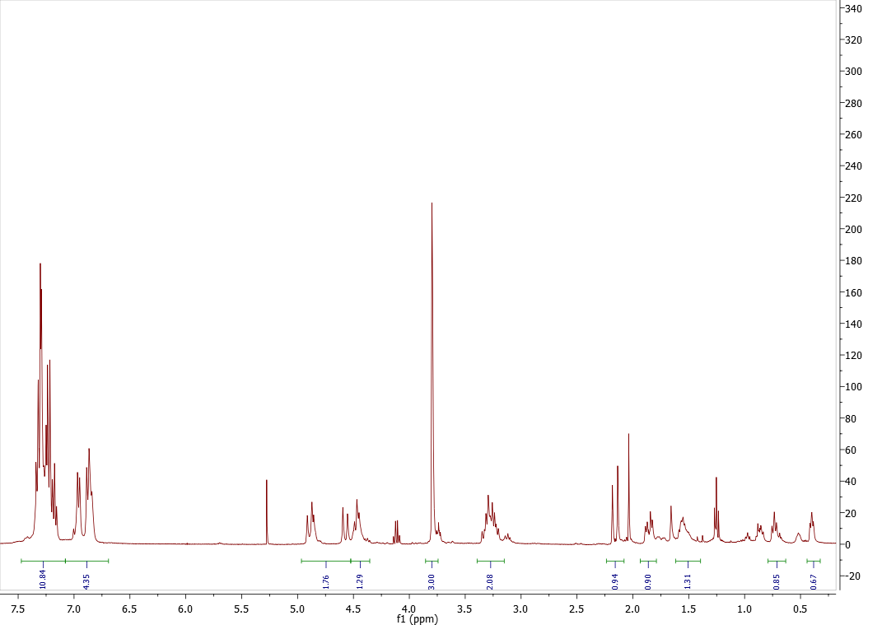
Synthesis of the Phenylalanine Derived Lactones Using a Zinc Mediated HCRL Reaction
Rekha K. Chhetri, Charles K. Zercher
Department of Chemistry, University of New Hampshire, NH
Abstract
The zinc-mediated homologation developed in the Zercher group has been applied to the formation of peptide isosteres¹. The zinc carbenoid-based methodology has been developed further to modify amino acid residues into bicyclic cyclopropyl-lactones, which are synthetic precursors to a novel class of peptide isosteres referred to as hydroxycyclopropane isosteres. Current research involves manipulation of phenylalanine to form the bicyclic lactones using zinc carbenoid-mediated reaction which can be further derivatized at the carbon adjacent to the cyclopropyl moiety and then opened with amines to provide access to the hydroxycyclopropane isostere. α-Functionalization of these lactones can provide access to a wide variety of peptide isostere side chains.
Introduction
Formation of bicyclic lactones derived from various amino acid has been succeeded in good yields. Proline derived imides are found to provide lactones with a variety of protecting groups.
The zinc carbenoid-mediated reaction is a one-pot homologation reaction which converts β-keto imides, amides, esters, phosphonates to their homologated products. ¹ The mechanism proposed is supported experimentally and computationally. ²
Mixed Claisen Route to β-Keto Imide
Alkylation of Lactones
The diprotected phenylalanine was converted to β-keto imide using mixed claisen reaction. The derivatized phenylalanine was subjected to zinc carbenoid-mediated HCRL reaction to obtain diastereomeric lactones.
Alkylation of the diastereomeric lactones were attempted to obtain the α-alkylated lactone from the major diastereomer. One of the major diastereomer was separated and analysed by NMR experiments like DEPT and NOESY.
Formation of bicyclic lactones
Formation of lactones during the chain extension reaction of β-keto imide has been observed by Taschner in Zercher group. ³
Future Work
Alkylation of the two diasteromeric lactones
To probe the diastereoselectivity of HCRL reaction and determine the stereochemistry of the α-alkylated lactones.
Reactive intermediates can be trapped with TMSCl to obtain the cyclopropanols which on deprotection provide the lactones. Formation of lactone requires cyclopropanoxide rearrangement and intramolecular acylation using the imide carbonyl. Hence the reaction is named Homologation cyclopropanation rearrangement lactonization (HCRL).
Acknowledgment
We are grateful for the generous support of NIH NIGMS R15 GM060967-03 and Robert E. and Gloria F. Lyle Professorship
References
1.Brogan, J. B; Zercher, C. K. J. Org. Chem. 1997, 62, 6444-6446
2.Eger, W. A.; Zercher, C. K. Williams, C. M. J. Org. Chem. 2010, 75, 7322-7331
3.Taschner, I. S. Ph.D.Thesis, University of New Hampshire, 2011

