Slide 1


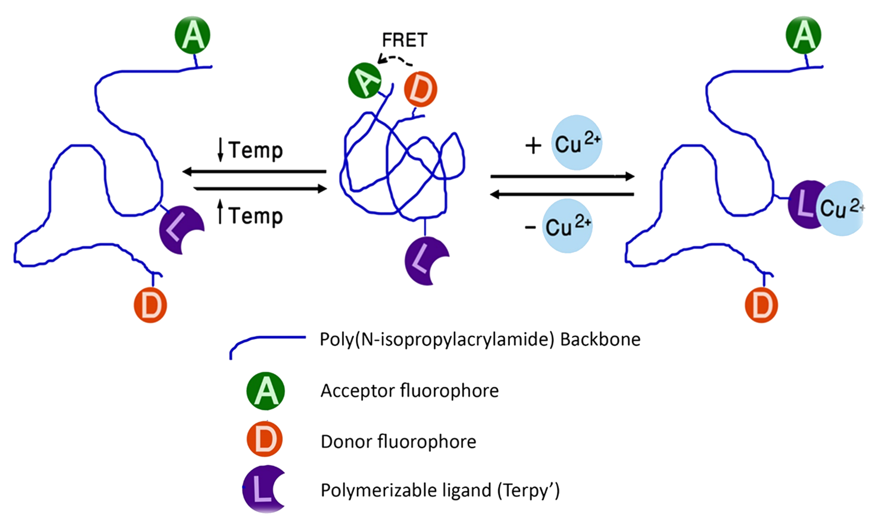
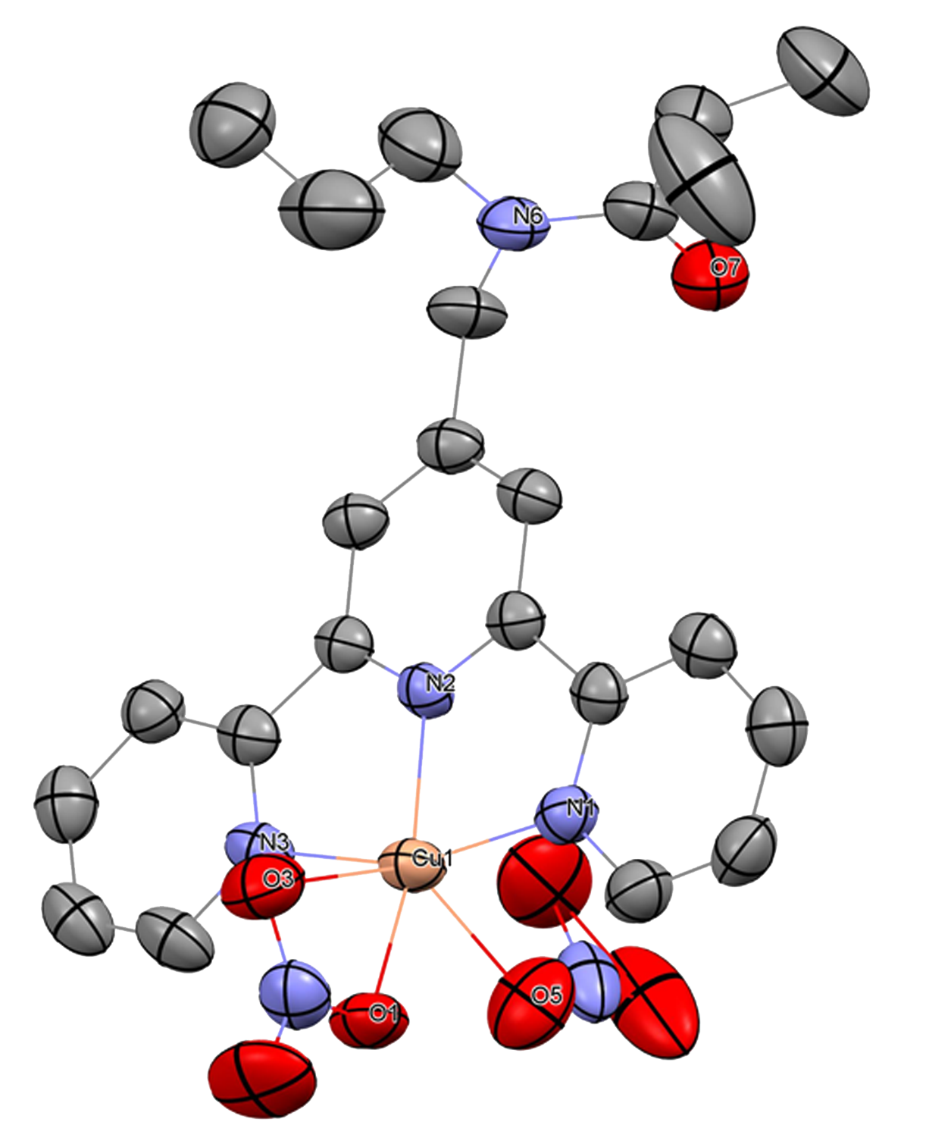
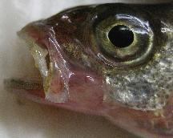
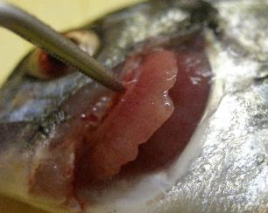
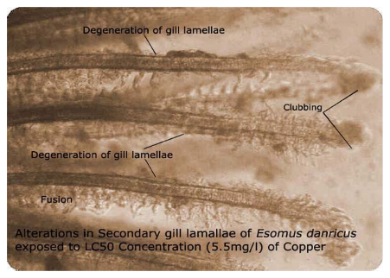
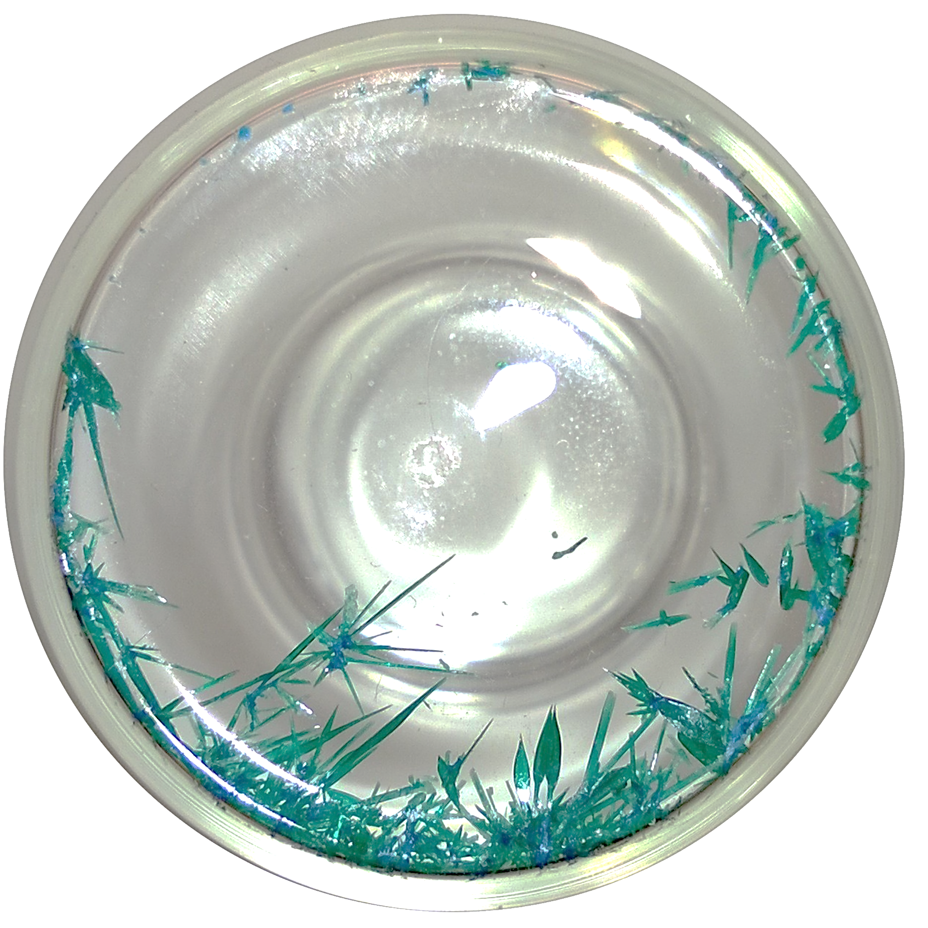
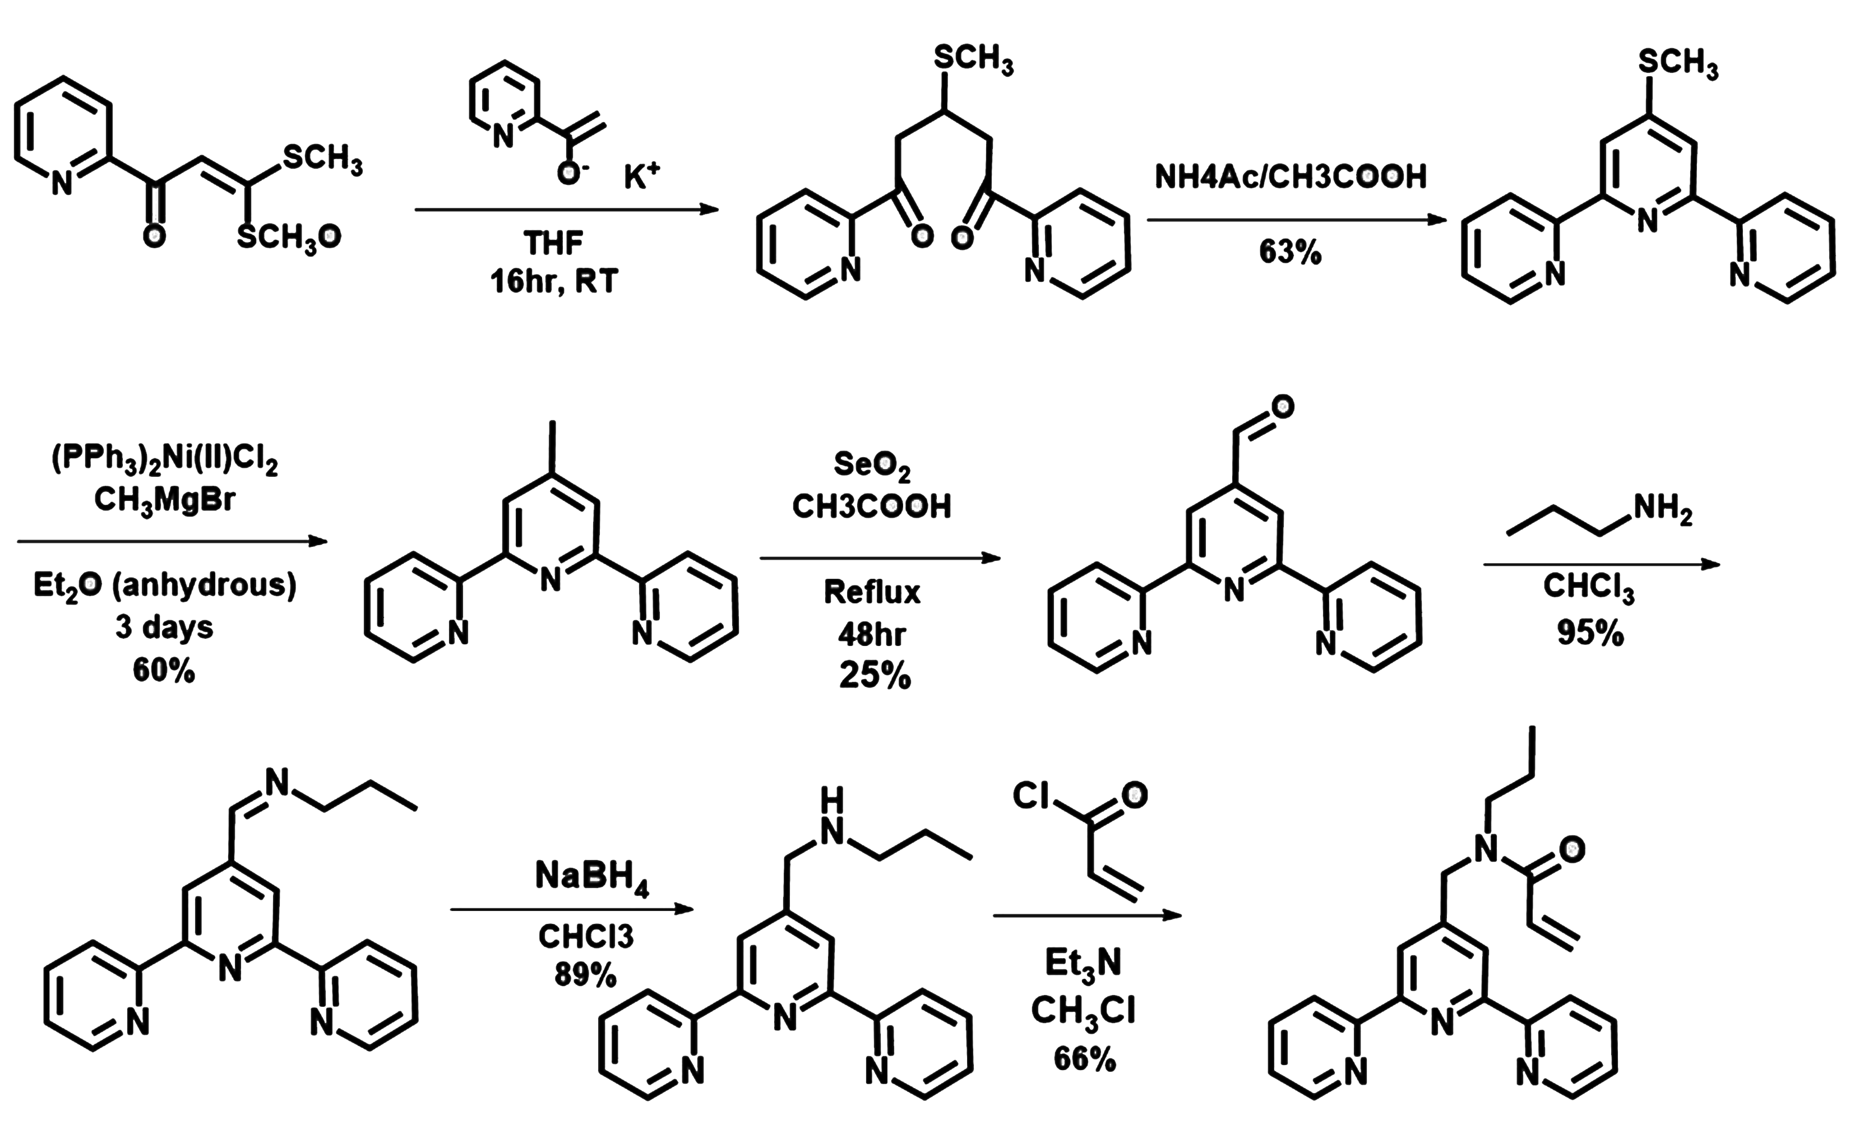
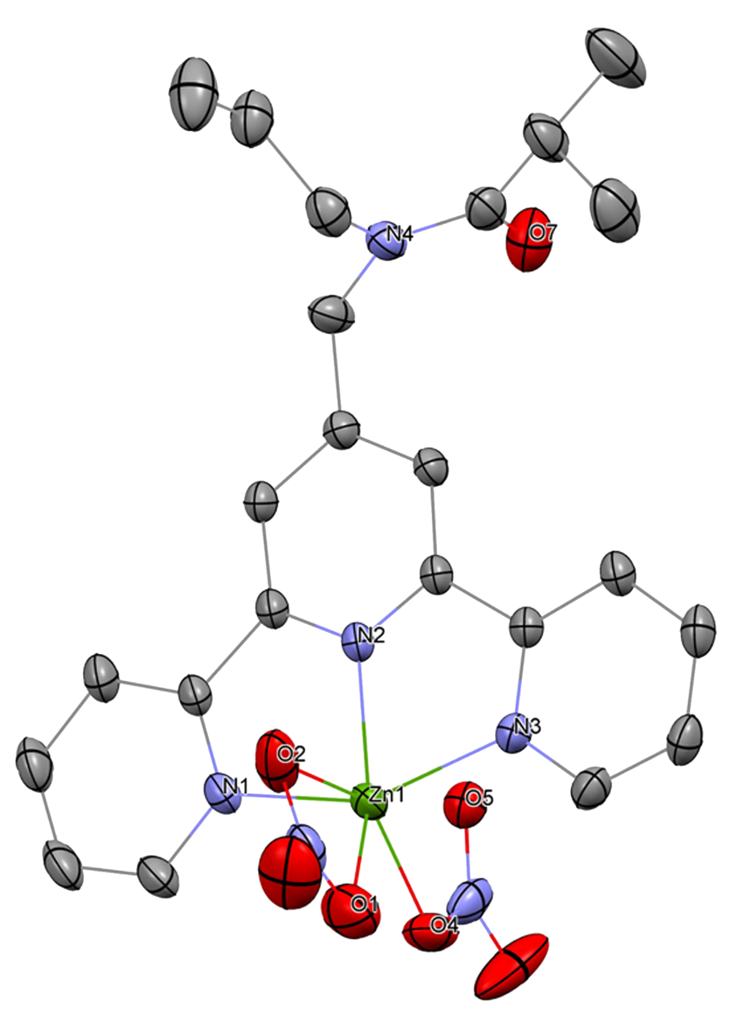
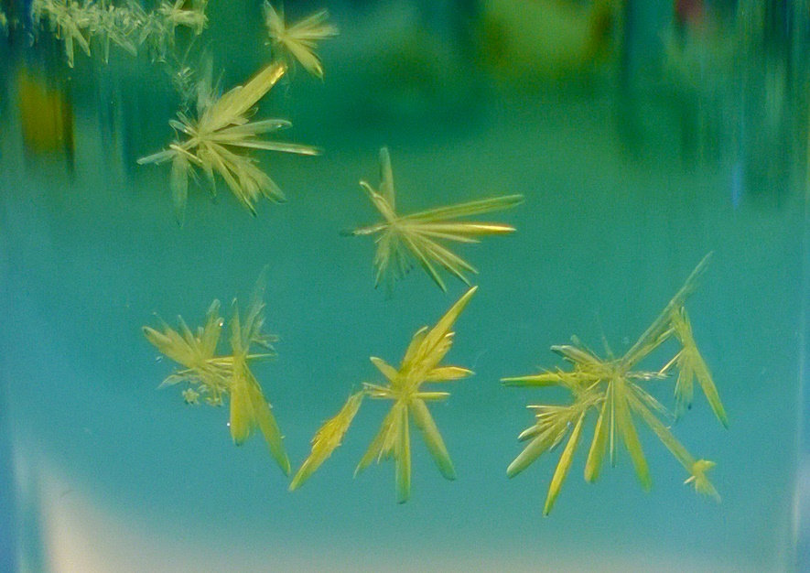

Ratiometric Cu(II) Sensor: Design and Synthesis of Bifunctional
Chelators to Detect Cu(II) and Minimize Zn(II) Interference
Mahmoud Abdalrahmanª, Roy Planalpª, Shawn Burdette^{b}, Fasil Abebe^{b}, Scott Kassel^{c}
a: University of New Hampshire, Durham NH 03824; b: Worcester Polytechnic Institute, Worcester 01609; c: Villanova University, Villanova PA 19085
Motivation
Although heavy metals play many important roles in living organism and the environment, they can be very toxic at elevated concentrations. Copper(II) for example is a heavy metal that is involved in the metabolic processes of prokaryotes and eukaryotes and there are many known copper-containing enzymes that catalyze redox processes. However, chronic Cu(II) exposure at high enough levels has been associated with multiple neurodegenerative diseases in humans¹ as well as acute toxicity to several types of marine species especially fish²⁻⁴. Toxic concentrations of Cu(II) for fish can be as low as 0.05 mg/L, which is 1/20 the accepted standard concentration in drinking water⁵. Cu(II) at such concentrations can bind to and damage the gills and other tissues of several fish species, while also degrading their immune system. Thus, there is a need for a convenient method that can accurately monitor the concentrations of toxic Cu(II) in the environment^{1,4,6,7}.
Sensor Design and Mechanism
Incorporation of Zn(II) Ligand
We have designed a ligand that can be incorporated into the polymer system to minimize Zn(II) interference in the process of sensing Cu(II). This ligand was tailored in a way that allows it comfortably chelate to Zn(II) while imposing a coordination environment that is not preferred by Cu(II). While this design will not completely prevent the ligand from Binding Cu(II), it will make it more probable for Zn(II) to chelate to it than to Terpy’.
Crystal Structures of Terpy’ with Cu(II) and Zn(II)
Cu(II)(Terpy’)(NO₃)₂
When the Cu(II) ligands are neutral and the temperature is above the lower critical solution temperature (LCST) of PolyNIPA, the polymer collapses and FRET occurs. However, when Cu(II) binds to the ligands, the polymer expands due to the imposed hydration sphere around Cu(II) and the increased hydrophilic interactions caused by the cationic character introduced to the system through Cu(II). As a result of this expansion, the fluorophores are forced apart from one another and FRET decreases.
Cu(II)Terpy' - Coordination Sphere Bond Distances (Å)
Cu1 | N1 | 2.032(3)
Cu1 | N2 | 1.938(2)
Cu1 | N3 | 2.020(3)
Cu1 | O1 | 1.978(3)
Cu1 | O3 | 2.648(3)
Cu1 | O5 | 2.25(1)
Cu(II)Terpy' - Coordination Sphere Bond Angles
N1 | Cu1 | N2 | 79.6(1)
N1 | Cu1 | N3 | 159.7(1)
N1 | Cu1 | O1 | 98.9(1)
N1 | Cu1 | O3 | 95.5(1)
N1 | Cu1 | O5 | 88.5(3)
N2 | Cu1 | N3 | 80.3(1)
N2 | Cu1 | O1 | 162.3(1)
N2 | Cu1 | O3 | 109.4(1)
N2 | Cu1 | O5 | 117.5(3)
N3 | Cu1 | O1 | 99.6(1)
N3 | Cu1 | O3 | 89.2(1)
N3 | Cu1 | O5 | 102.7(3)
O1 | Cu1 | O3 | 53.0(1)
O1 | Cu1 | O5 | 79.9(3)
O3 | Cu1 | O5 | 132.9(3)
The effects of Cu(II) exposure on fish gills
The skin darkens, thickens and appears fragile and ulcerated, in particular around the mouth. Excessive mucus is secreted, gill function and resistance against parasite and bacteria are compromised^{4,6,7}.
Synthesis of Bifunctional Cu(II) Ligand Terpy’
State of the Art
It has been found that Cu(II) toxicity to aquatic organisms does not correlate with total Cu(II) in water, but rather the free form, which is hydrated Cu(II)^{3,4,8}. For this reason, designing a sensor that only measures the free form of Cu(II) is of great interest. Some of the challenges one faces when designing a fluorescence-based Cu(II) sensor include the difficulty of distinguishing free and total Cu(II), quenching of fluorescence signals due to the paramagnetic nature of Cu(II), and interference of other metals that may be present in a water sample.
Our Approach
In the Planalp group, we have designed a polymer based copper sensor that utilizes Förster Resonance Energy Transfer (FRET) to measure low concentrations of Cu(II). The sensor is based on the thermal response of poly(N-isopropylacrylamide) (PolyNIPA). It is comprised of a PolyNIPA backbone, which has been labeled with donor and acceptor fluorophores, a Zn(II) ligand and a Cu(II) ligand. The design of this sensor accomplishes the following: it allows the detection method to be ratiometric making the results independent of experimental variables; small concentrations of Cu(II) can be detected since our method utilizes fluorescence spectroscopy, which is very sensitive to small changes; it overcomes the problem of signal quenching by spatially separating the fluorophores from the Cu(II) binding site. Another advantage is minimizing the interference of other metals that maybe be present in a given sample such as Zn(II) with the process of Cu(II) detection. This is achieved by incorporating a Zn(II) chelator in the sensor assembly. We focus on Zn(II) because it is likely to compete with Cu(II) in binding to the Cu(II) ligand, despite the relatively high affinity of the ligand towards Cu(II). Zn(II) is often present in much greater concentrations than Cu(II) especially in wastewater, which can find its way to aquatic habitats, by multiple orders of magnitude⁹⁻¹². Here we report the design, synthesis, and characterization of a bifunctional Cu(II) ligand Terpy’ and its complexes with Cu(II) and Zn(II).
N-[(2,2‘:6',2"-terpyridin-4’-yl)-methyl]-N-propylacrylamide
Zn(II)(Terpy’)(NO₃)₂
Zn(II)Terpy' - Coordination Sphere Bond Distances (Å)
Zn1 | N1 | 2.129(2)
Zn1 | O1 | 2.145(2)
Zn1 | N2 | 2.069(1)
Zn1 | O2 | 2.369(2)
Zn1 | N3 | 2.138(2)
Zn1 | O4 | 2.042(1)
Zn(II)Terpy' - Coordination Sphere Bond Angles
N1 | Zn1 | O1 | 108.96(6)
N1 | Zn1 | N2 | 76.57(5)
N1 | Zn1 | O2 | 90.19(6)
N1 | Zn1 | N3 | 152.56(6)
N1 | Zn1 | O4 | 97.27(6)
O1 | Zn1 | N2 | 143.39(6)
O1 | Zn1 | O2 | 56.00(6)
O1 | Zn1 | N3 | 94.55(6)
O1 | Zn1 | O4 | 83.11(6)
N2 | Zn1 | O2 | 88.49(6)
N2 | Zn1 | N3 | 76.10(5)
N2 | Zn1 | O4 | 133.02(6)
O2 | Zn1 | N3 | 91.53(6)
O2 | Zn1 | O4 | 138.44(6)
N3 | Zn1 | O4 | 99.48(6)
Absorbance Terpy'-Cu(II) Complex at Different Terpy : Cu(II) Mole Fractions
Acknowledgements
This research project was made possible thanks to the generosity of and the Chemistry Department at the University of New Hampshire. Jonathan Briggs provided crystal structure of Cu(II)(Terpy’)(NO₃)₂
References
1. Committee, N.R.C.-S.D.W., Drinking Water and Health. Vol. 1. 1977, Washington DC: National Academy of Sciences.
2. Di Toro, D.M., et al., Biotic ligand model of the acute toxicity of metals. 1. Technical basis. Environmental Toxicology and Chemistry, 2001. 20(10): p. 2383-2396.
3. Santore, R.C., et al., Biotic ligand model of the acute toxicity of metals. 2. Application to acute copper toxicity in freshwater fish and Daphnia. Environmental Toxicology and Chemistry, 2001. 20(10): p. 2397-2402.
4. Yanong, R.P., Use of copper in marine aquaculture and aquarium systems. 2010.
5. Oehme, F., Toxicity of Heavy Metals in the Environment, ed. F. Oehme. Vol. 1. 1978, New York: Marcel Dekker inc.
6. Varvarigos, P. Chronic Sublethal Copper Toxicity to Fish. 2007 8/10/2015]; Available from: http://www.vetcare.gr/ARTPRES/cutox.htm.
7. Vutukuru, S., et al., Studies on the development of potential biomarkers for rapid assessment of copper toxicity to freshwater fish using Esomus danricus as model. International journal of environmental research and public health, 2005. 2(1): p. 63-73.
8. Arnold, W.R., et al., A comparison of the copper sensitivity of six invertebrate species in ambient salt water of varying dissolved organic matter concentrations. Environmental Toxicology and Chemistry, 2010. 29(2): p. 311-319.
9. Ren, S., Probabilistic risk assessment for zinc in some commercial dishwashing detergents: The nitrification processes in US POTWs. Chemosphere, 2007. 68(8): p. 1474-1488.
10. Rahman, M.L., S.M. Sarkar, and M.M. Yusoff, Efficient removal of heavy metals from electroplating wastewater using polymer ligands. Frontiers of Environmental Science & Engineering, 2015: p. 1-10.
11. Mensing, T.M. and G. Faure, Effect of wastewater on the concentrations of Mo, Zn, Cu, and Ni in Mill Creek at Marysville, Ohio. 1998.
12. Karvelas, M., A. Katsoyiannis, and C. Samara, Occurrence and fate of heavy metals in the wastewater treatment process. Chemosphere, 2003. 53(10): p. 1201-1210.

