Slide 1

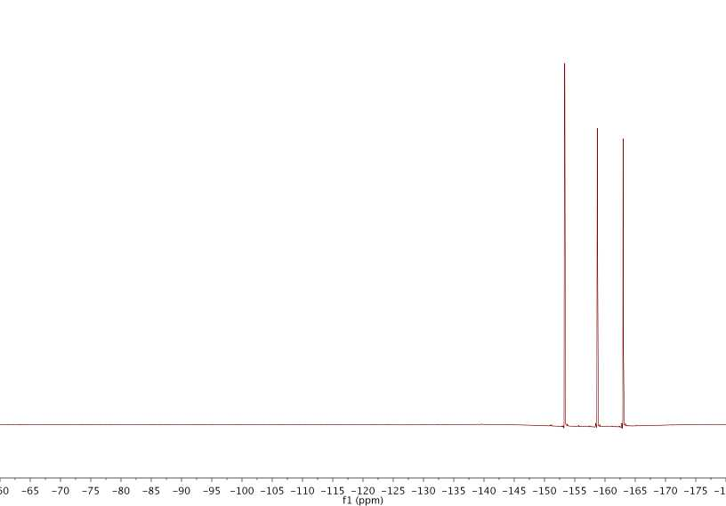
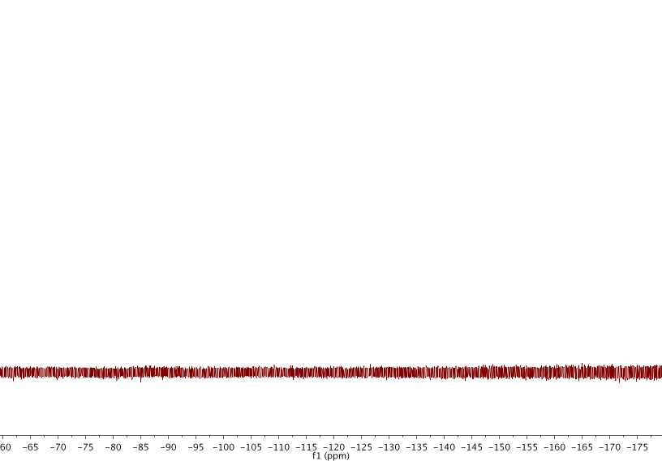
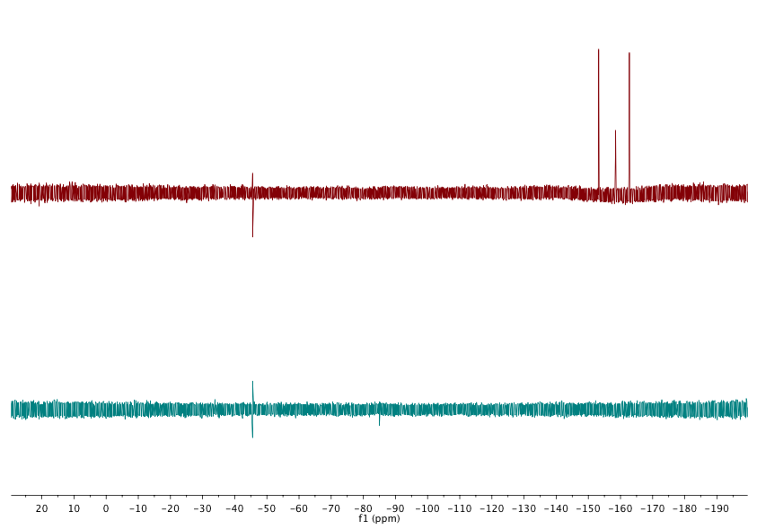
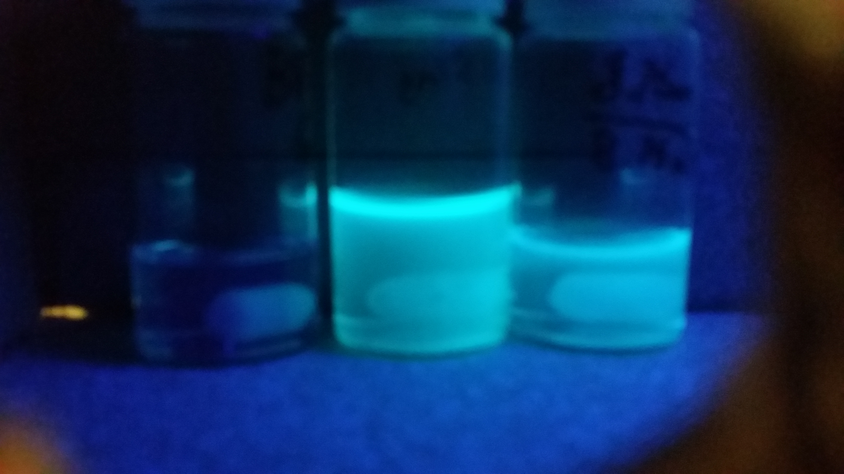
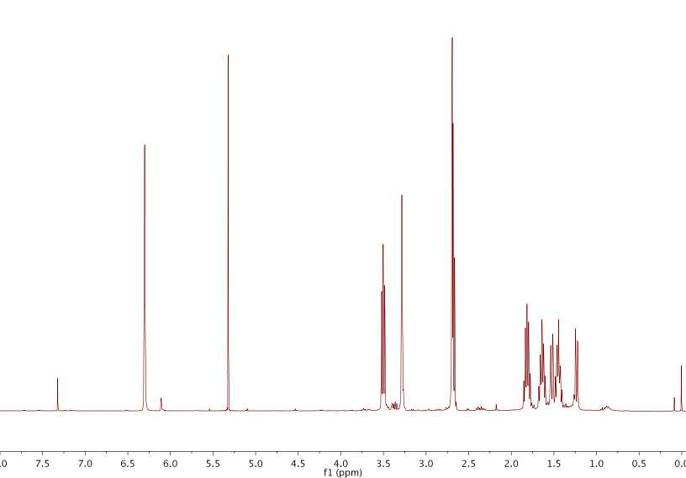
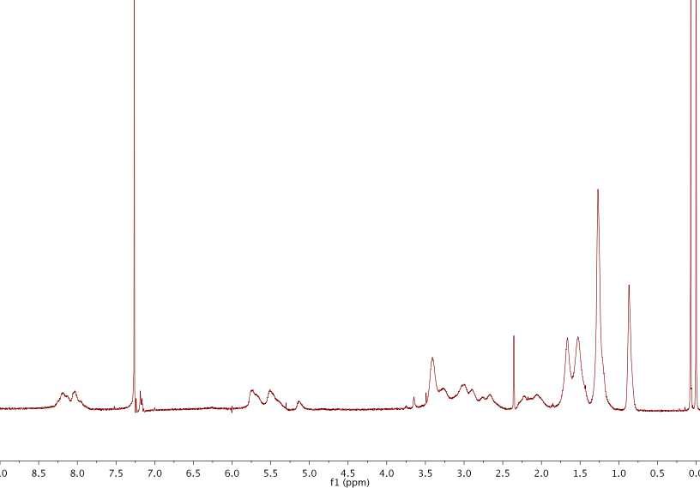





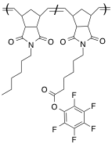
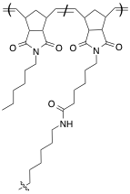
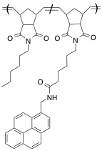
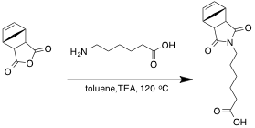


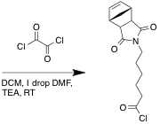




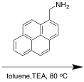
Modular approach to creating single-chain polymer nanoparticles
Materials Science
Bryan T. Tuten, Justin P. Cole, Christopher K. Lyon, Erik B. Berda
Introduction:
In analogy to nature, the fabrication of functional nanodevices from well-defined discrete macromelecules remains an important yet elusive research objective. Single-chain polymer nanoparticles (SCNPs) represent a significant step towards these ends. This technique is predicated on the concept that in sufficiently dilute polymer solutions (concentrations below the overlap concentration, c*), inter-chain interactions are minimized because the dimenstions of individual chains are smaller than the average distance between the chains. Thus, triggering a cross-linking reaction under these conditions will result in intrachain, rather than interchain coupling, facilitating a change in conformation from an expanded coil to a collapsed globule or particle.
By using 1-pyrene methylamine, precise characterization of the amount of activated esters in the polymer chains can be made using ¹H NMR, ¹⁹F NMR, and UV-Vis spectroscopy. This is useful as there are no characteristic proton peaks directly on the fluoroester moiety.
One drawback to the use of the activated ester in the formation of the SCNPs is that the external cross-linker must be used in stoichiometric amounts. This gives rise to the potential for a small amount of unreacted activated esters and monosubstituted diamines, which upon concentrating can lead to gelation.
Using standard ROMP conditions a polymer with 75% hexyl-norbornene-imide, and 25% fluoroester-norbornene-imide was synthesized.
In order to create a polymer that can undergo modular collapse via intra-chain cross-linking, a monomer containing multiple functional handles must be synthesized. The norbornene-imide based pentafluorophenyl ester provides multiple, sequential routes to creating SCNPs whether through thiol-ene chemistry through the olefin backbone, or primary alkyl amines through the fluoro-ester moiety.
Here, 1-pyrene methylamine is used to showcase the difference between the original parent polymer, the parent polymer with only monosubstitution of 1-pyrene methylamine, and lastly SCNPs “quenched” with 1-pyrene methylamine. As expected, the SCNP had fewer available activated esters thus the fluorescence is between that of the parent polymer and the monosubstituted polymer.
By using a large excess of 1-pyrene methylamine, one can A) “quench” the remaining activated esters, and B) provides an avenue for characterization and further functionalization of the remaining activated ester in the SCNPs.
Under dilute conditions, the polymer was exposed to hexamethylenediamine. The polymer underwent intra-chain cross-linking, shifting the chromatograph to a higher retention time. This shift to higher retention time is indicative of a smaller hydrodynamic volume.
Acknowledgments:
We graciously thank, UNH, NSF (NSF EEC0832785), and the US Army Research Office (W911NF-14-1-0177) for financial support
References:
E. Harth, B. V. Horn, V. Y. Lee, D. S. Germack, C. P. Gonzales,R. D. Miller and C. J. Hawker, J. Am. Chem. Soc., 2002, 124,8653–8660.
O. Altintas and C. Barner-Kowollik, Macromol. Rapid Commun.,2012, 33, 958–971.
J.-H. Ryu, S. Jiwpanich, R. Chacko, S. Bickerton and S. Thayumanavan, J. Am. Chem. Soc., 2010, 132, 8246–8247.
J. P. Cole, J. J. Lessard,C. K. Lyon, B. T. Tuten, E. B. Berda, Polym. Chem., 2015, 6, 5555
N. Mohr, M. Barz, R. Forst, R. Zentel, Macromol. Rapid Commun. 2014, 35, 1522-1527.
E. J. Foster, E. B. Berda and E. W. Meijer, J. Polym. Sci., Part A: Polym. Chem., 2011, 49, 118–126.
E. B. Berda, E. J. Foster and E. W. Meijer, Macromolecules, 2010, 43,1430–1437.

