Slide 1
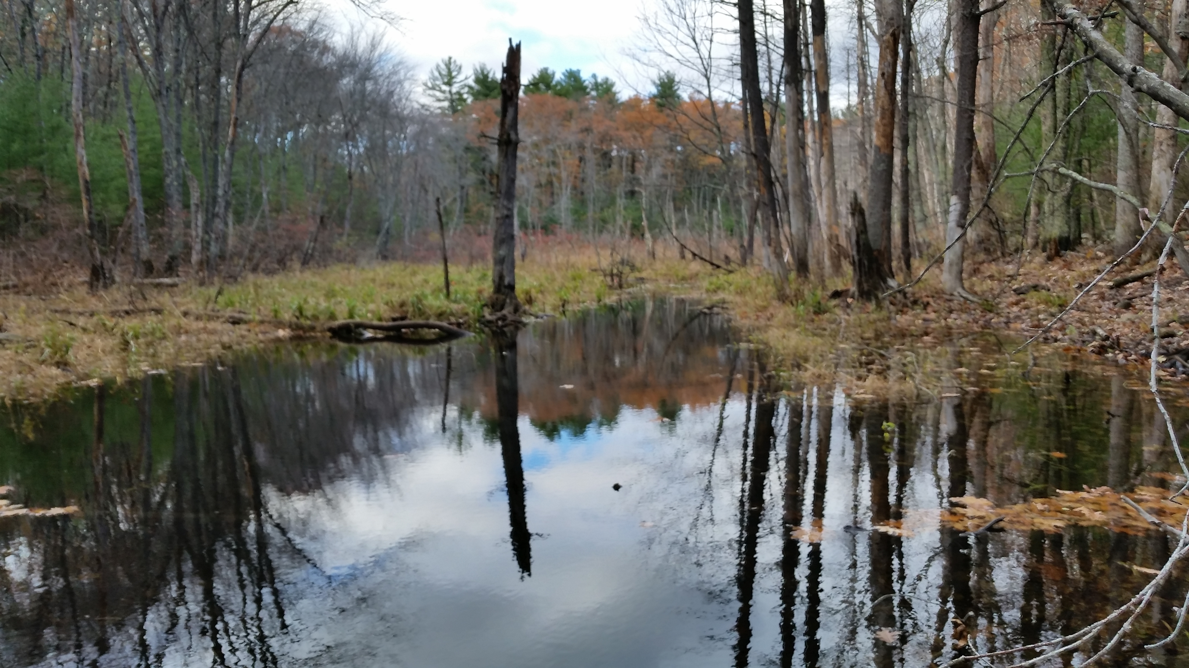




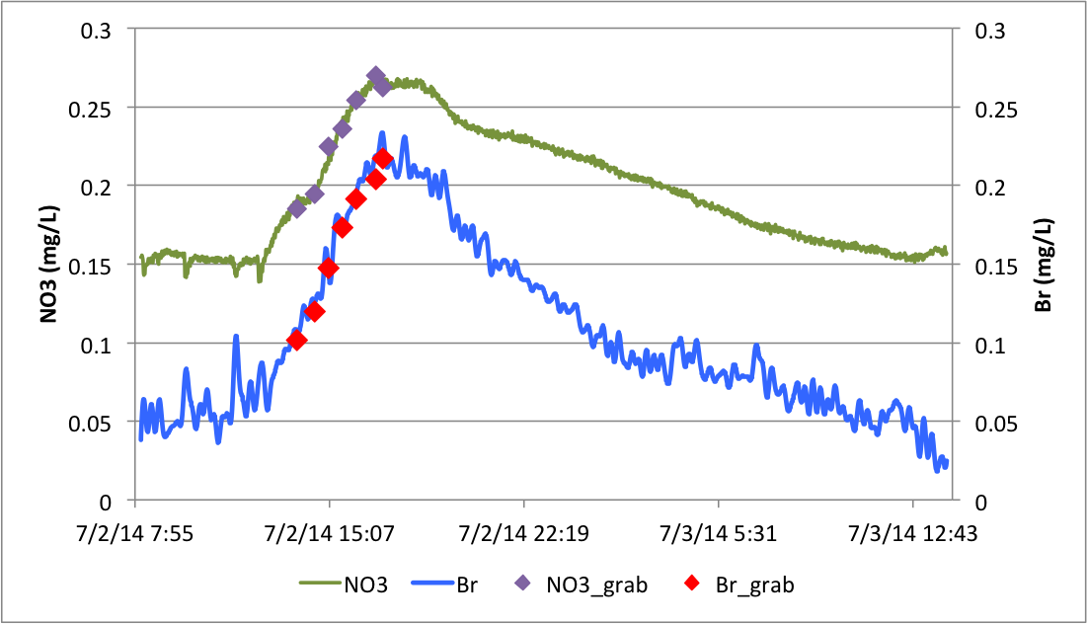
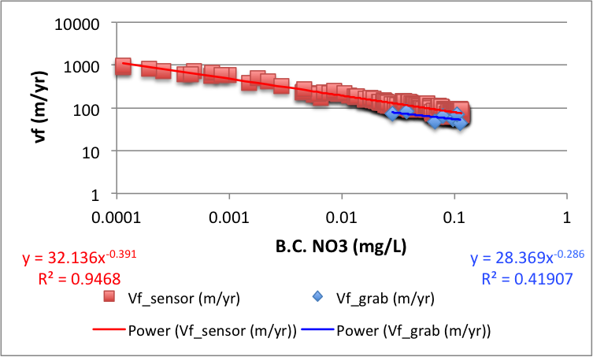
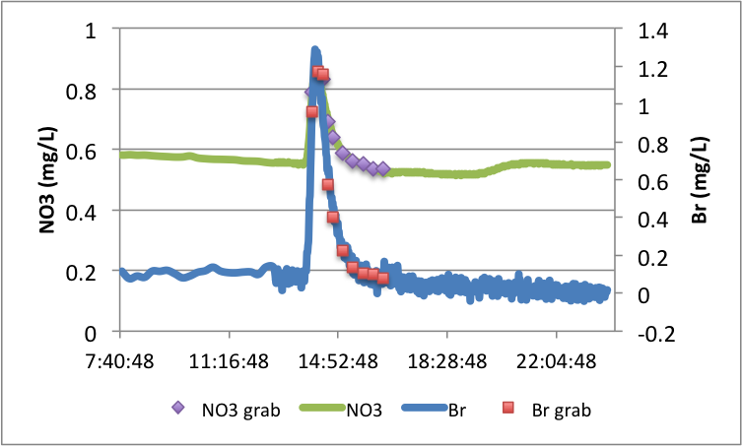
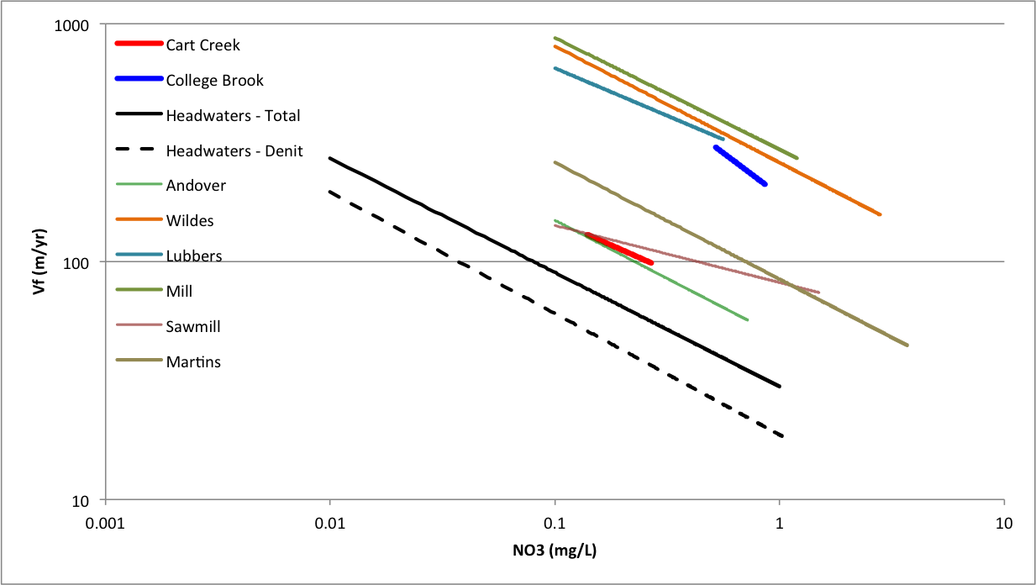
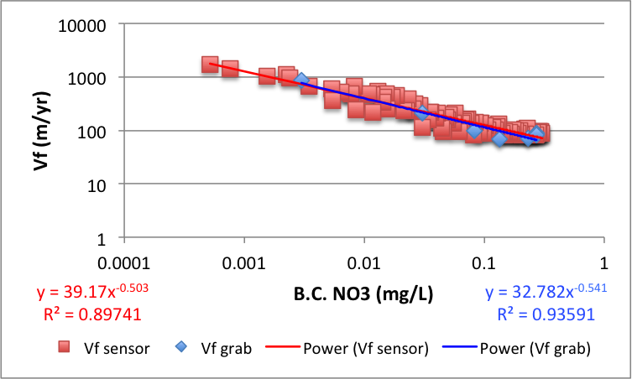
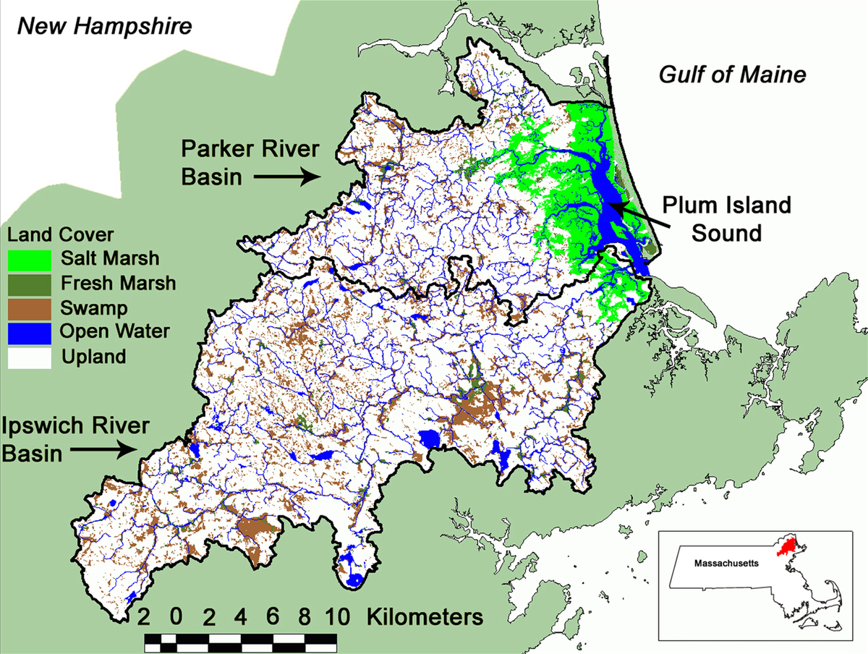
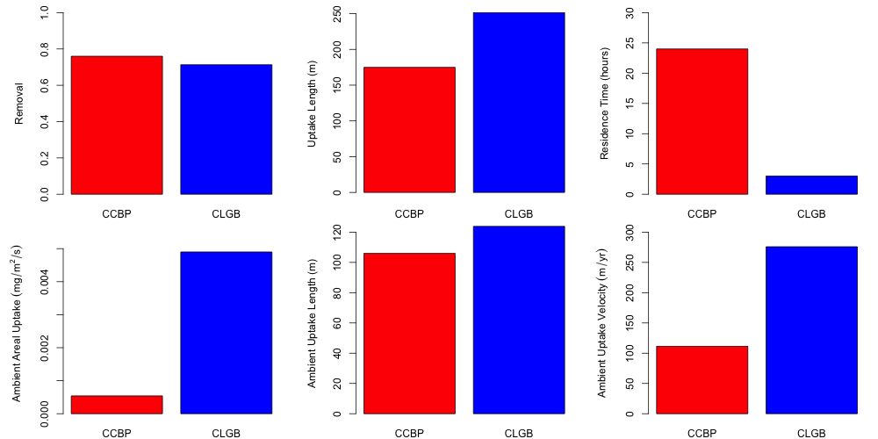
Quantification of fluvial wetland nitrogen removal in long residence time systems using whole ecosystem-scale experiments and in situ sensors
Christopher Whitney*, Wilfred Wollheim, Gopal Mulukutla, Anne Lightbody
*ctw1@wildcats.unh.edu
Background
Excess nitrogen (N) in the environment contributes to eutrophication of aquatic ecosystems leading to results such as harmful algal blooms and anoxic and hypoxic ‘dead zones’¹. In the northeastern US, typically about 80% of the total anthropogenic N inputs are retained or removed while the remainder is exported from basin mouths². However, in the coastal New England river networks that drain the shallow-sloped watersheds of the Plum Island Ecosystems (PIE) LTER, watershed removal can be even greater (>90%). Channelized reaches have been studied extensively³ but recent investigations in fluvial wetlands have suggested that they play a larger role in the removal of anthropogenic N from aquatic ecosystems compared to their channelized counterparts⁴. This is important because the shallow-sloped watersheds of the PIE LTER region that drain suburban Boston, MA contain a high abundance of fluvial wetlands. Coupled with high anthropogenic N loads, these are the perfect watersheds in which to study wetland role in N removal. Studies recently performed in fluvial wetlands in the PIE LTER region that have taken place at the smaller patch- or microcosm scale may not accurately represent N processing within the entire wetland. Therefore, we have developed a new approach for performing whole ecosystem-scale nutrient spiraling experiments in fluvial wetlands to account for the N processing taking place throughout these heterogeneous aquatic ecosystems. This new approach combines an existing method for quantifying N uptake in channelized stream reaches with new in situ nitrate analyzer technology to estimate N removal at the whole ecosystem scale. By performing whole ecosystem-scale nutrient spiraling experiments, we can gain more insight into the rates of N removal as well as potential drivers of N removal.
Methods
Experimental nutrient additions performed in three locations within the PIE watersheds during the summer and fall of the 2014 field season (Figure 1)
  An active beaver pond on Cart Creek in Newbury, MA (CCBP)
  A defunct beaver pond on Fish Brook in Boxford, MA
  A natural wetland on Saw Mill Brook in Wilmington, MA
  College Brook in Durham, NH as an urban, channelized comparison (CLGB)
TASCC⁵ approach using instantaneous slug addition of nitrate and bromide
SUNA to measure NO₃⁻ and Br⁻ continuously to characterize breakthrough curve (BTC)
Grab samples collected along BTC to calibrate SUNA data
Calculations using both distance and residence time approaches
Comparison of wetlands to channelized streams
Results
At CCBP, the tracer slug took a total of 24 hours to pass through the entire wetland and grab samples only captured the rising limb of the BTC (Figure 2A)
The tracer slug at CLGB took only 3 hours to pass through the entire reach and grab samples reasonably characterize the majority of the BTC (Figure 3A)
Power functions describing relationships between uptake velocities and background corrected NO₃⁻ (efficiency loss) calculated using both grab and sensor data have similar slopes for both CCBP and CLGB which suggests that the in situ sensor method agrees with the discrete grab sampling method (Figures 2B & 3B)
CCBP has a shorter uptake length than CLGB, suggesting that the beaver pond has a greater capacity for bulk removal of NO₃⁻ compared to College Brook (Figure 4)
Ambient areal uptake rate and uptake velocity are greater at CLGB but removal is greater at CCBP due to the longer residence time (Figure 4)
Efficiency loss slope is shallower at CCBP than CLGB but for a given level of NO₃⁻ , uptake velocity is greater in the channelized, urban stream (Figure 5)
CCBP has a greater uptake velocity compared to the 9 headwater streams in the PIE LTER region included in the LINX II³ study and is also within the range of uptake velocities found for 6 STS zones in Wollheim et al. (2014)⁴ (Figure 5)
Results
Breakthrough curve in beaver pond
NO₃⁻ uptake velocity vs. NO₃⁻ concentration
A
B
Uptake velocity efficiency loss for CCBP, CLGB, LINX II & STS zones in the PIE LTER region
Research Question
Q: What are the rates of N removal in fluvial wetlands and how do those rates compare to those found for channelized streams?
H: Whole ecosystem-scale estimates of N removal rates in fluvial wetlands will be greater than those for channelized reaches because of both longer residence times and higher uptake velocities that are due to wetlands being rich in organic matter and low in dissolved oxygen, resulting in higher uptake velocities.
Figure 2. Results from TASCC addition performed at the Cart Creek beaver pond in Newbury, MA on July 2, 2014 showing (A) BTC data collected via an in situ nitrate analyzer with discrete grab sample data points and (B) uptake velocity (vf) (m/yr) plotted against background corrected NO₃⁻ on log-log scale.
Breakthrough curve in channelized reach
NO₃⁻ uptake velocity vs. NO₃⁻ concentration
A
B
Study Area
Figure 5. Comparison of N uptake velocities (m/yr) plotted against total NO₃⁻ concentrations found for the Cart Creek beaver pond, College Brook (red and blue lines, respectively), the nine headwater streams in the PIE LTER region included in the LINX II study (black lines where the solid black line is total uptake velocity and the dashed line is denitrification uptake velocity) and 6 STS zones from Wollheim et al. (2014).
Figure 3. Results from TASCC addition performed in College Brook in Durham, NH on October 31, 2014 showing (A) BTC data collected via an in situ nitrate analyzer with discrete grab sample data points and (B) uptake velocity (vf) (m/yr) plotted against background corrected NO₃⁻ on log-log scale.
Conclusions & Future Work
Overall, the novel approach we have developed for quantifying N removal in fluvial wetlands is successful
Use of Br⁻ with SUNA is viable but requires calibration with grab samples
TASCC is a realistic approach in long residence time systems using in situ sensors
CCBP has greater removal because of longer residence time rather than greater uptake
Our new approach for quantifying N removal should be applied to more fluvial wetlands and channelized to further strengthen the conclusion that 1) our approach is successful and 2) fluvial wetlands have a greater capacity for removing N compared to channelized reaches
Investigate potential drivers for N removal including hydrological characteristics, transient storage parameters, geomorphology and metabolism
Fish Brook
Cart Creek
Comparison of uptake parameters for Cart Creek Beaver Pond (CCBP) and College Brook (CLGB)
Acknowledgements
This work was supported by the National Science Foundation Long-term Ecological Research Program NFS-OCE-1058747 and OCE-1238212 (Plum Island LTER).
Saw Mill Brook
Works Cited
[1] Davidson, E.A., et al. 2012. Excess nitrogen in the U.S. Environment: Trends, risks, and solutions. Issues in Ecology 15. [2] Howarth, R.W., et al. 1996. Regional nitrogen budgets and riverine N & P fluxes for the drainages to the North Atlantic Ocean: Natural and human influences. Biogeochemistry 35: 75-139. [3] Mulholland, P.J., et al. 2008. Stream denitrification across biomes and its response to anthropogenic nitrate loading. Nature 452: 202-207. [4] Wollheim, W.M., et al. 2014. Nitrate uptake dynamics of surface transient storage in stream channels and fluvial wetlands. Biogeochemistry 120: 239-257. [5] Covino, T.P., et al. 2010. Tracer additions for spiraling curve characterization (TASCC): Quantifying stream nutrient uptake kinetics from ambient to saturation. Limnology and Oceanography: Methods 8: 484-498.
Figure 1. Locations of the three fluvial wetlands within the PIE LTER watersheds in Northeastern Massachusetts.
Figure 4. Uptake parameters calculated using the TASCC approach for both the Cart Creek Beaver Pond (CCBP) and the channelized College Brook (CLGB)

