Slide 1
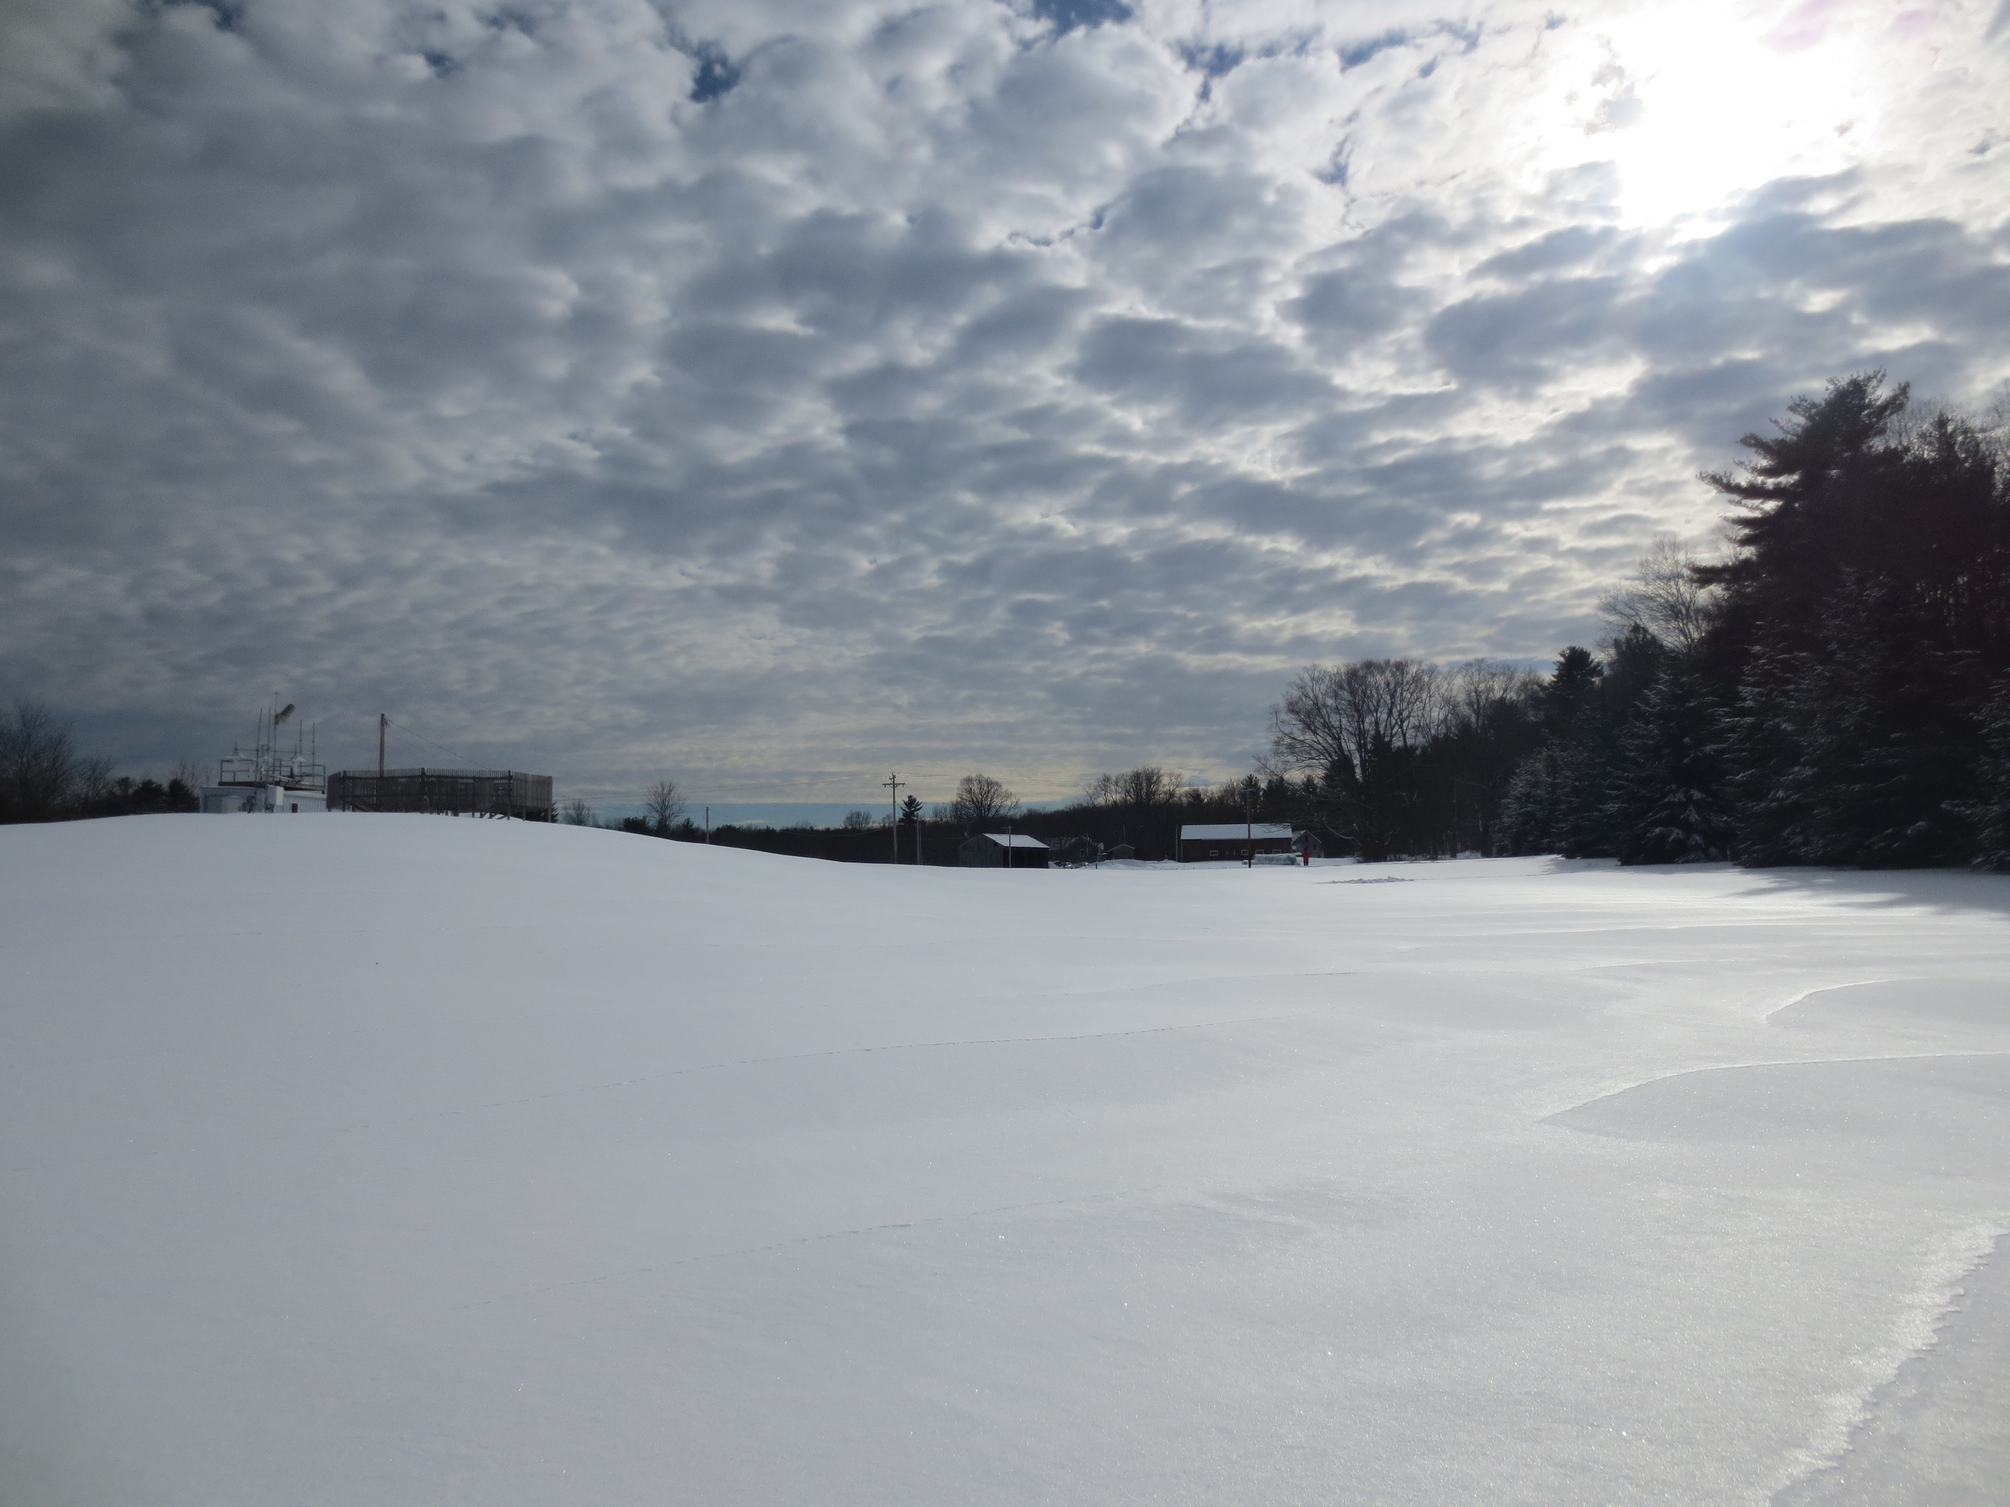


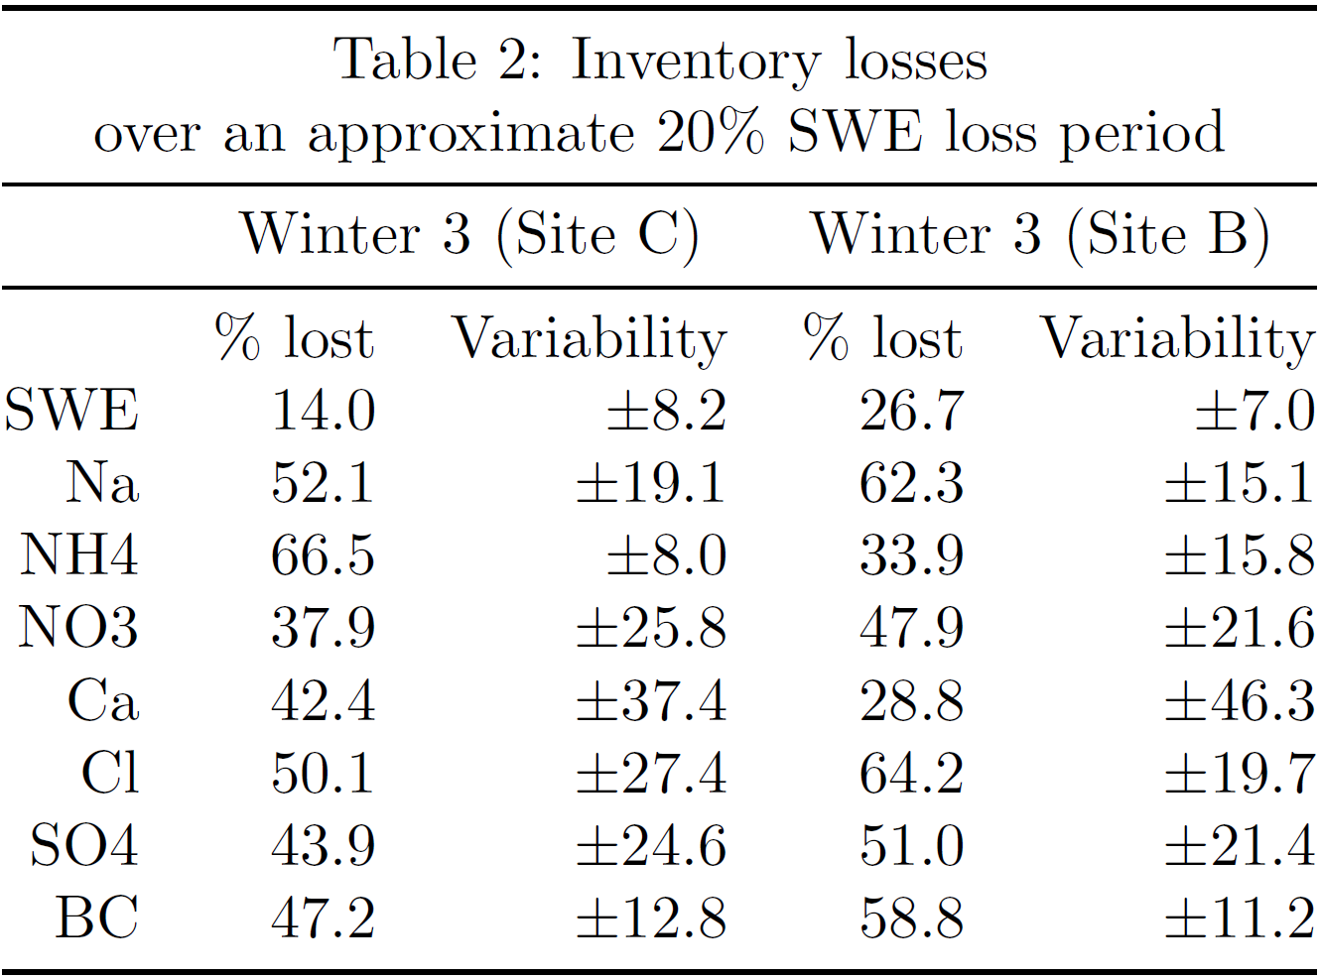
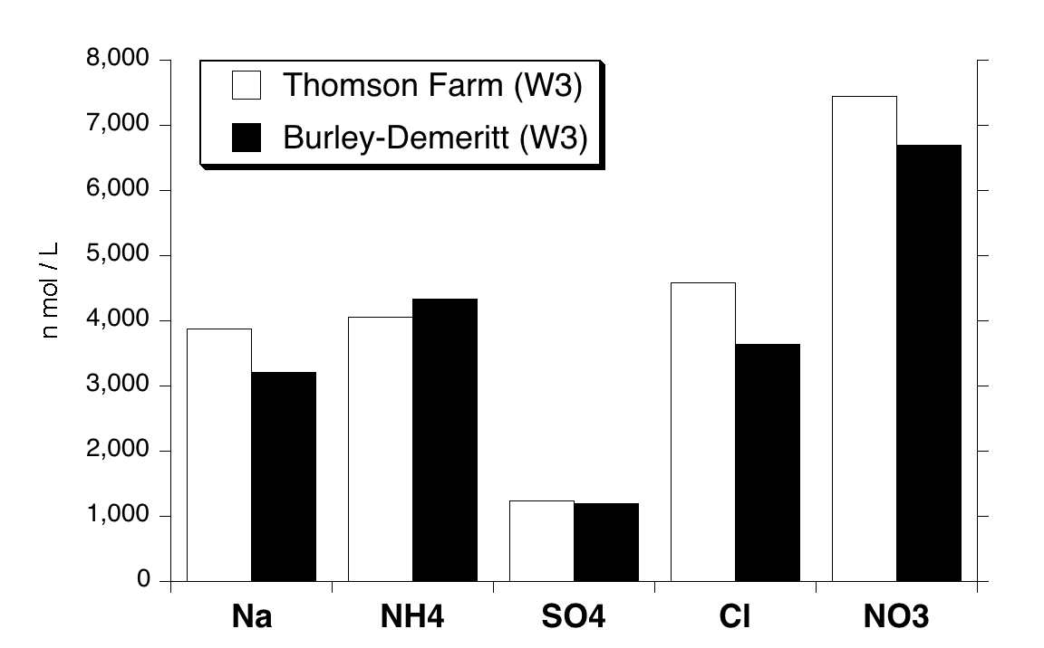
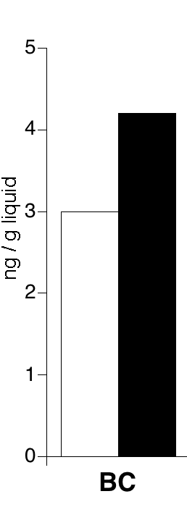
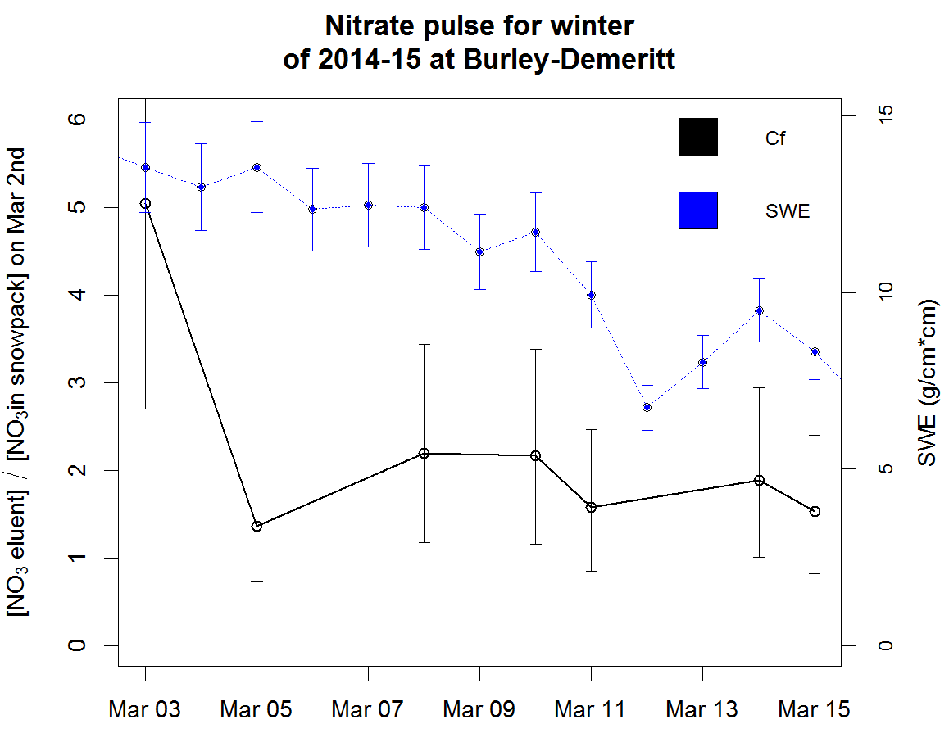
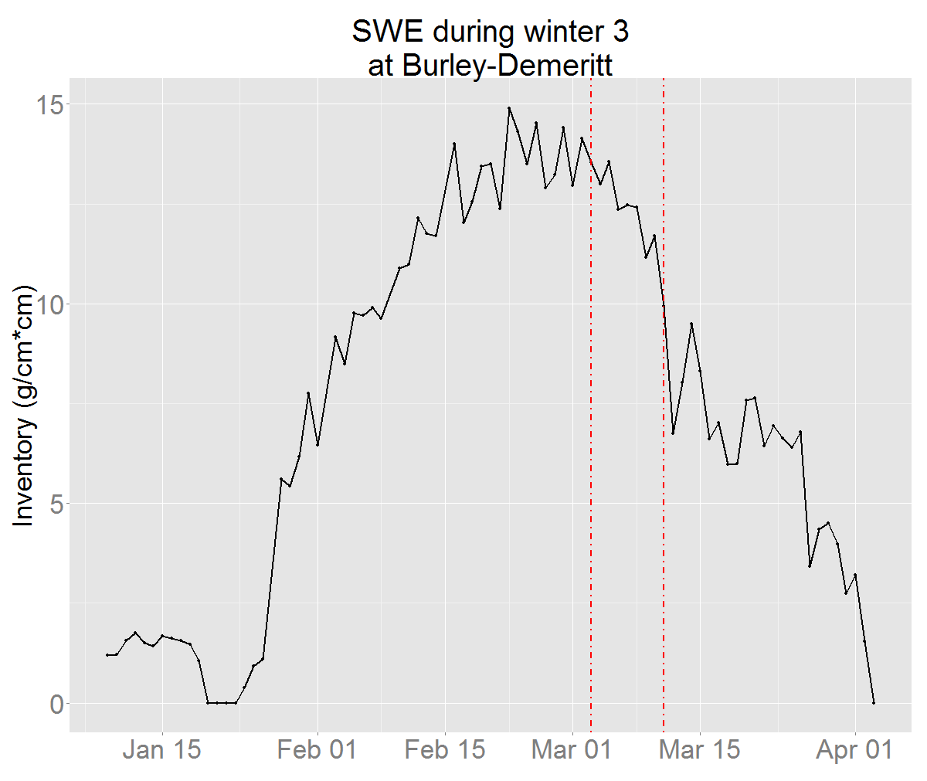
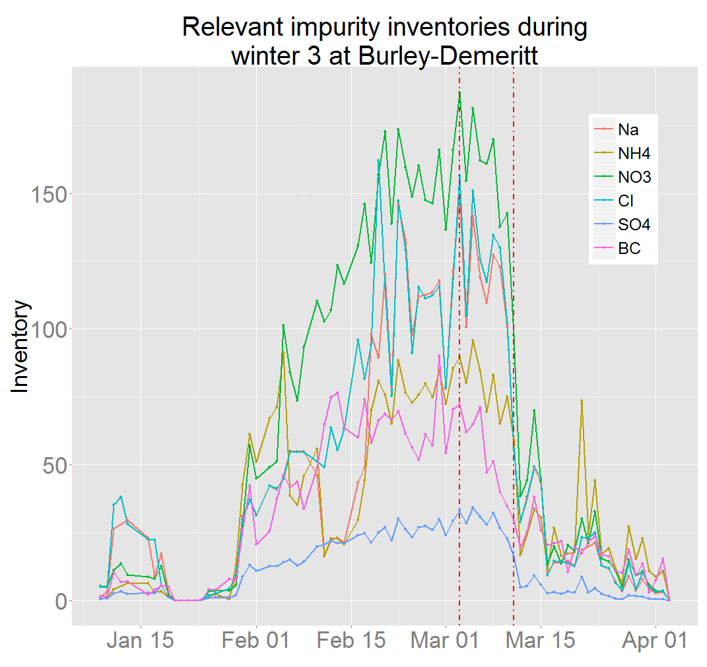
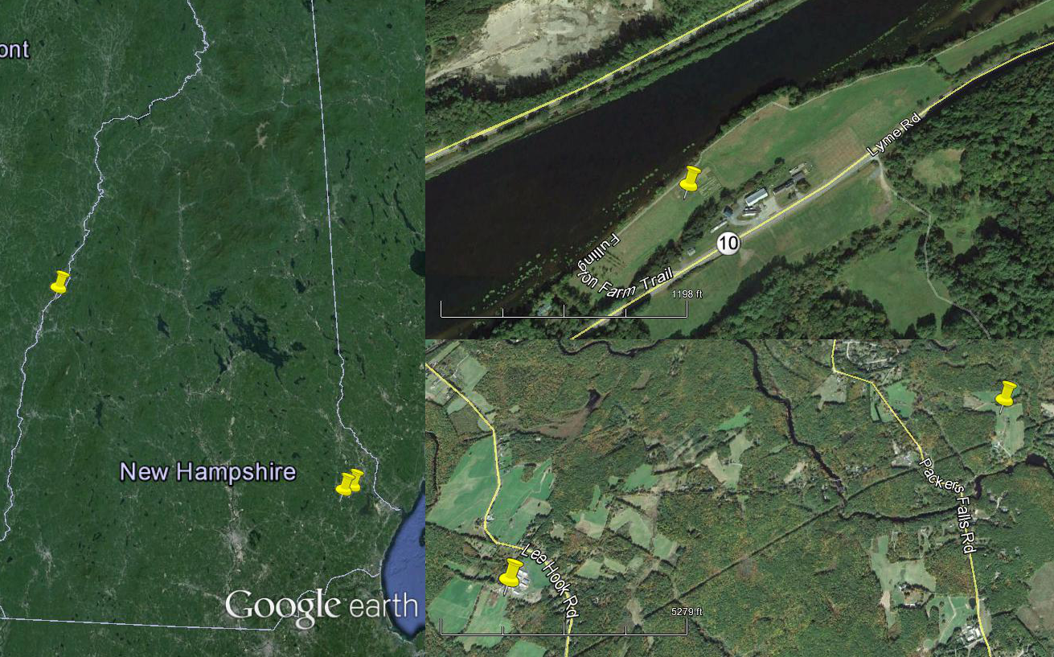
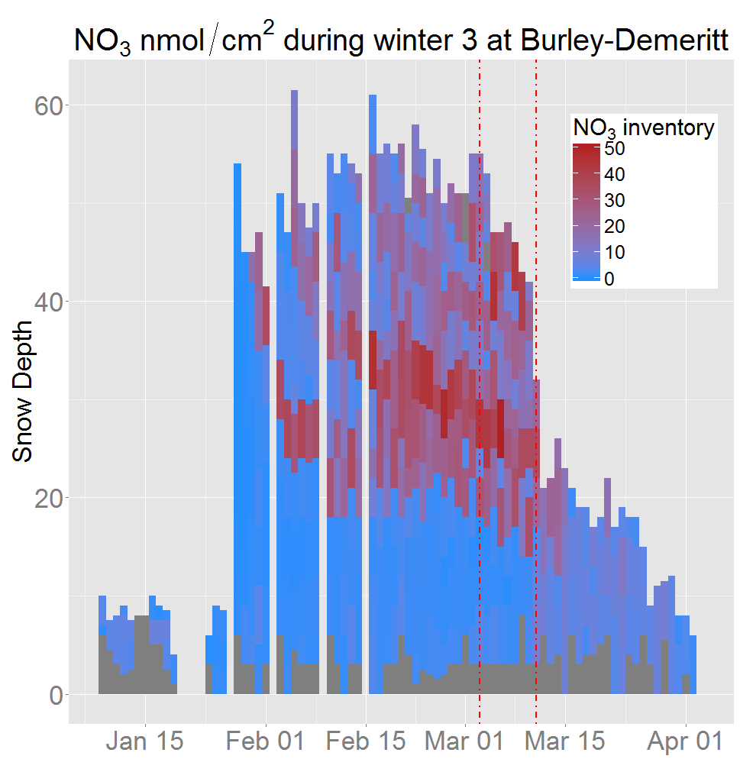
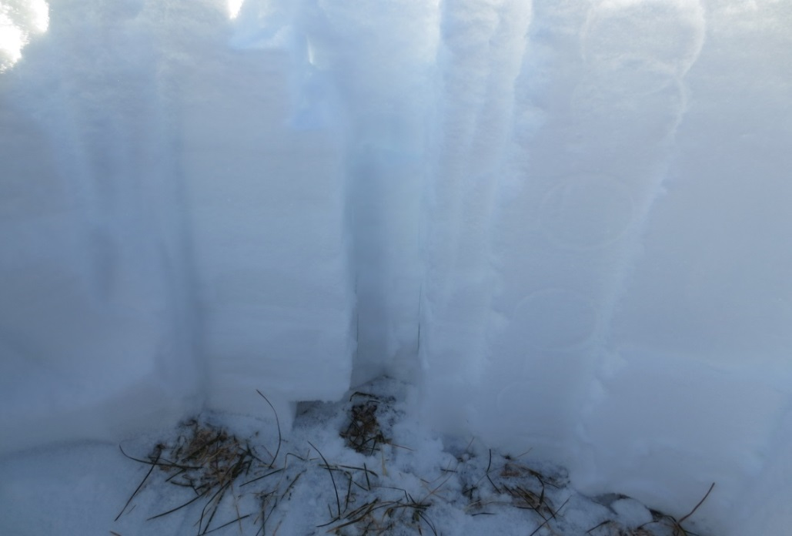


An In-depth Look at New Hampshire’s Snowpack
James Lazarcik ^{1, 2}, Jack Dibb ^{1, 2}, Cameron Wake ^{1, 2}, Alden Adolph³
¹ Department of Earth Science , University of New Hampshire, Durham, NH, USA
²Institute for the Study of Earth, Oceans and Space, University of New Hampshire, Durham, NH, USA
³Thayer School of Engineering, Dartmouth College, Hanover, NH, USA
Introduction
Seasonal snowpacks accumulate impurities derived from atmospheric aerosols and trace gases throughout the winter and can release them quickly during a melt period, thus having an impact on the surrounding environment. The timing of the melt and the amount of impurities within the snowpack will affect how receiving ecosystems can manage the rapid release of these materials during a melt event.
Previous field and laboratory studies have shown that a snowpack can lose up a significant portion of its ions in the early stages of the runoff, an event commonly known as an ionic pulse. On the other hand, some studies have found that particulate impurities (e.g. dust and black carbon (BC)) can be concentrated in surface layers during melt, darkening the snowpack. This study focuses on summarizing regional and temporal trends in NH snowpacks and identifying/quantifying the ionic pulse.
Results
Table 2 (left): Inventory losses over a short melt period indicate rapid loss of all species including BC at the two seacoast sites in winter 3. All of the select impurities lose a disproportionate amount of inventory compared to SWE.
Figure 3
Figure 3 (above): Median seasonal summaries for select impurities for winter 3 at sites B and C.
Figure 7 (right): A pulse plot using SWE and nitrate inventory losses to back-calculate eluent concentration factors (Cf). The first data point on the Cf line corresponds to a water flux of over 3000L/min*km².
Figure 7
Figure 4
Figure 5
Conclusions
As expected, sites close in proximity have very similar chemical summaries. Although not displayed, winter 2 data shows that site A is more different than either site B or C. Also expected for every site to some degree is a major impurity pulse, which in winter 3 in NH’s seacoast region was observed as about 50% of the inventory lost in about the first 20% of the melt fraction. BC also exhibited a pulse like behavior, in one case losing over 50% of its inventory in the first 26% of the melt fraction.
Methods
We sampled snow pits daily throughout the winter with respect to layer boundaries at 3 sites across New Hampshire. Snow samples are then thawed and analyzed for ion and BC content.
Figure 4 and 5 (above): Figure 3 is a time series SWE plot for winter 3 and Figure 4 is a time series for the same winter of select impurities. The red boundary lines bound the beginning of the pulse period (day before multiple SWE and inventory losses) and the end of a ~20% melt period.
Figure 1
Figure 6
A
Next Steps
Complete the pulse and summary analyses for the other sites at during the other winters.
Analyze Cl to Na ratios to determine major sourcing of salt for NH snowpacks.
Back-calculate potential conductivity of the melt using anion and cation differences to estimate major EC contributing ions such as hydrogen.
Infer as to potential environmental impacts of seasonal snowpacks with a strong major pulse.
A
Figure 6 (right): A stratigraphic plot for nitrate during winter 3 at Burley-Demeritt with the same boundary lines as in Figure 4 and 5. The blank days are periods of heavy snow which prevented sampling for that day.
C
C
B
B
Figure 1: A map of the winter 3 sample sites across the state.
Figure 2: An example of a fully sampled snow pit during winter 3 (2014-2015).
Figure 2
Support for the New Hampshire EPSCoR Program is provided by the National Science Foundation’s Research Infrastructure Improvement Award # EPS 1101-245

