Slide 1

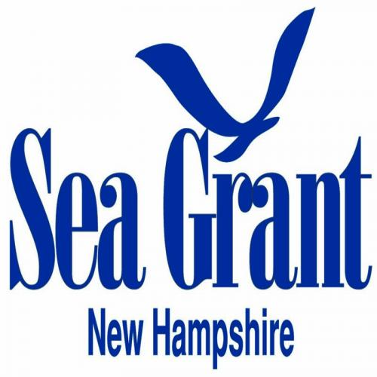
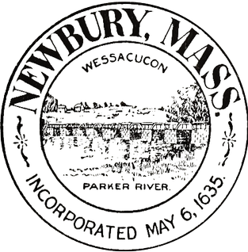

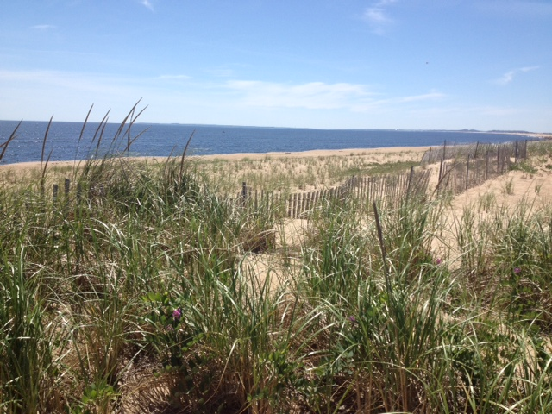
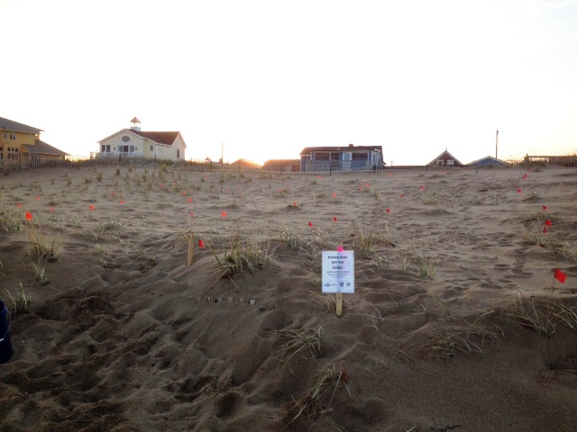
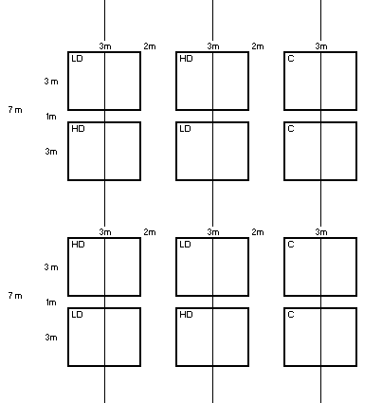
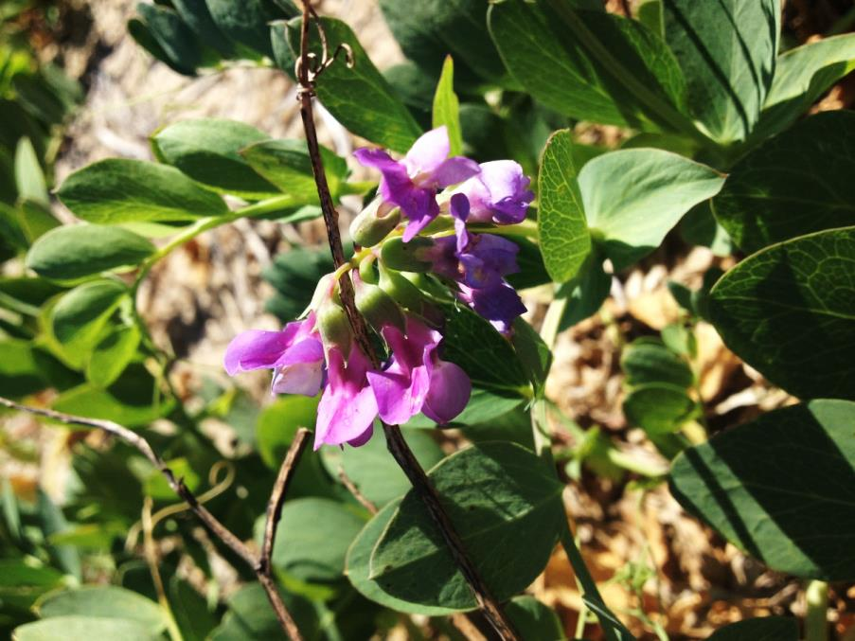
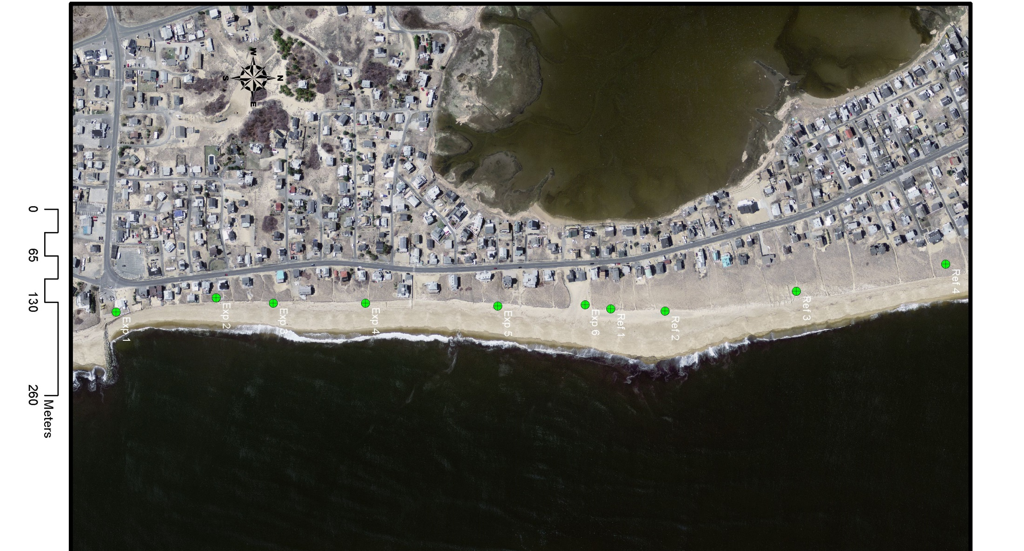
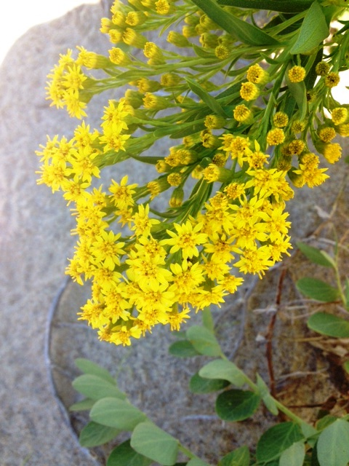
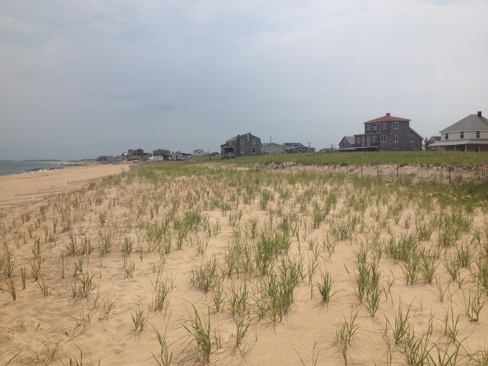
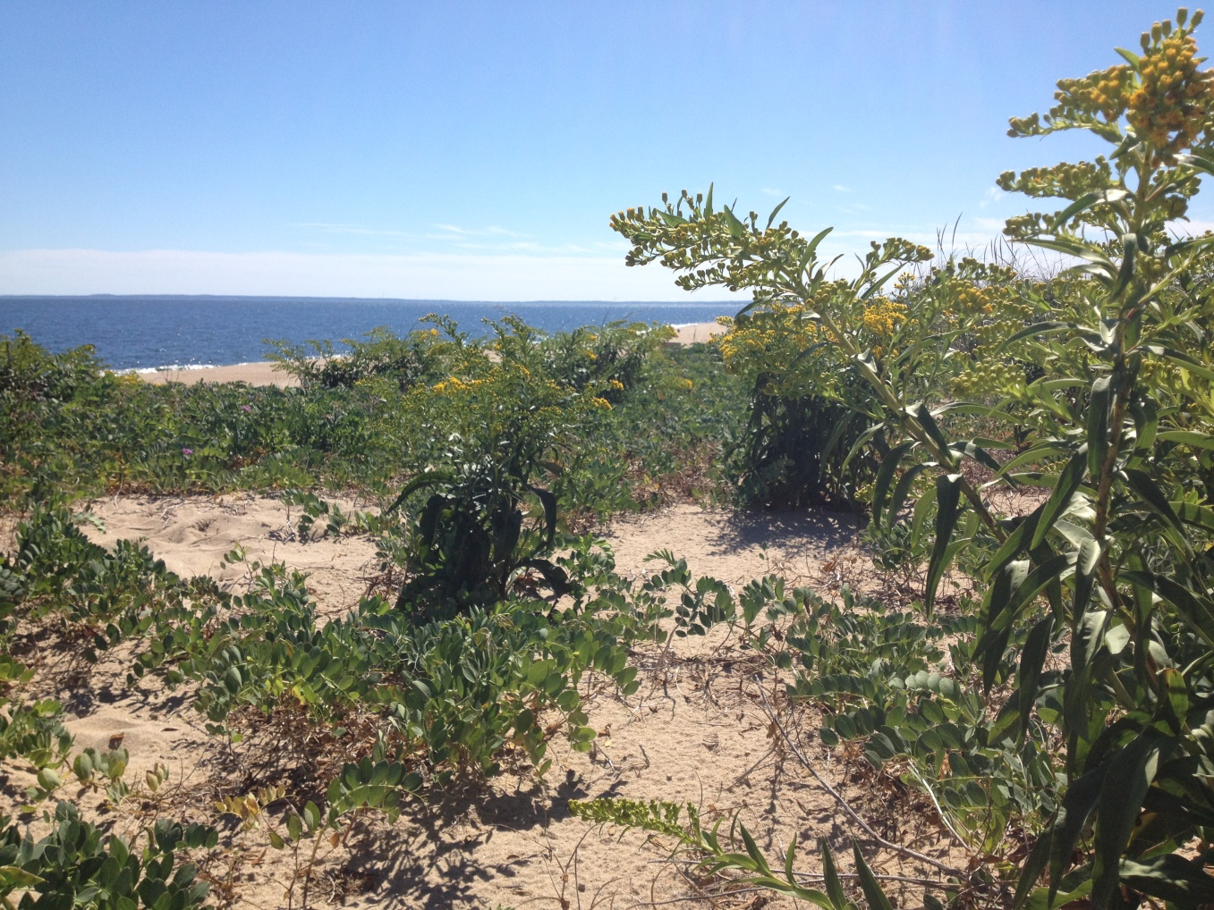
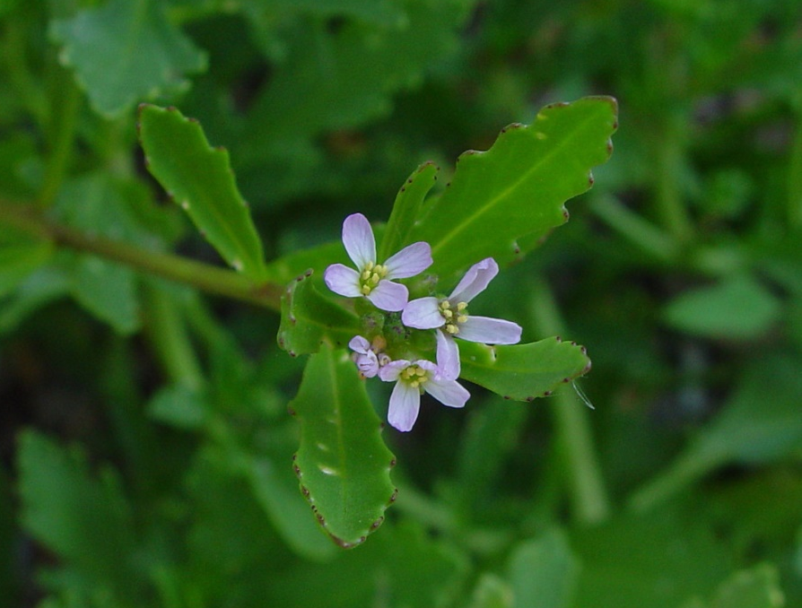

Coastal Sand Dune Restoration:
Increasing Plant Diversity and Restoration of Native Plant Communities
of Plum Island, Newbury, MA
Natalie Feldsine
Department of Biological Sciences, Plant Biology
Project funded by the
Massachusetts Office of Coastal Zone Management
Introduction
Coastal dunes are important for several reasons.
Essential for protecting coastal communities
Less expensive to maintain than manmade structures
Habitat for specialized plants and animals (Sperduto & Kimball, 2011)
  Piping plovers (Federally endangered)
Flowering plant species are beneficial for pollinators
Coastal resiliency has decreased due to factors including storms, coastal development, and beachgrass die-off. As a result, dunes are important to improving coastal resiliency.
Native Dune Species
Site Description
Plum Island is a barrier island located just south of the mouth of the Merrimack River. ). Plum Island has been impacted by coastal development and natural disturbances, specifically hurricanes, which have weakened dune resiliency. While intact dunes typically consist of a foredune, interdune, and backdune, the many of the dunes on Plum Island only consist of a foredune. For this reason, it is important to plant species that are adapted to foredune stresses.
Figure 3. Ammophila breviligulata (American beachgrass)
Grows up to 2-3 feet tall
Propagates via seeds and rhizomes
Highly tolerant of burial by sand (~1 m)
Common dune stabilizing plant
Tolerant of severe coastal stress
Susceptible to nematode predation
(Miller & Peterson, n.d.)
Project Goals
Improve dune diversity through planting of native species other than A. breviligulata (beachgrass)
Improve dune stability by increasing diversity
  Ease impacts of beachgrass die-off
  Increase sand accretion
Increase community involvement through group plantings and outreach to local schools
Develop a restoration plan that can easily be implemented by coastal communities
Figure 4. Lathyrus japonicus (Beach pea)
Perennial
1-2 feet in length
Blooms June-August
Nitrogen-fixing
Bee and butterfly pollinated
Tolerant of coastal stresses
(Brightmore & White, 1963)
Figure 5. Solidago sempervirens (Seaside goldenrod)
Perennial halophyte
Blooms in fall
Up to 6 feet tall
Tolerant of drought, salt spray & burial by sand
Common dune & erosion stabilization species
Bee and butterfly pollinated
  (Snell, 2010)
Figure 7. Experimental plots marked by orange flagging and sign
Figure 8. Diagram of experimental setup. C= control, HD = high diversity, LD = low diversity
Figure 6. Cakile edentula (American sea rocket)
Succulent ; tolerant of drought
Edible leaves
Summer annual
Blooms mid-summer through fall
6-20” in height
Two types of seed pods
Bee and butterfly pollinated
(Sea Rocket, n.d.)
Figure 1: Restored foredune with only A. breviligulata (American beachgrass).
Figure 2: Natural dune with Lathyrus japonicus (beach pea), Solidago sempervirens (goldenrod), and A. breviligulata. .
Figure 9. Location of four experimental transects on Plum Island, Newbury, MA
Cakile edentula photo courtesy of New England Wildflower Society
Methods
The field research component has been split into two phases: spring planting and fall planting. Dune plants must be planted in the spring or fall when dune temperatures are cooler and water is more available. Comparisons will be made to determine if one planting season is better than another.
Comparisons will also be made between high diversity and low diversity plantings, as well as between plot locations.
Elevation will be measured using laser levels to determine relative sand accretion. Success of plantings will be examined by measuring percent cover and transplant survival.
S. sempervirens was obtained from a New England based nursery and transplanted into newspaper pots to develop longer roots. L. japonicus was grown from collected seeds in peat pots. C. edentula was transplanted as seedlings into peat pots.
References
Brightmore, D., & White, P. (1963). Lathyrus Japonicus Willd. The Journal of
Ecology, 51(3), 795-795.
Miller, C., & Peterson, J. (n.d.). American Beach Grass Plant Guide.
Sea Rocket (Cakile edentula lacustris). (n.d.).
http://www.illinoiswildflowers.info/prairie/plantx/sea_rocket.html
Snell, S. 2010. Plant fact sheet for Seaside Goldenrod (Solidago sempervirens).
USDA-Natural Resources Conservation Service, Plant Materials Center.
Cape May, NJ.
Sperduto, D. D., & Kimball, B. (2011). The nature of New Hampshire: natural
communities of the granite state. Durham, N.H.: University of New Hampshire Press.
Project Components
Field Research: The hypotheses for this project are that higher diversity plantings will result in greater increases in sand accretion and will help to stabilize dunes in cases of beachgrass die-off. High diversity plantings will include S. sempervirens, C. edentula, and L. japonicus. Low diversity plantings will include S. sempervirens .
Outreach: In order to better translate research to the public, an outreach program has been developed and will be shared with the Dover Middle School STEAM Academy. Over the course of six one-day sessions, students will learn how University of New Hampshire students and professors are working to protect New England coastlines through the restoration of beach dunes. Participants will discover how native coastal plants can help this happen and learn about topics such as diversity, pollinator relationships, dune stabilization, erosion, storm effects, and green infrastructure.
Contact Information: Natalie Feldsine, nay53@wildcats.unh.edu

