Slide 1

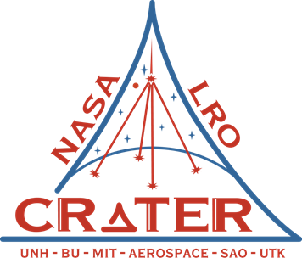
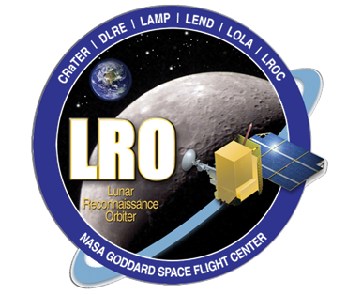
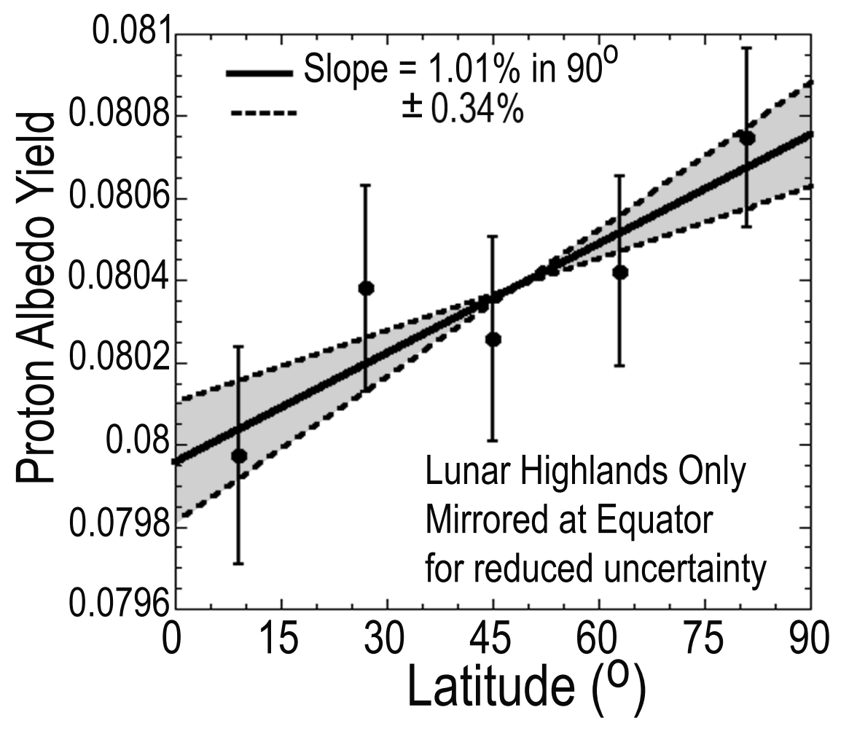
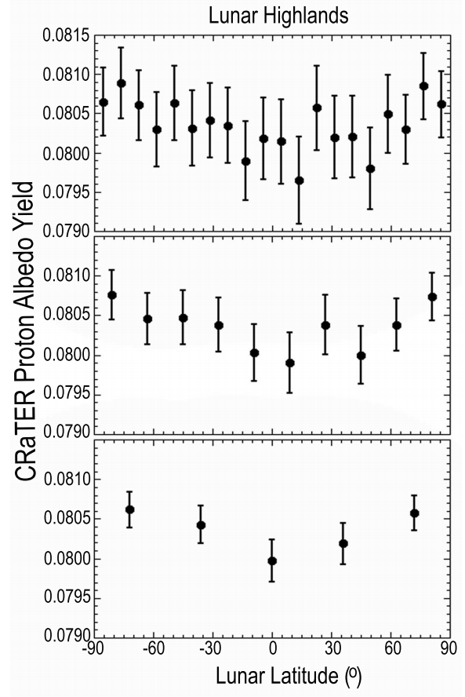
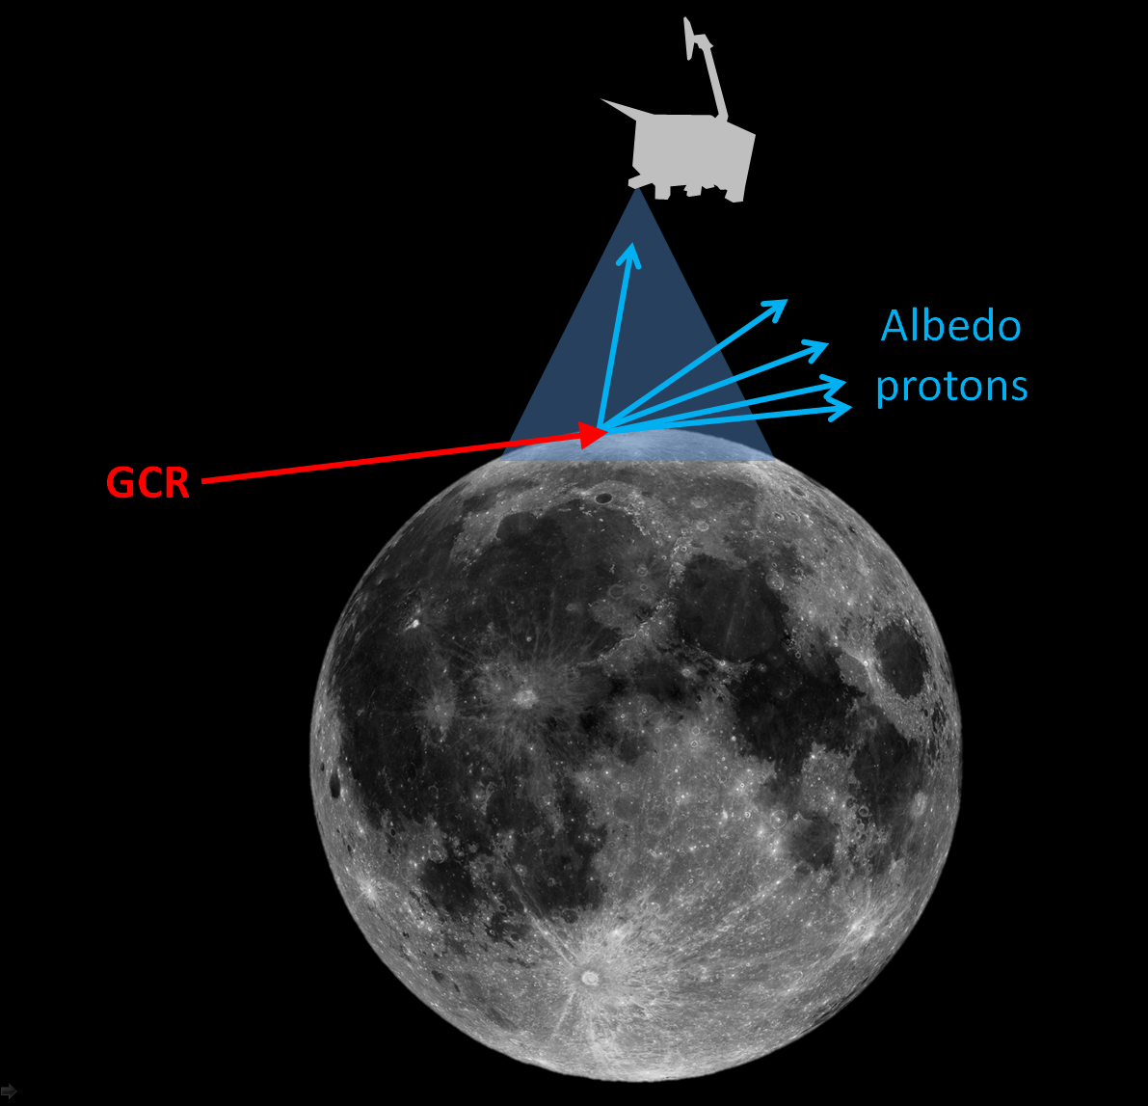
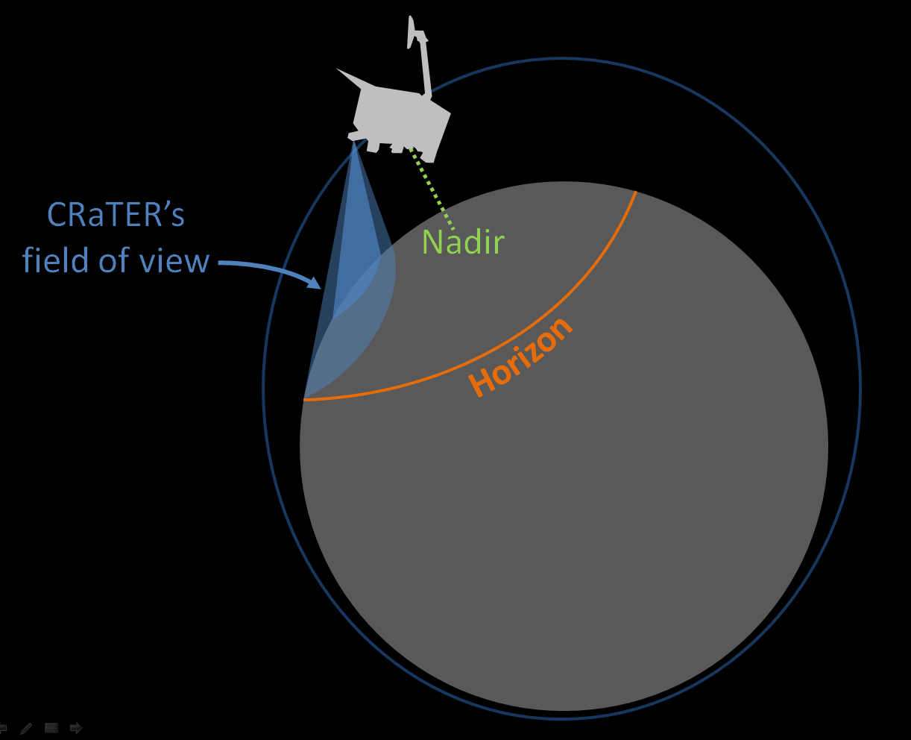
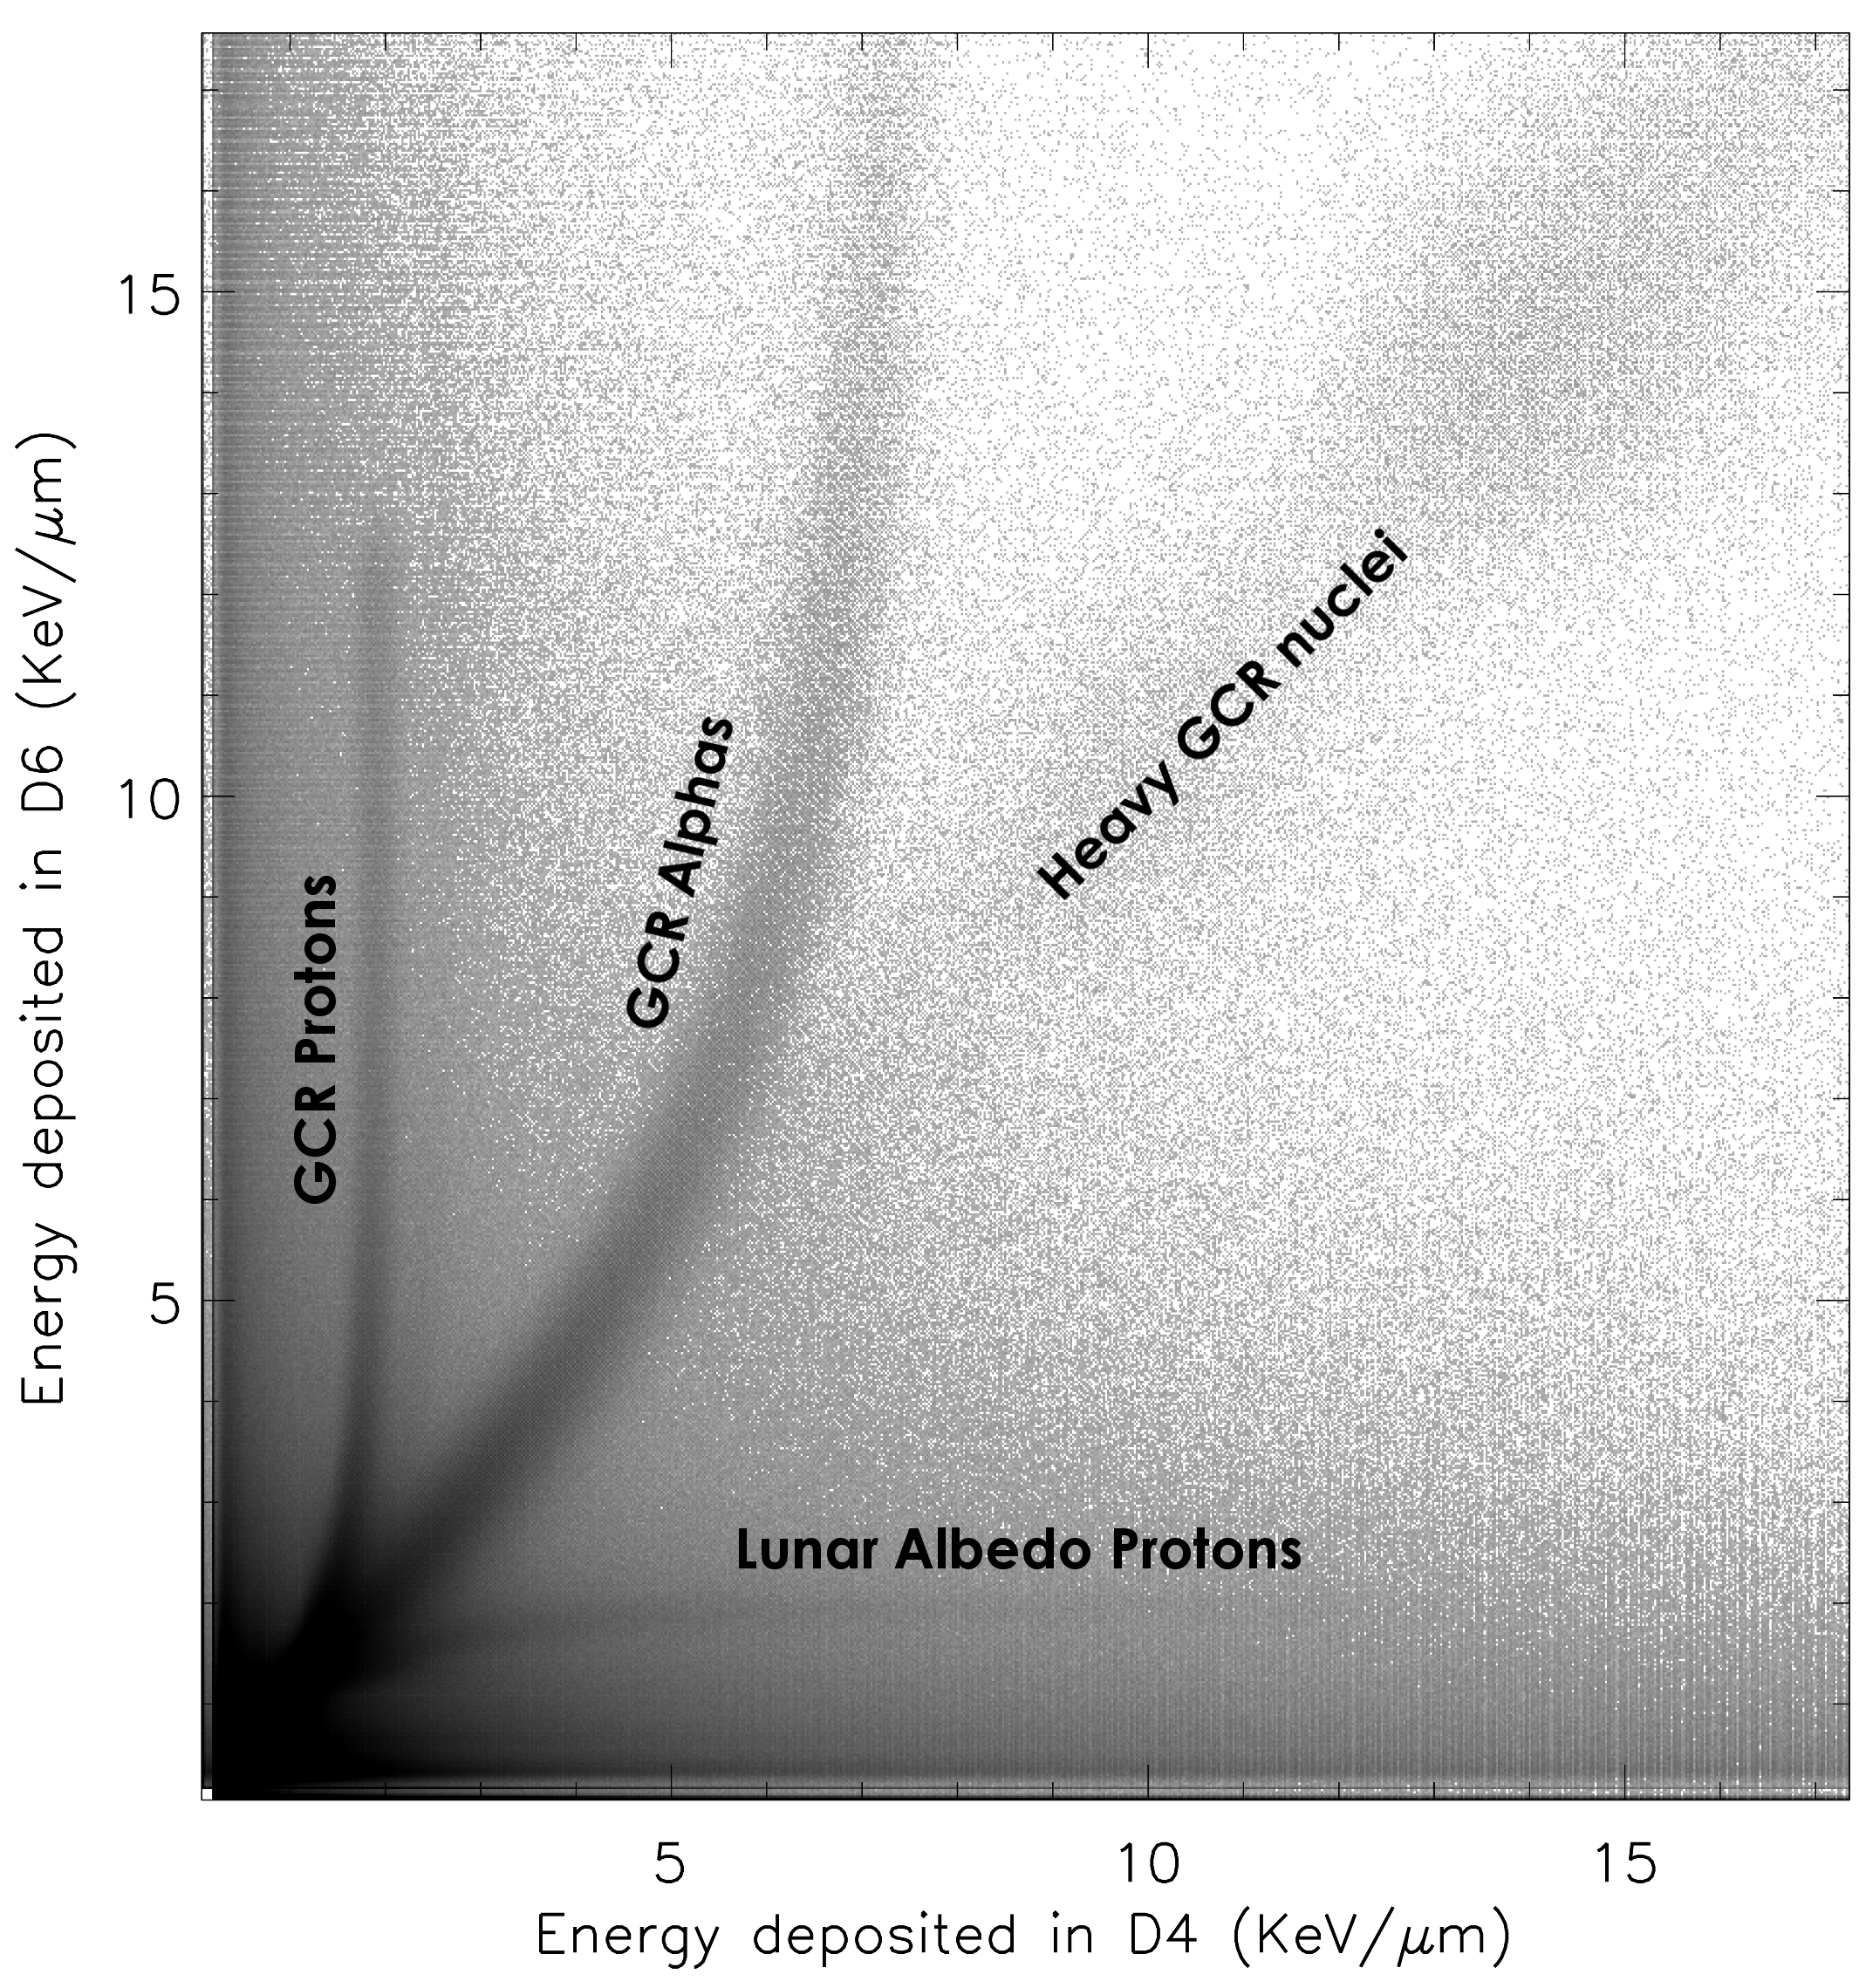
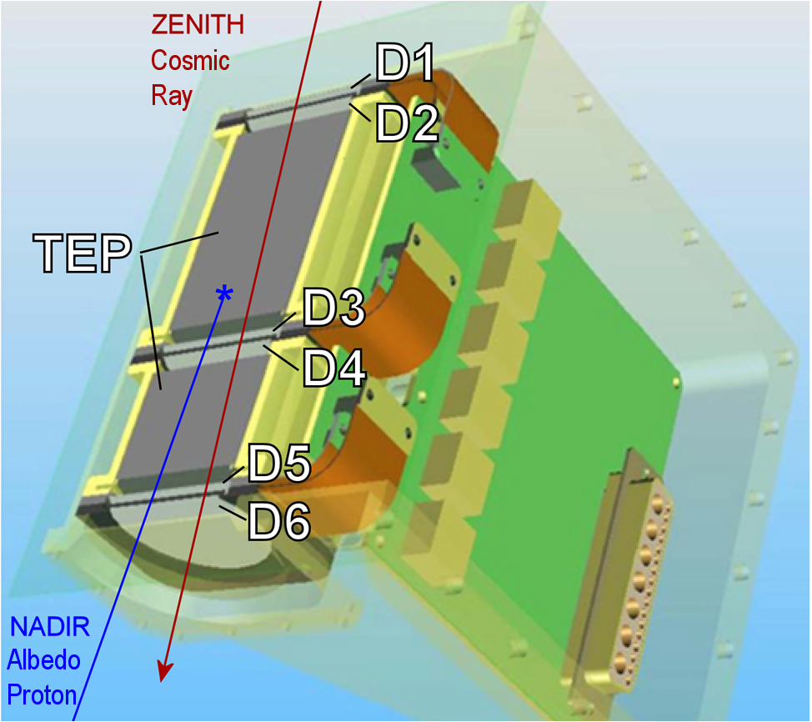
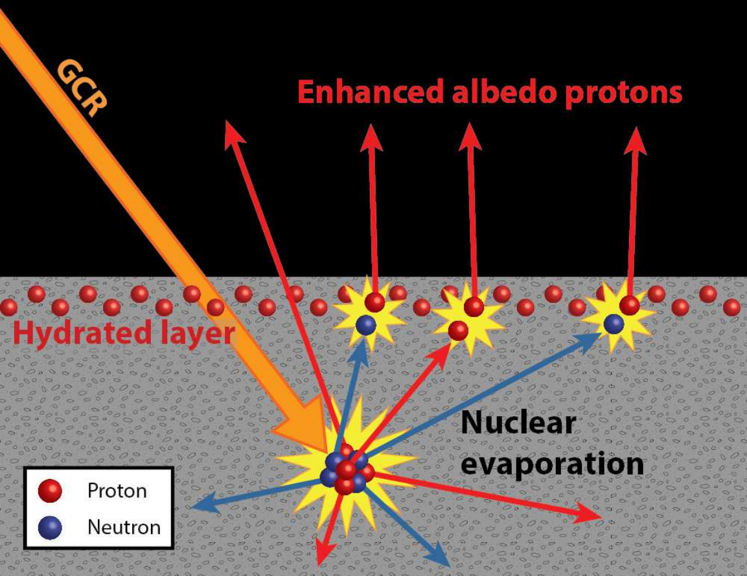
Shallow Lunar Hydrogen and Forward-Scattered Albedo Protons
Jody K. Wilson^{1,2} (jody.wilson@unh.edu), N. Schwadron^{1,2}, H. E. Spence^{1,2}, A. P. Jordan^{1,2}, M. D. Looper³, L. W. Townsend⁴
(1) Space Science Center, University of New Hampshire, Durham, NH; (2) Solar System Exploration Research Virtual Institute, NASA Ames Research Center, Mountain View, CA; (3) The Aerospace Corporation, Los Angeles, CA; (4) Dept. of Nuclear Engineering, Univ. of Tennessee, Knoxville, TN
Summary
The CRaTER instrument on LRO has observed a slight increase in lunar albedo proton yield with lunar latitude which may be due to the presence of a thin (< 10 cm) layer of hydration in the regolith [1]. This would be the first detection of lunar volatiles by high energy (> 60 MeV) albedo protons.
A new set of horizon-viewing observations over the next three years by CRaTER will test the hydrated layer hypothesis by looking for an enhanced flux of grazing-angle albedo protons produced by forward-scattering knock-on collisions with grazing-angle cosmic rays and solar energetic particles.
Albedo Proton Yield Latitudinal Trend
Horizon Observations
Hydrogen in the top 10 cm of lunar regolith should enhance the flux of albedo protons ejected at grazing (horizontal) angles relative to the vertically-directed protons that CRaTER normally measures.
In order to optimize measurements of grazing-angle albedo protons without contamination from cosmic rays, LRO needs to be oriented precisely, with CRaTER’s field of view almost touching the lunar horizon (within ~1°).
CRaTER successfully made its first horizon observations on May 26-28, 2015, and measured a ~40% higher proton yield at grazing angles (averaged over all latitudes) compared to near-normal angles. Intra-nuclear cascade collisions of grazing-angle cosmic rays probably contribute to this enhancement, as fragments from INCs are biased in the forward direction, but a small fraction may also be due to knock-on collisions between cosmic rays and H near the surface.
Schwadron et al. 2015
Schwadron et al. 2015
The yield of albedo protons in the highlands is ~1% greater near the poles than near the equator. This cannot be explained by hydration to depth in the polar regolith, as deep H should suppress the proton yield. Rather, we hypothesize that a thin layer (< 10 cm) of hydrated regolith could enhance the yield over dry regolith by converting albedo neutrons into albedo protons through knock-on collisions. Simulations of lunar albedo protons in wet and dry regolith using GEANT4 qualitatively support this mechanism, although the density of hydrogen required to produce the observed effect may be larger than the ~100-200 ppm suggested by neutron observations near poles and in permanently shaded regions [2].
CRaTER's six detectors can discriminate different elements in the galactic cosmic ray (GCR) population above ~10 MeV/nucleon, and can also distinguish between GCRs arriving from deep space and secondary particles traveling up from the lunar surface. http://crater.sr.unh.edu/
Future Work
More horizon observations are scheduled for November 2015 and May 2016, all of which occur over the lunar terminator at either dawn or dusk.
In the LRO Dynamic Moon Mission (2016-2018) CRaTER will make one horizon observation covering a full meridian (half orbit) every 4 days. These observations will cover all Earth-facing longitudes and all local times, meaning we can search for diurnal variations in the H abundance.
References
N. Schwadron et al., submitted to Icarus (2015)
D. Lawrence et al. [2006], JGR, 111, E08001;
A. Sanin et al. [2012], JGR, 117, E00H26
Acknowledgements: This work was supported by the NASA LRO project and the DREAM2 Project

