Slide 1






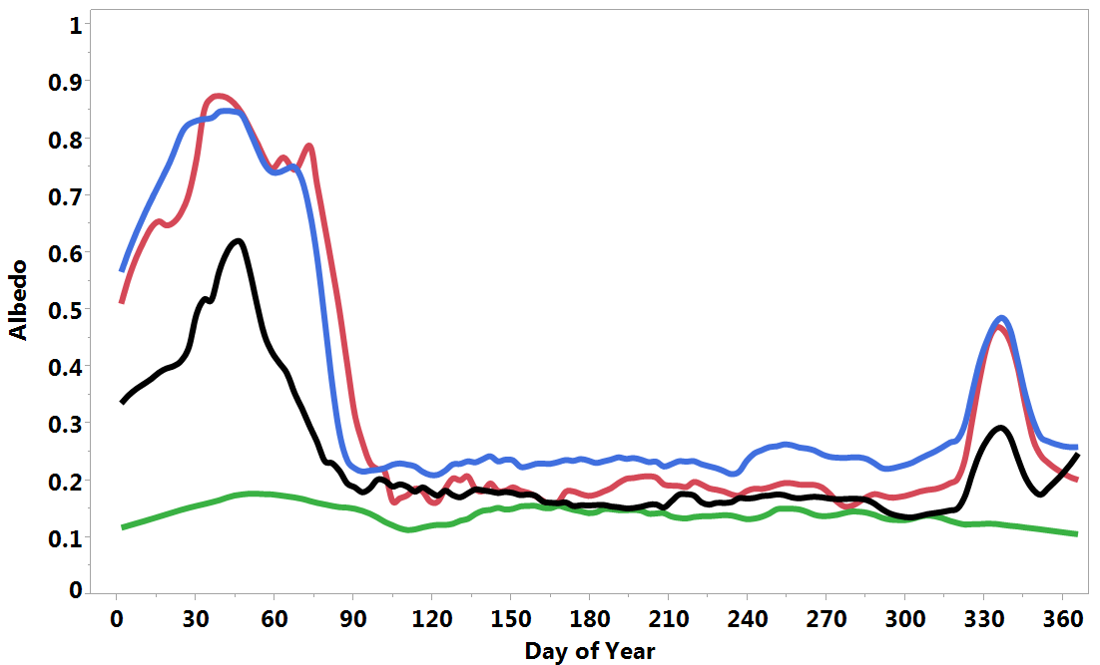

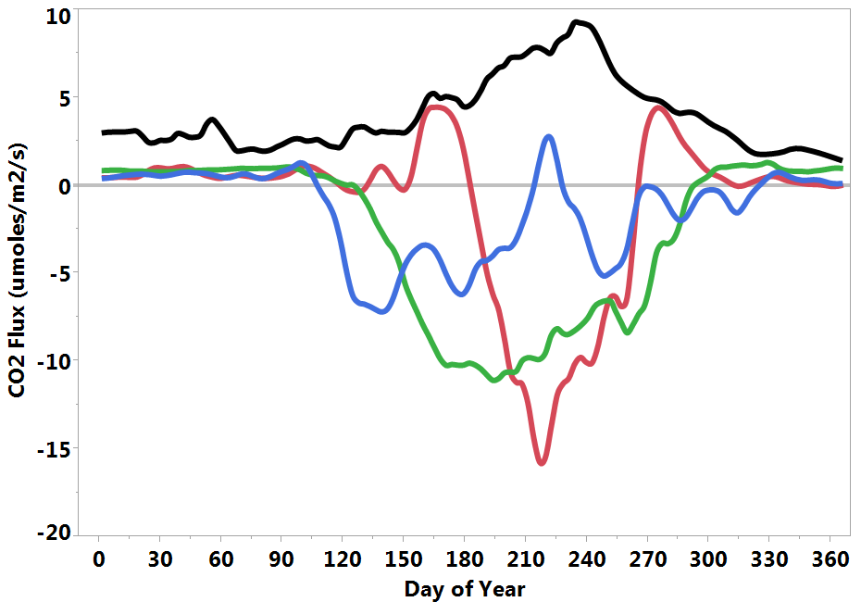

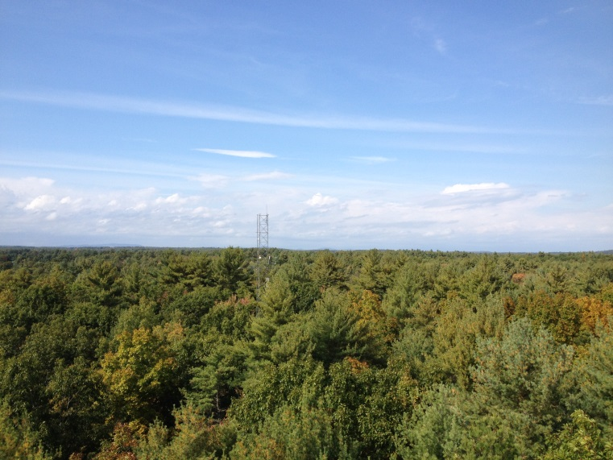
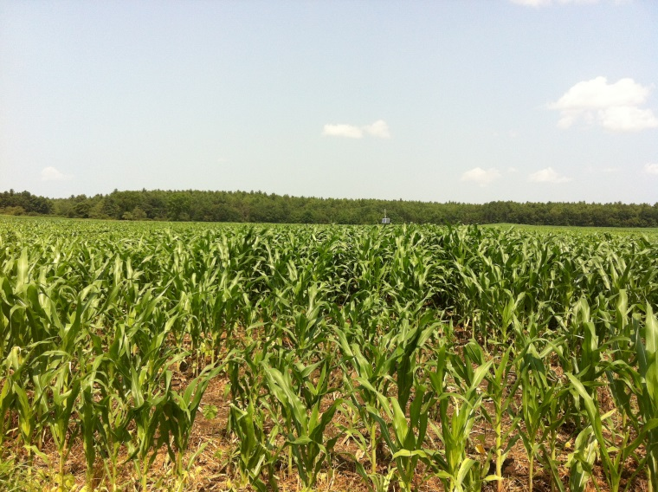
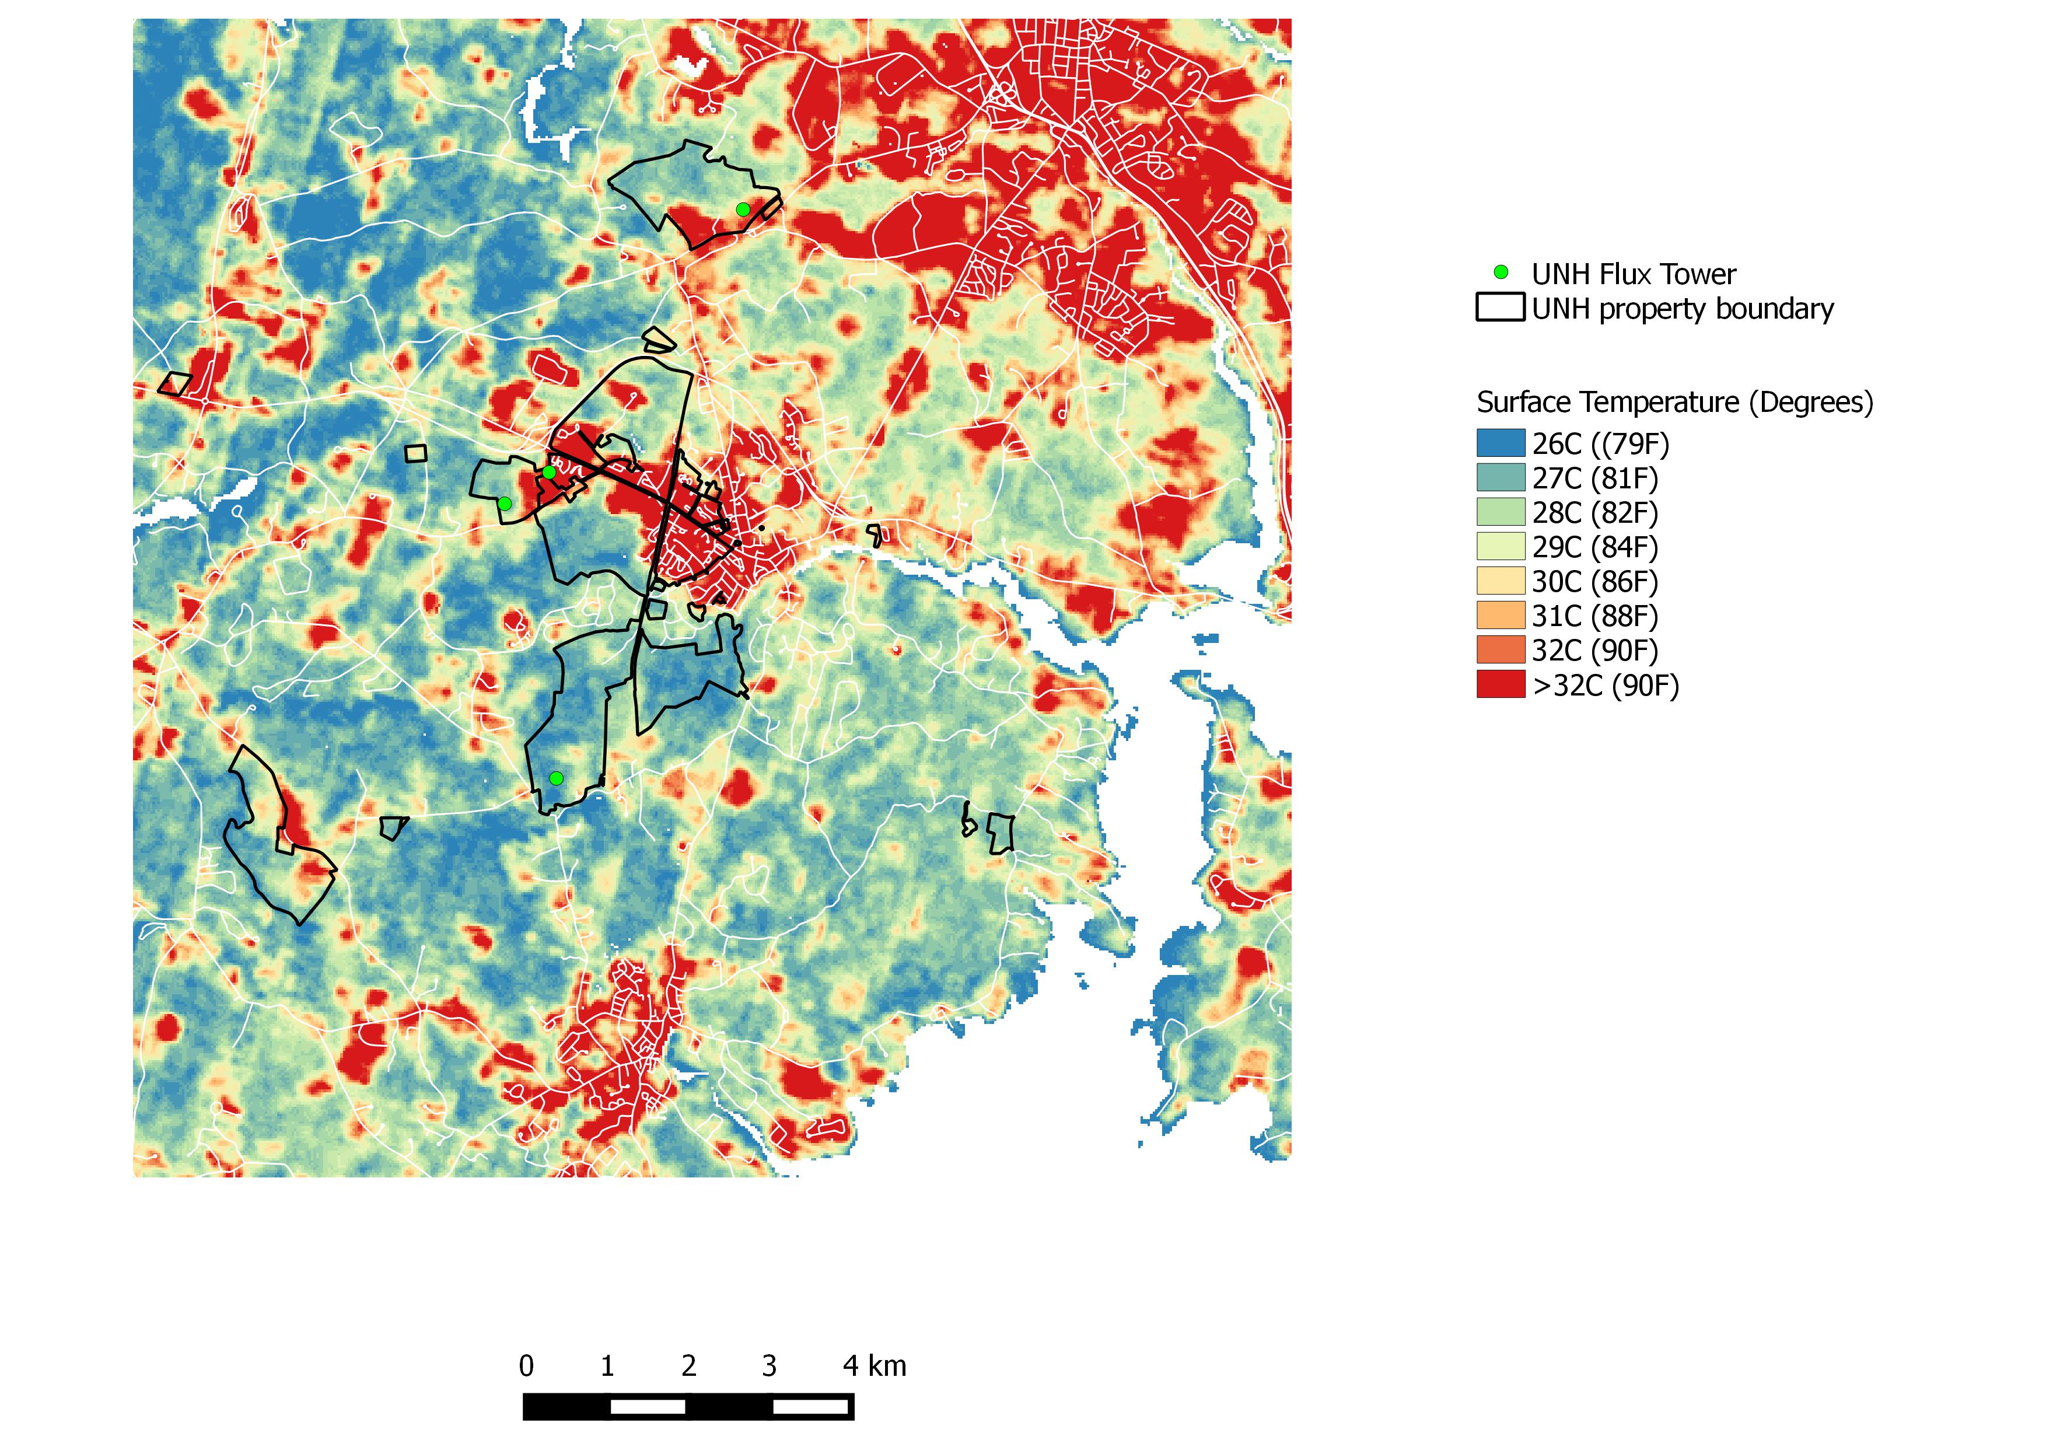
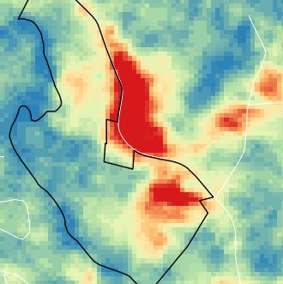
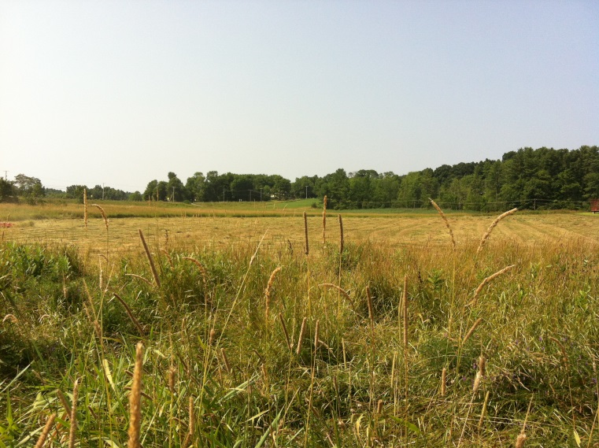
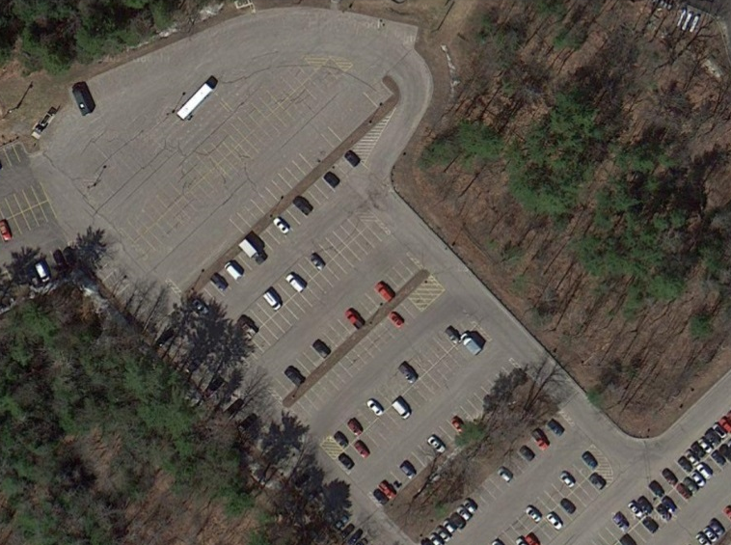
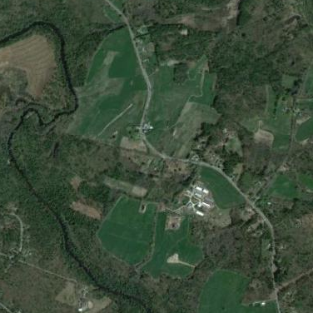
Land-Climate Interactions Across 4 Land Cover Types in New Hampshire
Andrew Ouimette, Lucie Lepine, Scott Ollinger, Sean Fogarty
Earth Systems Research Center, University of New Hampshire, Durham, NH 03824, USA
Andrew.Ouimette@unh.edu
Support for the NH EPSCoR Program is provided by the National Science Foundation's Research Infrastructure Improvement Award # EPS 1101245.
Abstract
Reflectivity of Different Landcover Types During the Year
Differences in “Sweating” Across Landcover Types
To better assess land-climate interactions in NH under future change scenarios, we are measuring greenhouse gas, energy, and radiation fluxes across 4 different land cover types that broadly represent the NH landscape: forest, field/pasture, corn/agriculture, residential/paved. In the simplest terms, these fluxes can be thought of as breathing (respiring CO₂ and other greenhouse gases), reflecting (albedo), and sweating (evapotranspiration). Here we present data from eddy covariance flux towers and biometeorological sensors across the 4 land cover types, highlighting the land-climate interactions of each land cover type and their effect on local and global climate.
Snow
Hayfield
Cornfield
Parking Lot
Forest
Growing Season
Net ecosystem exchange (NEE) at 4 different landcover types around Durham, NH. Negative values indicate carbon (C) uptake by the land surface (photosynthesis) while positive values indicate C release.
Comparison evapotranspiration rates of 4 landcover types during mid summer. The forested site has the highest water vapor flux rates presumably due to the larger leaf area index and deeper rooting depth of the forest stand. West Edge Parking Lot has comparably low evapotranspiration rates (inability to “sweat”).
Land-Climate Interactions
Albedo
Latent and sensible heat
Gas exchange
Carbon Flux of Different Landcover Types During the Year
Differences in Land Surface Temperature
“Reflectivity”
“Sweating”
“Breathing”
Hayfield
Cornfield
Parking Lot
~
~
Greenhouse Gases
Forest
~
~
~
~
Longwave
Radiation
Eddy Flux Tower Sites
Net ecosystem exchange (NEE) at 4 different landcover types around Durham, NH. Negative values indicate carbon (C) uptake by the land surface (photosynthesis) while positive values indicate C release.
Comparison of the difference between land surface temperature and air temperature for Kingman Hayfield, Thompson Forest, Moore Cornfield and West Edge parking lot during a typical July day. The inability of non-vegetated surfaces to “sweat” or evapo-transpire results in warmer surface temperatures (urban heat island effect).
Thompson Forest, Durham, NH
Moore Cornfield, Durham, NH
Carbon Flux and Land Management
Thermal Remote Sensing of Land Surface Temperature
Liquid manure application
Manure application
Mowing
Mowing
Mowing
The eddy flux systems and data they capture will also provide opportunities for undergraduate and graduate research projects, as well as middle and high school science and technology projects and internships.
Kingman Hayfield, Madbury, NH
West Edge Parking Lot, Durham, NH
Data derived from the eddy flux systems have direct relevance to the EPSCoR Ecosystems & Society project, as they will be used not only by terrestrial and hydrologic modeling groups, but also to assess climate and future land-use scenarios. By understanding how each component of the landscape contributes to the surface energy budget, we will be better able to estimate climate forcing under various land-use scenarios. This knowledge will help inform decisions about future land use.
Net ecosystem exchange (NEE) at Kingman Hayfield during 2014. Negative values indicate carbon (C) uptake by the land surface (photosynthesis) while positive values indicate C release. Data shown are only for daytime. Mowing resulted in a decrease of C uptake by the land surface while fertilization was coincident with an increase in C uptake.
Thermal remote sensing of land surface temperature of the Durham, NH area on a typical summer day. Figures on right are zoomed in on UNH’s Organic Dairy Farm.

