Slide 1

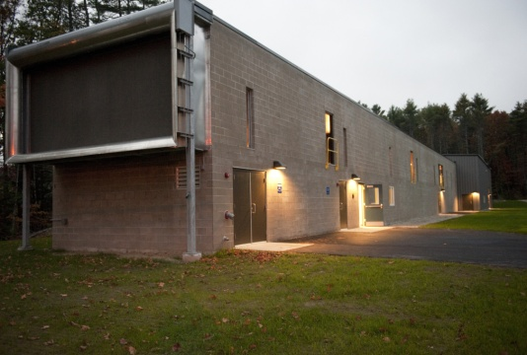
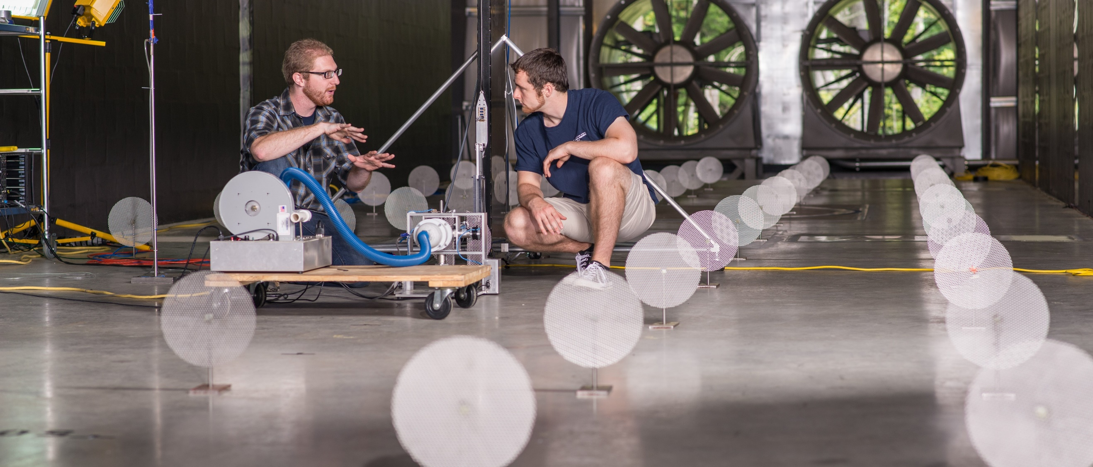
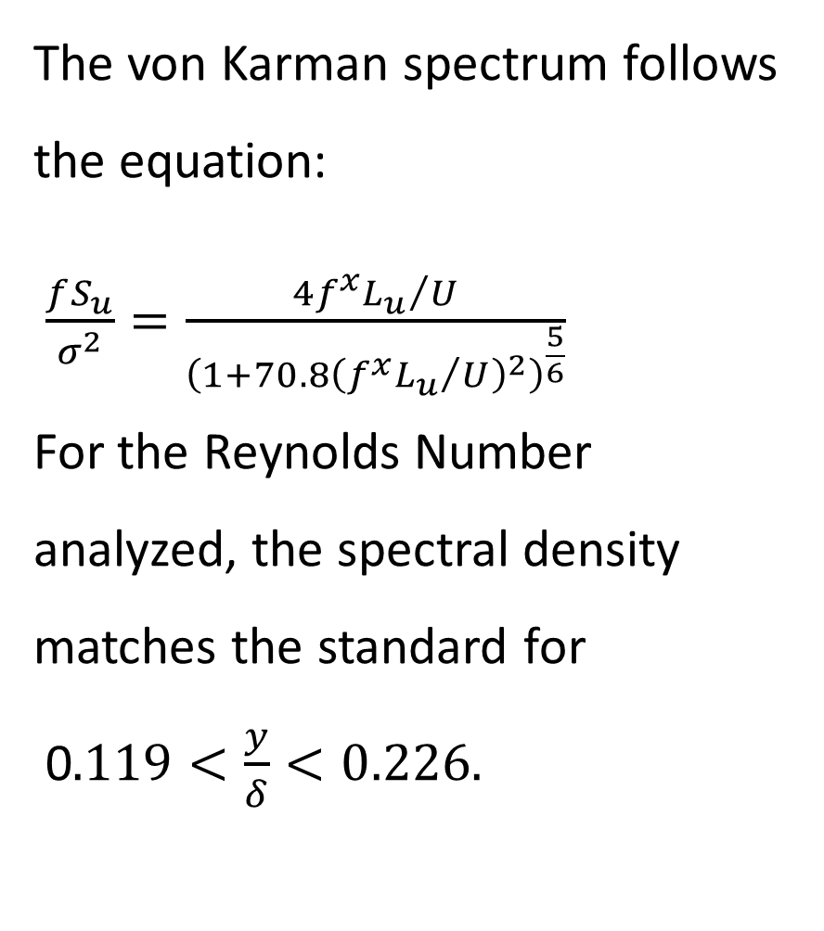
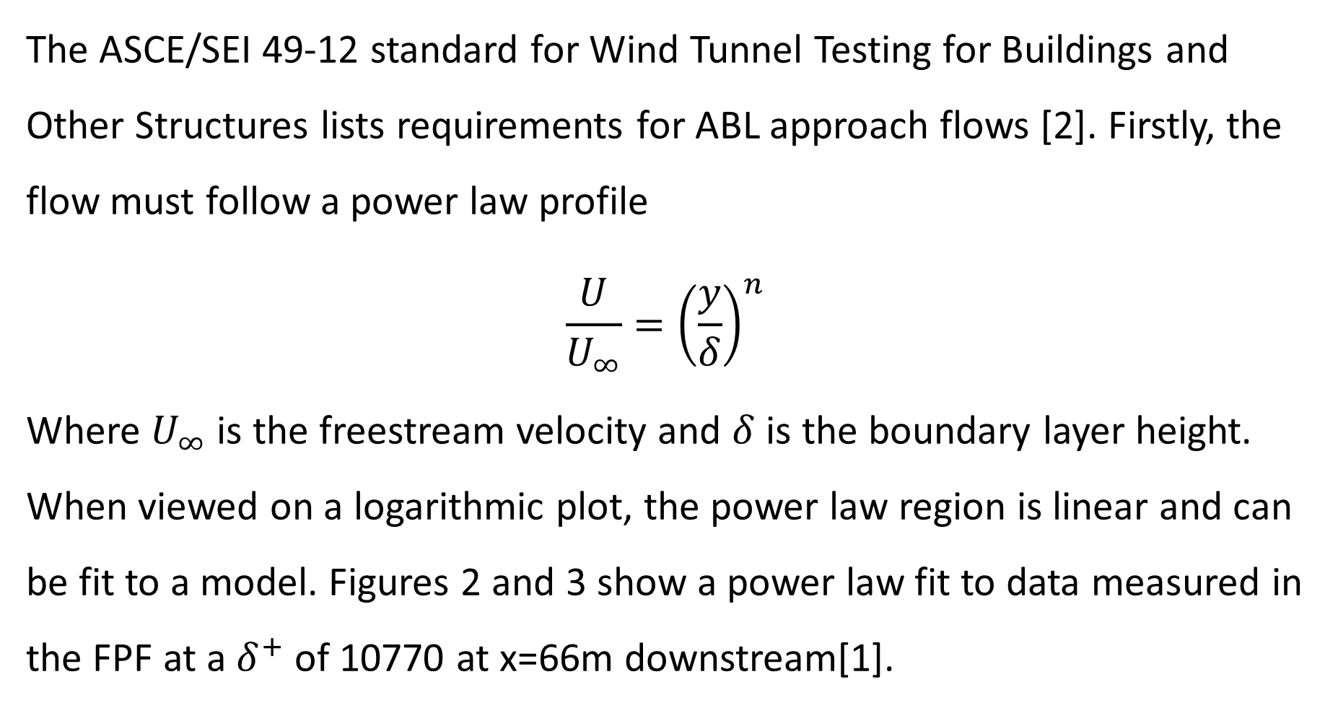

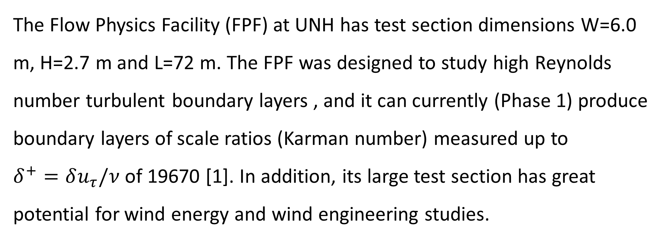
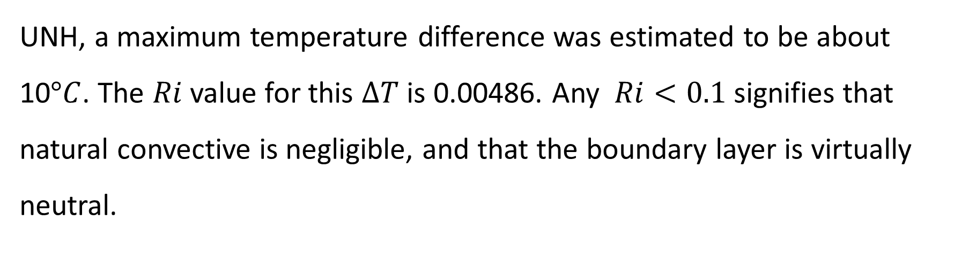
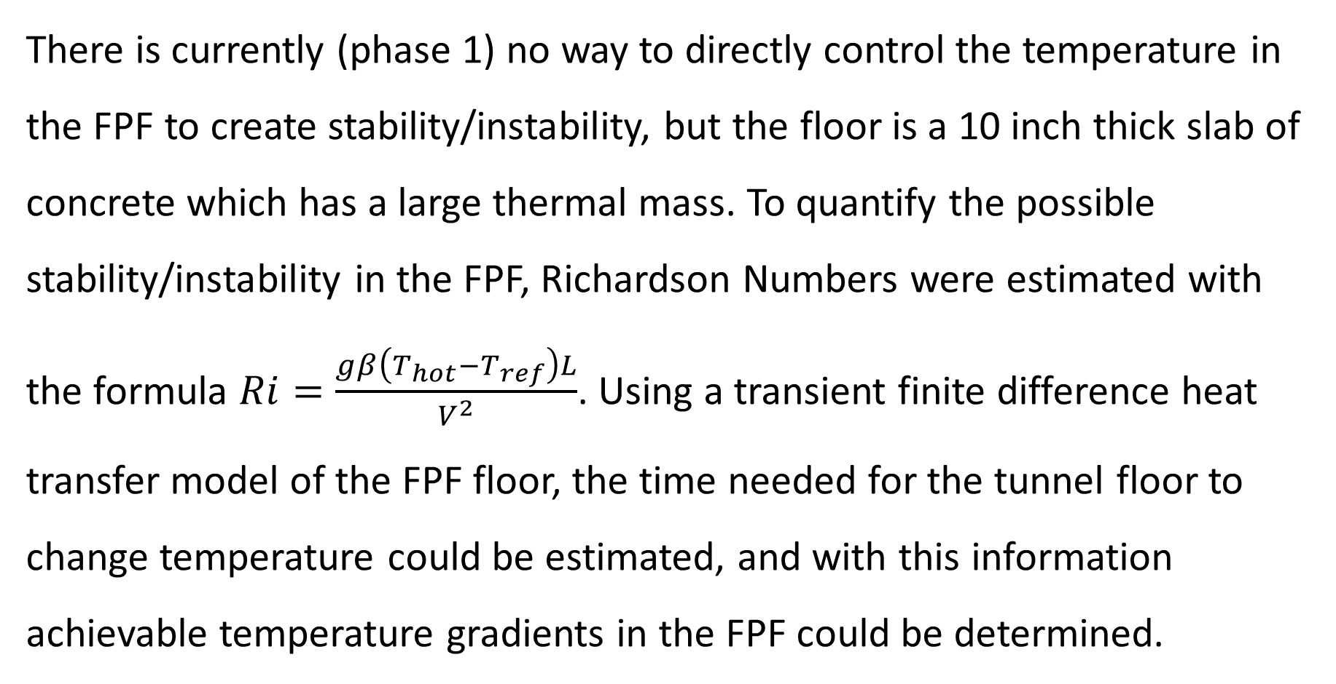
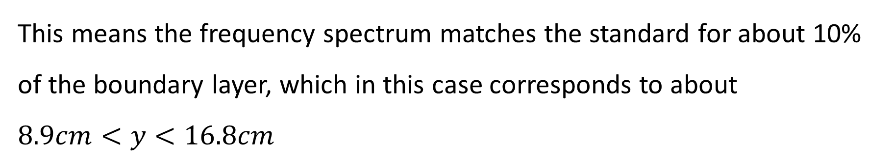
Physical Modeling of the Atmospheric Boundary Layer (ABL) for Wind Energy
and Wind Engineering Studies In the UNH Flow Physics Facility
Greg Taylor-Power, University of New Hampshire
John Turner V, University of New Hampshire
Martin Wosnik, University of New Hampshire
The UNH Flow Physics Facility
ASCE Standards
Potential for Stability/Instability
The ASCE/SEI 49-12 standard for Wind Tunnel Testing for Buildings and Other Structures lists requirements for ABL approach flows [2]. Firstly, the flow must follow a power law profile
$$\frac{U}{U_{∞}}={\left(\frac{y}{δ}\right)}^{n}$$
Where $U_{∞}$ is the freestream velocity and $δ$ is the boundary layer height. When viewed on a logarithmic plot, the power law region is linear and can be fit to a model. Figures 2 and 3 show a power law fit to data measured in the FPF at a $δ^{+}$ of 10770 at x=66m downstream[1].
Figure 5 – One Application for ABL Simulation in the FPF: Large Wind Turbine Arrays
Figure 1 – Flow Physics Facility Exterior
There is currently (phase 1) no way to directly control the temperature in the FPF to create stability/instability, but the floor is a 10 inch thick slab of concrete which has a large thermal mass. To quantify the possible stability/instability in the FPF, Richardson Numbers were estimated with the formula $Ri=\frac{gβ\left(T_{hot}−T_{ref}\right)L}{V^{2}}$. Using a transient finite difference heat transfer model of the FPF floor, the time needed for the tunnel floor to change temperature could be estimated, and with this information achievable temperature gradients in the FPF could be determined.
The Flow Physics Facility (FPF) at UNH has test section dimensions W=6.0 m, H=2.7 m and L=72 m. The FPF was designed to study high Reynolds number turbulent boundary layers , and it can currently (Phase 1) produce boundary layers of scale ratios (Karman number) measured up to $δ^{+}=δu_{τ}/ν$of 19670 [1]. In addition, its large test section has great potential for wind energy and wind engineering studies.
The Atmospheric Boundary Layer
Figure 2 – Log plot of FPF Boundary Layer Profile
with Power Fit
Figure 3 – Plot of FPF Boundary Layer Profile
with Power Fit
In order to perform wind energy or wind engineering studies on scale models in a wind tunnel, the approach flow must mimic the atmospheric boundary layer (ABL). The ABL exists in three different states determined by the vertical temperature gradient:
Neutral (no temperature gradient)
Stable (positive potential temperature gradient)
Unstable (negative potential temperature gradient)
This profile has a power law exponent of $n=0.137$ which corresponds to an ASCE type C boundary layer, or open flat terrain.
Results
Spectral Analysis
The non-convective heat transfer analysis showed that the FPF floor can retain its temperature within a degree for about 2 days when exposed to a constant ambient temperature. Knowing this and looking at air temperature data from
The ASCE standards also require the approach flow to match power spectra developed by von Karman (1948) [3]. Figure 4 shows the premultiplied power spectral density of the same data compared to the ASCE model.
The von Karman spectrum follows the equation:
$\frac{fS_{u}}{σ^{2}}=\frac{{4f^{x}L_{u}}/U}{{\left(1+70.8{\left({f^{x}L_{u}}/U\right)}^{2}\right)}^{\frac{5}{6}}}$
For the Reynolds Number analyzed, the spectral density matches the standard for
0$.119<\frac{y}{δ}<0.226.$
Research Objectives
Figure 6 – Tunnel Floor Temperature Distribution After 52 Hours
With initial floor temp of 270 K and initial air temp of 275 K
This study examines the FPF’s ability to simulate the ABL in the following ways:
Compare existing FPF boundary layer data to ASCE standards for wind tunnel tests
Perform a heat transfer analysis on the tunnel floor to estimate thermal lag
Determine the maximum achievable stable/unstable ABL simulation
UNH, a maximum temperature difference was estimated to be about 10$°C$. The $Ri$value for this $ΔT$ is 0.00486. Any $Ri<0.1$ signifies that natural convective is negligible, and that the boundary layer is virtually neutral.
Figure 4 – Spectral Density Plot from velocity data taken in the FPF
References
Acknowledgements
This means the frequency spectrum matches the standard for about 10% of the boundary layer, which in this case corresponds to about
$$8.9cm<y<16.8cm$$
[1] Vincenti P; Klewicki J; Morrill-Winter C; White C; Wosnik M (2013) Streamwise Velocity Statistics in Turbulent Boundary Layers that Spatially Develop to High Reynolds Number
[2] American Society of Civil Engineers (2012) Wind Tunnel Testing for Buildings and Other Structures:
ASCE/SEI 49-12
[3] von Kármán, T. (1948). Progress in the statistical theory of turbulence. Proc., National Academy of Sciences
[4] Incropera, Frank P., and David P. DeWitt (2011) Introduction to Heat Transfer Sixth Edition
Support comes from the UNH Hamel Center for Undergraduate Research via a Summer Undergraduate Research Fellowship.

