Slide 1

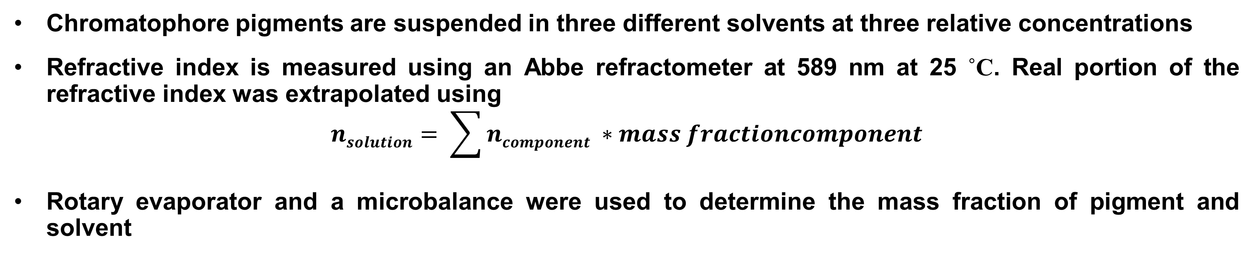
A potential mechanism describing color richness in squid Doryteuthis pealeii chromatophores
Sean R. Dinneen, Margaret E. Greenslade, and Leila F. Deravi
Biomaterials Design Group, Department of Chemistry
University of New Hampshire Durham, NH 03824
Background
Results
Doryteuthis pealeii
Cephalopods are well known for their ability to drastically camouflage to their environment in less than a second
Pigmented organs called chromatophores act as color filters to the light that is reflected off iridophores, the lowermost optical organ in their skin
Chromatophores contain radial muscle fibers that can change the organ size
The interior of the chromatophore organ contains nanostructured pigment granules, composed of protein and pigment
Hypothesis: The pigment contains high refractive index biomolecules that induce backscatter within the dermal tissue, contributing to the observed color richness in the animal
Chromatophore pigments are suspended in three different solvents at three relative concentrations
Refractive index is measured using an Abbe refractometer at 589 nm at 25 ˚C. Real portion of the refractive index was extrapolated using
$$nsolution= \sum{ncomponent ∗mass fractioncomponent}$$
Rotary evaporator and a microbalance were used to determine the mass fraction of pigment and solvent
a)
Acidic Methanol
b)
50/50 Methanol/Water
a)
Acidic Methanol
Figure 1. Mechanisms of cephalopod coloration span multiple spatial scales
c)
Methanol
d)
0.2M NaOH
Methods
b)
a)
b)
sea water
n = 1.34
45˚
53˚
Undiluted
Diluted by half
Diluted by fourth
Undiluted
Diluted by half
Diluted by fourth
reflectin
n = 1.59
Figure 4. Averaged refractive indices of solutions by concentration for A) acidic methanol, B) 50/50 methanol/water, C) methanol, and D) 0.2M NaOH. Error bars show ±1 standard deviation on 3 repeat measurements.
53˚
c)
d)
62˚
pigment
n = 1.99
HCl-MeOH
Refractive indices of xanthommatin/DC-xanthommatin pigments in chromatophore ranged from 1.73- 2.09 depending on solvent
Largest deviations are caused by solubility effects based on different solvent systems
Based on calculated and known refractive indices low incident rays of light can be refracted closer to the normal of the surface of the skin, allowing for better absorption of light
Figure 5. A) Average refractive index of pigment for each solution. Error bars show ±1 standard deviation. B) Depiction of light refraction starting at 45˚ through granule from sea water, including a reflectin protein layer. Angles calculated by Snell’s Law.
Figure 2. A) Dorsal mantle of the Doryteuthis pealeii, B) Microscope image of the chromatophore layer with 1 mm scale bar, C) SEM (1 µm scale bar) and photographic images of untreated pigment granules suspended in water, and D) SEM (1 µm scale bar) and photographic images of granules post-acidic methanol extraction
Pigment granules are isolated from Doryteuthis pealeii chromatophores and purified through centrifugation/wash cycles
Soluble pigment is extracted from the granules using acidic methanol
The extraction causes a 71% decrease in granule size on average
Summary
Characterization
Solution | Refractive Index | Standard Deviation
Acidic Methanol | 1.95 | 0.03
Acidic Methanol 2nd time | 1.97 | 0.01
Methanol | 1.95 | 0.36
50% (v/v) Methanol in Water | 2.09 | 0.21
0.2M NaOH | 1.73 | 0.15
Average refractive index of pigments (independent of solvent) is 1.99 ± 0.19
High refractive index biomolecules could provide a mechanism by which these animals can camouflage so efficiently
Table 1. Refractive indexes of the extracted pigment by solution. Each value is an average of the extrapolated value from each concentration where N=3
Our data shows that xanthommatin/DC-xanthommatin pigments have high refractive indices that may contribute to better absorption of light within the chromatophores
Future studies will focus on the role of pigments in optical scattering and absorption within the chromatophore
Figure 3. Absorbance profile of extracted pigment (left) and structures of identified pigment molecules (right)
Chromatophore pigments are xanthommatin and decarboxylated(DC) xanthommatin
We hypothesize that these pigments contribute to color richness in cephalopod chromatophores during actuation
To test this, we will measure refractive index of pigments extracted from the chromatophore granules
Acknowledgments
The authors would like to acknowledge the University of New Hampshire’s Instrumentation Center for use of their microbalance and the Marine Biological Laboratory at Woods Hole, MA for supplying the D. pealeii specimens.
This research was funded by the Department of Chemistry at the University of New Hampshire and the Center for Advanced Materials and Manufacturing Innovation at UNH

