Slide 1


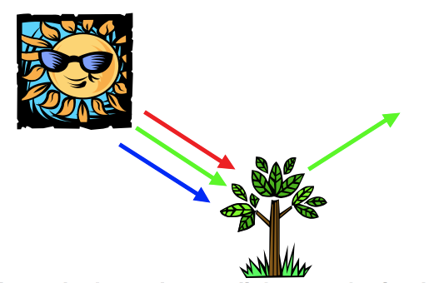
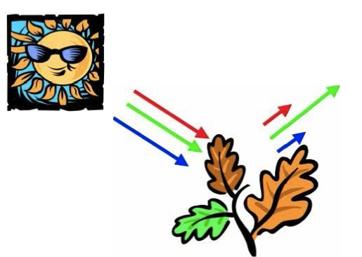
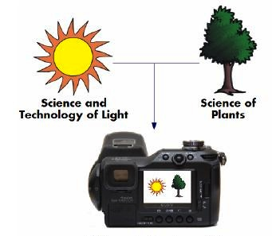
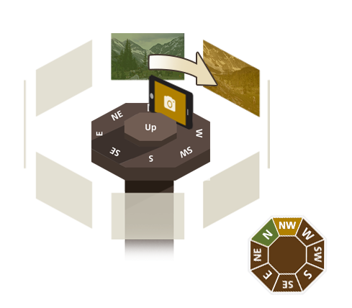
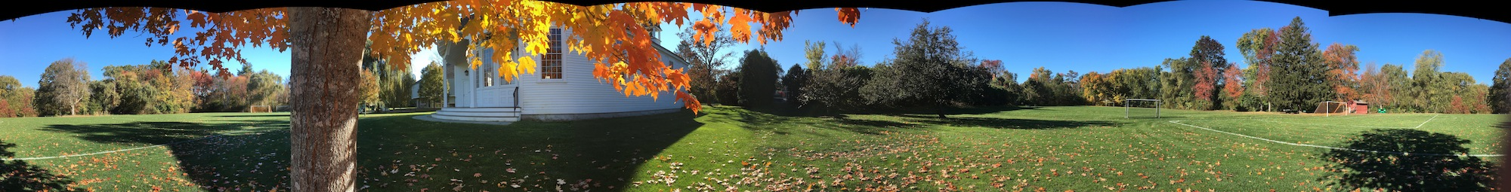
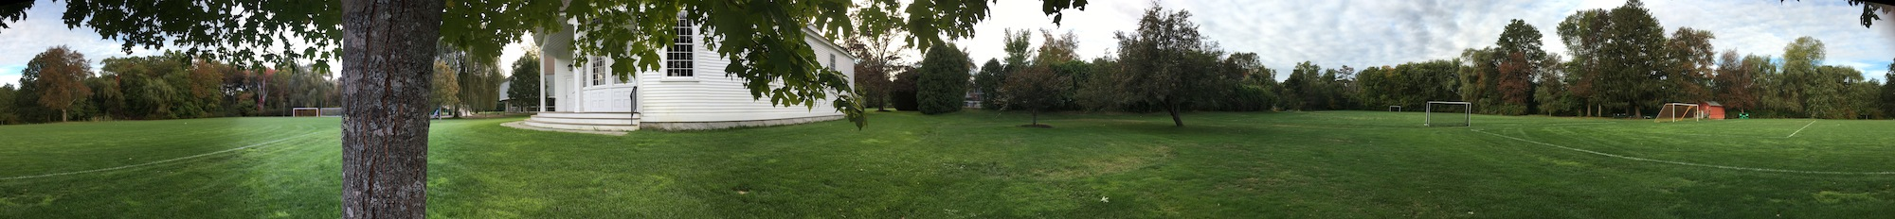
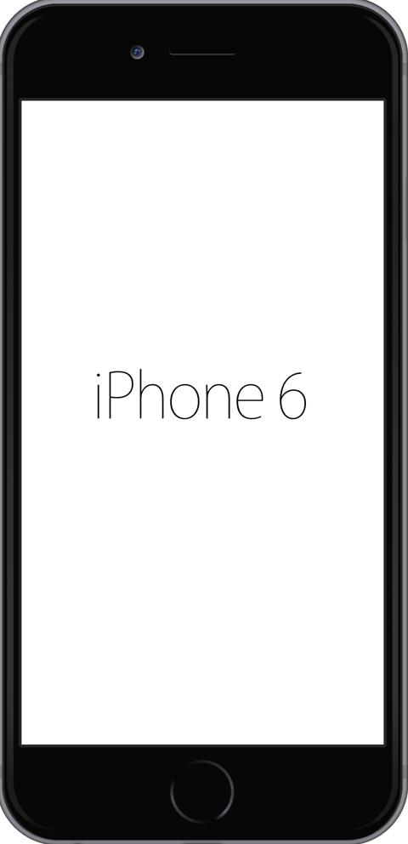

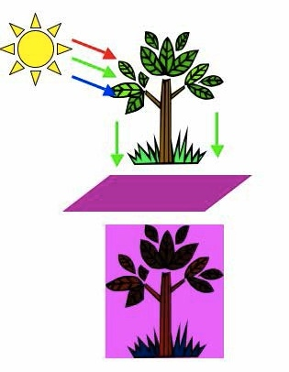
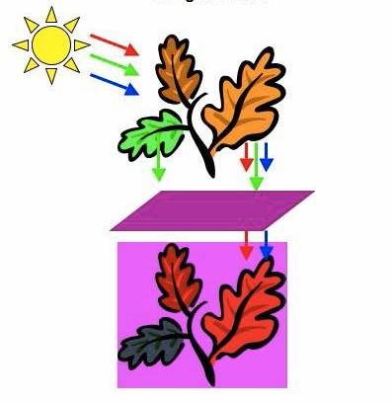
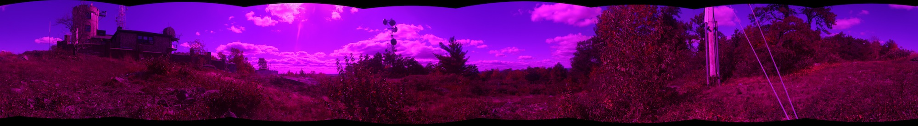
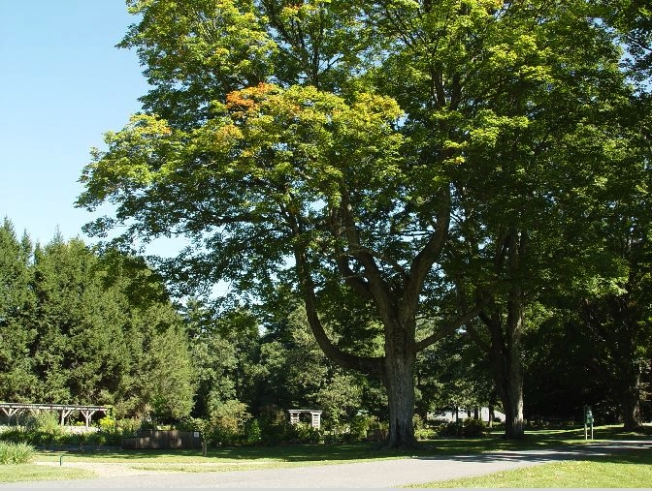
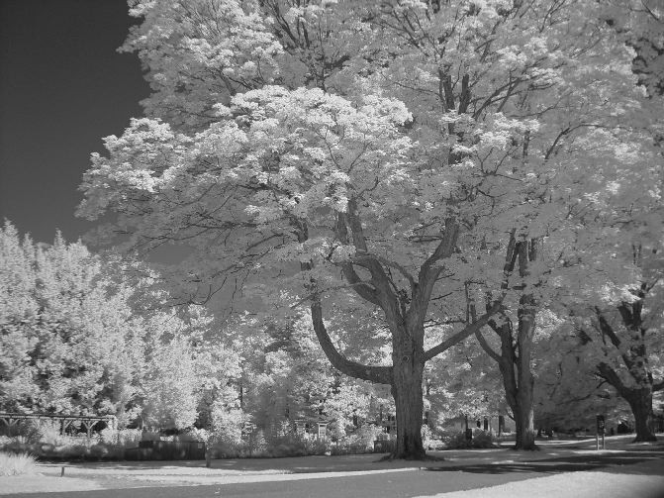
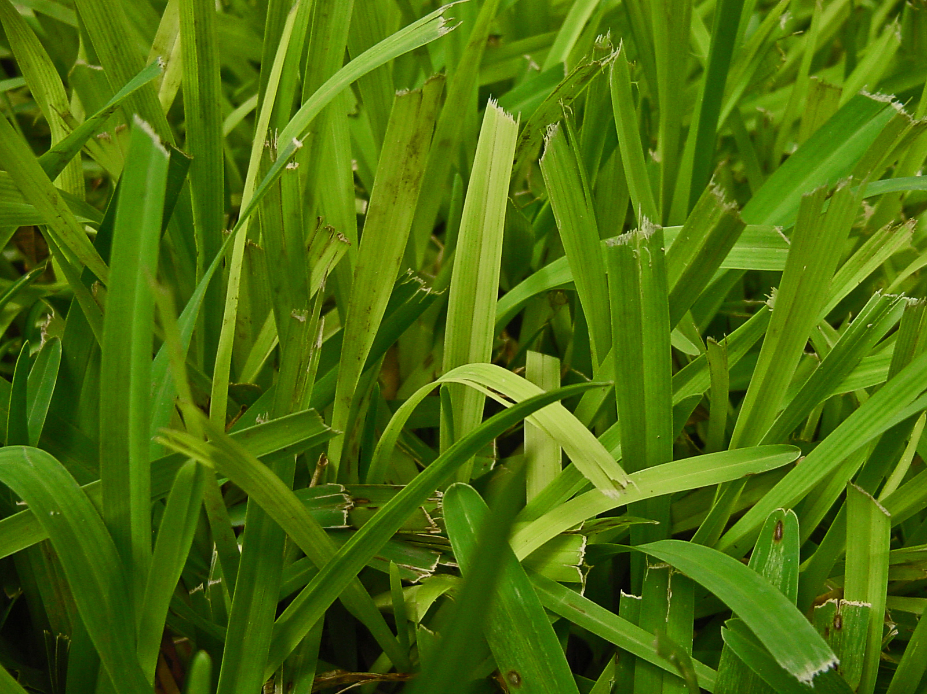
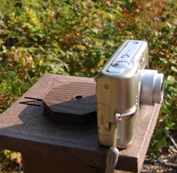
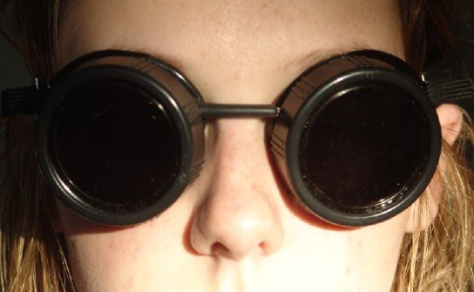
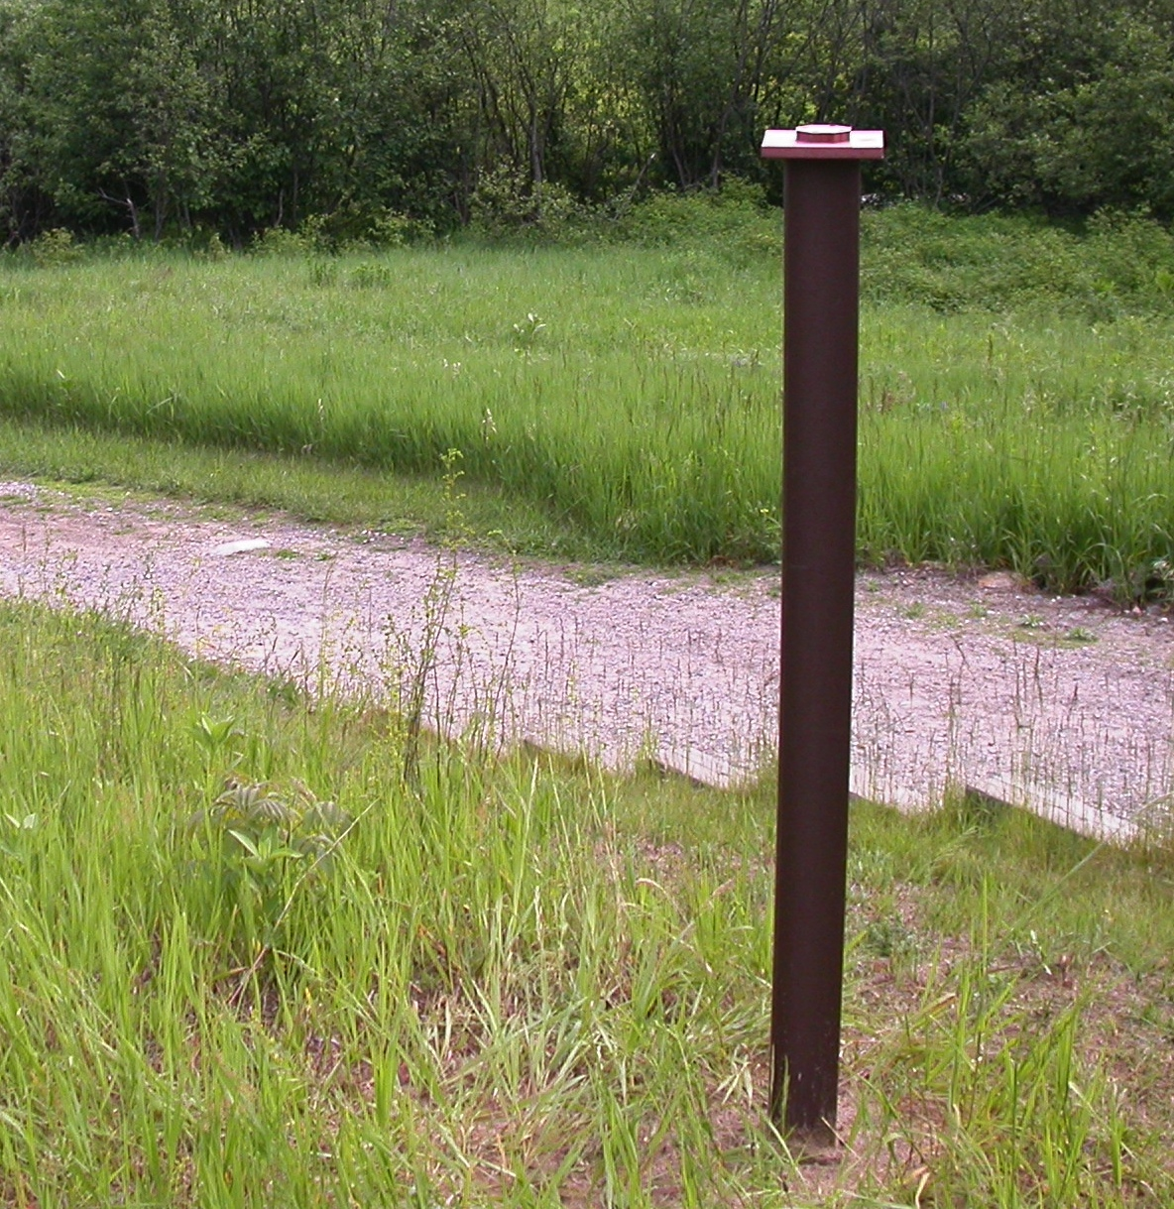
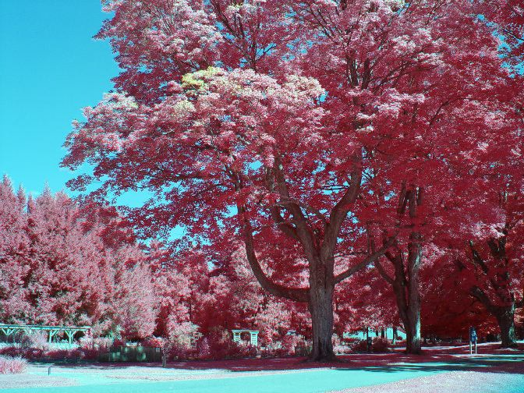
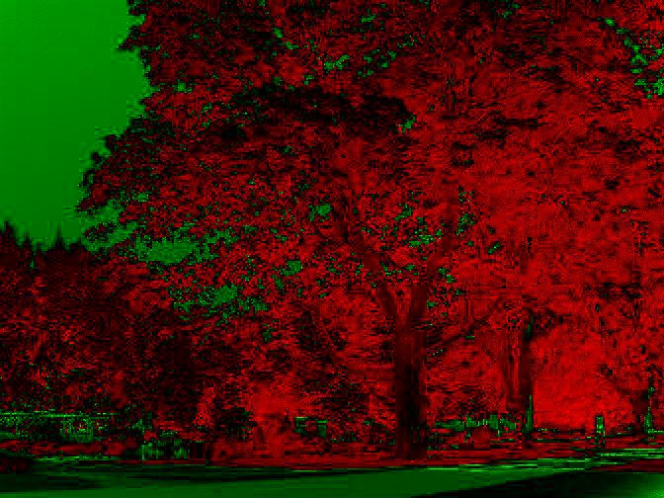
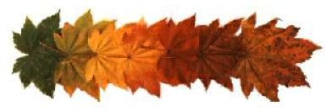
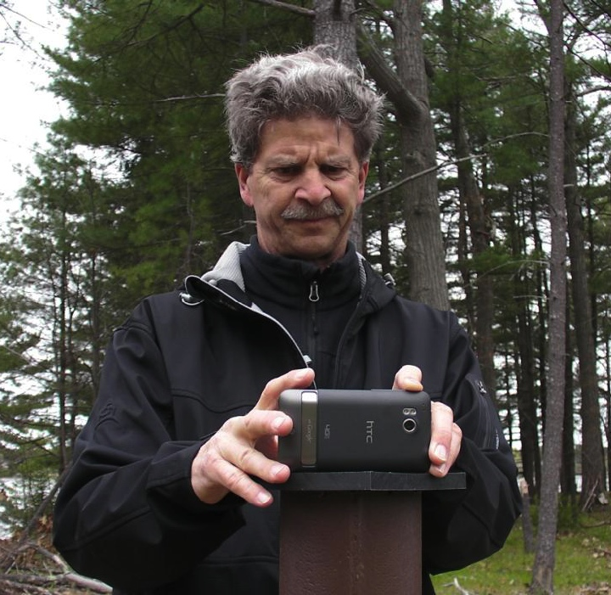
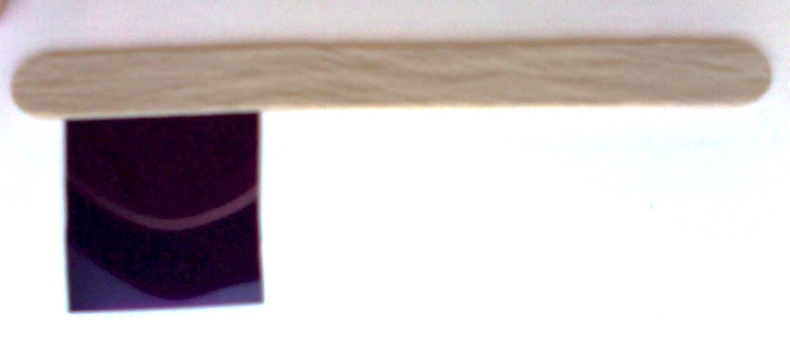
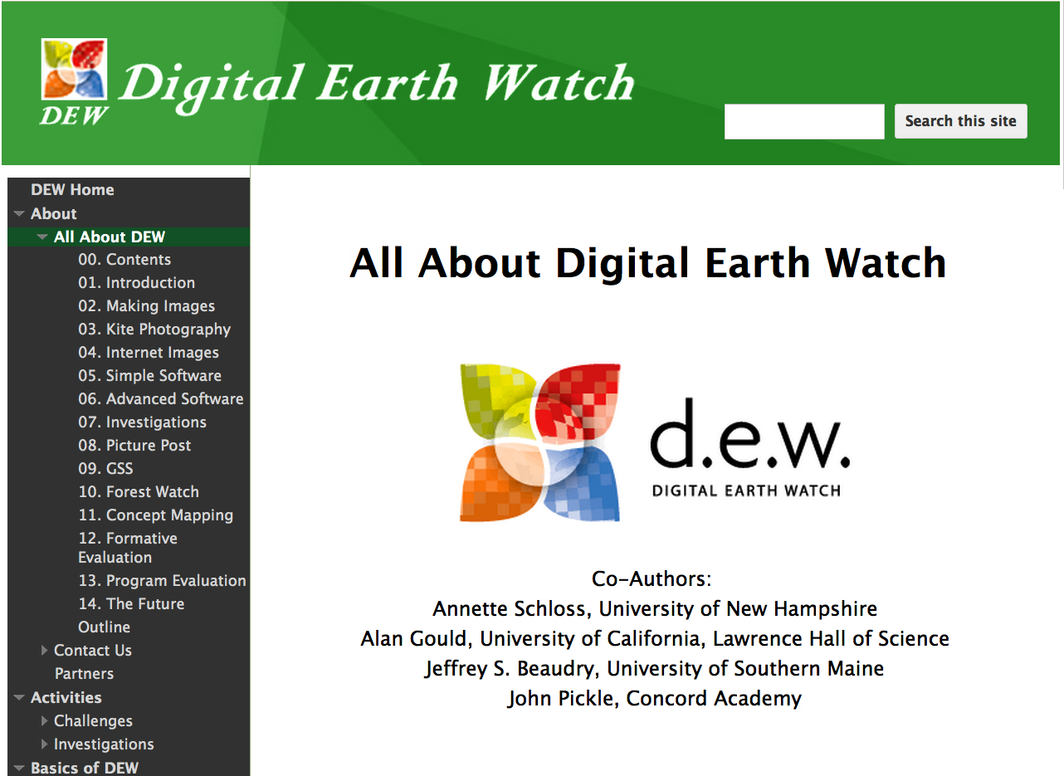
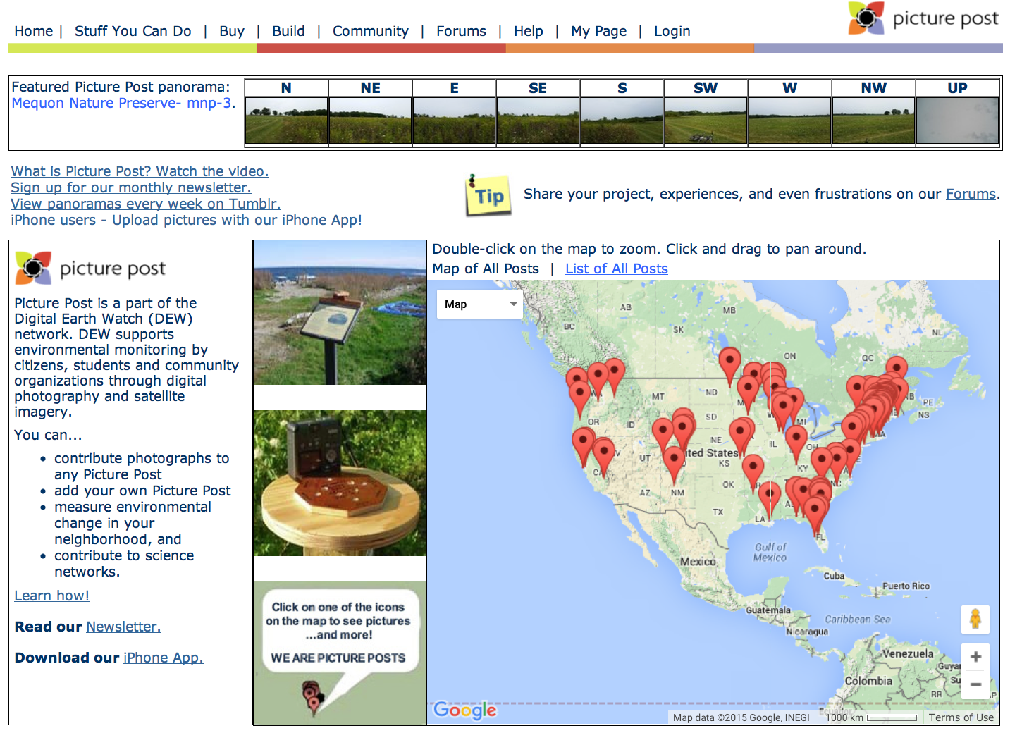
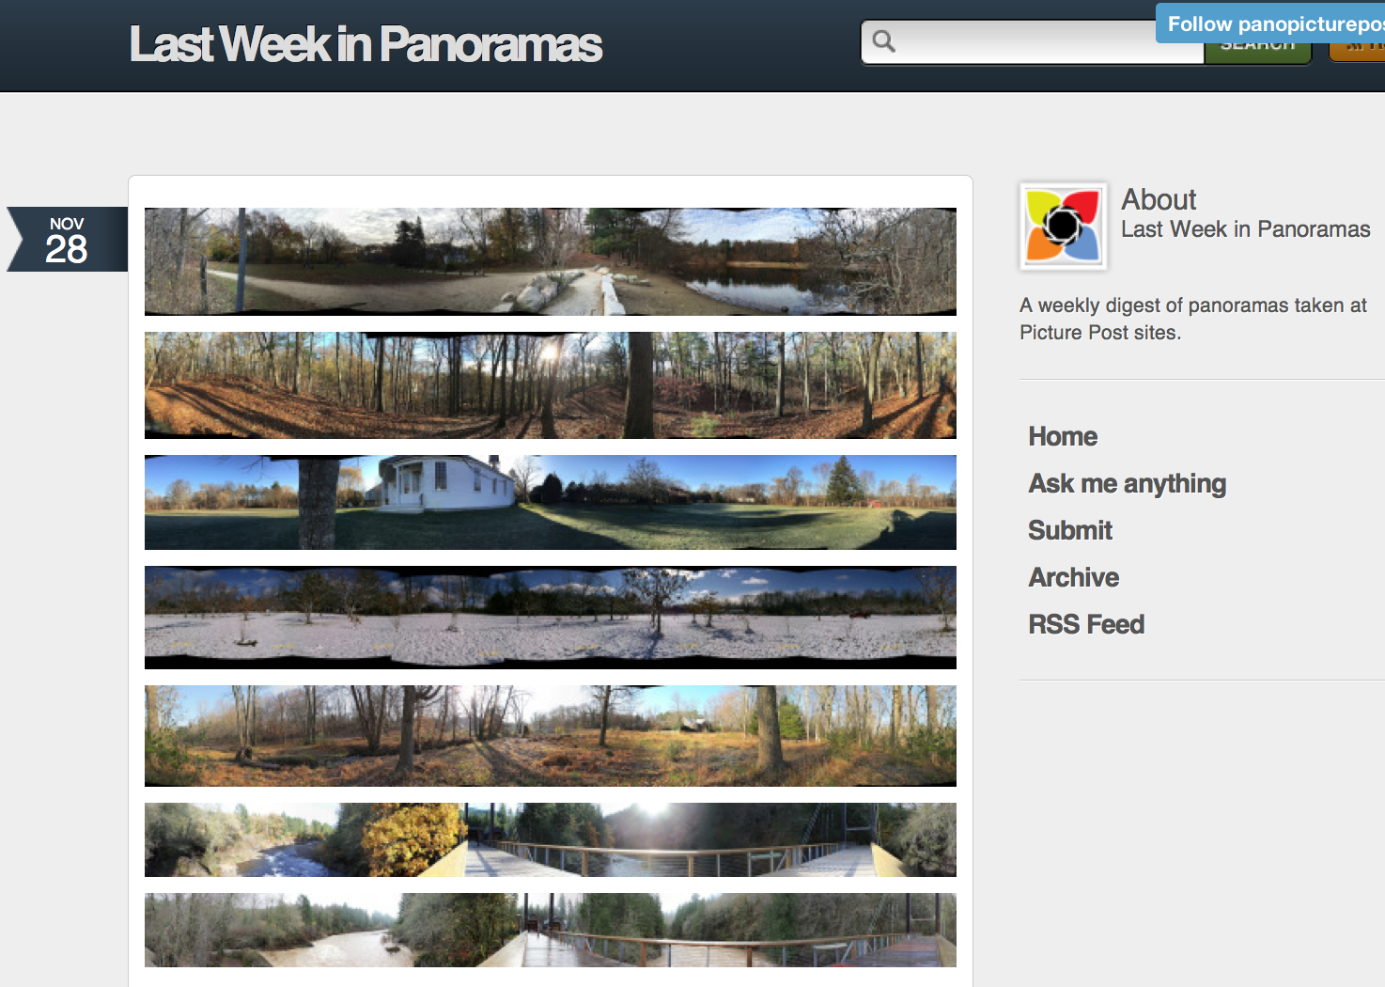

Digital Earth Watch & Picture Post
Simple Tools for Environmental Science
Using Colored Filters to see Plant Health
What is DEW?
Using Repeat Digital Photographs to Monitor
the Environment
Plants absorb red and blue light to make food (photosynthesis). Plants don’t need green light to make food, so it is reflected - which is why plants are green!
Plants that are stressed or unhealthy don’t make as much food, so they reflect more red and blue light.
Picture Posts are 8-sided platforms for taking pictures of the 360º landscape.
Put it All Together
Purple filters block green light
DEW is collection of activities that support environmental science field studies in middle schools, high schools, self-guided education, and citizen science.
A picture post picture set taken with a purple filter. The 8 photos were joined together to make the 360º panorama.
Infrared (IR) & false color highlight features in digital pictures.
Healthy plants look darker
Stressed plants look lighter
What is Picture Post?
Try it here with our DIY filter flags.
True color (r, g, b)
Infrared (IR)
Try our “IR” goggles. Learn how to make them using filter gels.
Leaves ranging from green to fully brown.
False color – (IR, g, b)
False color ratio (IR – r)/(IR+r)
Vegetation Index
Blades of grass showing nitrogen deficiency.
Visit us on the web to learn more!
Picture Post enables everyone to measure environmental change in their communities and contribute to climate change research.
Nasturtium leaves from a single plant show a range of leaf health & ages.
dew.globalsystemsscience.org
picturepost.unh.edu
panopicturepost.tumblr.com
DEW and Picture Post have been developed with support from NASA.
dew.globalsystemsscience.org picturepost.unh.edu panopicturepost.tumblr.com
Annette Schloss, Jeffrey Beaudry, Alan Gould, John Pickle
For more information, contact Annette Schloss
annette.schloss@unh.edu

