Slide 1
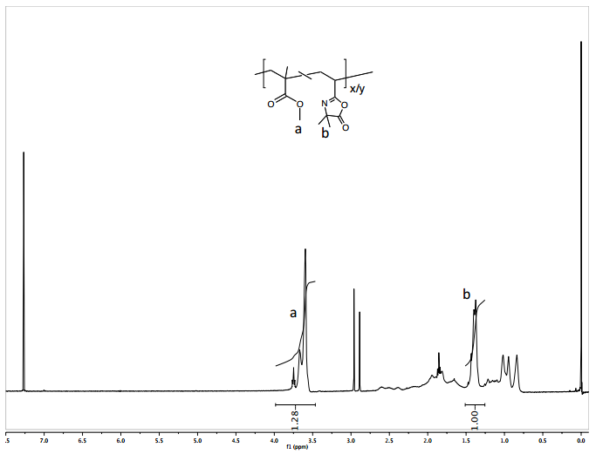
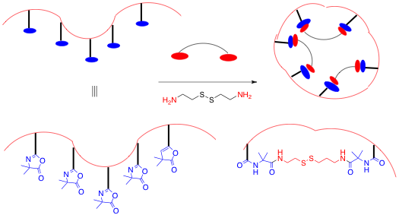
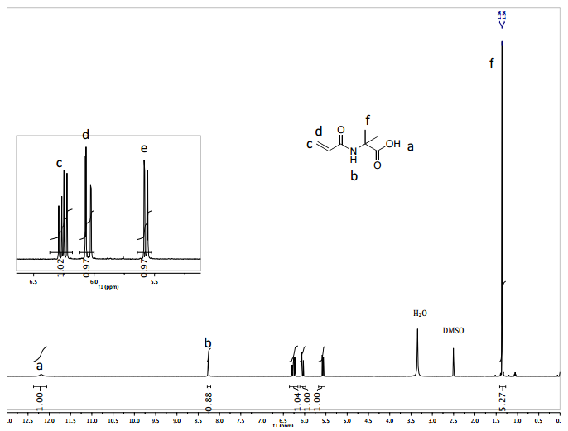
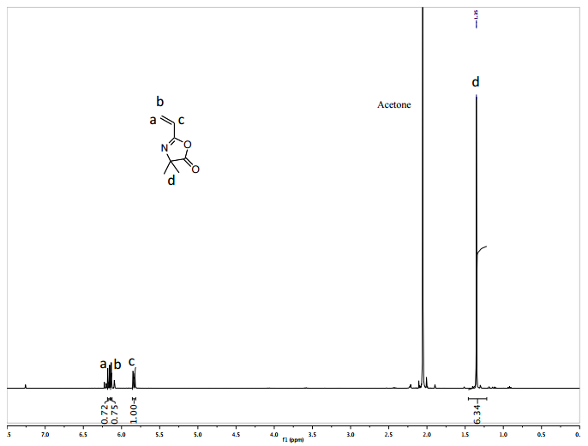
Azlactone Functionalized Copolymers as a Possible Route to Single-Chain Nanoparticles
Cynthia R. Gerber, Holly Guevara*, Alka Prasher*, Erik B. Berda*
cry85@wildcats.unh.edu; Parsons Hall, 23 Academic Way, Durham NH 03824
December 10th, 2015
Introduction
The azlactone functional group has been chosen as a reactive precursor for SCNP synthesis using diamines as an external cross-linker. The electrophilic azlactone ring has advantages as it undergoes a ring-opening addition reaction without using a catalyst and does not form any byproducts. The azlactone ring is also resistant to hydrolysis at neutral pH.
The synthesis and characterization of poly(VDMA-co- MMA) is being explored as a facile route to synthesize SCNPs where the azlactone ring reacts with diamines undergoing cross-linking in dilute solutions (Figure 1).
Monomer Synthesis
The procedure for the synthesis of the 2-vinyl-4,4-dimethyl azlactone (VDMA) was adapted from literature and involved first synthesizing N-acryloyl-2-methylalanine by reacting aminoisobutyric acid with acryloyl chloride using 2,6,-di-tert-butyl-p-cresol as a catalyst. This was then reacted with ethyl chloroformate to form VDMA (Figure 2).
Polymer Synthesis
The VDMA monomer was copolymerized with methyl methacrylate using reversible addition-fragmentation chain transfer (RAFT) polymerization (Figure 3).
Figure 3. Synthesis of poly[(2-vinyl-4,4-dimethyl azlactone)-co-(methyl methacrylate)]
Figure 2. Synthesis of 2-vinyl-4,4-dimethyl azlactone
Figure 1. Synthesis of SCNPs using diamines as a cross-linker for P(VDMA-co-MMA) copolymers
Future Work
The copolymer was collapsed by cross-linking using hexanediamine to form the single-chain nanoparticle (Figure 4). It will be analyzed by GPC and NMR to determine success of the reaction.
Acknowledgments
Special thanks to Alka Prasher and the other members of the Berda group, Holly Guevara, and the Department of Chemistry at UNH for funding.
References
1. Lyon, C. K.; Prasher, A.; Hanlon, A. M.; Tuten, B. T.; Tooley, C. A.; Frank, P. G.; Berda, E. B. Polym. Chem. 2015, 6, 181-197.
2. Levere, M. E.; Ho, H. T.; Pascual, S.; Fontaine, L. Polym. Chem. 2011, 2, 2878-2887.
Figure 4. Scheme for the collapse of P[VDMA-co-MMA] to the single-chain nanoparticle
Conclusions
The monomer and polymer syntheses were successful and the SCNP synthesis is currently being explored in the Berda group lab.

