Slide 1
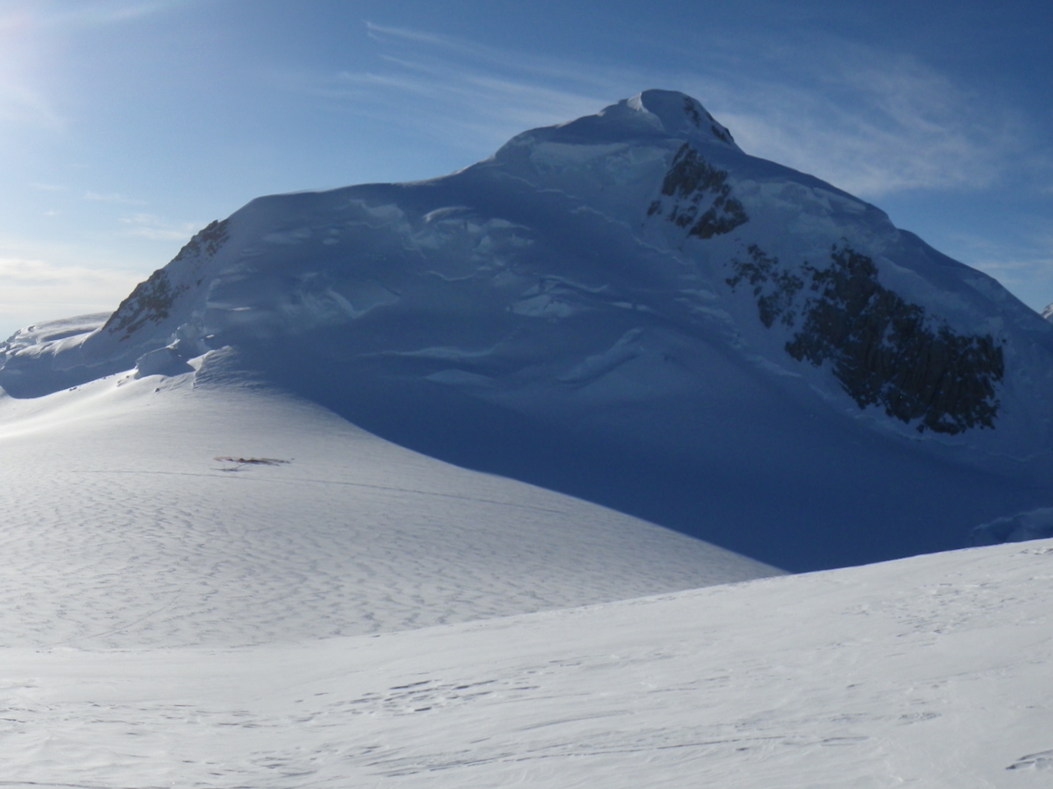



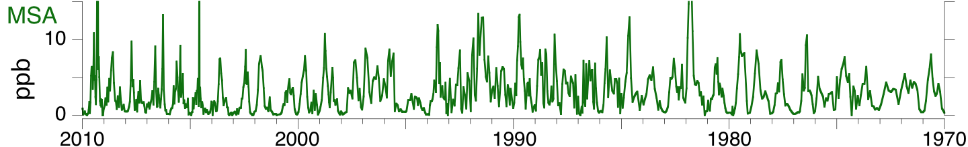
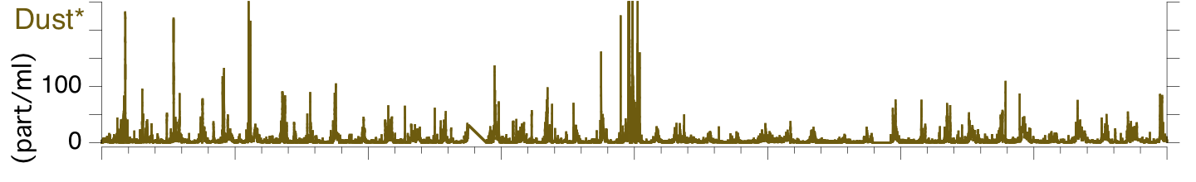
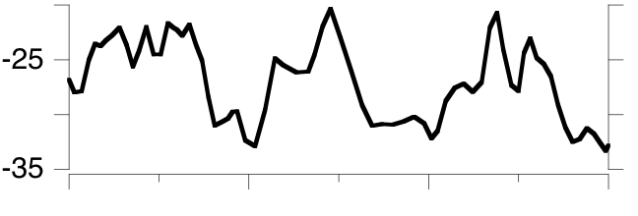
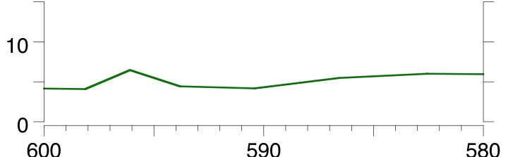
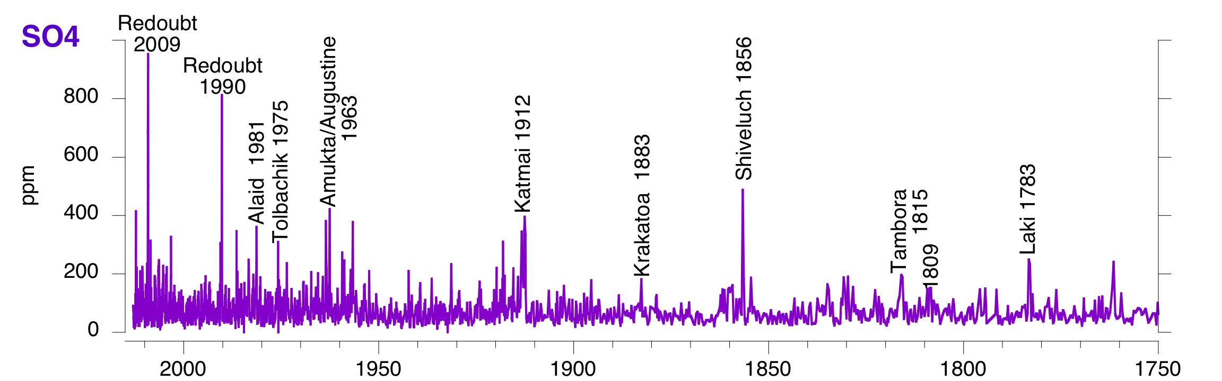
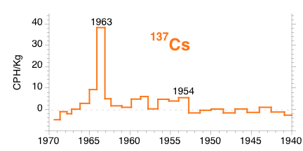
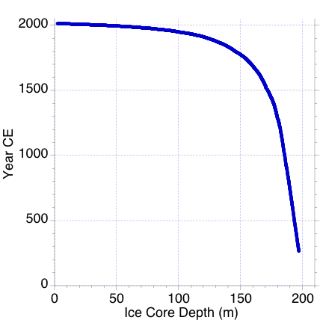
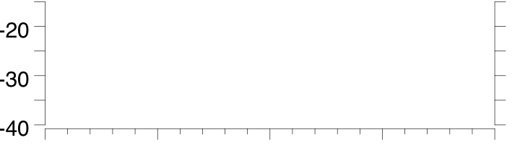
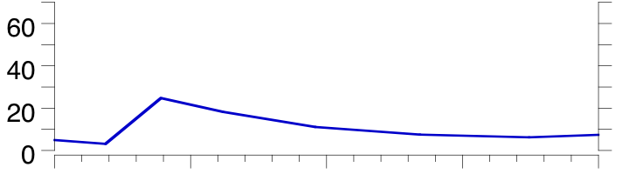
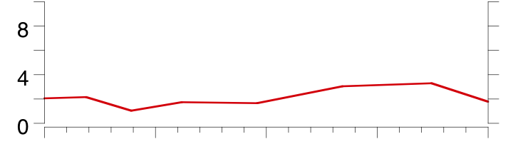

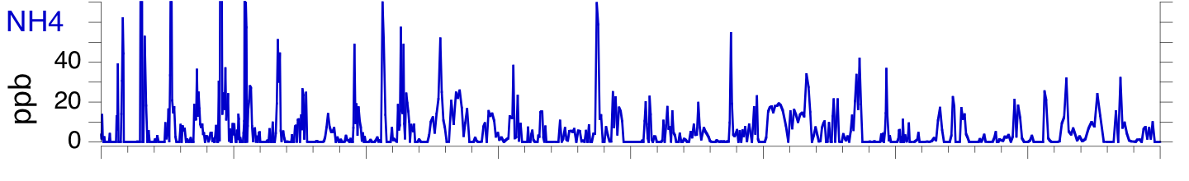
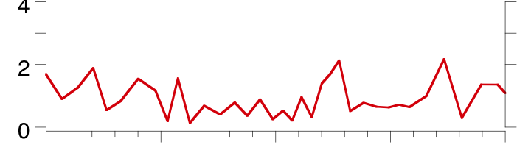
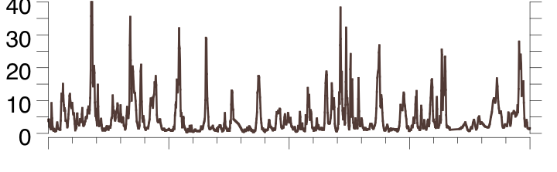
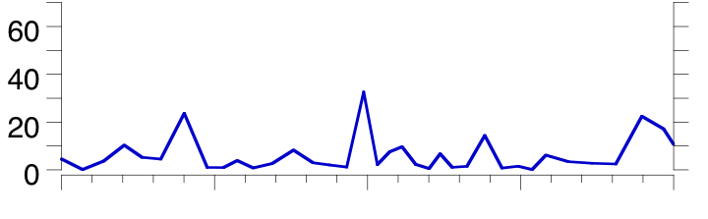
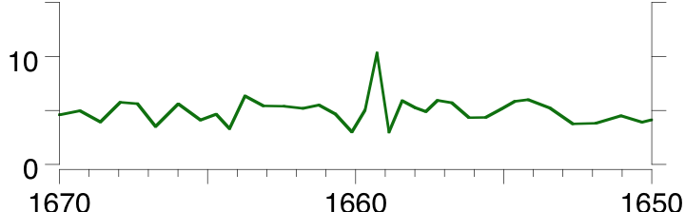
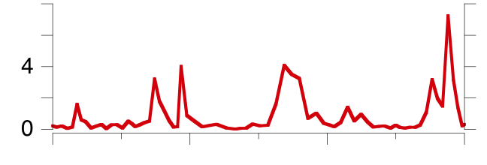
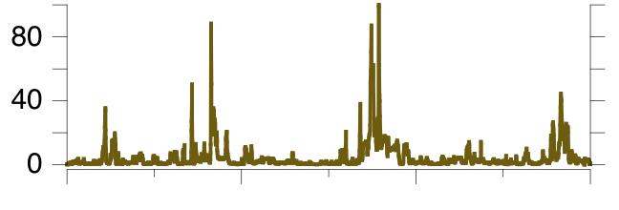
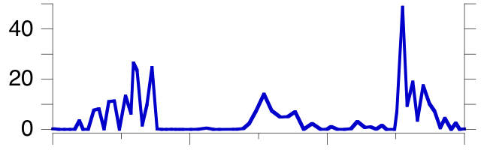
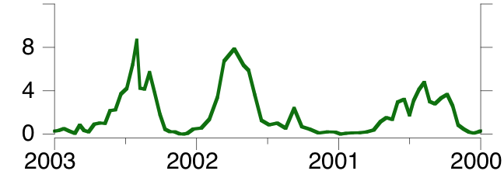
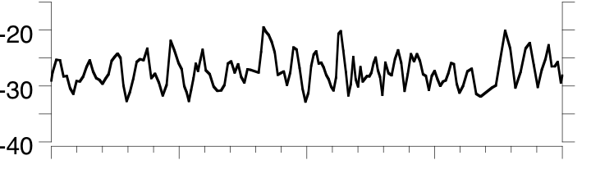
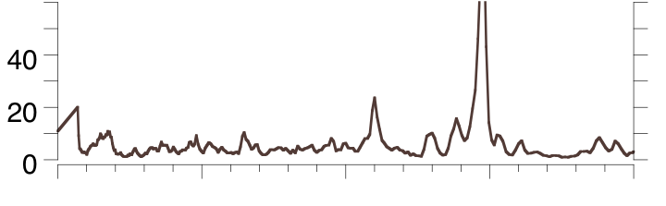
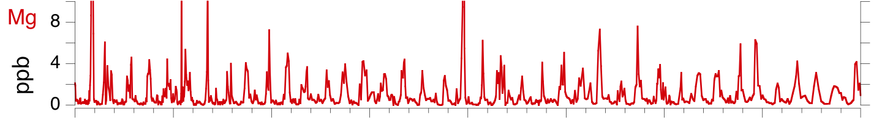
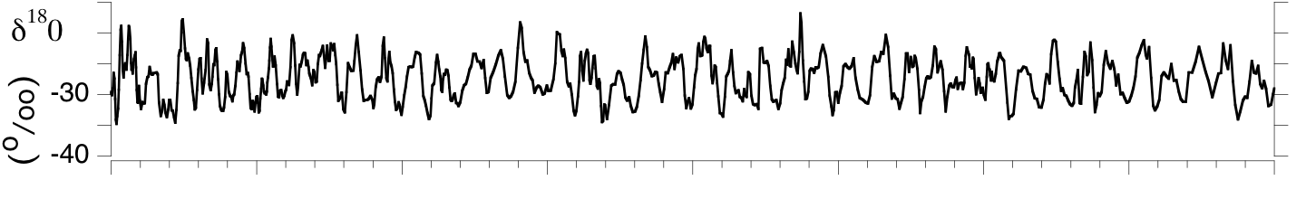
Establishing a Reliable Depth-Age Relationship for the Denali Ice Cores
Cameron Wake¹, Erich Osterberg², Dom Winski², David Ferris², Megan Dalton¹, Karl Kreutz³ & Douglas Introne³
¹Earth Systems Research Center, EOS, University of New Hampshire ²Dept. of Earth Sciences, Dartmouth College ³Climate Change Institute & School of Earth and Climate, University of Maine
Contact info: cameron.wake@unh.edu; erich.c.osterberg@dartmouth.edu; Dominic.A.Winski.GR@dartmouth.edu; karl.kreutz@me.com
AGU Fall Meeting 2015 PP33A-2271
Background
We have established sub-annual resolution depth-age relationships for the upper 198 meters of two - 208 m ice cores recovered in 2013 from Mt. Hunter (3,900 m asl), Denali National Park, central Alaska. Sub-seasonal ice core samples were analyzed for major ions, trace metals, particle size and concentration, electric conductivity, and stable isotope ratios.
Annual Layers (Fig. 1)
The depth-age relationship was established via annual layer counting of glaciochemical time-series. Strong annual signal in many chemical species are apparent (Fig. 1a). Higher resolution δ¹⁸0 and dust particle records were used to identify annual layers in older (pre-1800) sections of the core (Fig. 1b & 1c).
Fig 1a. Annual Layers 2010 – 1970 CE (10 – 83 m)
Fig 1b. 1670-1650 CE (161-163 m)
Fig 1c. 600-580 CE (192-192.3 m)
Fig 2. Seasonal Timing
Fig 3. Volcanic and Radionuclide Reference Horizons
Fig 4. Depth-Age Relationship
δ¹⁸0
winter trough
Mg
spring
peak
Dust
spring
peak
NH4
summer
peak
Volcanic reference horizons in the upper 265 years (160 m) of Denali Ice Core 2 identified from the sulfate record. Future geochemical analysis of several tephra samples will assist with positive identification of several of these volcanic events Inset figure shows the Cs-137 record with the prominent 1954 and 1963 peaks resulting from atmospheric nuclear weapons testing.
MSA
fall
peak
Results
• Mean snow accumulation rate from 2003 – 2012: 1.64 m water equivalent per year. This allows for very high resolution record.
• Seasonal signals used to count annual layers for at least the past 1,800 years (upper 198 m of the ice cores); still waiting for analyses to complete hi-resolution stable isotope record down to 198 m.
• Volcanic and radionuclide signals used as reference horizons to confirm annual layer counting
• Still need to analyze and date bottom 10 m of both cores.
Acknowledgements: This research was supported by NSF-P2C2 Grants AGS-1203863 (UNH), AGS-1204035 (Dartmouth), AGS-1203838 (UMaine) Reconstructing Central Alaskan Precipitation Variability and Atmospheric Circulation during the Past Millennium. Logistics support provided by CPS and Denali National Park are much appreciated. Special thanks to our field crews that included Elizabeth Burakowski, Seth Campbell, Tim Godaire, Brad Markle & Mike Waszkiewicz.

