Slide 1
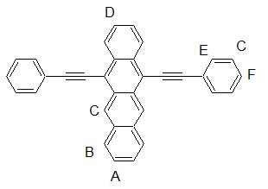
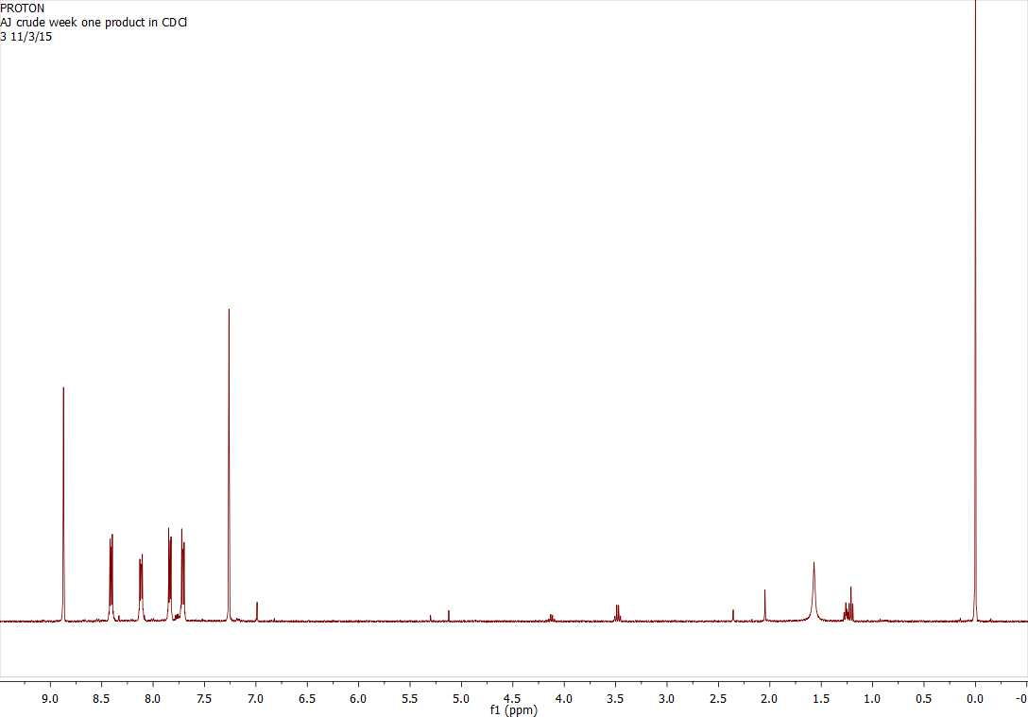
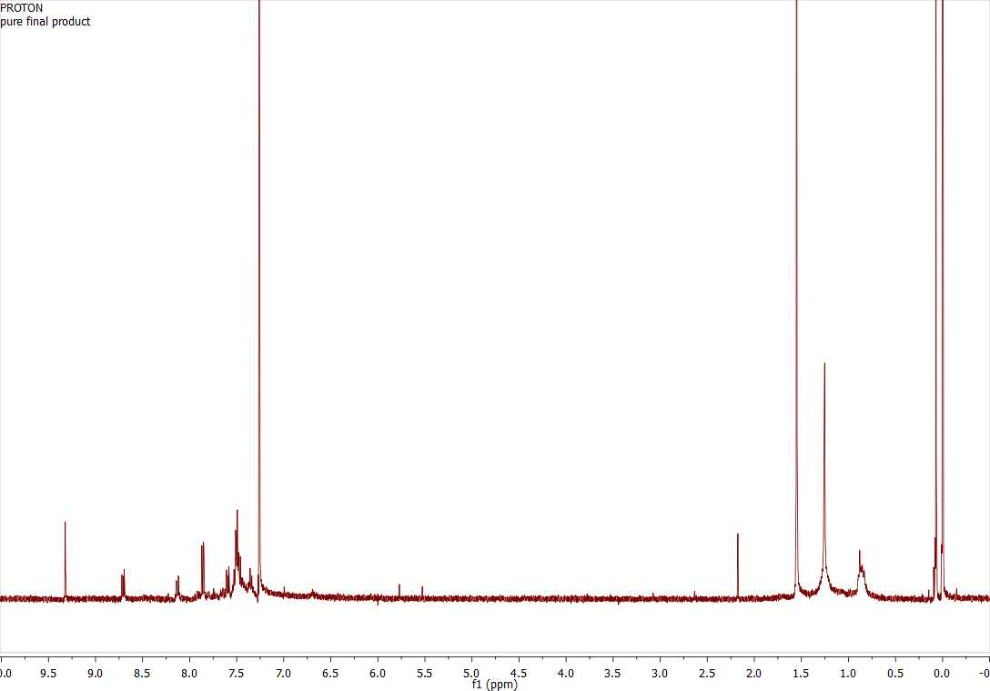
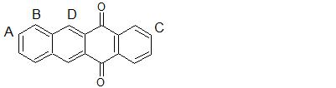
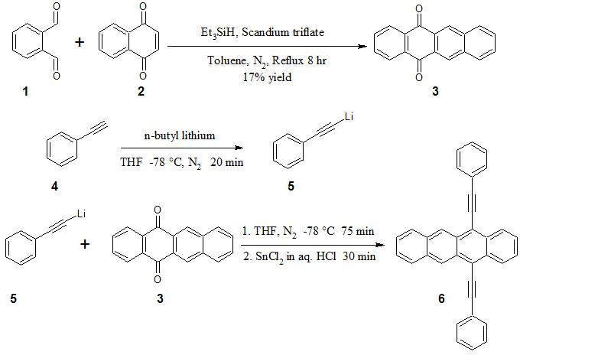
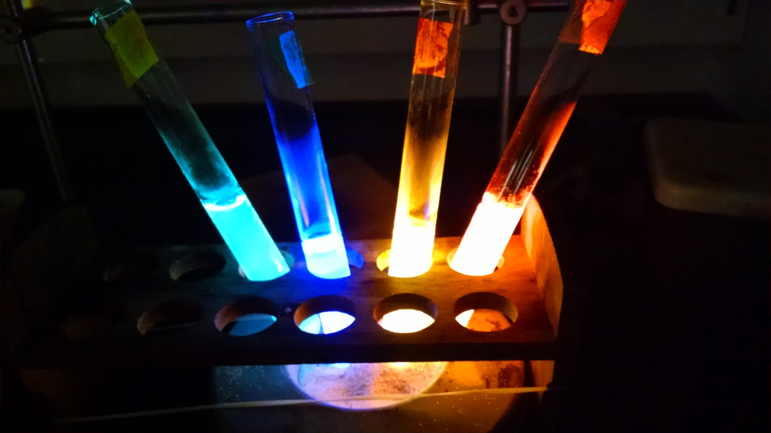
UNH Chemistry 756: Synthesis of 5,12-bis(phenylethynyl)-tetracene (BPEN)
Anthony Jennings, Holly Guevara, Alka Prasher
asu54@wildcats.unh.edu; Parsons Hall, 23 Academic Way, Durham NH 03824
Introduction
5,12-bis(phenylethynyl)napthacene, or BPEN, is a chemiluminescent compound which emits orange light when excited. It is commonly used as the dye in orange glow sticks, emitting light after being excited by reaction with an unstable peroxyacid ester formed from hydrogen peroxide and diphenyl oxalate. This phenomenon is studied in an experiment for the CHEM 546 laboratory, so BPEN is needed for that course each semester. The goal of this experiment was to determine a method to synthesize BPEN, and to produce enough of the compound for use in the organic laboratory course next semester.
Results and Discussion
A
B
D
A
C
C
B
F
E
D
Figure 3. NMR spectrum for 5,12-tetracenequinone
Figure 4. NMR spectrum for 5,12-bis(phenylethynyl)tetracene
Quinone Synthesis
Very low initial yield, likely from short reaction time, literature suggested 24 hour reflux
Reaction was redone, scaled threefold and refluxed for 13 hours, appeared to give higher yield
Pipette silica columns for filtering were ineffective because of a large amount of solids, used a filtering funnel in second reaction, but silica ran through the funnel.
BPEN Synthesis
Hexanes solvent system in column easily separated product from starting material, but gave extremely poor bandwidth
100% chloroform solvent system was suggested by literature, could be more effective
Methanol was used to flush out column
Future Work
Although only a small amount of BPEN was synthesized, a fairly large amount of impure tetracenequinone remains from the second run of this reaction. This material should yield enough BPEN for the next semester of CHEM 546.
Figure 1. Synthetic scheme for BPEN
Experimental
3 was synthesized from 1(1.5 eq.) and 2(1 eq.) using Et₃SiH(1.5 eq.) and scandium triflate(cat.), resulting solution filtered through silica with EtOAc
3 was purified by recrystallization with Et₂O, recovered a dark brown solid(79 mg)
4(1 eq.) was converted to 5 using n-butyl lithium(0.9 eq.)
To the same flask, 3(0.33 eq.) was added to produce 6, a purple-red solid
6 was purified by column chromatography with hexanes and MeOH(recovered 215 mg)
Conclusions
BPEN was successfully synthesized from o-pthalaldehyde and 1,4-napthoquinone, though not in the desired amount. The yield from the synthesis of 5,12-tetracenequinone was unexpectedly low, resulting in a low overall yield. The success of this synthesis mainly depends on the yield of this first step, as the second step worked extremely well on the first attempt.
Acknowledgments
Thanks to the UNH Chemistry Department for providing funding for this synthesis, and to Holly Guevara for assisting with much of the procedure.
References
Nishina, Y., T. Kida and T. Ureshino. Facile Sc(OTf)3-Catalyzed Generation and Successive Aromatization of Isobenzofuran from o-Dicarbonylbenzenes. Organic Letters. 2011. 13. 3960-3963.
Maulding, D. R. and B. G. Roberts. Electronic absorption and fluorescence of phenylethynyl-substituted acenes. Journal of Organic Chemistry. 1969. 34. 1734-1736.
Odom, S. A., S. R. Parkin and J. E. Anthony. Tetracene Derivatives as potential red emitters for organic LEDs. Organic Letters. 2003. 5. 4245-4248.
Zhang, J. et al. Structure, photophysics and photooxidation of crowded diethynyltetracenes. J. Materials Chemistry. 2012. 22. 6182-6188.
Figure 2. Chemiluminescence of BPEN(center-right)

