Slide 1
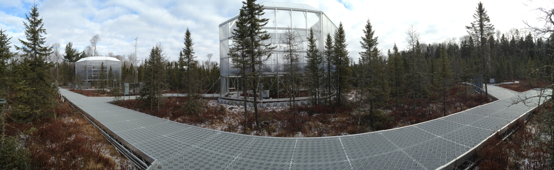
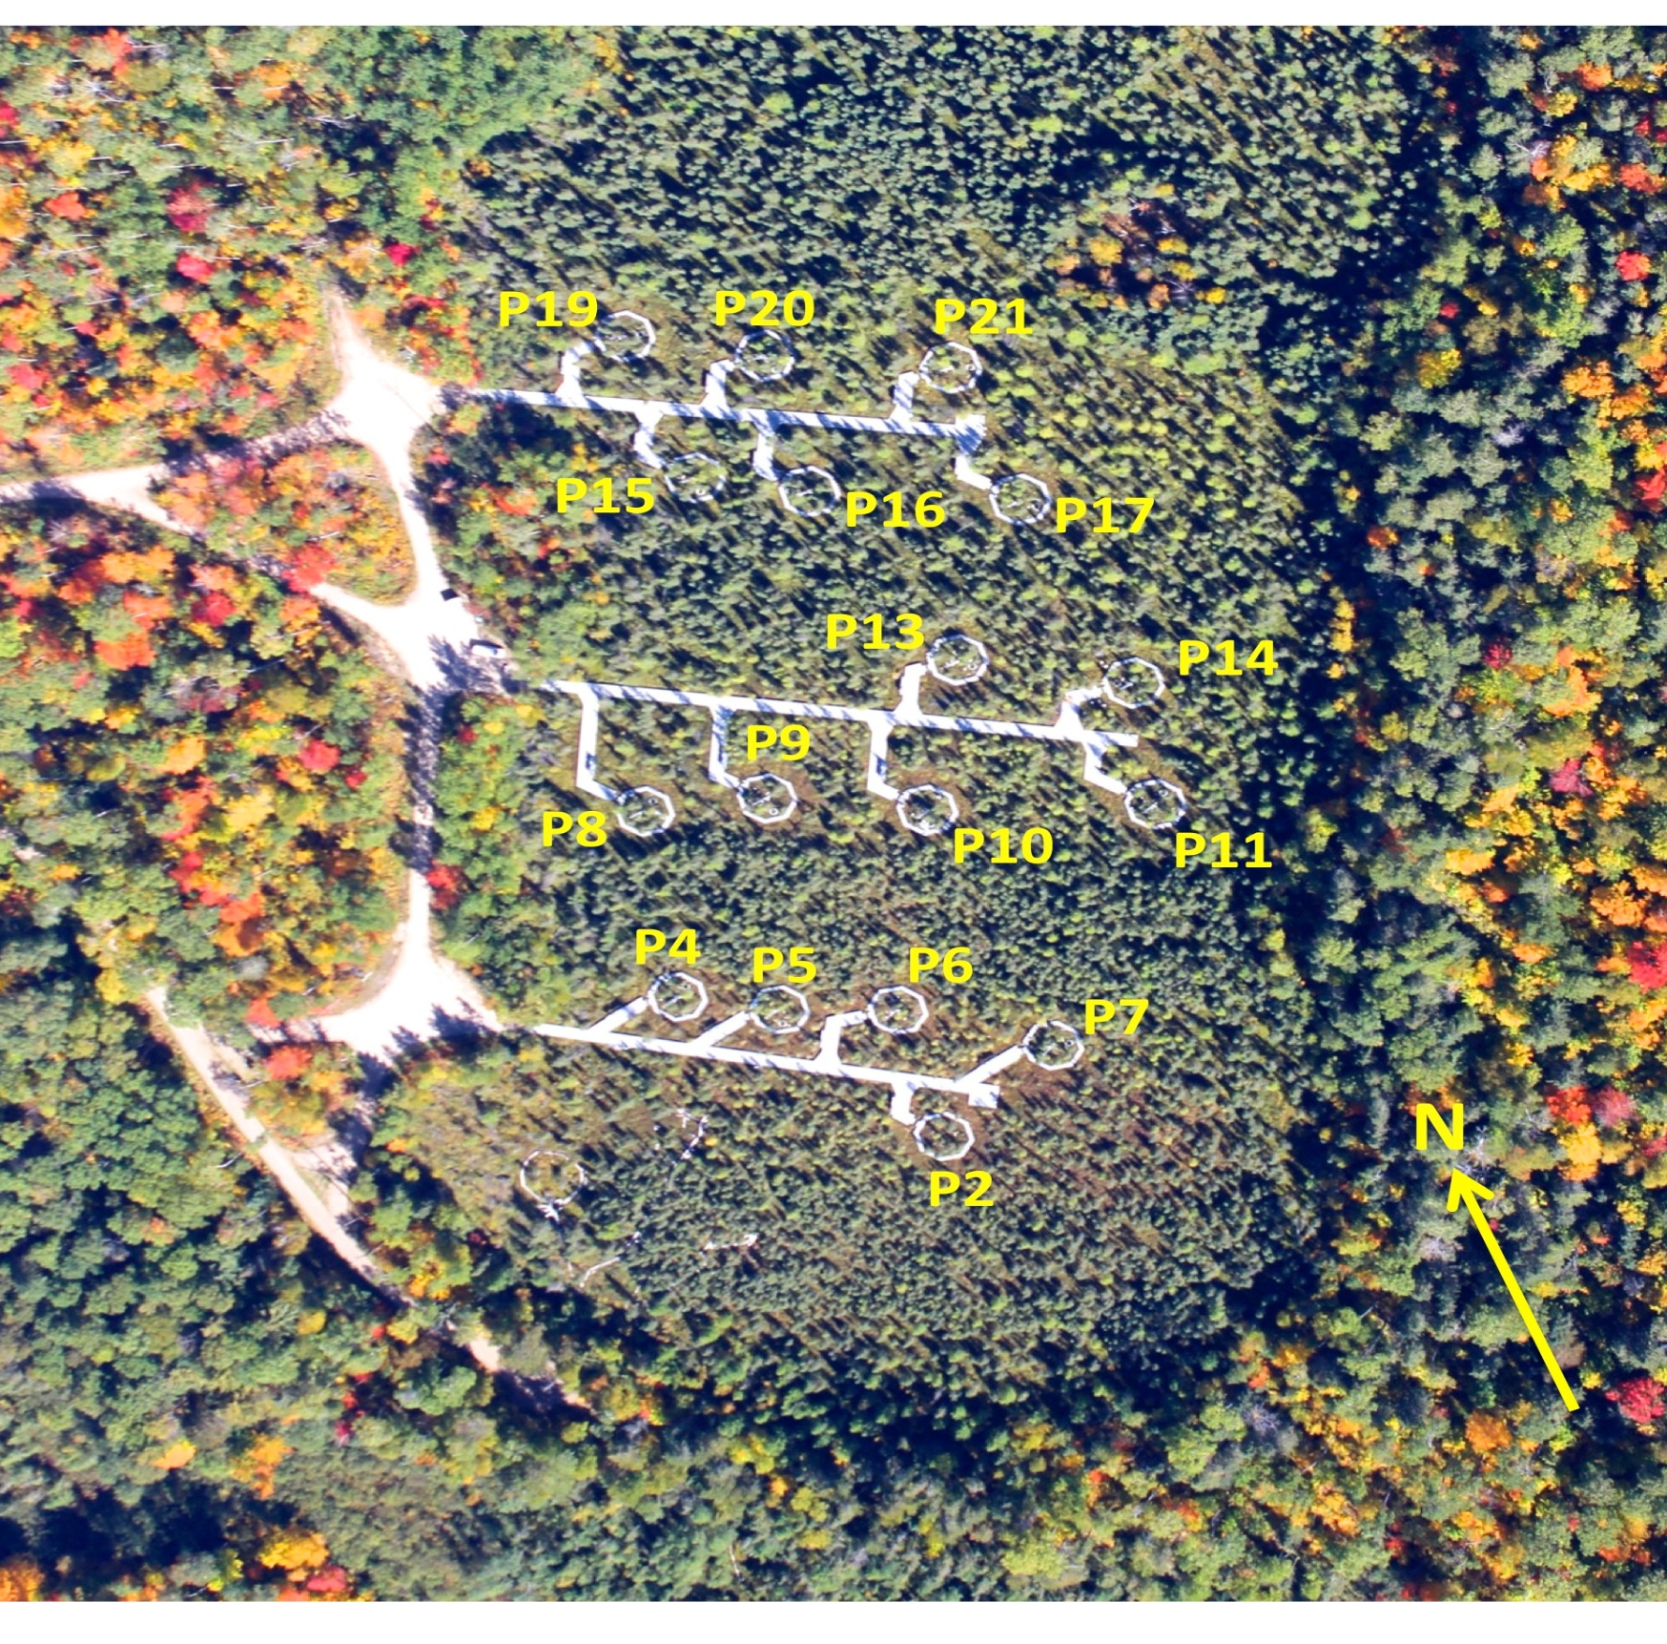
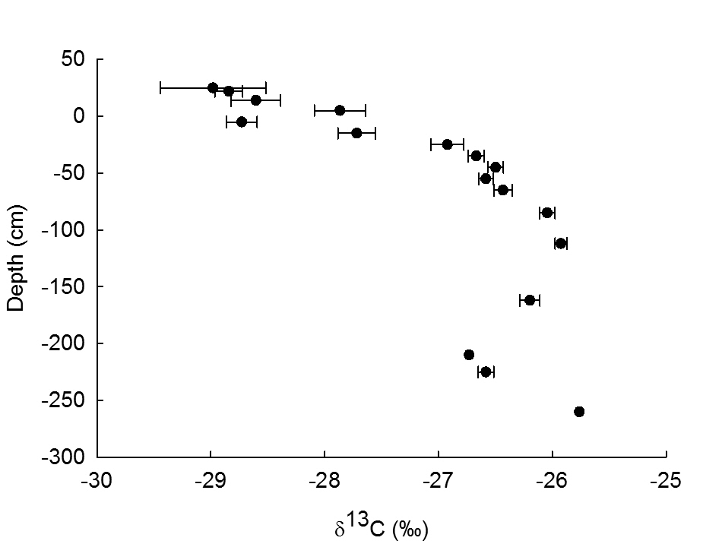
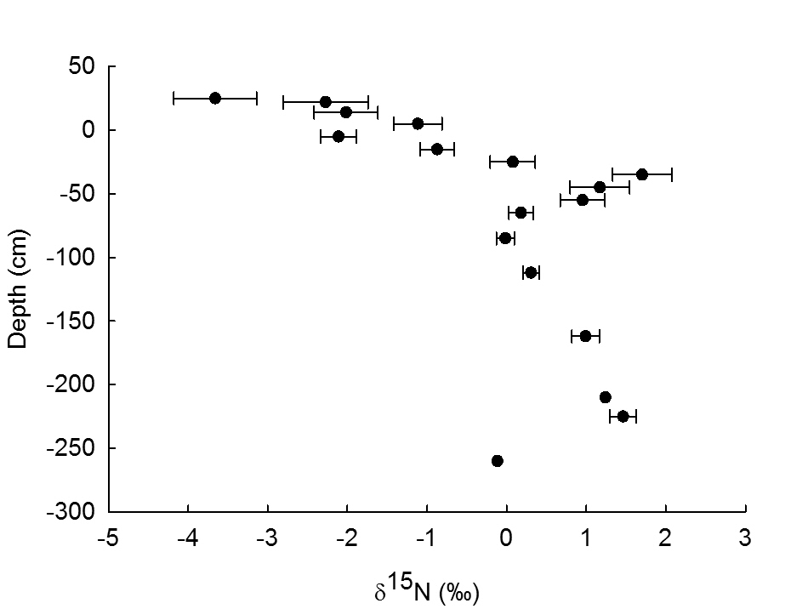
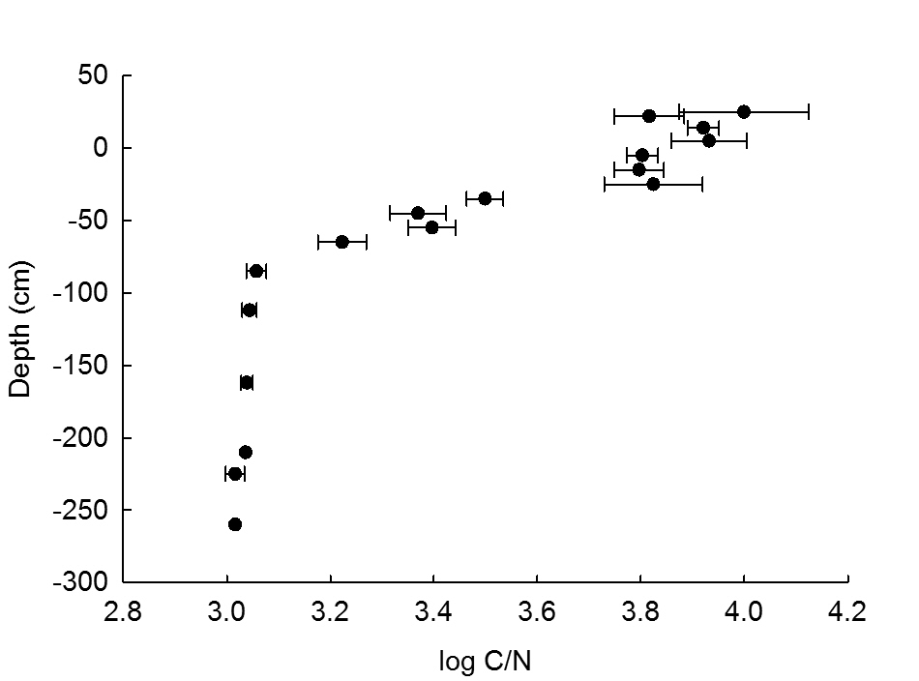
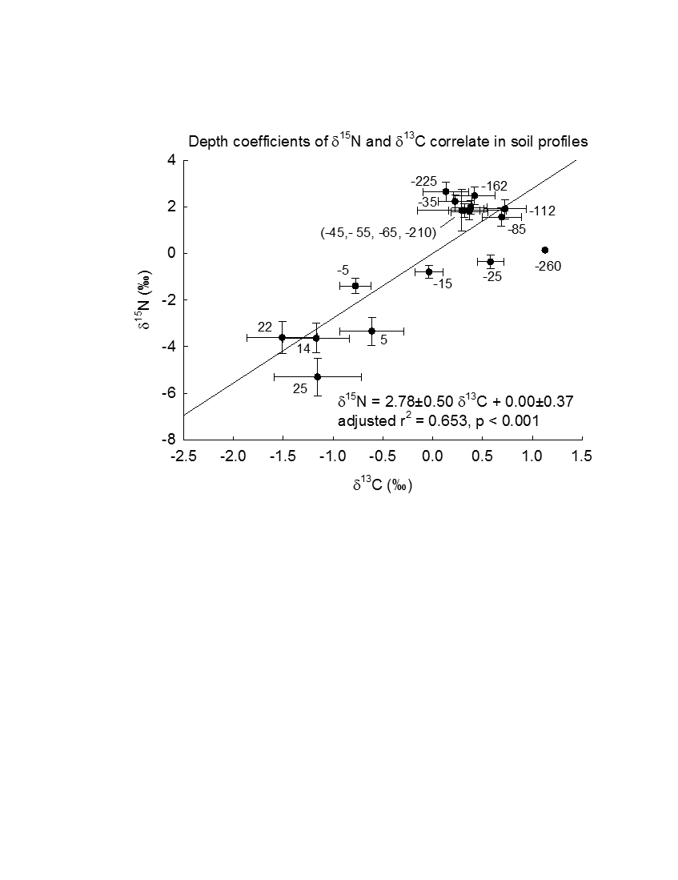
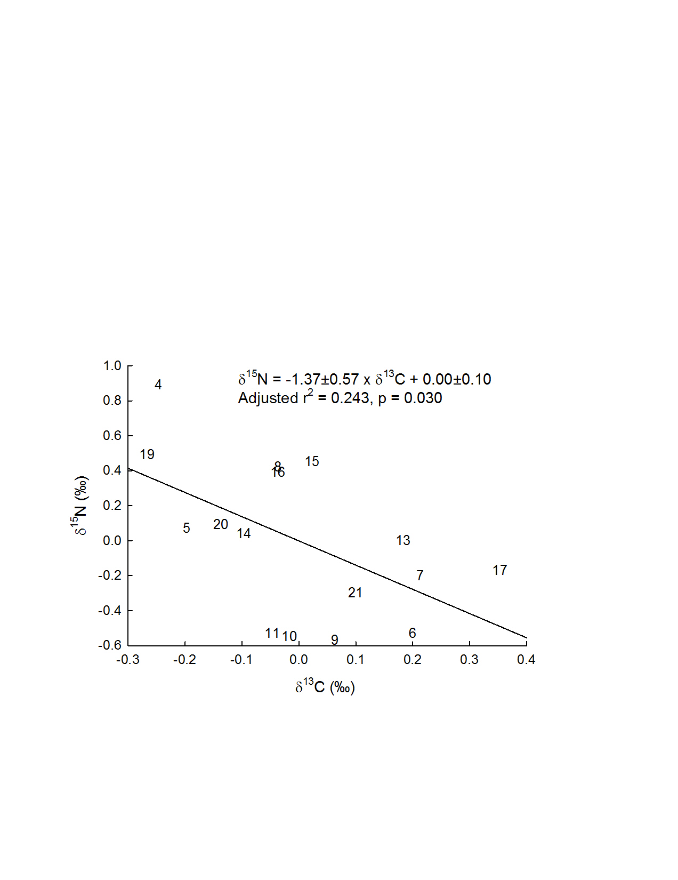
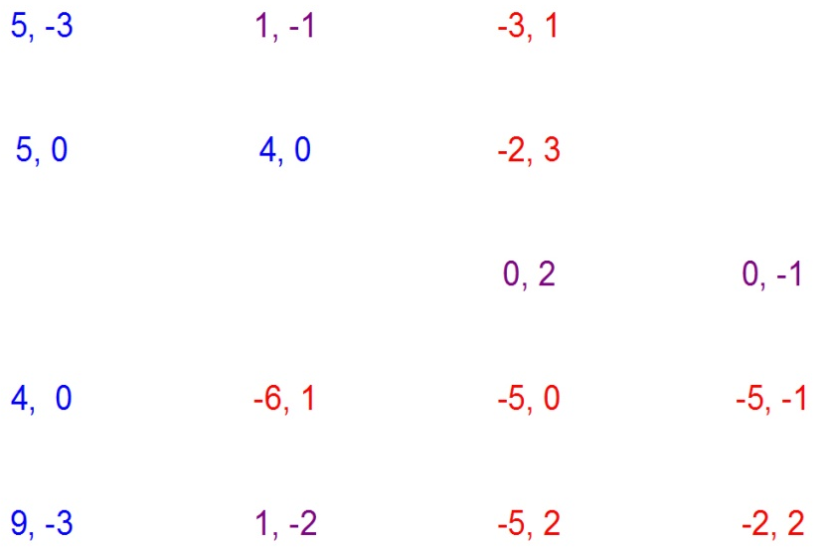
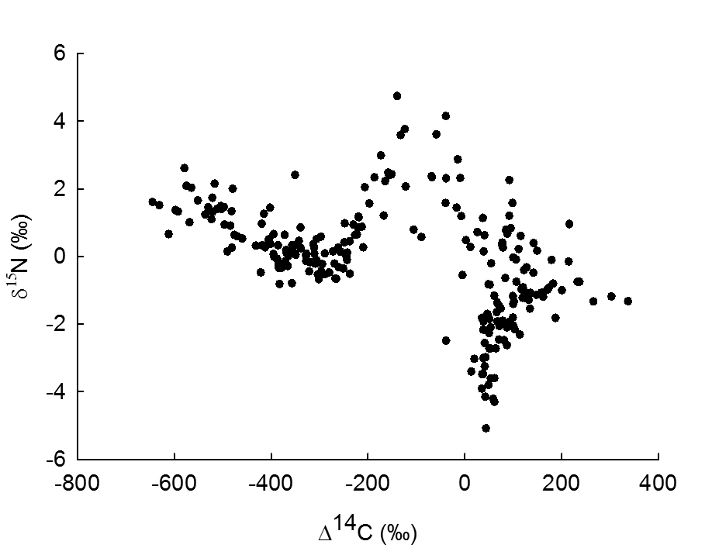
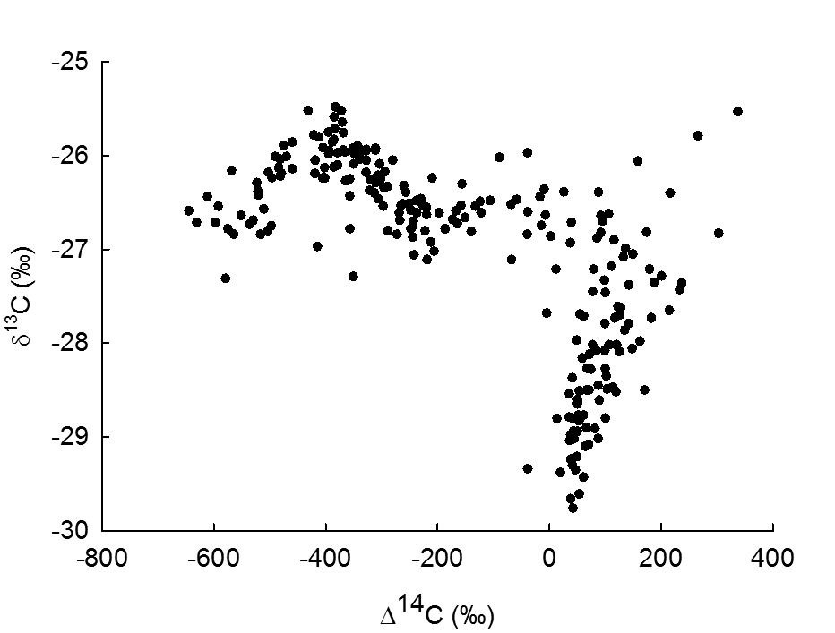
Stable Isotopes in Peat Profiles Reveal Long-term Carbon and Nitrogen Dynamics at SPRUCE
Erik A. Hobbie¹, Kirsten S. Hofmockel², Karis J. McFarlane³, Colleen M. Iversen⁴, Janet Chen¹, Nathan R. Thorp¹, Paul J. Hanson⁴
¹University of New Hampshire, ²Iowa State University, ³Lawrence Livermore National Laboratory, ⁴Oak Ridge National Laboratory
Introduction
Peat is a large reservoir of stored carbon and peat cores preserve a long-term record of system carbon and nitrogen dynamics. Stable isotopes are one marker of carbon and nitrogen dynamics in peat cores. Here, we investigated controls over δ¹⁵N and δ¹³C patterns in peat cores from the Marcell S1 forested bog in northern Minnesota.
Methods
∙ Peat cores were collected in mid-August 2012 in 17 plots along 3 boardwalks extending out into bog S1 (Figure 1) using a modified hole saw (0-30 cm) or a Russian peat corer (30-250 cm depth).
∙ Hollows were sampled to -250 cm and hummocks to -10 cm. Cores were sampled every 10 cm to 1 m; every 25 cm from 1-2 m, every 50 cm thereafter. Cores were taken in treed or non-treed locations. Mean depth of core sections is reported.
∙ Foliage, roots, and fungi were also sampled.
∙ δ¹⁵N and δ¹³C in samples were measured at the University of new Hampshire; radiocarbon was measured at Lawrence Livermore National Laboratory.
∙ δ¹³C patterns were analyzed using multiple regression in JMP with δ¹⁵N, %N, and %C as continuous variables and depth, plot location, topography (hummock or hollow), or vegetation (treed or non-treed) as nominal variables. δ¹⁵N was analyzed using the same variables and δ¹³C.
∙ δ¹³C and δ¹⁵N were also correlated against radiocarbon (∆¹⁴C).
Results
∙ δ¹³C was lowest in hummocks (above 0 cm) and then increased by 3‰ to -85 cm (Figure 2a).
∙ δ¹⁵N was lowest in hummocks and increased by up to 6‰ to -35 cm before declining (Figure 2b).
∙ The log C/N steadily declined to around 3 at -85 cm (C/N = 20) (Figure 2c).
∙ In multiple regression analyses, δ¹⁵N and δ¹³C correlated strongly with depth, plot location, %C, %N, and each other, with δ¹³C also correlating with topography (Table 1). The models explained 85% and 74% of variance for δ¹³C and δ¹⁵N.
∙ Depth accounted for <50% of variance and the depth coefficients for δ¹³C and δ¹⁵N correlated strongly (Figure 3).
∙ Plot location accounted for <15% of variance and the plot coefficients for δ¹³C and δ¹⁵N correlated negatively (Figure 4a), with high δ¹⁵N and low δ¹³C coefficients in the western lagg zone closer to uplands (Figure 4b).
∙ Patterns in δ¹⁵N and δ¹³C against radiocarbon (Figure 5a and 5b) were used to link stable isotopes to specific time periods.
Discussion/Conclusions
∙ The negative correlation of δ¹⁵N with %N (Table 1) could reflect either removal of ¹⁵N-enriched N or addition of ¹⁵N-depleted N, possibly via N fixation. The increase in the depth coefficient for δ¹⁵N of ~3‰ from -25 cm to -35 cm (Figure 3) suggested that the N removal process primarily operates at a discrete depth, presumably corresponding to the juncture between aerobic and anaerobic layers defined by the water table.
∙ Higher δ¹⁵N and lower δ¹³C in plots closer to uplands (Figure 4b) may reflect distinct hydrology and accompanying shifts in C and N dynamics in the lagg area.
∙ The Suess effect and aerobic decomposition lowered δ¹³C in recent surficial samples.
∙ Small increases in δ¹³C at -112 cm (4290 calibrated years BP) and -85 cm (3820 calibrated years BP) may reflect C dynamics during a suspected transitional fen stage (based on paleoecology at a nearby bog, Verry and Janssens 2011), with reduced methanotrophy during this period retaining less ¹³C-depleted carbon derived from methane than in later periods.
∙ This may reflect a phase during which sedges transported methane directly to the atmosphere, thereby minimizing the refixation in Sphagnum cells of ¹³C-depleted, methanotrophic-derived carbon dioxide.
∙ A peak in δ¹³C and trough in δ¹⁵N at -400‰ ∆¹⁴C (4220 calibrated years BP, Figure 5) suggests that processes increasing δ¹³C such as high sedge abundance may decrease sequestration of ¹⁵N-enriched organic matter.
∙ We are currently exploring whether climate can be linked to these isotopic shifts and whether isotopic modeling will provide further insights into C and N dynamics at S1 during the Holocene.
Referencess:
Verry ES, Janssens J. 2011. Geology,vegetation, and hydrology of the S2 bog at the MEF: 12,000 years in northern Minnesota. RK Kolka, Peatland Biogeochemisty and Watershed Hydrology at the Marcell experimental Forest: 93-135.
Figure 2a
Figure 2b
Figure 2. δ¹⁵N, δ¹³C, and log C/N versus depth (Figure 2a, 2b, and 2c). Values (±SE) are averaged across hummock versus hollow cores and across treed versus non-treed cores. Averages (±SE) are given for each depth, with n given in parentheses following the depth: 25 cm (3), 22 cm (7), 14 cm (14), 5 cm (14), -5 cm (19), -15 cm (17), -25 cm (17), -35 cm (15), -45 cm (17), -55 cm (17), -65 cm (17), -85 cm (18), -112 cm (17), -162 cm (17), -210 cm (1), -225 cm (8), -260 cm (1).
Figure 2c
Figure 1. Aerial photograph of the S1 bog (23 September 2014) showing the 17 experimental plots (each 10.4 m in diameter to the outer edge of the visible perimeter boardwalk). Plot numbers on the image represent the plot areas within which peat was sampled.
Table 1. Regression model for explaining δ¹³C and δ¹⁵N in peat profiles at SPRUCE. Vegetated vs non-vegetated, hummock vs. hollow topography. Plot and depth treated as nominal variables. Value = Coefficient ± standard error; Var. = % variance explained. n = 219.
δ¹³C model, adjusted r² = 0.853, p <0.001 δ¹⁵N model, adjusted r² = 0.738, p <0.001
Source Value±SE %Var. P Source Value±SE %Var. P
Intercept -30.68±1.14 -- -- Interc 33.41±4.47 -- --
δ¹⁵N 0.18±0.03 14.4 <0.001 δ¹³C 0.74±0.14 9.7 <0.001
%N 0.366±0.141 3.4 0.010 %N -1.061±0.277 5.0 <0.001
%C 0.066±0.024 3.9 0.006 %C -0.235±0.045 9.1 <0.001
Vegetated -0.07±0.07 0.6 0.287 Veg 0.12±0.14 0.3 0.367
Hummock 0.29±0.12 1.9 0.056 Humm 1.11±0.29 4.8 <0.001
Plot -- 16.7 0.008 Plot -- 17.8 <0.001
Depth -- 59.2 <0.001 Depth -- 53.3 <0.001
Figure 3. Depth coefficients of δ¹⁵N and δ¹³C from regression models correlate in peat profiles. The depth in cm is indicated next to coefficients (±SE).
Figure 4b. Plot coefficients of δ¹⁵N and δ¹³C showing the spatial relationship among coefficient values. Plot locations as given as in Figure 1, with plot 4 at lower left. Values are given × 10 for the δ¹⁵N and δ¹³C coefficients, as (δ¹⁵N, δ¹³C). Coefficients are color-coded, with blue = high δ¹⁵N, red = low δ¹⁵N, and purple intermediate δ¹⁵N.
Figure 4a. Plot coefficients of δ¹⁵N and δ¹³C from regression models correlate in peat profiles. Standard error bars omitted for clarity, and averaged 0.24‰ for δ¹⁵N and 0.12‰ for δ¹³C. The plot number is the symbol for the paired coefficient values. Data plotted below, equation, δ¹⁵N = -1.37±0.57 × δ¹³C + 0.00±0.10, adjusted r² = 0.243, p = 0.030.
Figure 5a. Relationship between ∆¹⁴C and δ¹⁵N.
Figure 5b. Relationship between ∆¹⁴C and δ¹³C.
Acknowledgements
The authors appreciate field sampling by members of the SPRUCE research group, in particular Jana Phillips and Deanne Brice. This material is based upon work supported in part by the U.S. Department of Energy, Office of Science, Office of Biological and Environmental Research. Oak Ridge National Laboratory is managed by UT-Battelle, LLC, for the U.S. Department of Energy under contract DE-AC05-00OR22725. DOE grant ER65430 to Iowa State University also supported this work. The data referenced here are archived at and available from the SPRUCE long-term repository (http://mnspruce.ornl.gov).

