Slide 1

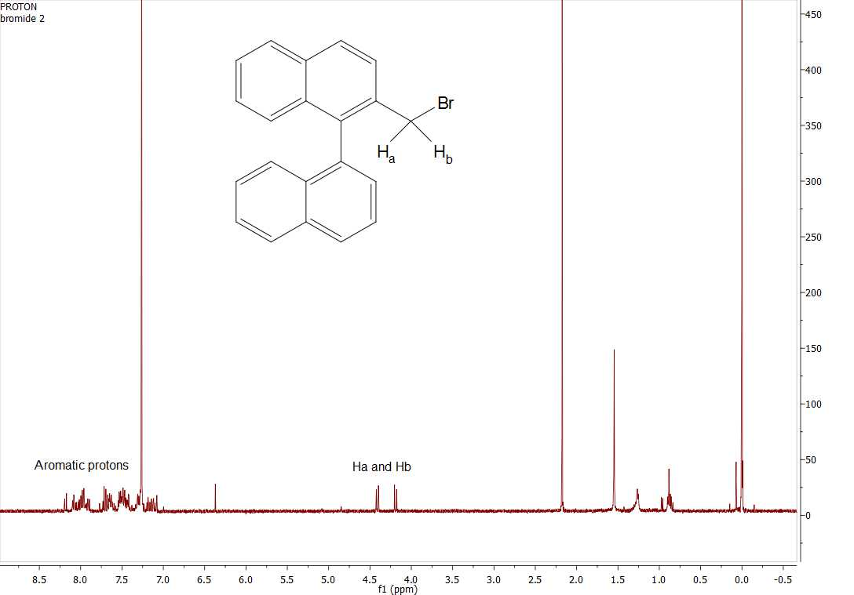
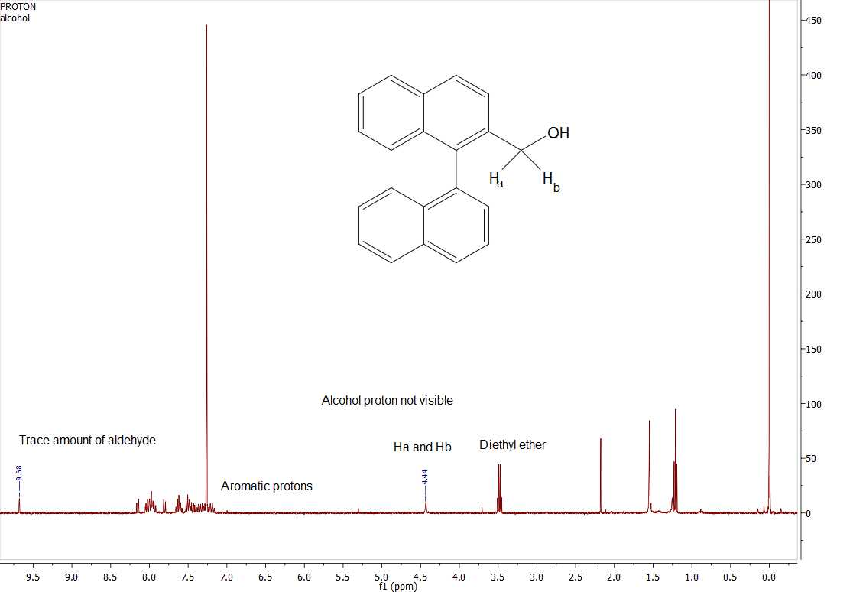
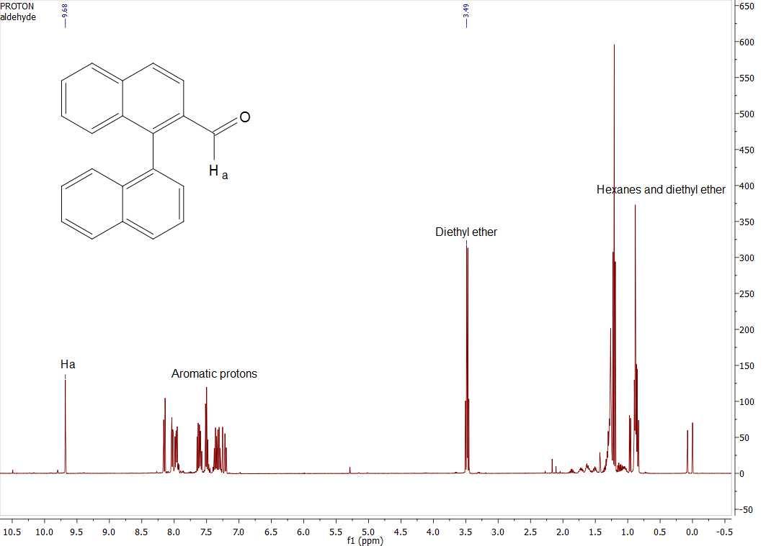
Towards the Synthesis of 1,1-binaphthyl-2-carboxylic acid
Tim Mcardle, Holly Guevara and Alka Prasher
tam1016@wildcats.unh.edu, Department of Chemistry, University of New Hampshire, Durham, NH
9.12.15
Introduction:
In recent years there has been a lot of interest in enantioselective synthesis with atropisomeric binaphthyls and their derivatives acting as chiral reagents.¹ In this context, 1,1-binaphthyl-2-carboxylic acid can be used as a chiral reagent. A complication is, however, that it is difficult to synthesise the axially chiral skeleton.² 1,1-binaphthyl-2-carboxylic acids are very interesting molecules when used as chiral reagents not only for their optical resolution abilities but also because the acid group can be converted into many different functional groups.^{3,4} As a result, 1,1-binaphthyl-2-carboxylic acids are very good starting materials for enantioselective synthesis.
A four step synthesis pathway was designed to produce 1,1-binaphthyl-2-carboxylic acid 5. Due to time constraints, the carboxylic acid itself was not synthesized. 2-methyl-1,1’-binaphthyl 1 was used as the starting compound. 1 underwent a radical reaction with NBS using benzoyl peroxide as the radical initiator. 2-Bromomethyl-1,1’-binaphthyl 2 was hydrolysed by p-dioxane,CaCO₃ and water to obtain 2-hydroxymethyl-1,1’-binaphthyl 3. 3 was then oxidised to 2-formyl-1,1’-binaphthyl 4 by CrO₃ in pyridine. 1 was obtained from the Johnson group laboratory.
1 2
³ ⁴
Scheme 1. Synthetic pathway of 2-formyl-1,1’-binaphthyl.
Results and Discussion:
From a starting mass of 0.5 g of 1 a yield of 0.08 g of 4 was obtained with a yield of 15.6%. ¹H NMR was used to determine the structure of the products obtained at each step.
2
3
4
Fig 1. ¹H NMR of crude 2, 3 and purified 4.
Future work will focus on completing the synthesis pathway by making 1,1-binaphthyl-2-carboxylic acid from 2-formyl-1,1’-binaphthyl as described by Miyano et al.⁵
4 5
Scheme 2. Synthesis of 1,1-binaphthyl-2-carboxylic acid
The synthesis of the aldehyde was successful. The ¹H NMR spectrum shows that there are no impurities present with the sample of aldehyde. The yield of the product can be improved by avoiding loss of materials during the procedure. The aldehyde produced, will be used by the Johnson group for further research in poly aromatic hydrocarbons.
The UNH chemistry department and Ryan Fitzgerald are gratefully acknowledged.
Yang, Hua., Petersen, Jeffrey.,Wang, Kung., Elsevier. 2006, 6, 8133-8141
Cottineau, F., Maigrot, N., Mazaleyrat, J. Tetrahedron Lett. 1985, 3, 421
Goto, J., Goto, N., Nambra, T. Chem. Pharm. Bull, 1983, 104, 879
Bell, F., Waring, D. J. Chem. Soc.. 1949,1597
Miyano, S., Okada, S., Suzuki, T., Handa, S., Hashimoto, H. Chemical Society of Japan.. 1986, 59, 2004-2046
Future Work:
Experimental:
Conclusion:
Acknowledgements:
References:

