Slide 1

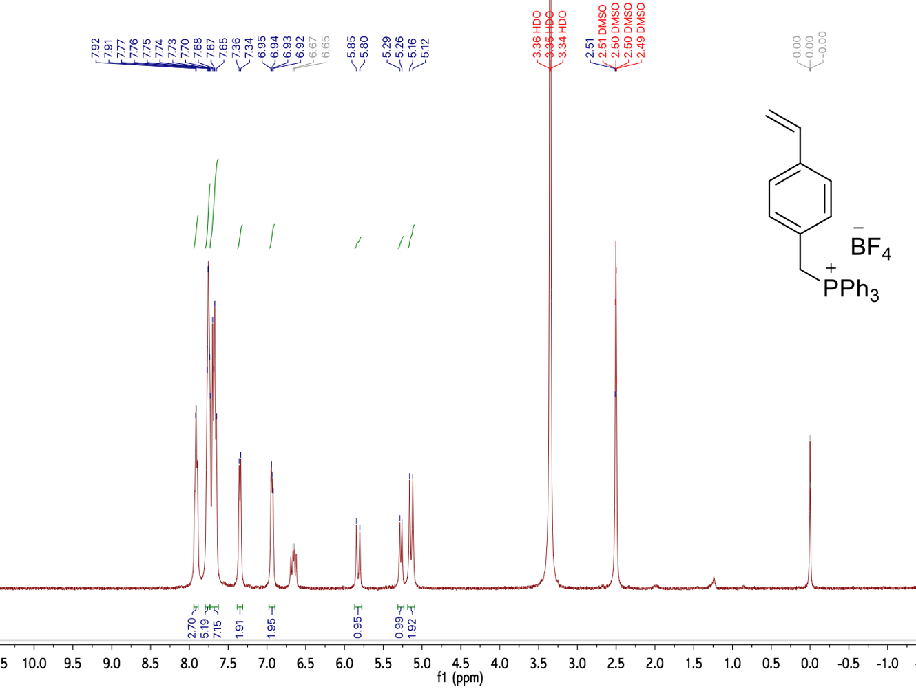
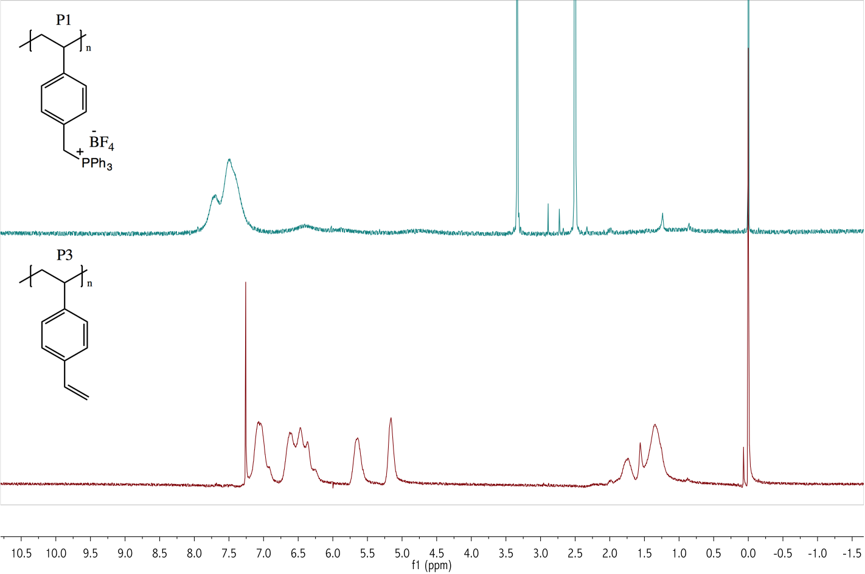
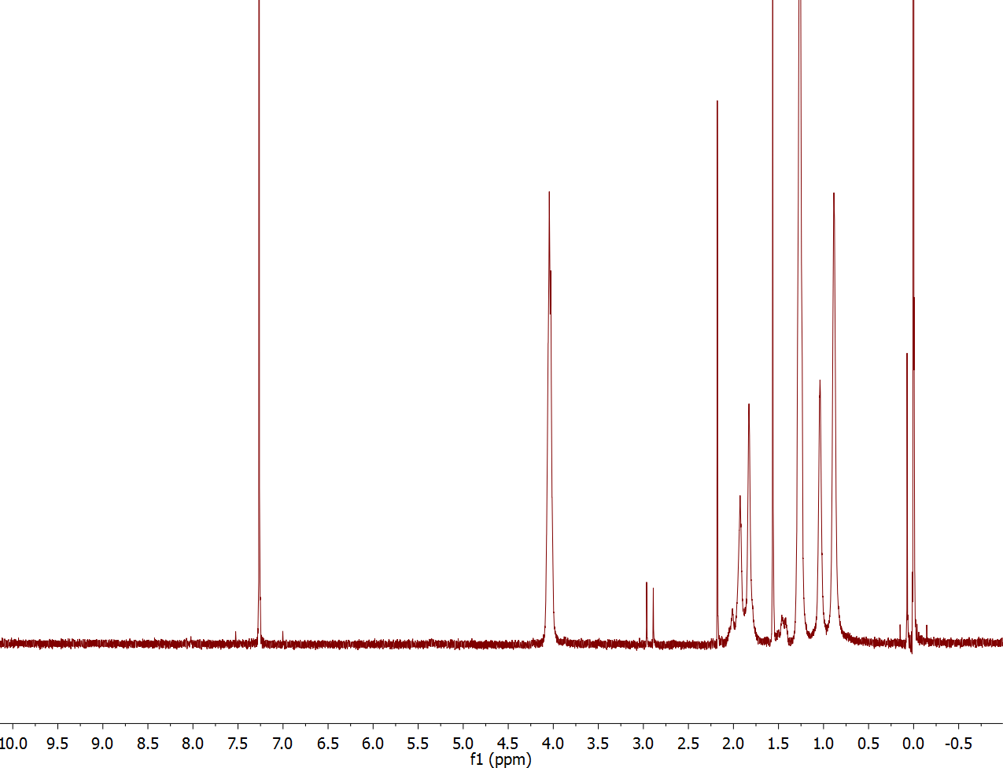
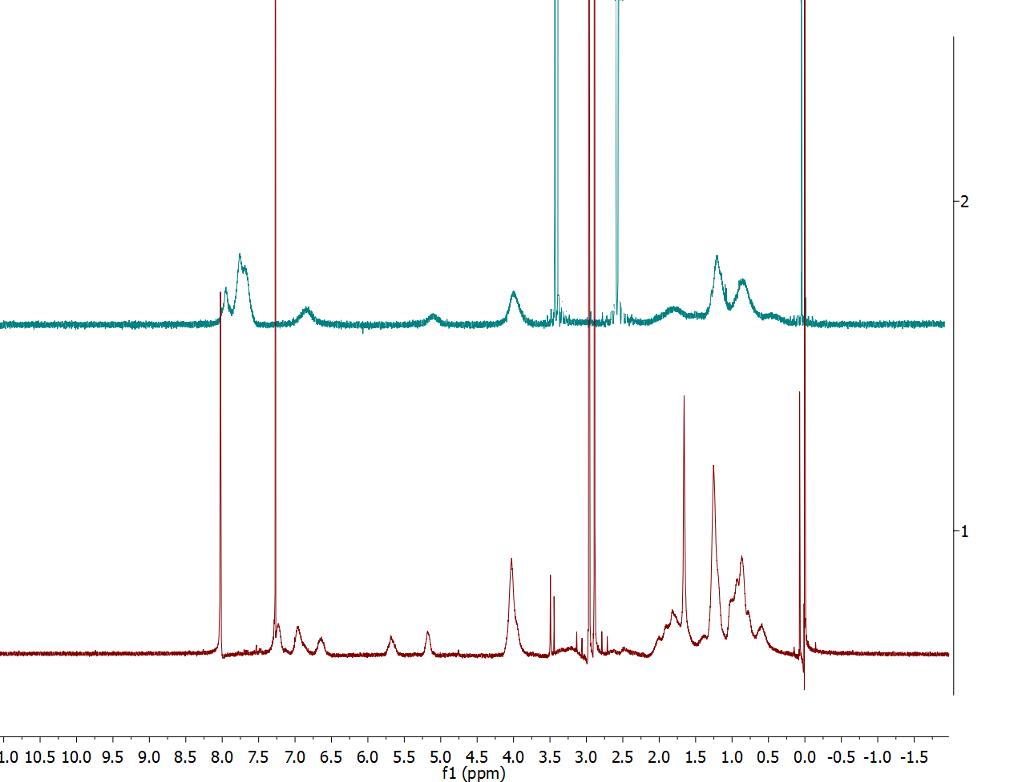
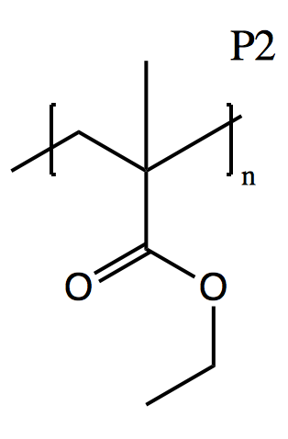
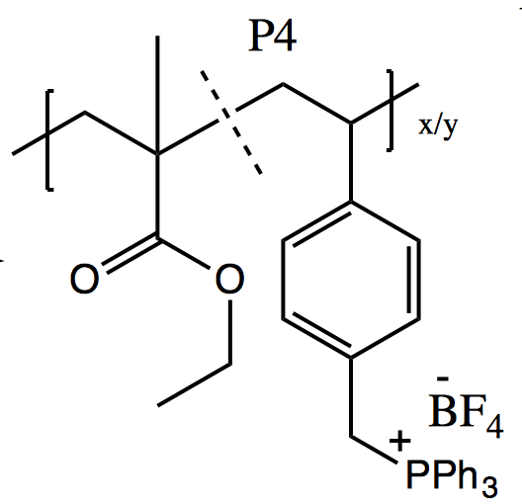
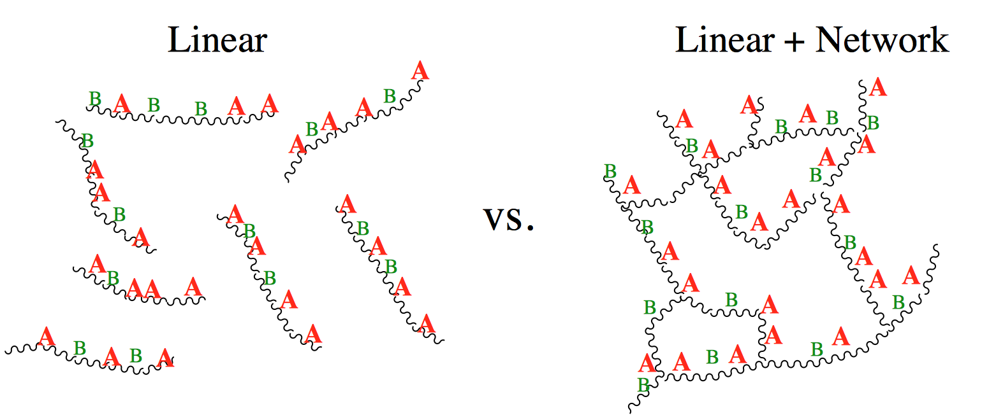
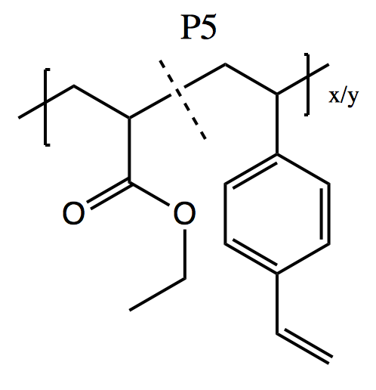
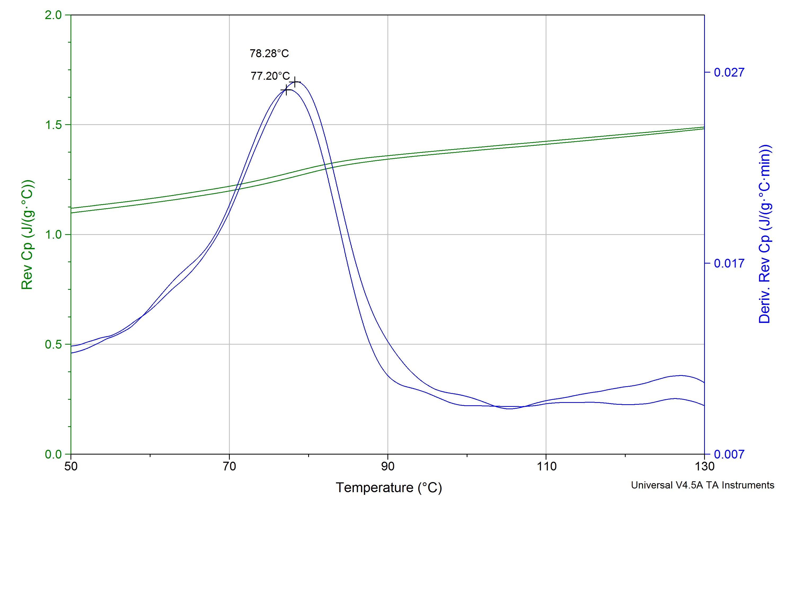
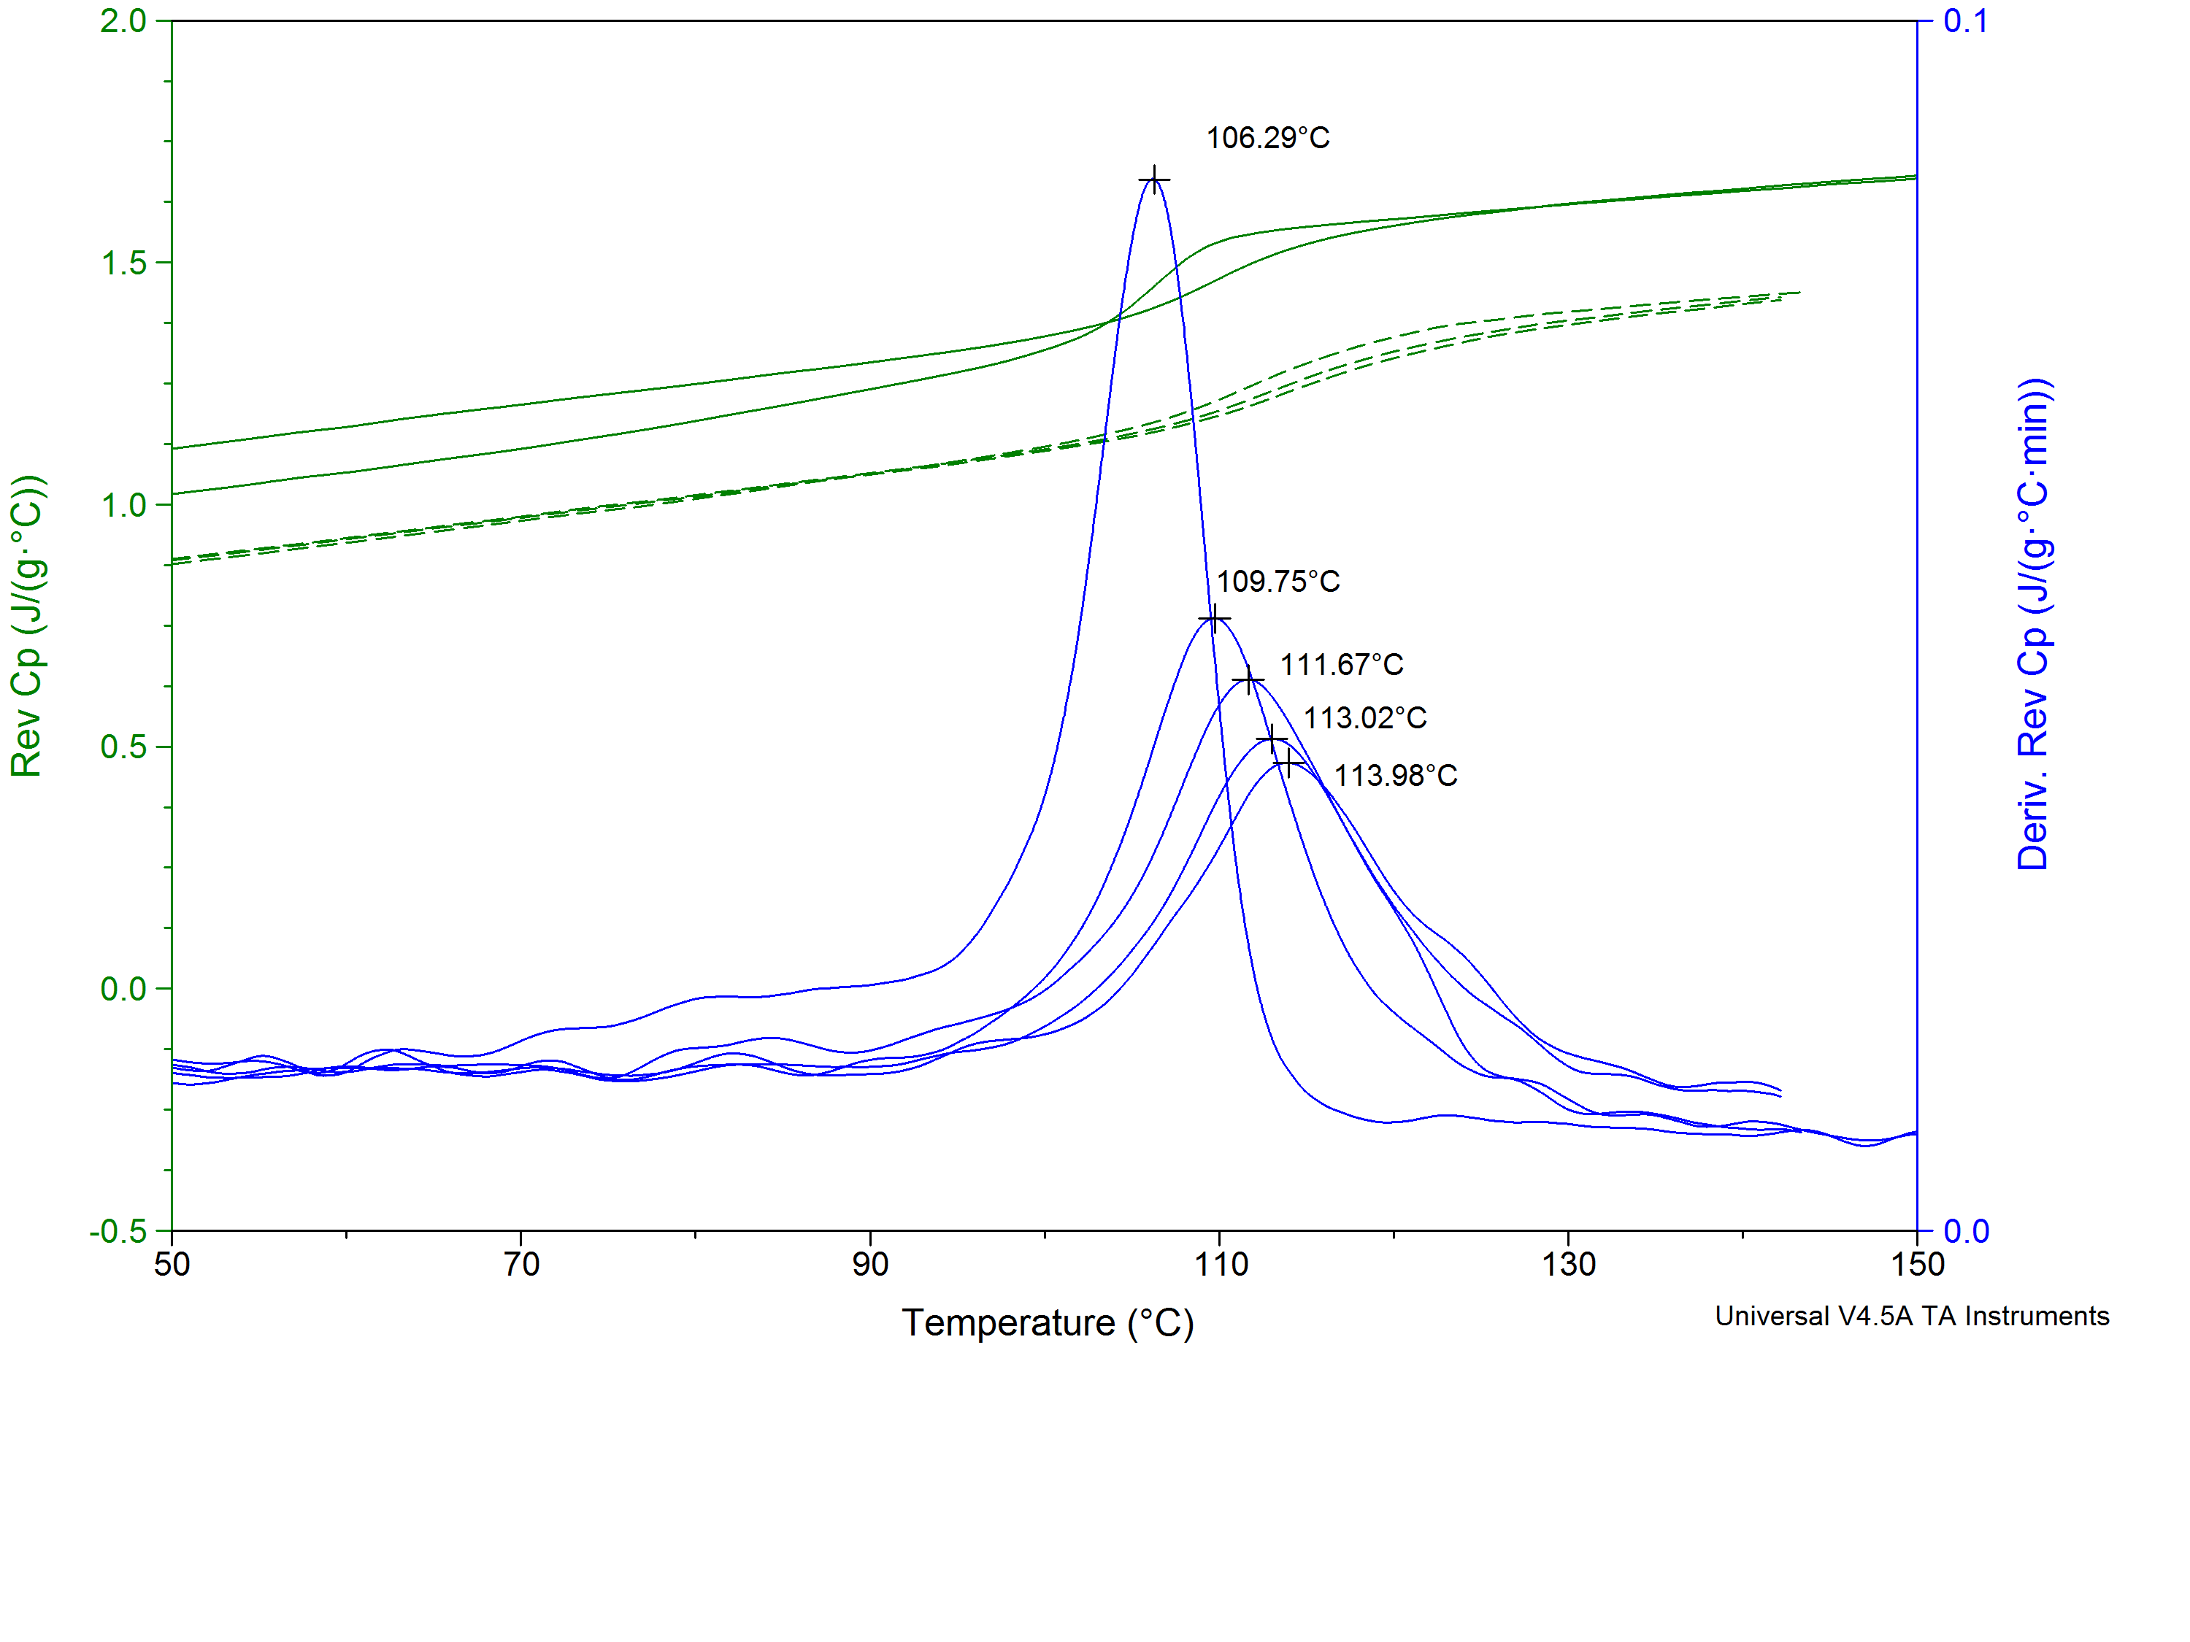
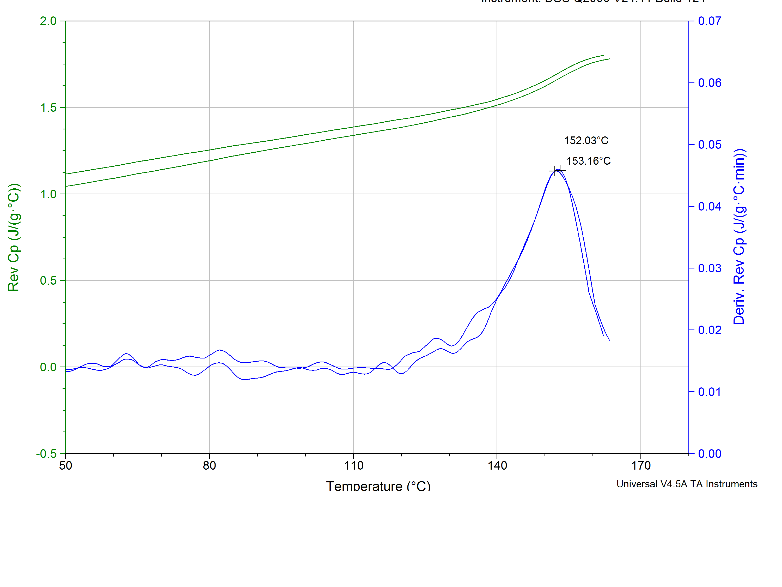
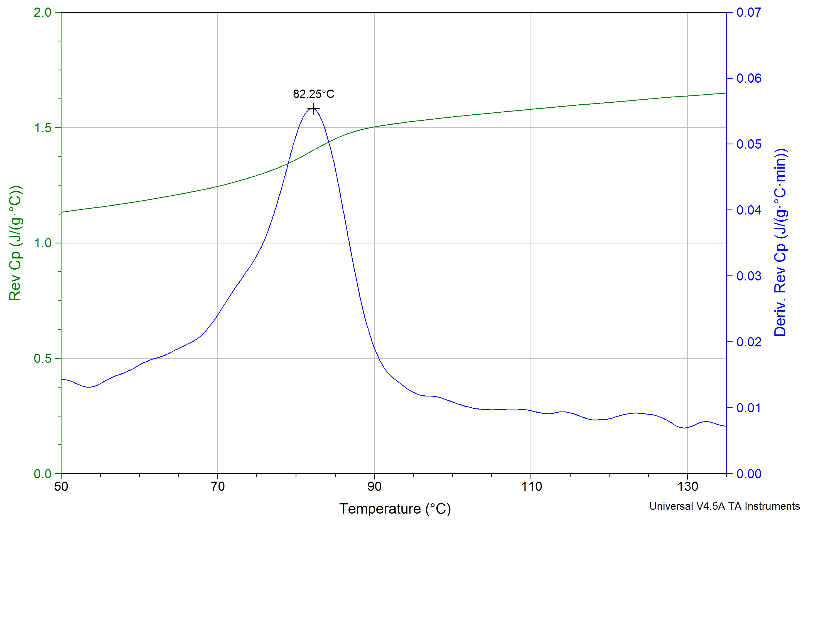
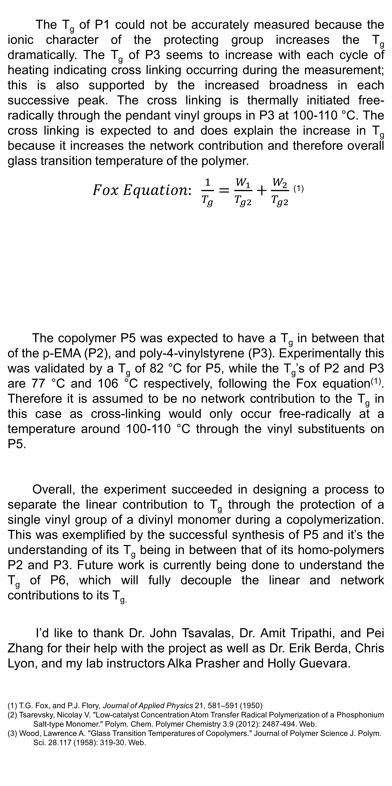
Estimating The Contribution of Divinylbenzene on Glass Transition Temperature in Copolymers
Robert Biro, Holly Guevara, Alka Prasher,
rah285@wildcats.unh.edu, Department of Chemistry, University of New Hampshire, Durham, NH
12/ 10/ 2015
Introduction:
Results:
Discussion:
The co-polymerization of two vinyl monomers yields a linear polymer chain whose glass transition temperature (T_{g}) can be predicted through their homo-polymer linear chain analogs through the Fox Equation⁽¹⁾⁽²⁾. However co-polymerization of a vinyl monomer with a divinyl monomer results in a polymer chain that is cross linked via the pendant vinyl group. Therefore the linear contribution to T_{g} can no longer be determined as the T_{g} is contributed to linearly and through the network⁽³⁾.
Therefore, this experiment was designed to protect a vinyl group of the divinyl monomer during the copolymerization until it can undergo a post polymerization modification to deprotect before characterization. This becomes more important as one can then therefore decouple the linear and network contribution to T_{g}.
The monomer, 4-VBTPPBF₄ was successfully synthesized and isolated and characterized by ¹H-NMR. Each polymer was also successfully isolated, and characterized by ¹H-NMR and compared to one another before and after de-protection.
GPC data was collected for
selected polymers to ensure
sufficient molecular weights for
DSC. The resulting polymer
DSC data gave relevant glass transition temperatures (T_{g}) which were compared to find the linear contribution of divinylbenzene (DVB) to the T_{g}.
The T_{g} of P1 could not be accurately measured because the ionic character of the protecting group increases the T_{g} dramatically. The T_{g} of P3 seems to increase with each cycle of heating indicating cross linking occurring during the measurement; this is also supported by the increased broadness in each successive peak. The cross linking is thermally initiated free-radically through the pendant vinyl groups in P3 at 100-110 °C. The cross linking is expected to and does explain the increase in T_{g} because it increases the network contribution and therefore overall glass transition temperature of the polymer.
$Fox Equation: \frac{1}{T_{g}}=\frac{W_{1}}{T_{g2}}+\frac{W_{2}}{T_{g2}}$ ⁽¹⁾
The copolymer P5 was expected to have a T_{g} in between that of the p-EMA (P2), and poly-4-vinylstyrene (P3). Experimentally this was validated by a T_{g} of 82 °C for P5, while the T_{g}’s of P2 and P3 are 77 °C and 106 °C respectively, following the Fox equation⁽¹⁾. Therefore it is assumed to be no network contribution to the T_{g} in this case as cross-linking would only occur free-radically at a temperature around 100-110 °C through the vinyl substituents on P5.
Overall, the experiment succeeded in designing a process to separate the linear contribution to T_{g} through the protection of a single vinyl group of a divinyl monomer during a copolymerization. This was exemplified by the successful synthesis of P5 and it’s the understanding of its T_{g} being in between that of its homo-polymers P2 and P3. Future work is currently being done to understand the T_{g} of P6, which will fully decouple the linear and network contributions to its T_{g.}
I’d like to thank Dr. John Tsavalas, Dr. Amit Tripathi, and Pei Zhang for their help with the project as well as Dr. Erik Berda, Chris Lyon, and my lab instructors Alka Prasher and Holly Guevara.
(1) T.G. Fox, and P.J. Flory, Journal of Applied Physics 21, 581–591 (1950)
(2) Tsarevsky, Nicolay V. "Low-catalyst Concentration Atom Transfer Radical Polymerization of a Phosphonium
Salt-type Monomer." Polym. Chem. Polymer Chemistry 3.9 (2012): 2487-494. Web.
(3) Wood, Lawrence A. "Glass Transition Temperatures of Copolymers." Journal of Polymer Science J. Polym.
Sci. 28.117 (1958): 319-30. Web.
Experimental Work:
Polymer | Đ | M_{n} (g/mol) | M_{w} (g/mol)
P1 | - | - | -
P2 | 1.225 | 4.153 x 10⁴ | 5.090 x 10⁴
P3 | 1.254 | 4.417 x 10⁴ | 5.540 x 10⁴
P4 | 1.396 | 4.910 x 10⁴ | 6.854 x 10⁴
P5 | 1.344 | 4.034 x 10⁴ | 5.420 x 10⁴
P6 | - | - | -
Conclusion and Future Work:
*All Reactions run under inert gas conditions.
Synthesis of the monomer 4-VBTPPBF₄ was followed by a procedure reported by Tsarevsky.⁽¹⁾ Using the monomer, P1 was synthesized by Reversible Addition Chain Transfer Fragmentation polymerization (RAFT) and de-protected to poly 4-vinylstyrene (P3) and both characterized. Via RAFT techniques, p-EMA (P2) was synthesized and characterized as well. Copolymer P4 was synthesized and de-protected to P5 as well. P6 was synthesized with the intent to compare the network contribution to the glass transition temperature (T_{g}) due to the effects of cross linking. Each characterization involved H-NMR, DSC, and if possible GPC.
P2
P3
Acknowledgments:
References:
P4
P5

