Slide 1

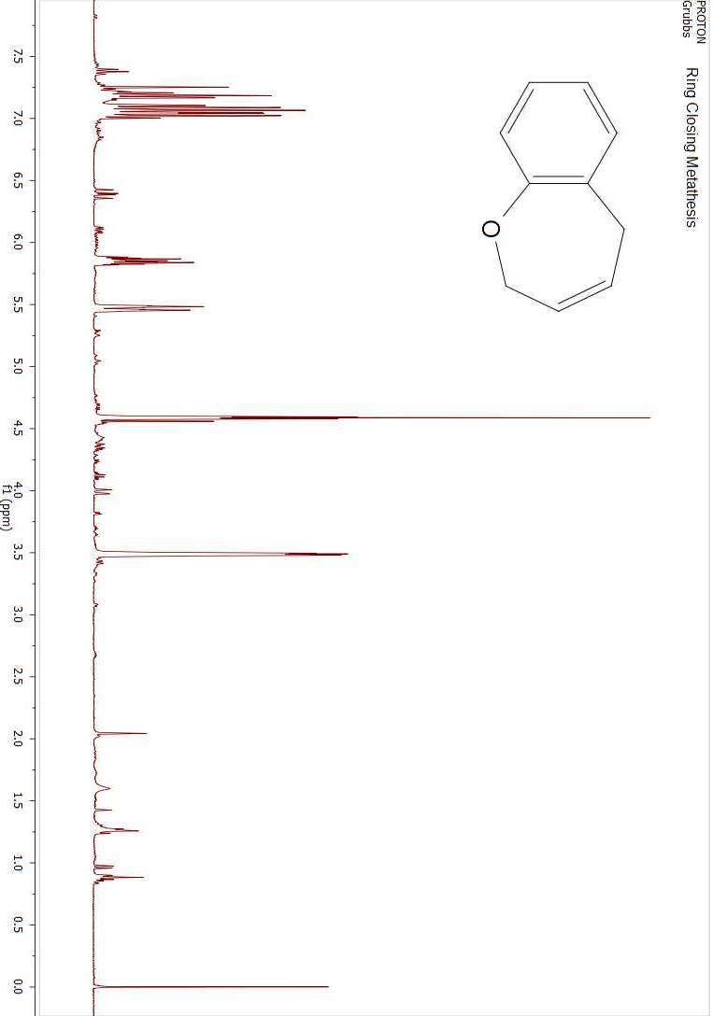
Progress towards the Synthesis of 1-Benzoxepin; A Model Oxepin Substrate
Ian Smith, Ryan Fitzgerald, Holly Guevara, Arthur Greenberg
imw8@wildcats.unh.edu, Department of Chemistry, University of New Hampshire, Durham, NH
12/10/2015
Introduction:
The Greenberg Group at UNH is interested in the mechanistic pathway through the use of Oxepins. Oxepin derivatives such as 1-benzoxepin 5 are useful models in investigating the ring opening mechanism of oxepin as seen in benzene metabolism. This project focuses on the organic synthesis of 1-benzoxepin for use in the Greenberg group in one electron oxidation reactions and enzyme reactions with cytochrome-P450 to mimic the environment of benzene/oxepin metabolism.
A multistep synthesis was performed starting with 2-allyl-phenol 1 to get to 1-Benzosepin 5. The suggested synthesis is shown in Scheme 1. This was stopped short due to time constraints, which resulted in the testing of the 2,5-dibromo-1-benzoxepin’s purity. This synthesis pathway goes through a Grubbs ring Catalyst formation performed on 2 to obtain 3. A bromination of 2,5-dihydro-1-benzoxepin 3 gives us 2,5-dibromo-1-benzoxepin 4. This is where the reaction would progress to 1-benzoxepin 5 through the use of 24hr reflux. Each step of the synthesis was purified and analyzed with proton NMR to verify purity and if unreacted starting material still remained.^{1,3,7}
Scheme 1. Synthetic Pathway to 1-Benzoxepin
The reaction is a variation of creating 1-benzoxepin for enzymatic studies. The process would spend less resources and is a little safer due to the use of less harmful chemicals. The yield of these stages was near close to 100% for the overall completed synthesis reaction steps. Between compound 1 and 2 there was a 90% yield, which was kept through the next step between compounds 2 and 3. The purification process for compound 4 from 3 needs to be tweaked in order to see actual product.
¹H NMR was used to characterize crude and pure products.
Figure 1. ¹H NMR of purified 3 and purified 2. (From top to bottom)
This reaction was attempted and was found to have four different products. These products are currently being analyzed.
1-benzoxepin will be synthesized via dehydrohalogenation of compound 4. Purification of the finally product would also be required to determine whether this chemical pathway is viable.
Scheme 2. Future work of Synthetic Pathway to 1-Benzoxepin
The organic synthesis of 1-Benzoxepin 5 was not completed due to time constraints. The synthesis was completed to the compound 2,5-dibromo-1-benzoxepin, which is being purified and analyzed as it has additional unknown products. With this process if the analysis is proven to work a new synthetic pathway would be open for creation of 1-benzoxepin.
Each synthetic step had exceptional yields and can be run from the beginning with better results. The additional compounds found with 2,5-dibromo-1-benzoxepin will be further analyzed.
Ryan and Holly of the Greenberg research group and UNH chemistry department are gratefully acknowledged.
Vogel, E., Gunther, H., Angew. Chem. Int. Ed. 1967, 6, 385-476
Davies, S. G., Whitham, G. H., J. Chem. Soc. Perkin Trans. I, 1977, 1346-1347
Morgan, J., Greenberg, A., J. Org. Chem. 2010, 75, 4761-4768
Greenberg, A., et. al., Structural Chemistry, 1998, 9(3), 223-236
Nauduri, D., Greenberg, A., Tetrahedron Letters, 2004, 45, 4789-4793
Paquette, L. A., Barrett, J. H., Org. Synth. 1969, 49, 62.
Rabideau, Peter W., Burkholder, E., J. Org Chem. 1978, 43, 4283-4288
Results and Discussion:
Future Work:
Experimental Work:
Conclusions:
Acknowledgements:
References:

