Slide 1
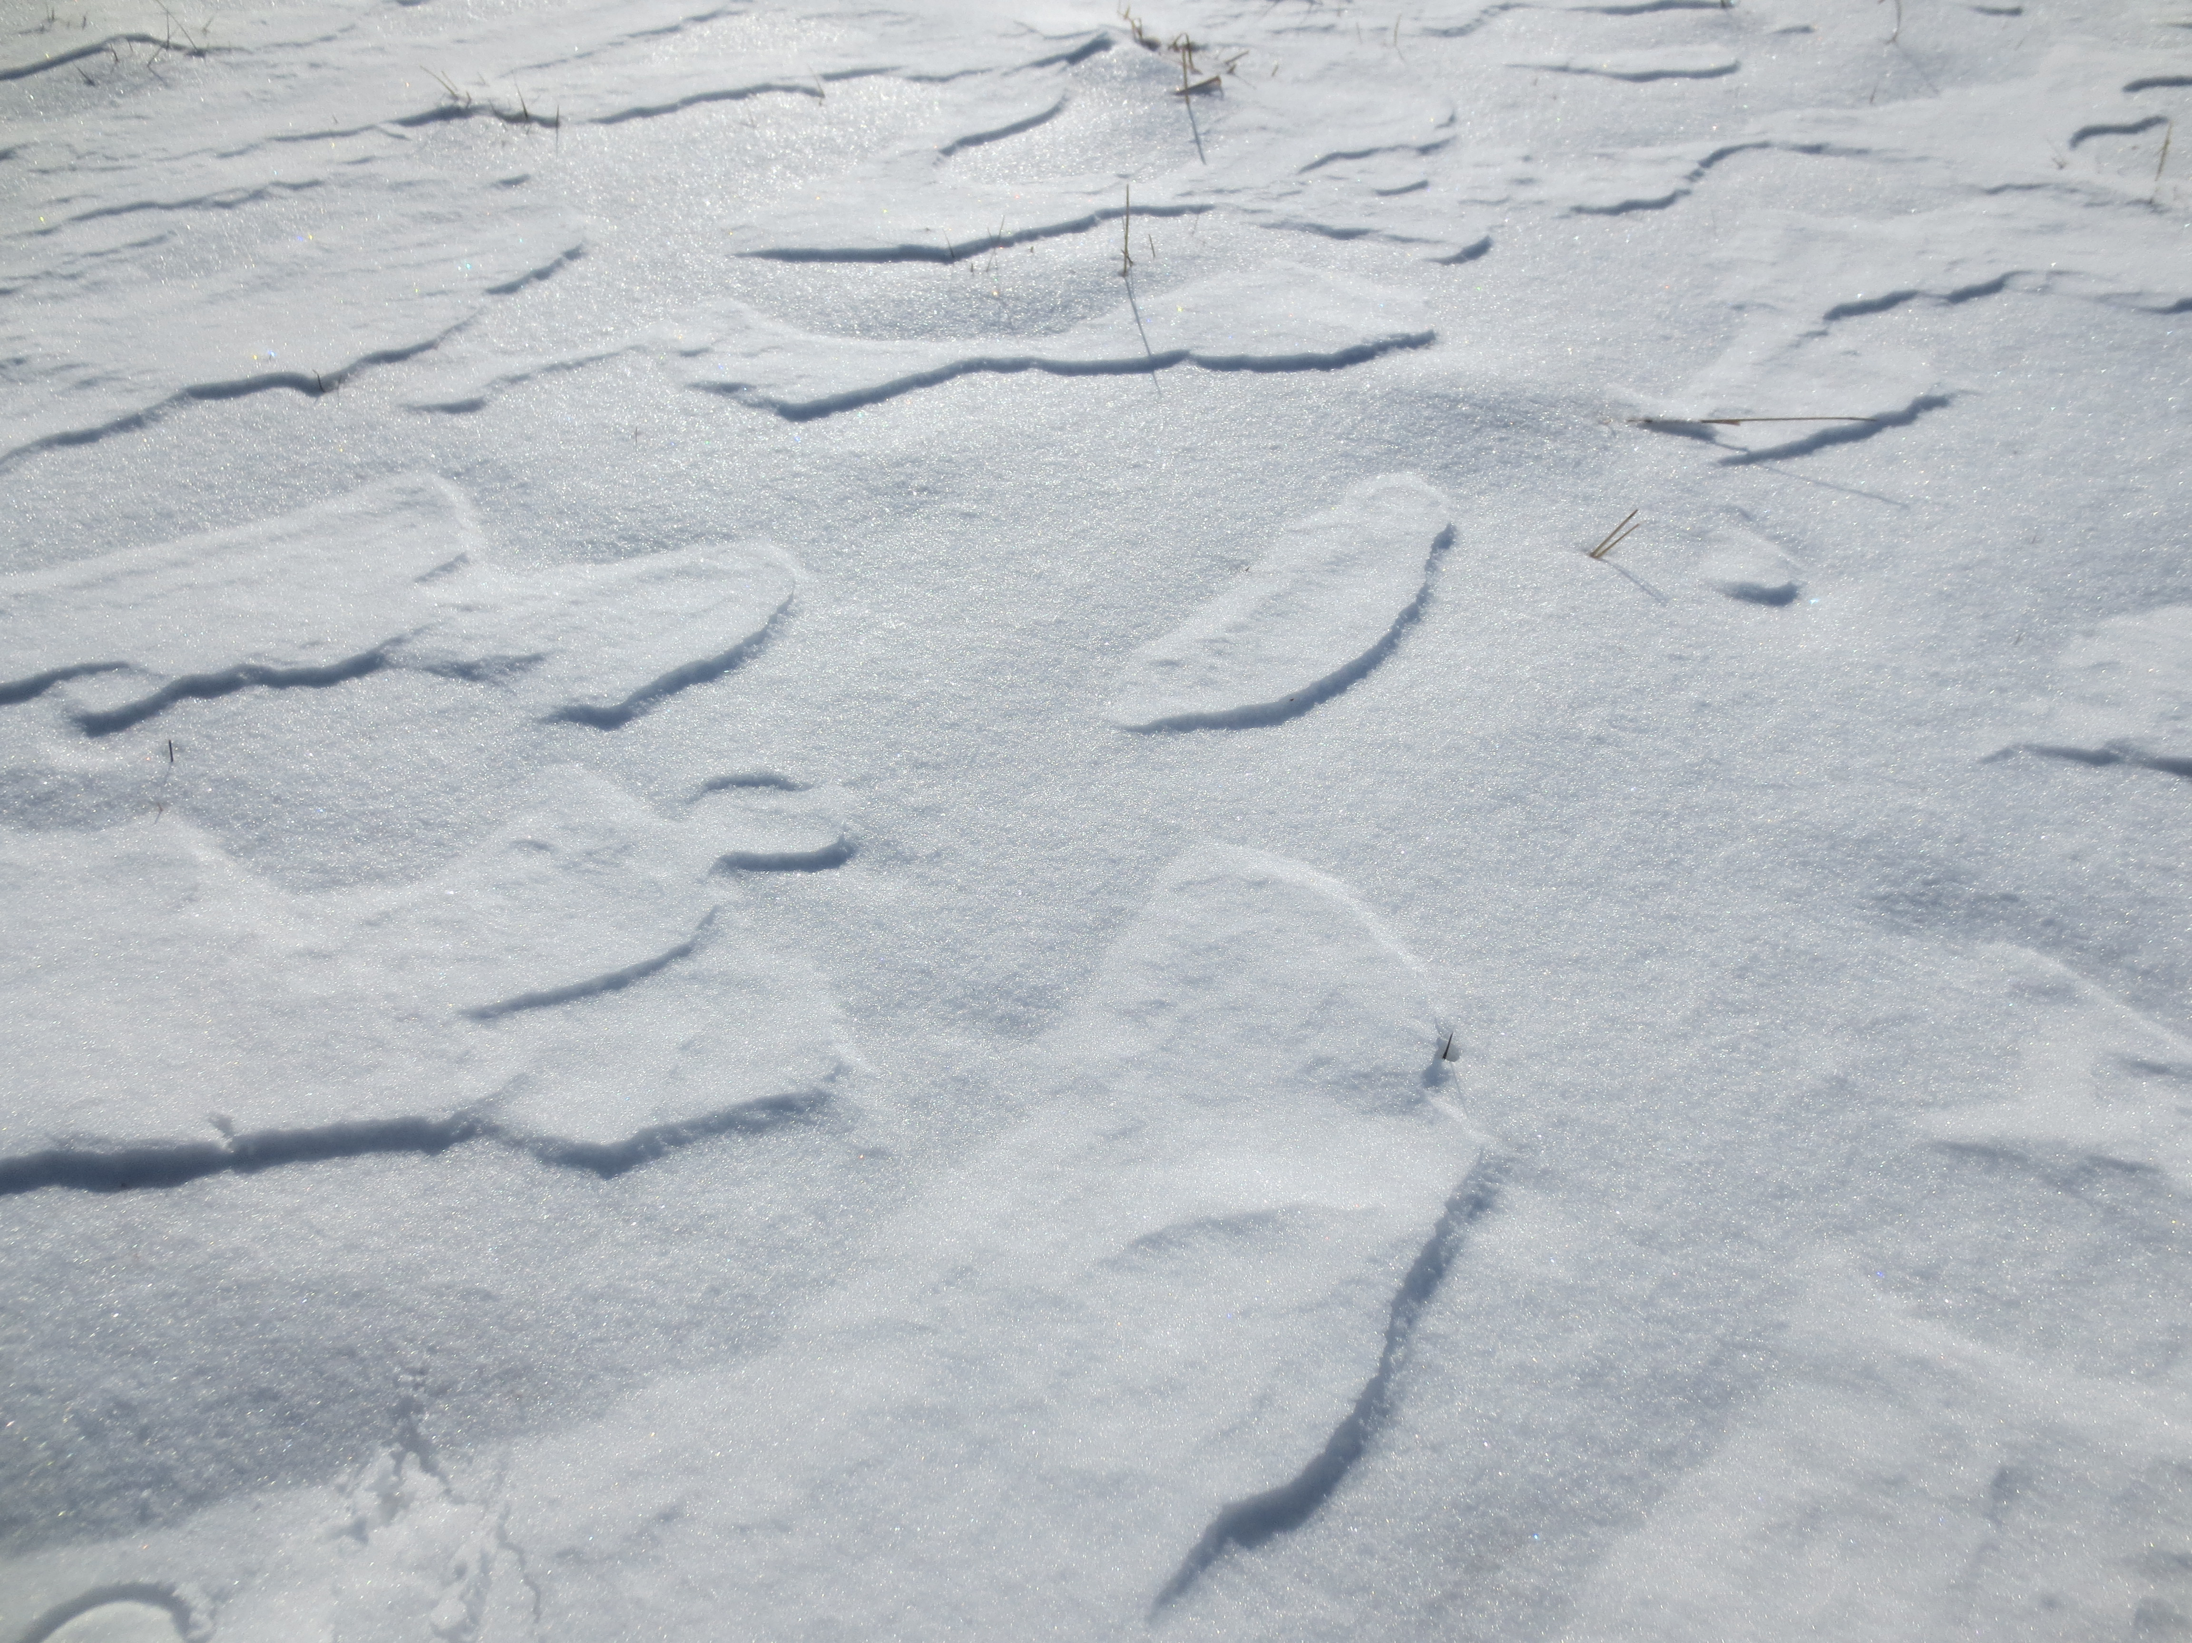
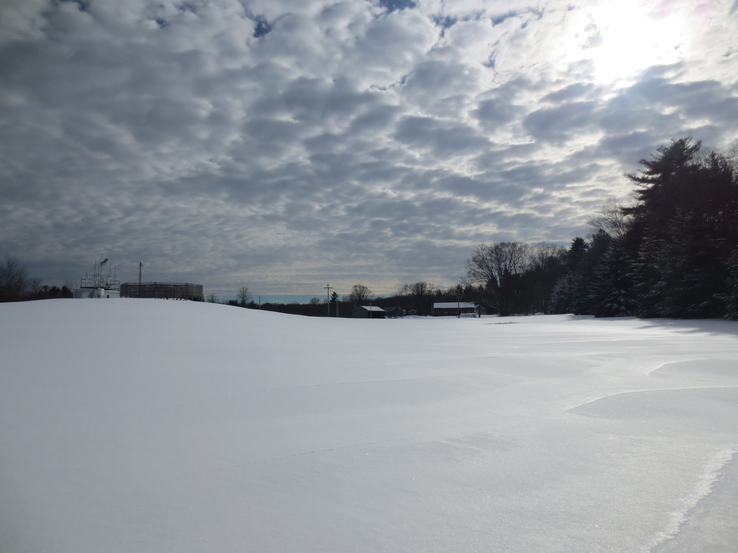


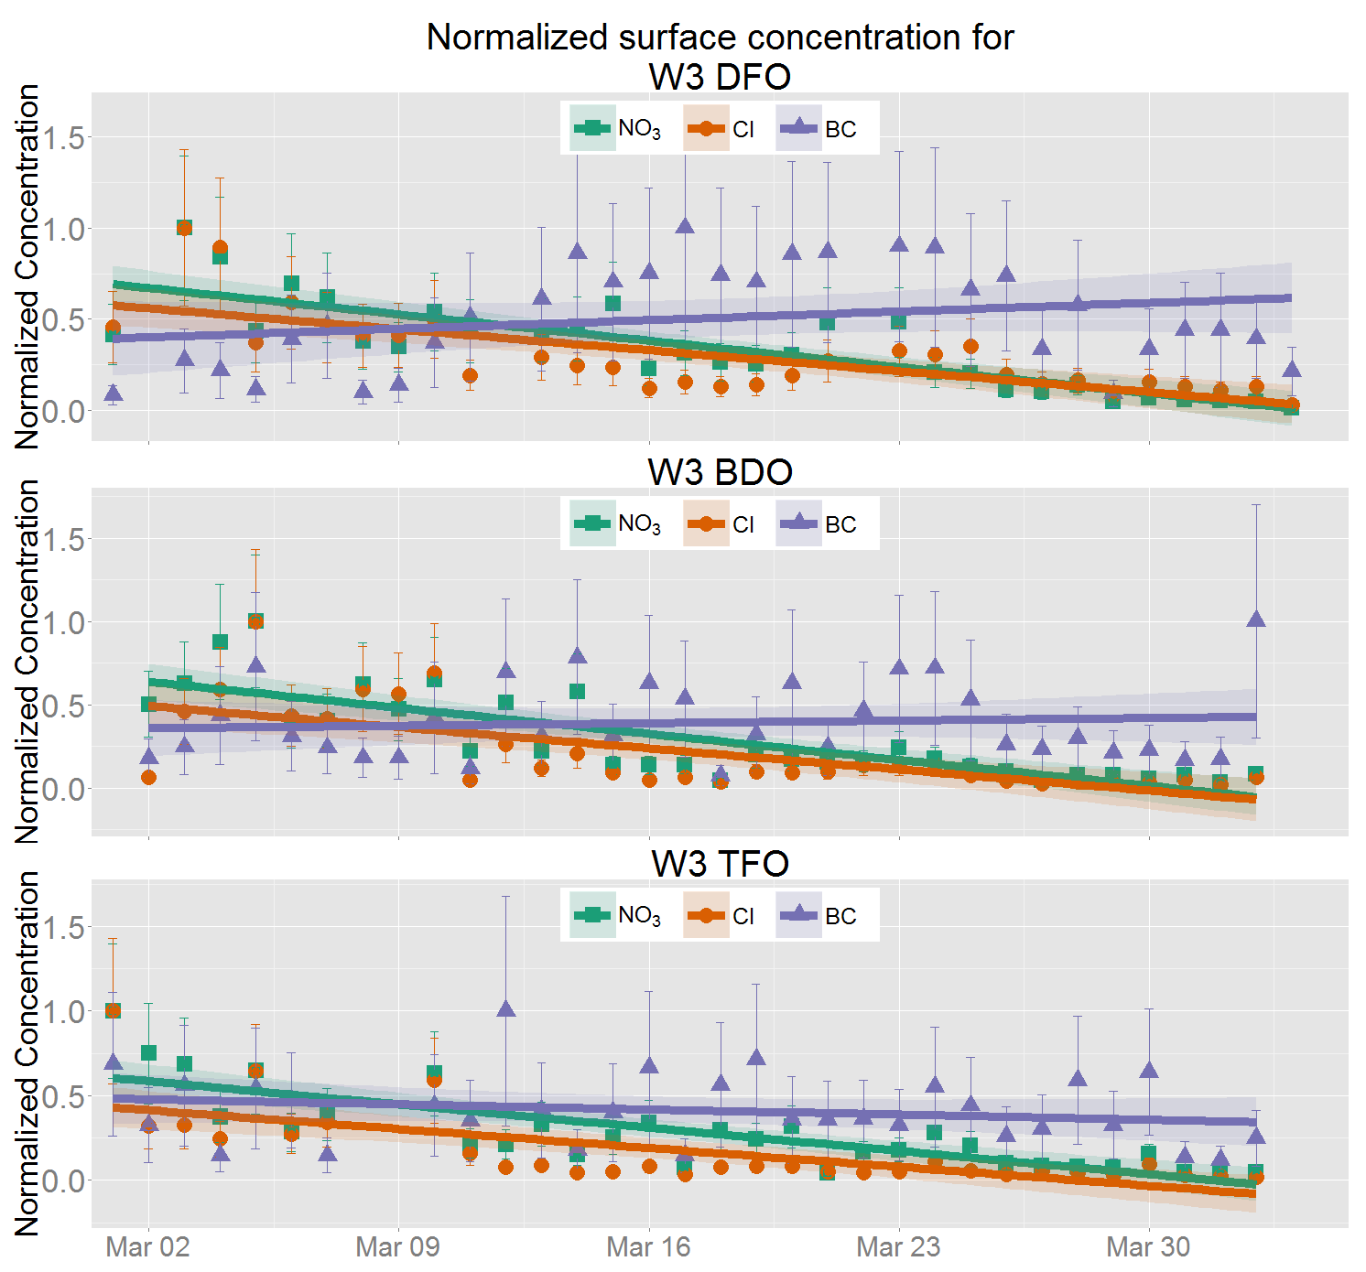
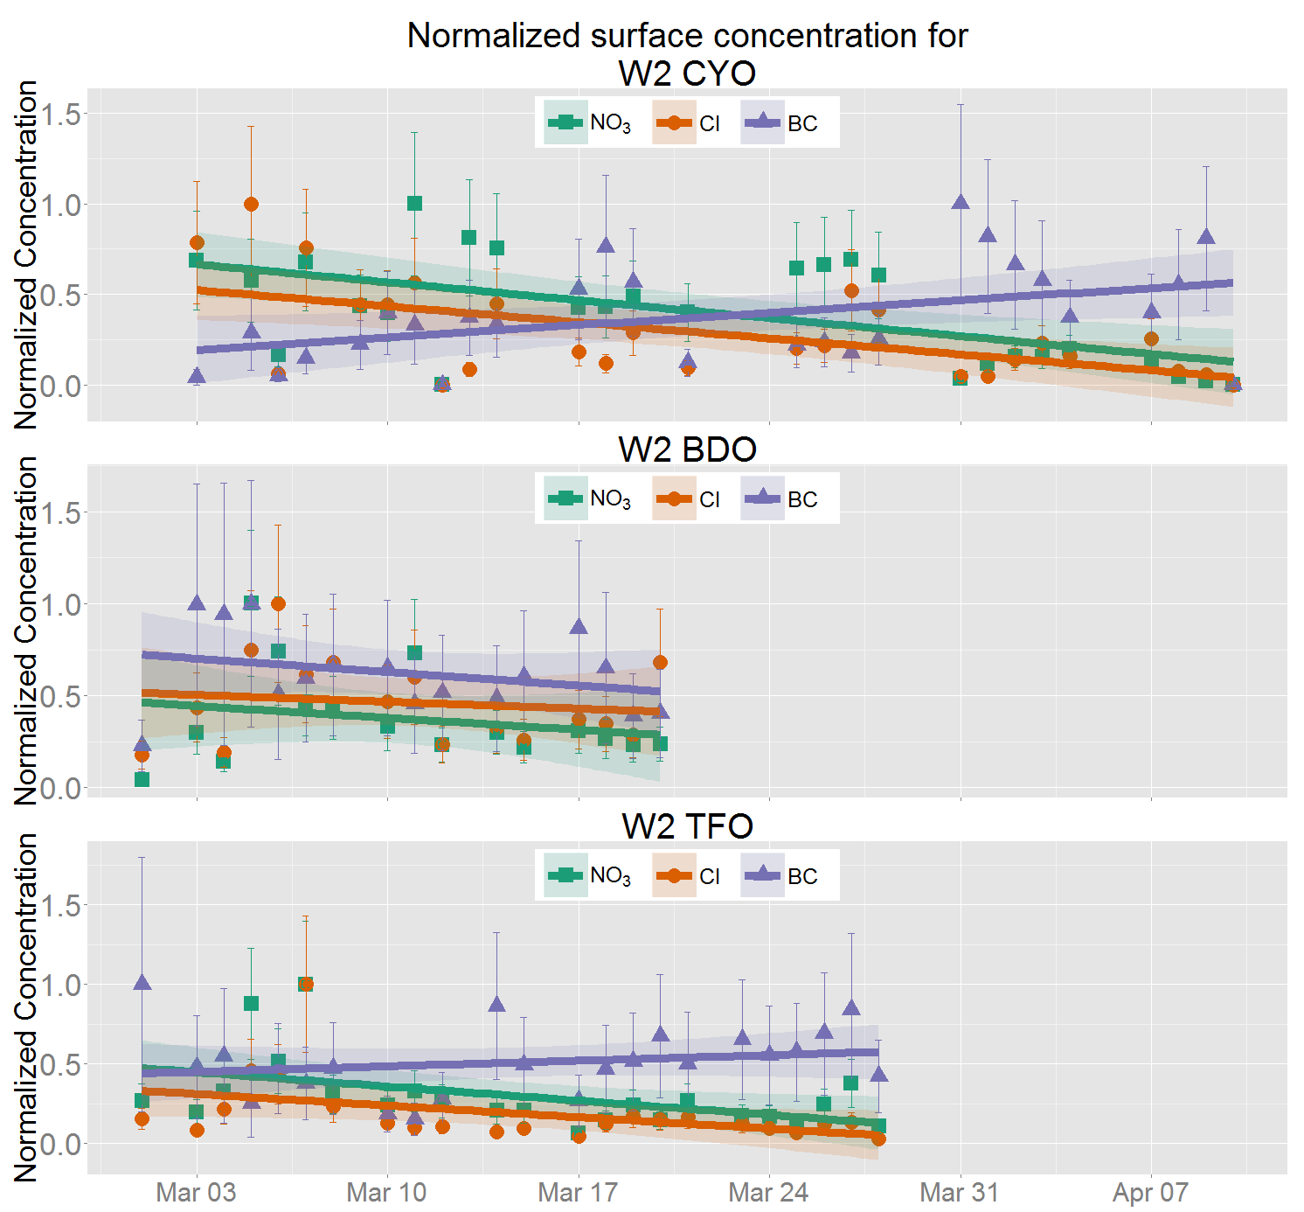
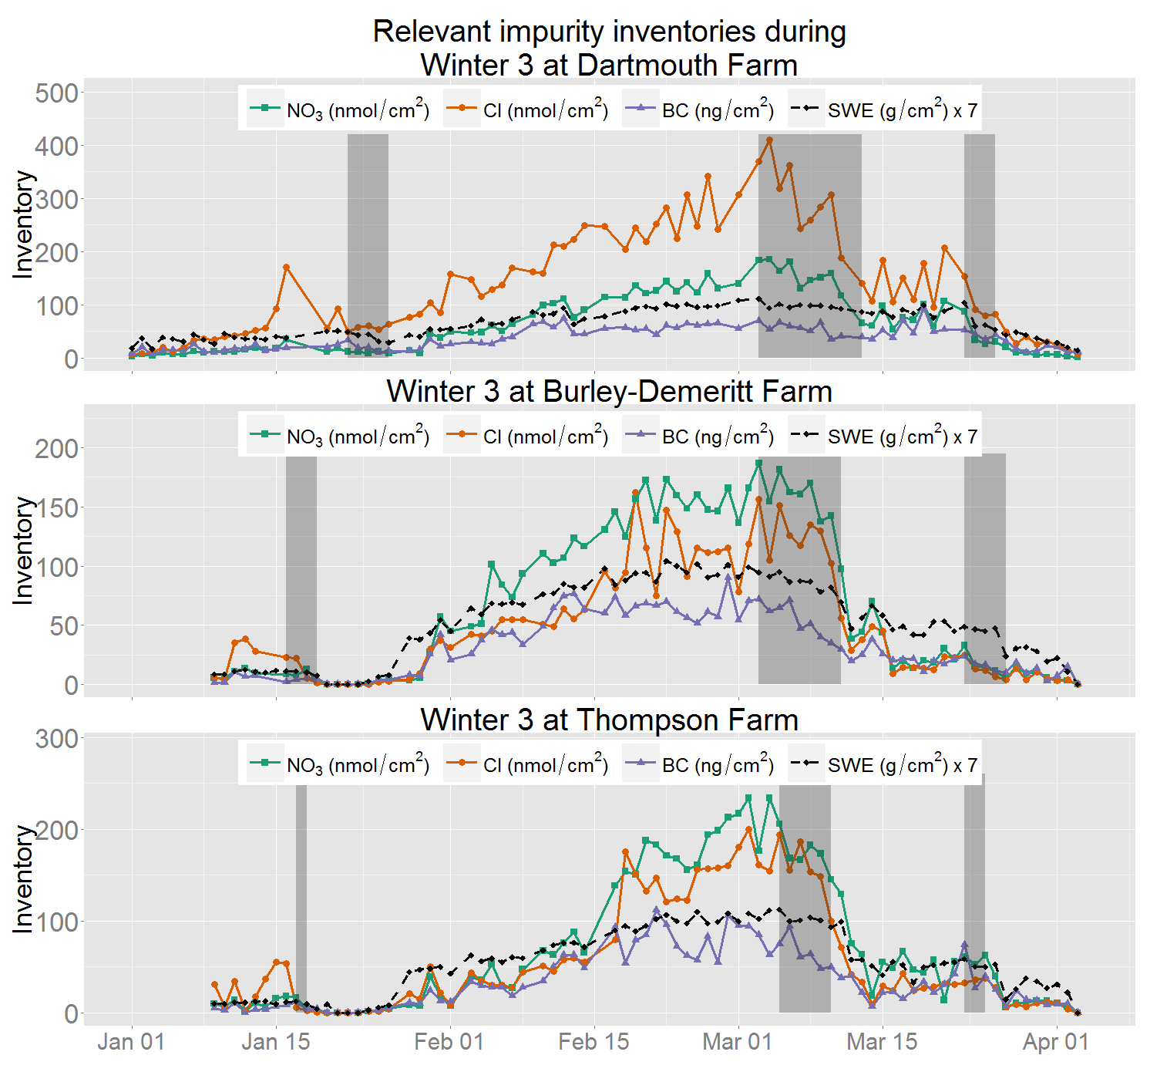
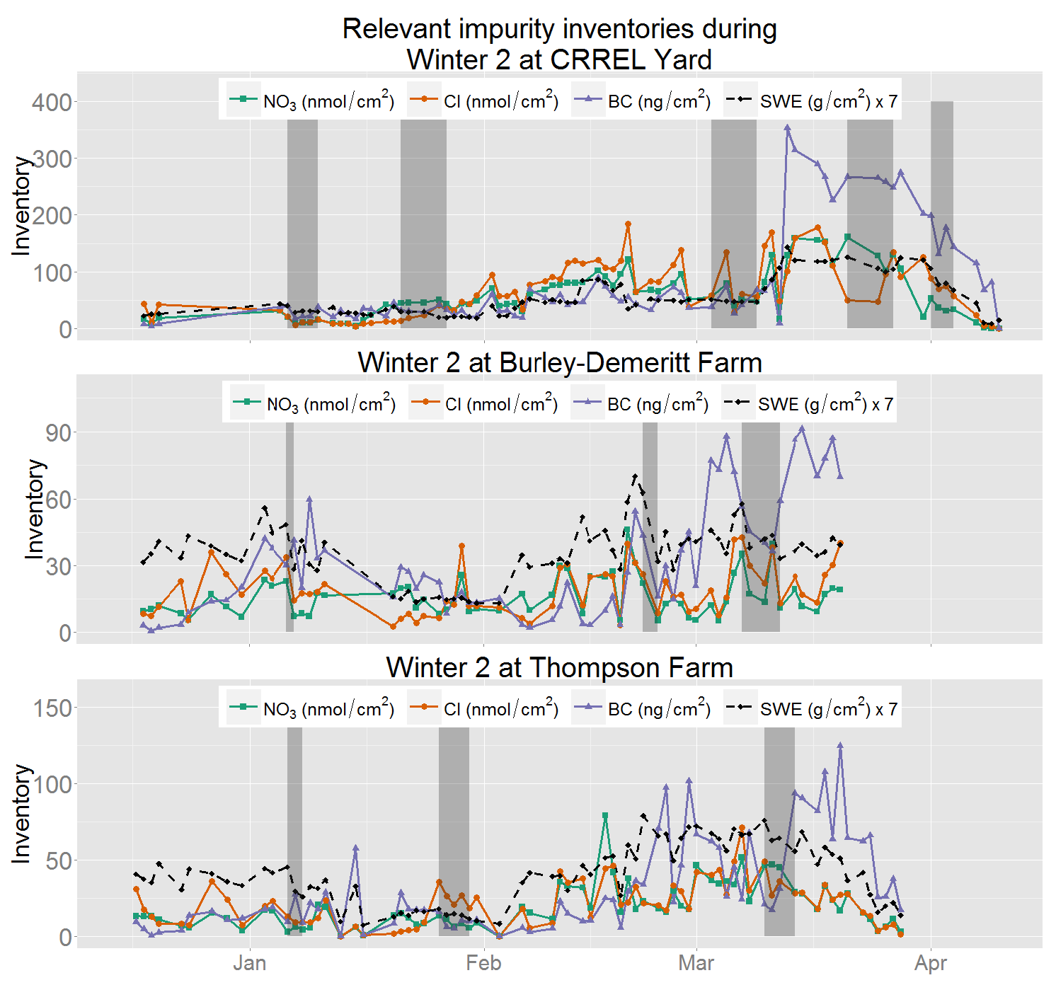
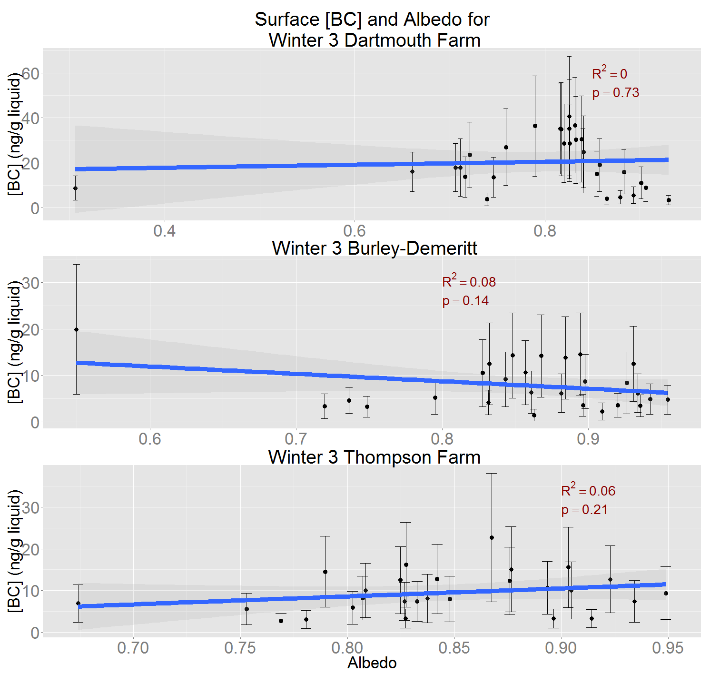
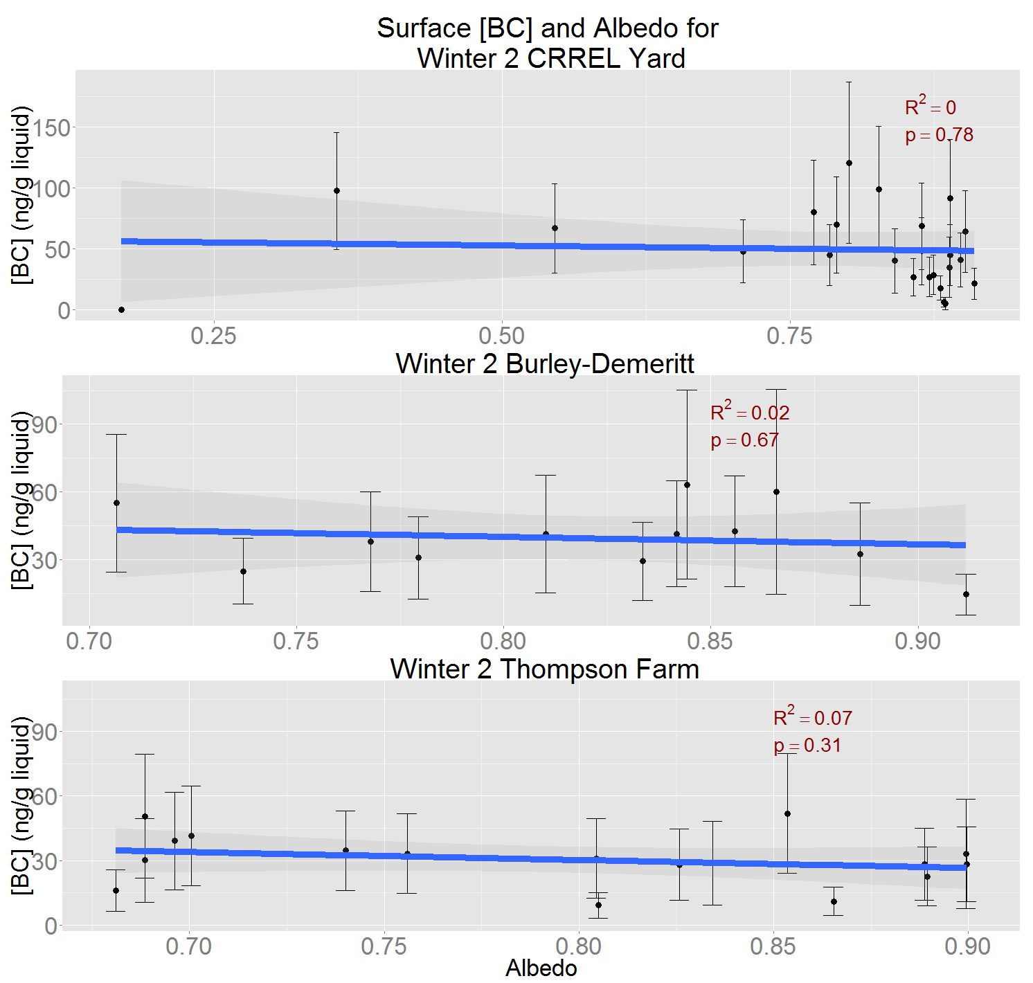
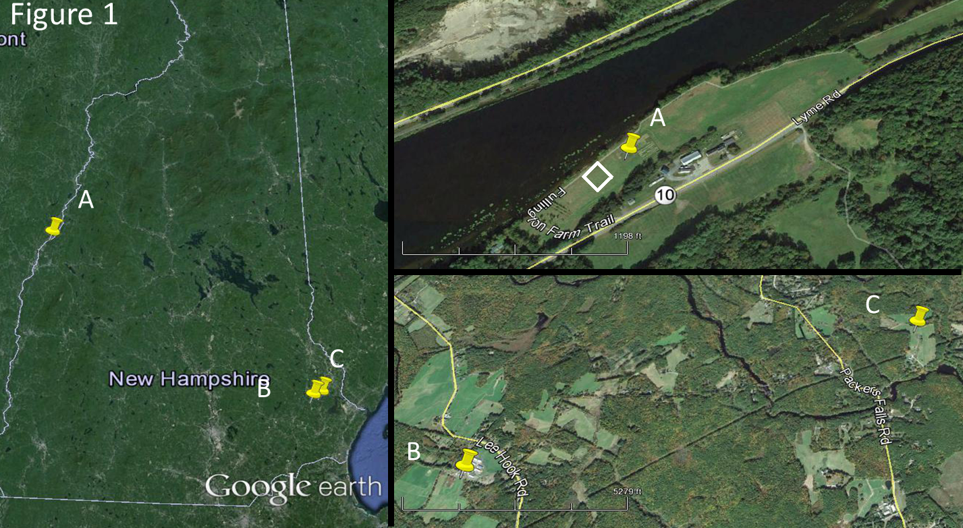
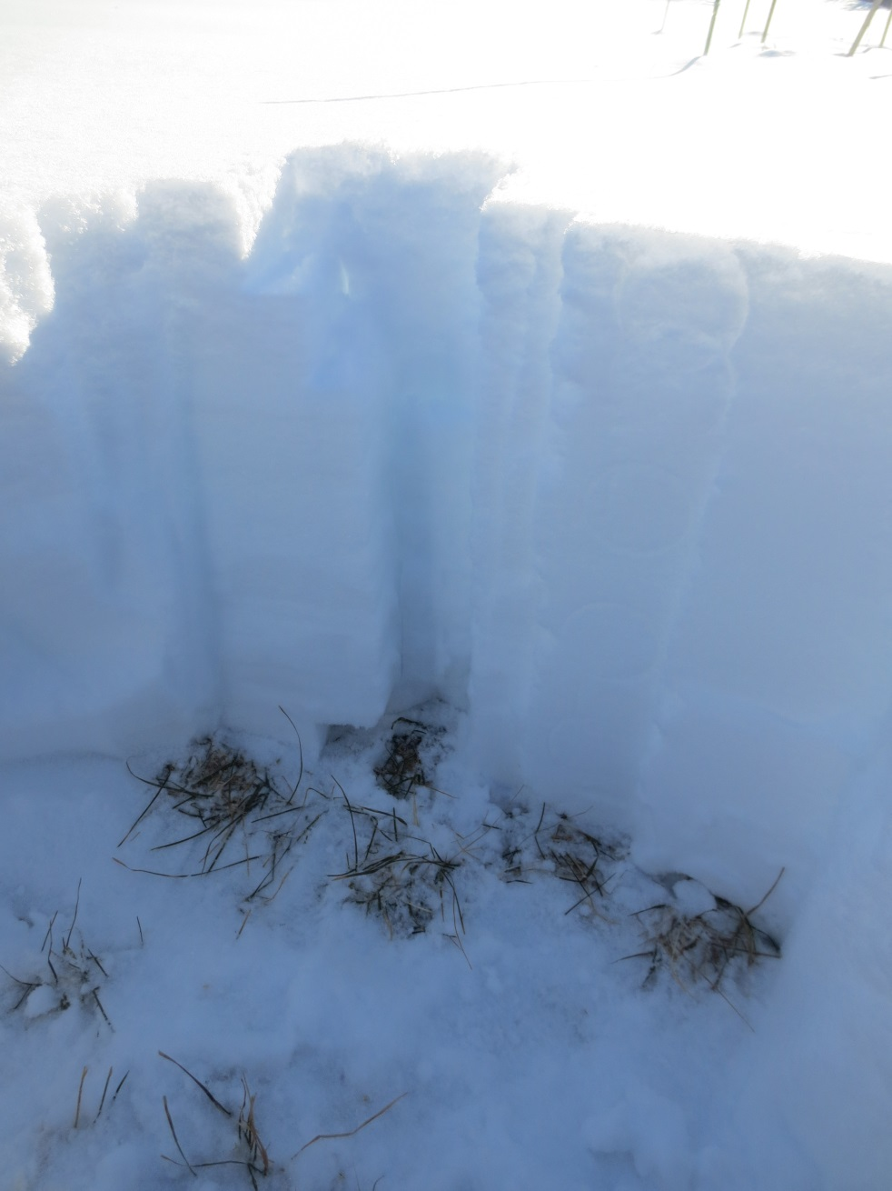







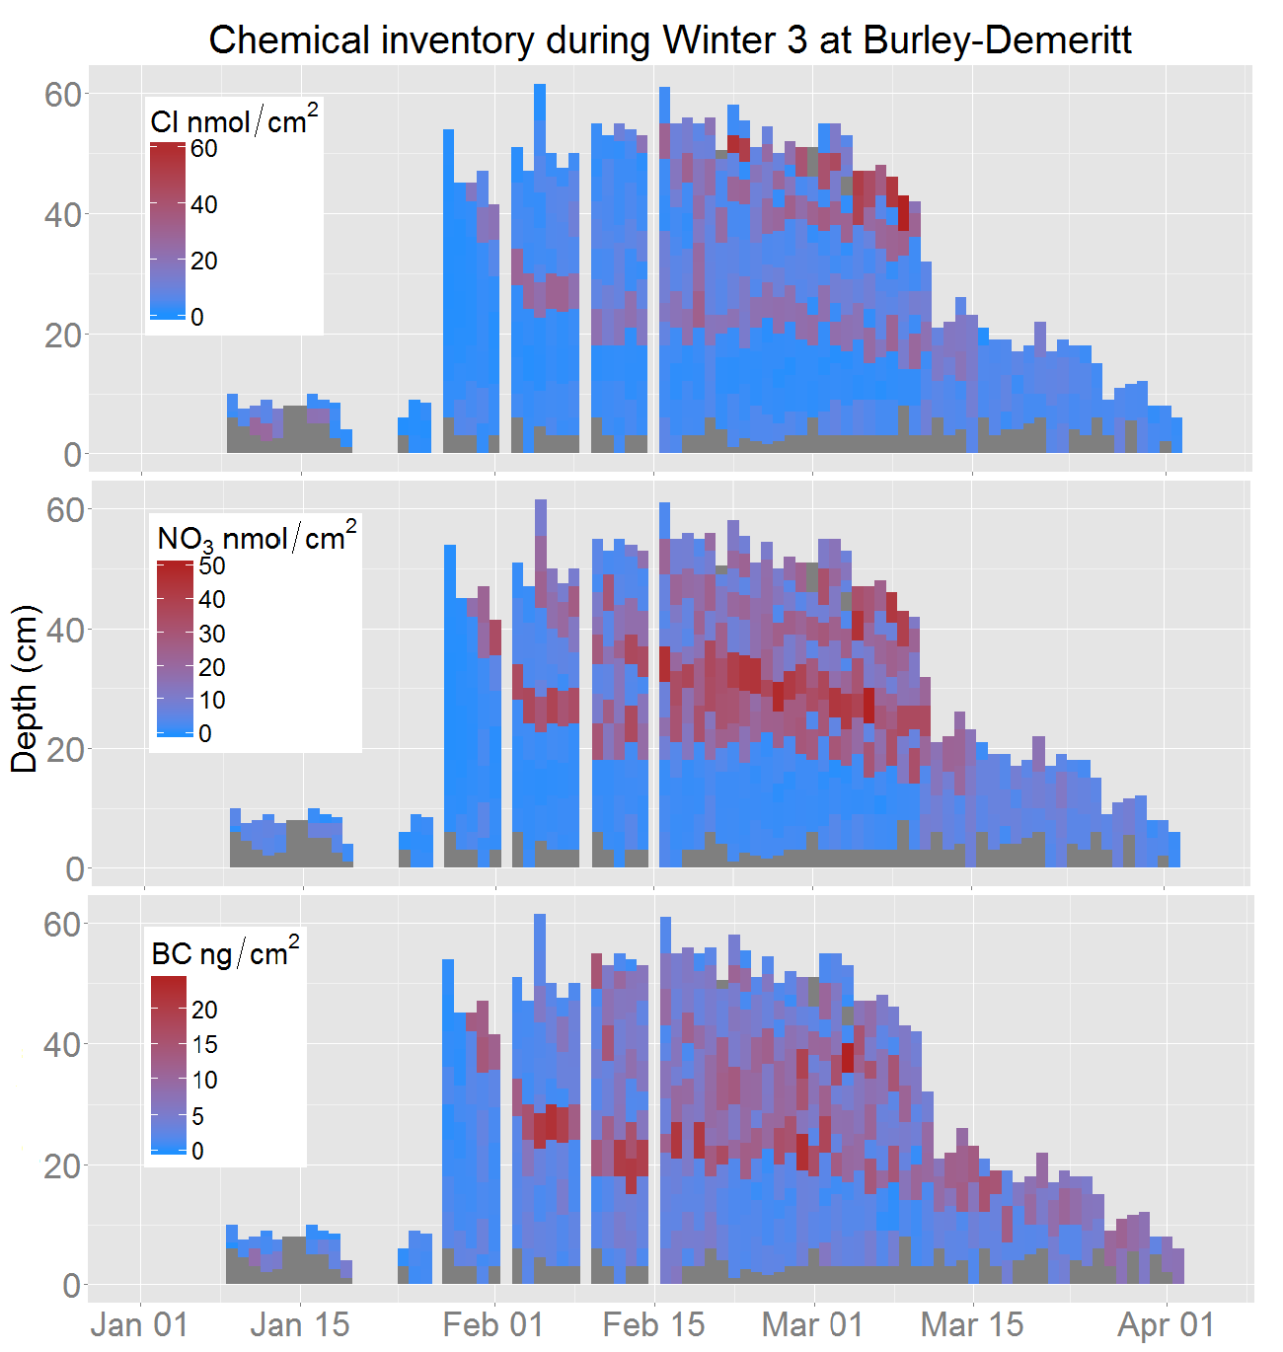
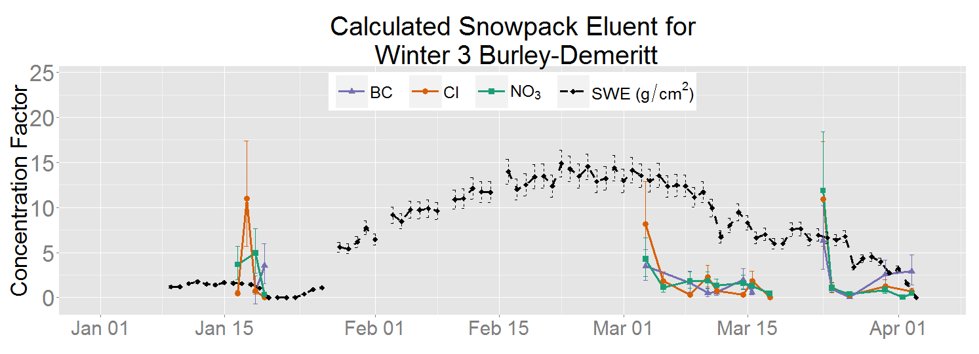

Quantifying Snowpack Properties and Snow Impurity Dynamics Over Three Consecutive Winters in New Hampshire
James Lazarcik ^{1, 2}, Jack E Dibb ^{1, 2}, Cameron P Wake ^{1, 2}, Alden C Adolph³, Madeleine Mineau^{1, 2},
Eric M Scheuer², Jacqueline Amante^{1, 2}
¹ Department of Earth Science , University of New Hampshire, Durham, NH, USA
²Institute for the Study of Earth, Oceans and Space, University of New Hampshire, Durham, NH, USA
³Thayer School of Engineering, Dartmouth College, Hanover, NH, USA
AGU Fall Meeting
C33C #821
Introduction
Previous field and laboratory studies have shown that a snowpack can lose a significant portion of its ions in the early stages of the melt, an event commonly known as an ionic pulse. On the other hand, some studies have found that particulate impurities (e.g. dust and black carbon (BC)) can enhance in surface layers during melt, darkening the snowpack. Most field studies are performed on alpine or arctic/sub-arctic snowpacks where the BC concentration remains relatively low; therefore, the effects of snowmelt on BC dynamics are less well characterized in seasonal snowpacks where mean BC concentrations are sometimes over double what is measured in Greenland. High concentrations of BC in snow may lower the albedo of snow, resulting in more absorbed solar radiation.
Results
Figure 6:
Figure 3:
Figure 6 (above): Concentrations have been normalized by the maximum value in the set. We see an overall increase in BC concentration, whereas we see a decrease in nitrate and chloride concentration.
Methods
Snow pits are sampled daily throughout the winter at three sites across New Hampshire for three consecutive winters.
Figure 3 (above): The grey boxes denote times of melt determined by a separate analysis. Clearly in winter three we can see that these melt events correspond with gradual SWE declination and rapid inventory loss.
Figure 7:
Figure 4:
Figure 4 (left): We see a disproportionate loss of inventory with SWE. Cases with inventory gains over the melt period have not been included. SWE loss values during the first part of the melt for winter are typically around 20% in early spring and vary greatly during the first and last melts.
Figure 1 (above): Sites A, B and C correspond to Dartmouth Farm (DFO) (and CRREL Yard (CYO)), Burley-Demeritt (BDO), and Thompson Farm (TFO), respectively. The white square near Site A notes the location of a spatial variability survey site.
Figure 7 (above): Surface BC concentrations (<5cm from boundary layer) and albedo (350nm to 700nm) with a linear fit. The effect of surface BC concentration on broadband albedo is minimal, as indicated by the low correlation coefficients and high p-values.
Figure 2:
Samples with
soil/grass
Example of a sampled snowpit
Figure 5:
Conclusions
We see a pulse of all impurity inventories, with concentration factors typically ranging from 5 to 20 during the first part of the melt fraction, even insoluble black carbon.
BC behaves differently as the snowpack continues to melt - major ions are continually flushed from the snowpack but BC tends to enhance on the surface.
Depending on the overall amount of impurity in a snowpack, the ion pulse could cause temporary impairment in a receiving ecosystem, especially if the receiving ecosystem is not primed for such a load (as streams can be in spring).
There is very little correlation between snowpack radiation absorption in the visible range and BC concentration on the surface of the snowpack, which suggests that albedo is driven more by other factors.
(C/C₀)
Figure 5 (above): Concentration factors (C/C₀) are the ratio of calculated snowpack eluent over bulk snowpack concentration. A separate analysis shows that most pulse events correspond to a disproportionate loss of impurity inventory, including BC inventory (see Figure 4). Typical calculated eluent concentrations are between 1 and 10 ppm for both nitrate and chloride.
Acknowledgements: Most notably those who’ve helped collect data – Amber Whelsky, Tristan Amaral, Megan Dalton, Andrea Price, Jeferson Prado Swerts, and Jessica Lindes Fonseca. Also Elizabeth Burakowski and Mary Albert.
Figure 2 (above): Note subtle changes in snowpack depth, impurity inventory additions to the surface of the snowpack, and their retention until melt.
Support for the New Hampshire EPSCoR Program is provided by the National Science Foundation’s Research Infrastructure Improvement Award # EPS 1101-245

