Slide 1






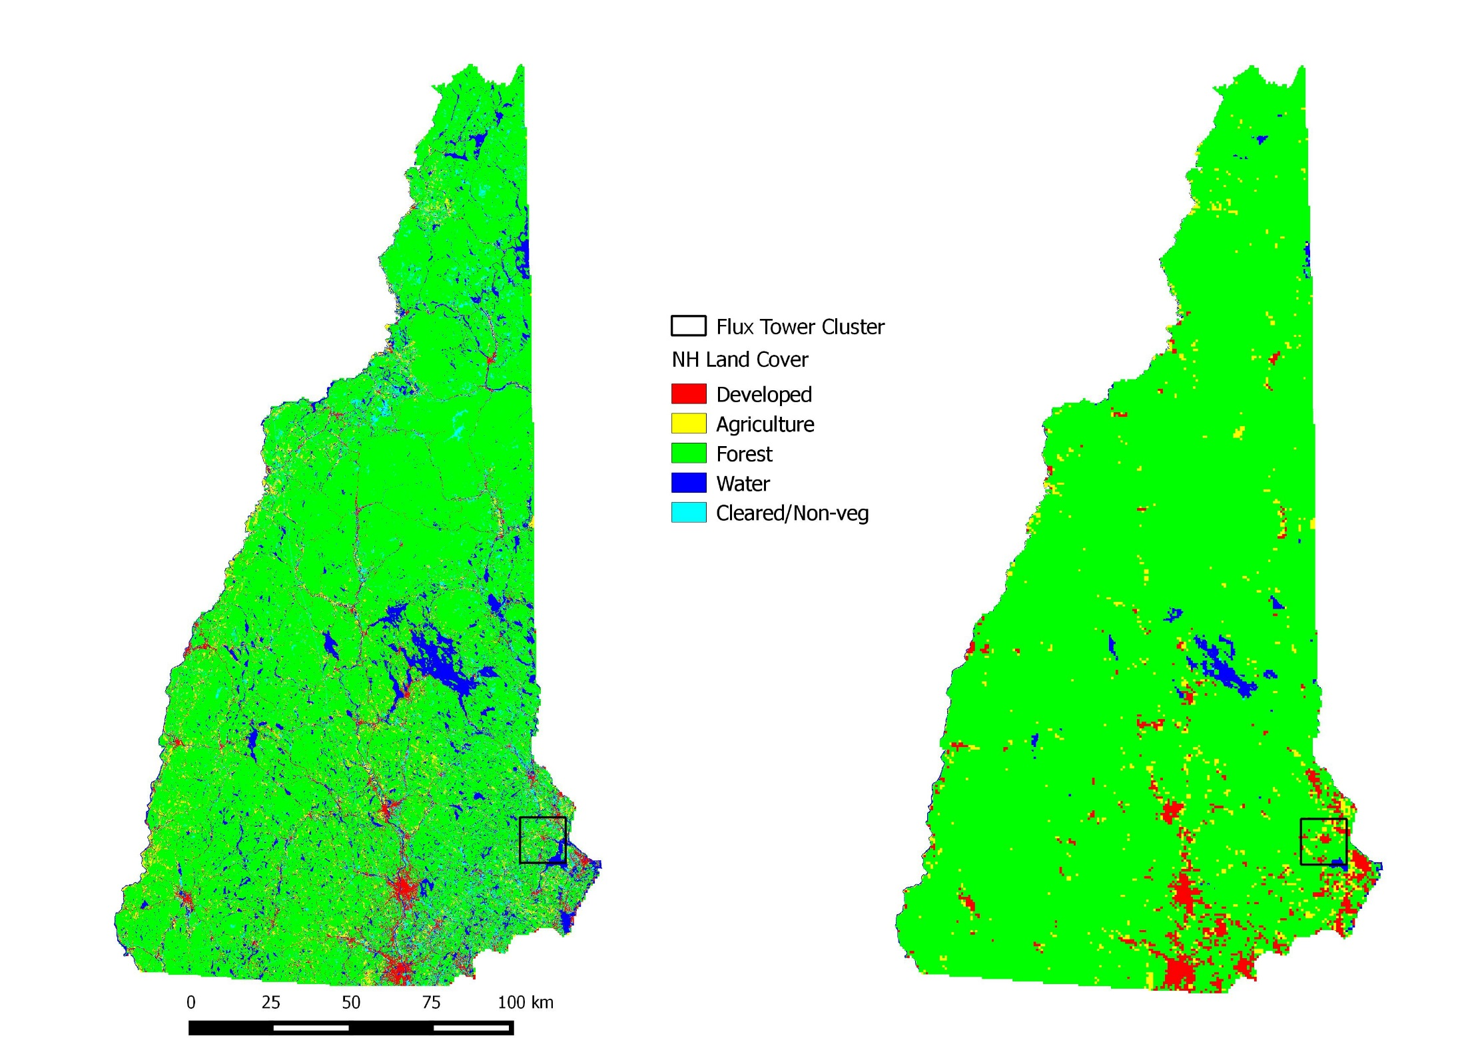

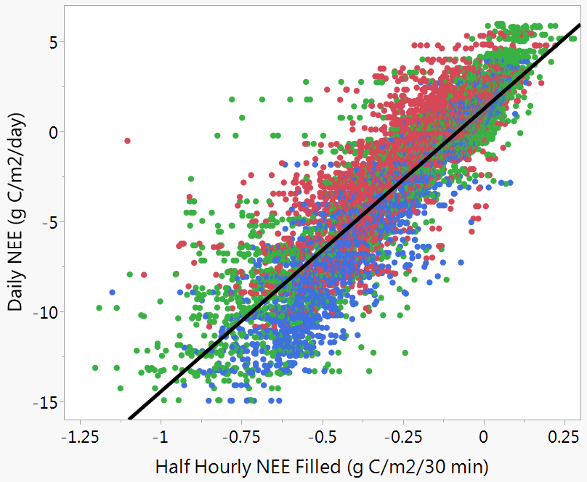
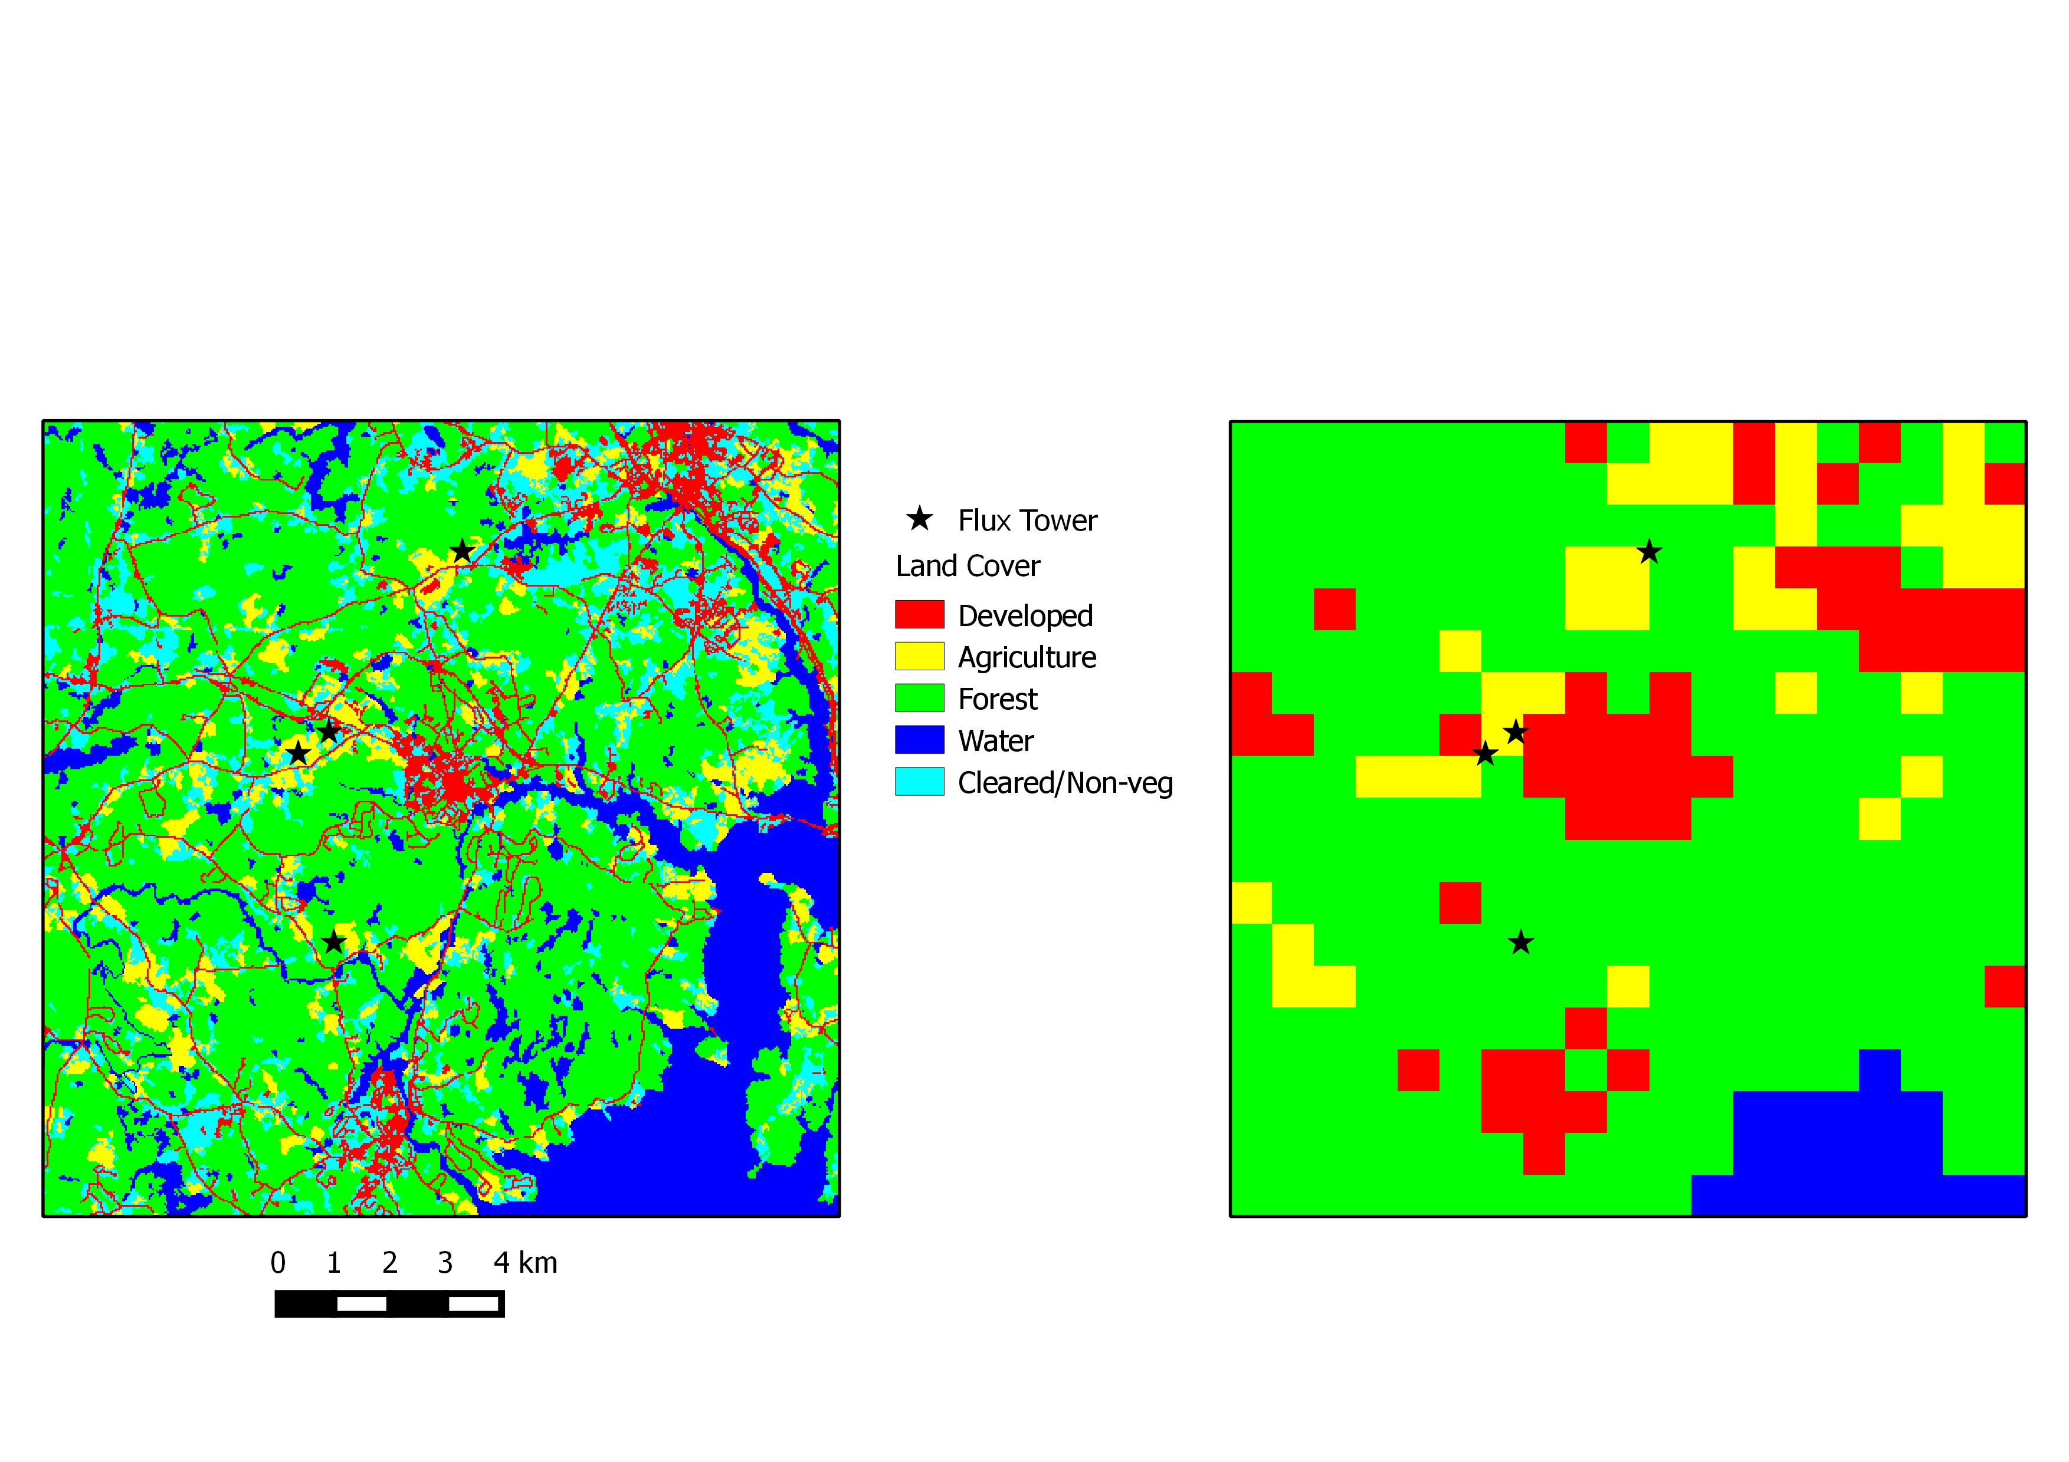
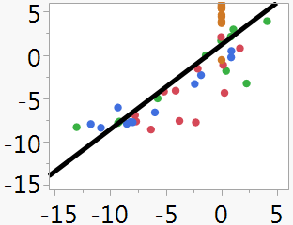
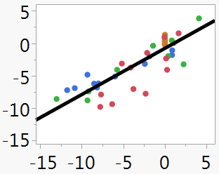
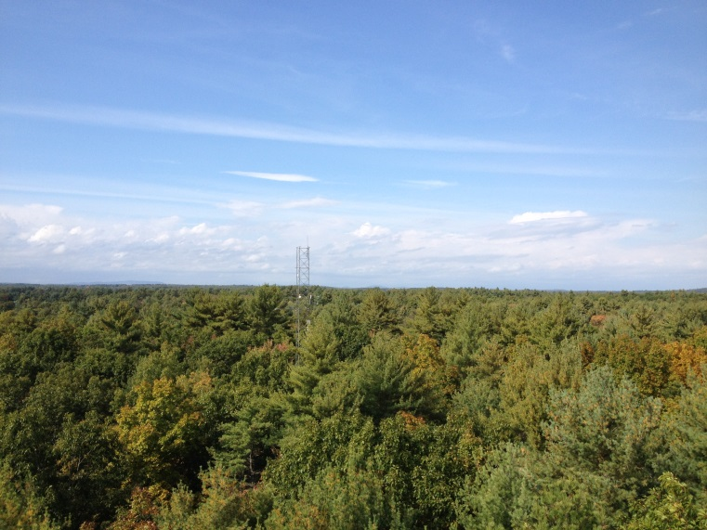
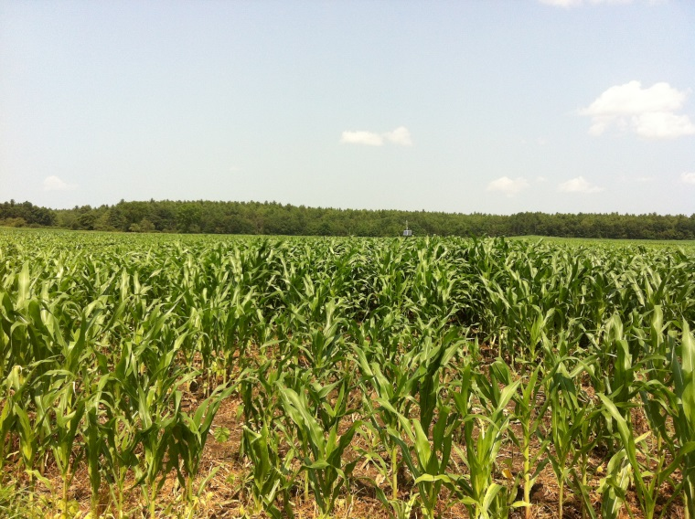
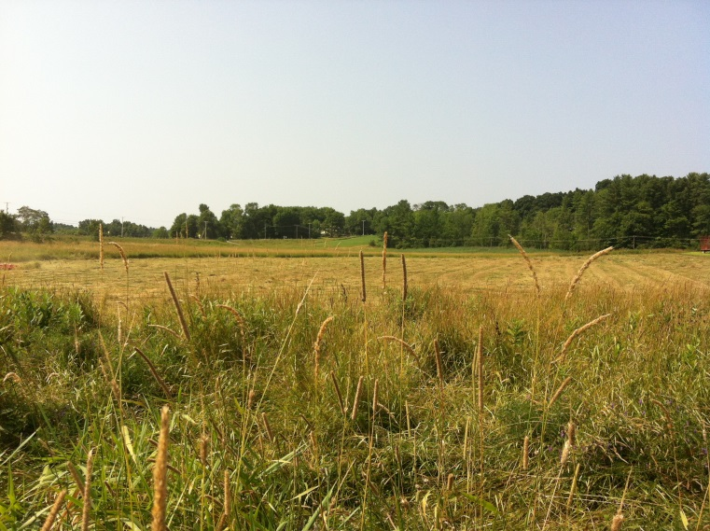
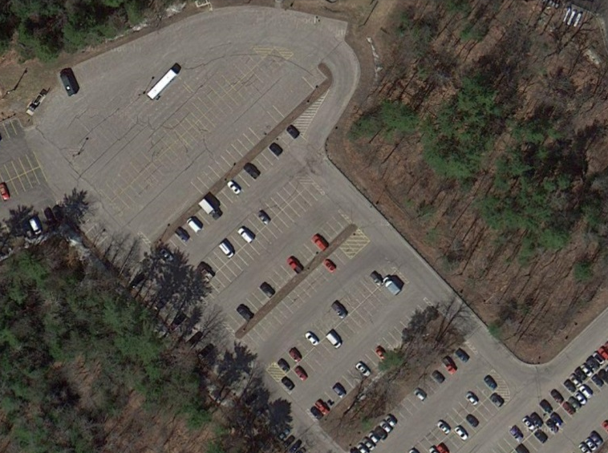
Coupling Eddy Covariance Measurements with Remote Sensing to Upscale Net Carbon Flux Across a Heterogeneous Landscape
Andrew Ouimette, Lucie Lepine, Scott Ollinger, Sean Fogarty, Elizabeth Burakowski
Andrew.Ouimette@unh.edu
This study is supported by National Aeronautics and Space Administration (NASA) through the Carbon Cycle Science Program (award number NNX14AJ18) and the NH EPSCoR Program. Support for the NH EPSCoR Program is provided by the National Science Foundation's Research Infrastructure Improvement Award # EPS 1101245.
Earth Systems Research Center, University of New Hampshire, Durham, NH 03824, USA
Abstract
Influence of Spatial Resolution on Landcover Classification
Influence of Temporal Resolution on Upscaling NEE
Estimates of net carbon exchange at broad spatial scales that capture finer scale landscape heterogeneity offer the possibility to improve our understanding of the interactions between land use and climate change across mixed landscapes. We used a cluster of eddy flux towers located within 7.5 km of one another in southern New Hampshire across four land cover types—mixed forest, cornfield, hayfield, and impervious surface — to investigate the tradeoffs among different approaches to upscaling tower-based estimates of net ecosystem exchange (NEE) using remote sensing data layers.
Initial results indicate that the fine scale spatial heterogeneity found in southern New Hampshire and much of New England are likely only captured using remote sensing products with circa 30m resolution. For example, the fraction of land area in New Hampshire classified as forest from a MODIS-derived 500m resolution land cover map is 0.94, as compared to 0.77 from a 30m resolution Landsat-derived land cover map, indicating that other land cover types are not explicitly classified with coarse resolution imagery.
Strong correlations were observed between Landsat data layers and NEE aggregated at 3 differential temporal scales (half-hourly, daily, monthly), although finer temporal scales reduce predictive errors. Results of empirical multiple regression models across snow-free vegetated sites using Landsat 8 show that red, NIR, and EVI were strongest predictors of NEE, while a model including snow-covered conditions and an impervious surface site selected for bands more indicative of water status (SWIR, blue, NDWI) in addition to EVI.
Future work will investigate the potential of hybrid remote sensing data layers that blend high temporal resolution (MODIS) data with high spatial resolution (Landsat) to upscale NEE in New England.
Eddy Flux Data
Modeling Results
Daily NEE (g C/m²/day)
R² = 0.83
RMSE = 1.7
KF Hayfield
MF Cornfield
TF Forest
Half Hourly NEE (g C/m²/30 min)
State-wide
Study-area
Figure (above): Temporal correlation between half-hourly (10:30-13:30) and daily eddy flux estimates of NEE. Correlations between daily and monthly estimates (not shown) are also robust (r² = 0.75, RMSE = 54.0).
Fig and Table (right): Results of stepwise multiple regression modeling using reflectance, thermal bands and LST and vegetation indices derived from Landsat 8 to estimate NEE data aggregated at different temporal scales. This figure shows the importance of the 4 parameters chosen to explain NEE at different temporal scales. Temporal scale did not affect parameter selection, but influenced the importance of each parameter and overall model fit (Table).
Temporal Scale | adjusted r² | CV of RMSE
Half hourly | 0.84 | 0.11
Daily | 0.72 | 0.14
Monthly | 0.72 | 0.17
Land cover maps of New Hampshire developed from Landsat (left; NH GRANIT www.granit.unh.edu) and MODIS (right; MCD12Q1) showing the influence of spatial resolution (30m vs. 500m). 12 x 12 km study area in southern NH outlined as a black square. Bar graph (right) shows the difference in the proportion of land cover types using Landsat- and MODIS-derived land cover maps for the state as well as for the study area (see panel below). The proportion of the state and study area classified as forest is 15-20% higher when using 500m vs. 30 m spatial resolution, while a smaller fraction of land is classified as water and cleared/non-vegetated surfaces.
Influence of Spatial Resolution: Heterogeneous Landscape
Upscaling Vegetated and Developed Surfaces
Predicted NEE
(g C/m²/day)
KF Hayfield
Predicted NEE
(g C/m²/day)
MF Cornfield
TF Forest
WE Parking Lot
Eddy Flux Tower Sites
Observed NEE (g C/m²/day)
Observed NEE (g C/m²/day)
Thompson Forest, Durham, NH
Moore Cornfield, Durham, NH
Parameter | Contribution
EVI | 43%
NIR (850-880) | 29%
Red (640-670) | 20%
Green (530-590) | 8%
RSquare Adj | 0.71
RMSE | 2.45
Parameter | Contribution
EVI | 52%
SWIR (1570-1650) | 20%
Blue (450-510) | 15%
NDWI | 12%
RSquare Adj | 0.71
RMSE | 2.22
Land cover maps (as described in the panel above) of the 12 x 12 km study area in southern NH within which the flux tower cluster is located. Bar graph (above) shows the difference in the proportion of different land cover types using Landsat- and MODIS-derived land cover maps for the state as well as for the study area. This example demonstrates the influence of spatial resolution on land cover classification, and in particular, the differences in proportions of the study area classified as forest vs. water and cleared/non-vegetated surfaces. (The large body of water in the lower right of the map is part the Great Bay Estuary.)
r
Results of stepwise multiple regression models using vegetation indices, reflectance and thermal bands from Landsat to predict daily NEE at the 3 vegetated sites under snow-free conditions (left) or at all 4 sites under all conditions (right). When including only the 3 vegetated sites EVI, as well as reflectance bands indicative of vegetation structure and activity (NIR, red, green) are chosen as the most important parameters for predicting NEE. When including the parking lot (impervious surface) and times when the vegetation is snow-covered, EVI as well as reflectance bands and indices more indicative of water status (SWIR, blue, NDWI) are chosen as the most important for predicting NEE.
Spatial and Carbon Flux Heterogeneity
KF Hayfield
TF Forest
Conclusions and Future Directions
Kingman Hayfield, Madbury, NH
West Edge Parking Lot, Durham, NH
MF Cornfield
WE Parking Lot
The eddy flux systems and data they capture will also provide opportunities for undergraduate and graduate research projects, as well as middle and high school science and technology projects and internships.
Initial results highlight the temporal and spatial tradeoffs that exist when using remote sensing data layers to upscale field estimates of net carbon fluxes from eddy covariance sites. Tradeoffs may also exist between the number of remote sensing data layers included in predictive models (e.g. data layers available at different temporal and spatial resolution) and the generality of predictive models (stronger predictive models were generated for snow covered, minimally vegetated sites when bands with coarser resolution were used).
Data derived from the eddy flux systems have direct relevance to the EPSCoR Ecosystems & Society project, as they will be used not only by terrestrial and hydrologic modeling groups, but also to assess climate and future land-use scenarios. By understanding how each component of the landscape contributes to the surface energy budget, we will be better able to estimate climate forcing under various land-use scenarios. This knowledge will help inform decisions about future land use.
Future work will:
1) Investigate the ability of the limited number of MODIS products available at 250 meter resolution to upscale field measured NEE
2) Investigate a hybrid remote sensing data layer approach that blends Landsat and MODIS data.
3) Include additional forested eddy flux sites in New England (Bartlett, Harvard, Howland, Hubbard Brook)
4) Include latent and sensible heat fluxes
5) Compare regional estimates of carbon and energy fluxes from remote sensing-based upscaling techniques to results from process-based ecosystem models (e.g. CLM, PnET)
Photographs of the 4 sites that are part of the eddy covariance cluster in southern New Hampshire. The sites span 4 land cover types and include a mixed forest, a managed hayfield, a managed cornfield, and a parking lot (impervious surface). At the 3 vegetated sites landcover is homogeneous for at least 300 meters in the dominant wind direction from the tower.
Correlogram (left) demonstrating spatial correlation in the Enhanced Vegetation Index (EVI) data product from Landsat. EVI is shown because it is often strongly correlated to carbon fluxes. Lower values of the correlation statistic indicate relatively higher homogeneity among neighboring pixels. At 250m, 500m, and 1 km spatial resolution much of the homogeneity among neighboring pixels is lost, indicating that at coarse spatial resolution, pixels would include a heterogeneous mix of land cover and EVI values.
Time series (right) of daily net ecosystem exchange (NEE) for the four flux tower sites clustered in the southern New Hampshire. Note the differences in temporal patterns of net carbon exchange for the 3 vegetated sites .

