Slide 1
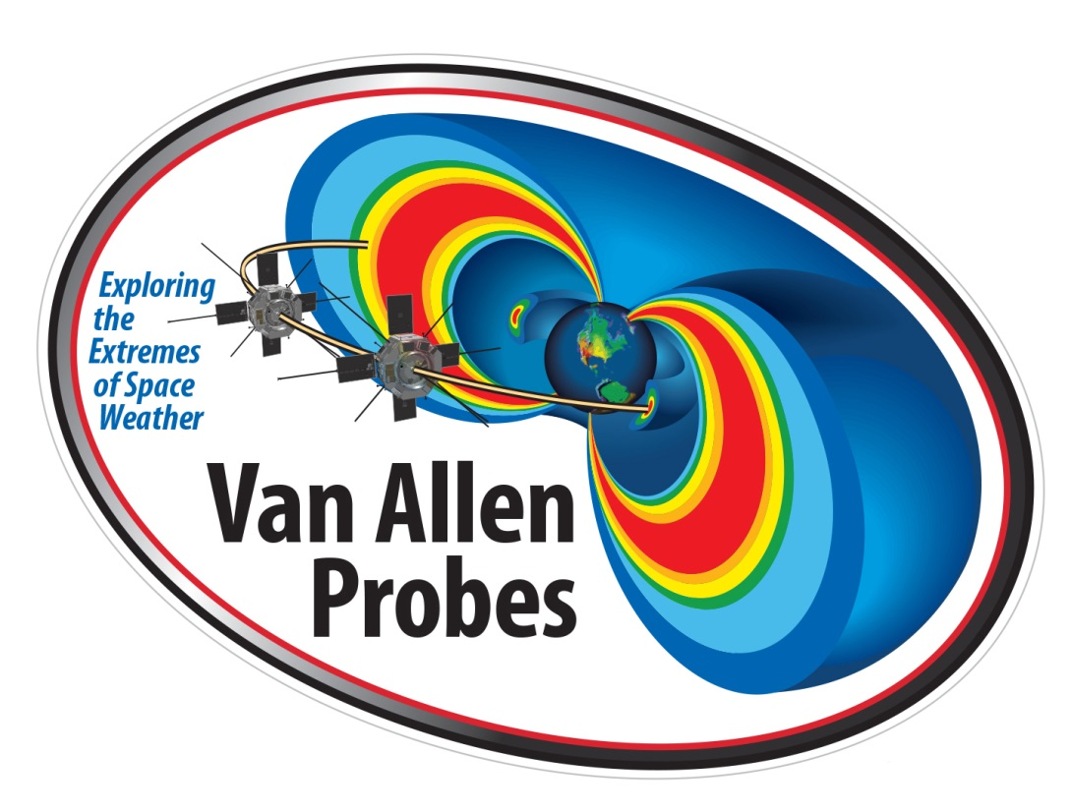
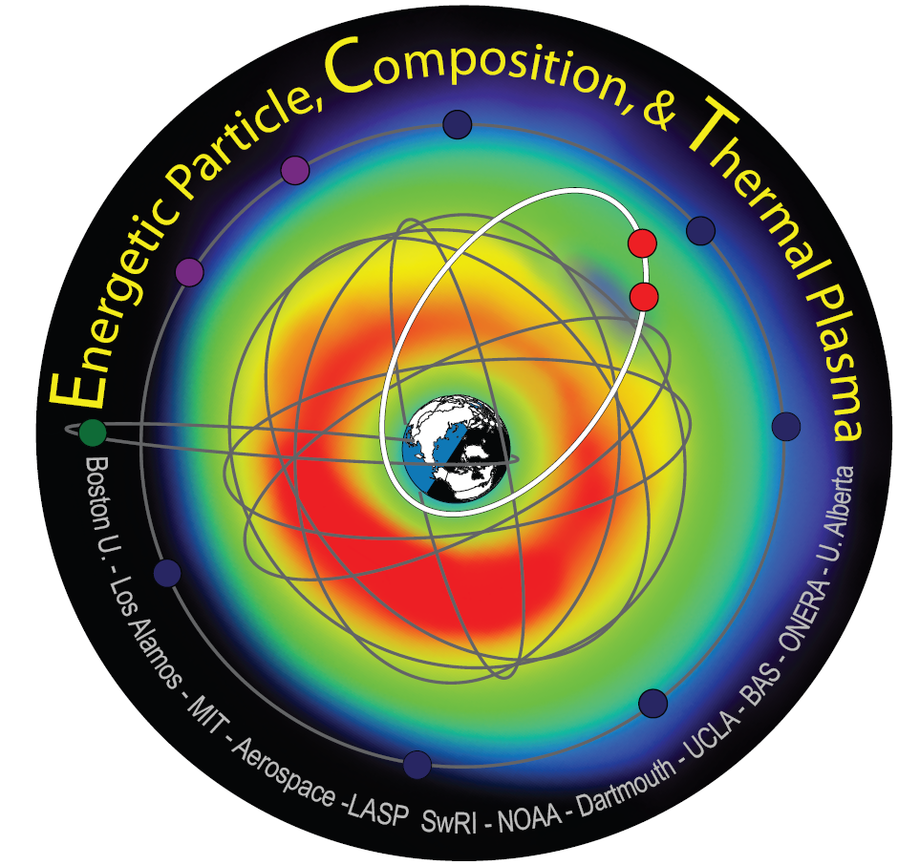
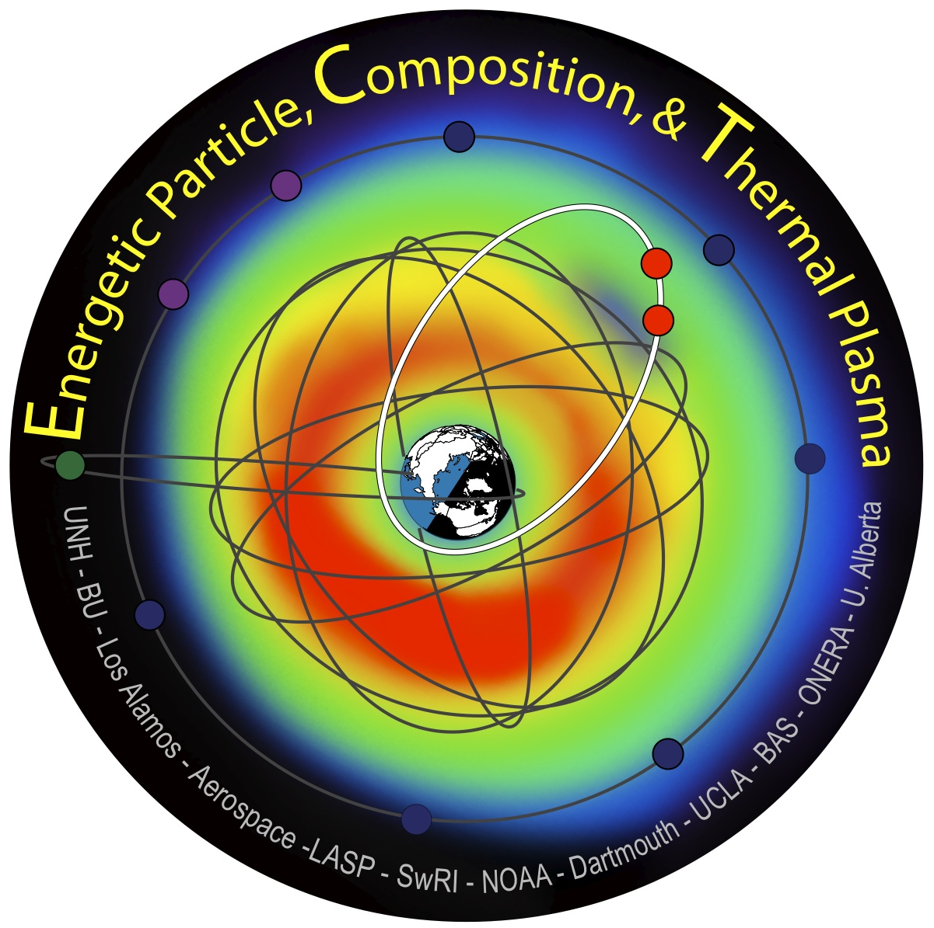
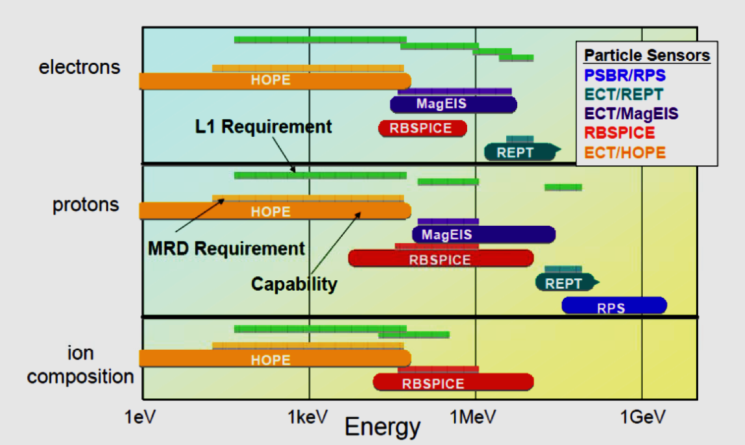
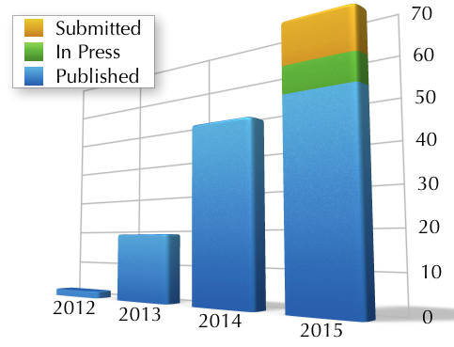
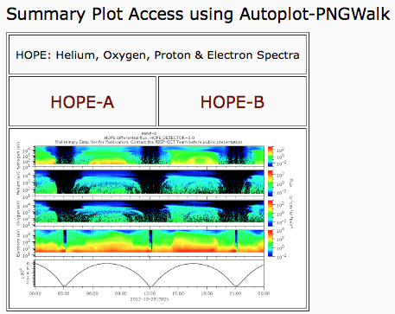
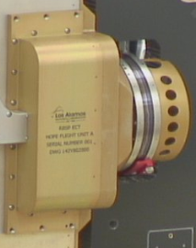
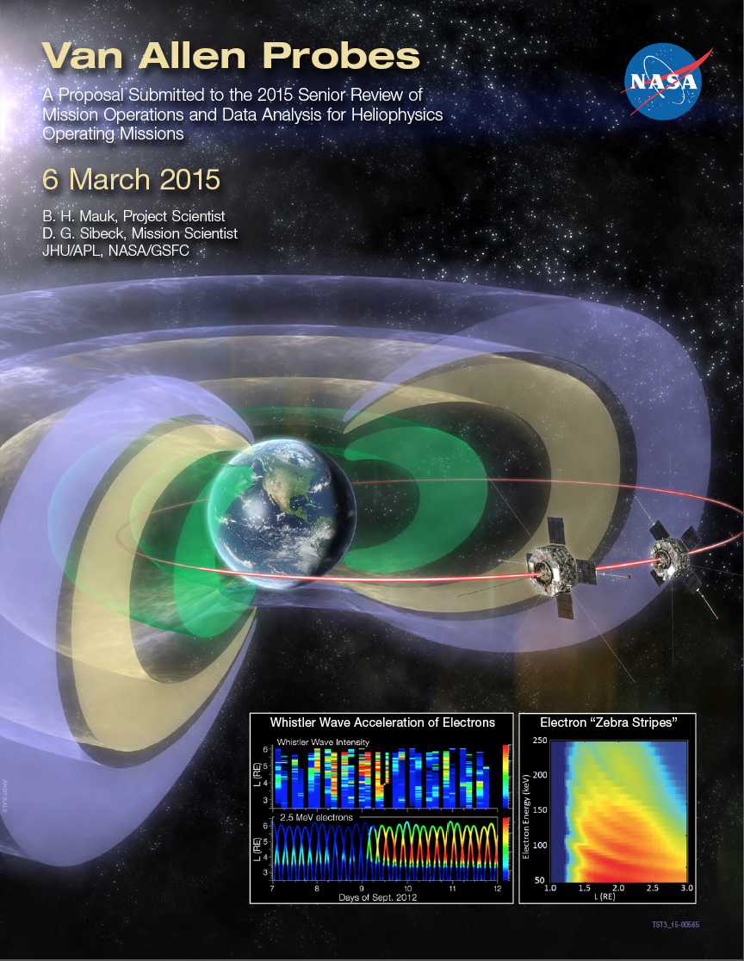
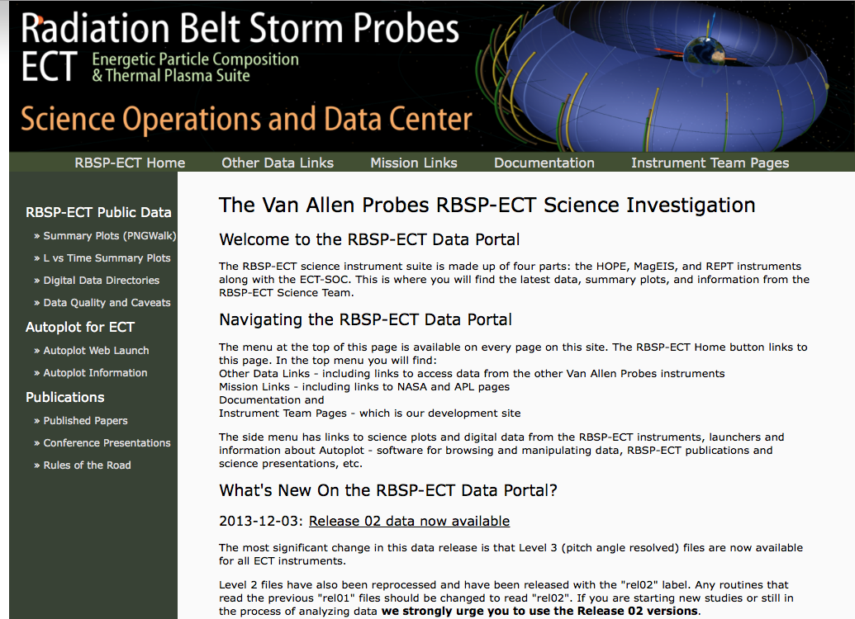
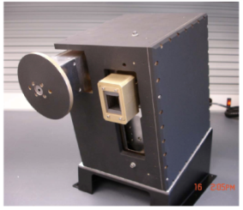
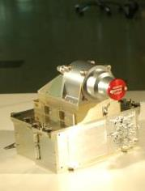
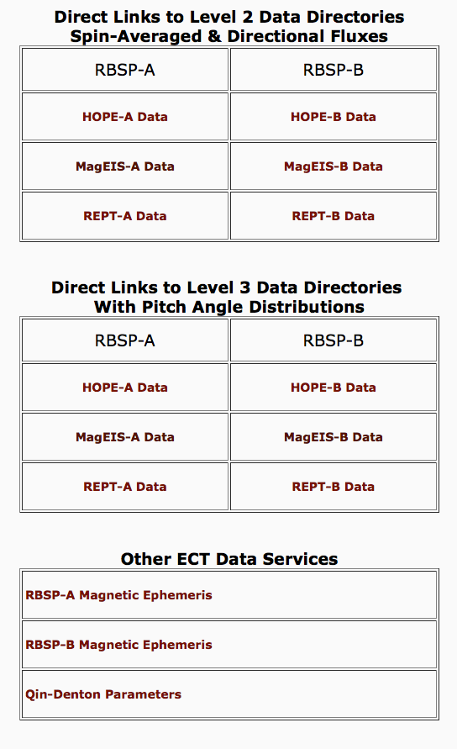
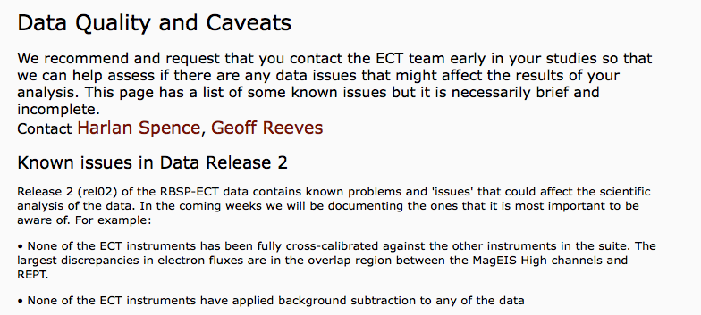
The RBSP-ECT Science Investigation of the Van Allen Probes Mission: Highlights of the Prime Mission Phase, Data Access Overview, and Opportunities to Collaborate in the Extended Mission Phase
Sonya Smith¹, Reiner Friedel², Michael Henderson², Brian Larsen², Geoff Reeves², Harlan Spence¹ on behalf of the entire RBSP-ECT Team
¹UNH/Space Science Center, ²L.A.N.L. Science Operations Center
RBSP-ECT Instrument Suite Overview
RBSP-ECT Publication Summary
Data Overview
Radiation Belt Storm Probes Energetic Particle, Composition, and Thermal Plasma Suite
(RBSP-ECT)
A Hearty Thank You to All Who Contributed to a Growing List of High Impact Publications
RBSP-ECT Data Available on SOC Site Once Verification and Validation is Complete
As of November 2015, papers including ECT data as a significant element, many in high impact journals:
Submitted and in review: 15
In press: 7
Published in 2015: 52
Published in 2014: 48
Published in 2013: 19
Published in 2012: 2
Level 2 and Level 3 data Availability as of 8 December 2015
 | HOPE-A | HOPE-B | MagEIS-A | MagEIS-B | REPT-A | REPT-B
Level 2 | 2015-11-29 | 2015-11-29 | 2015-11-30 | 2015-11-30 | 2015-11-30 | 2015-11-30
Level 3 | 2015-11-27 | 2015-11-27 | 2015-11-26 | 2015-11-27 | 2015-11-27 | 2015-11-27
Spence et al., 2013
http://www.rbsp-ect.lanl.gov/publications/Publications_Journals.php
Summary plots of Level 2 and Level 3 also available through Autoplot interface
Access to Autoplot provided for easy access
Making Definitive Particle Measurements in a Harsh Radiation Environment
(*) Please help us accurately credit your contributions by letting us know about your papers at the RBSP-ECT website noted above
RBSP-ECT Instrument Overview
RBSP-ECT Science Operation Center
Extended Mission Phase Science
ECT In-flight Instrument Performance Meets or Exceeds all Requirements
All RBSP-ECT Data, Documentation, and Science Activity Available Through Single Suite SOC
Science Plan Articulated in 2015 Senior Review Traceability Matrix
Helium Oxygen Proton Electron (HOPE)
Funsten et al., 2013
All 12 ECT instrument packages performing beautifully: 1 HOPE, 4 MagEIS (1 “Lo”, 2 “Meds”, 1 “Hi” , 1 REPT per s/c)
Inflight performance meets or exceeds L1 measurement requirements
Background rejection techniques successful on all instruments
Cross-cal ongoing
RBSP-ECT SOC at LANL provides access to:
Public data including summary plots, digital data directories, as well as data descriptions
Autoplot for ECT
Publications and Rules of the Road
RBSP-ECT contributes strongly to the three prioritized science goals of the Extended Science Mission with the overarching objective of quantifying the processes which govern Earth’s radiation belt during the declining phase of the solar cycle
Perfect understanding of relative roles of local versus transport mechanisms of particle acceleration and the role that nonlinear mechanisms play in the acceleration process
Perfect understanding of relative importance of precipitation and magnetopause losses in inner magnetosphere and provide more definitive information about causes and consequences of the precipitation
Perfect understanding of the relative roles of global-scale transport processes and mesoscale dynamic injections in the inner magnetosphere and their respective roles in the production of geoeffective waves
Magnetic Electron Ion Spectrometer (MagEIS)
Blake et al., 2013
Relativistic Electron Proton Telescope (REPT)
Baker et al, 2013
http://www.rbsp-ect.lanl.gov/rbsp_ect.php
Prime Mission ECT Science Highlights
RBSP-ECT Data Access Overview
Opportunities to Collaborate
Broadly extended RBSP-ECT team contributed significantly to achieving mission success
The RBSP-ECT Provides Links to Level 2 and Level 3 RBSP-ECT Data and Ancillary Data
Please Join Us in the Continuing Excitement of Radiation Belt Discoveries!
Examples demonstrate quality of contributions in the following representative areas (see Spence et al, 2015 for review):
Public access to Level 2 and 3 data from each ECT instrument on both spacecraft
SOC provides extensive ephemeris information for both spacecraft
Access to ancillary data (such as Qin-Denton parameter files)
Please refer to “Data Quality and Caveats” before using data!
Increased T/M capability during Prime Mission has already and will allow us to produce better and new science into Extended Phase (better pitch angle coverage, focused science modes during high data rate periods, improved direct event capability)
We encourage you to participate in accomplishing Van Allen Probes science during the Extended Science Phase by using the high quality RBSP-ECT data but ask that you abide by our “Rules of the Road” (http://www.rbsp-ect.lanl.gov/publications/
DataProductsUsage.php) so that we may:
Maintain the high quality of RBSP-ECT publications by ensuing consultation with members of the team who are familiar with the operation of the instrument, subtleties in the instrument response, and any potential pitfalls;
Acknowledge the work put into the design and development of the RBSP-ECT instrument to produce the capable and calibrated instruments now available for science;
Coordinate the efforts across the team to avoid duplication of effort and maximize science return.
Understanding characteristics and sources of the electron radiation belt
Importance of plasmapause position (Baker et al., 2013; Li et al., 2013; Thorne et al., 2013; Shprits et al., 2013; Foster et al., 2014; Goldstein et al., 2014)
Quantified energetization processes and conditions (Reeve et al., 2013; Thornet et al., 2013; Su et al., 2014; Schiller et al., 2014)
Clarified a variety of loss processes (Blum et al., 2013; Hudson et al., 2014; Shprits et al., 2013; Turner et al., 2014)
Improved model predictability (Tu et al., 2014; Jordanova et al, 2014)
Understanding specific physical candidate processes which lead to radiation belt dynamics
Differentiated between competing mechanisms (Baker et al.., 2014; Turner et al., 2014)
Understanding VLF, ELF, and ULF wave effects that control dynamics
ULF wave effects (Claudepierreet al., 2013; Dai et al., 2013; Mann et al., 2013)
EMIC wave effects (Usanova et al., 2013)
Plasmaspheric hiss effects (Li et al., 2013)
Direct wave particle interactions s (Fennell et al., 2013; Mozer et al., 2014)
Acknowledgement: This research was supported by RBSP-ECT funding under NASA’s Prime contract number NAS5- 01072.
Notes:
I should add the APL SCIENCE GATEWAY. You can use that to plot also.
Once you plot you can hit button and sent the URL/QR Code

