Slide 1




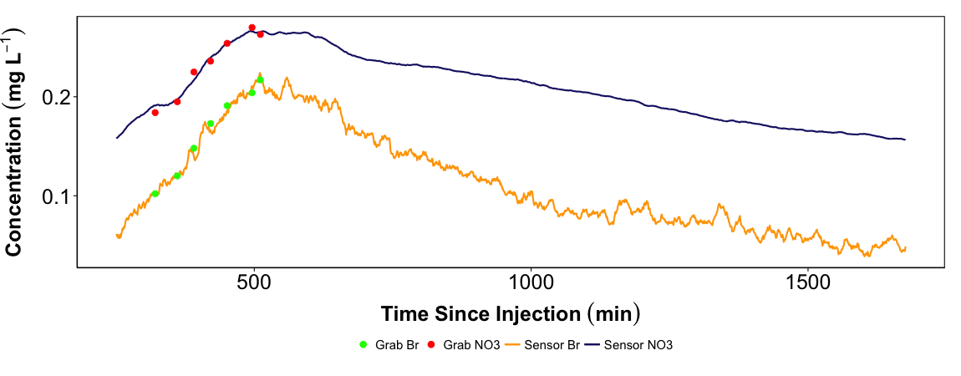
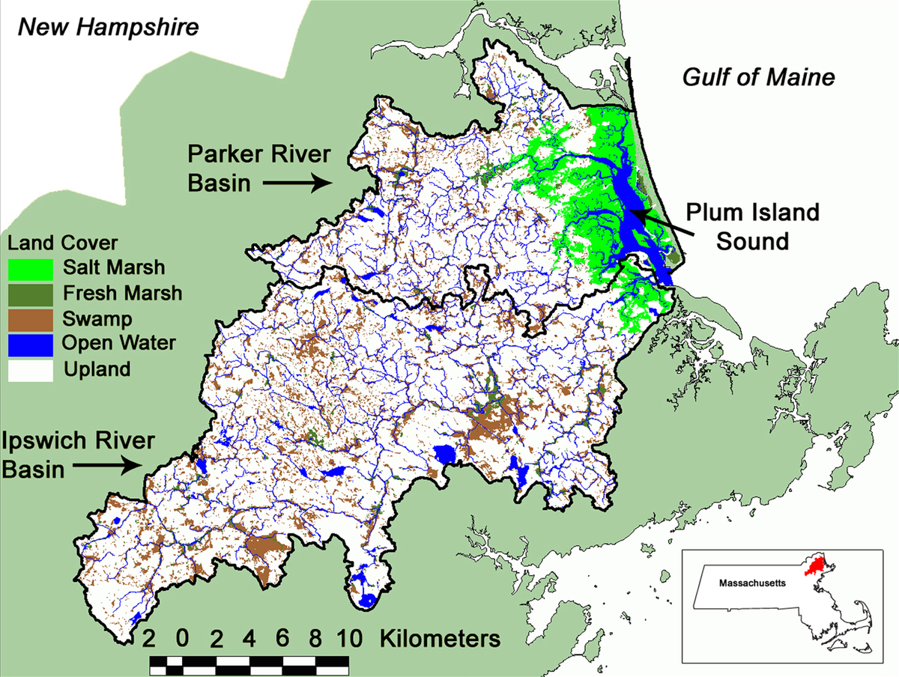
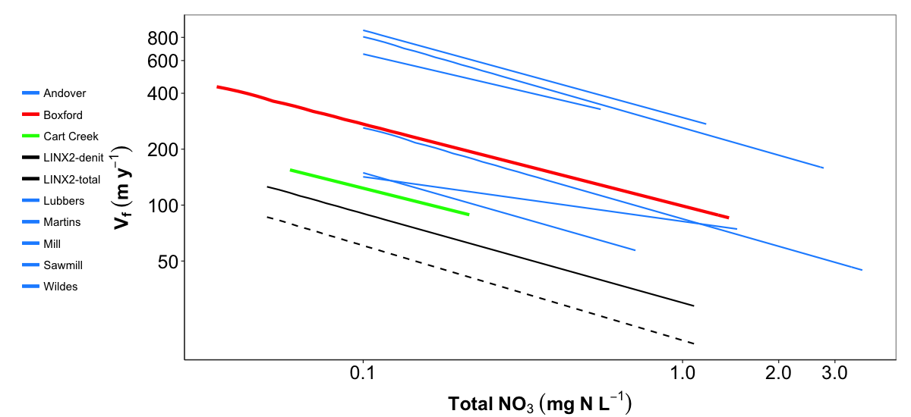
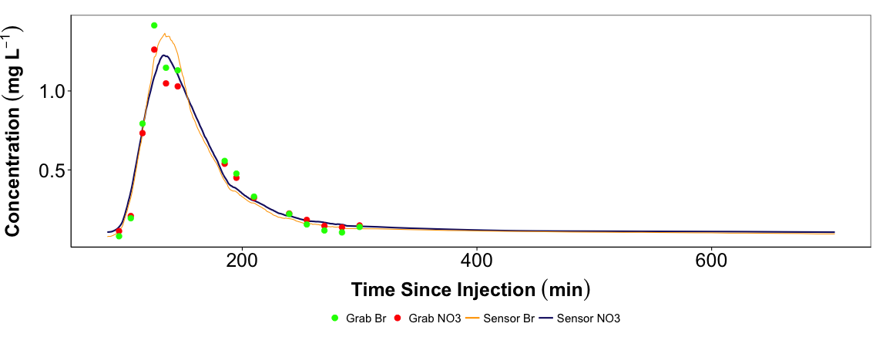
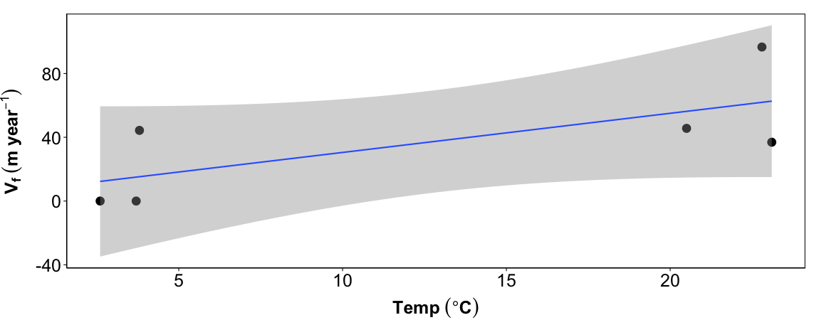
Fluvial wetland nitrogen removal in shallow-sloped, coastal New England watersheds
Christopher Whitney^{1,2}*, Wilfred Wollheim^{1,2}, Gopal Mulukutla², Anne Lightbody³
*ctw1@wildcats.unh.edu
¹University of New Hampshire, Department of Natural Resources; ²University of New Hampshire, Earth Systems Research Center; ³University of New Hampshire, Department of Earth Sciences
B11F-0493
Abstract
Excess nitrogen (N) in the environment contributes to eutrophication that can result in “dead zones” and fish kills. Most of the anthropogenic N is retained or removed by terrestrial and aquatic systems within watersheds, preventing this N from reaching the coast. Much research has focused on N removal in channelized stream reaches but recent studies have suggested that fluvial wetlands may play a larger role in the removal of anthropogenic N from aquatic ecosystems. We use the “Tracer Additions for Spiraling Curve Characterization” (TASCC) method coupled with deployment of new in situ nitrate analyzer technology to conduct experiments in long residence time, wetland dominated stream reaches (e.g. beaver ponds, flood plains, natural wetlands). These sensor based TASCC experiments were performed in three headwater fluvial wetlands in the spring and early summer and repeated in the fall and early winter during the 2014 field season. Results from a beaver pond reach show that N removal (as a percentage of inputs) was greater than in similar length channelized streams in the same region, but that most of this was due to longer residence time rather than increased biological uptake rates. This suggests that fluvial wetlands, increasing in abundance in the region due to beaver activity, will enhance network-scale retention. Use of the in situ sensor allows us to capture fine-scale variations, allowing for a better understanding of different flow paths taken by water parcels traversing a wetland and providing a better estimate of N removal compared to the discrete grab sampling method.
Methods
Experimental nutrient additions performed in three locations within the Parker and Ipswich River watersheds, MA, USA during the summer and fall of the 2014 field season (Figure 1)
  An active beaver pond on Cart Creek in Newbury, MA (CCBP)
  A defunct beaver pond on Fish Brook in Boxford, MA (Box)
  A natural wetland on Saw Mill Brook in Wilmington, MA (Sawmill)
TASCC¹ approach using instantaneous slug addition of nitrate and bromide
Sensor (SUNA) to measure NO₃⁻ and Br⁻ continuously to characterize breakthrough curve (BTC)
Grab samples collected along BTC to calibrate SUNA data and also to estimate spiraling metrics to compare to metrics estimated using sensor data
Calculations using both distance and residence time approaches
Comparison of wetlands to surface transient storage (STS) zones and channelized streams
Results
Ambient uptake velocities (Vf) in wetlands were higher during the warm season than the cold season, with Vf in the winter near zero in two of the three wetlands (Fig. 4, Table 1)
Continuous measurements of the BTC resulted in very different uptake lengths compared to using grab samples and there was no consistent difference (Table 1)
Efficiency loss slope is comparable for both CCBP and Box and for a given level of NO₃⁻ , uptake velocity is greater in wetlands and STS zones compared to channelized stream reaches (Figure 5)
Both CCBP and Box have greater uptake velocities compared to the 9 headwater streams in the PIE LTER region included in the LINX II² study and are also within the range of uptake velocities found for 6 STS zones in Wollheim et al. (2014)³ (Figure 5)
Results
Table 1. Ambient uptake velocities (Vf, m/yr) for TASCC experiments performed at all three wetland sites during both warm and cold seasons
Sensor and grab sample breakthrough curve at CCBP
Site | Date | Ambient Uptake Velocity-Grab (m/yr) | Ambient Uptake Velocity-Sensor (m/yr)
Boxford | 06-11-2014 | 45.60 | 125.43
Boxford | 11-11-2014 | 44.33 | 20.55
Cart Creek | 07-02-2014 | 93.63 | 43.38
Cart Creek | 11-19-2014 | No uptake detected | No uptake detected
Sawmill | 07-17-2014 | 36.90 | 253.85
Sawmill | 12-05-2014 | No uptake detected | No uptake detected
Study Area
Uptake velocity efficiency loss for CCBP, Box, LINX II & STS zones in the PIE LTER region
Fish Brook
Cart Creek
Figure 2. Results from TASCC addition at CCBP on 07-02-2014 showing BTC data collected with the sensor and grab samples
Sensor and grab sample breakthrough curve at Boxford
Figure 5. Comparison of N uptake velocities (m/yr) plotted against total NO₃⁻ concentrations found for Boxford and CCBP (red and green lines, respectively), the nine headwater streams in the PIE LTER region included in the LINX II study (black lines where the solid black line is total uptake velocity and the dashed line is denitrification uptake velocity) and 6 STS zones from Wollheim et al. (2014) (blue lines).
Saw Mill Brook
Conclusions & Future Work
Uptake metrics estimated with sensor data are very different from estimates made using grab samples suggesting that there are discrepancies with the sensor method
Nitrate uptake in wetlands decreases with decreasing water temperature, suggesting uptake is minimal during winter months
Uptake velocity in wetlands is greater than uptake velocity for channelized reaches in the same region and within the range of uptake velocities measured in STS zones
The use of sensors for quantifying N removal in long residence time systems should be applied to more fluvial wetlands and channelized reaches to reconcile the differences between metrics calculated using grab samples and sensor data
Understand causes of variability in N removal among wetlands due to hydrological characteristics, transient storage parameters, geomorphology and metabolism
Figure 1. Locations of the three fluvial wetlands within the Parker and Ipswich River watersheds in Northeastern MA
Figure 3. Results from TASCC addition at Boxford on 11-11-2014 showing BTC data collected with the sensor and grab samples
Research Questions
Q1: What are the rates of N removal in fluvial wetlands and how do those rates compare to those found for channelized streams?
H1: Estimates of N removal rates in fluvial wetlands will be greater than those for channelized reaches because of both longer residence times and greater uptake rates that are due to wetlands being rich in organic matter and low in dissolved oxygen, resulting in higher uptake velocities.
Q2: Do continuous measurements of the breakthrough curve provide different uptake estimates compared to discrete grab sampling?
H2: Uptake estimates made using sensor data will indicate greater uptake compared to discrete grab sampling because high resolution sensor data captures greater variability, and more of the tail of the breakthrough curve, in long residence time systems
Relationship between uptake velocity and water temperature
Y=2.456x+5.927, R²=0.50
Acknowledgements
This work was supported by the National Science Foundation Long-term Ecological Research Program NFS-OCE-1058747 and OCE-1238212 (Plum Island LTER).
Works Cited
[1] Covino, T.P., et al. 2010. Tracer additions for spiraling curve characterization (TASCC): Quantifying stream nutrient uptake kinetics from ambient to saturation. Limnology and Oceanography: Methods 8: 484-498.[2] Mulholland, P.J., et al. 2008. Stream denitrification across biomes and its response to anthropogenic nitrate loading. Nature 452: 202-207. [3] Wollheim, W.M., et al. 2014. Nitrate uptake dynamics of surface transient storage in stream channels and fluvial wetlands. Biogeochemistry 120: 239-257.
Figure 4. Ambient wetland uptake velocities (Vf, m/yr) plotted against water temperatures during TASCC additions.

