Slide 1


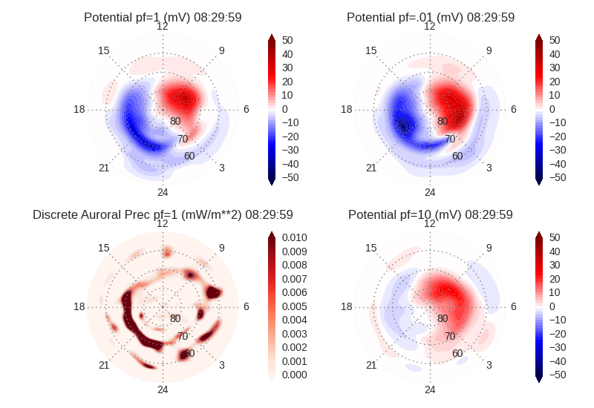
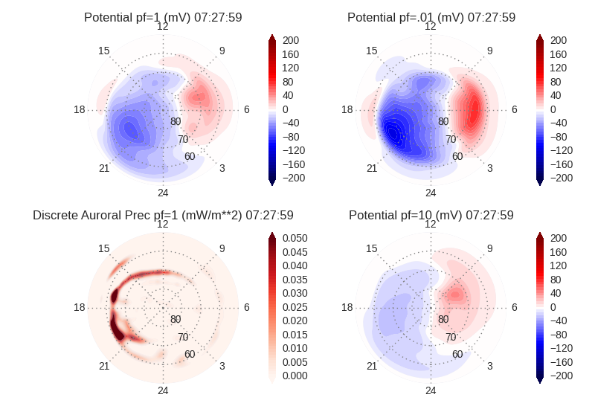
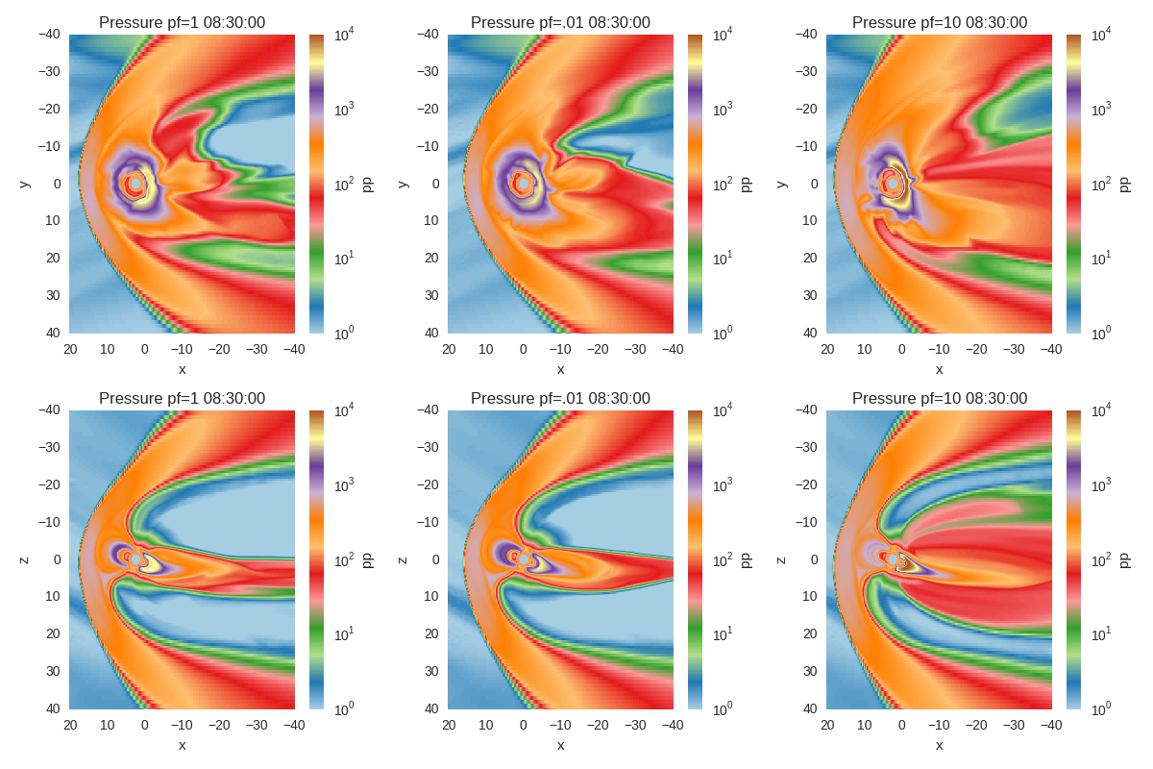
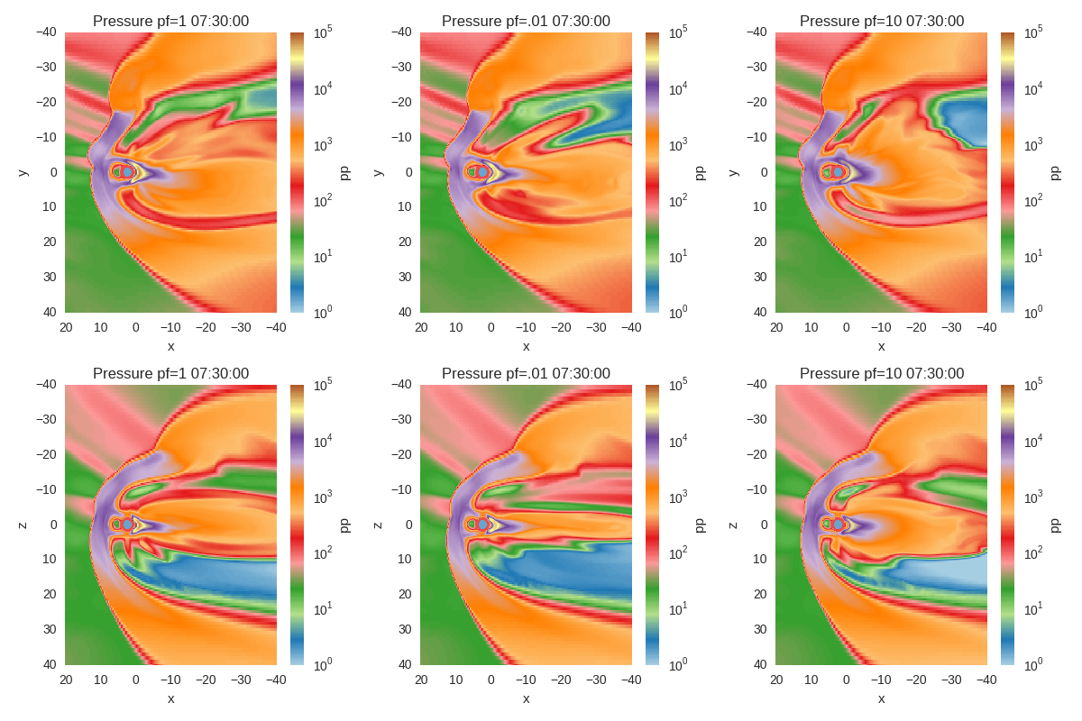
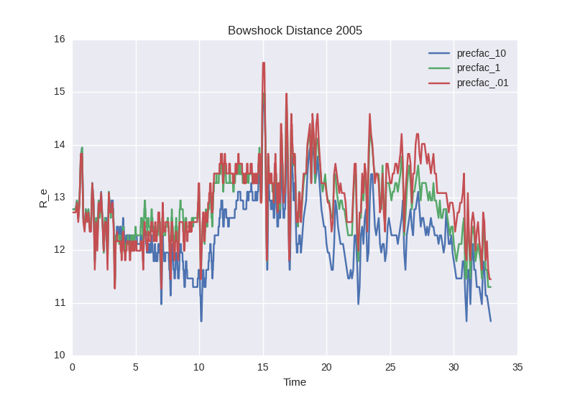
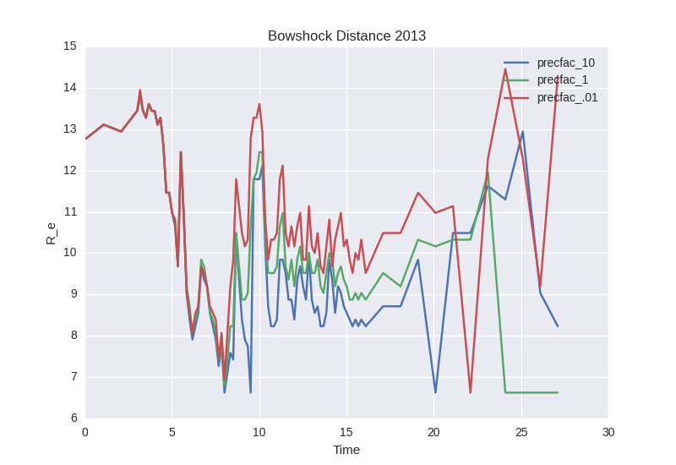
Effects of Particle Precipitation Feedback on the Earth's Magnetosphere
Authors: Joseph B. Jensen¹, Jimmy Raeder¹, W. Douglas Cramer¹
1.University of New Hampshire, Space Science Center, Durham NH, USA
Introduction
Particle precipitation has been intensely studied by ionospheric and magnetospheric physicists. As particles bounce along the earth's magnetic fields they are accelerated, often, into the ionosphere. They impart energy into the ionosphere by stripping the electrons from their molecules increasing the ionization and changing the conductivity of the ionosphere. These changes directly affects the cross polar cap potential, conductivity, and total electron content. Changing these parameters can affect the heating in the ionosphere, the densities of certain species, and even satellite drag.
The ionosphere plays a very important role as the base of the magnetosphere system. The particle densities in the ionosphere are greater and able to carry much larger currents and allow them to diffuse and reconnect. The ionosphere is not fully ionized so there is a “resistance” or constant colliding into other particles that prevents ions and electrons from moving freely along the magnetic fields. The currents that come from the magnetosphere are very dependent on the conductivity of the ionosphere.
The effect of precipitation that feeds back to the magnetosphere has received less study. There have been a few that have looked at a simple model and tried to understand what the effects are in the magnetosphere [Wolf 1966, Ridley et al 2004, Coroniti 1973, Axford 1969]. In this poster we do something similar but instead of changing the conductivity of the ionosphere flatly, we increase and decrease the precipitation to the ionosphere and see if the localized changes in conductivity have any effect on the magnetosphere. We look at a certain parameter in the magnetosphere and see if there are the same changes that have been theorized and modeled would change due to conductivity changes in the ionosphere.
We have two different case studies the first is May 4, 2005 that is a quiet solar wind conditions and March 17, 2013 that has a strong shock that occurs. We ran three simulations using the OpenGGCM model coupled with the RCM and CTIM models using real time solar wind data from the ACE Satellite. We artificially modified the amount of precipitation into the ionosphere by decreasing it by two orders of magnitude and increasing it by one order of magnitude.
May 4, 2005 Case Study
March 17, 2013 Case Study
Current Densities
May 4 was selected since the solar wind was mild and bz was only about -2 nT for the majority of the time. There are a couple of tangential discontinuities as it brushes by the magnetosphere that result in interesting physics.
March 17, 2013 was selected as a GEM focus day and we the precipitation effects during a storm could be studied. As can be seen in figure 2 there is a large shock that occurs at ~6:00 UT and the Bz turns southward. This resulted in a Dst of -132.
Figure 1: solar wind taken from the ACE Satellite. Magnetic field is in nT velocities in km/s.
Figure 2: solar wind taken from the ACE Satellite. Magnetic field is in nT velocities in km/s.
2005 Ionospheric Response
2013 Ionospheric Responce
Current Densities
The ionospheric response is fairly well understood. The particle precipitation changes conductivity. The panels in figure 3 show the three different runs. The precipitation factor (pf) set to one gives a fairly typical potential for quite time conditions. The pf= .01 shows that the potential is greater. This makes sense as the conductivity is lower thus greater potentials can arise. For the pf=10 the potentials is much lower due to the increased conductivities. The discrete auroral precipitation was graphed as well for the pf=1 case, the others just showed the order of magnitude changes that were introduced.
The ionospheric response shown here is 1.5 hours after the shock arrives. It can be seen in figure 4 that the potential is greater for the pf=.01 since the conductivities are less. But also interesting to note is the change in the configuration of the positive and negative regions of the potential, for the pf=1 and .01 the negative dominates the polar cap while the pf=10 there is more balance between the two. The precipitation is very heavy on the dusk side in this case. So perhaps the increase conductivity on the dusk side for the pf=10 case is what makes the potential become more centered over the polar cap.
Figure 3: Ionospheric potential in mV and discrete auroral precipitation for the northern hemisphere. Precipitation factor (pf) of 1, .01 ,and 10.
Figure 4: Ionospheric potential (in mV) and discrete auroral precipitation for March 17, 2013, note that the scale different from figure 3.
2005 Magnetospheric Response
2013 Magnetospheric Response
The magnetospheric response for May 4, 2005 is shown in figure 5. The inner magnetosphere is slightly different. The ring current is very well shown as we have coupled the RCM model with OpenGGCM to give a more accurate response. The ring current is intensified for the pf=10. The tail region is enhanced for the higher pf values. In the time series plots discrepancies are found at the time of reconnection and release of the bursty bulk flow is different for each of the runs.
The Magnetosphere response for the march 17th 2013 storm is found in figure 6. There are many similar features as those found in figure 5. The plasma pressure is in general increased during this storm period. The convection in the magnetosphere while not clear in plasma pressure is increased in the simulation with the large precipitation factor. The timing release of substorms is also different for the different precipitation factors.
Figure 5: Magnetosphere in the x-y plane for the top panels and the x-z plane for the bottom panels. These are graphs of Plasma Pressure in pPa, with from left to right the pf = 1, .01, and 10 .
Figure 6: Same form as that of figure 5, note that the scale is slightly different and the time of this is ~2 hours after the shock hits.
2005 Bowshock Response
2013 Bowshock Response
In order to quantify the changes a little better we decided to map out the bowshock distance. We did this by finding the maximum of the current in the y direction along the bowshock. By using the magnetopause currents in the bowshock we were able to identify the location of the bowshock. There are perhaps a few points that are enhanced currents in the the inner magnetosphere that throw off the location algorithm. Figure 7 shows the results. The precipitation factor or precfac of 1, .01, and 10 have been graphed. The hypothesis that as conductivity increases magnetospheric convection will decrease and the bowshock will move in can be seen in this graph of the position.
Bowshock distance for March 17 2013 storm are found in figure 8. Many features are similar to figure 7, but the bowshock has moved in more during the storm time. At 15 hours it can be seen very clearly the hypothesis that greater conductance brings the bowshock in even more so than figure 7, even if all you are changing is the conductivity due to particle precipitation. The affect would theoretically be greater if we increased the conductance due to photoionization. Note that the algorithm used fails to location the bowshock maximum at some points after 20 hrs due to the high currents in the inner magnetosphere.
Figure 7: Graph of the bowshock location for the 3 runs. Precipitation factor (precfac) are given in the legend.
Figure 8: Same format as figure 7 but for March 17, 2013. Note at ~20 UT some inner Magnetosphere noise.
Conclusion and References
The hypothesis proposed by Wolf that the convection is affected by the conductivity of the ionosphere is also true when the conductivity that comes from the particle precipitation is changed. We have shown the bowshock position can be changed when particle precipitation is changed because of the variation in magnetospheric convection. This shows that modeling the precipitation correctly is very important not only for ionospheric parameters but also for the magnetosphere. Further work is to look at the inner magnetosphere and see how the field aligned currents change and also to see the timing of the reconnection in the magnetotail due to variations in particle precipitation.
References:
-Axford, W. I. (1969), Magnetospheric convection, Rev. Geophys., 7(1, 2), 421–459, doi:0.1029/RG007i001p00421.
-Coroniti, F. V., and C. F. Kennel (1973), Can the ionosphere regulate magnetospheric convection?, J. Geophys. Res., 78(16),2837–2851, doi:10.1029/JA078i016p02837.
-Ridley, A. J., T. I. Gombosi, and D. L. De Zeeuw (2004), Ionospheric control of the magnetospheric Configuration: Conductance, Ann. Geo-
phys., 22, 567.
-Wolf, R. A. (1970), Effects of ionospheric conductivity on convective flow of plasma in the magnetosphere, J. Geophys. Res.,75(25), 4677–4698, doi:10.1029/JA075i025p04677.

