Slide 1

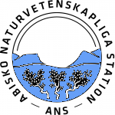




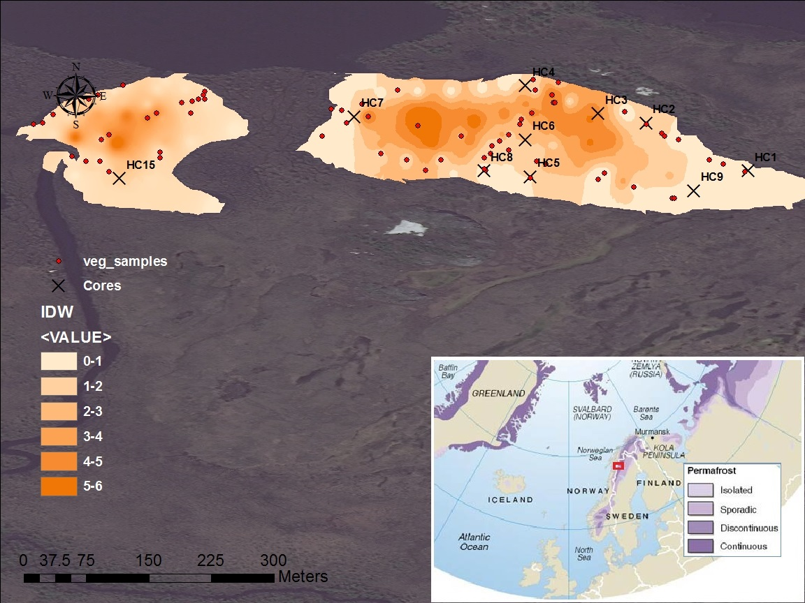
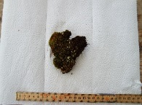
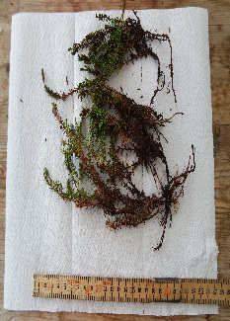
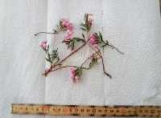
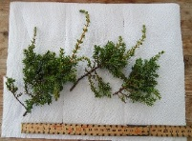
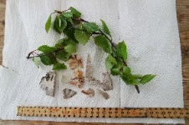
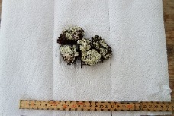
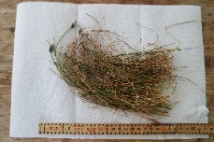
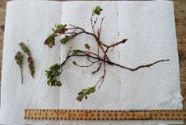
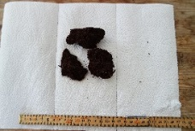
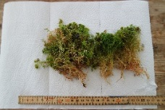
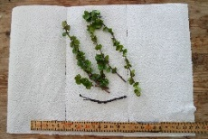
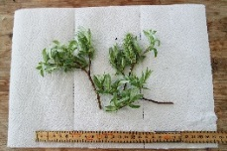
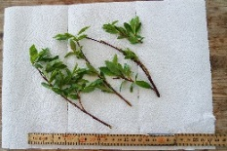
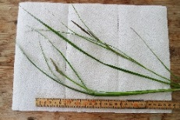
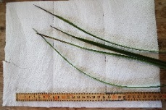
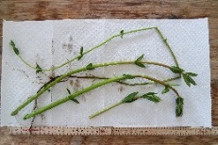
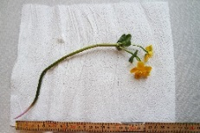
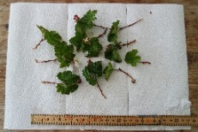
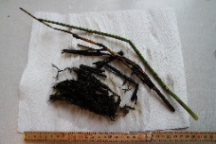
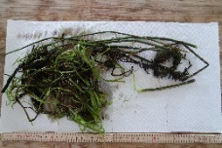
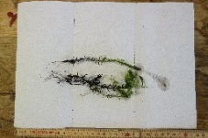
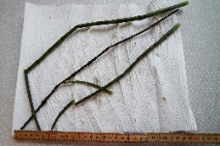
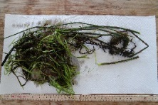
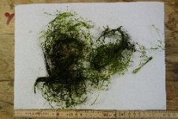
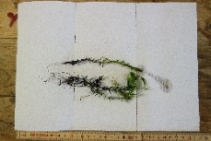
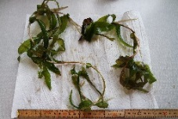
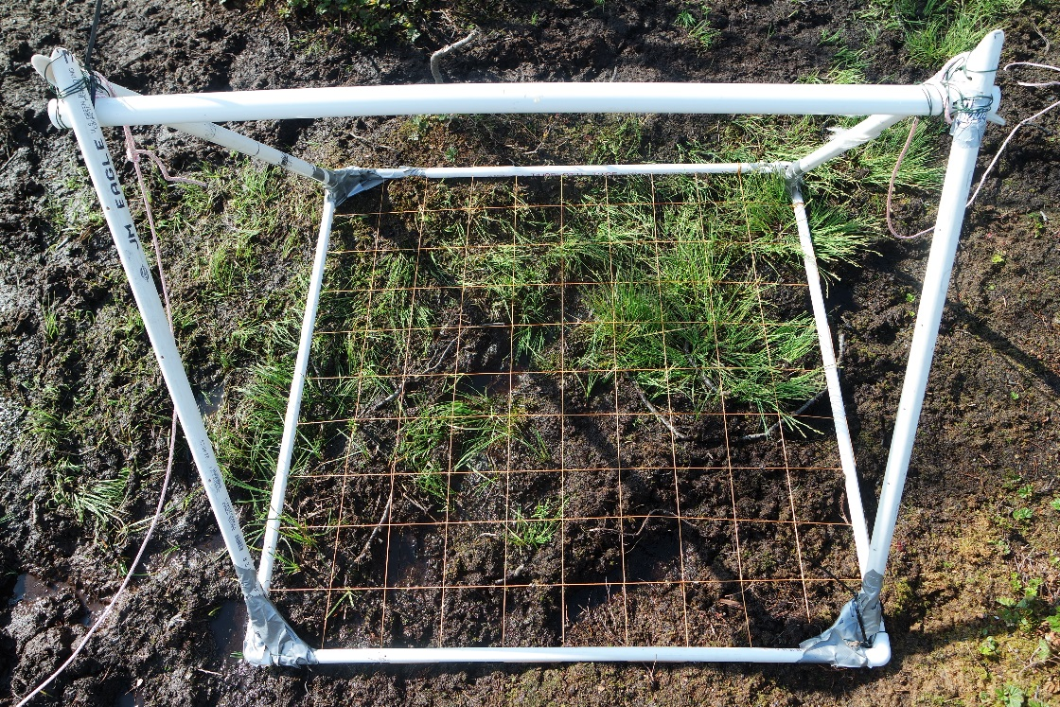
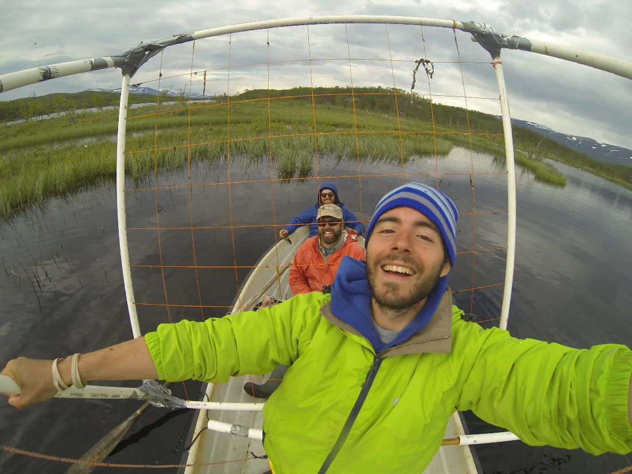
The role of aquatic vegetation in methane production
in a shallow high latitude lake in Abisko, Sweden
Christopher D. Horruitiner^{[1]} Adam J.D. Nicastro^{[2]} Michael W. Palace^{[3]}
Maurice K. Crawford^{[5]} Dylan Lundgren^{[4]} Samantha Sinclair^{[4]} Martin Wik Ruth K. Varner^{[3,4]} Joel E. Johnson^{[4]}
Examining the role of aquatic vegetation in methane production
in a shallow high latitude lake in Abisko, Sweden
Christopher D. Horruitiner^{[1]} Adam J.D. Nicastro^{[2]} Michael W. Palace^{[3]} Maurice K. Crawford^{[5} Dylan Lundgren^{[4]} Samantha Sinclair^{[4]]} Martin Wik^{[6]} Joel E. Johnson^{[4]} Ruth K. Varner^{[3,4]}
[1] Department of Natural Resources and Environment, University of Florida, Gainesville. [2] Department of Geology and Environmental Earth Science, University of Miami. Oxford, Ohio. [3] Institute for the Study of Earth, Oceans and Space, University of New Hampshire, Durham, NH.
[4] Department of Earth Sciences, University of New Hampshire, Durham, NH. [5] Department of Natural Sciences, University of Maryland Eastern Shore. Princess Anne, MD. [6] Department of Geological Sciences, Stockholm University, Stockholm, Sweden.
Core | Length (cm) | avg. temp | vegetation | avg CH4 (µg per g ds) | avg C/N | avg TOC | avg TS | Avg TN
HC01 | 74 | 13.47 | no plants | 4.51 | 15.59 | 3.49 | 0.253 | 0.107
HC02 | 58 | 13.35 | potamogeton spp. | 35.33 | 14.64 | 12.01 | 0.984 | 0.247
HC03 | 42 | 13.55 | pota & HT | 9.26 | 15.49 | 10.80 | 0.833 | 0.408
HC04 | 48 | 13.55 | juvenile Utricularia i. | 38.65 | 16.13 | 18.48 | 1.329 | 0.271
HC05 | 54 | 12.34 | juvenile Utricularia i. | 10.57 | 17.07 | 5.90 | 0.436 | 0.058
HC06 | 70 | 12.32 | chara spp. | 19.11 | 15.05 | 7.23 | 0.605 | 0.102
HC07 | 63 | 12.25 | potamogeton o. | 3.47 | 11.50 | 2.31 | 0.108 | 0.023
HC08 | 28 | 12.11 | chara spp. | 8.10 | 16.29 | 5.10 | 0.386 | 0.058
HC09 | 71 | 13.75 | pot spp. & juvenile U | 10.65 | 16.15 | 8.39 | 0.611 | 0.116
HC15 | 46 | 13.47 | potamogeton spp. | 15.48 | 15.83 | 5.20 | 0.381 | 0.061
83308
B41C-0447
Background
Results
Wetlands account for 60-80% of natural atmospheric methane emissions [1]
High latitude lakes and ponds are a large source of atmospheric methane [2]
Lakes are impacted by permafrost both in formation of thaw lakes and in increasing DOC input
Permafrost thaw in peatlands is thought to increase export of DOC because of increased hydrological access to peatland carbon [3]
Mire
Lake
CH₄
Terrestrial vegetation
Aquatic vegetation
Allochthonous C
High C/N
Air
CH₄
CO₂
Water
Ebullition
Autochthonous C
Low C/N
Oxidation
CH₄ produced by methanogenic bacteria
CO₂ + 4 H₂ → CH₄ + 2H₂O
Hydrogenotrophic reduction
Plankton
Anoxic sediments
δ¹³C Fractionation from CO₂ to CH₄ 60 to 90 ‰
A. B. C. D. E. F. G. H. I. J. K. L. M. N. O. P. Q. R. S. T. U. V. W. X. Y. Z.
Figure 11. Sources of carbon in anoxic aquatic sediments
Figure 4. C:N across all sampled vegetation
Implications
Image credit: Digital Globe
C/N ratios of lake sediments reflect that of aquatic vegetation, emphasizing the importance of autochthonous carbon source as potential carbon for methanogenesis
δ¹³CH₄ is relatively constant downcore, which indicates little methane oxidation
The methane produced in sediments is consistently within the range of hydrogenotrophic methanogenesis via CO₂ reduction
As the Arctic warms, aquatic vegetation in subarctic mire lakes may become an increasing source of organic carbon for methanogenesis
Figure 1. Inre Harrsjön (right) and Mellersta Harrsjön (left) [4]
Source: International Permafrost Association, Philippe Rekacewicz, 2005
Hypothesis
C/N ratios in the sediment will more closely resemble that of overlying aquatic vegetation
Methods and Sampling
Method | Sampling interval | Sample type
CH₄ , ¹³CH4 (porewater) | 5 cm | 2cm³ plugs
Grain size/CHNS | 5cm | 2cm³ plugs
Vegetation | By species | Whole sample
Figure 5.
Figure 6.
Figure 7.
Acknowledgments
We would like to thank the Abisko Naturvetenskapliga Station and staff for use of facilities while in Sweden. Special thanks to Alison Hobbie for teaching me proper rowing technique. Due regards extended towards Dylan Lundgren and Samantha Sinclair for processing all of our samples. Thank you to Patrick Crill for letting us use the GC lab in Abisko. Lastly, a most heartfelt thank you to all of the NERU students for helping along the way. This research has been supported by the National Science Foundations REU program: Northern Ecosystems Research for Undergraduates (EAR#1063037).
Table 1. Methods
References
[1] Quiquet, A., Archibald, A. T., Friend, A. D., Chappellaz, J., Levine, J. G., Stone, E. J., ... Pyle, J. A. (2015). The relative importance of methane sources and sinks over the Last Interglacial period and into the last glaciation. Quaternary Science Reviews, 112, 1-16. 10.1016/j.quascirev.2015.01.004
[2] Wik, M., Crill, P. M., Varner, R. K ., & Batsviken, D. (2013). Multiyear measurements of ebullitive methane flux from three subarctic lakes. Journal of Geophysical Research: Biogeosciences. 118, 1307-1321. DOI:10.1002
[3] Olefeldt, D., Roulet, N. (2012). Effects of permafrost and hydrology on the composition and transport of dissolved organic carbon in a subarctic peatland complex. Journal of Geophysical Research: Biogeosciences,117. 10.1029/2011JG001819
[4] Adapted from Philippe Rekacewicz, 2005, UNEP/GRID-Arendal Maps and Graphics Library based on International Permafrost Association (1998) Circumpolar Active-Layer Permafrost System (CAPS), version 1.0.
Figure 2. Submerged quadrat
Figure 3. Photo from GoPro
Figure 8.
Figure 9.
Figure 10.
Notes:
“adapted from…” for indicator image
No periods w/ bullets
Aerodyne research QCL
Include fractionation with processes
Graph of methane vs. TOC

