Slide 1

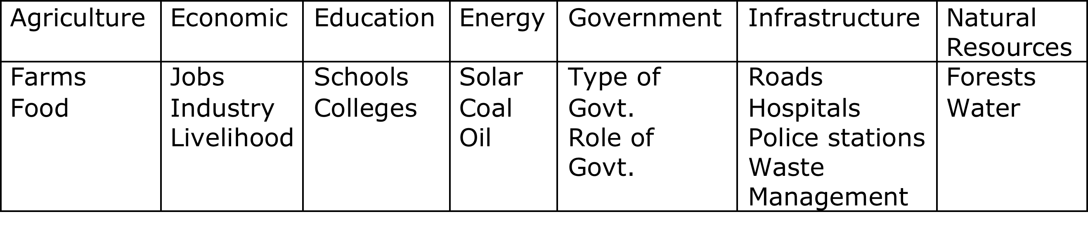
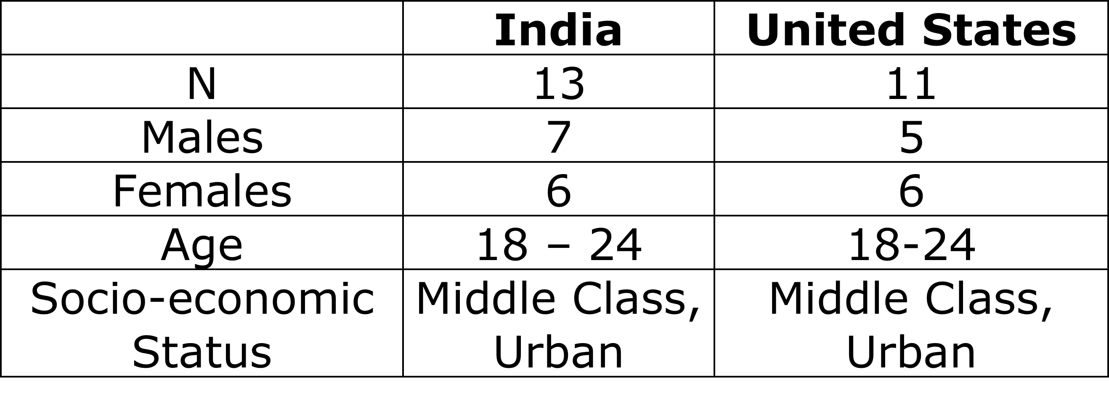
Learning to Adapt: Environmental Decision Making Processes Among Youth Across Cultures
Sameer Honwad
NAED/Spencer Postdoctoral Fellow
Abstract
Methods and Tools
Results
Learning to make decisions that lead to environmental sustainability will allow communities to cope with impacts that are already occurring, and to shape the way future environmental impacts occur. Both formal and informal knowledge sources provide crucial elements that can be used for making decisions to build sustainable communities. Keeping this in mind the study addresses the following research questions:
What are the different types (indigenous, western modern science) and sources (formal – e.g. school curriculum and informal – e.g. parents, grand parents, friends) of knowledge that youth in India and the United States use to make decisions about their environmental problems while planning to build a sustainable community?
How does the decision-making process in the urban India differ from or is similar to the decision-making process in urban United States?
The preliminary findings for this study tell us that while making decisions with regards to the environment youth across both the cultures tend to use knowledge from the informal learning environments more than the formal learning environments. Knowledge imparted to them from their parents, friends and other informal sources such as media hold more value than the knowledge gained from the formal curriculum. The value systems vary between the two different cultures; values play an important role in how the youth prioritize their ‘needs’ and ‘wants’ while making decisions about the environmental problems.
What are the important factors affecting environmental decision-making
India
Economic
Energy
Infrastructure
Decision-making
Government
Education
Agriculture
Natural resources
Step 1: Students are asked to design a community
Step 2: Participants plan/design a community on paper.
United States
Infrastructure
Agriculture
Education
Decision-making
Natural Resources
Energy
Other issues discussed exclusively by either group:
India:
Equity, Poverty, classes, Happiness, Immigration, Theories of capitalism – socialism, Population
USA:
Issues of Security (whether or not police/law enforcement is required in the community), Zombies (imagination and creativity), Population
Step 3: Participants transfer their community onto a Lego mat.
Step 4: Participants pick event cards and decide whether they have planned for that particular event.
Participants
Step 5: Semi structured interviews revolved around the following main questions:
When you were making that particular decision, where do you think you learned the information to make that decision?
Did you feel like your opinions were heard while doing the activity?
How would you do things differently now that you have had a day to think about it?
Do you think this activity had any relevance to your daily life?
Discussion and Conclusion
95% of the decision were made using informal knowledge.
Indian participants exhibited more understanding of the complexity involved in decision-making processes.
There was very little consensus building/deliberation but in general Indian participants deliberated issues more than their American counterparts.
Decision-making was influenced by values and culture.
-
Acknowledgements: This research is funded by the NAED/Spencer foundation postdoctoral fellowship program

