Slide 1


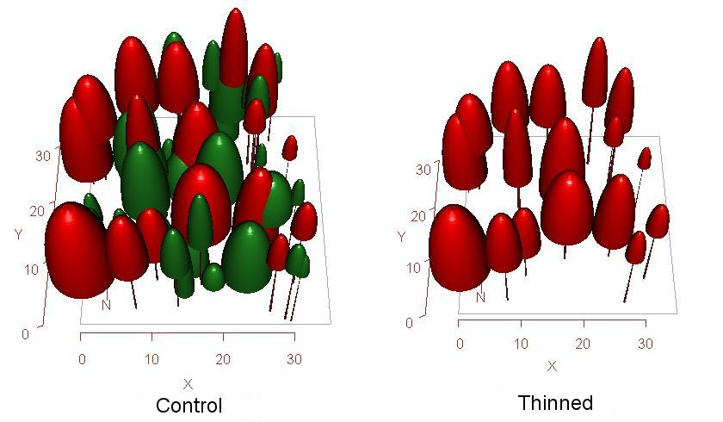
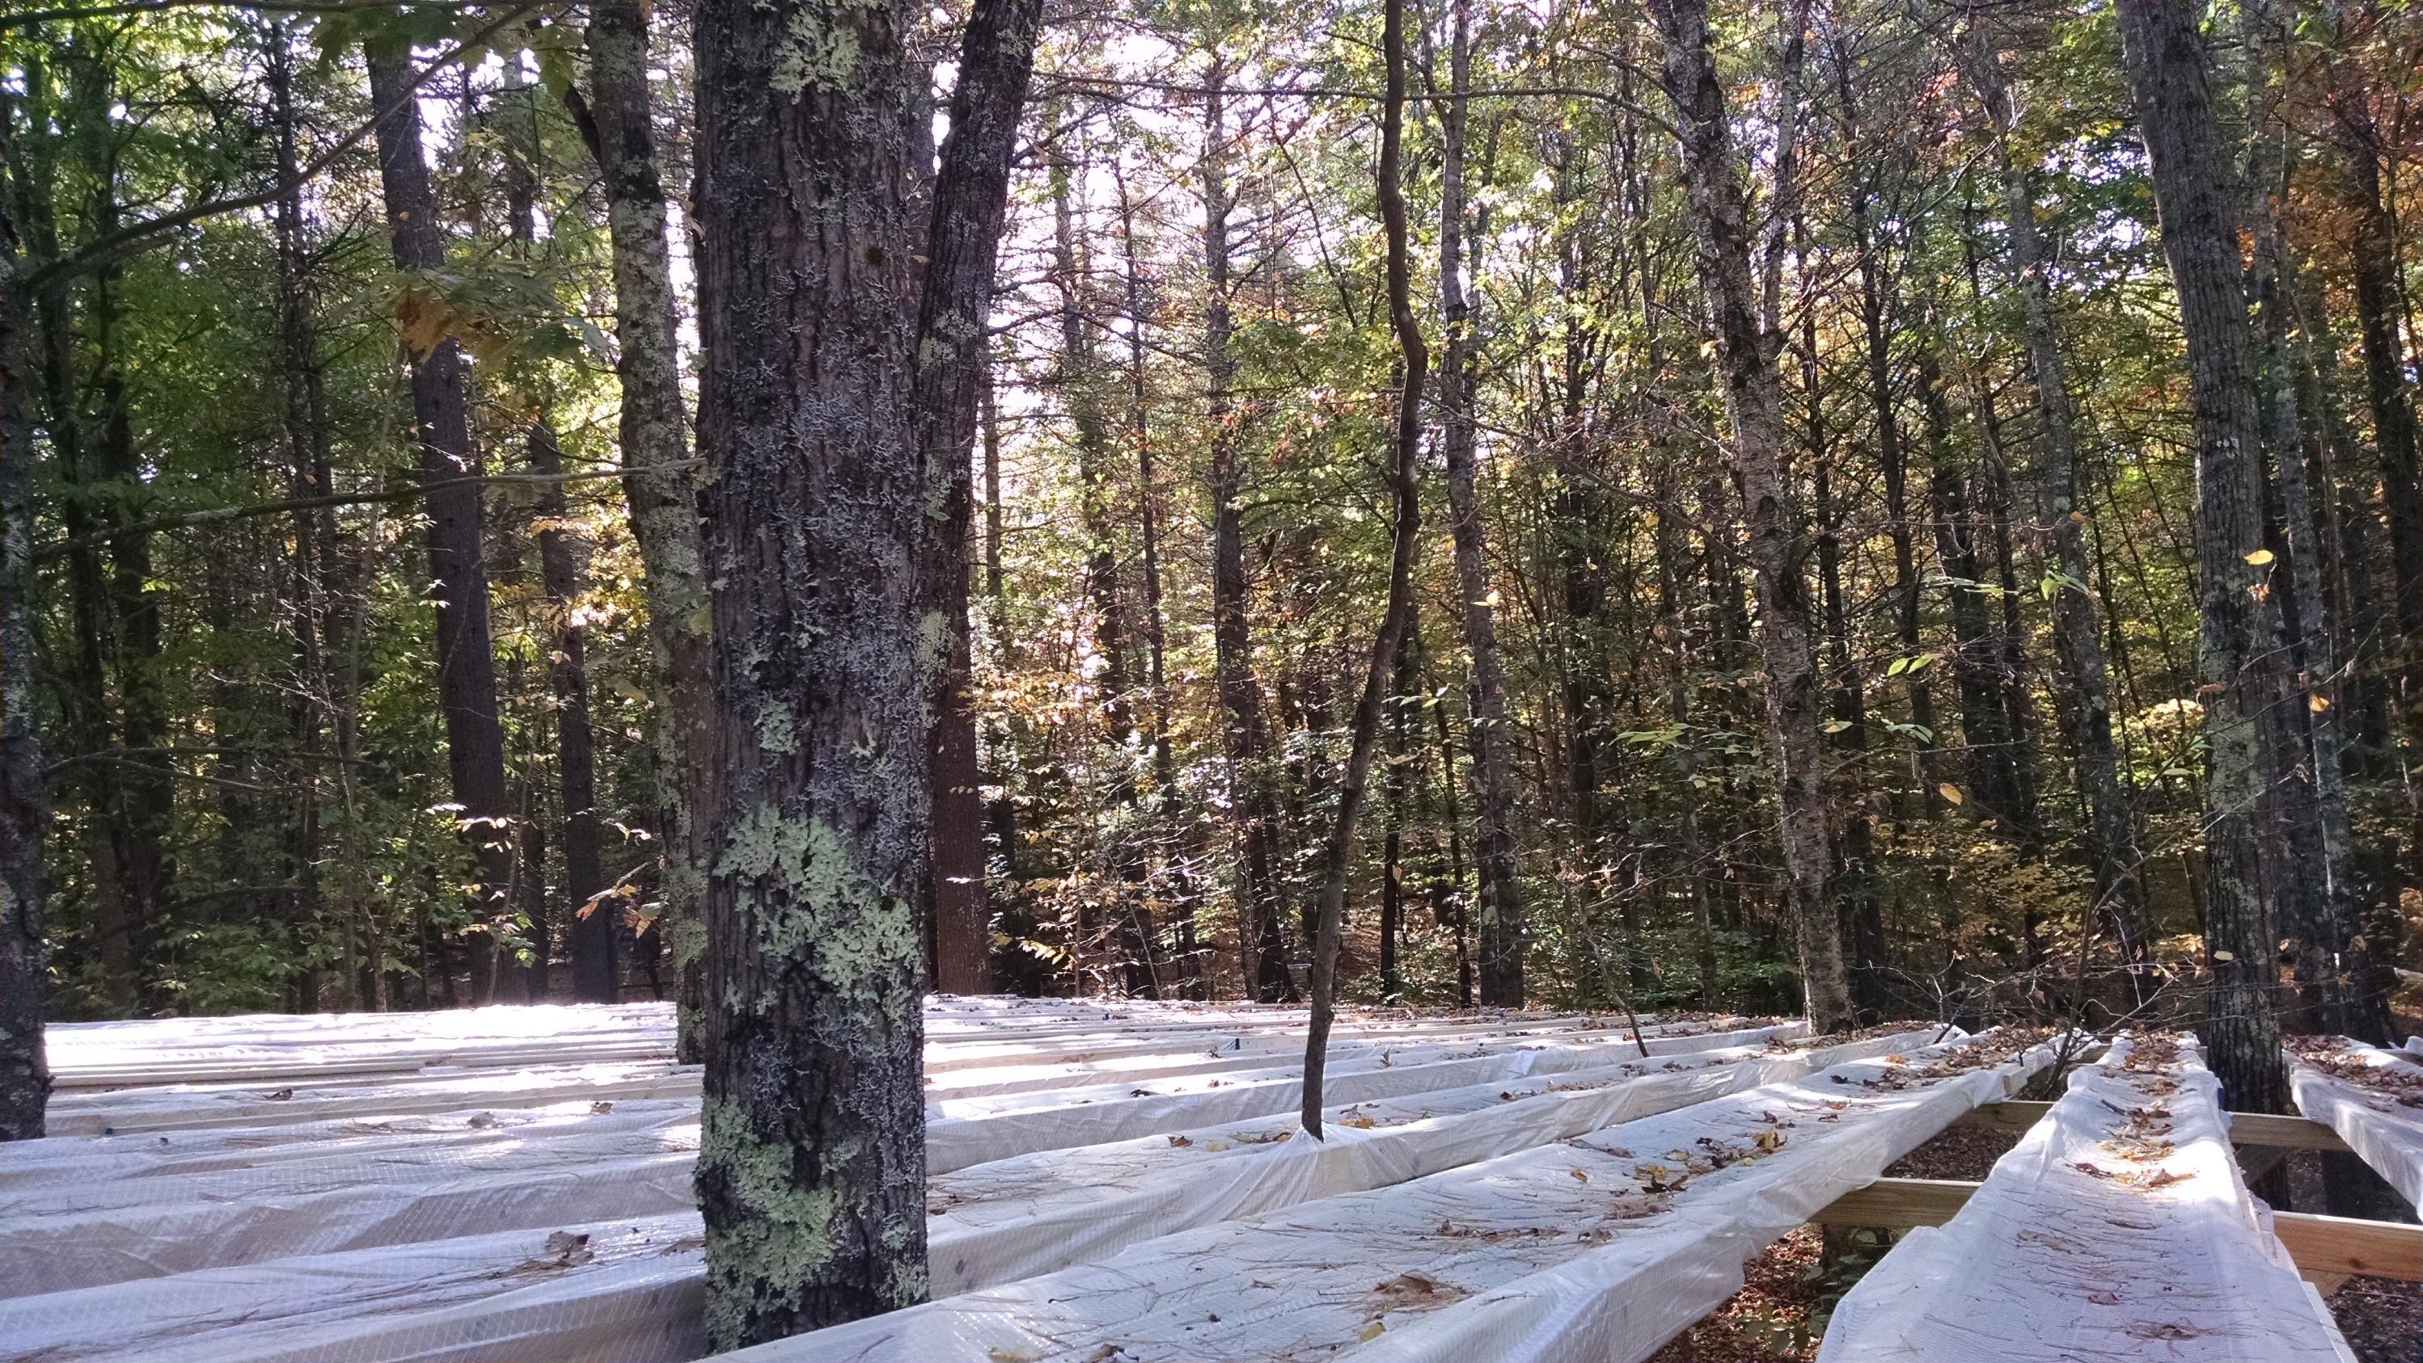
Refining model-based approaches to silvicultural management
Adam P. Coble¹ and Heidi Asbjornsen²
Department of Natural Resources and the Environment, University of New Hampshire
¹Adam.Coble@unh.edu, ²Heidi.Asbjornsen@unh.edu
Introduction
Modeling and Management Scenarios
Preliminary Modeling Results (continued)
In the northeastern U.S., precipitation intensity and frequency have increased, but dry periods between rainfall events and potential for drought are also predicted to increase^{1,2}. Evidence suggests that reduced precipitation negatively impacts temperate deciduous tree growth and forest ecosystem function^{3,4}. Management actions are likely to interact with drought⁵, and forest thinning may reduce the negative impacts of drought on forests⁶, but studies are lacking.
  Objective: Incorporate plant physiological data for dominant tree species from two existing forest drought experiments in New Hampshire into an ecosystem model to simulate impacts of forest management actions on stand-level drought-response.
Hypothesis: Experimental thinning to reduce stem density mitigates drought impacts on stand-level transpiration and productivity due to reduced competition for soil water.
MAESPA
Three-dimensional array model that estimates absorbed radiation, photosynthesis, and transpiration⁷.
Multiple spatial (leaf-, tree-, and stand-level) and temporal (half-hourly to daily) scales.
Suitable for modeling under various management scenarios due to flexibility in adjusting tree density, dimensions, and locations.
Management scenarios
Crown thinning at TF to improve growth of selected crop trees.
Individual tree selection thinning at HBEF to mimic natural disturbance and increase structural complexity.
Figure 5.
To identify thresholds in drought-responses, we conducted a dry-down simulation for control and thinned stands (e.g., precipitation set to zero).
Thinning increased the number of zero-precipitation days required to induce a reduction in transpiration.
Figure 2. Elevated view of a plot (TF) showing the original unthinned (control) and thinned stand as represented by the MAESPA model. Seven target trees from the center of the plot were selected for model simulations.
Table 1. Sensitivity analysis of key parameters
Minimum stomatal conductance (g₀) and marginal cost of carbon per unit water (g₁) were the most sensitive parameters during both wet and dry soil conditions.
Minimum leaf water potential (Min Ψ_{L}) and leaf-specific hydraulic conductance (K_{L}) were more sensitive under dry soil conditions compared with wet soil.
Methods
 |  | June (wet soil) |  | September (dry soil)
Parameter | Value | Mean Daily T (mm day⁻¹) | % Change from base case | Mean Daily T (mm day⁻¹) | % Change from base case
g₀ (mol m⁻² s⁻¹) | 0.038 0.076 (base case) 0.113 | 3.97 4.93 5.75 | -21.6% +15.3% | 0.64 0.27 0.20 | +82.0% -29.3%
g₁ | 4.03 8.05 (base case) 12.08 | 3.73 4.93 6.07 | -27.7% +19.6% | 0.89 0.27 0.19 | +18.6% -34.3%
Min Ψ_{L} (MPa) | -1.0 -2.0 (base case) -3.0 | 4.80 4.93 4.93 | -2.7% 0.0% | 0.36 0.27 0.23 | +29.6% -15.7%
K_{L} (mmol m⁻² s⁻¹ MPa⁻¹) | 2.0 4.0 (base case) 6.0 | 4.81 4.93 4.93 | -2.5% 0.0% | 0.32 0.27 0.26 | +17.5% -2.6%
Study sites:
Hubbard Brook Experimental Forest, NH (HBEF)
Thompson Farm, University of New Hampshire (TF)
Throughfall displacement experiments:
Intercepts and removes ~50% of throughfall (based on 1st quantile of 100-year precipitation record).
Each site contains 2 drought and 2 control plots (Fig. 1).
HBEF plot size: 225 m²; TF plot size: 900 m²
Target Species: Acer rubrum (HBEF); Pinus strobus and Quercus rubra (TF)
Field Measurements
Sap-flow: 3 trees per species per plot
Micrometeorology: air temperature, soil moisture availability, relative humidity, incoming radiation, wind speed
Leaf physiology: CO₂ assimilation (A) vs. intercellular CO₂ (C_{i}) and light curves, predawn and midday leaf water potential
Roots: Total root biomass (g m⁻²)
Preliminary Modeling Results (Thompson Farm)
Conclusions and Next Steps
  Late season development of drier soils led to reductions in transpiration, which could be alleviated by forest thinning.
  Validate soil moisture and transpiration model output using data from the throughfall displacement experiments (soil moisture & sap-flow).
  Parameterize and fine-tune the model with additional site-specific data: g₀, g₁, Min Ψ_{L}, K_{L}.
    Conduct a thorough sensitivity analysis on additional plant physiology and soil parameters to identify priority for field measurements.
Figure 1. Throughfall displacement plot at TF showing troughs that remove throughfall off of the plots.
Figure 3.
Model simulations included the control and thinned stand during 2015 ambient conditions (5.7% below 30-yr average) and a simulated drought (50% reduction in precipitation).
Soil water content (θ, 0-20 cm) declined through the growing season for all scenarios.
As expected, a 50% reduction in precipitation resulted in a greater reduction in θ for the control stand compared to the thinned stand.
Acknowledgements and References
We thank Drs. Brett Huggett, Matthew Vadeboncoeur, Lindsey Rustad, John Campbell, and Melinda Smith and Maria Janowiak and Cameron McIntire for providing helpful suggestions for this project. We also thank Steve Eisenhaure for visiting Thompson Farm and selecting trees for the crown thinning. Research was sponsored by the UNH-New Hampshire Agricultural Experiment Station (Grant #11ME16; Post-doctoral research associate support) and USDA Northern States Research Cooperative (Grant #110250) and conducted in collaboration with the RCN Drought-Net initiative (PI: Melinda Smith).
¹IPCC (2014) Climate change 2014: impacts, adaptation, and vulnerability. Part A: global and sectoral aspects. In: Field CB, Barros VR, Dokken DJ, Mach KJ, Mastrandrea MD, Bilir TE, et al. (eds) Contribution of Working Group II to the Fifth Assessment Report of the IPCC. Cambridge University Press, Cambridge, UK; New York, NY, USA.
²Hayhoe K, Wake CP, Huntington TG, Luo L, Schwartz MD, Sheffield J, et al. (2007) Past and future changes in climate and hydrological indicators in the US Northeast. Clim Dyn 28:381-407.
³Booth RK, Jackson ST, Sousa VA, Sullivan ME, Minckley TA, Clifford MJ (2012) Multi-decadal drought and amplified moisture variability drove rapid forest community change in a humid region. Ecology 93:219-226.
⁴Pederson N, D’Amato AW, Dyer JM, Foster DR, Goldblum D, Hart JL, et al. (2015) Climate remains an important driver of post-European vegetation change in the eastern United States. Glob Change Biol 21:2105-2110.
⁵Millar CI, Stephenson NL (2015) Temperate forest health in an era of emerging megadisturbance. Science 350:823-826.
⁶Kerhoulas LP, Kolb TE, Hurteau MD, Koch GW (2013) Managing climate change adaptation in forests: a case study from the U.S. Southwest. J Appl Ecol 50:1311-1320.
⁷Duursma RA, Medlyn BE (2012) MAESPA: a model to study interactions between water limitation, environmental drivers and vegetation function at tree and stand levels, with an example application to [CO2]×drought interactions. Geosci Model Dev 5:919-940.
Figure 4.
A 50% reduction in precipitation resulted in a greater reduction in stand transpiration (T) for the control stand (Jul, Aug) compared to the thinned stand.
Transpiration was greater for the control stand in Jun, but lower in Aug and Sept as compared with thinned stand, suggesting late-season moisture stress for the control.

