Slide 1


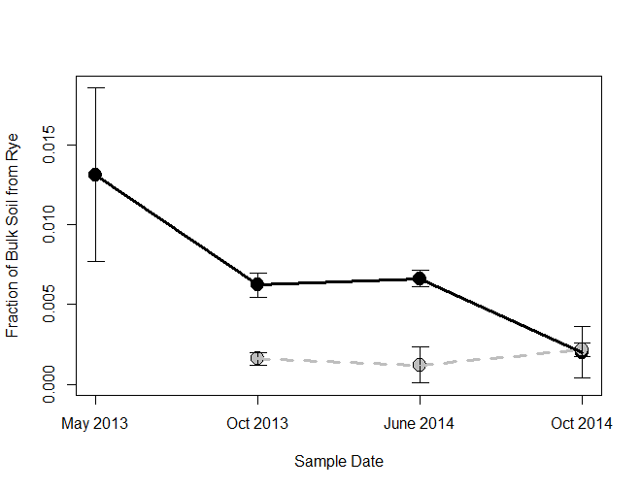
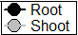
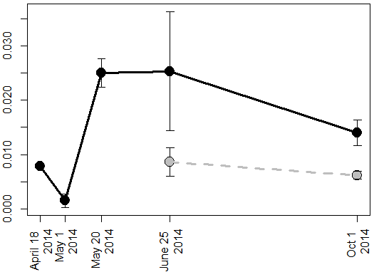
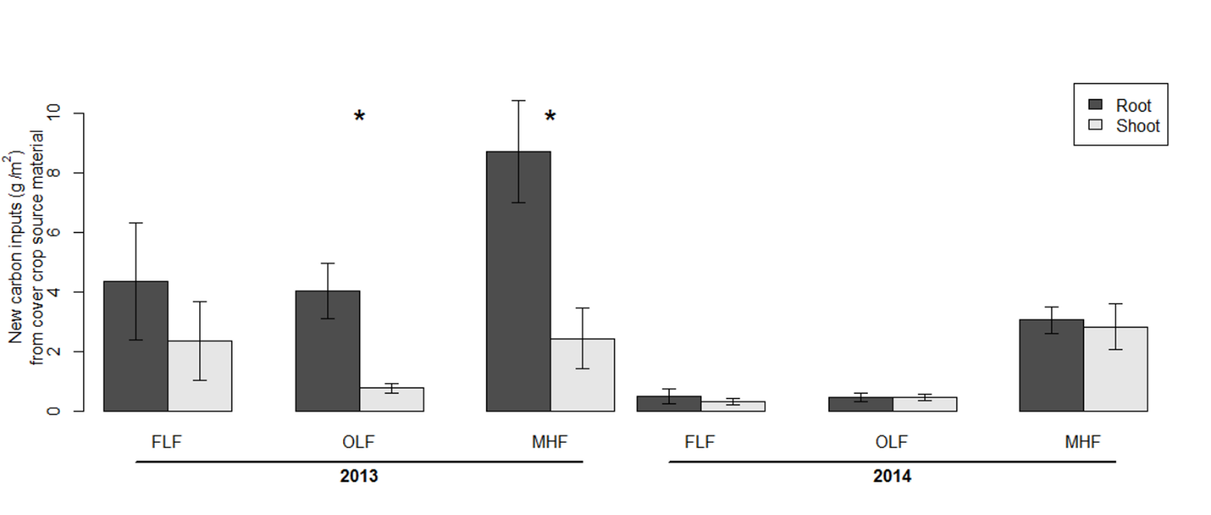
More soil organic matter derived
from cover crop roots than shoots
A. Stuart Grandy, Emily E. Austin, Kyle Wickings and Marshall McDaniel
Greater root carbon storage compared to shoot carbon storage in soil
Greater root carbon than shoot carbon in soil
More root than shoot carbon for one year
Increased productivity of biofuel crops via residue removal must be balanced with the potential for carbon storage in soils. Belowground carbon inputs (root carbon) may be more abundant in soil carbon pools than aboveground plant inputs (shoot carbon). Greater root carbon storage could be due in part to belowground carbon inputs during the growing season. Root carbon may be more physically protected or readily sorbed to mineral particles. Understanding the mechanism for increased root carbon storage in relation to shoot carbon storage can have important implications for management of biofuel systems.
Cover crop root carbon inputs were more abundant than aboveground shoot carbon following rye cutting in May 2013. Root carbon inputs comprised about 1.3% of bulk soil at the time of harvest, indicating the importance of rhizodeposition during plant growth (e.g. sloughed cells, root hair turnover, exudates, etc.) as a belowground, root carbon source. The greater abundance of root carbon persisted for over a year, however after a second summer of corn growth, the difference between root and shoot carbon in these soils was no longer detectable. The short lived nature of both root and shoot carbon in these soils may be site specific. Low levels of soil organic matter at KBS and high sand content could be associated with faster carbon cycling and slow accumulation of soil carbon.
Fraction of bulk soil C
from rye cover crop
Fig 2 The fraction of bulk soil from cover crop root (black) and shoot (grey) carbon sources labelled in the spring of 2013
Isotopic methods for tracing root and shoot carbon
Rhizodeposition is an important root carbon source
c
c
No
Label (control)
¹³C0₂
¹³C labelled rye
Root
label
Shoot
label
Greater root inputs are only part of the story
Fig 1 We labeled cereal rye cover crop with ¹³CO₂ (left) aboveground biomass was transferred between 1m² plots so that one plot - “root label” - contained isotopically labelled decomposing belowground biomass, one plot – “shoot label” – contained labelled decomposing aboveground biomass and one plot was unlabeled control (right). We used this design in 2013 to trace root and shoot carbon following cover crop harvest and in 2014 to measure belowground inputs during cover crop growth.
Cover crop carbon inputs were present in the bulk soil and microbial biomass 24 hours following the first labelling event and accumulated in the bulk soil during cover crop growth. However, the proportion of total carbon inputs remaining (including rhizodeposits) was greater for belowground inputs than for aboveground inputs up to one year following cover crop harvest.
Fraction of bulk soil C
from rye cover crop
Fig 3 Root carbon inputs to bulk soil during cover crop growth in 2014 and up to five months following rye harvest
More root carbon in occluded and mineral fractions
More root carbon in occluded and mineral soil fractions
We found that the greater abundance of root carbon compared to shoot carbon was more pronounced in the occluded light fraction and mineral associated heavy fraction of soils. Physical protection and mineral sorption could contribute to the greater proportion of root carbon inputs remaining in bulk soil for up to one year.
C (g*m⁻²) from rye
Fig 4. Root carbon inputs were more abundant than shoot carbon inputs in the occluded light fraction (OLF) and mineral heavy fraction (MHF) five months following rye harvest, in October 2013. There was no difference in the C remaining from roots vs shoots in any soil fraction seventeen months following rye harvest, in October 2014.
We are grateful for financial support from Department of Energy Office of Science (DE-FCO2-07ER64494), the National Science Foundation LTER program and the University of New Hampshire Agricultural Experiment Station

