Slide 1
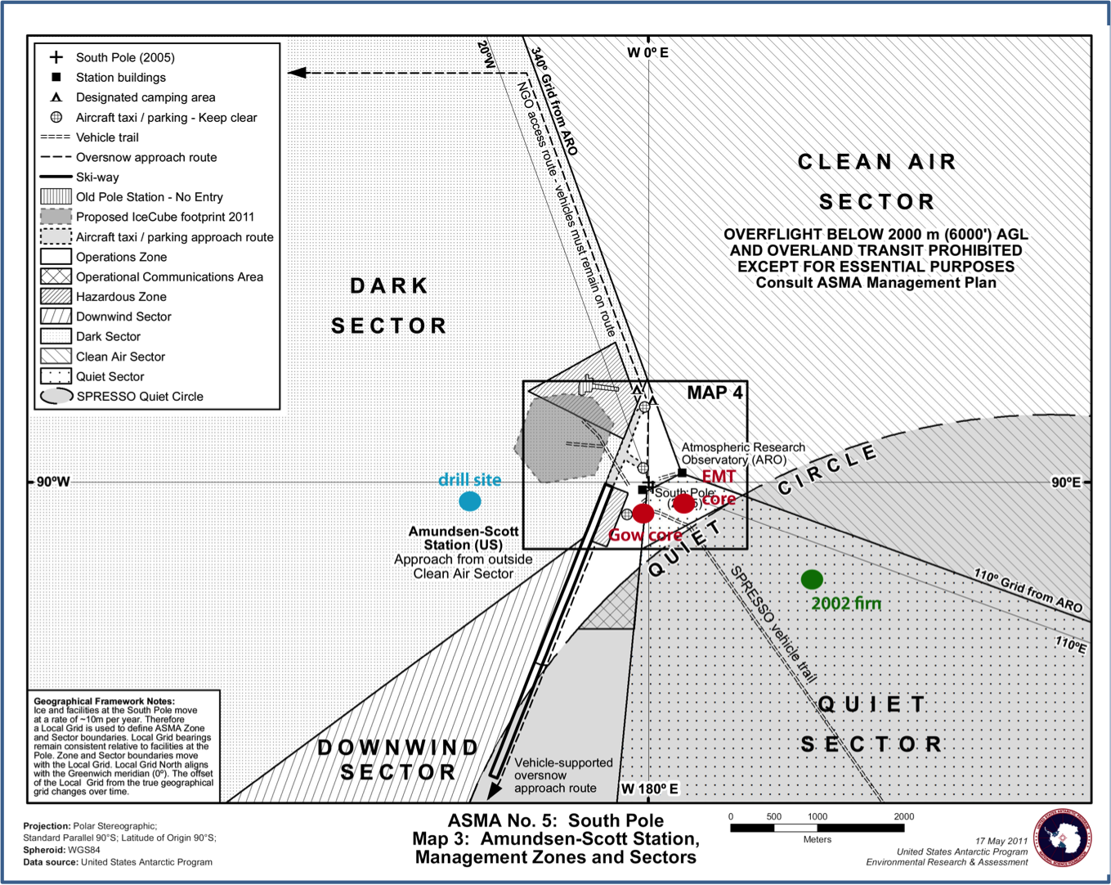
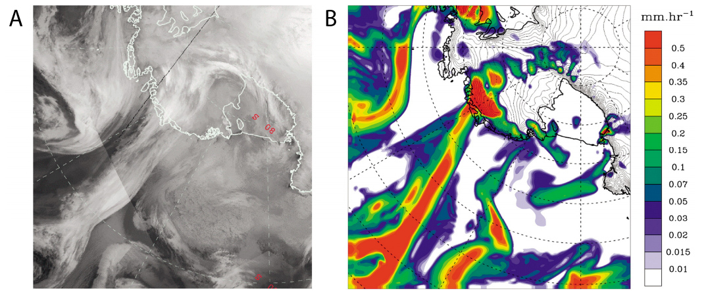
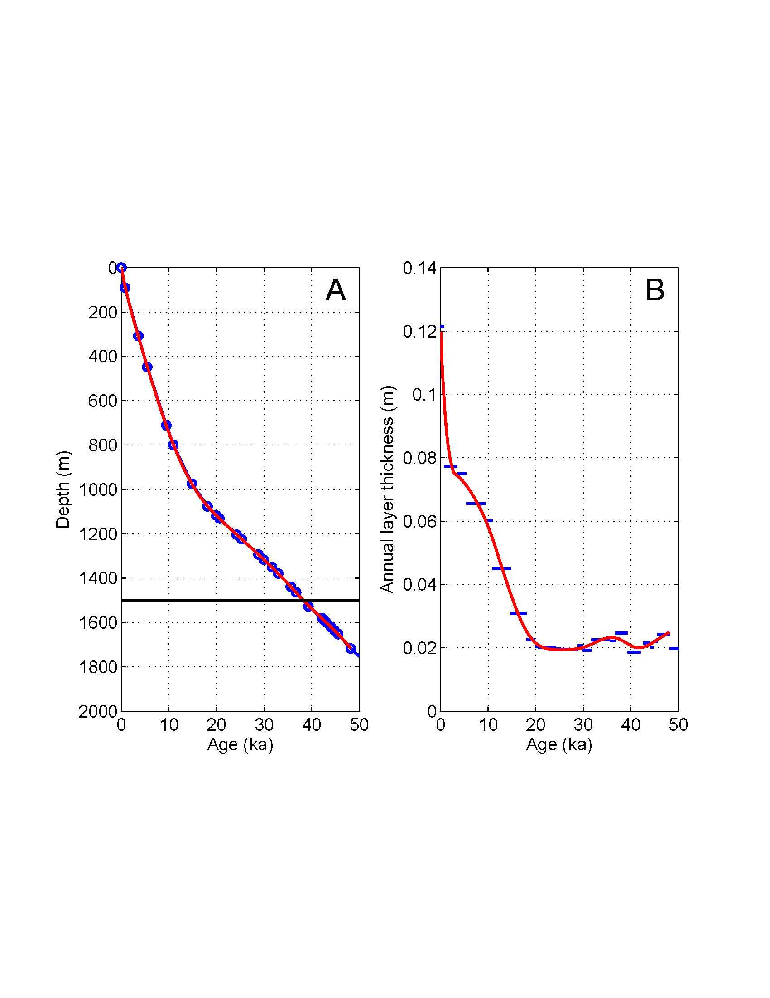
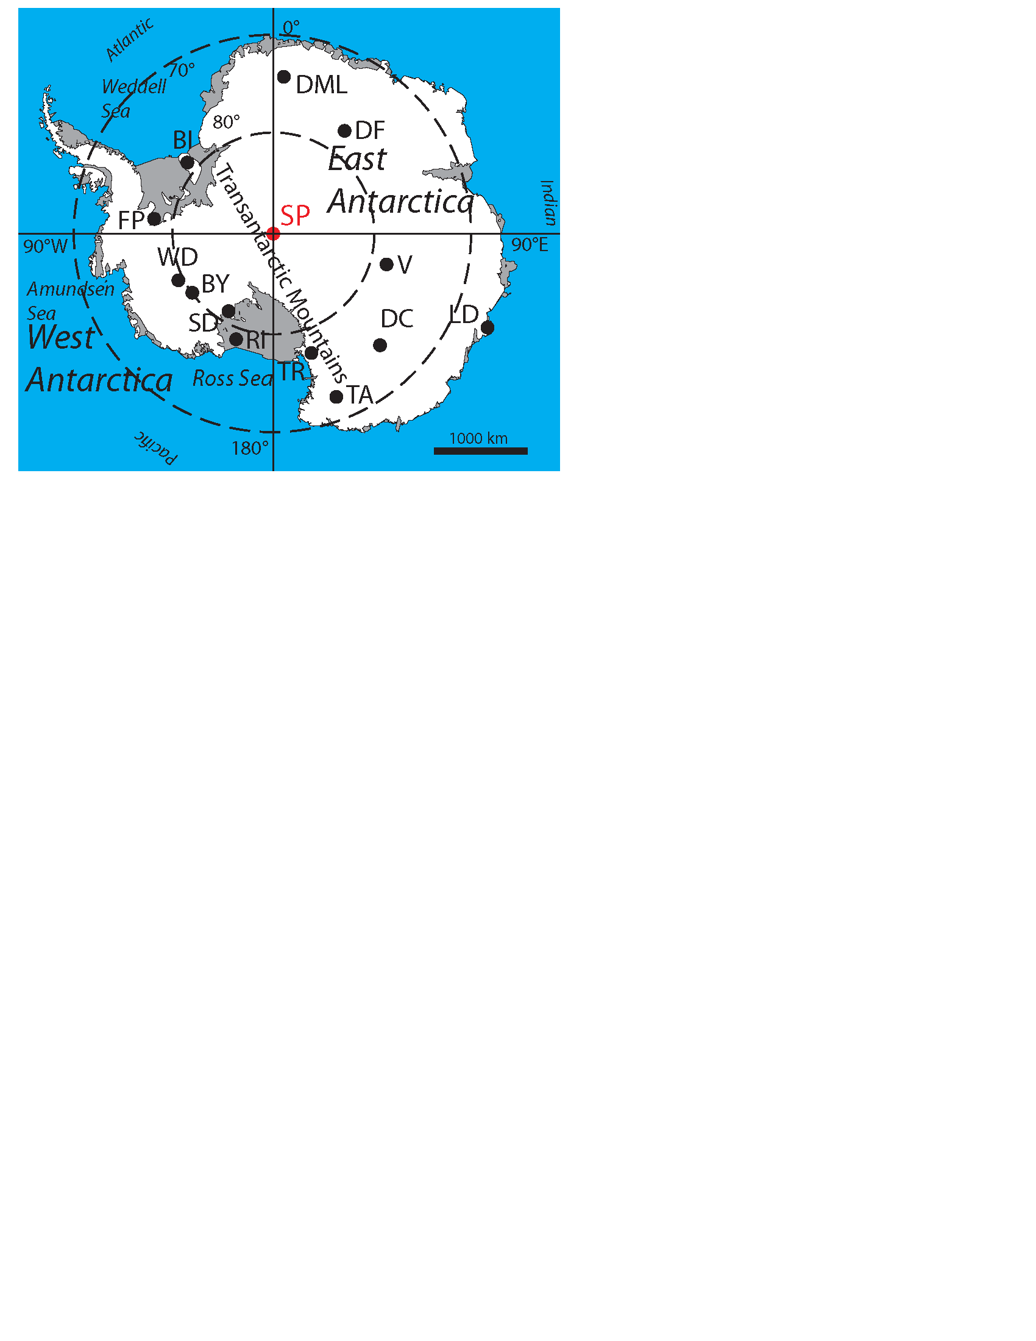
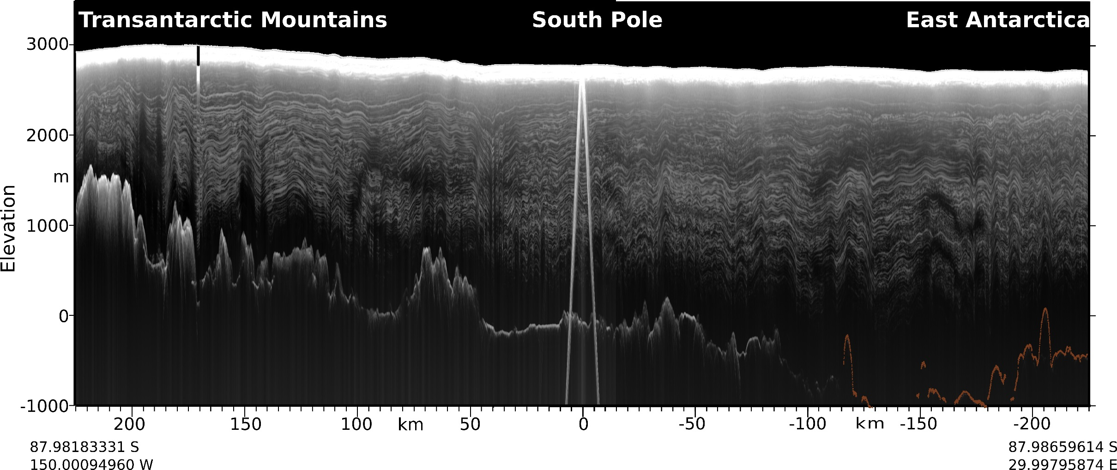
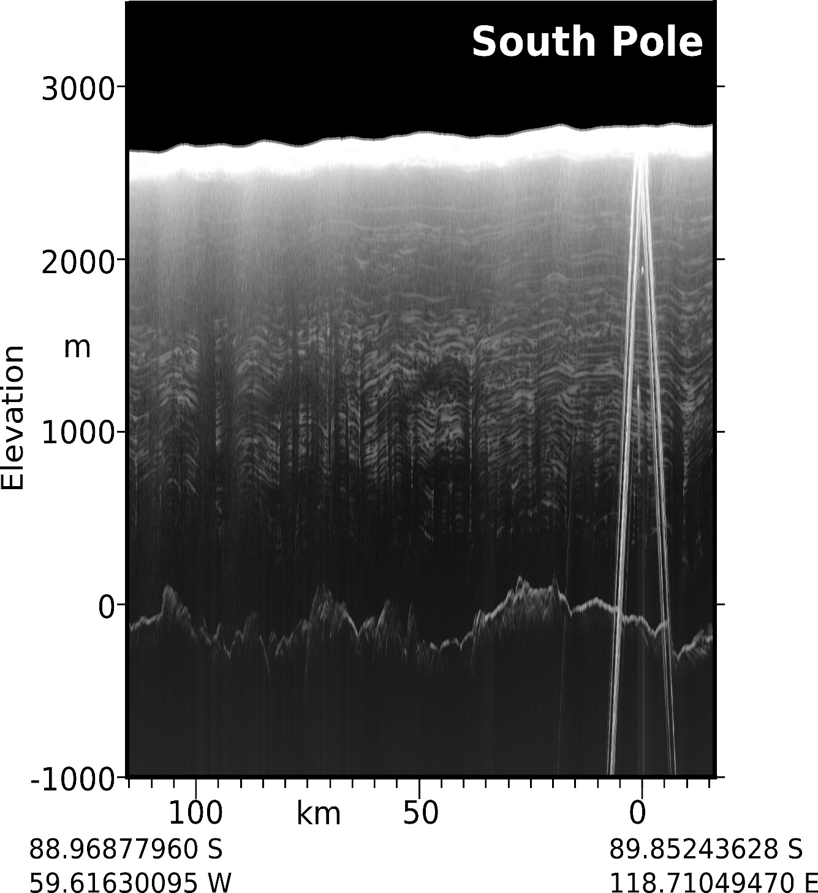
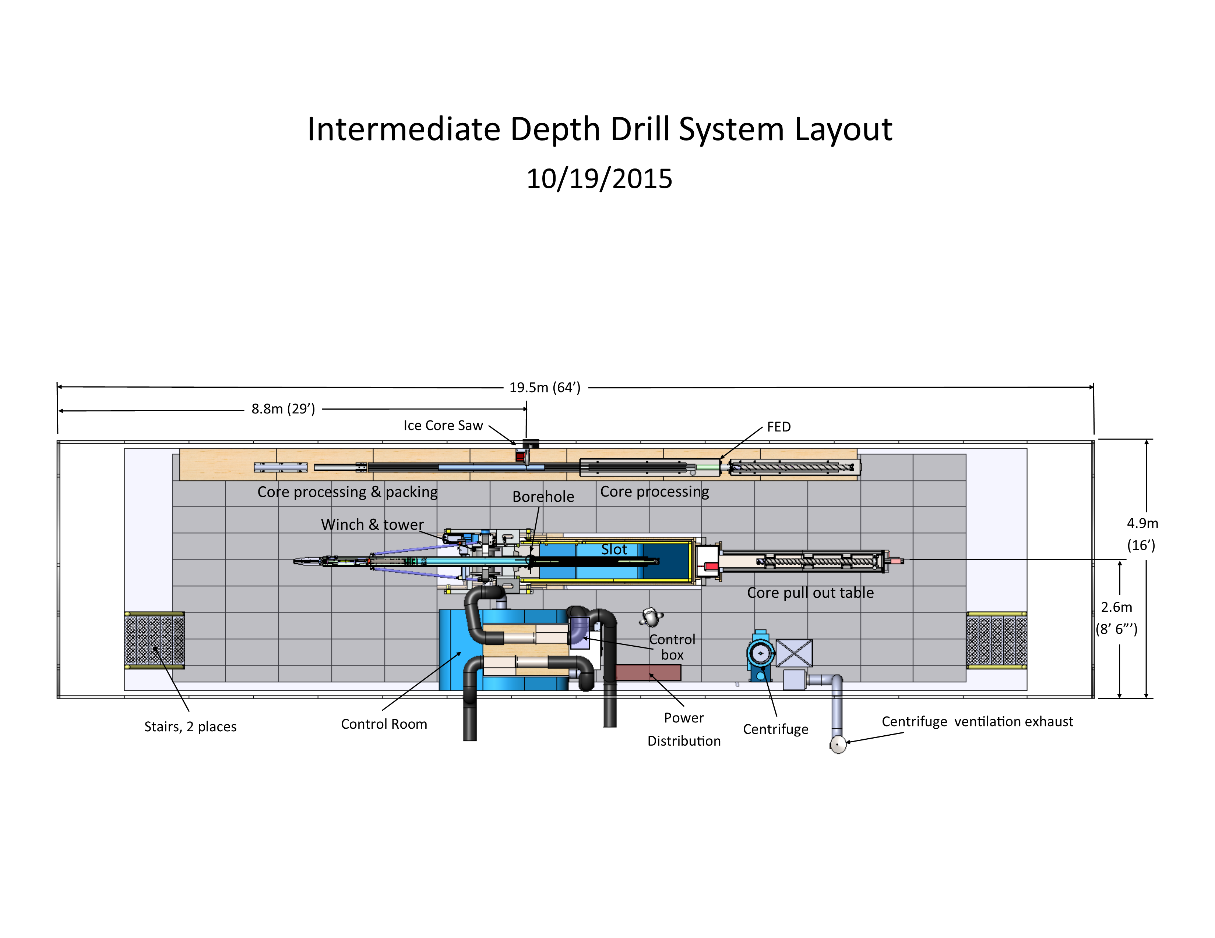
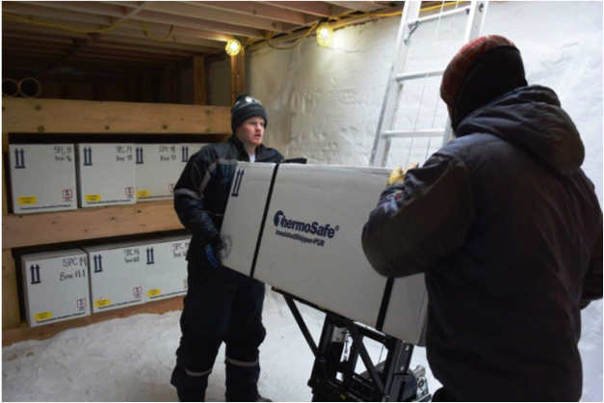
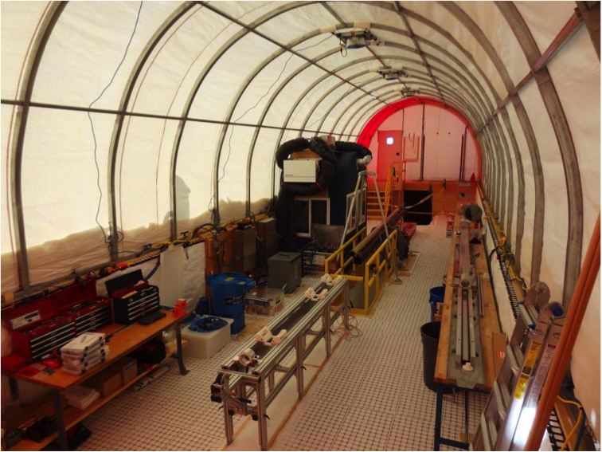
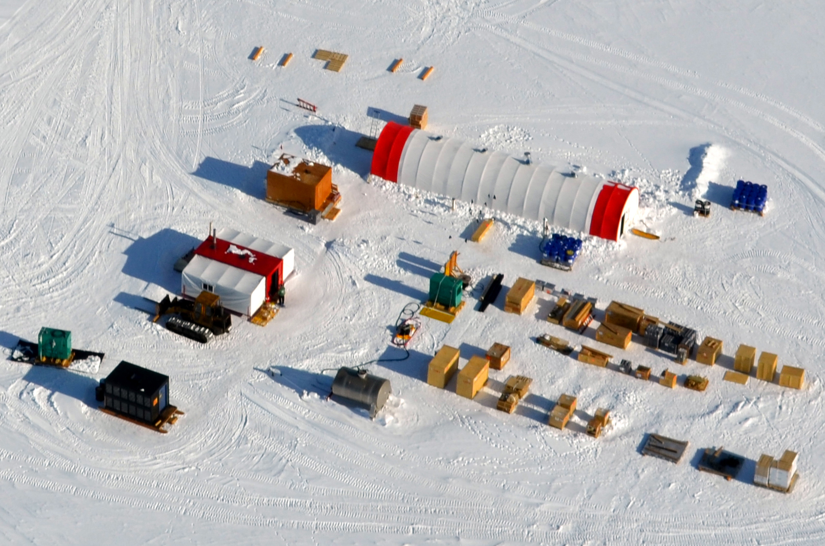
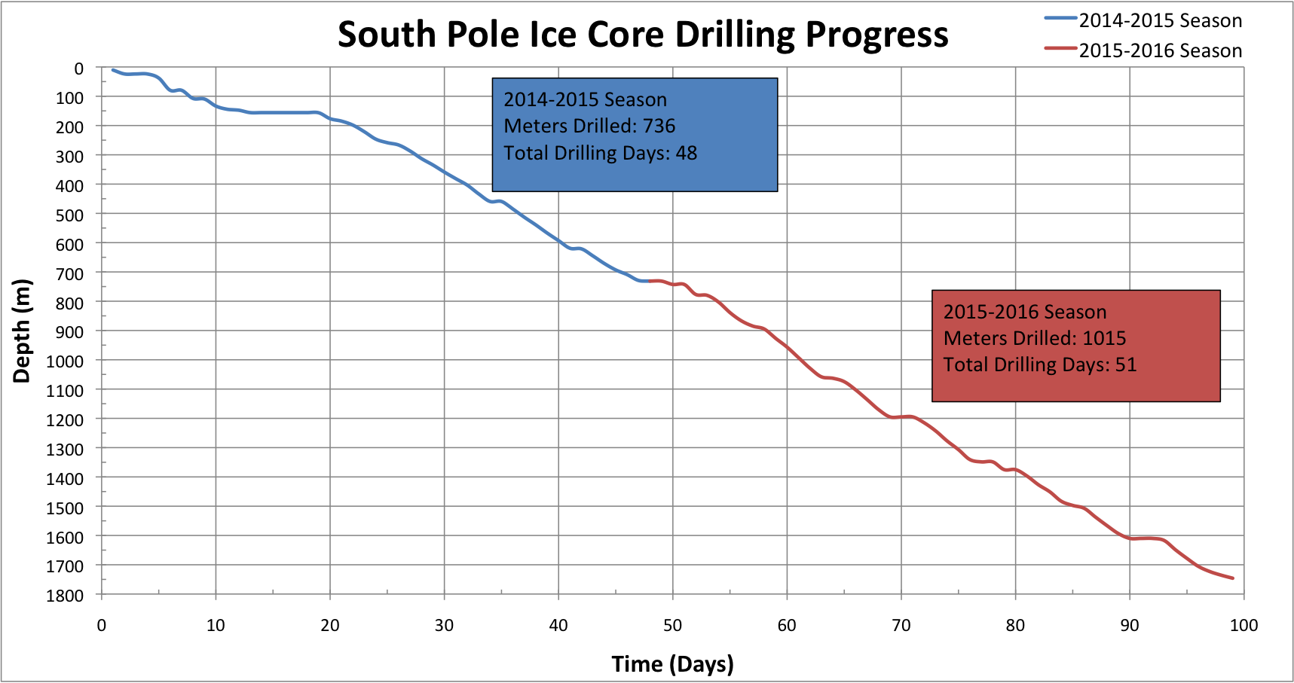
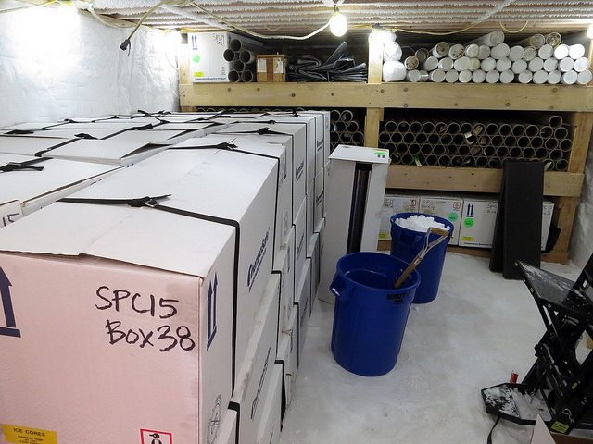
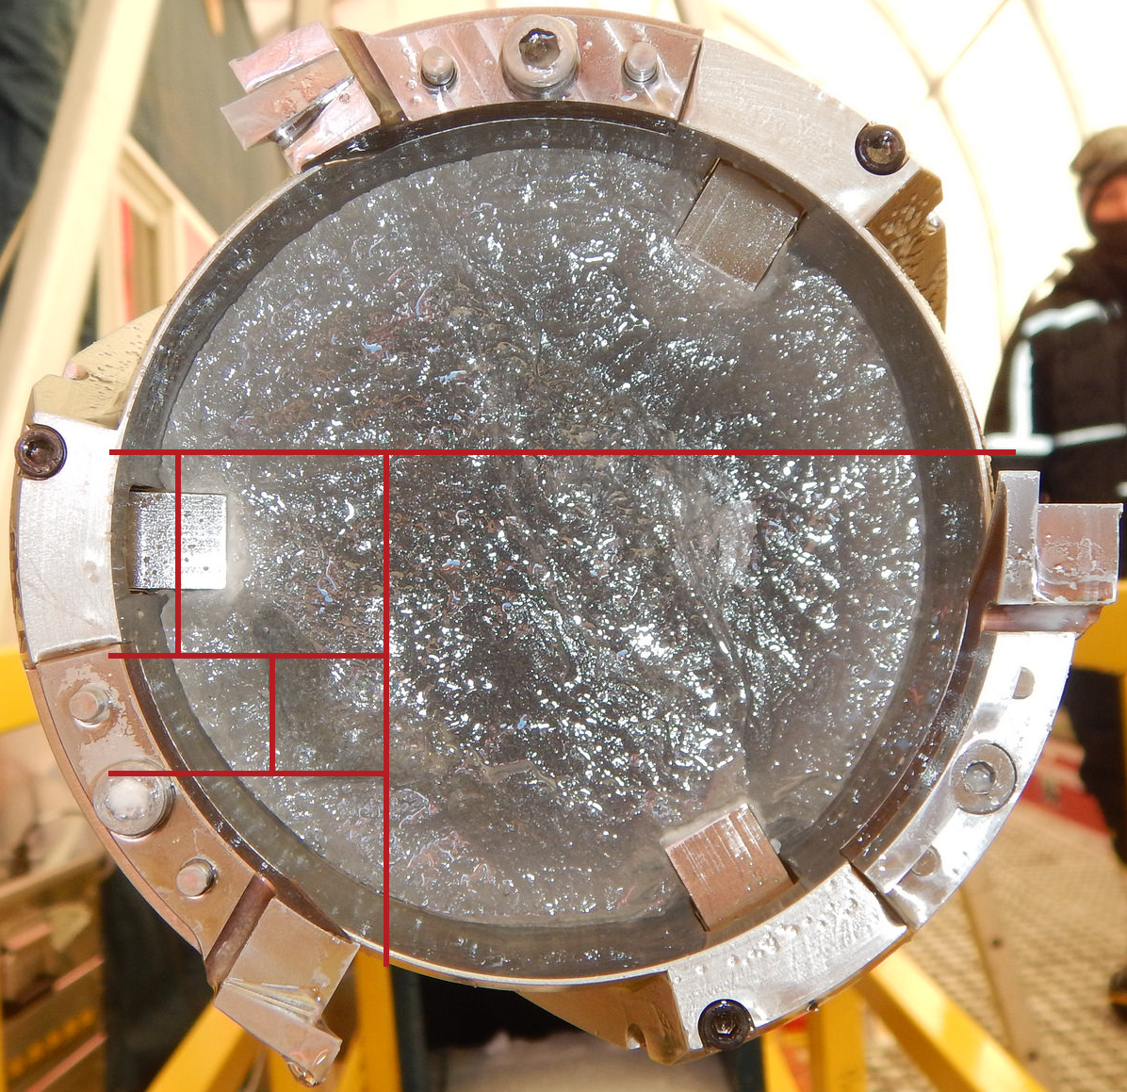

T01: Major recent drilling projects
The 1500 1751 m South Pole Ice Core:
Recovering a 50,000 year environmental record
http://spicecore.org/
J.M. Souney¹, M. Aydin², K.A. Casey^{3,4}, J.M. Fegyveresi⁵, T.J. Fudge⁶, J.A. Johnson⁷, E.C. Kahle⁶, T.W. Kuhl⁷, T.A. Neumann³, M.R. Nicewonger², E.S. Saltzman², E.J. Steig⁶ and M.S. Twickler¹
¹University of New Hampshire, Durham, NH, United States ²University of California Irvine, Irvine, CA, United States ³NASA Goddard Space Flight Center, Greenbelt, MD, United States
⁴University of Maryland, College Park, MD, United States ⁵Cold Regions Research and Engineering Laboratory, Hanover, NH, United States ⁶University of Washington, Seattle, WA, United States
⁷IDDO, University of Wisconsin, Madison, WI, United States
ABSTRACT
The stable isotope, aerosol, and atmospheric gas records in ice cores provide exceptional archives of past climate. Supported by the U.S. National Science Foundation Division of Polar Programs (Antarctic Glaciology Program), a new approximately 50,000-year long ice core was recovered from South Pole during the 2014-2015 field season (0 to 736 m) and the 2015-2016 field season (736 m to 1751 m) using the new U.S. Intermediate Depth Drill. Thus far, 555 m have been processed, with a bottom age just over 7000 years determined by annual layer counting of visual stratigraphy and volcanic matches to the WAIS Divide ice core record. The combination of low temperature, relatively high accumulation rate, and low impurity concentrations will yield a detailed record of atmospheric trace gases. The South Pole ice core will also provide a record of the climate history of a unique area of the East Antarctic plateau that is partly influenced by weather systems that cross the West Antarctic ice sheet.
Location and glaciological characteristics
Latitude | 89°59’ 20.168” S
Longitude | 98°09’ 34.528” W
Altitude | 2835 m a.s.l.
Ice thickness | 2700 m
Accumulation rate | 8 cm w.e.a⁻¹ (20 cm snow)
Ice velocity | 10 ma⁻¹ along 40°W
Mean annual temperature | -49°C (-56°F)
15 m depth firn temperature | -51°C (-60°F)
LOCATION AND CONTEXT
GLACIOLOGICAL SETTING
ICE FLOW MODELING
CLEAN
AIR
SECTOR
FIGURE 3. Along-flow (left) and across-flow (above) airborne radar profiles collected by UTIG in 1997-1998 over South Pole. The profiles display continuous layering with minimal stratigraphic disturbance in the upper 1500 m near South Pole. The predominant reflector in the radargrams is the reflection from the station; Casey et al. (2014).
FIGURE 1. South Pole (SP, inset) drill site (blue circle) relative to dark, clean air, quiet and downwind sectors, prior firn and ice cores (EMT - Mosley-Thompson, 1980; Gow - Kuivinen, 1983; 2002 firn - Aydin et al., 2008). The drill site is approximately 2.7 km from the Station at 89°59’ 20.168” S, 98°09’ 34.528” W.
FIGURE 2. Moisture-bearing weather systems can impact both West Antarctica and the South Pole. Panel A is an infrared satellite image from Nicholas and Bromwich, 2011; Panel B is an Antarctic Mesoscale Prediction System (AMPS) weather forecast of precipitation rate on the same day, 5 August 2006.
FIGURE 4. Panel A shows the depth-age relationship derived by matching optical dust logs between South Pole and Dome C (data from IceCube Collaboration, 2013). Tie points are in blue; red line is the modeled depth-age. Panel B indicates annual layer thickness (red curve) inferred from depth-age relationship; blue bars indicate average annual layer thickness between tie points.
DRILLING OPERATION
Intermediate Depth Drill specifications
Core recovery diameter | 98 mm (± 3 mm )
Core recovery length | 2 m per run
Core recovery total depth capability | 1900 m
Drill design | Wet or dry drilling capability
Surface operation temperature | -40°C
Sonde operation temperature | -57°C
Sonde length | 6.4 m
Drill system weight (includes tent) | 12,000 kg (26,000 lbs)
Total project cargo (includes drill, tent, casing, and drill fluid; excludes generator and camp equipment) | 25,000 kg (55,000 lbs)
A
7.3m (24’)
ceiling
hatch
4.5m
(15’)
shelving
Underground core storage trench
reaming & casing
B
C
D
dry drilling
brittle ice handling
wet drilling
FIGURE 5. Panel A shows the layout for the drilling and core processing operations that take place inside a 19.5 m L x 4.9 m W x 2.8 m H un-insulated WeatherPORT tent. Panel B shows the inside of the underground core storage trench. The trench serves as a storage area for all of the drilled ice until it is ready to be flown from South Pole Station to McMurdo Station. In addition, all of the ice from the ‘brittle ice zone’ is stored in the trench over winter to provide more time to relax internal stresses before the ice is shipped back to the U.S. Panel C shows the inside of the drilling tent. The Ice Drilling Design and Operations (IDDO) group at the University of Wisconsin-Madison designed and built the drilling system, called the Intermediate Depth Drill (IDD). Based on the Danish Hans-Tausen drill (Johnson et al., Annals Glac. 2014), the IDD was purpose-built for coring 1,500+ meters of ice. Panel D shows an aerial view of the drill site, located about 2 km from South Pole Station. The drilling takes place inside the long red and white tent.
FIGURE 6. General specifications of the Intermediate Depth Drill (table, top) and the drilling progress of the South Pole ice core (chart, bottom). It took a total of 99 days to drill the 1751 meter ice core.
PROJECT SCHEDULE
FUNDED SCIENCE/MEASUREMENTS
CUT PLAN (0-555 m)
2013
2014
2015
2016
2017
Gases
Carbonyl Sulfide, Methyl Chloride, Methyl Bromide – M. Aydin
Inert Gas, δ¹⁵N, Methane – T. Sowers, J. Severinghaus, E. Brook
Carbon Monoxide (and CO Isotopes) – V. Petrenko, J. Mak
Carbon Dioxide and Nitrous Oxide - E. Brook
Planning
Workshop
Planning
Workshop
Science
Workshop
Science
Workshop
Science
Workshop
chemistry
archive
Greenland
drill test
install, drill
to 736m
drill to 1751m, begin packup
complete packup
South Pole drilling
operations:
Stable Isotopes, Aerosols/Chemistry, Physical Properties
Water Isotopes (δD, δ¹⁸O, Δ¹⁷O) – E. Steig, J. White
Trace elements, major ions, particles, conductivity – E. Osterberg, K. Kreutz, J. Cole-Dai
Electrical conductivity – T.J. Fudge, E. Waddington
continuous
isotopes
0-584m
585-734m
1078-1478m
735-1077m
1479-1751m
gases
South Pole ice
retrograde:
discrete isotopes
0-555m
556-734m
1078-1478m
735-1077m
1479-1751m
NICL CPL’s:
Ice Dynamics
Upstream Ice and Firn Dynamics – M. Koutnik, E. Waddington, H. Conway, T.J. Fudge, R. Hawley, E. Osterberg
archive
* several additional pending proposals *
98 mm
ACKNOWLEDGEMENTS
This work is supported by US National Science Foundation grants PLR-1142517 (Aydin), PLR-1141839 (Steig), PLR-1142646 (Twickler) and the NASA Cryospheric Sciences Program. We thank the Ice Drilling Program Office and the Ice Drilling Design and Operations group for drilling the ice core; the National Ice Core Laboratory for curating the core; the Antarctic Support Contractor for logistics support in Antarctica; and the 109th New York Air National Guard for airlift support in Antarctica. We appreciate the collaboration with the Centre for Ice and Climate, University of Copenhagen, Denmark, on the design of the U.S. Intermediate Depth Drill.
REFERENCES
Casey, KA, TJ Fudge, TA Neumann, EJ Steig, MGP Cavitte, DD Blankenship. The 1500 m South Pole ice core: recovering a 40 ka environmental record. Ann. Glac. 55(68), 137-146, 2014.
Johnson, JA, Shturmakov, TW Kuhl, N Mortensen, CJ Gibson. Next generation of an intermediate depth drill. Ann. Glaciol. 55(68), 27-33, 2014.
Kuivinen, K. A 237-m ice core from South Pole Station. Ant. J. US, 18(5), 113-114, 1983.
Mosley-Thompson, E. 911 years of microparticle deposition at the South Pole: a climatic interpretation. Inst. Polar Stud. Rep. 73, 1980.
Nicholas JP, DH Bromwich. Climate of West Antarctica and influence of marine air intrusions. J. Climate, 2(1), 49-67, 2011.

