Slide 1


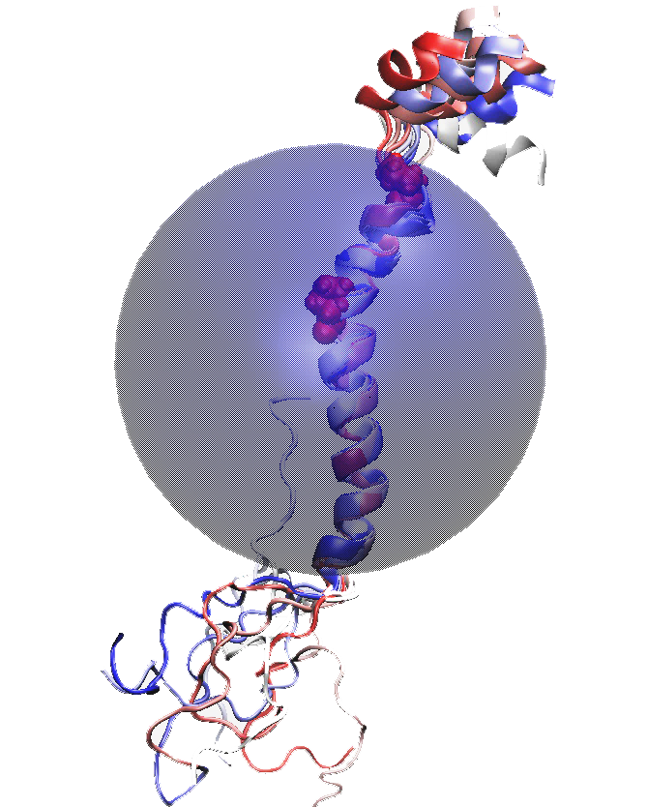
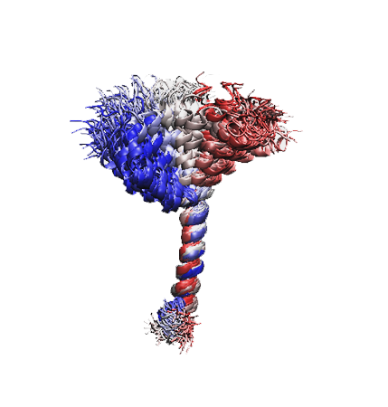
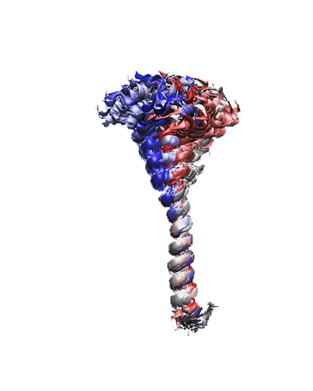
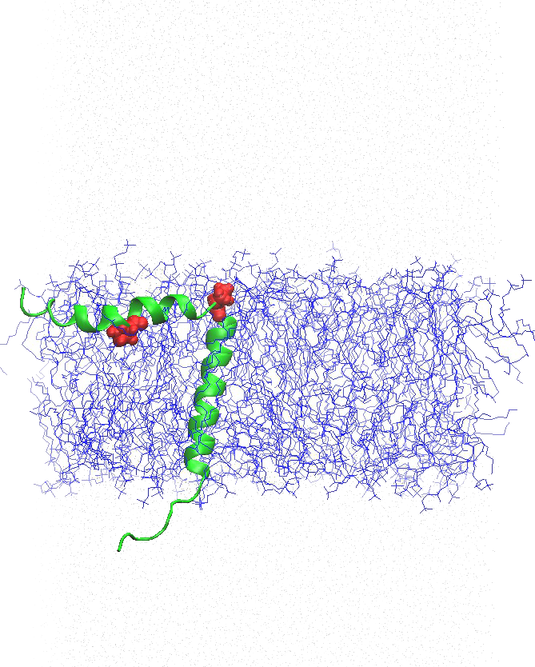
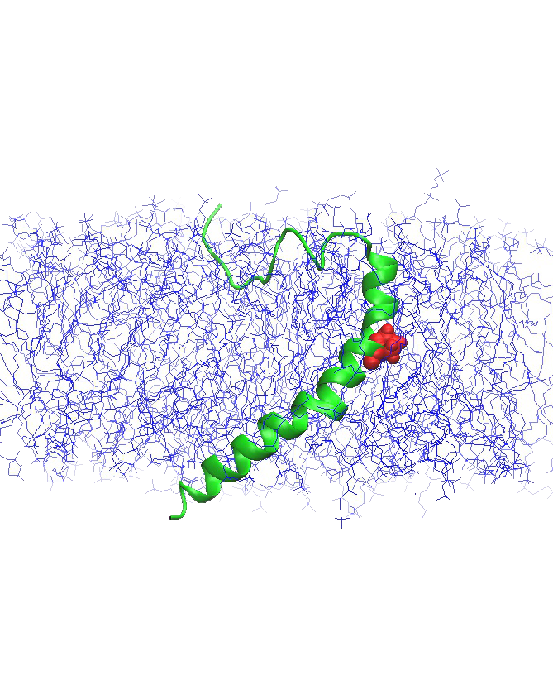
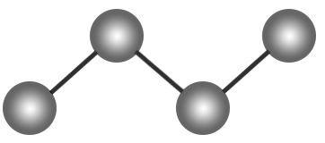
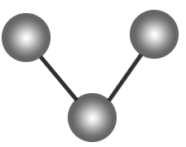

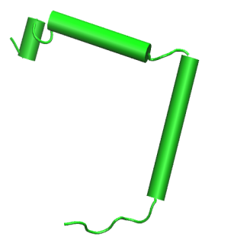
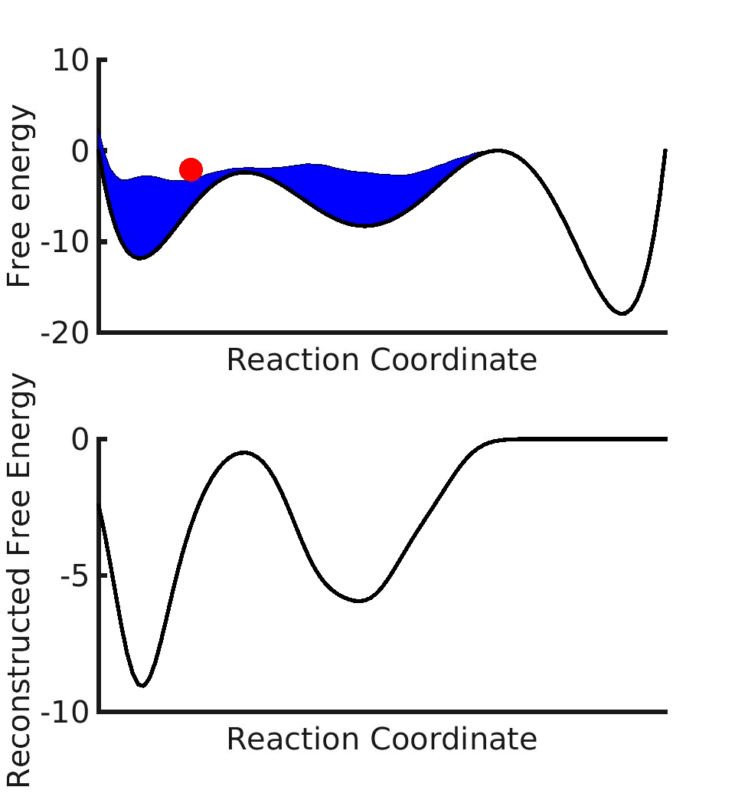
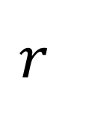
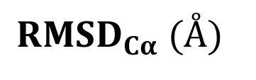
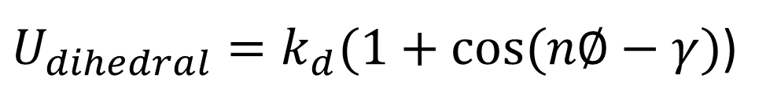
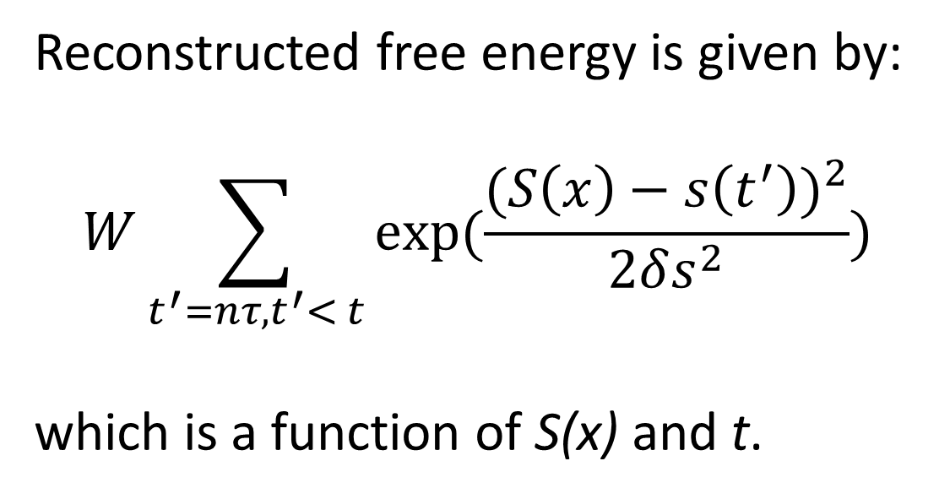
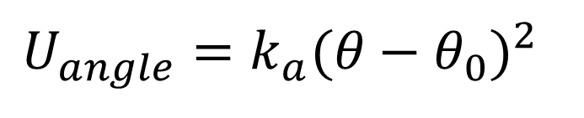
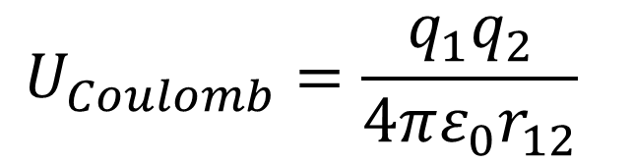
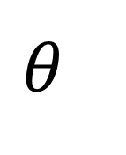
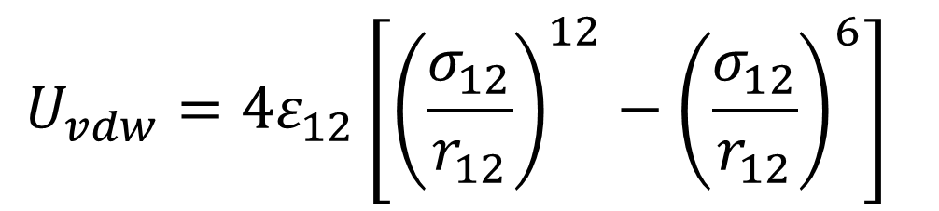
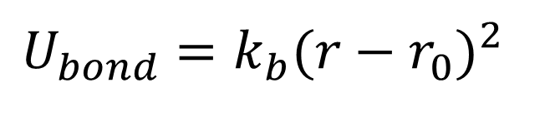

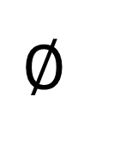

All-atom structural models of the transmembrane domains of insulin
receptor and type-1 insulin-like growth factor receptor
Hossein Mohammadiarani and Harish Vashisth
Department of Chemical Engineering, University of New Hampshire, Durham, NH
Abstract
The binding of insulin and insulin-like peptides to their cell surface receptors is the first key step in triggering signaling pathways for controlling processes related to normal cellular growth and metabolism. However, the mechanistic details of this first step remain poorly understood at a molecular scale in part due to the lack of knowledge of intact structures of full-length receptors. Constructing such structural models would require information on the structures of extracellular domains, intracellular domains, and more importantly the transmembrane domains (TMDs) that serve a critical role in signal transduction. In this work, we present all-atom structural models of TMDs of the insulin receptor (IR) and the type-1 insulin-like growth factor receptor (IGF1R) constructed using atomistic molecular dynamics (MD) simulations. In particular, the folding/unfolding behavior of membrane-embedded peptide sequences from IR and IGF1R was studied using enhanced sampling methods such as metadynamics. Simulations reveal that a proline residue in IR-TMD results in increased flexibility in comparison to IGF1R-TMD, while the metastable structures of both peptides have kinks near the N-terminus. The predicted structure of IR-TMD is consistent with a recent experimental structure determined in micelles using NMR, and the IGF1R-TMD structure is consistent with predictions from long unbiased MD simulations. These results have key implications for future work aimed at constructing all-atom structural models of full-length receptors.
Sequence Alignment of Receptor Transmembrane Domain
Proline residues induce a kink in the peptide structure.
Aligned metastable/stable conformations
Human insulin receptor (IR):
939 PTYFYVTDYLDVPSNIAKIIIGPLIFVFLFSVVIGSIYLFLRKRQPDGPLG 989
Human type-1 insulin-like growth factor receptor (IGF1R):
918 DPVFFYVQAKTGYENFIHLIIALPVAVLLIVGGLVIMLYVFHRKRNNSRLG 968
Hydrophobic
Polar or Charged
Proline
Residue numbering adopted from www.uniprot.org
a)
b)
c)
MD Equilibration of Initial Structure
Equilibration simulation parameters:
IR immersed in membrane (80 Å x 80 Å)
Neutralized in saline water (0.05 mol/L KCl)
NPT ensemble with periodic boundary conditions
Number of atoms: ~75000 atoms
CHARMM force filed with CMAP correction
Equilibration steps:
1- 0.5 ns, Water and protein are frozen
2- 5 ns, Protein is frozen
3- 50 ns, all molecules are relaxed
Aligned metastable/stable conformations of TMD-IR (a), TMD-IGF1R (b) and NMR structure of TMD-IR (940-988) in DPC micelles (c). [6] The red residue is Gly at which form kink and bending in TDM.
Results
Methods and Software
NAMD (NAnoscale Molecular Dynamics) is a parallel molecular dynamics code designed for high performance simulation of large systems of particles based on Newtonian equation of motion:
VMD (Visual Molecular Dynamics) is a molecular visualization software for displaying and analyzing MD simulations.
Metadynamics is a technique for enhanced exploration of the free-energy landscape of biomolecules.
n : is an integer number
S : current reaction coordinate
s : all previous reaction coordinate
W : the Gaussian height
2δs: the Gaussian width
τ : the frequency at which the
Gaussians are added
Aligned frames of
TMD-IR in equilibration simulation
Aligned frames of
TMD-IGF1R in equilibration simulation
The N-terminus amino acids sequence of the TMD-IR (residues 942-956) form a perfect helix in most stable state while it switches to metastable states with lower helicity. The kink in the middle (Residues 959-961) and the C-terminus random coil are elusive from helix formation. Figure (b) illustrates that TMD-IGF1R forms a random coil in N-terminus and never shows a perfect helix. The rest of residues (933-966) ,except residue 950, form a perfect helix in all metastable/stable states. Simulation shows a bend in residue 950, which mostly switches to perfect helix.
a)
Helicity
IR
$m_{i}\vec{{\ddot{r}}_{i}}=−\frac{∂}{∂\vec{r}}U_{total} i=1, 2, 3,…,N$
b)
$U_{total}=U_{bond}+U_{angle}+U_{dihedral}$+$U_{vdw}$+$U_{coulomb}$
IGF1R
$$U_{Coulomb}=\frac{q_{1}q_{2}}{4πε_{0}r_{12}}$$
$$U_{vdw}=4ε_{12}\left[{\left(\frac{σ_{12}}{r_{12}}\right)}^{12}−{\left(\frac{σ_{12}}{r_{12}}\right)}^{6}\right]$$
Conformational Sampling of Membrane Peptide with Metadynamics
Folding Thermodynamics (Potential of Mean Force)
The average number of water molecules in 4.6 Ǻ residues vicinity in metastable/stable states of TMD-IR (a) and TMD-IGF1R metadynamics MD simulations (b). The number of water molecules in the vicinity of each residue is a clear indication of what extent a residue is buried within bilayer lipids.
a)
The number of water molecules vicinity
$$∅$$
Metadynamics Parameters:
Time step : 1.0 fs
Reaction coordinate: 0 < RMSD < 15 Å
Reaction coordinate grid spacing : 0.2 Å
Simulation time ~ 160 ns
IR
$$θ$$
$$r$$
Gaussian height : 0.1
Gaussian width : 0.2 Å
Gaussian frequency : 1 ps
b)
α°
β°
IGF1R
$U_{dihedral}=k_{d}(1+cos⁡(n∅−γ)$)
$$U_{angle}=k_{a}{(θ−θ_{0})}^{2}$$
$$U_{bond}=k_{b}{(r−r_{0})}^{2}$$
a)
δ°
$$Residue sequences$$
a)
b)
α°
Angles of helices in TMD-IR correlate with RMSD. Angle between N-terminus helix (residues 943-955) and normal vector of bilayer membrane versus RMSD (a). Angle between C-terminus helix (residues 963-981) and normal vector of bilayer membrane (b). Angle between N-terminus helix and C-terminus helix versus RMSD (c). Chang in RMSD is mostly resulting from changing angles between helices. As the RMSD increases, angles between helices are decreased to promote deviation from the perfect helix. Scattered data shows all along metadynamics MD simulation data.
TMD-IR
TMD-IGF1R
b)
β°
Reconstructed free energy is given by:
$$W\sum_{t^{′}=nτ, t^{′}< t}{exp(\frac{(S\left(x\right)−s\left(t^{′}\right))^{2}}{2δs^{2}})}$$
which is a function of S(x) and t.
c)
δ°
$${RMSD}_{Cα} (Å)$$
TMD-IR energy landscape (a) has small fluctuations in a wide range of RMSD which provides a smooth landscape for the protein to switch steadily to and from other metastable states. The maximal and minimal difference in TMD-IGF1R (b) is larger than IR that puts more limitation on the conformations TMD-IGF1R may take. Regardless of magnified profile, both profiles are flatted within 5 Ǻ of RMSD range. Standard deviation of calculated free energy is sketched around averaged free energy plot. The standard deviation computed based on free energy data, which calculated every 1 ns of the last 10 ns of simulation.
References and Acknowledgements
1. L. Schaffer, et al., 2003, PNAS, 100:4435–4439.
2. J. Henin, et al., 2010, J. Chem. Theory Comp., 6:35–47.
3. J. C. Phillips, et al., 2005, J. Comp. Chem., 26:1781-1802.
4. M. K. Baker, et al, 2014, Biochim. Biophys. Acta, 1838:1396–1405.
5. C.W. Ward, et al., 2009, BioEssays, 31:422–434.
6. Q. Li, et al, 2014, Biochim. Biophys. Acta, 1838:1313–1321.
7. W. Humphrey, et al., 1996, J. Mol. Graphics, 14:33-38.
Computations were performed on Trillian, a Cray XE6m-200 supercomputer at UNH supported by the NSF-MRI program under grant PHY-1229408.
Summer TA Fellowship (Mohammadiarani; UNH Graduate School)
Summer Faculty Fellowship (Vashisth; UNH Graduate School)

