Slide 1


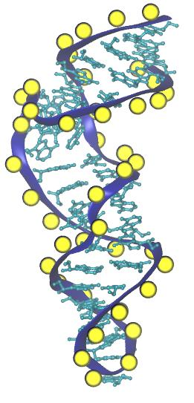
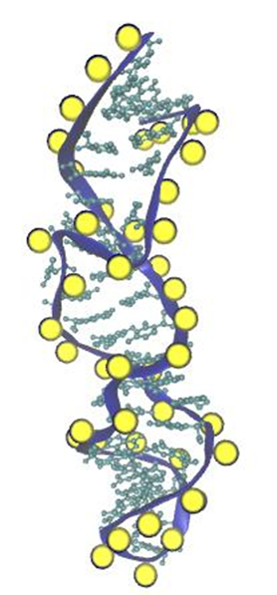
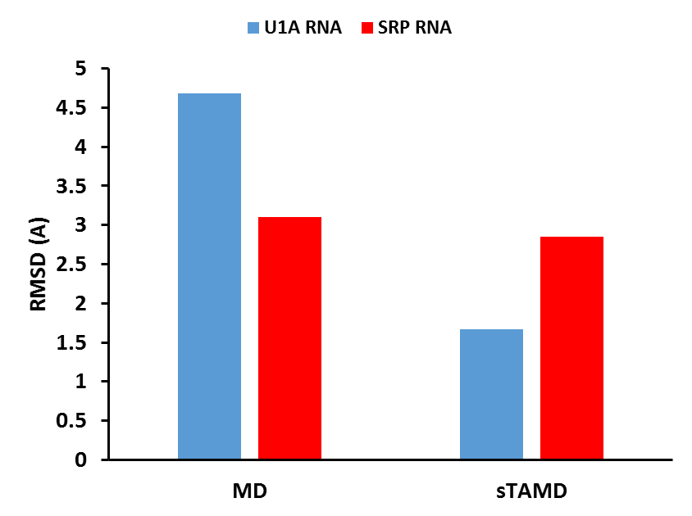
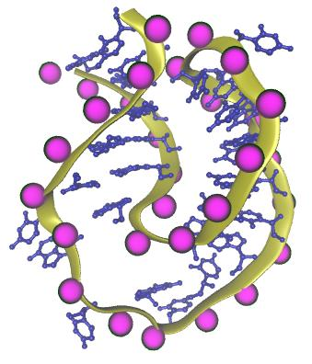
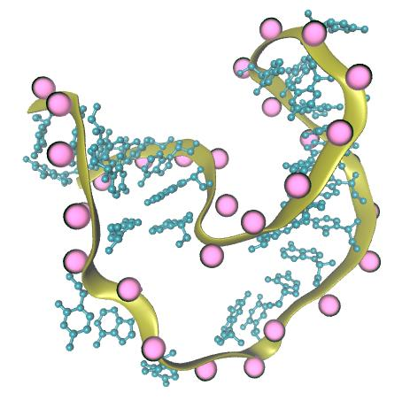
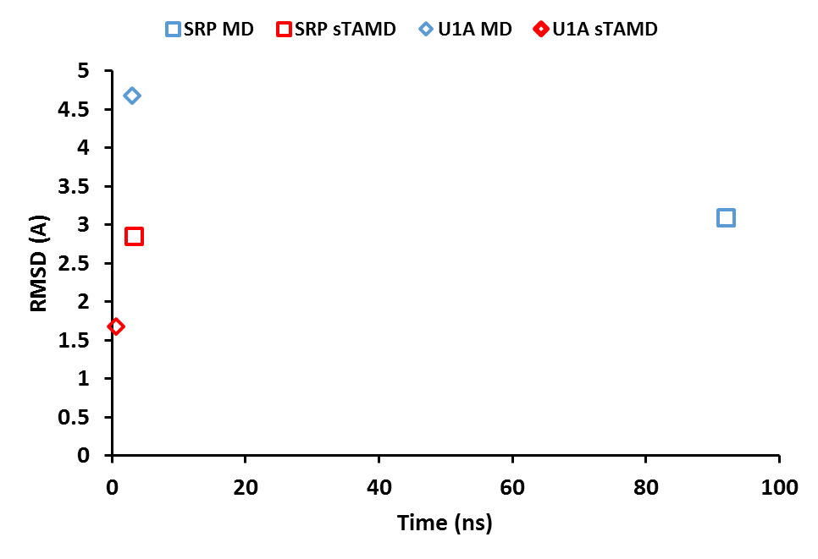
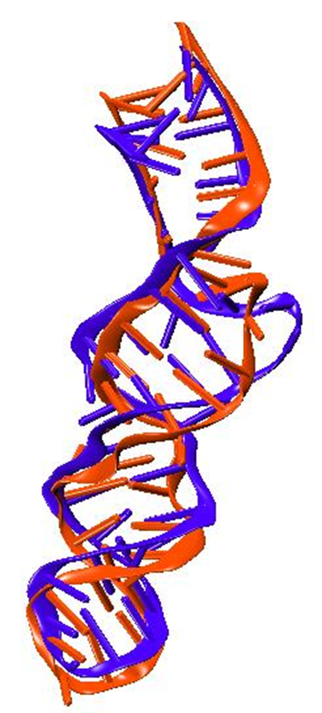
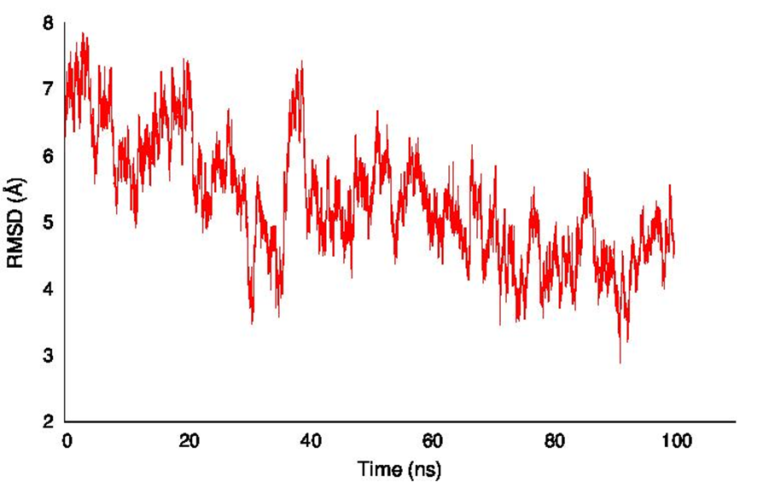
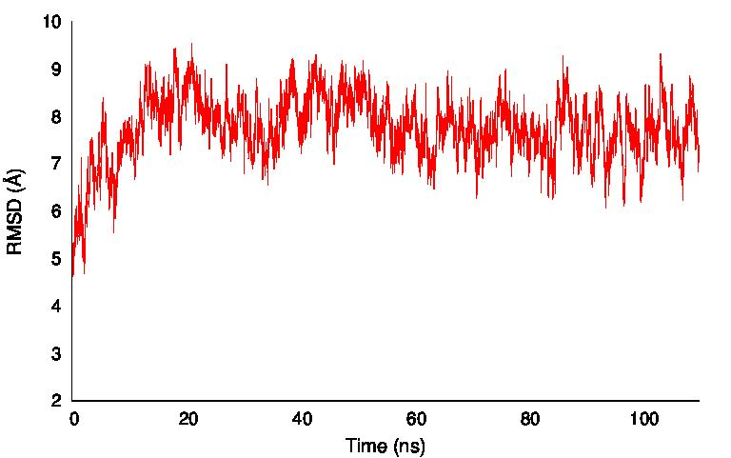
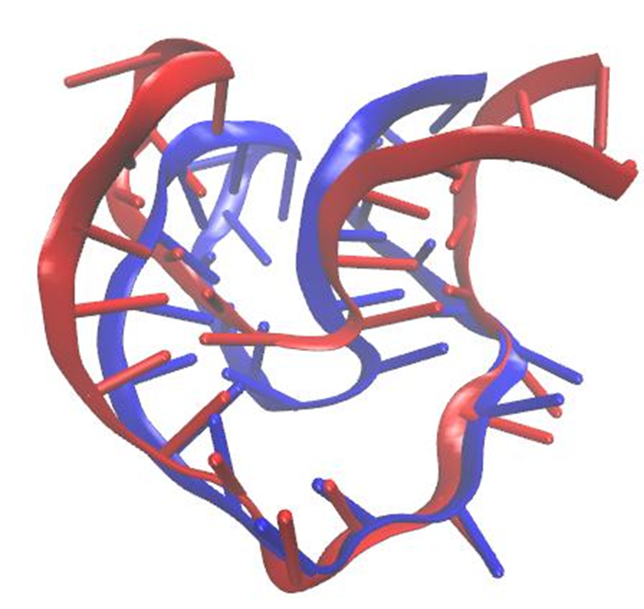
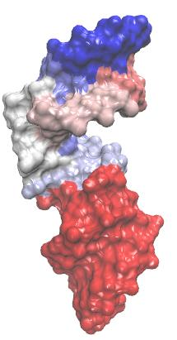
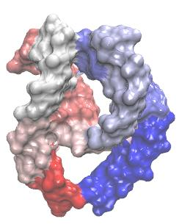
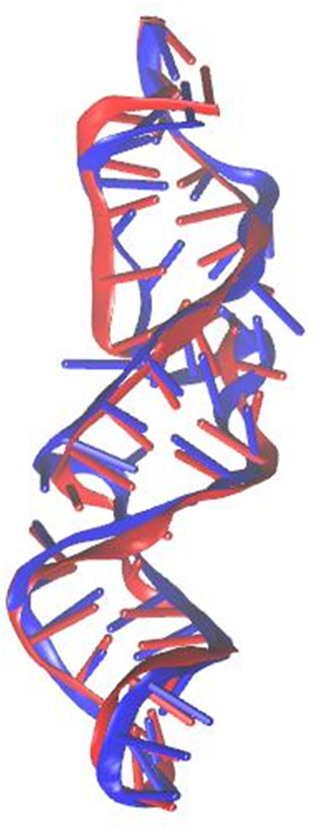
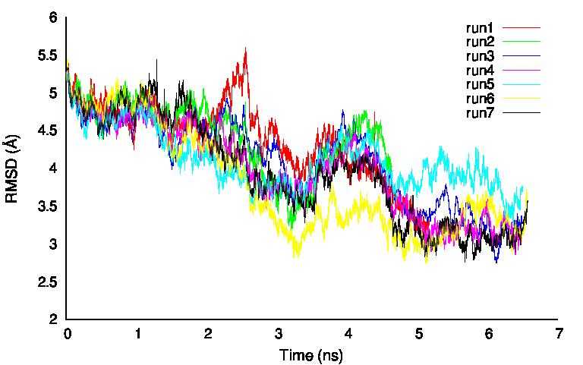
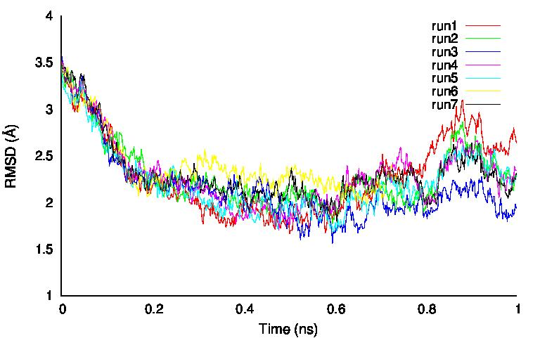
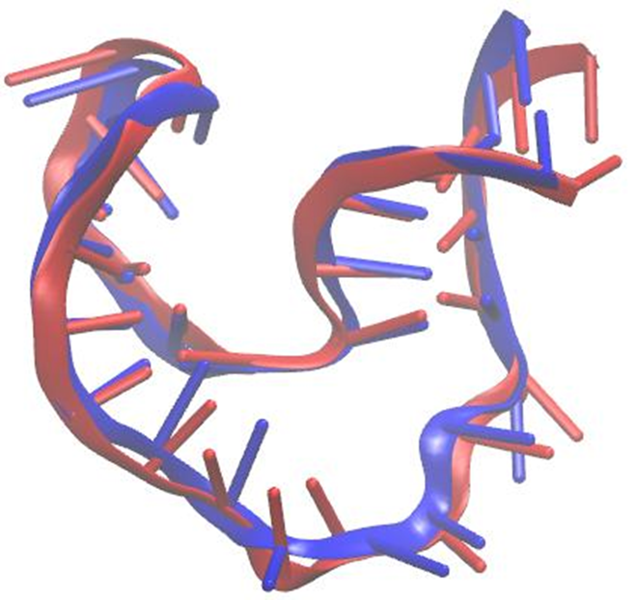

A Computational Study of RNA Structure and Dynamics
Rhiannon Jacobs and Harish Vashisth
Department of Chemical Engineering, University of New Hampshire, Durham, NH 03824
Abstract
Multiple Conformations
Results
Evidence from experimental characterization of structures of nucleic acids such as RNA suggests that nucleic acids are highly flexible similar to proteins, and can undergo large-scale conformational rearrangements due to motions encoded in their structure or due to binding of triggering factors such as small metabolites or proteins. These observations warrant a detailed understanding of the dynamics of RNA molecules, yet it is not possible to capture all transiently populated conformations of biomolecules using experimental methods alone. Proposed in this work is the development and application of a temperature-based enhanced sampling simulation methodology that has proven successful in the study of conformational changes in proteins. Extending this methodology for application to nucleic acids will increase its scope not only for understanding RNA dynamics, but also for understanding RNA-protein complexes. The technique will be tested on small RNA molecules that are known to undergo large-scale conformational transitions. A better understanding of variables that can be accelerated in molecular dynamics (MD) simulations will help in the development of improved simulation algorithms and methodologies to characterize structural flexibility of RNA.
SRP RNA
U1A-UTR RNA
State 1
State 2
State 1
State 2
Figure 9: Comparison of lowest RMSD values for the U1A-UTR RNA (blue) and the SRP RNA (orange) for classical molecular dynamics simulation (MD) and enhanced sampling method (sTAMD).
Long Scale MD Simulations
Methodology
SRP RNA
U1A-UTR RNA
Molecular dynamics simulation is a computer based approach to statistical mechanics which allows for an estimation of equilibrium and dynamic properties of a complex system that cannot be done analytically.
Approach to evolve positions of a system of particles in time, where particles interact with each other under a complex potential function.
Operate on the principle of classical mechanics; where F=ma.
Structural files obtained from the Nucleic Acid Database
Force Field Parameters: CHARMM 36
Solvated in a water box
Temperature Accelerate Molecular Dynamics (TAMD)
Enhanced sampling method based upon the use of collective variables (CV’s).
Collective variables: functions of atom Cartesian coordinates
Selected as center of mass of spatially continuous atoms
6 subdomains → 18 CV’s
Steered Temperature Accelerated Molecular Dynamics (sTAMD)
Enhances likelihood of largescale conformational change by adding a harmonic biasing potential
Technique has proven effective for proteins, new to nucleic acids
Software
Visual Molecular Dynamics (VMD): visualization software which displays, animates, and analyzes biomolecular systems using 3D graphics.
Nanoscale Molecular Dynamics (NAMD): simulation software which is distinctly designed for high performance simulation of biological systems
Figure 10: Comparison of lowest RMSD values for the U1A-UTR RNA and the SRP RNA for classical MD simulation (blue) and sTAMD (red) with the corresponding simulation time to achieve plotted RMSD value.
Conclusions
Figure 1: RMSD plot against State 2 as a function of simulation time.
Figure 3: RMSD plot against State 2 as a function of simulation time.
Figure 4: State 2 (red) overlaid with the closest conformation from simulation data (blue).
Enhanced simulation techniques display that the same RNA at an initial conformation can achieve a second known conformation;
The pathway the RNA takes as it trends to a second conformation exhibit great variability;
Enhanced sampling method (sTAMD) approaches the second state in less time than with classical MD;
Greater analysis and on more systems is necessary before trends can be confirmed.
Figure 2: State 2 (red) overlaid with the closest conformation from simulation data (blue).
sTAMD Simulations
sTAMD Simulations
SRP RNA
U1A-UTR RNA
Acknowledgements
CV subdomains
I would like to thank my advisor Dr. Harish Vashisth, University of New Hampshire Department of Chemical Engineering, and the UNH McNair Scholars Program. We are grateful to the National Science Foundation for support through grant No. CBET-1554558.
References
Figure 7: RMSD plot against State 2 as a function of simulation time.
Figure 8: State 2 (red) overlaid with the closest conformation from simulation data (blue).
[1] Vashisth, Harish, and C. L. Brooks, III. "Conformational Sampling of Maltose-Transporter Components in Cartesian Collective Variables Is Governed by the Low-Frequency Normal Modes. "Journal of Physical Chemistry Letters 3.22 (2012): 3379-384. 01 Nov. 2012. Web. 07 Mar. 2016.
[2] Vashisth, H., Skiniotis, G., & Brooks, C. L. III (2014). Collective variable approaches for single molecule flexible fitting and enhanced sampling. Chemical Reviews, 114, 3353- 3365.
[3] Al-Hashimi, H. M.; Walter, N. G (2008). RNA dynamics: It is about time. Current Opinion in Structural Biology, 18, 321– 329
[4] Bailor et al. (2011). Topological constraints: using RNA secondary structure to model 3D conformation, folding pathways, and dynamic adaptation. Current Opinion in Structural Biology, 21, 296-305.
[5] Maragliano, L.; Vanden-Eijnden, E (2006). A temperature accelerated method for sampling free energy and determining reaction pathways in rare events simulations. Chemical Physics Letters, 426, 168– 175.
Figure 5: RMSD plot against State 2 as a function of simulation time.
Figure 6: State 2 (red) overlaid with the closest conformation from simulation data (blue).

