Slide 1
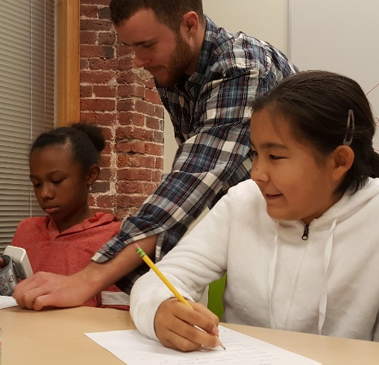
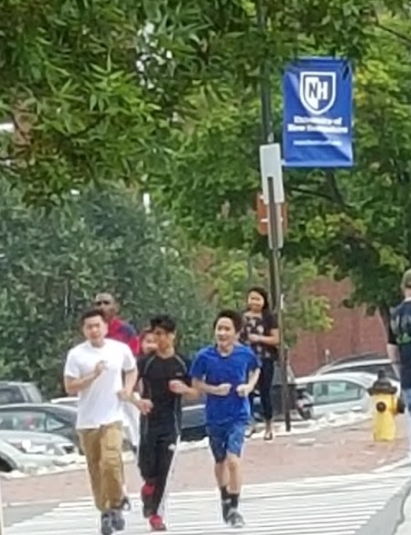
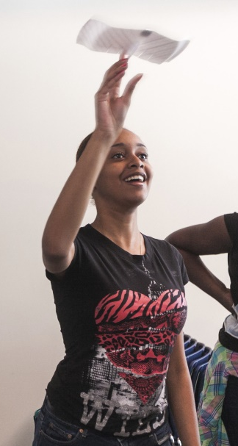
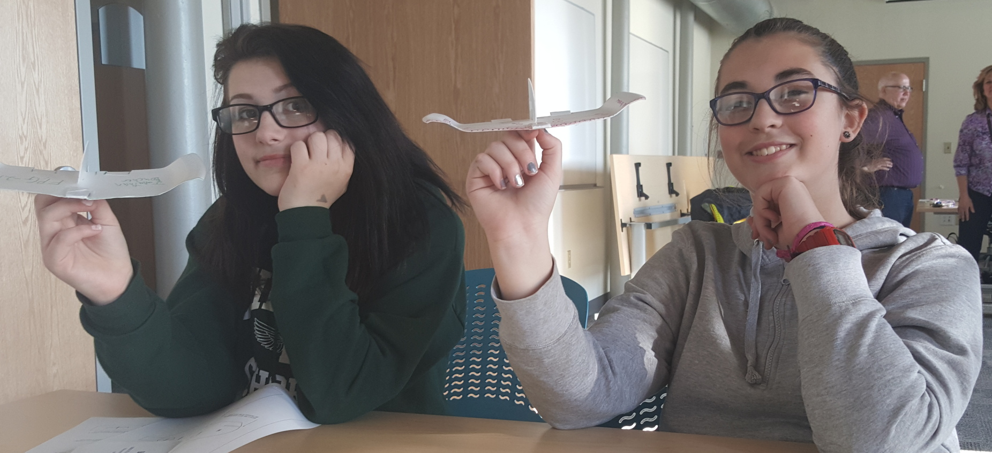
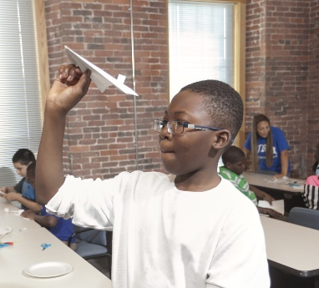
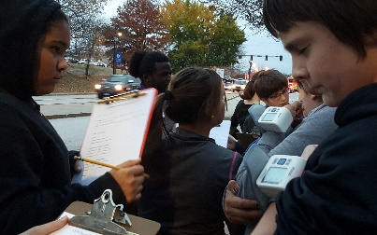
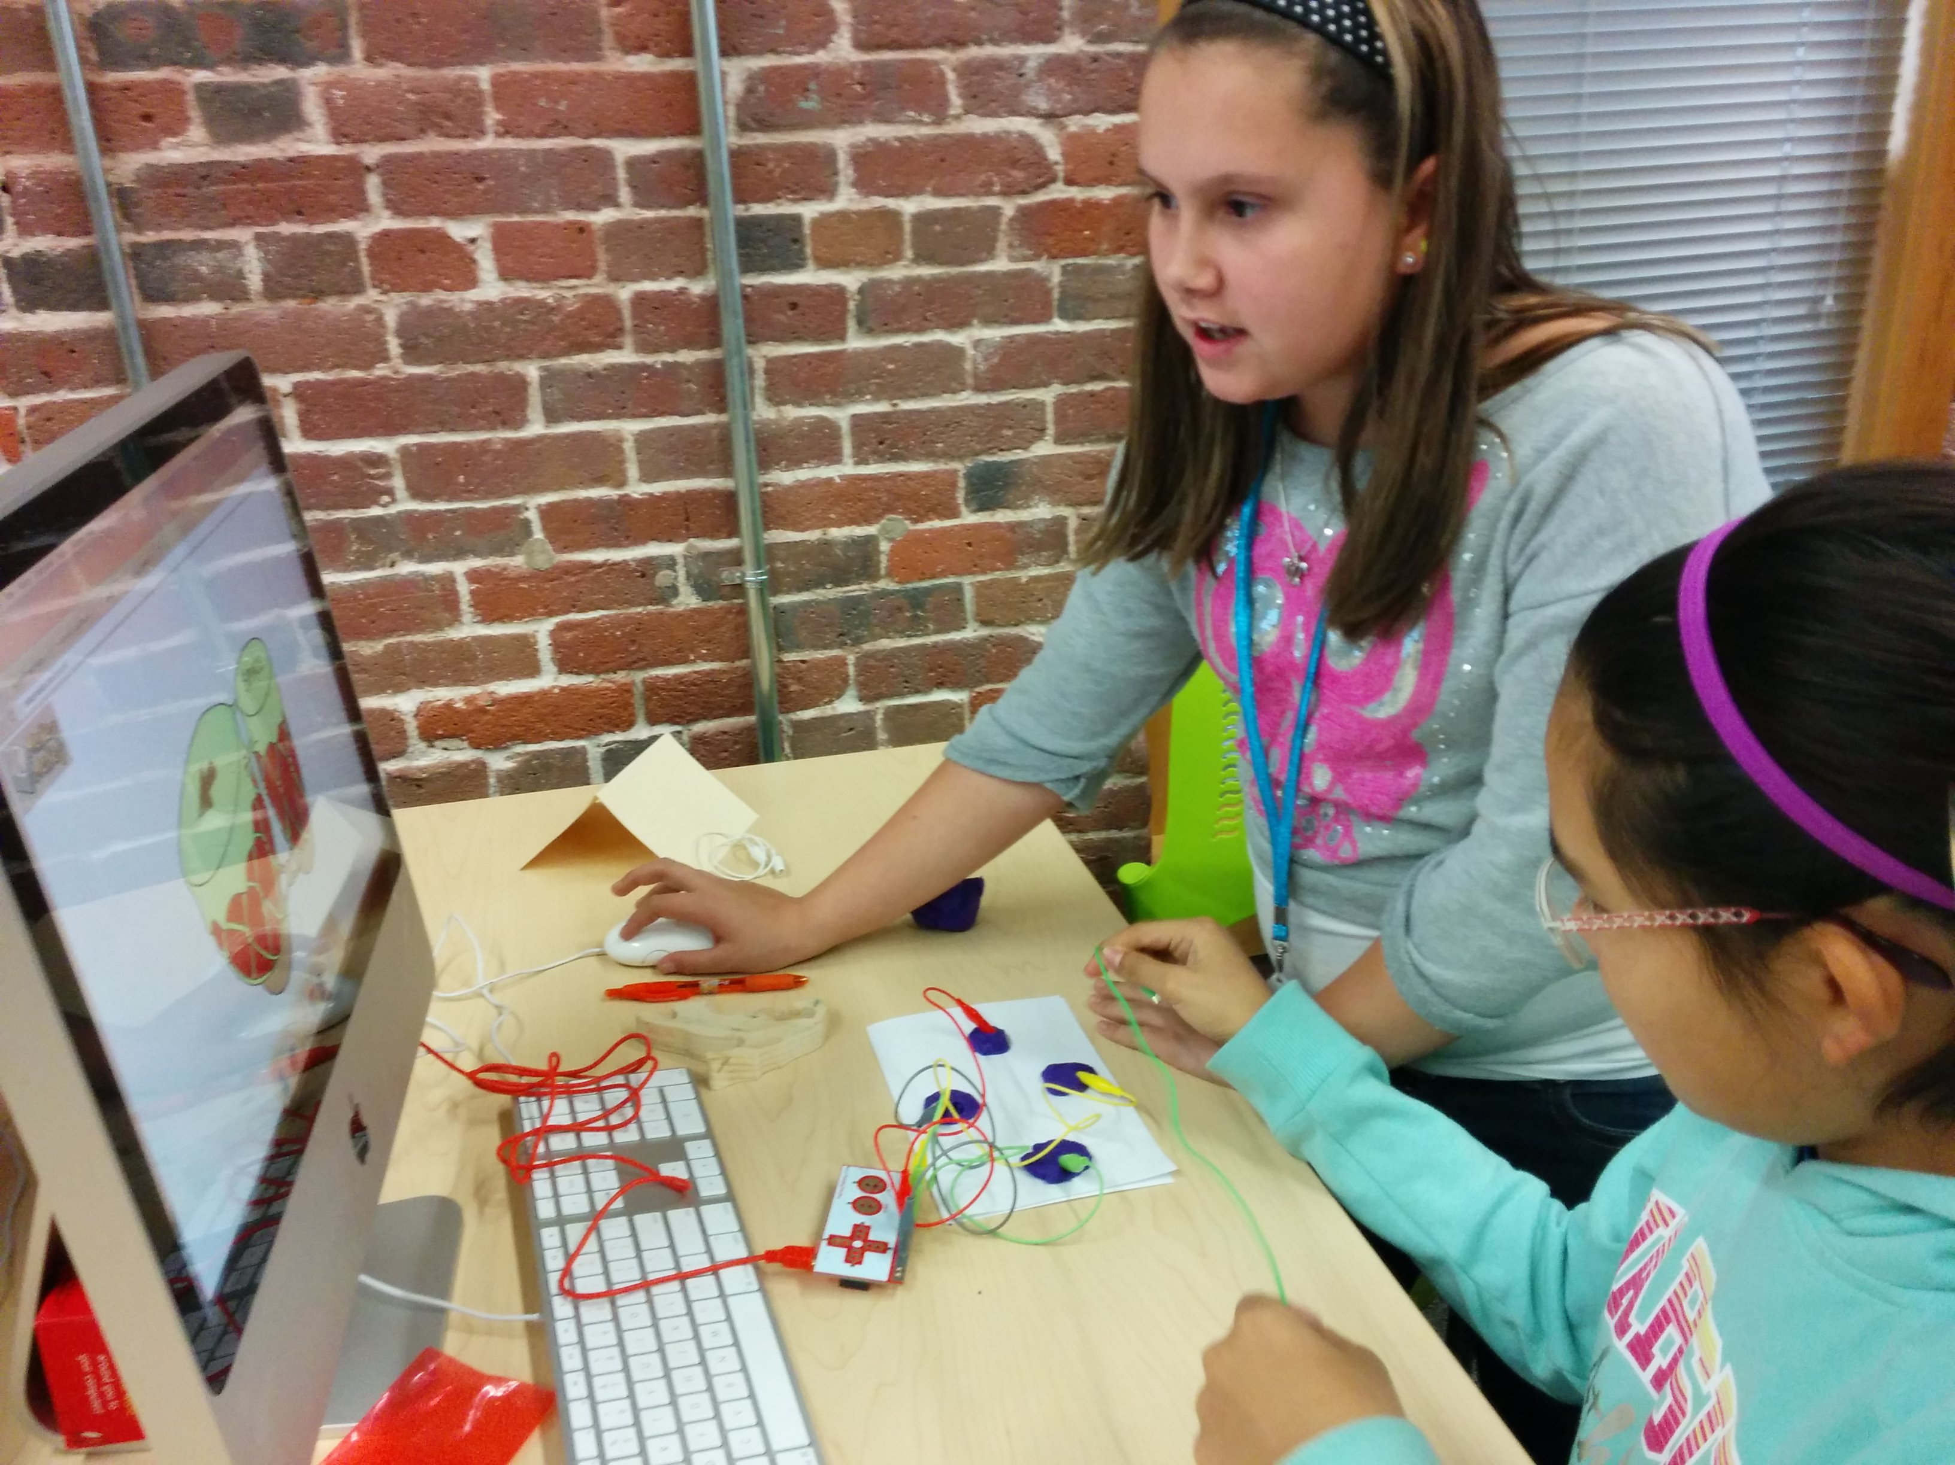
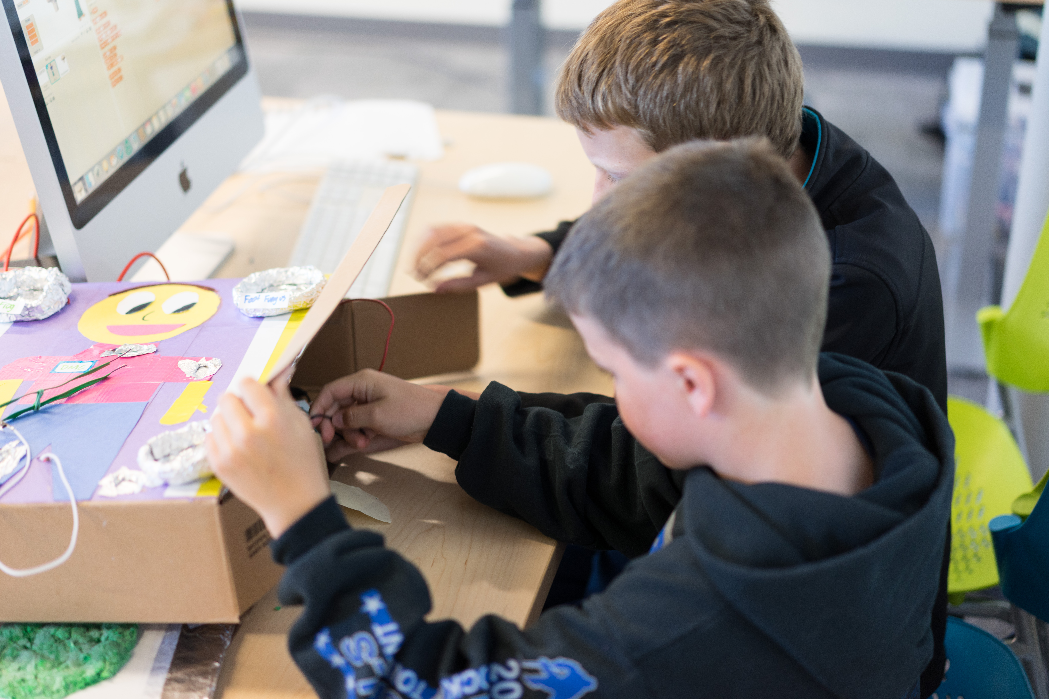
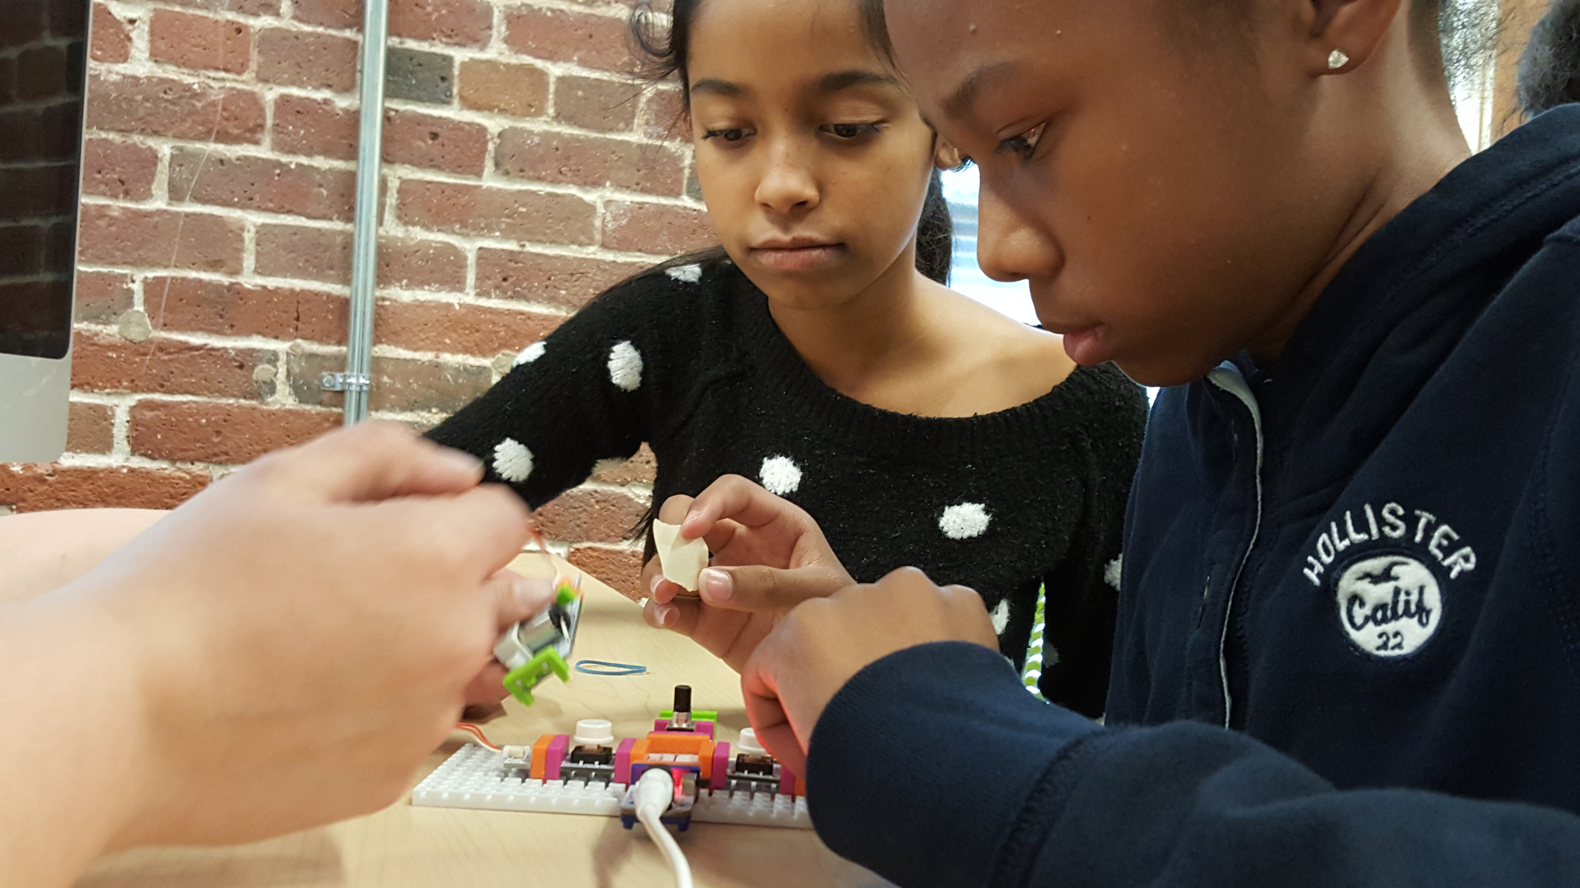
An Interdisciplinary Approach Combines Physiology, Engineering, and Computer Science
to Increase Awareness of STEM Professions among Middle School Students
Patricia A. Halpin*, Sean Tavares# and Mihaela Sabin¥
Biological Sciences Program*, Mechanical Engineering Technology Program#, Computing Technology Program¥
University of New Hampshire, Manchester NH 03101
5451
Purpose
Methods
Results
Enhance middle school outreach program on college campus with STEM experiments
Capture learner potential with experiments from three STEM subjects: computing, engineering, and physiology
Facilitate interdisciplinary collaboration among STEM faculty
Afterschool Program
Students recruited from three public middle schools in the Manchester School District, the largest and most diverse school district in New Hampshire
Transportation by school bus to UNH Manchester campus
10-week after school program, once a week, 3:30 – 5 pm
Program curriculum combines learning activities in computing, engineering, and physiology.
Practice problem solving, team work, and sharing of engineering and computing artifacts and experiment results
Reflect on how observations of the natural world and use of computing tools help with design improvements
Contextualize the benefits of healthy eating and active living
Exercise Physiology Experiment
Design hypothesis: exercise increase heart rate and blood pressure
Take pre-exercise heart rate and blood pressure measurements using monitors
Perform physical exercise and take post-exercise measurements
Review basic concepts, measurement units, data collection and analysis, experiment evaluation
With a few minutes work, a bit of tape, and a penny for balance weight, a 9” foam dinner plate is transformed into a surprisingly capable glider
Engineering Experiment
Build and fly model gliders
Run experiments that inspire curiosity about the mechanics of flight
Discuss role of balance and adjustment of aerodynamic surfaces in achieving stable flight
Modify model to experiment with design changes.
Students take their resting heart rate and blood pressure.
Students exercise for five minutes.
Computing Experiment
Build simple circuits and experiment with measuring, controlling, and calibrating system performance
Design and program interactive stories and animations
Fabricate ingenious controllers with construction materials, microcontrollers, and computer programs
Students take their heart rate and blood pressure post exercise.
Make a controller for their game or animation with MakeyMakey and construction materials
After flying the foam plate glider, some students are inspired to compare its performance against that of other simple gliders like the folded paper airplane.
Acknowledgments
Conclusion
We thank our sponsors, Norwin S. and Elizabeth N. Bean Foundation, Agnes Lindsay Trust, Manchester School District, for their generous support. We also thank UNH Manchester students who volunteered their time to assist with STEM experiments in the Design Make Code program.
Create Scratch programs that implement animations and interactive stories
Interact directly with STEM professionals and undergraduate students pursuing career paths in STEM
Increases student understanding of value of STEM in society and awareness of STEM professions.
Design and test functionality of circuits built with littleBits components

