Slide 1
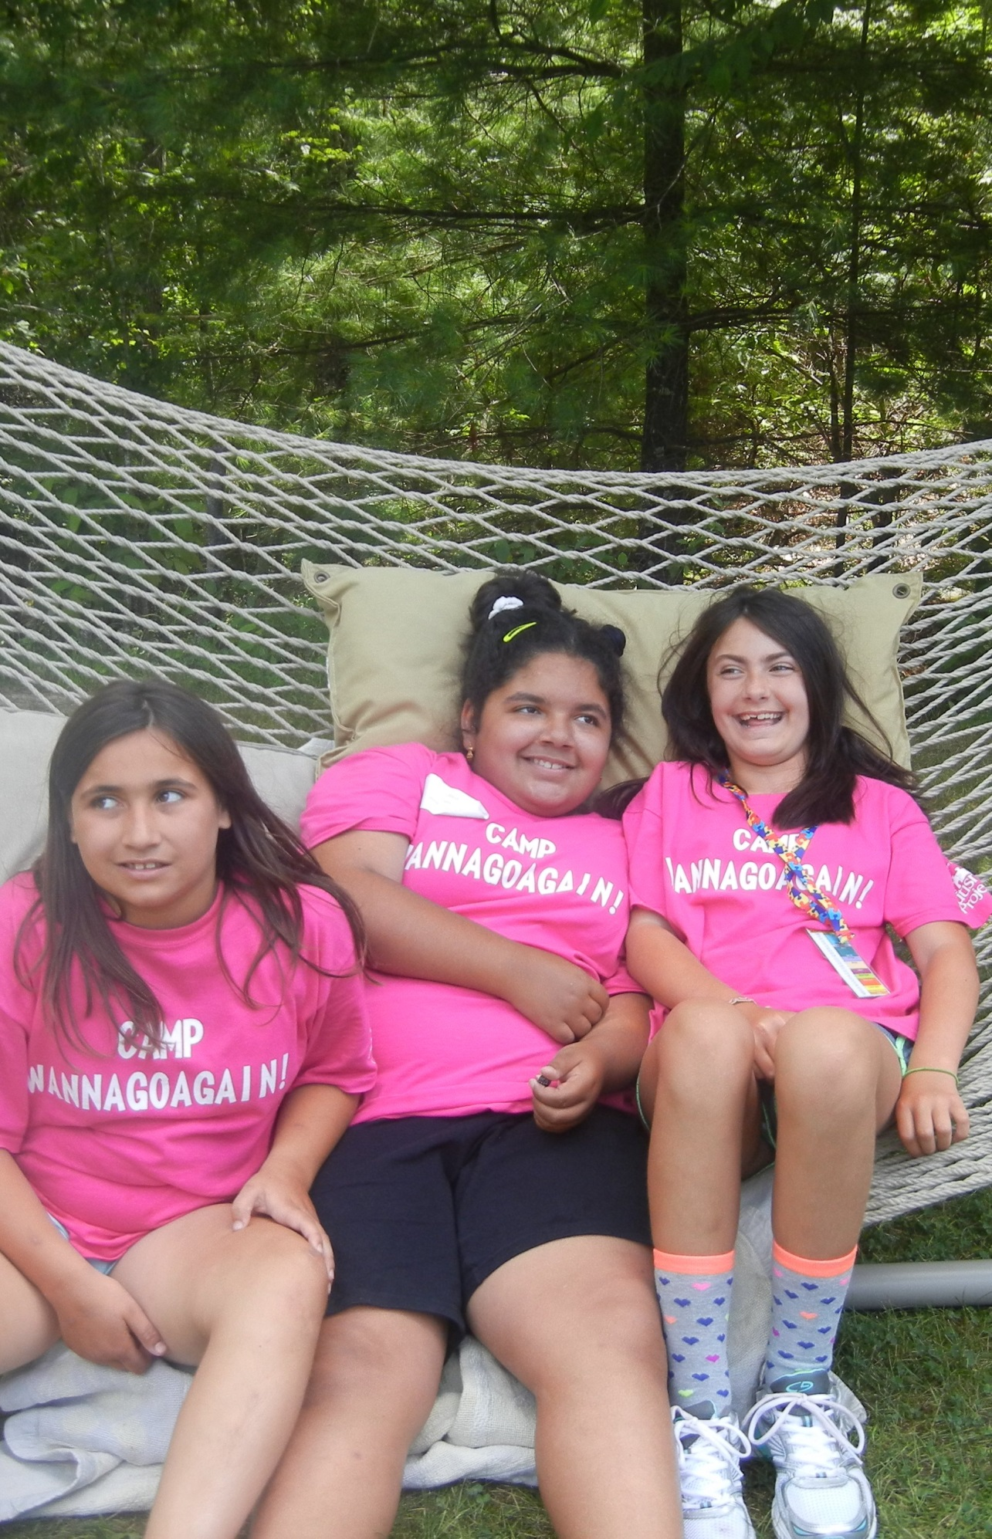
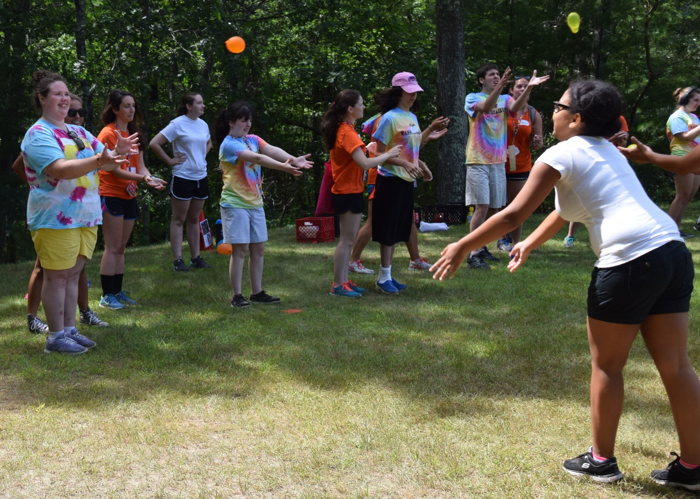
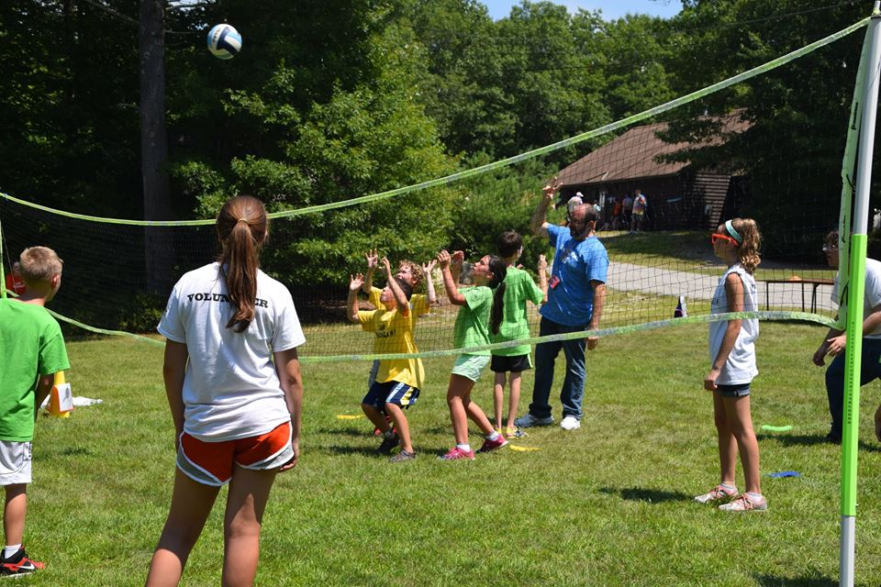
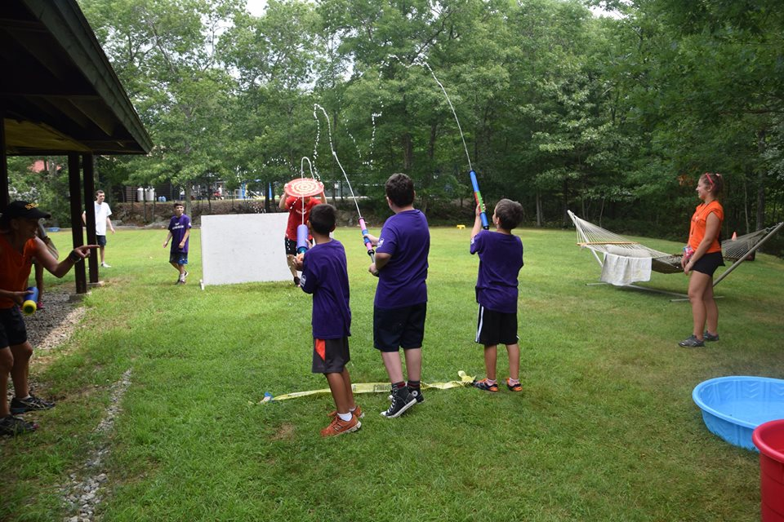
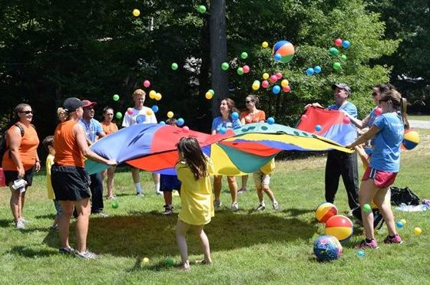
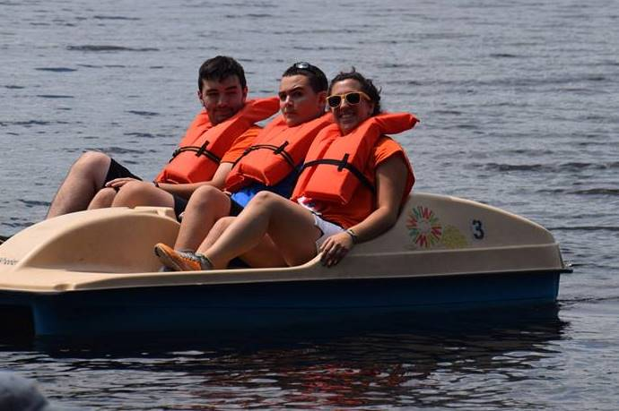
Examination of the Effectiveness of an Intense One-Week Camp Experience on Quality of Social Interaction for Children with an Autism Spectrum Disorder
By Maureen O’Brien, OTS
University of New Hampshire
Background
Results
Persons with an autism spectrum disorder (ASD) experience challenges interacting with others
Many intervention approaches to improve quality of social interaction for youth with ASD:
Comparing ESI measures for each participant
ESI measures over time
Higher-functioning participants: Solid Lines
Occur in artificial contexts
Occur less intensively over an extended period of time
Are evaluated by parent report
Participant # | Functioning Level | Change Time 1-Time 2 | Change Time 2-Time 3 | Significance between Time 2-3
1 | High | 0 | 0.4 | SS
2 | High | 0.2 | 0.4 | SS
3 | High | 0.1 | 0.3 | OB
4 | High | -0.2 | 0.3 | OB
5 | High | -0.2 | 0.4 | SS
6 | High | 0.2 | 0.3 | OB
7 | High | 0.2 | 0.4 | SS
8 | High | 0 | 0.4 | SS
9 | High | 0.1 | 0.1 | NO
10 | Low | -0.2 | -0.1 | NO
11 | Low | 0.1 | -0.1 | NO
12 | Low | 0.1 | -0.2 | NO
13 | Low | 0 | 0.1 | NO
14 | Low | -0.2 | -0.3 | OB
15 | Low | -0.2 | 0.5 | SS
5 of 9 higher-functioning participants demonstrated statistically significant improvement in quality of social interaction
As a group, campers with higher functioning ASD demonstrated a significant improvement in the quality of social interaction between times 2 and 3 (t= -10.000, df = 8, p≤ .000).
Research Questions
Does an intense one-week camp program improve the quality of social interaction for children with ASD?
What strategies do camp counselors use to promote social interaction among the campers?
Lower-functioning participants: Dashed Lines
Only 1 of 6 lower-functioning campers demonstrated statistically significant improvement in quality of social interaction
As a group, participants with lower functioning ASD, demonstrated no difference between times 2 and 3 (t=-.752, df= 5, p≤ .486)
Methods
Activity context to support social interaction at camp
Counselor strategies used to support
social interaction
Question 1 methodology
Familiarity of Context | Familiar | Somewhat familiar | Unfamiliar
 | 25 | 12 | 8
Structure | High (formal rules) | Relaxed (informal rules) | Free (no rules)
Task structure | 6 | 27 | 12
Setting structure | 7 | 29 | 9
Presence of adults | 3 | 38 | 4
Noise Level | Quiet | Moderate | Extreme
 | 4 | 41 | 0
Dominant number of actions required | Between 1-3 | Between 4-6 | Between 7-10
 | 34 | 11 | 0
Timing expected | Immediate | Readily, but at child’s own pace | Long delays acceptable
 | 2 | 17 | 26
Two evaluations prior to camp (Time 1 and Time 2)
One evaluation after the camp (Time 3)
The change between Times is measured by “logits”
Logits are determined by OTAP software based on the raw scores, the challenge of the interaction, and the severity of the person scoring.
SS: Statistically Significant
OB: Observable difference
No: No change
Questions 2 methodology
During camp week, I used an observation checklist to note:
Activity context provided
What strategies counselors use to promote social interaction
Camp Wannagoagain
Modeling 36 %
One-week, natural day-camp experience for youth with ASD
Supports social skills and participation in camp activities :
Team sports
Crafts
Peddle boating
Drumming
Swimming
Bounce house
Swings
Cueing 35 %
Participants (N = 15)
Conclusions
Acknowledgements
Gender:
Age:
Functional level:
An intense, one-week experience with a focus on promoting social interactions in a natural context improves quality of social interaction for youth with high-functioning ASD when evaluated outside of that camp experience.
Activity context, modeling, and cuing were used as prevalent strategies to support social interaction during camp week.
These results can assist program directors plan similar programs for youth with ASD.
The Autism Project of Rhode Island
The Hamel Center at the University of New Hampshire
Lou Ann Griswold, PhD, OTR/L, FAOTA
Mean: 12.8 years
Median: 12 years
Range: 7-17 years
12 Males
3 Females
9 high- functioning
6 lower- functioning
Assessment Measure
Evaluation of Social Interaction (ESI)
Standardized & criterion-referenced
Evaluates quality of social interaction in a natural setting
Based on observation
4-point rating scale on 27 different social skills

