Slide 1
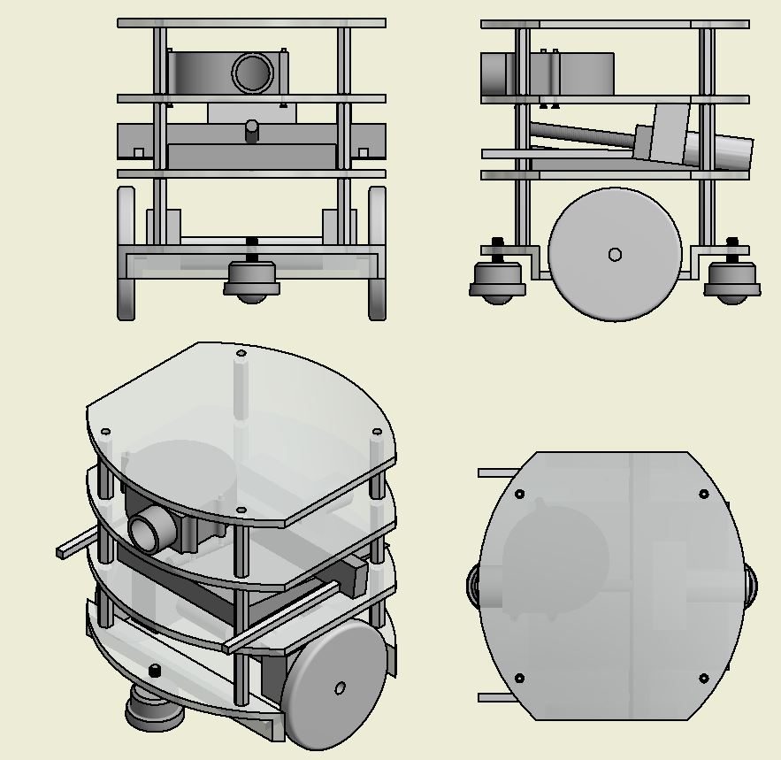
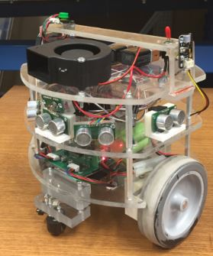
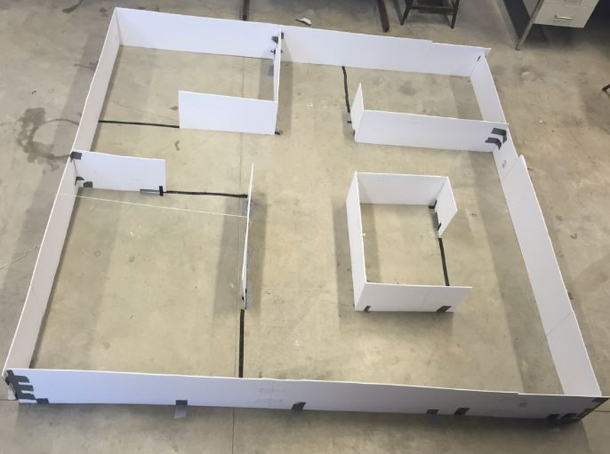
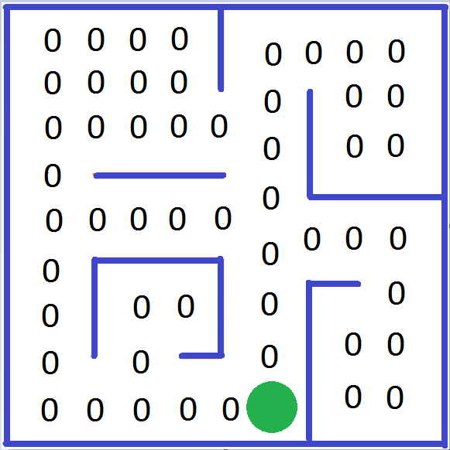
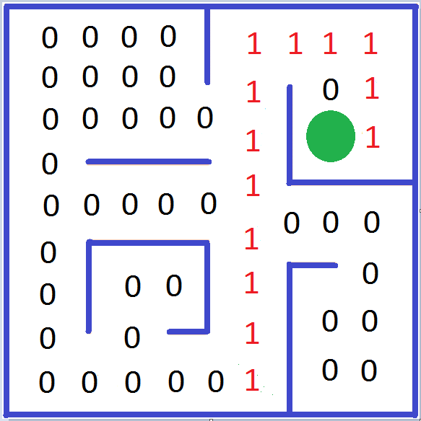
ABSTRACT
UNH FIREFIGHTING ROBOT
RESULTS
The robot is designed for a level 2 maze.
A design with a center axis of rotation and a multi-tier chassis was chosen.
To account for the changing shape of the level two maze, sensors were integrated in order to navigate without having a predetermine path.
The robot uses dead reckoning and sensor integration.
A top mounted fan is used for extinguishing the flame.
Originally the robot was designed for level 3.
In order to achieve this, we plan to replace the fan with compressed CO₂, design a full wiring diagram and solder all components, and implement a mechanical arm to retrieve the baby.
We hope that with these improvements our robot will effectively navigate and complete a level 3 maze.
The robot was tested using our own constructed maze, shown below.
DESIGN
ACTUAL
The robot has been tested positively when activated by a push button.
The robot has successfully identified walls and adjust course correctly utilizing our ultra-sonic range finding sensors, thus, it can efficiently navigate any level 1 and 2 maze configuration autonomously.
The robot confidently traverses a 1 cm rug lip and its surface.
The robot determines if it has entered a room using white line sensors.
The robot has effectively followed a lit flame by means of our thermal array sensor, orienting itself within the room to approach the candle.
The robot, once positively identifying the flame, has full capability of extinguishing the flame with our top-mounted horizontal fan.
The robot utilizes our unique algorithm that mixes various control methods to maintain itself with no human interference. We have taken a dead-reckoning system that uses both the time past while traveling and the known distances of the maze to determine its orientation. The sensors listed above relinquish the need for the robot to actually determine what configuration the maze is in, and rather have it focus on getting through the maze in any configuration.
This figure depicts the original design of our robot.
This figure depicts the final result after completion.
CONCLUSIONS
DESIGN PROCESS
Most important criterion were size, mobility, and simplicity for a level 3 maze.
In order to navigate well within tight time and space restrictions, center-axis rotation was key (especially for corners) as opposed to a multi-axis turning radius as seen in cars.
Building off this, the robot was chosen to have a multi-tier cylindrical plexi-glass body, maintaining equidistant symmetrical sensors.
Testing ensued to determine if spherical bearings, treaded tracks, or wheels would fit our design statement best.
An Arduino MEGA was chosen for our controller over the older lower-level Motorola M68HC11 microprocessor.
Determination of the contents of each level began from the ground up.
To ensure mobility and simplicity, the dual motor-tachometer-wheel system was bolted under the first tier; thus creating a lower center of mass.
The motor driver and battery pack to power, motor driver and motor system were placed on the first tier (directly above the motor system) in order to avoid wire misconnections
Testing yielded toppling of the robot during navigation when only utilizing two wheels. Spherical bearings were placed in the front and back to guarantee stability.
The original design contained a CO₂ canister and valve system on the second tier to extinguish the flame. This was scrapped for simplicity purposes and replaced with a fan.
To complete the search and rescue mission of the baby, a piston-powered extending arm system was chosen over a draw-bridge type system.
When it was decided to only pursue level 2, this system was removed and the second tier was replaced with our interaction sensors, the Arduino, and a breadboard.
Multiple sensing technologies were tested, but our final design only operates off five ultrasonic range finders (for navigation), our thermal array sensor (for flame detection), and white line sensors (for determining doorways).
We plan to revise our algorithm to not only make the return trip home much easier, but also make autonomous maze navigation itself easier. The new algorithm follows the Hansel and Gretel methodology and would leave behind a digital trail of breadcrumbs. An initial matrix of zeroes would be placed for the map dimensions, discretizing squares equally. Once the robot passes through a certain coordinate, the 0 is replaced with a 1. Thus, the robot finds the most efficient path through the maze and home. The figure above illustrates this.
The robot performs well, but certain misconnections in wiring causes shorts and haywire sensing technology. We plan to create a full blown wiring diagram for the whole robotic system and with this; solder everything. This will ensure no possible wire misconnections.
Although, the fan is efficient, replacing it with a CO₂ canister and valve system would yield more points and be more effective.
Finally, we plan to implement our mechanical extending arm design for search and rescue of the baby.
With these improvements, our robot will sufficiently navigate a level 3 maze autonomously.
PROBLEM DESCRIPTION
The purpose of this project is to a design and invent a fully autonomous firefighting robot.
This robot must be capable of navigating a maze with obstacles, finding a flame, extinguishing that flame, and returning to the starting point.
During navigation the robot will encounter multiple obstacles such as: ramps, rugs, mirrors, and a toy dog blocking the hallway, which will attempt to throw off navigation.
This robot will need to take in information from multiple sensors, interpret that information, and then use that information to navigate through the maze and around obstacles safely in order to find a flame and extinguish it.
The robot will be entered into the Trinity College Fire Fighting Robot Competition, where it will be judge on its ability to navigate the maze and extinguish the flame while avoiding hazards.

